Slide 1
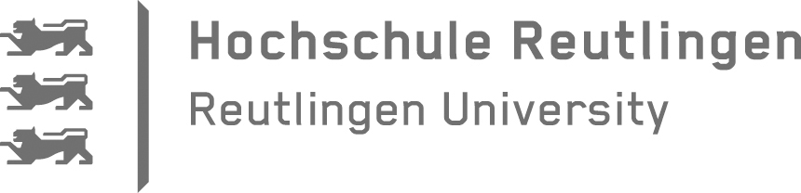


Evolvability Assurance of Microservices
Interview Artifacts
Justus Bogner, Jonas Fritzsch, 10/2018

Slide 2
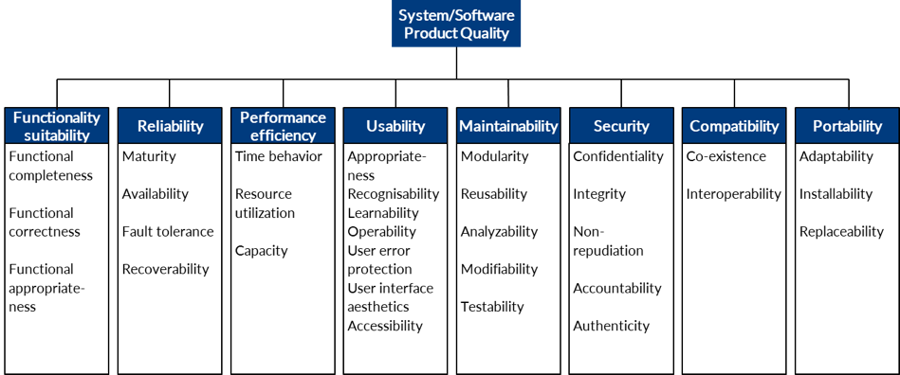
ISO 25010 Software Product Quality

Slide 3
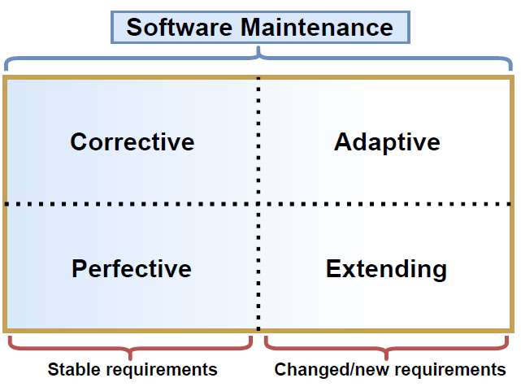
Definition: Maintainability
The degree of effectiveness and efficiency with which a software system can be modified.
Based on [ISO/IEC 25010, 2011] and [Rowe, 1998]
Notes:
International Organization For Standardization Iso, “ISO/IEC 25010: 2011,” 2011.
D. Rowe, J. Leaney, and D. Lowe, “Defining Systems Architecture Evolvability - a taxonomy of change,” Int. Conf. Work. Eng. Comput. Syst., no. December, pp. 45–52, 1998.

Slide 4
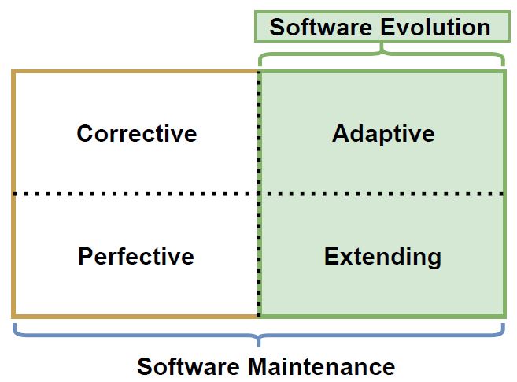
Definition: Evolvability
The ability of a software system to efficiently accommodate changes and extensions to its functional and cross-functional requirements.
Based on [Rowe, 1998] and [Bode, 2010]
Notes:
D. Rowe, J. Leaney, and D. Lowe, “Defining Systems Architecture Evolvability - a taxonomy of change,” Int. Conf. Work. Eng. Comput. Syst., no. December, pp. 45–52, 1998.
S. Bode and M. Riebisch, “Impact evaluation for quality-oriented architectural decisions regarding evolvability,” Lect. Notes Comput. Sci. (including Subser. Lect. Notes Artif. Intell. Lect. Notes Bioinformatics), vol. 6285 LNCS, pp. 182–197, 2010.

Slide 5
Examples: Symptoms of Technical Debt
Low release frequency
High number of defects with new releases
Reported issues are open for a long time
Missing or outdated documentation
Outdated libraries or middleware components
More time needed to add new functionality
Inadequate testing
Lots of duplicate code
Slow/manual deployment process
Architectural erosion or complexity
Many inter-module/inter-component dependencies
Very large/complex components or modules

Slide 6
Definition: Evolvability Assurance (EA)
The set of activities that provides sufficient confidence that a software system can be sustainably extended and evolved.
Activities can either be performed for identification (analytical EA) or for remediation (constructive EA).
EA includes for example processes, techniques, standardization, management of “technical debt”, and the usage of tools, metrics, principles, or guidelines.
Based on [Wagner, 2013]
Notes:
Wagner, S.: Software Product Quality Control. Springer Berlin Heidelberg, Berlin, Heidelberg (2013).

Slide 7
Assurance Maturity Levels
0
No conscious addressing of evolvability
1
Implicit and basic (e.g. occasional refactoring, some guidelines and standards without enforcement, etc.)
2
Explicit, but non-structured (e.g. tool support, metrics, quality model, elaborate guidelines and standards, etc.)
3
Using a systematic process (i.e. applying level 2 techniques in a structured and recurring way at scale)

Slide 8
Examples: Evolvability Assurance Tools
SonarQube
FindBugs
Squale
Lattix
Ndepend
CAST
Structure101
…
Teamscale
Checkstyle
PMD
JMetrics
Codecov
Cobertura
Codacy
…

Slide 9
Examples: Evolvability Metrics
Test coverage
Cyclomatic complexity
Clone coverage
LoC
Comment ratio
Coupling metrics
# of architectural violations
Cohesion metrics
# of naming convention violations
Defect resolution time
…

