Slide 1
WAW – Machine Learning 6
Tutorial: NLP with Python
Sivasurya Santhanam
Intelligent software systems
Institute for Software Technology (SC-IVS)
27.10.2020

Slide 2
Agenda
9:30 - 10:30 : Part I (Pre-processing of text)
10:30 - 10:45: Break
10:45 - 11:45: Part II (Sentiment analysis)
11:45 - 12:00: Break
12:00 - 12:30: Part III + Q & A

Slide 3
Why is NLP hard?
Representation of semantic meanings and contexts
Syntax, Semantics, pragmatics
Humans also apply sarcasm now and then
Accents and dialects (Speech recognition)

Slide 4
Part - I
Pre- processing

Slide 5
Words & representations – Bag of words
Example:
I read a book about book reading
a about book I read reading
Sentence-1 1 1 2 1 1 1

Slide 6
Words & representations – Term-Document matrix
Example:
1. This sample is a sample of the bigger sample
2. This is not a good sample
vocabulary
Documents a bigger good Is not of sample the this
Sentence-1 1 1 0 1 0 1 3 1 1
Sentence-2 0 0 1 1 1 0 1 0 1

Slide 7
Words & representations – Bag of words (Impl.)
Extract vocabularies
Compute the occurrences of every word in vocabulary in each sentence
Generate Term-document matrix
[impl.]: from Sklearn.feature_extraction.text import CountVectorizer

Slide 8
Tokenization
Word tokenization
foo = “Oh God!\n I haven't saved any of it's responses!”
[Oh, God, !, I, have, n't, saved, any, of, it, 's, responses, !]
Sentence tokenization
bar = “ Sent tokenize knows that time period from 10 a.m. to 1 p.m. are not sentence boundaries. neither are the names G.H.Hardy and J.J.Thompson. you can even start the sentence without Caps”
[“Sent tokenize knows that time period from 10 a.m. to 1 p.m. are not sentence boundaries”,
“neither are the names G.H.Hardy and J.J.Thompson”
“you can even start the sentence without Caps”]
[impl.]: from nltk import word_tokenize

Slide 9
Stemming
Stemming tries to extract the stem word.
Defined by a set of algorithms like Porter stemmer, Snowball stemmer
Stem words do not necessarily makes sense
foo = „cylists in all of cities use cycles to cycle the city“
Stems = [cylist, in, all, of, citi, use, cycl, to, cycl, the, citi]
[impl.]: from nltk import PorterStemmer, SnowballStemmer

Slide 10
Lemmatization
Stemming tries to extract the root word.
Defined by vocabulary of the language
Lemmas have meanings incontrast to Stem words
Lemmatization is slower than stemming
Based on part-of-speech
foo = „it has been used in multiple places“
Lemmas= [it, have, be, use, in, multiple, place]
[impl.]: from nltk.stem import WordNetLemmatizer

Slide 11
Part - II
Sentiment Analysis

Slide 12
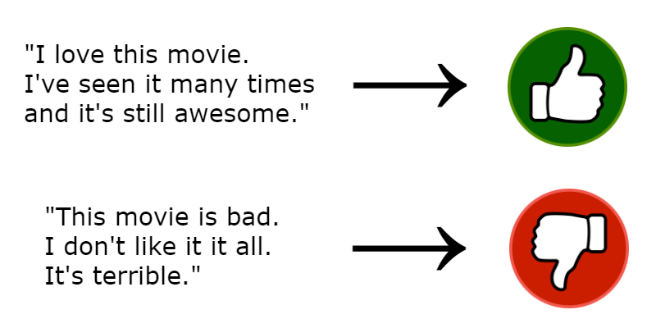

Slide 13
Sentiment classification
Steps to be followed:
Load the dataset
Encode the reviews and sentiments
Compute Term-document frequency matrix
Model training
Model prediction

Slide 14
Neural network architecture
128
64
32
1
Relu
Relu
Relu
Dropout (0.3)
Dropout (0.2)
Sigmoid

Slide 15
Part - III
Machine translation

Slide 16
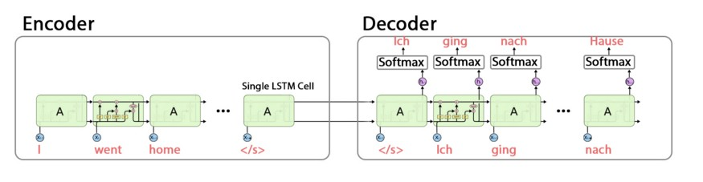

Slide 17
Machine translation
Steps to be followed:
Load the dataset (Prepare input and target texts)
Encode the characters/tokens as one-hot representation
Design the encoder-decoder network
Train both the encoder as well as decoder network simultaneously
Infer the model using encoder-states and decoder network

Slide 18
Encoder – Decoder structure
Encoder input data: I went home - - - -
Decoder input data: \t Ich ging nach Hause \n -
Decoder target data: Ich ging nach Hause \n - -
Encoder input data shape: (#Sentences, Max length of input sequence, # English vocabulary)
Decoder input data shape: (#Sentences, Max length of target sequence, #German vocabulary)
Decoder target data shape: (#Sentences, Max length of target sequence, #German vocabulary)

Slide 19
Thank you!

