Slide 1



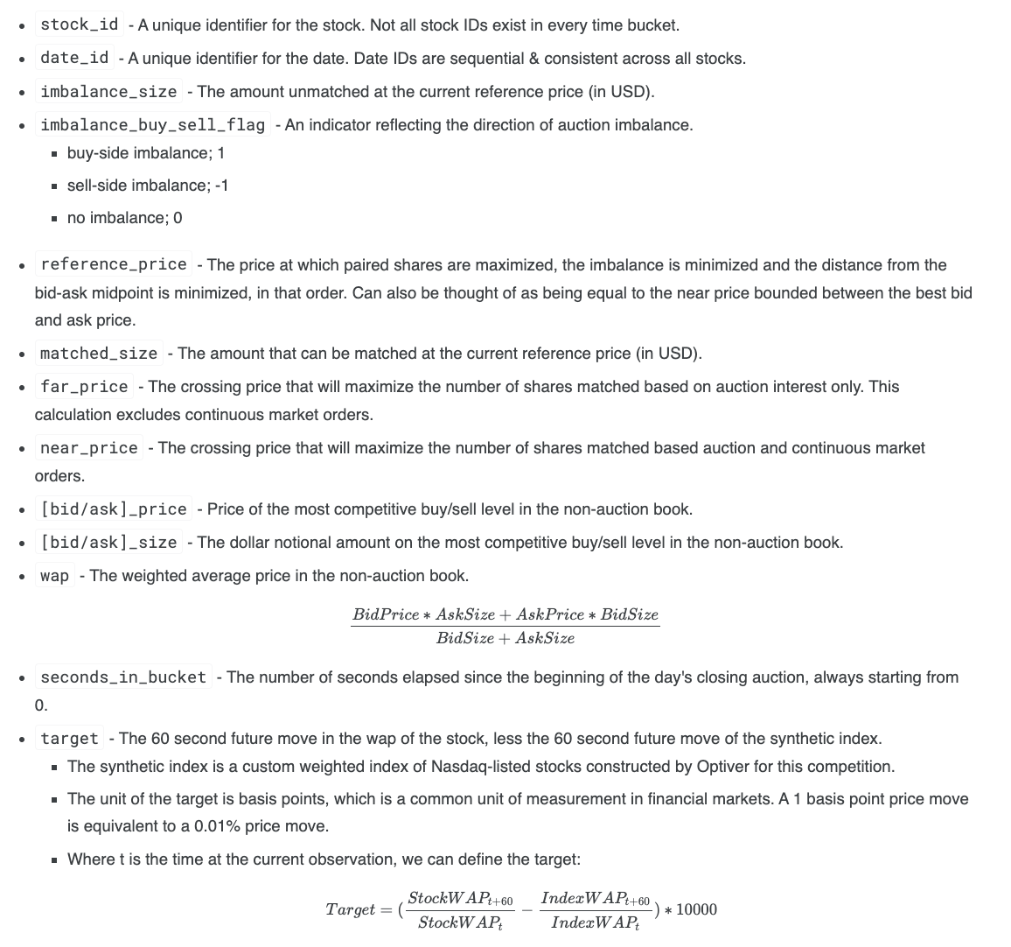
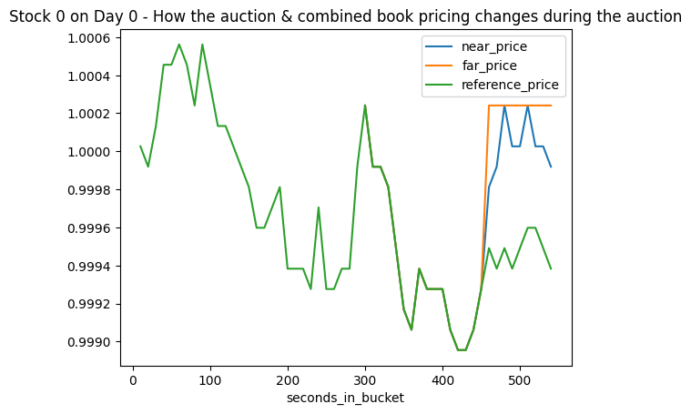
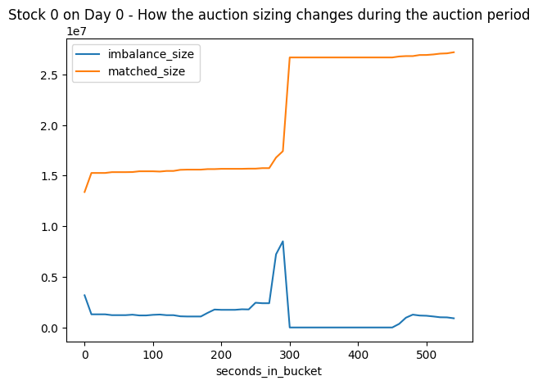
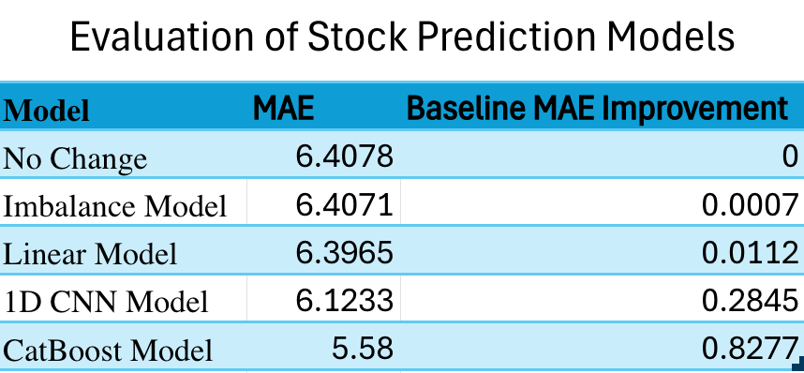

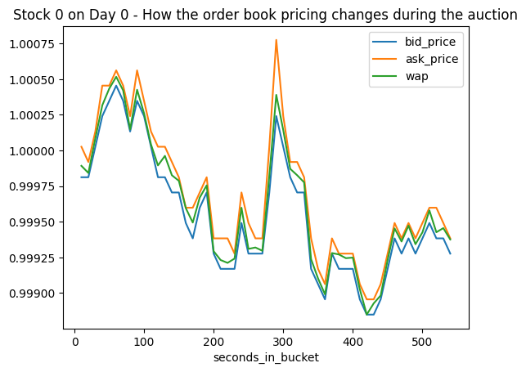
Trading at the Close: Forcasting Future Stock Price Movements Using Machine Learning
Henry Morris, Charlie Morris, Dawson Haddox, Alan Ngouenet
Department of Engineering, Dartmouth College
Abstract
Competition Dataset
Baseline Model
Inspired by a Kaggle competition hosted by Optiver, our group attempted to build a model that predicts the closing price movements for hundreds of Nasdaq listed stocks using data only from the order book and the closing auction of the stock. In order to tackle the problem, we wanted to compare more classical models like linear regression which we learned about in the beginning of the term to deep learning and advanced machine learning approaches. Success in this endeavor would be game-changing, unlocking enormous profit potential.
From the Kaggle competition data of the short term price movements during the 10 minute auction period, the first step was to perform a split into training and testing data so that we could fairly judge the effectiveness of the models we build. The columns of this dataset are as follows:
A simple baseline that we hope to outperform is one that always outputs a predicted value of 0. Going further, intuitively it should follow that price movement correlates with whether there is an an imbalance. Thus we could predict a target of 0.1 when there is a buy imbalance, -0.1 when there is a sell imbalance, and 0 when there is equilibrium. The MAE of these models are actually very close, with the imbalance model improving the metric by just 0.0007
Linear Regression Model
The success of building a linear regression model for forecasting was very limited. This is certainly not surprising because many of the assumptions necessary for a linear regression model to work are violated in our problem - in other words, this problem is not set up to be solved in this manner. In fact, visualizing the relationship between every feature column and the target, there appears to the naked eye to be no significant association for any of them. Ultimately, through lasso regularization, the linear regression model constructed had fewer than 20 non-zero weights and gave an MAE improvement of just over 0.01 from the baseline.
Introduction
Each trading day on the Nasdaq Stock Exchange concludes with the Nasdaq Closing Cross auction. This process establishes the official closing prices for securities listed on the exchange by merging the traditional order book with the price auction data. The price is determined as that which maximizes the number of shares which can be matched. In the last ten minutes of the Nasdaq exchange trading session, the state of the auction book becomes public. It is here that we as computer scientists are interested in finding patterns to predict short term price movements. The below visuals demonstrate how all this may play out:
CNN and CatBoost Model
One type of model we thought could be successful here is a convolutional neural network given its inherent strength in learning hierarchical representations in order to capture complex, non-linear patterns from the order book data. Thus we constructed a 1D CNN that by definition uses several layers of convolution and pooling to extract features, followed by fully connected layers to generate predictions. Training the network using cross-validation with early stopping and adaptive learning rates, we found that that this deep learning model gave us an MAE more than 0.28 better than the baseline.
However, our best performing approach was a CatBoost model. This is a gradient boosting algorithm that utilizes an ensemble of decision trees in a sequential manner in order. After training, we found this advanced machine learning model beat the baseline MAE by nearly 0.83 which is markedly better than any of the other models. Additionally, we determined from this model that 95% of the predictive importance from all the features comes from just 18 features. This is an incredibly useful to know as we continue trying to build better and better models. By reduing dimensionality to just these features, limiting factors around computational space and efficiency will not be as extreme and thus we may be able to both build models with greater complexity as well as actually use the entire Kaggle competition dataset in our training, something we have not been able to do up to now.
Using these original columns, we constructed almost 150 other columns, many of which involve ranking, comparing ratios, calculating a multitude of summary statistics, and anything else that we thought could possibly be useful in our model. The next challenge was determining which of these feature columns were actually useful in predicting price movements.
Evaluation
Since it is impossible to not have large errors/outliers for some predictions given the topic, an evaluation metric of mean absolute error is preferable to a mean squared error loss function which would, by amplifying the influence of outliers, undermine the model’s ability to generalize effectively. The formula for MAE is:
Where:
n is the total number of data points
yᵢ is the predicted value for the iᵗʰ data point
xᵢ is the predicted value for the iᵗʰ data point
1 2 3

