Slide 1
Mineração de Dados
Bases de Dados: Breast Cancer, Adult e Syntetic Control
Carlos Timoteo
Diego Araújo
Elliackin Figueiredo
Rafael Praxedes

Slide 2
Trilha
Introdução
Bases de Dados
Breast Cancer
Adult
  Resultados Execução Padrão
  Resultados Execução de Prova
  Resultados Clusterização de Dados
  Análise Gráfica

Slide 3
Introdução
A mineração de dados é uma técnica que tem como objetivo extrair informações não facilmente visíveis de uma base de dados que agregue valor para a predição de comportamentos, a tomada de decisões e a classificação dos dados, por exemplo.
Esse trabalho tem o objetivo de aplicar algoritmos para classificação, geração de regras de associação e análise temporal de dados.

Slide 4
Base de Dados
As bases de dados escolhidas podem ser encontradas nos endereços a seguir.
  Breast Cancer: Aplicar árvore de decisão J48
    http://archive.ics.uci.edu/ml/machine-learning-databases/breast-cancer/
  Adult: regras de associação=> Apriori
    http://archive.ics.uci.edu/ml/machine-learning-databases/adult/
  Série Temporal=>SimplekMeans
    http://archive.ics.uci.edu/ml/databases/synthetic_control/synthetic_control.html

Slide 5
Breast Cancer

Slide 6
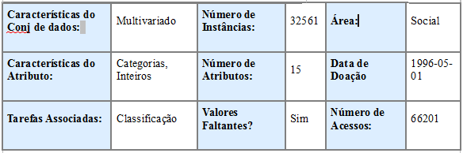
Adult
Resumo: Predizer se o redimento excede $50K/ano baseado nos dados do census.

Slide 7
Adult
Informação do Conjunto de Dados:
  A extração foi feita do banco de dados do census de 1994. Um conjunto de registros razoavelmente limpos foi extraído usando as seguintes condições: ((AAGE>16) && (AGI>100) && (AFNLWGT>1)&& (HRSWK>0)) .
  A tarefa de predição é determinar se a pessoa faz mais de 50.000 por ano.

Slide 8
Adult
Lista de Atributos:
  age: continuous.
  workclass: Private, Self-emp-not-inc, Self-emp-inc, Federal-gov, Local-gov, State-gov, Without-pay, Never-worked.
  fnlwgt: continuous.
  education: Bachelors, Some-college, 11th, HS-grad, Prof-school, Assoc-acdm, Assoc-voc, 9th, 7th-8th, 12th, Masters, 1st-4th, 10th, Doctorate, 5th-6th, Preschool.
  education-num: continuous.
  marital-status: Married-civ-spouse, Divorced, Never-married, Separated, Widowed, Married-spouse-absent, Married-AF-spouse.
  occupation: Tech-support, Craft-repair, Other-service, Sales, Exec-managerial, Prof-specialty, Handlers-cleaners, Machine-op-inspct, Adm-clerical, Farming-fishing, Transport-moving, Priv-house-serv, Protective-serv, Armed-Forces.
  relationship: Wife, Own-child, Husband, Not-in-family, Other-relative, Unmarried.
  race: White, Asian-Pac-Islander, Amer-Indian-Eskimo, Other, Black.
  sex: Female, Male.
  capital-gain: continuous.
  capital-loss: continuous.
  hours-per-week: continuous.
  native-country: United-States, Cambodia, England, Puerto-Rico, Canada, Germany, Outlying-US(Guam-USVI-etc), India, Japan, Greece, South, China, Cuba, Iran, Honduras, Philippines, Italy, Poland, Jamaica, Vietnam, Mexico, Portugal, Ireland, France, Dominican-Republic, Laos, Ecuador, Taiwan, Haiti, Columbia, Hungary, Guatemala, Nicaragua, Scotland, Thailand, Yugoslavia, El-Salvador, Trinadad&Tobago, Peru, Hong, Holand-Netherlands.

Slide 9
Adult
Pré-Processamento:
  Nessa etapa, pegamos os dados no arquivo “.data” e após a inserção de um template de arquivo “.arff”. Nós o importamos para o Weka Explorer.
  Após isso, passamos um filtro para a inserção dos dados faltantes e salvamos em outro arquivo.
  Por último, filtramos os atributos de tipo Numérico para Nominal.

Slide 10
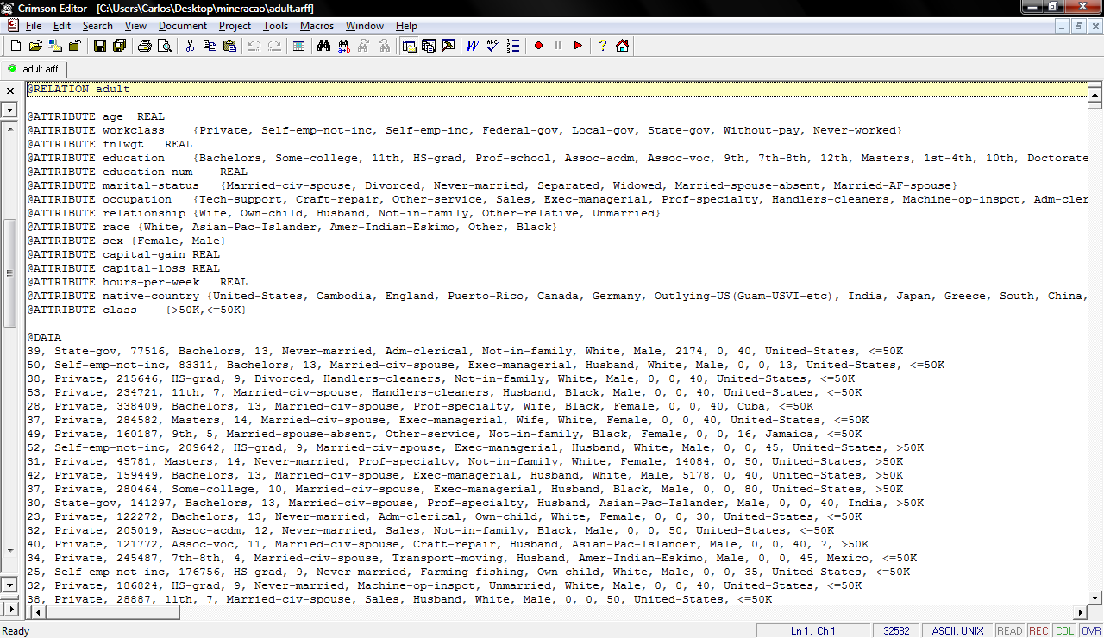
Adult
Arquivo Arff:

Slide 11
Adult
Associação:
  Na associação selecionamos o algoritmo Apriori, que tem os seguintes argumentos relevantes:
    Delta – indica de quanto o suporte é reduzido nas iterações.
    MetricType– Tipo de Métrica, no caso, Confiança.
    NumRules – Número de regras a serem encontradas.
  Melhor Caso:
  weka.associations.Apriori -N 10 -T 0 -C 0.9 -D 0.1 -U 1.0 -M 0.1 -S -1.0 -V -c -1

Slide 12
Adult
Casos Analisados:
  Execução Padrão: Execução com a base de dados “replace missing” e convertida de “Numeric” para “Nominal”.
  Execução de Prova das regras encontradas: Execução com a base de dados com atributos selecionados.
  Clusterização dos Conjuntos: Tentativa de formar grupos que melhor possam representar a distribuição numérica após o filtro para Nominal.

Slide 13
Resultados Execução Padrão
1ª Execução
Execução Padrão:
=== Run information ===
Scheme: weka.associations.Apriori -N 10 -T 0 -C 0.9 -D 0.05 -U 1.0 -M 0.1 -S -1.0 -c -1
Relation: adult-weka.filters.unsupervised.attribute.NumericToNominal-Rfirst-last
Instances: 32561
Attributes: 15
=== Associator model (full training set) ===
Apriori
=======
Minimum support: 0.7 (22793 instances)‏
Minimum metric <confidence>: 0.9
Number of cycles performed: 6
Generated sets of large itemsets:
Size of set of large itemsets L(1): 5

Slide 14
Resultados Execução Padrão
Best rules found:
1. class=<=50K 24720 ==> capital-loss=0 23974 conf:(0.97)‏
2. capital-gain=0 class=<=50K 23685 ==> capital-loss=0 22939 conf:(0.97)‏
3. class=<=50K 24720 ==> capital-gain=0 23685 conf:(0.96)‏
4. capital-loss=0 class=<=50K 23974 ==> capital-gain=0 22939 conf:(0.96)‏
5. native-country=United-States 29170 ==> capital-loss=0 27791 conf:(0.95)‏
6. race=White 27816 ==> capital-loss=0 26470 conf:(0.95)‏
7. capital-gain=0 29849 ==> capital-loss=0 28330 conf:(0.95)‏

Slide 15
Resultados Execução Padrão
2ª Execução
Execução Padrão:
=== Run information ===
Scheme: weka.associations.Apriori -N 10 -T 0 -C 0.9 -D 0.05 -U 1.0 -M 0.1 -S -1.0 -c -1
Relation: adult-weka.filters.unsupervised.attribute.ReplaceMissingValues-weka.filters.unsupervised.attribute.NumericToNominal-Rfirst-last
Instances: 32561
Attributes: 15
=== Associator model (full training set) ===
Apriori
=======
Minimum support: 0.75 (24421 instances)‏
Minimum metric <confidence>: 0.9
Number of cycles performed: 5

Slide 16
Resultados Execução Padrão
Generated sets of large itemsets:
Size of set of large itemsets L(1): 6
Size of set of large itemsets L(2): 6
Size of set of large itemsets L(3): 2
Best rules found:
1. native-country=United-States 29753 ==> capital-loss=0 28338 conf:(0.95)‏
2. race=White 27816 ==> capital-loss=0 26470 conf:(0.95)‏
3. capital-gain=0 29849 ==> capital-loss=0 28330 conf:(0.95)‏
4. race=White 27816 ==> native-country=United-States 26007 conf:(0.93)‏
5. race=White capital-loss=0 26470 ==> native-country=United-States 24713 conf:(0.93)‏
6. native-country=United-States 29753 ==> capital-gain=0 27228 conf:(0.92)‏
7. race=White 27816 ==> capital-gain=0 25407 conf:(0.91)‏
8. capital-loss=0 31042 ==> native-country=United-States 28338 conf:(0.91)‏

Slide 17
Resultados Execução Padrão
3ª Execução
=== Run information ===
Scheme: weka.associations.Apriori -N 10 -T 0 -C 0.9 -D 0.05 -U 1.0 -M 0.1 -S -1.0 -c -1
Relation: adult-weka.filters.unsupervised.attribute.NumericToNominal-Rfirst-last
Instances: 32561
Attributes: 15
=== Associator model (full training set) ===
Apriori
=======
Minimum support: 0.7 (22793 instances)‏
Minimum metric <confidence>: 0.9
Number of cycles performed: 6
Generated sets of large itemsets:
Size of set of large itemsets L(1): 5
Size of set of large itemsets L(2): 8
Size of set of large itemsets L(3): 5

Slide 18
Resultados Execução Padrão
Best rules found:
1. class=<=50K 24720 ==> capital-loss=0 23974 conf:(0.97)‏
2. capital-gain=0 class=<=50K 23685 ==> capital-loss=0 22939 conf:(0.97)‏
3. class=<=50K 24720 ==> capital-gain=0 23685 conf:(0.96)‏
4. capital-loss=0 class=<=50K 23974 ==> capital-gain=0 22939 conf:(0.96)‏
5. native-country=United-States 29170 ==> capital-loss=0 27791 conf:(0.95)‏
6. race=White 27816 ==> capital-loss=0 26470 conf:(0.95)‏
8. capital-gain=0 29849 ==> capital-loss=0 28330 conf:(0.95)‏

Slide 19
Resultados Execução Padrão
4ª Execução
=== Run information ===
Scheme: weka.associations.Apriori -I -N 5 -T 0 -C 0.9 -D 0.1 -U 1.0 -M 0.1 -S -1.0 -V -c -1
Relation: adult-weka.filters.unsupervised.attribute.NumericToNominal-Rfirst-last-weka.filters.unsupervised.attribute.ReplaceMissingValues
Instances: 32561
Attributes: 15
=== Associator model (full training set) ===
Apriori
=======
Minimum support: 0.8 (26049 instances)‏
Minimum metric <confidence>: 0.9
Number of cycles performed: 2

Slide 20
Resultados Execução Padrão
Generated sets of large itemsets:
Size of set of large itemsets L(1): 4
Large Itemsets L(1):
race=White 27816
capital-gain=0 29849
capital-loss=0 31042
native-country=United-States 29753
Size of set of large itemsets L(2): 4
Large Itemsets L(2):
race=White capital-loss=0 26470
capital-gain=0 capital-loss=0 28330
capital-gain=0 native-country=United-States 27228
capital-loss=0 native-country=United-States 28338

Slide 21
Resultados Execução Padrão
Best rules found:
1. native-country=United-States 29753 ==> capital-loss=0 28338 conf:(0.95)‏
2. race=White 27816 ==> capital-loss=0 26470 conf:(0.95)‏
3. capital-gain=0 29849 ==> capital-loss=0 28330 conf:(0.95)‏
4. native-country=United-States 29753 ==> capital-gain=0 27228 conf:(0.92)‏
5. capital-loss=0 31042 ==> native-country=United-States 28338 conf:(0.91)‏

Slide 22
Resultados Execução Padrão
Melhor Caso:
=== Run information ===
Scheme: weka.associations.Apriori -N 10 -T 0 -C 0.9 -D 0.1 -U 1.0 -M 0.1 -S -1.0 -V -c -1
Relation: adult-weka.filters.unsupervised.attribute.NumericToNominal-Rfirst-last
Instances: 32561
Attributes: 15
=== Associator model (full training set) ===
Apriori
=======
Minimum support: 0.7 (22793 instances)‏
Minimum metric <confidence>: 0.9
Number of cycles performed: 3

Slide 23
Resultados Execução Padrão
Generated sets of large itemsets:
Size of set of large itemsets L(1): 5
Size of set of large itemsets L(2): 8
Size of set of large itemsets L(3): 5
Best rules found:
1. class=<=50K 24720 ==> capital-loss=0 23974 conf:(0.97)‏
2. capital-gain=0 class=<=50K 23685 ==> capital-loss=0 22939 conf:(0.97)‏
3. class=<=50K 24720 ==> capital-gain=0 23685 conf:(0.96)‏
4. capital-loss=0 class=<=50K 23974 ==> capital-gain=0 22939 conf:(0.96)‏
5. native-country=United-States 29170 ==> capital-loss=0 27791 conf:(0.95)‏
6. race=White 27816 ==> capital-loss=0 26470 conf:(0.95)‏
7. race=White native-country=United-States 25621 ==> capital-loss=0 24349 conf:(0.95)‏
8. capital-gain=0 29849 ==> capital-loss=0 28330 conf:(0.95)‏
9. capital-gain=0 native-country=United-States 26699 ==> capital-loss=0 25320 conf:(0.95)‏
10. race=White capital-gain=0 25407 ==> capital-loss=0 24061 conf:(0.95)‏

Slide 24
Resultados Execução de Prova
1ª Execução:
=== Run information ===
Scheme: weka.associations.Apriori -N 10 -T 0 -C 0.9 -D 0.05 -U 1.0 -M 0.1 -S -1.0 -c -1
Relation: adult-weka.filters.unsupervised.attribute.ReplaceMissingValues-weka.filters.supervised.attribute.AttributeSelection-Eweka.attributeSelection.CfsSubsetEval-Sweka.attributeSelection.BestFirst -D 1 -N 5-weka.filters.unsupervised.attribute.NumericToNominal-Rfirst-last
Instances: 32561
Attributes: 6
education-num
marital-status
relationship
capital-gain
capital-loss
class

Slide 25
Resultados Execução de Prova
=== Associator model (full training set) ===
Apriori
=======
Minimum support: 0.35 (11396 instances)‏
Minimum metric <confidence>: 0.9
Number of cycles performed: 13
Generated sets of large itemsets:
Size of set of large itemsets L(1): 5
Size of set of large itemsets L(2): 8
Size of set of large itemsets L(3): 4
Best rules found:
1. class=<=50K 24720 ==> capital-loss=0 23974 conf:(0.97)‏
2. capital-gain=0 class=<=50K 23685 ==> capital-loss=0 22939 conf:(0.97)‏
3. class=<=50K 24720 ==> capital-gain=0 23685 conf:(0.96)‏
4. capital-loss=0 class=<=50K 23974 ==> capital-gain=0 22939 conf:(0.96)‏
5. capital-gain=0 29849 ==> capital-loss=0 28330 conf:(0.95)‏

Slide 26
Resultados Execução de Prova
2ª Execução:
=== Run information ===
Scheme: weka.associations.Apriori -N 10 -T 0 -C 0.9 -D 0.05 -U 1.0 -M 0.1 -S -1.0 -c -1
Relation: adult-weka.filters.unsupervised.attribute.ReplaceMissingValues-weka.filters.unsupervised.attribute.Remove-V-R1-2,4,6-15-weka.filters.unsupervised.attribute.NumericToNominal-Rfirst-last
Instances: 32561
Attributes: 13
age
workclass
education
marital-status
occupation
relationship
race
sex

Slide 27
Resultados Execução de Prova
capital-gain
capital-loss
hours-per-week
native-country
class
=== Associator model (full training set) ===
Apriori
=======
Minimum support: 0.75 (24421 instances)‏
Minimum metric <confidence>: 0.9
Number of cycles performed: 5
Generated sets of large itemsets:
Size of set of large itemsets L(1): 6
Size of set of large itemsets L(2): 6

Slide 28
Resultados Execução de Prova
Size of set of large itemsets L(3): 2
Best rules found:
1. native-country=United-States 29753 ==> capital-loss=0 28338 conf:(0.95)‏
2. race=White 27816 ==> capital-loss=0 26470 conf:(0.95)‏
3. race=White native-country=United-States 26007 ==> capital-loss=0 24713 conf:(0.95)‏
4. capital-gain=0 29849 ==> capital-loss=0 28330 conf:(0.95)‏
5. capital-gain=0 native-country=United-States 27228 ==> capital-loss=0 25813 conf:(0.95)‏
6. race=White 27816 ==> native-country=United-States 26007 conf:(0.93)‏
7. race=White capital-loss=0 26470 ==> native-country=United-States 24713 conf:(0.93)‏
8. native-country=United-States 29753 ==> capital-gain=0 27228 conf:(0.92)‏
9. race=White 27816 ==> capital-gain=0 25407 conf:(0.91)‏
10. capital-loss=0 31042 ==> native-country=United-States 28338 conf:(0.91)‏

Slide 29
Resultados Execução de Prova
3ª Execução:
=== Run information ===
Scheme: weka.associations.Apriori -N 10 -T 0 -C 0.9 -D 0.05 -U 1.0 -M 0.1 -S -1.0 -c -1
Relation: adult-weka.filters.unsupervised.attribute.Remove-V-R5-6,8,11-13,15-weka.filters.unsupervised.attribute.NumericToNominal-Rfirst-last
Instances: 32561
Attributes: 7
education-num
marital-status
relationship
capital-gain
capital-loss
hours-per-week
class

Slide 30
Resultados Execução de Prova
=== Associator model (full training set) ===
Apriori
=======
Minimum support: 0.4 (13024 instances)‏
Minimum metric <confidence>: 0.9
Number of cycles performed: 12
Generated sets of large itemsets:
Size of set of large itemsets L(1): 6
Size of set of large itemsets L(2): 8
Size of set of large itemsets L(3): 2

Slide 31
Resultados Execução de Prova
Best rules found:
1. class=<=50K 24720 ==> capital-loss=0 23974 conf:(0.97)‏
2. capital-gain=0 class=<=50K 23685 ==> capital-loss=0 22939 conf:(0.97)‏
3. class=<=50K 24720 ==> capital-gain=0 23685 conf:(0.96)‏
4. capital-loss=0 class=<=50K 23974 ==> capital-gain=0 22939 conf:(0.96)‏
5. capital-gain=0 hours-per-week=40 14096 ==> capital-loss=0 13438 conf:(0.95)‏
6. capital-gain=0 29849 ==> capital-loss=0 28330 conf:(0.95)‏
7. class=<=50K 24720 ==> capital-gain=0 capital-loss=0 22939 conf:(0.93)‏

Slide 32
Resultados Clusterização de Dados
Melhor Caso:
=== Run information ===
Scheme: weka.clusterers.SimpleKMeans -M -N 4 -A "weka.core.ManhattanDistance -R first-last" -I 500 -O -S 10
Relation: adult
Instances: 32561
Attributes: 15
Test mode: evaluate on training data
=== Model and evaluation on training set ===
kMeans
======
Number of iterations: 6
Sum of within cluster distances: 100953.44221306295

Slide 33
Resultados Clusterização de Dados
Cluster centroids:
Cluster#
Attribute Full Data 0 1 2 3
(32561) (7917) (8039) (8350) (8255)‏
============================================================================================================================
age 37 24 43 40 41
workclass Private Private Private Private Private
fnlwgt 178356 185554 176118 176851 176724
education HS-grad Some-college HS-grad HS-grad Bachelors
education-num 10 10 9 9 13
marital-status Married-civ-spouse Never-married Married-civ-spouse Divorced Married-civ-spouse
occupation Prof-specialty Other-service Craft-repair Adm-clerical Prof-specialty
relationship Husband Own-child Husband Not-in-family Husband
race White White White White White

Slide 34
Resultados Clusterização de Dados
sex Male Male Male Female Male
capital-gain 0 0 0 0 0
capital-loss 0 0 0 0 0
hours-per-week 40 40 40 40 40
native-country United-States United-States United-States United-States United-States
class <=50K <=50K >50K <=50K <=50K
Clustered Instances
0 7917 ( 24%)‏
1 8039 ( 25%)‏
2 8350 ( 26%)‏
3 8255 ( 25%)‏

Slide 35
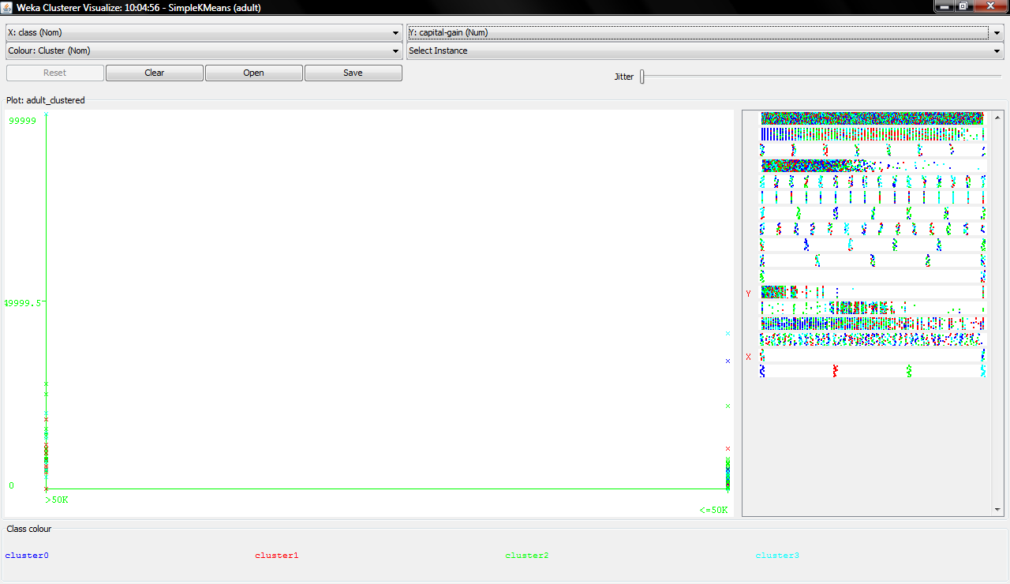
Análise Gráfica

Slide 36
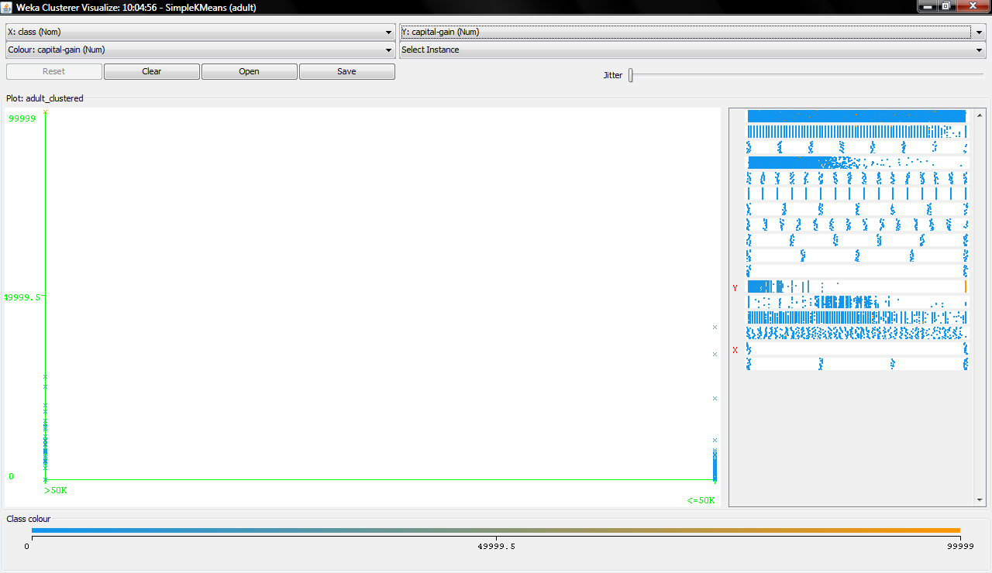
Análise Gráfica

Slide 37
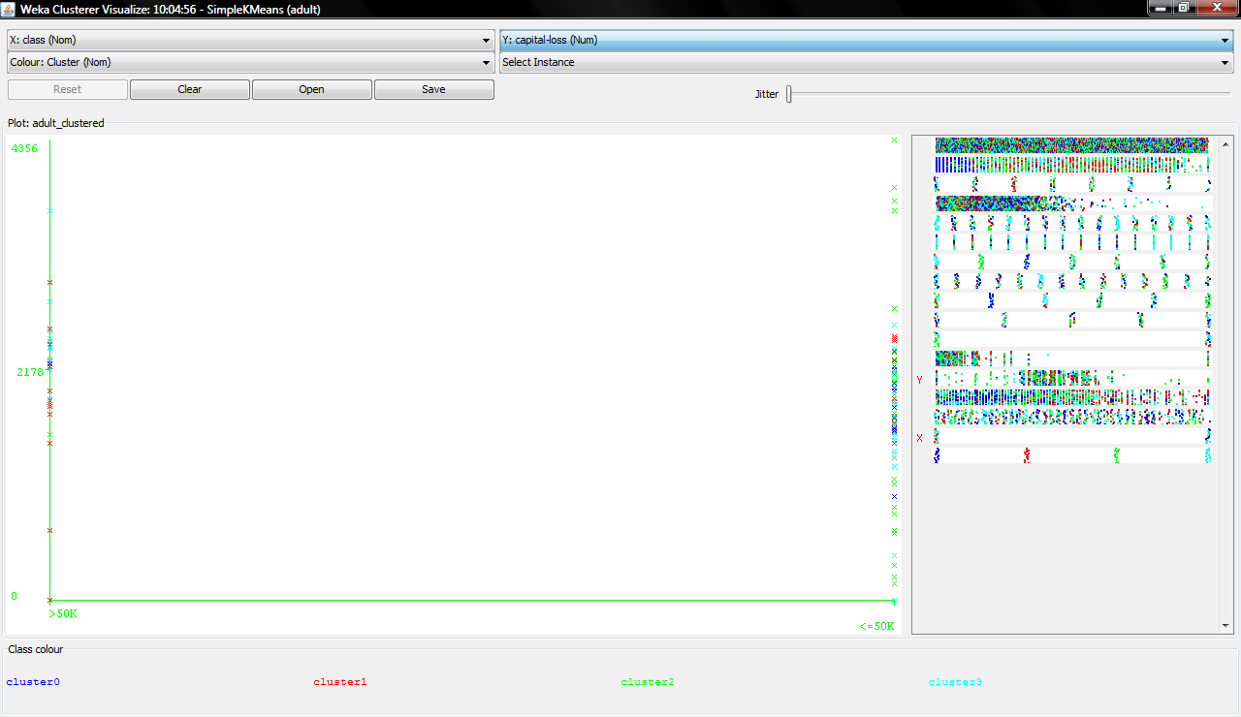
Análise Gráfica

Slide 38
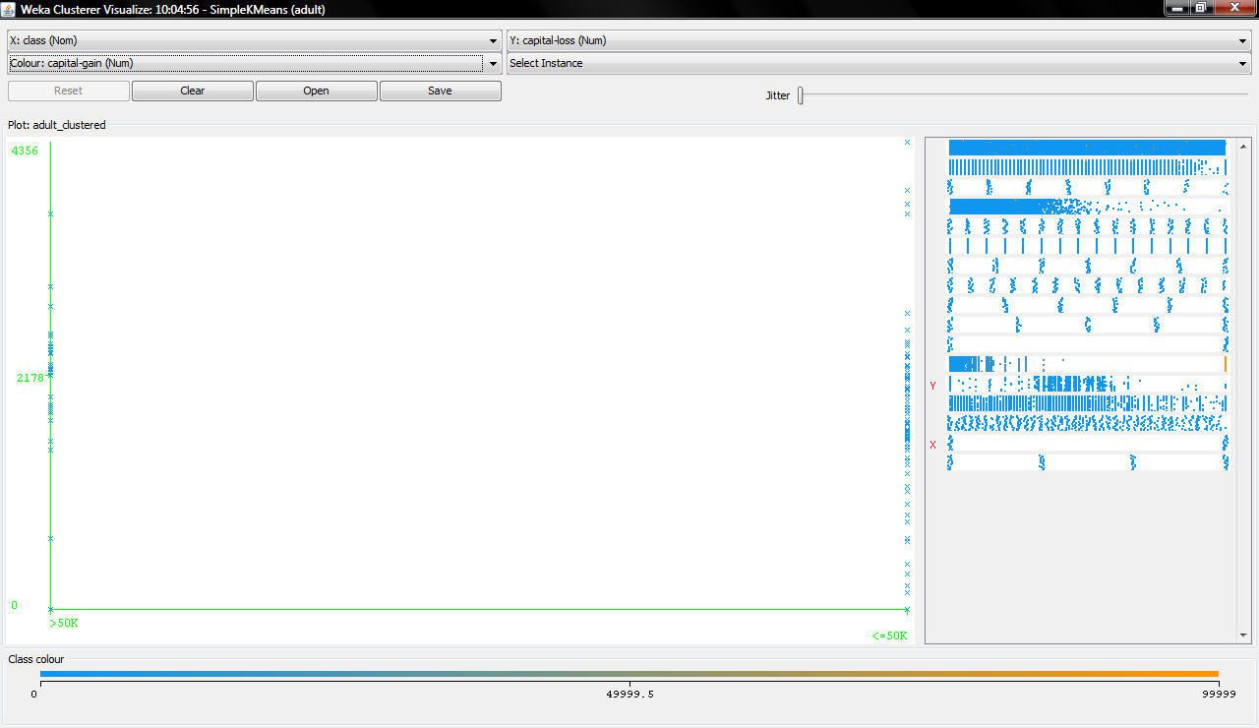
Análise Gráfica

