Slide 1
Classification: Basic Concepts and Decision Trees

Slide 2
Classification: Definition
Given a collection of records (training set )
  Each record contains a set of attributes, one of the attributes is the class.
Find a model for class attribute as a function of the values of other attributes.
Goal: previously unseen records should be assigned a class as accurately as possible.
  A test set is used to determine the accuracy of the model. Usually, the given data set is divided into training and test sets, with training set used to build the model and test set used to validate it.

Slide 3

Illustrating Classification Task

Slide 4




Examples of Classification Task
Predicting tumor cells as benign or malignant
Classifying credit card transactions
as legitimate or fraudulent
Classifying secondary structures of protein
as alpha-helix, beta-sheet, or random
coil
Categorizing news stories as finance,
weather, entertainment, sports, etc

Slide 5
Classification Techniques
Decision Tree based Methods
Rule-based Methods
Memory based reasoning
Neural Networks
Naïve Bayes and Bayesian Belief Networks
Support Vector Machines

Slide 6

Example of a Decision Tree
categorical
categorical
continuous
class
Splitting Attributes
Refund
Yes
No
NO
MarSt
Single, Divorced
Married
TaxInc
NO
< 80K
> 80K
NO
YES
Training Data
Model: Decision Tree

Slide 7
Another Example of Decision Tree
categorical
categorical
continuous
class
MarSt
Single, Divorced
Married
NO
Refund
Yes
No
NO
TaxInc
< 80K
> 80K
NO
YES
There could be more than one tree that fits the same data!

Slide 8

Decision Tree Classification Task
Decision Tree

Slide 9

Apply Model to Test Data
Test Data
Start from the root of tree.
Refund
Yes
No
NO
MarSt
Single, Divorced
Married
TaxInc
NO
< 80K
> 80K
NO
YES

Slide 10
Apply Model to Test Data
Test Data
Refund
Yes
No
NO
MarSt
Single, Divorced
Married
TaxInc
NO
< 80K
> 80K
NO
YES

Slide 11

Apply Model to Test Data
Test Data
Refund
Yes
No
NO
MarSt
Single, Divorced
Married
TaxInc
NO
< 80K
> 80K
NO
YES

Slide 12
Apply Model to Test Data
Test Data
Refund
Yes
No
NO
MarSt
Single, Divorced
Married
TaxInc
NO
< 80K
> 80K
NO
YES

Slide 13

Apply Model to Test Data
Test Data
Refund
Yes
No
NO
MarSt
Single, Divorced
Married
TaxInc
NO
< 80K
> 80K
NO
YES

Slide 14
Apply Model to Test Data
Test Data
Refund
Yes
No
NO
MarSt
Single, Divorced
Married
Assign Cheat to “No”
TaxInc
NO
< 80K
> 80K
NO
YES

Slide 15

Decision Tree Classification Task
Decision Tree

Slide 16
Decision Tree Induction
Many Algorithms:
  Hunt’s Algorithm (one of the earliest)
  CART
  ID3, C4.5
  SLIQ,SPRINT

Slide 17

General Structure of Hunt’s Algorithm
Let D_{t} be the set of training records that reach a node t
General Procedure:
  If D_{t} contains records that belong the same class y_{t}, then t is a leaf node labeled as y_{t}
  If D_{t} is an empty set, then t is a leaf node labeled by the default class, y_{d}
  If D_{t} contains records that belong to more than one class, use an attribute test to split the data into smaller subsets. Recursively apply the procedure to each subset.
D_{t}
?

Slide 18

Hunt’s Algorithm
Refund
Don’t
Cheat
Yes
No
Don’t
Cheat
Don’t
Cheat
Refund
Refund
Yes
No
Yes
No
Don’t
Cheat
Marital
Status
Don’t
Cheat
Marital
Status
Single,
Divorced
Single,
Divorced
Married
Married
Cheat
Don’t
Cheat
Taxable
Income
Don’t
Cheat
< 80K
>= 80K
Don’t
Cheat
Cheat

Slide 19
Tree Induction
Greedy strategy.
  Split the records based on an attribute test that optimizes certain criterion.
Issues
  Determine how to split the records
    How to specify the attribute test condition?
    How to determine the best split?
  Determine when to stop splitting

Slide 20
Tree Induction
Greedy strategy.
  Split the records based on an attribute test that optimizes certain criterion.
Issues
  Determine how to split the records
    How to specify the attribute test condition?
    How to determine the best split?
  Determine when to stop splitting

Slide 21
How to Specify Test Condition?
Depends on attribute types
  Nominal
  Ordinal
  Continuous
Depends on number of ways to split
  2-way split
  Multi-way split

Slide 22
Splitting Based on Nominal Attributes
Multi-way split: Use as many partitions as distinct values.
Binary split: Divides values into two subsets.
Need to find optimal partitioning.
CarType
Family
Luxury
Sports
CarType
OR
CarType
{Sports, Luxury}
{Family,
Luxury}
{Family}
{Sports}

Slide 23
Splitting Based on Ordinal Attributes
Multi-way split: Use as many partitions as distinct values.
Binary split: Divides values into two subsets.
Need to find optimal partitioning.
What about this split?
Size
Small
Large
Medium
Size
Size
{Small, Medium}
OR
{Medium,
Large}
{Large}
{Small}
Size
{Small, Large}
{Medium}

Slide 24
Splitting Based on Continuous Attributes
Different ways of handling
  Discretization to form an ordinal categorical attribute
    Static – discretize once at the beginning
    Dynamic – ranges can be found by equal interval bucketing, equal frequency bucketing
    (percentiles), or clustering.
  Binary Decision: (A < v) or (A ≥ v)
    consider all possible splits and finds the best cut
    can be more compute intensive

Slide 25
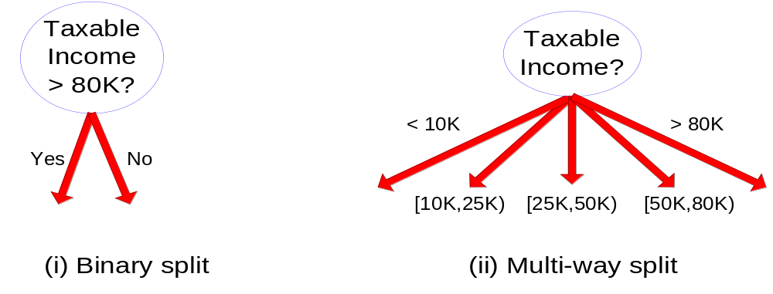
Splitting Based on Continuous Attributes

Slide 26
Tree Induction
Greedy strategy.
  Split the records based on an attribute test that optimizes certain criterion.
Issues
  Determine how to split the records
    How to specify the attribute test condition?
    How to determine the best split?
  Determine when to stop splitting

Slide 27

How to determine the Best Split
Before Splitting: 10 records of class 0,
10 records of class 1
Which test condition is the best?

Slide 28


How to determine the Best Split
Greedy approach:
  Nodes with homogeneous class distribution are preferred
Need a measure of node impurity:
Non-homogeneous,
High degree of impurity
Homogeneous,
Low degree of impurity

Slide 29
Measures of Node Impurity
Gini Index
Entropy
Misclassification error

Slide 30





How to Find the Best Split
Before Splitting:
M0
A?
B?
Yes
No
Yes
No
Node N1
Node N2
Node N3
Node N4
M1
M2
M3
M4
M12
M34
Gain = M0 – M12 vs M0 – M34

Slide 31





Measure of Impurity: GINI
Gini Index for a given node t :
    (NOTE: p( j | t) is the relative frequency of class j at node t).
  Maximum (1 - 1/n_{c}) when records are equally distributed among all classes, implying least interesting information
  Minimum (0.0) when all records belong to one class, implying most interesting information

Slide 32



Examples for computing GINI
P(C1) = 0/6 = 0 P(C2) = 6/6 = 1
Gini = 1 – P(C1)² – P(C2)² = 1 – 0 – 1 = 0
P(C1) = 1/6 P(C2) = 5/6
Gini = 1 – (1/6)² – (5/6)² = 0.278
P(C1) = 2/6 P(C2) = 4/6
Gini = 1 – (2/6)² – (4/6)² = 0.444

Slide 33

Splitting Based on GINI
Used in CART, SLIQ, SPRINT.
When a node p is split into k partitions (children), the quality of split is computed as,
where, n_{i} = number of records at child i,
n = number of records at node p.

Slide 34

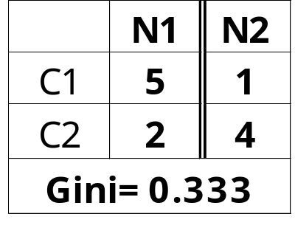
Binary Attributes: Computing GINI Index
Splits into two partitions
Effect of Weighing partitions:
  Larger and Purer Partitions are sought for.
B?
Yes
No
Node N1
Node N2
Gini(N1)
= 1 – (5/6)² – (2/6)²
= 0.194
Gini(N2)
= 1 – (1/6)² – (4/6)²
= 0.528
Gini(Children)
= 7/12 * 0.194 +
5/12 * 0.528
= 0.333

Slide 35



Categorical Attributes: Computing Gini Index
For each distinct value, gather counts for each class in the dataset
Use the count matrix to make decisions
Multi-way split
Two-way split
(find best partition of values)

Slide 36

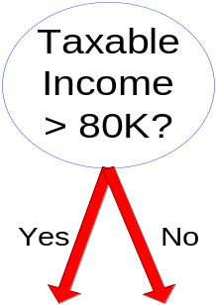
Continuous Attributes: Computing Gini Index
Use Binary Decisions based on one value
Several Choices for the splitting value
  Number of possible splitting values
  = Number of distinct values
Each splitting value has a count matrix associated with it
  Class counts in each of the partitions, A < v and A ≥ v
Simple method to choose best v
  For each v, scan the database to gather count matrix and compute its Gini index
  Computationally Inefficient! Repetition of work.

Slide 37

Continuous Attributes: Computing Gini Index...
For efficient computation: for each attribute,
  Sort the attribute on values
  Linearly scan these values, each time updating the count matrix and computing gini index
  Choose the split position that has the least gini index
Sorted Values
Split Positions

Slide 38

Alternative Splitting Criteria based on INFO
Entropy at a given node t:
    (NOTE: p( j | t) is the relative frequency of class j at node t).
  Measures homogeneity of a node.
    Maximum (log n_{c}) when records are equally distributed among all classes implying least information
    Minimum (0.0) when all records belong to one class, implying most information
  Entropy based computations are similar to the GINI index computations

Slide 39

Examples for computing Entropy
P(C1) = 0/6 = 0 P(C2) = 6/6 = 1
Entropy = – 0 log 0 – 1 log 1 = – 0 – 0 = 0
P(C1) = 1/6 P(C2) = 5/6
Entropy = – (1/6) log₂ (1/6) – (5/6) log₂ (1/6) = 0.65
P(C1) = 2/6 P(C2) = 4/6
Entropy = – (2/6) log₂ (2/6) – (4/6) log₂ (4/6) = 0.92

Slide 40

Splitting Based on INFO...
Information Gain:
    Parent Node, p is split into k partitions;
    n_{i} is number of records in partition i
  Measures Reduction in Entropy achieved because of the split. Choose the split that achieves most reduction (maximizes GAIN)
  Used in ID3 and C4.5
  Disadvantage: Tends to prefer splits that result in large number of partitions, each being small but pure.

Slide 41


Splitting Based on INFO...
Gain Ratio:
    Parent Node, p is split into k partitions
    n_{i} is the number of records in partition i
  Adjusts Information Gain by the entropy of the partitioning (SplitINFO). Higher entropy partitioning (large number of small partitions) is penalized!
  Used in C4.5
  Designed to overcome the disadvantage of Information Gain

Slide 42

Splitting Criteria based on Classification Error
Classification error at a node t :
Measures misclassification error made by a node.
    Maximum (1 - 1/n_{c}) when records are equally distributed among all classes, implying least interesting information
    Minimum (0.0) when all records belong to one class, implying most interesting information

Slide 43
Examples for Computing Error
P(C1) = 0/6 = 0 P(C2) = 6/6 = 1
Error = 1 – max (0, 1) = 1 – 1 = 0
P(C1) = 1/6 P(C2) = 5/6
Error = 1 – max (1/6, 5/6) = 1 – 5/6 = 1/6
P(C1) = 2/6 P(C2) = 4/6
Error = 1 – max (2/6, 4/6) = 1 – 4/6 = 1/3

Slide 44

Comparison among Splitting Criteria
For a 2-class problem:

Slide 45

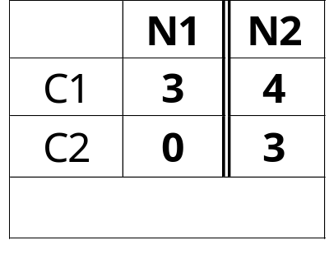
Misclassification Error vs Gini
A?
Yes
No
Node N1
Node N2
Gini(N1)
= 1 – (3/3)² – (0/3)²
= 0
Gini(N2)
= 1 – (4/7)² – (3/7)²
= 0.489
Gini(Children)
= 3/10 * 0
+ 7/10 * 0.489
= 0.342

Slide 46
Tree Induction
Greedy strategy.
  Split the records based on an attribute test that optimizes certain criterion.
Issues
  Determine how to split the records
    How to specify the attribute test condition?
    How to determine the best split?
  Determine when to stop splitting

Slide 47
Stopping Criteria for Tree Induction
Stop expanding a node when all the records belong to the same class
Stop expanding a node when all the records have similar attribute values
Early termination (to be discussed later)

Slide 48
Decision Tree Based Classification
Advantages:
  Inexpensive to construct
  Extremely fast at classifying unknown records
  Easy to interpret for small-sized trees
  Accuracy is comparable to other classification techniques for many simple data sets

Slide 49
Example: C4.5
Simple depth-first construction.
Uses Information Gain
Sorts Continuous Attributes at each node.
Needs entire data to fit in memory.
Unsuitable for Large Datasets.
  Needs out-of-core sorting.
You can download the software from:
http://www.cse.unsw.edu.au/~quinlan/c4.5r8.tar.gz

Slide 50
Practical Issues of Classification
Underfitting and Overfitting
Missing Values
Costs of Classification

Slide 51

Underfitting and Overfitting (Example)
500 circular and 500 triangular data points.
Circular points:
0.5 ≤ sqrt(x₁²+x₂²) ≤ 1
Triangular points:
sqrt(x₁²+x₂²) > 0.5 or
sqrt(x₁²+x₂²) < 1

Slide 52

Underfitting and Overfitting
Overfitting
Underfitting: when model is too simple, both training and test errors are large

Slide 53

Overfitting due to Noise
Decision boundary is distorted by noise point

Slide 54

Overfitting due to Insufficient Examples
Lack of data points in the lower half of the diagram makes it difficult to predict correctly the class labels of that region
- Insufficient number of training records in the region causes the decision tree to predict the test examples using other training records that are irrelevant to the classification task

Slide 55
Notes on Overfitting
Overfitting results in decision trees that are more complex than necessary
Training error no longer provides a good estimate of how well the tree will perform on previously unseen records
Need new ways for estimating errors

Slide 56
Estimating Generalization Errors
Re-substitution errors: error on training (Σ e(t) )
Generalization errors: error on testing (Σ e’(t))
Methods for estimating generalization errors:
  Optimistic approach: e’(t) = e(t)
  Pessimistic approach:
    For each leaf node: e’(t) = (e(t)+0.5)
    Total errors: e’(T) = e(T) + N × 0.5 (N: number of leaf nodes)
    For a tree with 30 leaf nodes and 10 errors on training
    (out of 1000 instances):
    Training error = 10/1000 = 1%
    Generalization error = (10 + 30×0.5)/1000 = 2.5%
  Reduced error pruning (REP):
    uses validation data set to estimate generalization
    error

Slide 57
Occam’s Razor
Given two models of similar generalization errors, one should prefer the simpler model over the more complex model
For complex models, there is a greater chance that it was fitted accidentally by errors in data
Therefore, one should include model complexity when evaluating a model

Slide 58
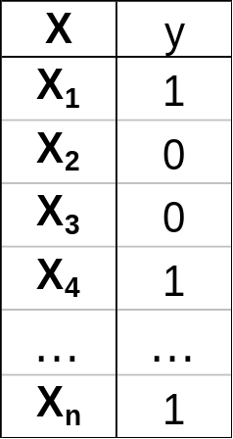
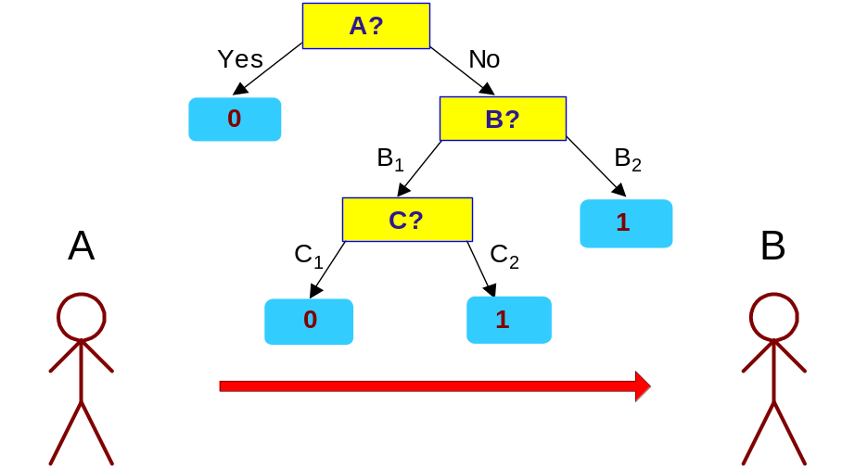
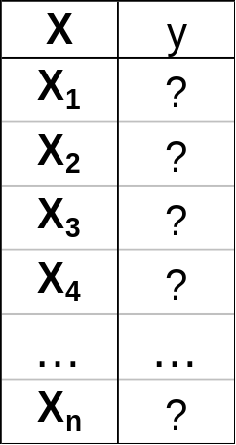
Minimum Description Length (MDL)
Cost(Model,Data) = Cost(Data|Model) + Cost(Model)
  Cost is the number of bits needed for encoding.
  Search for the least costly model.
Cost(Data|Model) encodes the misclassification errors.
Cost(Model) uses node encoding (number of children) plus splitting condition encoding.

Slide 59
How to Address Overfitting
Pre-Pruning (Early Stopping Rule)
  Stop the algorithm before it becomes a fully-grown tree
  Typical stopping conditions for a node:
    Stop if all instances belong to the same class
    Stop if all the attribute values are the same
  More restrictive conditions:
    Stop if number of instances is less than some user-specified threshold
    Stop if class distribution of instances are independent of the available features (e.g., using χ ² test)
    Stop if expanding the current node does not improve impurity
    measures (e.g., Gini or information gain).

Slide 60
How to Address Overfitting…
Post-pruning
  Grow decision tree to its entirety
  Trim the nodes of the decision tree in a bottom-up fashion
  If generalization error improves after trimming, replace sub-tree by a leaf node.
  Class label of leaf node is determined from majority class of instances in the sub-tree
  Can use MDL for post-pruning

Slide 61
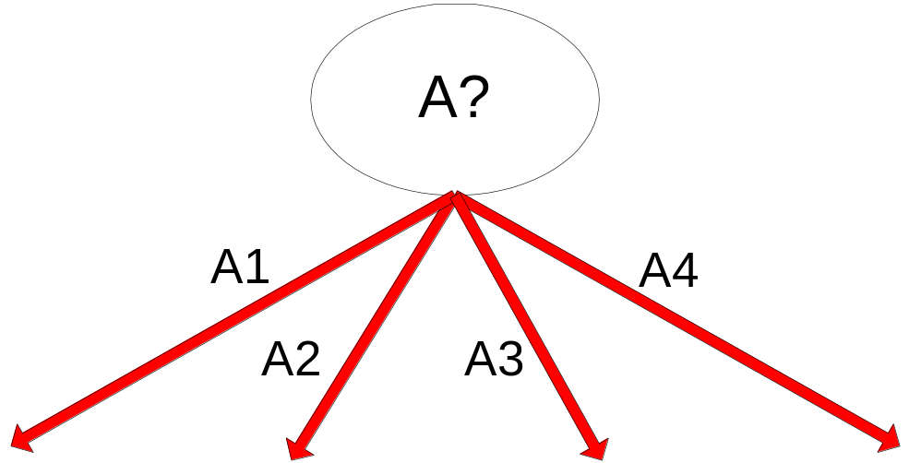
Example of Post-Pruning
Training Error (Before splitting) = 10/30
Pessimistic error = (10 + 0.5)/30 = 10.5/30
Training Error (After splitting) = 9/30
Pessimistic error (After splitting)
= (9 + 4 × 0.5)/30 = 11/30
PRUNE!
Class = Yes | 20
Class = No | 10
Error = 10/30
Class = Yes | 8
Class = No | 4
Class = Yes | 3
Class = No | 4
Class = Yes | 4
Class = No | 1
Class = Yes | 5
Class = No | 1

Slide 62
Examples of Post-pruning
Case 1:
  Optimistic error?
  Pessimistic error?
  Reduced error pruning?
Don’t prune for both cases
C0: 11
C1: 3
C0: 2
C1: 4
Don’t prune case 1, prune case 2
Case 2:
Depends on validation set
C0: 14
C1: 3
C0: 2
C1: 2

Slide 63
Handling Missing Attribute Values
Missing values affect decision tree construction in three different ways:
  Affects how impurity measures are computed
  Affects how to distribute instance with missing value to child nodes
  Affects how a test instance with missing value is classified

Slide 64

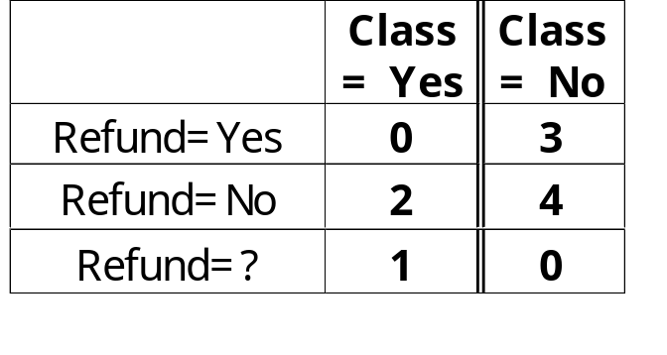
Computing Impurity Measure
Before Splitting:
Entropy(Parent)
= -0.3 log(0.3)-(0.7)log(0.7) = 0.8813
Split on Refund:
Entropy(Refund=Yes) = 0
Entropy(Refund=No)
= -(2/6)log(2/6) – (4/6)log(4/6) = 0.9183
Entropy(Children)
= 0.3 (0) + 0.6 (0.9183) = 0.551
Gain = 0.9 × (0.8813 – 0.551) = 0.3303
Missing value

Slide 65
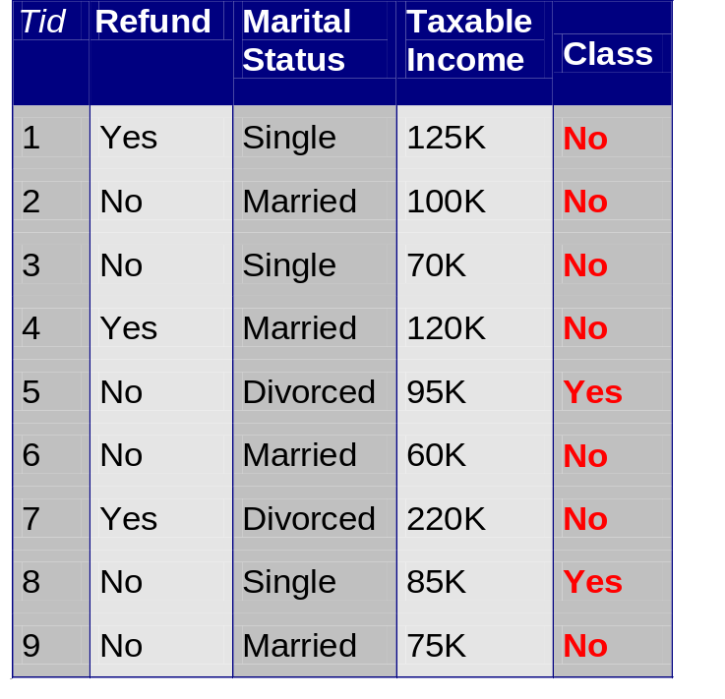
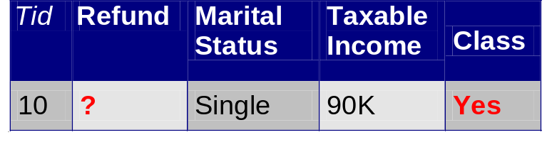
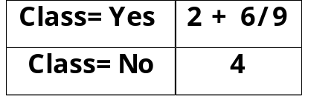
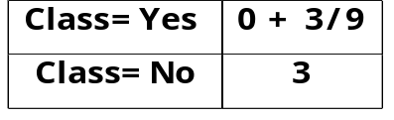
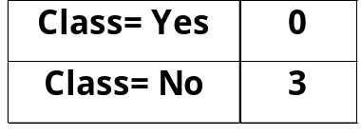
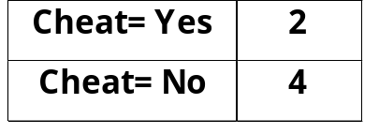
Distribute Instances
Refund
Yes
No
Probability that Refund=Yes is 3/9
Probability that Refund=No is 6/9
Assign record to the left child with weight = 3/9 and to the right child with weight = 6/9
Refund
Yes
No

Slide 66
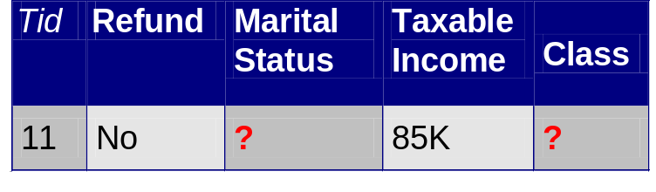
Classify Instances
New record:
 | Married | Single | Divorced | Total
Class=No | 3 | 1 | 0 | 4
Class=Yes | 6/9 | 1 | 1 | 2.67
Total | 3.67 | 2 | 1 | 6.67
Refund
Yes
No
NO
MarSt
Single,
Divorced
Married
Probability that Marital Status
= Married is 3.67/6.67
Probability that Marital Status ={Single,Divorced} is 3/6.67
TaxInc
NO
< 80K
> 80K
NO
YES

Slide 67
Other Issues
Data Fragmentation
Search Strategy
Expressiveness
Tree Replication

Slide 68
Data Fragmentation
Number of instances gets smaller as you traverse down the tree
Number of instances at the leaf nodes could be too small to make any statistically significant decision

Slide 69
Search Strategy
Finding an optimal decision tree is NP-hard
The algorithm presented so far uses a greedy, top-down, recursive partitioning strategy to induce a reasonable solution
Other strategies?
  Bottom-up
  Bi-directional

Slide 70
Expressiveness
Decision tree provides expressive representation for learning discrete-valued function
  But they do not generalize well to certain types of Boolean functions
    Example: parity function:
      Class = 1 if there is an even number of Boolean attributes with truth value = True
      Class = 0 if there is an odd number of Boolean attributes with truth value = True
    For accurate modeling, must have a complete tree
Not expressive enough for modeling continuous variables
  Particularly when test condition involves only a single attribute at-a-time

Slide 71
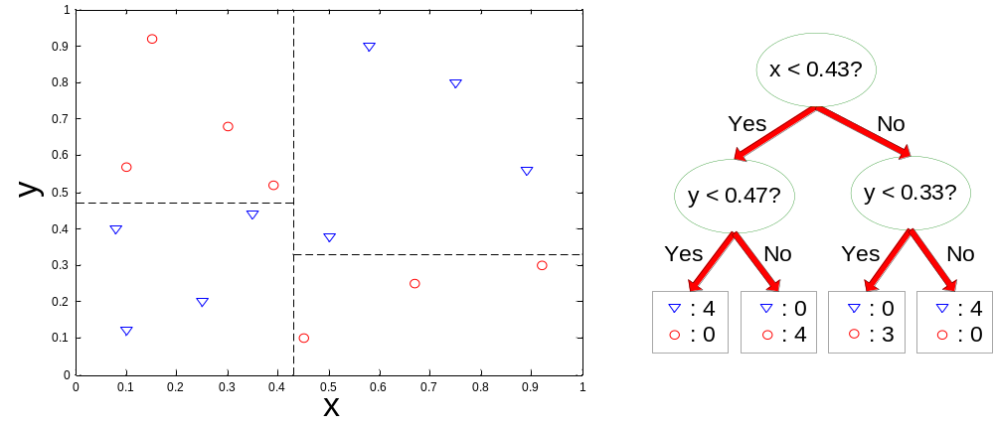
Decision Boundary
Border line between two neighboring regions of different classes is known as decision boundary
Decision boundary is parallel to axes because test condition involves a single attribute at-a-time

Slide 72
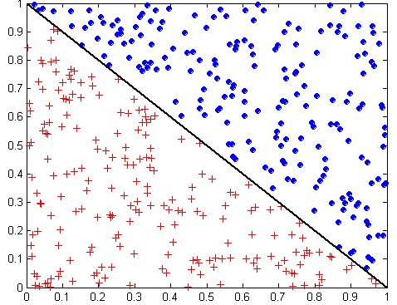
Oblique Decision Trees
x + y < 1
Class = +
Class =
Test condition may involve multiple attributes
More expressive representation
Finding optimal test condition is computationally expensive

Slide 73
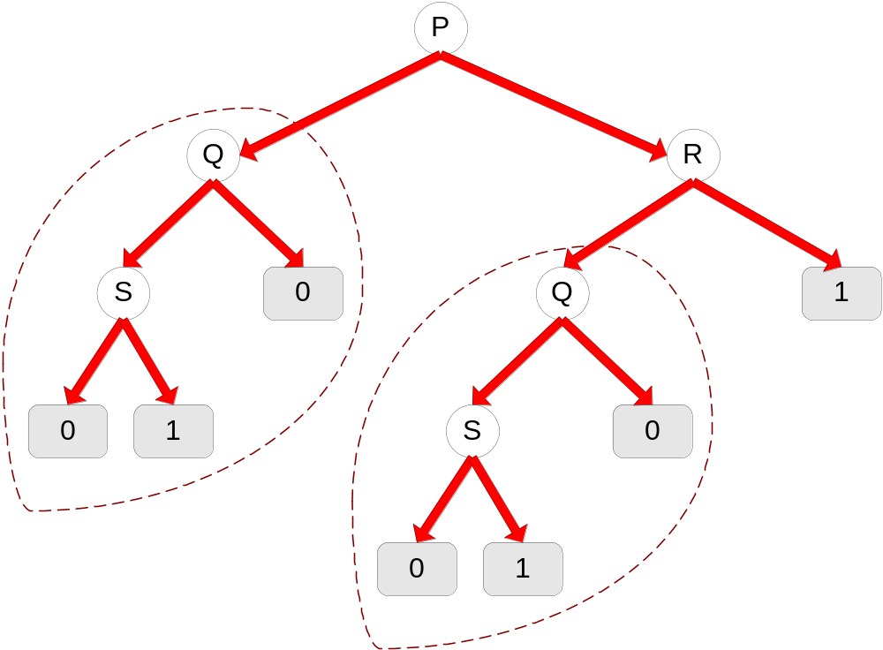
Tree Replication
Same subtree appears in multiple branches

Slide 74
Scalable Decision Tree Induction Methods
SLIQ (EDBT’96 — Mehta et al.)
  Builds an index for each attribute and only class list and the current attribute list reside in memory
SPRINT (VLDB’96 — J. Shafer et al.)
  Constructs an attribute list data structure
PUBLIC (VLDB’98 — Rastogi & Shim)
  Integrates tree splitting and tree pruning: stop growing the tree earlier
RainForest (VLDB’98 — Gehrke, Ramakrishnan & Ganti)
  Builds an AVC-list (attribute, value, class label)
BOAT (PODS’99 — Gehrke, Ganti, Ramakrishnan & Loh)
  Uses bootstrapping to create several small samples

Slide 75
Scalability Framework for RainForest
Separates the scalability aspects from the criteria that determine the quality of the tree
Builds an AVC-list: AVC (Attribute, Value, Class_label)
AVC-set (of an attribute X )
  Projection of training dataset onto the attribute X and class label where counts of individual class label are aggregated
AVC-group (of a node n )
  Set of AVC-sets of all predictor attributes at the node n

Slide 76

Rainforest: Training Set and Its AVC Sets
Training Examples
AVC-set on Age
AVC-set on income
income | Buy_Computer
 | yes | no
high | 2 | 2
medium | 4 | 2
low | 3 | 1
Age | Buy_Computer
 | yes | no
<=30 | 3 | 2
31..40 | 4 | 0
>40 | 3 | 2
AVC-set on
credit_rating
AVC-set on Student
student | Buy_Computer
 | yes | no
yes | 6 | 1
no | 3 | 4
Credit rating | Buy_Computer
 | yes | no
fair | 6 | 2
excellent | 3 | 3

Slide 77
Handling of Numerical Attributes for Disk-Resident Datasets
Sorting the disk-resident records is way too expensive!
SLIQ (Mehta et al), SPRINT (Shafer et al)
  Pre-sort and use attribute-list
  Recursively construct the decision tree
  Re-write the dataset – Expensive!
RainForest (Gehrke et al)
  Materialize class histogram (No sorting)
  Breadth-first search style to construct the tree
  Try to avoid re-writing the dataset, online partial classification! (why we can do that? I/O bounds)
  show good performance if the class-histogram can be held in the main memory!
Notes:
Decision tree construction for large datasets has been widely studied.
SLIQ and SPRINT are the two well-known approaches, but both of them require presorting and vertical partitioning of datasets.
RainForest provides alternative approach to scale decision tree construction without these two requirements.
It constructs decision tree in the top-down fashion.
From the root, it computes sufficient statistics for the splitting node, and chooses splitting attribute and predicate based on the sufficient statistics.
Clearly, if the main memory could hold the sufficient statistics for all of the nodes in one level of decision tree,
We could split them by a single pass.
However, the size of the sufficient statistics in a single level could not always be hold in main memory.
In this case, we either have to read the dataset several times to construct one level of the tree,
Or we partition the dataset such as every small partition will be building a sub-tree.
Then we process every partition independently.
The first variant algorithm is RF-read, the second one is RF-write.
Sometimes, we could combine them together as RF-hybrid which is partitioning the dataset only when it is necessary.
We can see that RF-read bares a lot of similarity with the requirement of FREERIDE approach.
But the difficulty is that the large size of sufficient statistics results.
So one nature problem to be asked is that if it it possible to reduce the sufficient statistics.
In the following, we provide a solution to this problem, and a new algorithm based on it.

Slide 78
Scaling Decision Tree Construction
The huge memory cost of the class histograms for numerical attributes
  Millions of distinct points (ZIP code, IP address, …)
The size of class histogram for a single level of nodes might not fit in the main memory
  To construct a single level of nodes, the dataset needs to be scanned several times!
The vast communication volume results in a very low speedup
Can we do a better job?

Slide 79
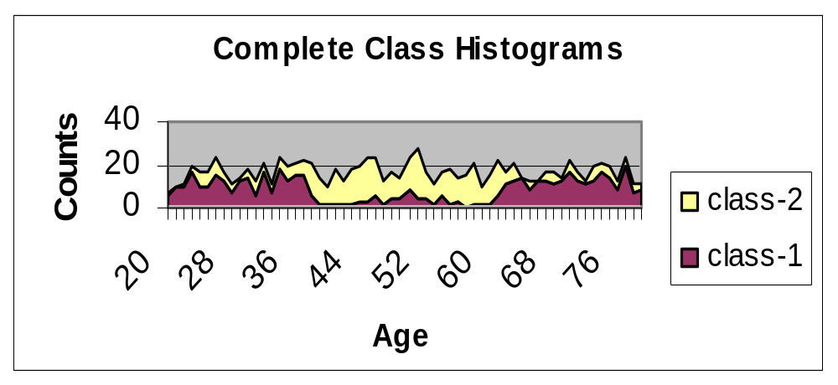
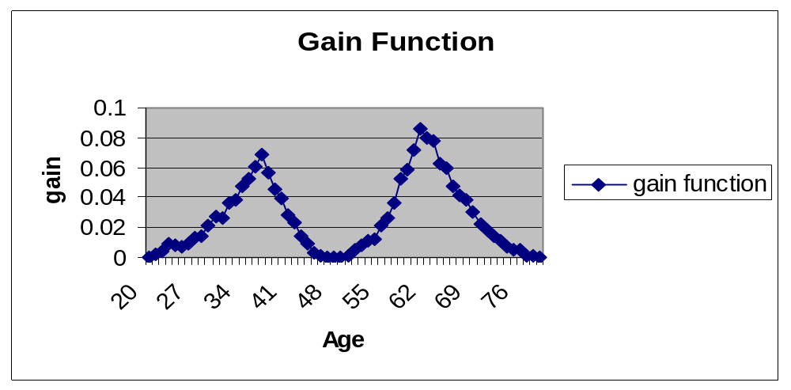
Finding the Best Split Point for Numerical Attributes
The data comes from a IBM Quest synthetic dataset for function 0
Best Split Point
In-core algorithms, such as C4.5, will just online sort the numerical attributes!

Slide 80
SPIES approach (Jin, SDM03)
Statistical Pruning of Intervals for Enhanced Scalability
  Reduce the size of the class histogram by partial materialization
Sampling based approach
  Divide the range of numerical attributes into intervals
  Use samples to estimate class histogram for intervals
  Prune the intervals that are unlikely to have the best split point
  Scan the complete dataset and materialize the class histogram for points in the unpruned intervals
  An additional pass might be necessary if false pruning happens

Slide 81
The Intuition
The number of intervals will be much smaller than the number of distinct points
For one attribute, only one interval can contain the best split point, and the large number of intervals that actually do not contain the best point points can be pruned by using samples
The additional computation from samples and interval processing can be offset by avoiding re-writing and reducing the number of passes over the dataset!
Notes:
Now we look at how sampling is used to replace the first pass of the algorithm and some responding modification of the algorithm.
So,
If you are interested in technical detail of how to use Hoeffding bound, please look at our paper or Domingo’s paper on VFDT.

Slide 82
The Technical Challenges
How can it work?
  Memory reduction by maximally pruning the interval
  Avoid more passes by reducing false pruning
Three key problems
  How to get a good upper bound of gain for an interval?
  How sampling can help in reducing false pruning?
  How to derive the sample size?

Slide 83
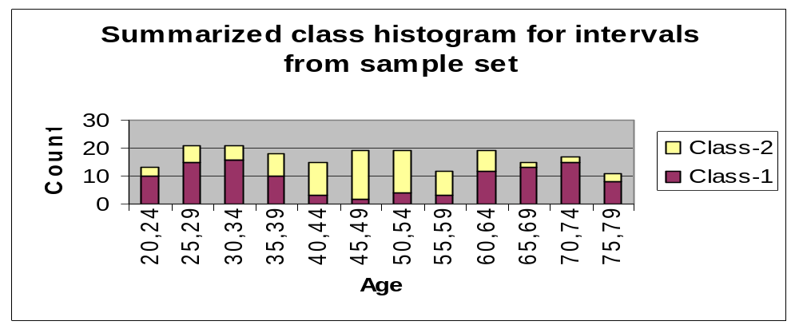
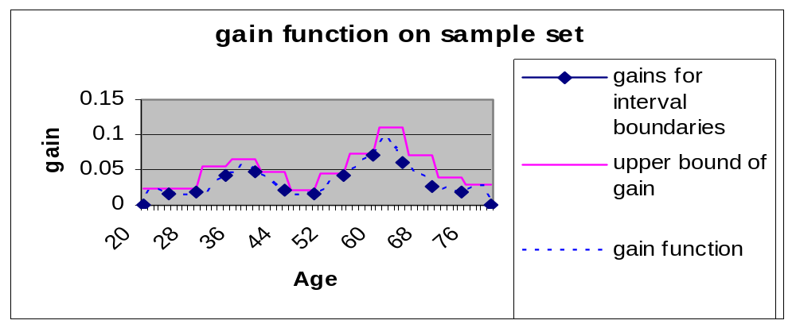
Sampling Step
Maximal gain from interval boundaries
Upper bound of gains for intervals

Slide 84
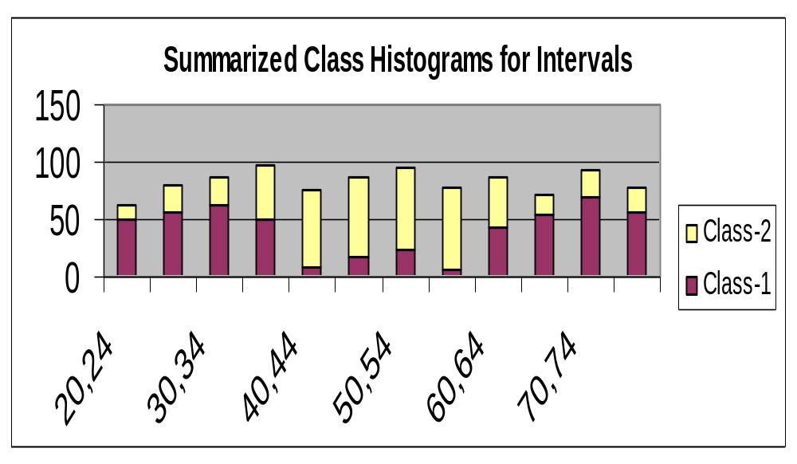
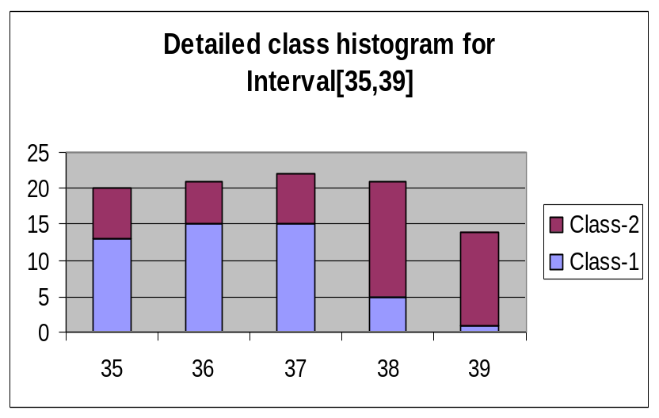
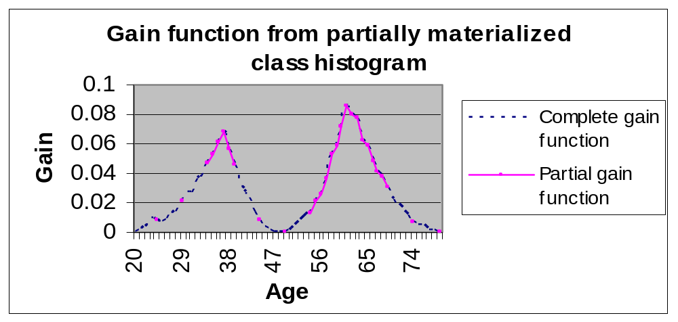
Completion Step
Best Split Point

Slide 85
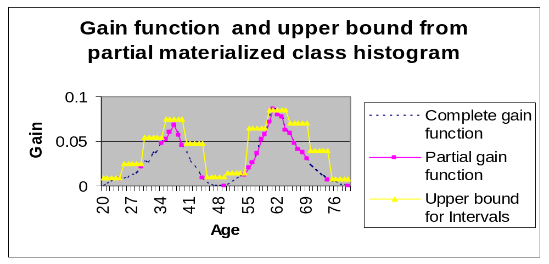
Verification
False Pruning
Gain of Best Split Point
An additional pass might be required if false pruning happens

Slide 86
Sketch of SPIES
Three Steps
  Sampling step
  Completion step
  Verification
How can it work?
  Memory reduction by maximally pruning the interval
  Avoid more passes by reducing false pruning
Three key problems
  How to get a good upper bound of gain for an interval?
  How sampling can help in reducing false pruning?
  How to derive the sample size?
Notes:
Now we look at how sampling is used to replace the first pass of the algorithm and some responding modification of the algorithm.
So,
If you are interested in technical detail of how to use Hoeffding bound, please look at our paper or Domingo’s paper on VFDT.

Slide 87
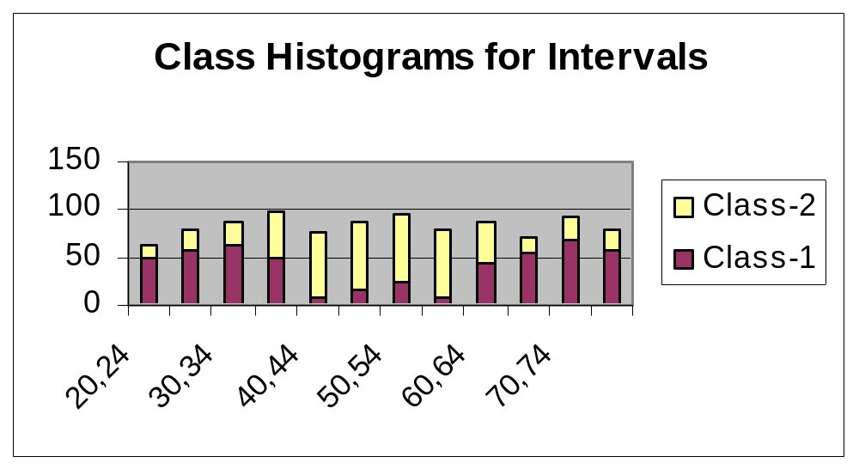
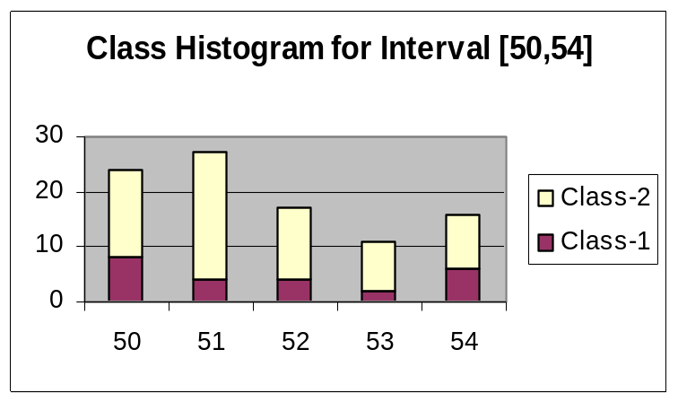
Least Upper Bound of Gain for an Interval
[ 50 ,54 ]
[ 50 ,54 ]
Possible Best Configuration-1
Possible Best Configuration-2

Slide 88
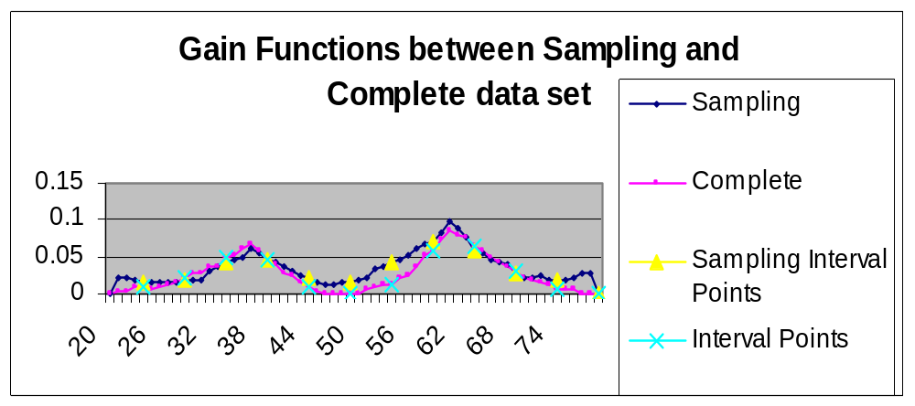
Estimation based on Samples
The difference can be bounded by statistical rules, such as Hoeffding Inequality.
Interestingly, by utilizing delta method, the gain function in any fixed point can be approximated as Normal distribution. Comparing the efficiency of different estimation methods is explored in our KDD’03 paper.

Slide 89
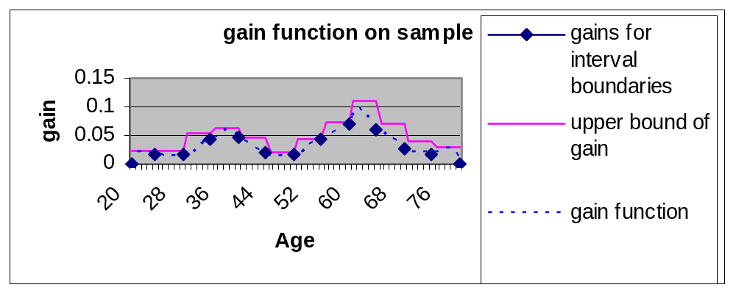

Sample size
Δ_{i}
Hoeffding bound
The probability of false pruning an interval is bounded by δ, such that
Pr( Δ_{i} < ε ) < δ, where
Bonferroni’s Inequality
Pr(∪(Δ_{i} < ε )) ≤∑(Pr(Δ_{i} < ε)) < δ

Slide 90
SPIES algorithm
Sampling step
  Estimate class histograms for intervals from samples
  Compute the estimate intermediate best gain and upper bound of intervals
  Apply Hoeffding bound to perform interval pruning
Completion step
  Materialize class histogram for unpruned intervals
  Compute the final best gain
Verification
  An additional pass might be needed if false pruning happens and it will be executed together with next completion step
SPIES always finds the best split point by just partially materializing class histogram with practically one pass of dataset for each level of the decision tree
SPIES can be efficiently parallelized!
Notes:
Now we look at how sampling is used to replace the first pass of the algorithm and some responding modification of the algorithm.
So,
If you are interested in technical detail of how to use Hoeffding bound, please look at our paper or Domingo’s paper on VFDT.

Slide 91
Experimental Set-up and Datasets
SUN SMP clusters
  8 ultra Enterprise 450’s, each has 4 250MHz Ultra-II processors
  Each node has 1 GB main memory, 4 GB system disk and 18 GB data disk
  Interconnected by Myrinet
Synthetic Data set from IBM Quest group
  9 attributes, 3 attributes are categorical, 6 are numerical
  Function 1, 6 and 7 is used
  Two groups of dataset ( 800MB/20 m, 1600MB/40 m)

Slide 92
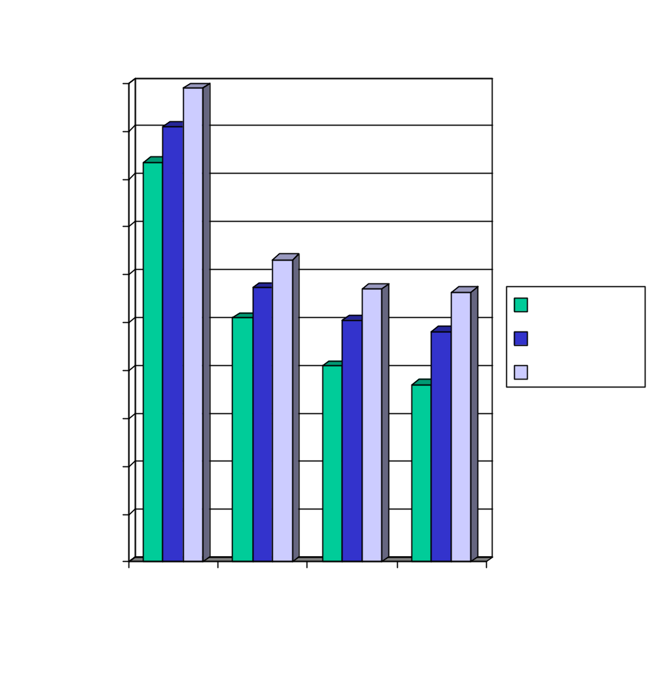
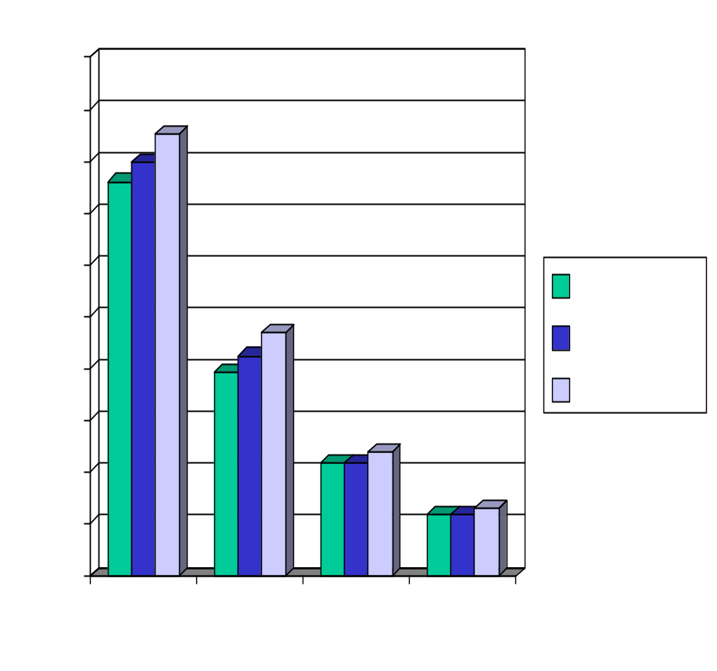
Parallel Performance
Distributed Memory Speedup of RF-read (without intervals), 800 MB datasets
SPIES with 1000 intervals
Notes:
8 nodes, around 4.
2.25, 1.88 and 1.75
Better sequential performance,
Almost linear, about 8.

Slide 93
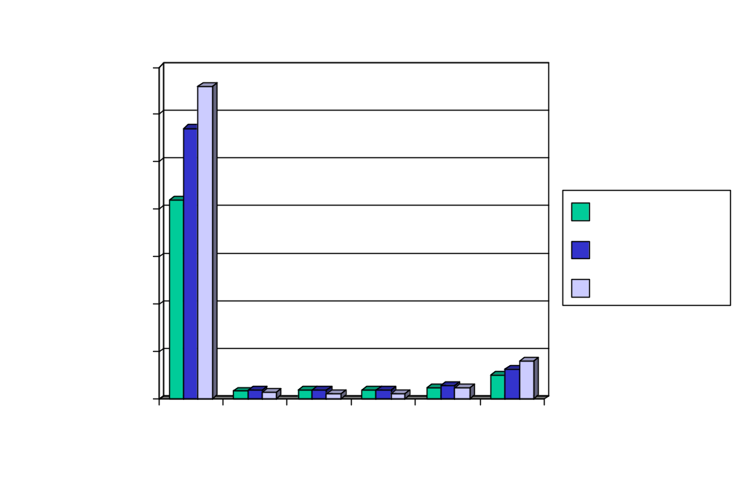
Memory Requirement
800MB dataset with number of intervals 0, 100, 500,1000, 5000, 20000
Notes:
800MB dataset 0,
From 100 to 1000, several memory we have 95% memory reduction .

Slide 94
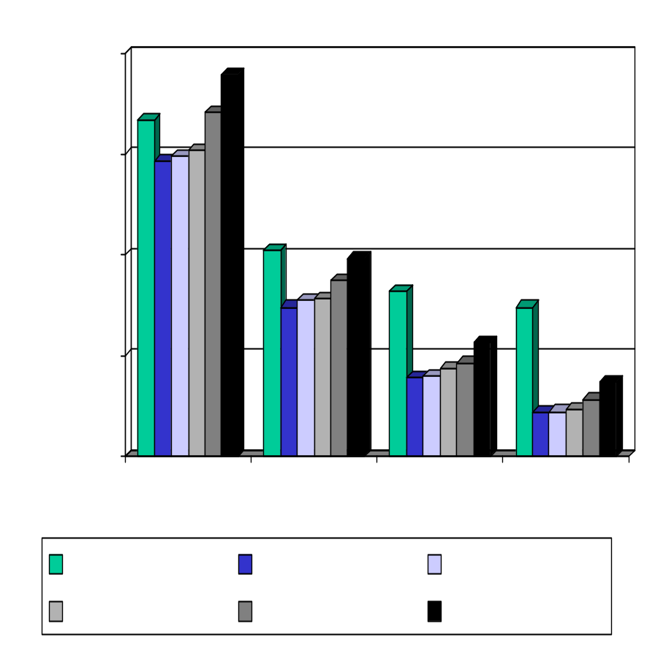
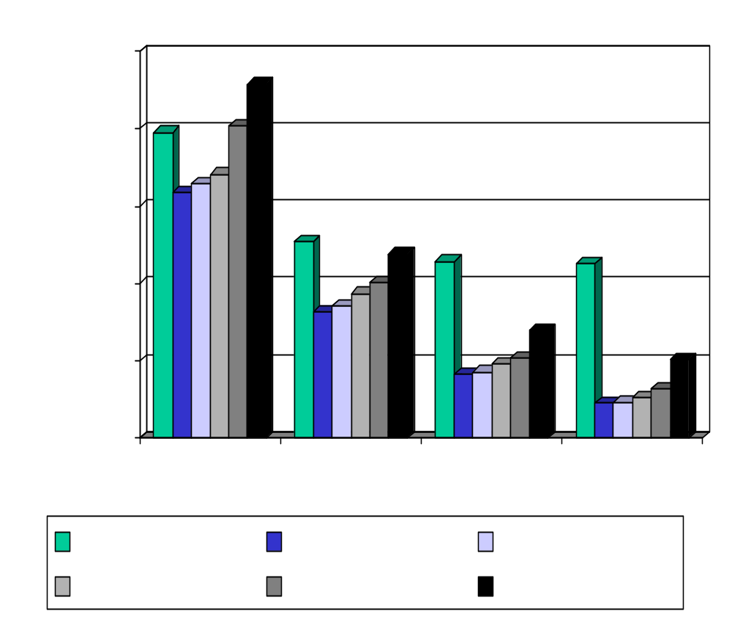
Impact of Number of Intervals on Sequential and Parallel Performance
800 MB, function 1
800 MB, function 7
Notes:
100-5000, better or competitive sequential performance
All of them have almost linear speedup.
We can not get very good performance from very large number of intervals.

Slide 95
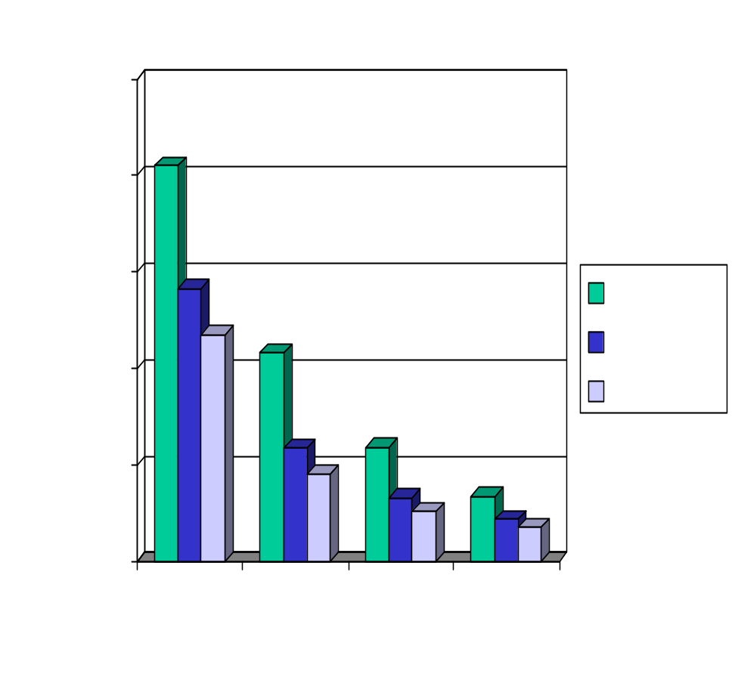
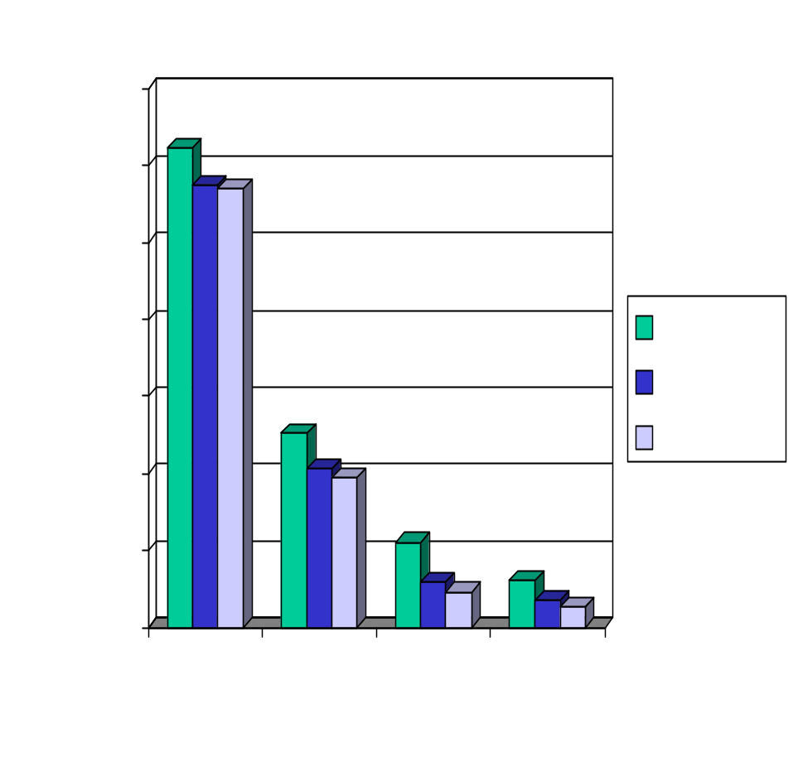
Scalability on Cluster of SMPs
Shared Memory and Distributed Memory Parallel Performance, 800MB, function 7
1600MB dataset
Notes:
Averagely, 2 out of 3 threads.
1 nodes, the shared memory, I/O bound.
Super-linear on 1600MB.

Slide 96
Conclusions for SPIES
SPIES approach
  Guaranteed to find the exact best split point
  No pre-sorting or writing back of the dataset
  The size of the in-memory data structure is very small
  The communication volume is very low when the algorithm is parallelized
  The number of passes over the dataset is almost the same as the number of levels of the decision tree to be constructed (False pruning rarely happens!)

Slide 97
BOAT (Bootstrapped Optimistic Algorithm for Tree Construction)
Use a statistical technique called bootstrapping to create several smaller samples (subsets), each fits in memory
Each subset is used to create a tree, resulting in several trees
These trees are examined and used to construct a new tree T’
  It turns out that T’ is very close to the tree that would be generated using the whole data set together
Adv: requires only two scans of DB, an incremental alg.

Slide 98
Classification Using Distance
Place items in class to which they are “closest”.
Must determine distance between an item and a class.
Classes represented by
  Centroid: Central value.
  Medoid: Representative point.
  Individual points
Algorithm: KNN

Slide 99
K Nearest Neighbor (KNN):
Training set includes classes.
Examine K items near item to be classified.
New item placed in class with the most number of close items.
O(q) for each tuple to be classified. (Here q is the size of the training set.)

Slide 100
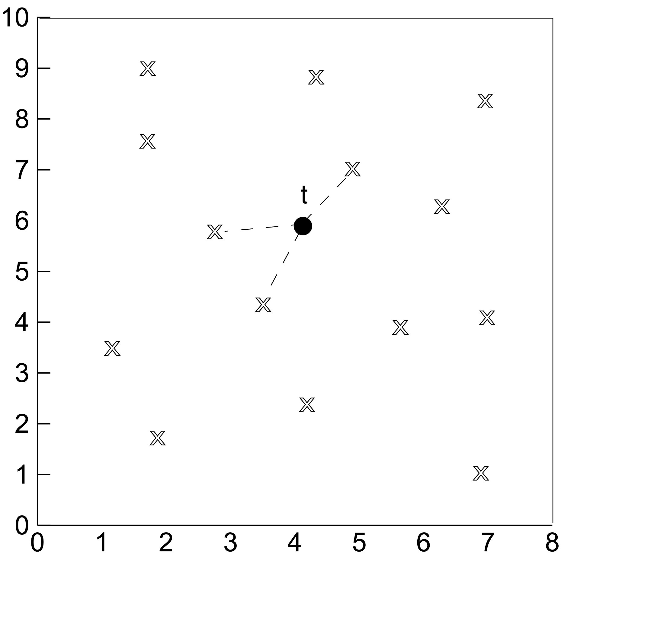
KNN

Slide 101
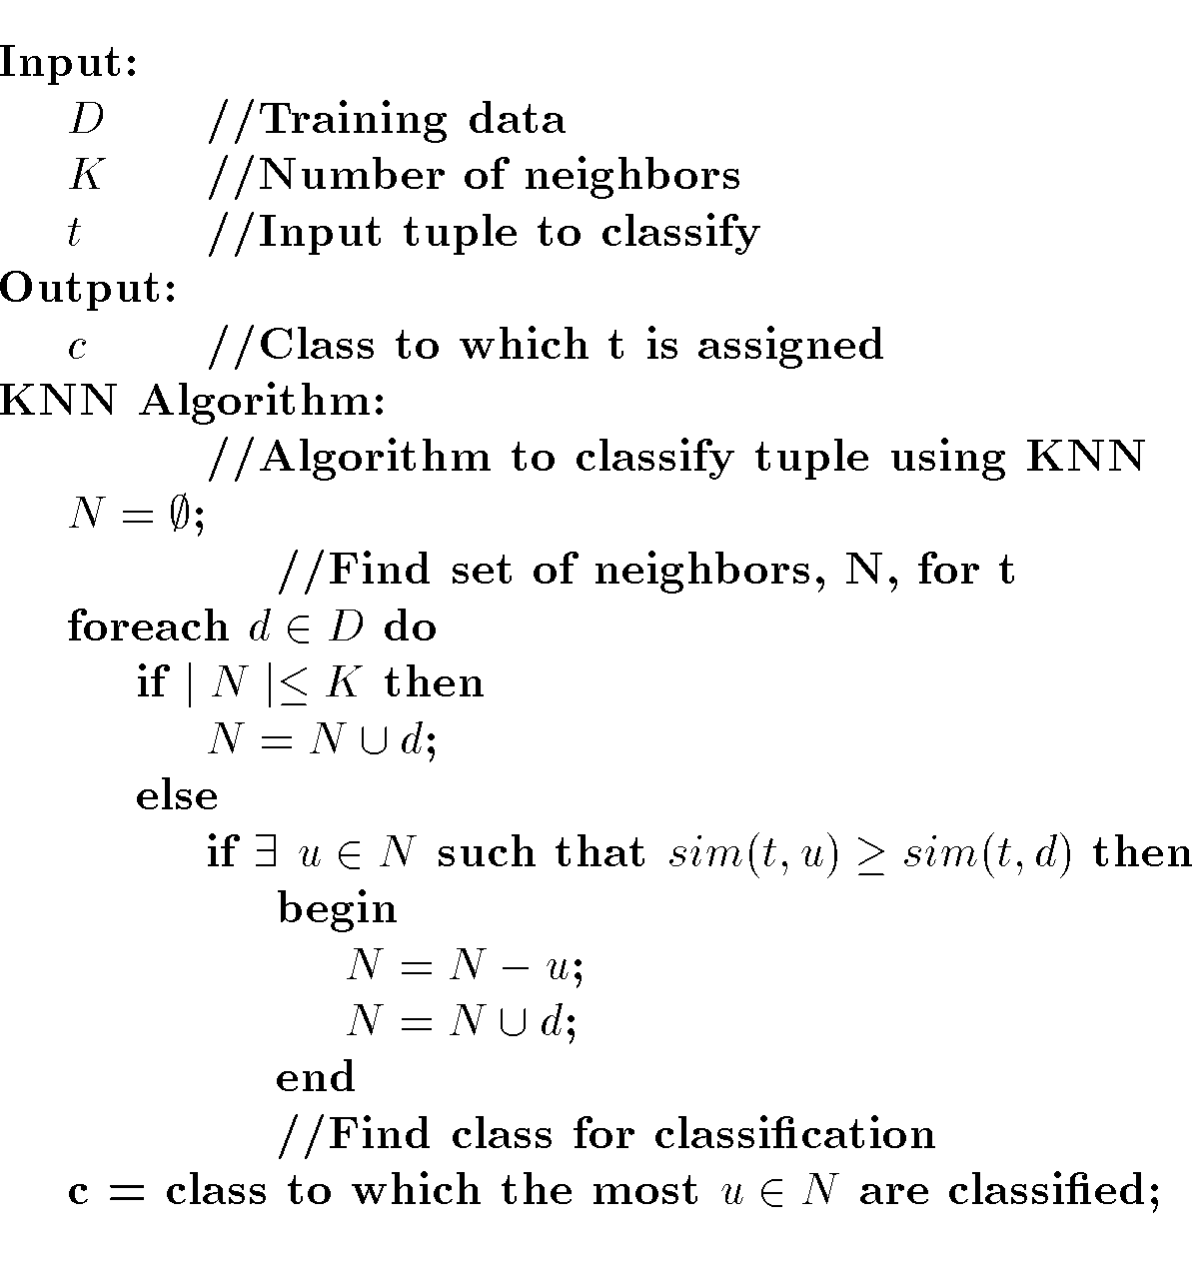
KNN Algorithm

