Slide 1
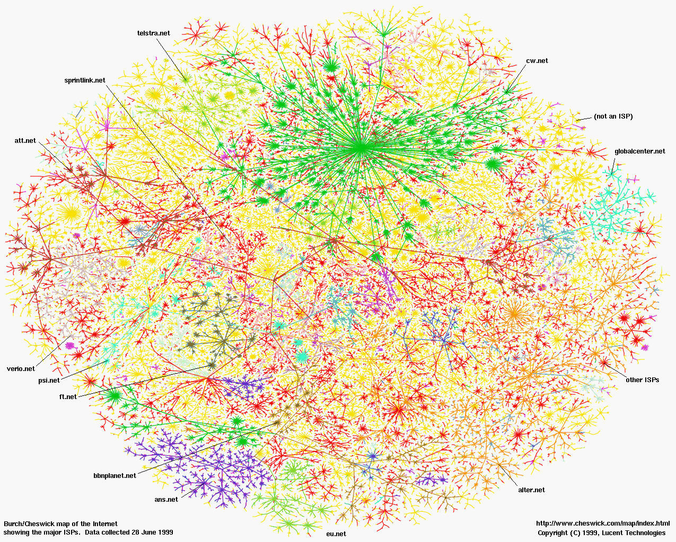
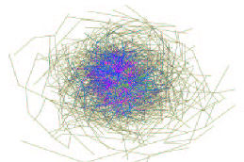
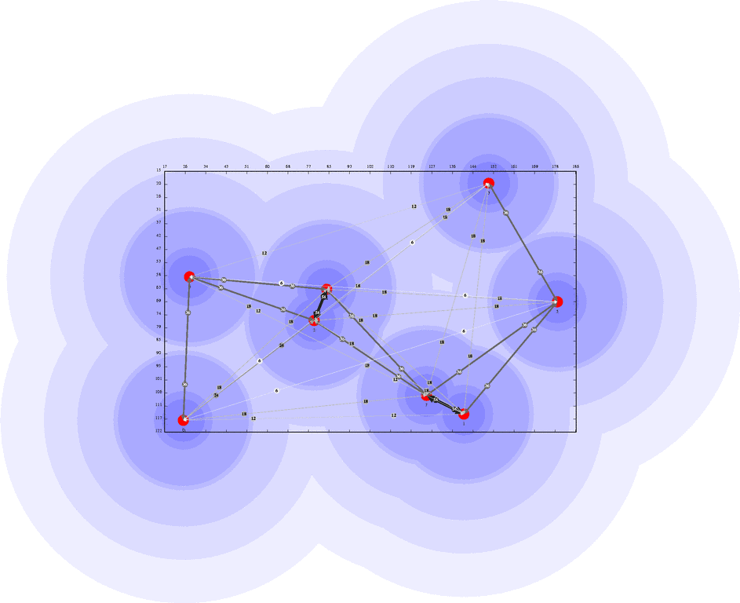
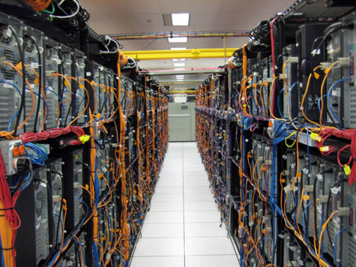
CS525
Advanced Distributed Systems
Spring 2017
Indranil Gupta (Indy)
Lecture 1
January 17, 2017
https://courses.engr.illinois.edu/cs525
All Slides © IG

Slide 2
What is a Distributed System? (examples)
The Internet
Gnutella peer to peer system
A Sensor Network
Datacenter/Cloud

Slide 3
Can you name some examples of Operating Systems?

Slide 4
Can you name some examples of Operating Systems?
…
Linux Windows Unix FreeBSD macOS
2K Aegis Scout Hydra Mach SPIN
OS/2 Express Flux Hope Spring
AntaresOS EOS LOS SQOS LittleOS TINOS
PalmOS WinCE TinyOS iOS
…

Slide 5
What is an Operating System?

Slide 6
What is an Operating System?
User interface to hardware (device driver)
Provides abstractions (processes, file system)
Resource manager (scheduler)
Means of communication (networking)
…

Slide 7
FOLDOC definition
The low-level software which handles the interface to peripheral hardware, schedules tasks, allocates storage, and presents a default interface to the user when no application program is running.
The OS may be split into a kernel which is always present and various system programs which use facilities provided by the kernel to perform higher-level house-keeping tasks, often acting as servers in a client-server relationship.
Some would include a graphical user interface and window system as part of the OS, others would not. The operating system loader, BIOS, or other firmware required at boot time or when installing the operating system would generally not be considered part of the operating system, though this distinction is unclear in the case of a roamable operating system such as RISC OS.
The facilities an operating system provides and its general design philosophy exert an extremely strong influence on programming style and on the technical cultures that grow up around the machines on which it runs.

Slide 8
Can you name some examples of Distributed Systems?

Slide 9
Can you name some examples of Distributed Systems?
Client-server (e.g., NFS)
The Internet
The Web
A sensor network
DNS
BitTorrent (peer to peer overlay)
Datacenters
Hadoop

Slide 10
What is a Distributed System?

Slide 11
FOLDOC definition
A collection of (probably heterogeneous) automata whose distribution is transparent to the user so that the system appears as one local machine. This is in contrast to a network, where the user is aware that there are several machines, and their location, storage replication, load balancing and functionality is not transparent. Distributed systems usually use some kind of client-server organization.

Slide 12
Textbook definitions
A distributed system is a collection of independent computers that appear to the users of the system as a single computer.
[Andrew Tanenbaum]
A distributed system is several computers doing something together. Thus, a distributed system has three primary characteristics: multiple computers, interconnections, and shared state.
[Michael Schroeder]
Notes:
Contradictions:
uh, doesn’t each computer need to know about a few other computers in the system (somewhere deep down there in the RAM)?
If computers don’t exchange any information and make no progress, would this count as a distributed system?

Slide 13
Unsatisfactory
Why are these definitions short?
Why do these definitions look inadequate to us?
Because we are interested in the insides of a distributed system
  algorithmics
  design and implementation
  maintenance
  study

Slide 14
I shall not today attempt further to define the kinds of material I understand to be embraced within that shorthand description; and perhaps I could never succeed in intelligibly doing so. But I know it when I see it…
[Potter Stewart, Associate Justice, US Supreme Court (talking about his interpretation of a technical term laid down in the law, case Jacobellis versus Ohio 1964) ]

Slide 15
A working definition for us
A distributed system is a collection of entities, each of which is autonomous, programmable, asynchronous and failure-prone, and which communicate through an unreliable communication medium.
Our interest in distributed systems involves
  algorithmics, design and implementation, maintenance, study
Entity=a process on a device (PC, PDA, mote)
Communication Medium=Wired or wireless network
Notes:
Designers and progammers interested in : algorithmics, maintenance.
(informal definition, for us programmers of distributed systems)
Ok: peer to peer systems
Contradiction: a computer without ROM or disk drives that needs to boot over the network. Is a collection of these computers a distributed system?

Slide 16
A range of interesting problems for Distributed System designers
P2P systems [Gnutella, Kazaa, BitTorrent]
Cloud Infrastructures [AWS, Azure, Google cloud]
Cloud Storage [Key-value stores, NoSQL, BigTable]
Cloud Programming [MapReduce, Pig, Hive, Storm, Pregel]
Coordination [Paxos]
Routing [Sensor Networks, Internet]

Slide 17
A range of challenges
Failures: no longer the exception, but rather a norm
Scalability: 1000s of machines, Terabytes of data
Asynchrony: clock skew and clock drift
Security: of data, users, computations, etc.

Slide 18
Multicast

Slide 19
Multicast
Node with a piece of information
to be communicated to everyone
Distributed
Group of
“Nodes”=
Processes
at Internet-
based hosts
Notes:
Eliminate single points of failure
Use gossiping
Basics of gossiping (random target selection, sufficiency of partial views and resulting good properties in the presence of failures etc.) and
why the naïve solution is O(n^2 log n) msgs, O(n log n) time – gossip provides good f-t, but bad scalability.
But wait a minute – these can be combined ! (motivate next slide)
[Need to reduce this, and make use of composability of functions such as average, max, min etc.]

Slide 20
Fault-tolerance and Scalability
Multicast sender
X
Nodes may crash
Packets may
be dropped
1000’s of nodes
X
Multicast Protocol
Notes:
Eliminate single points of failure
Use gossiping
Basics of gossiping (random target selection, sufficiency of partial views and resulting good properties in the presence of failures etc.) and
why the naïve solution is O(n^2 log n) msgs, O(n log n) time – gossip provides good f-t, but bad scalability.
But wait a minute – these can be combined ! (motivate next slide)
[Need to reduce this, and make use of composability of functions such as average, max, min etc.]

Slide 21
Centralized
Simplest
implementation
Problems?
UDP/TCP packets
Notes:
Eliminate single points of failure
Use gossiping
Basics of gossiping (random target selection, sufficiency of partial views and resulting good properties in the presence of failures etc.) and
why the naïve solution is O(n^2 log n) msgs, O(n log n) time – gossip provides good f-t, but bad scalability.
But wait a minute – these can be combined ! (motivate next slide)
[Need to reduce this, and make use of composability of functions such as average, max, min etc.]

Slide 22
Tree-Based
e.g., IPmulticast, SRM
RMTP, TRAM,TMTP
Lower load per node
Tree setup
and maintenance
Problems?
UDP/TCP packets
Notes:
Eliminate single points of failure
Use gossiping
Basics of gossiping (random target selection, sufficiency of partial views and resulting good properties in the presence of failures etc.) and
why the naïve solution is O(n^2 log n) msgs, O(n log n) time – gossip provides good f-t, but bad scalability.
But wait a minute – these can be combined ! (motivate next slide)
[Need to reduce this, and make use of composability of functions such as average, max, min etc.]

Slide 23
A Third Approach
Multicast sender
Notes:
Eliminate single points of failure
Use gossiping
Basics of gossiping (random target selection, sufficiency of partial views and resulting good properties in the presence of failures etc.) and
why the naïve solution is O(n^2 log n) msgs, O(n log n) time – gossip provides good f-t, but bad scalability.
But wait a minute – these can be combined ! (motivate next slide)
[Need to reduce this, and make use of composability of functions such as average, max, min etc.]

Slide 24
Periodically, transmit to
b random targets
Gossip messages (UDP)
Notes:
Eliminate single points of failure
Use gossiping
Basics of gossiping (random target selection, sufficiency of partial views and resulting good properties in the presence of failures etc.) and
why the naïve solution is O(n^2 log n) msgs, O(n log n) time – gossip provides good f-t, but bad scalability.
But wait a minute – these can be combined ! (motivate next slide)
[Need to reduce this, and make use of composability of functions such as average, max, min etc.]

Slide 25
Other nodes do same
after receiving multicast
Gossip messages (UDP)
Notes:
Eliminate single points of failure
Use gossiping
Basics of gossiping (random target selection, sufficiency of partial views and resulting good properties in the presence of failures etc.) and
why the naïve solution is O(n^2 log n) msgs, O(n log n) time – gossip provides good f-t, but bad scalability.
But wait a minute – these can be combined ! (motivate next slide)
[Need to reduce this, and make use of composability of functions such as average, max, min etc.]

Slide 26
Notes:
Eliminate single points of failure
Use gossiping
Basics of gossiping (random target selection, sufficiency of partial views and resulting good properties in the presence of failures etc.) and
why the naïve solution is O(n^2 log n) msgs, O(n log n) time – gossip provides good f-t, but bad scalability.
But wait a minute – these can be combined ! (motivate next slide)
[Need to reduce this, and make use of composability of functions such as average, max, min etc.]

Slide 27
“Epidemic” Multicast (or “Gossip”)
Infected
Protocol rounds (local clock)
b random targets per round
Gossip Message (UDP)
Uninfected
Notes:
Eliminate single points of failure
Use gossiping
Basics of gossiping (random target selection, sufficiency of partial views and resulting good properties in the presence of failures etc.) and
why the naïve solution is O(n^2 log n) msgs, O(n log n) time – gossip provides good f-t, but bad scalability.
But wait a minute – these can be combined ! (motivate next slide)
[Need to reduce this, and make use of composability of functions such as average, max, min etc.]

Slide 28
Properties
Claim that this simple protocol
Is lightweight in large groups
Spreads a multicast quickly
Is highly fault-tolerant

Slide 29

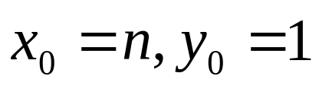
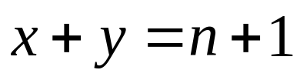
Analysis
From old mathematical branch of Epidemiology [Bailey 75]
Population of (n+1) individuals mixing homogeneously
Contact rate between any individual pair is
At any time, each individual is either uninfected (numbering x) or infected (numbering y)
Then,
  and at all times
Infected–uninfected contact turns latter infected, and it stays infected

Slide 30
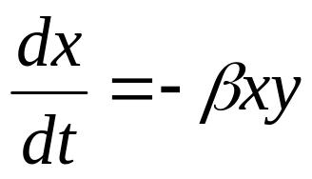
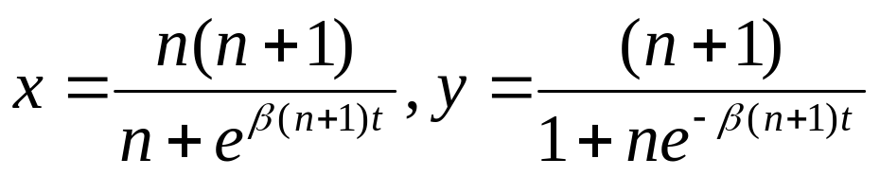
Analysis (contd.)
Continuous time process
Then
(why?)
with solution
(correct? can you derive it?)

Slide 31
Epidemic Multicast
Infected
Protocol rounds (local clock)
b random targets per round
Gossip Message (UDP)
Uninfected
Notes:
Eliminate single points of failure
Use gossiping
Basics of gossiping (random target selection, sufficiency of partial views and resulting good properties in the presence of failures etc.) and
why the naïve solution is O(n^2 log n) msgs, O(n log n) time – gossip provides good f-t, but bad scalability.
But wait a minute – these can be combined ! (motivate next slide)
[Need to reduce this, and make use of composability of functions such as average, max, min etc.]

Slide 32
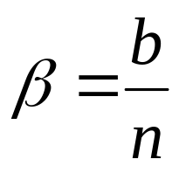
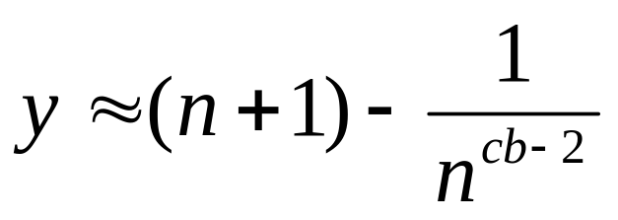
Epidemic Multicast Analysis
(why?)
Substituting, at time t=clog(n), num. infected is
(correct? can you derive it?)

Slide 33
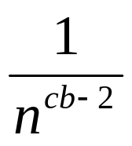
Analysis (contd.)
Set c,b to be small numbers independent of n
Within clog(n) rounds, [low latency]
  all but number of nodes receive the multicast
  [reliability]
  each node has transmitted no more than cblog(n) gossip messages [lightweight]

Slide 34
Fault-tolerance
Packet loss
  50% packet loss: analyze with b replaced with b/2
  To achieve same reliability as 0% packet loss, takes twice as many rounds
Node failure
  50% of nodes fail: analyze with n replaced with n/2 and b replaced with b/2
  Same as above

Slide 35
Fault-tolerance
With failures, is it possible that the epidemic might die out quickly?
Possible, but improbable:
  Once a few nodes are infected, with high probability, the epidemic will not die out
  So the analysis we saw in the previous slides is actually behavior with high probability
  [Galey and Dani 98]
Think: why do rumors spread so fast? why do infectious diseases cascade quickly into epidemics? why does a virus or worm spread rapidly?

Slide 36
So,…
Is this all theory and a bunch of equations?
Or are there implementations yet?

Slide 37
Some implementations
Clearinghouse and Bayou projects: email and database transactions [PODC ‘87]
refDBMS system [Usenix ‘94]
Bimodal Multicast [ACM TOCS ‘99]
Sensor networks [Li Li et al, Infocom ’02, and PBBF, ICDCS ‘05]
Usenet NNTP (Network News Transport Protocol) ! [‘79]
AWS EC2 and S3 Cloud (rumored). [’00s]

Slide 38
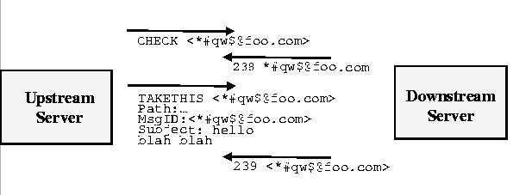
NNTP Inter-server Protocol
Each client uploads and downloads news posts
from a news server
2.
Server retains news posts for a while,
transmits them lazily, deletes them after a while

Slide 39
We’ll cover some of these other implementations during the course
But let’s dwell on the big picture of the course

Slide 40
Angles of Distributed Systems
Infrastructured D.S.’s
e.g., Internet-based
Distributed System (D.S.) Theory
Non-infrastructured D.S.’s
e.g., ad-hoc network based

Slide 41
CS 525 and Distributed Systems
Peer to peer systems
Cloud Computing
D.S. Theory
Sensor Networks

Slide 42
CS 525 and Distributed Systems
…DHTs, apps, …
Causality, snapshots, consensus,…
…MapReduce,
NoSQL, …
…Smart Dust, TinyOS,
In-network processing…

Slide 43
Interesting: Area Overlaps
Epidemics
NNTP
Gossip-based ad-hoc routing

Slide 44
Interesting: Area Overlaps
Do projects that are either entrepreneurial or research
The Internet
Gnutella peer to peer system
A Sensor Network
Clouds

Slide 45
Research Project
Your project has to be related to distributed systems
Must show keen awareness of the current state of the art
Must solve thoroughly at least one practical research problem
Must have innovative ideas and originality (algorithms)
Must build a real system and evaluate it in deployment
You will write a conference-quality research paper as a part of your project
We will submit the best papers from this class to top conferences/workshops in the area of distributed systems
  Past versions of CS525 highly successful in getting papers into conferences and journals, and have won awards (see course website)
To help you get insight into the current and bleeding edge of d.s. research, we will read 2 research papers per class

Slide 46
Entrepreneurial Project
Proposes new ideas that can be accommodated into a (your own!) startup
  Company
  Or non-profit
Has to be a remarkable and marketable product/services with real users in mind
  Need to write reports (similar timeline and guideline as Research Projects)
  Need to write a short Business Plan
You need to develop ideas for the company. What you do later with it is solely up to you.
EnterpriseWorks incubator at Illinois
Has to use or leverage concepts from the CS525 class
To help you get leverage the current and bleeding edge of d.s. research, we will read 2 research papers per class

Slide 47
Research vs. Users
Initial direction =/= Final outcome
  Apple I and II (Wozniak and Jobs): Research challenge was to minimize cost of chips in the PC. Users loved Apple II and III because it had color and it had flexibility for users to write their own software (until then, every new game was done in hardware!)
  Flickr (Caterina Fake): Initially were writing “Game Nevernding”. Research challenges included scalability. Users loved it because of social network, and tagging. Tagging enabled groups (Squared Circle group), news feeds, and find photos of anything.
  TiVo (Mike Ramsay): Initially were writing a network server for video content. Research challenges included disk management, n/w management, security. Users were amazed by pausing live TV and being given significant flexibility but without needing to be a “techie”.
  Mosaic (Andreesen) was originally an NSF-funded project at UIUC, and then became a startup
Be ready to change direction (“pivot”)
Both in research project and entrepreneurial project

Slide 48
Materials for Course
All readings available on the course website (you don’t need to buy any textbook or material)
Lots of new papers!
The Spring 2017 schedule is brand new –100% papers are new for the student sessions compared to the last version of CS525 (SP16).

Slide 49
Project Buildup
To ensure semester-wide progress, project is structured into systematic stages:
  Initial meeting in Feb (+ open office hours)
  Survey report due late-Feb (proposal + survey)
  Midterm report due Mar-end (first prototype of system built + initial experimental results)
  Final report due early May (final version of project and paper)
Project groups: 2-3 students

Slide 50
Let’s Look at the Course Information Sheet…
No exams
Paper Reading
  Presentations from Feb 9th onwards
    Per session: Two students presenting + 1 student scribing
  Everyone else: reviews (2 papers per lecture, from Feb 9th onwards)
  See instructions on website for presentations and reviews
Project
  Access to a few VMs on the CS VM Server Farm
  Access to Microsoft Azure
Piazza: all announcements, reviews, etc. (please sign up!)
  Link is on course website: https://courses.engr.illinois.edu/cs525
Class Participation a must (and fun!)
TAs: Le Xu and Shiv Verma (emails on website)
My office hours: right after lecture/class (3112 SC), until about 4.00 pm
Please read instructions on course website – you’re responsible for following them!

Slide 51
Things for you to do today
Look at the course website
Follow “Schedule / Papers and Presentations link” and read instructions
  http://courses.engr.illinois.edu/cs525/
  Need to sign up for a presentation slot by Jan 31
Take a look at conference papers arising out of previous versions of this course (CS598IG/CS525)
  Many CS525 project papers published in conferences and journals

Slide 52
Prerequisites
Background in OS’es is required (CS241/CS423)
Distributed Systems/Algorithms is recommended
  If you haven’t taken CS425/ECE428 or ECE526, then …
  … you should highly consider taking the Coursera course on Cloud Computing Concepts (Parts 1 and 2). It’s a free course.

Slide 53
Next Lecture
Cloud Computing
  Take a look at all papers on website for that session
  Read at least one of those papers completely
  Try to read all of them completely
  (no reviews required yet)

Slide 54
Backup Slides

Slide 55
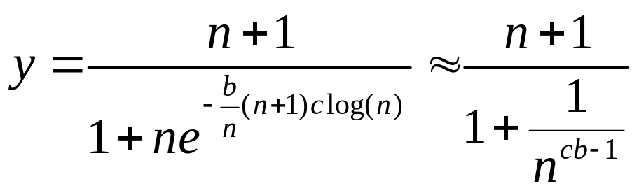
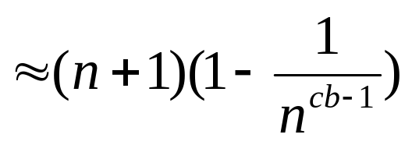
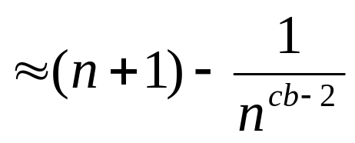
Analysis (contd.)
(why?)
Substituting, at time t=clog(n)

