Slide 1
CS411
Database Systems
04: Relational Algebra
Ch 2.4, 5.1

Slide 2
Basic RA Operations

Slide 3
Set Operations
Union, difference
  Binary operations
  Remember, a relation is a SET of tuples, so set operations are certainly applicable

Slide 4
Set Operations: Union
Union: all tuples in R1 or R2
Notation: R1 U R2
  R1, R2 must have the same schema
Output: R1 U R2 has the same schema as R1, R2
Example:
  ActiveEmployees(SSN, name)
  RetiredEmployees(SSN, name)
  ActiveEmployees U RetiredEmployees

Slide 5
Set Operations: Difference
Difference: all tuples in R1 and not in R2
Notation: R1 – R2
  R1, R2 must have the same schema
Output: R1 – R2 has the same schema as R1, R2
Example
  AllEmployees – RetiredEmployees

Slide 6
Selection
Returns all tuples which satisfy a condition
Notation: σ_{c}(R)
  c is a condition (uses =, <, >, AND, OR, NOT)
Output schema: same as input schema
Find all employees with salary more than $40,000:
  σ_{Salary > 40000} (Employee)

Slide 7
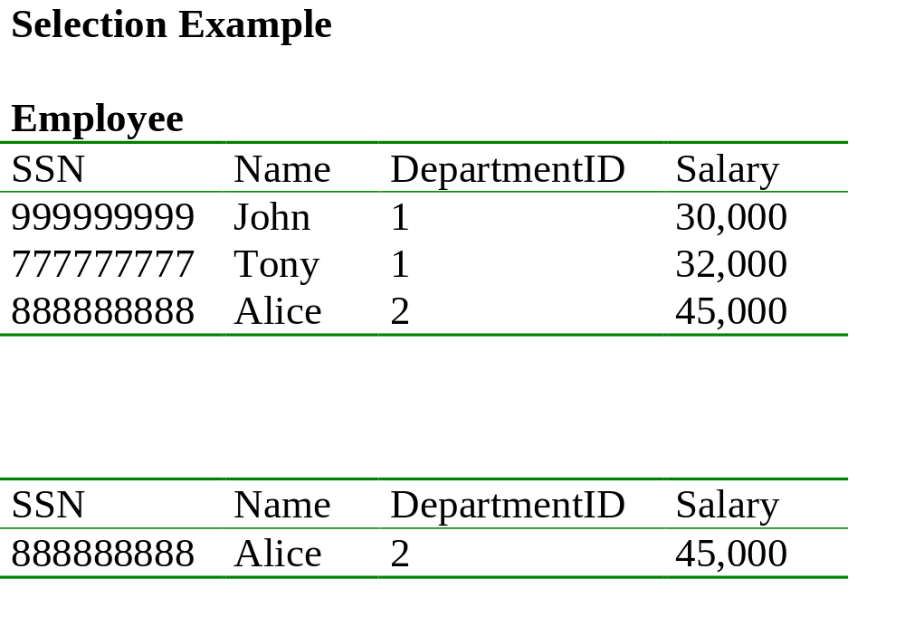
Emp. with salary more than $30,000 and department id = 2
σ Salary > 30000 AND DepartmentID = 2 (Employee)

Slide 8

Projection
Unary operation: returns certain columns
Eliminates duplicate tuples !
Notation: π _{A1,…,An} (R)
  If input schema R(B1,…,Bm)
  then {A1, …, An} {B1, …, Bm}
Output schema S(A1,…,An)
Example: project social-security number and names from Employee (SSN, Name, Dept, Salary)
  π _{SSN, Name} (Employee)

Slide 9
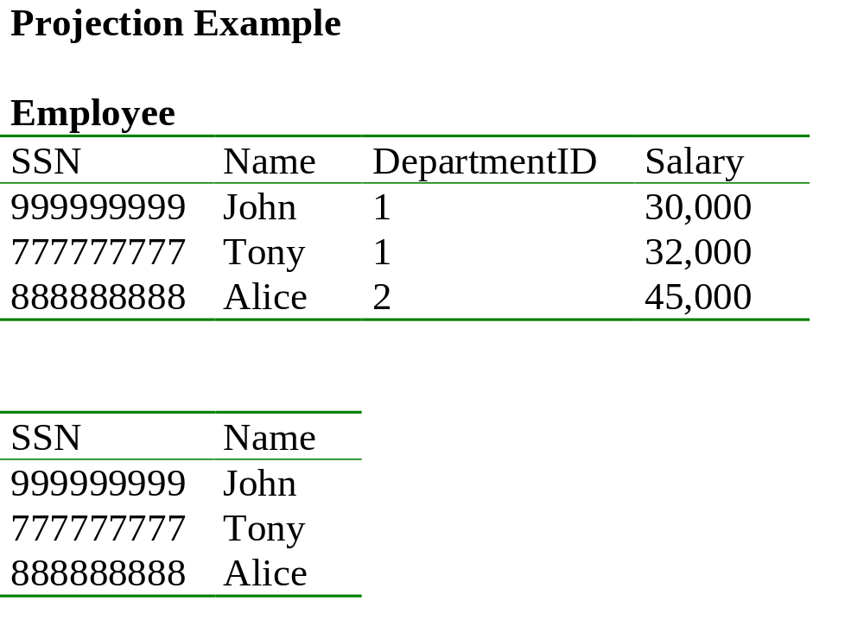
π _{SSN, Name} (Employee)
π _{DepartmentID} (Employee) ??

Slide 10
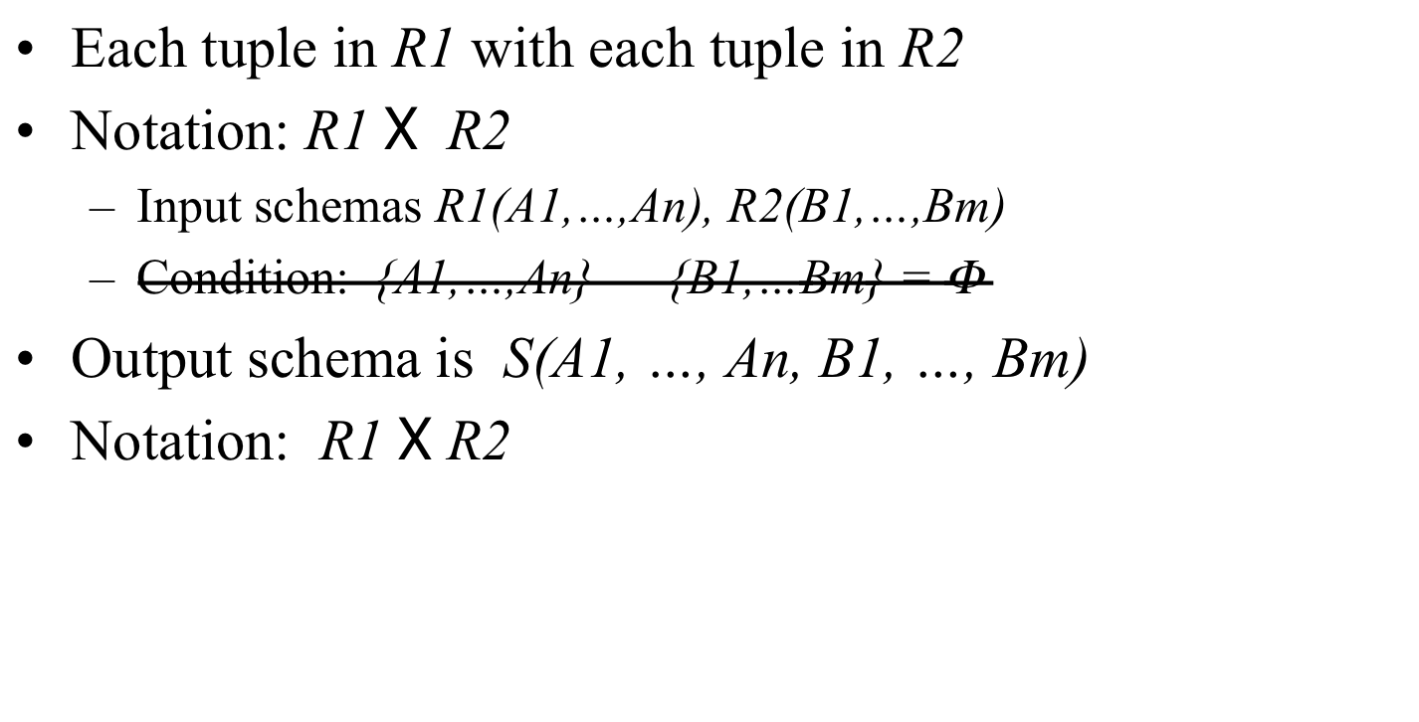

Cartesian Product
If Ai is same as Bj, rename them as R1.Ai, R2.Ai

Slide 11
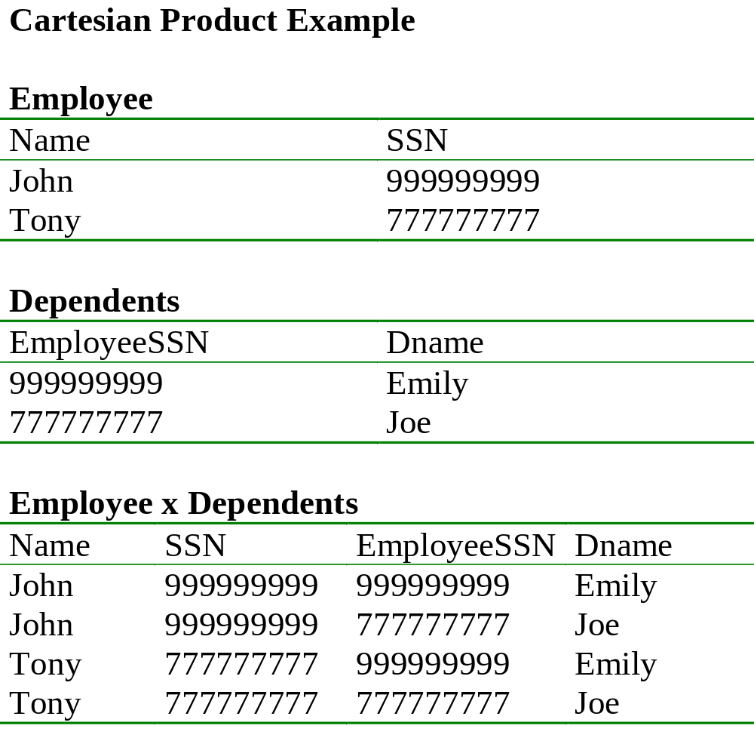

Slide 12
Renaming
Does not change the relational instance
Changes the relational schema only
Notation: ρ _{S(B1,…,Bn)} (R)
Input schema: R(A1, …, An)
Output schema: S(B1, …, Bn)
Example: rename Employee(Name, SSN)
    ρRenamedEmployee(LastName, SocSocNo) (Employee)

Slide 13
Renaming Example
Employee
Name
SSN
John
999999999
Tony
777777777
ρRenamedEmployee(LastName, SocSocNo) (Employee)
LastName
SocSocNo
John
999999999
Tony
777777777

Slide 14
Derived RA Operations
1) Intersection
2) Most importantly: Join

Slide 15
Set Operations: Intersection
Difference: all tuples both in R1 and in R2
Notation: R1 R2
  R1, R2 must have the same schema
Output: R1 R2 has the same schema as R1, R2
Example
  UnionizedEmployees RetiredEmployees
Intersection is derived:
  R1 R2 = R1 – (R1 – R2)

Slide 16
Joins
Theta join
Natural join
Equi-join
etc.

Slide 17
Theta Join
A cartesian product followed by a selection
Notation: R1 _{θ} R2 where θ is a condition
Input schemas: R1(A1,…,An), R2(B1,…,Bm)
Output schema: S(A1,…,An,B1,…,Bm)
Derived operator:
R1 _{θ} R2 = σ _{θ} (R1 x R2)
Note that in output schema, if an attribute of R1 has the same name as an attribute of R2, we need renaming, as in Cartesian Product.

Slide 18
Example
Sells( bar, beer, price ) Bars( name, addr )
Joe’s Bud 2.50 Joe’s Maple St.
Joe’s Miller 2.75 Sue’s River Rd.
Sue’s Bud 2.50
Sue’s Coors 3.00
BarInfo := Sells _{Sells.bar = Bars.name} Bars
BarInfo( bar, beer, price, name, addr )
Joe’s Bud 2.50 Joe’s Maple St.
Joe’s Miller 2.75 Joe’s Maple St.
Sue’s Bud 2.50 Sue’s River Rd.
Sue’s Coors 3.00 Sue’s River Rd.

Slide 19

Natural Join
Notation: R1 R2
Input Schema: R1(A1, …, An), R2(B1, …, Bm)
Output Schema: S(C1,…,Cp)
  Where {C1, …, Cp} = {A1, …, An} U {B1, …, Bm}
Meaning: combine all pairs of tuples in R1 and R2 that agree on the attributes:
  {A1,…,An} {B1,…, Bm} (called the join attributes)
Equivalent to a cross product followed by selection
Example Employee Dependents

Slide 20
Natural Join Example
Employee
Name
SSN
John
999999999
Tony
777777777
Dependents
SSN
Dname
999999999
Emily
777777777
Joe
Employee Dependents =
Π_{Name, SSN, Dname}(σ _{SSN=SSN2}(Employee x ρ_{SSN2, Dname}(Dependents))
Name
SSN
Dname
John
999999999
Emily
Tony
777777777
Joe

Slide 21
Natural Join
R= S=
R S =
A | B
X | Y
X | Z
Y | Z
Z | V
B | C
Z | U
V | W
Z | V
A | B | C
X | Z | U
X | Z | V
Y | Z | U
Y | Z | V
Z | V | W

Slide 22
Natural Join
Given the schemas R(A, B, C, D), S(A, C, E), what is the schema of R S ?
Given R(A, B, C), S(D, E), what is R S ?
Given R(A, B), S(A, B), what is R S ?
Notes:
Answers: (1) A, B, C, D, E (2) By convention: Cartesian Product (3) R \intersect S

Slide 23
Equi-join
A generalization of Natural Joins, or special case of theta joins where C = equality predicate
R1 _{Α=Β} R2
A lot of research on how to do it efficiently

Slide 24
The Joins and Cross Products
Cross Product: R(A, B) X S (B, C)
  Schema (A, R.B, R.S, C)
  All pairs from R with all pairs of S
Theta Join: R(A, B) _{Cond} S (B, C)
  Schema (A, R.B, R.S, C)
  All pairs of R with all pairs of S minus those that don’t satisfy Cond
Natural Join: R(A, B) S (B, C)
  Schema (A, B, C)
  All pairs of R with all pairs of S where R.B = S.B

Slide 25
Summary of Relational Algebra
Basic primitives:
  E ::= R
  | σ_{C}(E)
  | Π _{A1, A2, ..., An} (E)
  | E1 X E2
  | E1 U E2
  | E1 - E2
  |
  |ρ_{S(A1, A2, …, An)}(E)
Abbreviations:
  | E1 E2
  | E1 _{C} E2
  | E1 ∩ E2

Slide 26
How would we do this: Natural Join
How do we express using the basic operators?
  R(A, B) and S (B, C)

Slide 27
How would we do this: Natural Join
How do we express using the basic operators?
  R(A, B) and S (B, C)
  At least three solutions:
    Π_{A, B, C} (σ _{B=B1}(R x ρ_{B1, C}(S))

Slide 28
Relational Algebra
Six basic operators, many derived
Combine operators in order to construct queries: relational algebra expressions

Slide 29
Building Complex Expressions
Algebras allow us to express sequences of operations in a natural way.
Example
  in arithmetic algebra: (x + 4)*(y - 3)
Relational algebra allows the same.
Three notations:
    Sequences of assignment statements.
    Expressions with several operators.
    Expression trees.

Slide 30
1. Sequences of Assignments
Create temporary relation names.
Renaming can be implied by giving relations a list of attributes.
  R3(X, Y) := R1
Example: R3 := R1 _{C} R2 can be written:
  R4 := R1 x R2
  R3 := σ_{C} (R4)

Slide 31
2. Expressions with Several Operators
Precedence of relational operators:
    Unary operators --- select, project, rename --- have highest precedence, bind first.
    Then come products and joins.
    Then intersection.
    Finally, union and set difference bind last.
But you can always insert parentheses to force the order you desire.

Slide 32
3. Expression Trees
Leaves are operands (relations).
Interior nodes are operators, applied to their child or children.

Slide 33
Example
Given Bars(name, addr), Sells(bar, beer, price), find the names of all the bars that are either on Maple St. or sell Bud for less than $3.

Slide 34
As a Tree:
Given Bars(name, addr), Sells(bar, beer, price), find the names of all the bars that are either on Maple St. or sell Bud for less than $3.
UNION
RENAME_{R(name)}
PROJECT_{name}
PROJECT_{bar}
SELECT_{addr = “Maple St.”}
SELECT _{price<3 AND beer=“Bud”}
Bars
Sells

Slide 35
How would we do this?
Given Bars(name, addr), Sells(bar, beer, price), find the names of all the bars that are either on Maple St. or sell Bud for less than $3.
Start with a theta of Bars and Sells

Slide 36
How would we do this?
Given Bars(name, addr), Sells(bar, beer, price), find the names of all the bars that are either on Maple St. or sell Bud for less than $3.
    Π_{name}(σ addr = “Maple St” OR(beer =“bud” AND price < 3) (Bars _{name=bar}Sells))
    Many right answers!

Slide 37
Q: How would we do this?
Using Sells(bar, beer, price), find the bars that sell two different beers at the same price.

Slide 38
Q: How would we do this?
Using Sells(bar, beer, price), find the bars that sell two different beers at the same price.
    Π_{bar} (σ_{beer1 != beer} (Sells ρ_{Sells1(bar,beer1,price)}(Sells(bar, beer, price)))

Slide 39
Exercise!
Product ( pid, name, price, category, maker-cid)
Purchase (buyer-ssn, salesperson-ssn, store, pid)
Company (cid, name, stock price, country)
Person (ssn, name, phone number, city)
Find phone numbers of all individuals who have made a sale.

Slide 40
More Queries
Product ( pid, name, price, category, maker-cid)
Purchase (buyer-ssn, salesperson-ssn, store, pid)
Company (cid, name, stock price, country)
Person (ssn, name, phone number, city)
Find phone numbers of people who bought gizmos from Fred.

Slide 41
Expression Tree
Many right answers!!
Π _{numbers}
Product ( pid, name, price, category, maker-cid)
Purchase (buyer-ssn, salesperson-ssn, store, pid)
Company (cid, name, stock price, country)
Person (ssn, name, phone number, city)
Find phone numbers of people who bought gizmos from Fred.
ssn=buyer-ssn
pid=pid
salesperson-ssn=ssn
Π _{ssn}
Π _{pid}
σ_{name=fred}
σ_{category=gizmo}
Person Purchase Person Product

Slide 42
Practice!!
Hard to get better at coming up with relational algebra expressions without practice
Lots of problems in the textbook
Feel free to post questions on piazza

Slide 43
Sets vs. Bags
So far, we have considered set-oriented relational algebra
There’s an equivalent bag-oriented relational algebra
  Multisets instead of sets
Relational databases actually use bags as opposed to sets…
  Most operations are more efficient

Slide 44
Operations on Bags
Selection: preserve the number of occurrences
  Same speed as sets
Projection: preserve the number of occurrences
  Faster than sets: no duplicate elimination
Cartesian product, join
  Every copy joins with every copy
  Faster than sets: no duplicate elimination

Slide 45
Operations on Bags
Union: {a,b,b,c} U {a,b,b,b,e,f,f} = {a,a,b,b,b,b,b,c,e,f,f}
  add the number of occurrences
  Faster than sets, no need to look for duplicates
Difference: {a,b,b,b,c,c} – {b,c,c,c,d} = {a,b,b}
  subtract the number of occurrences
  Similar speed
Intersection: {a,b,b,b,c,c} {b,b,c,c,c,c,d} = {b,b,c,c}
  minimum of the two numbers of occurrences
  Similar speed
Read the book for more details: Some non-intuitive behavior

Slide 46
Summary of Relational Algebra
Why bother ? Can write any RA expression directly in C++/Java, seems easy.
Two reasons:
  Succinct: Each operator admits sophisticated implementations (think of , σ _{C}) but can be declared rather than implemented
  Expressions in relational algebra can be rewritten: optimized

