Slide 1
CS411
Database Systems
04: Relational Algebra
Ch 2.4, 5.1

Slide 2
What have we learnt so far?
“Data Definition”
  Step 1: Developing an ER Model
  Step 2: Translating into relations
Now, onto “Data Manipulation”: querying and updating relations.

Slide 3
Querying the Database
Goal: specify what we want from our database
UIUC-employee (SSN, name, address, salary)
IRS (SSN, year-of-filed-return, amount-paid)
Find all the employees who have a salary of $100,000 and yet have paid more than $50,000 in taxes.
How would I do this?

Slide 4
Querying the Database
Goal: specify what we want from our database
UIUC-employee (SSN, name, address, salary)
IRS (SSN, year-of-filed-return, amount-paid)
Find all the employees who have a salary of $100,000 and yet have paid more than $50,000 in taxes this year.
How would I do this? Write a program to identify common SSNs, and check salary, amount paid, and year.

Slide 5
Querying the Database
So, could implement this in C++/Java, but is in general a bad idea
Why?
  Pain Point 1: “Keep writing code”
    Every time I get a new request I have to write long code for it (painful), e.g., if I now want to find all the employees who have a salary of $200,000 and yet have paid more than $50,000 in taxes this year.
  Pain Point 2: “Hand-optimization”
    I will have to painstakingly hand-optimize this code for efficiency – the compiler doesn’t help me here. E.g., Be careful of O(n^2) vs. O(n log n)

Slide 6
Querying the Database
So, could implement this in C++/Java, but is in general a bad idea
Why? (1) Keep writing code (2) hand optimizing
Instead use high-level query languages:
  Succinct: describe what you want at a high level, not how it must be done/implementation details
  Optimizable: for this space of queries, the database can figure out how to best execute it
  So, limited burden on users
  Also called “declarative” query languages

Slide 7
Declarative-behavior is common!
Two main characteristics:
  Restricted space of operations
  Express what you want not how you get it
  (➔ Internally optimizable)
Can you think of some examples?

Slide 8
Declarative-behavior is common!
Two main characteristics:
  Restricted space of operations
  Express what you want not how you get it
  (➔ Internally optimizable)
Can you think of some examples?
  A search engine: restricted to keyword search plus a few special keywords AND, OR, “”
  Many data structure APIs: stack.init(), push(), pop(); graph.find_neighbors(i);
  …?

Slide 9
Declarative Query Languages
Best/most ubiquitous example: SQL
Internally represented and manipulated using Relational Algebra
  Thus, not a “user-facing” language
  Instead, is a “theoretical” language
  But we will see how relational algebra comes back to the fore in query optimization
  At its core, relational algebra defines a set of operations that can be performed on relations to give new relations

Slide 10
What is an “Algebra”?
Mathematical system consisting of:
  Operands --- variables or values from which new values can be constructed.
  Operators --- symbols denoting procedures that construct new values from given values.

Slide 11
Q: Example algebra?
Arithmetic algebra. Linear algebra.
What are operands?
What are operators?

Slide 12
What is Relational Algebra?
An algebra whose:
  Operands are relations or variables that represent relations.
  Operators are designed to do common things that we need to do with relations in a database.
The result is an algebra that can be used as a query language for relations.

Slide 13
Relational Algebra at a Glance
Operators: relation(s) as input, new relation as output
Five basic RA operations:
  Basic Set Operations
    union, difference (no intersection, no complement)
  Selection: σ
  Projection: π
  Cartesian Product: X
When our relations have attribute names:
  Renaming: ρ
Derived operations:
  Intersection, complement
  “Join”s (natural, equi-join, theta join)

Slide 14
Basic RA Operations

Slide 15
Set Operations
Union, difference
  Binary operations
  Remember, a relation is a SET of tuples, so set operations are certainly applicable

Slide 16
Set Operations: Union
Union: all tuples in R1 or R2
Notation: R1 U R2
  R1, R2 must have the same schema
Output: R1 U R2 has the same schema as R1, R2
Example:
  ActiveEmployees(SSN, name)
  RetiredEmployees(SSN, name)
  ActiveEmployees U RetiredEmployees

Slide 17
Set Operations: Difference
Difference: all tuples in R1 and not in R2
Notation: R1 – R2
  R1, R2 must have the same schema
Output: R1 – R2 has the same schema as R1, R2
Example
  AllEmployees – RetiredEmployees

Slide 18
Selection
Returns all tuples which satisfy a condition
Notation: σ_{c}(R)
  c is a condition (uses =, <, >, AND, OR, NOT)
Output schema: same as input schema
Find all employees with salary more than $40,000:
  σ_{Salary > 40000} (Employee)

Slide 19
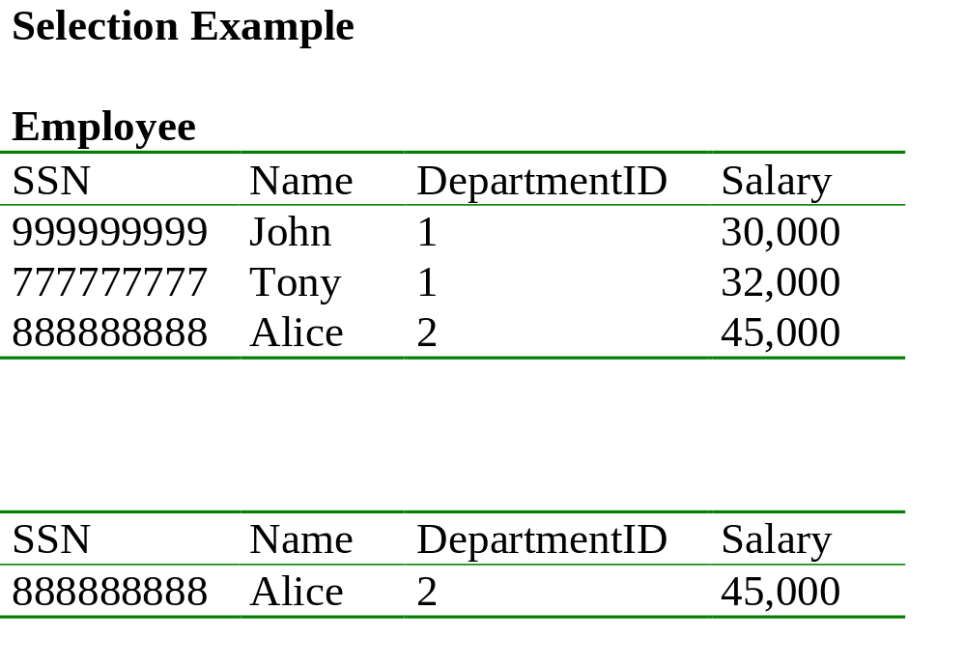
Find all employees with salary more than $40,000.
σ _{Salary > 40000} (Employee)

Slide 20
Emp. with salary more than $30,000 and department id = 2
σ Salary > 30000 AND DepartmentID = 2 (Employee)

Slide 21

Projection
Unary operation: returns certain columns
Eliminates duplicate tuples !
Notation: π _{A1,…,An} (R)
  If input schema R(B1,…,Bm)
  then {A1, …, An} {B1, …, Bm}
Output schema S(A1,…,An)
Example: project social-security number and names from Employee (SSN, Name, Dept, Salary)
  π _{SSN, Name} (Employee)

Slide 22
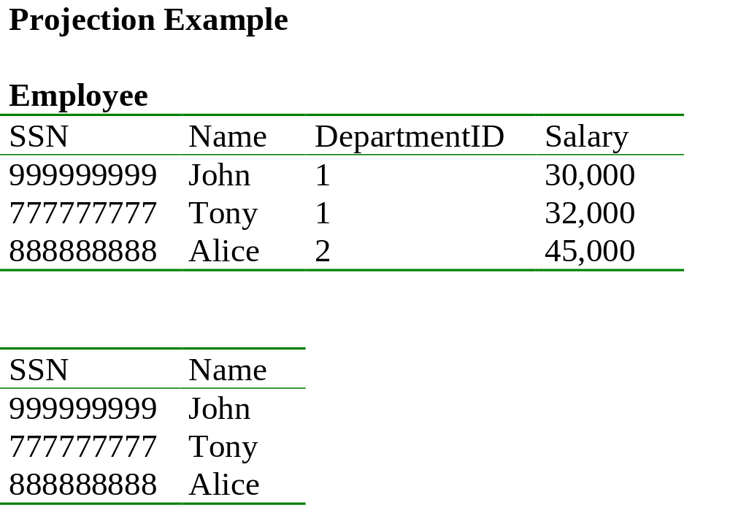
π _{SSN, Name} (Employee)
π _{DepartmentID} (Employee) ??

Slide 23
Q: Comparing projection and selection?
How are they similar?
How are they different?
Why do you need both?

Slide 24
Q: Comparing projection and selection?
Both are single-table operations
Projection throws away columns; selection throws away rows.
Both are essential to a query language!

Slide 25

Cartesian Product
Each tuple in R1 with each tuple in R2
Notation: R1 X R2
  Input schemas R1(A1,…,An), R2(B1,…,Bm)
  Condition: {A1,…,An} {B1,…Bm} = Φ
Output schema is S(A1, …, An, B1, …, Bm)
Notation: R1 X R2
Very rare in practice; but join (operation derived from cartesian product) is very common

Slide 26
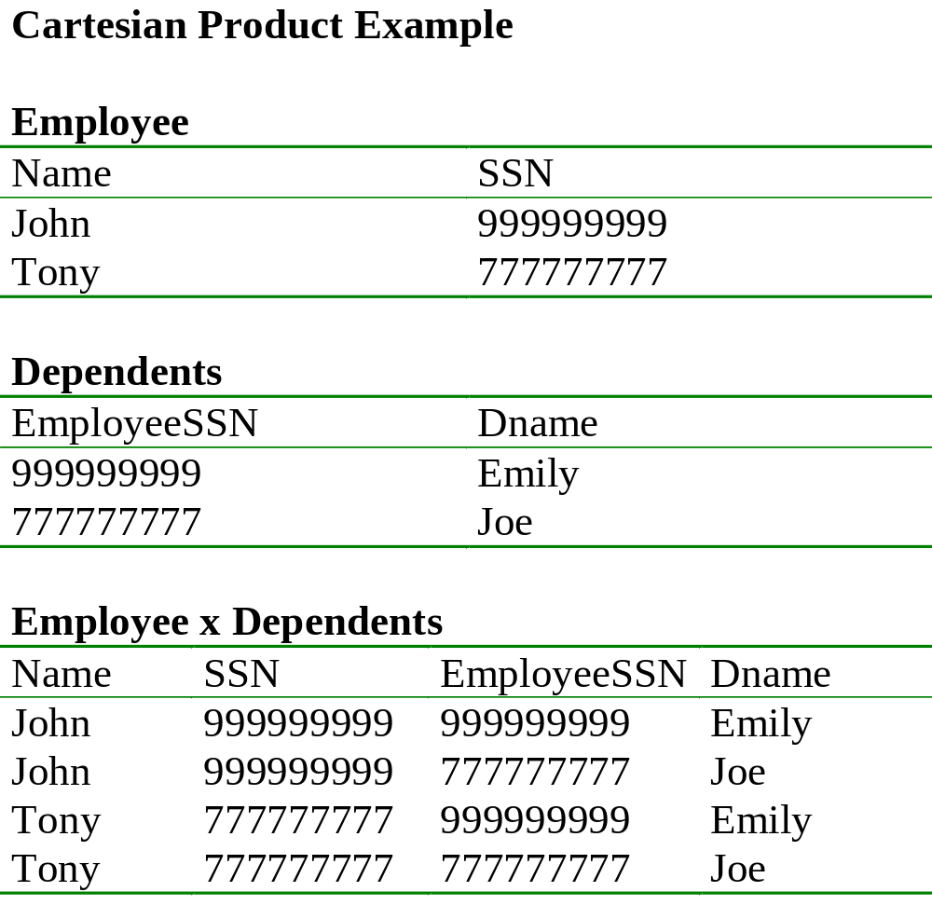

Slide 27
Cartesian Product
Each tuple in R1 with each tuple in R2
Notation: R1 X R2
  Input schemas R1(A1,…,An), R2(B1,…,Bm)
  Condition: {A1,…,An} {B1,…Bm} = Φ
Output schema is S(A1, …, An, B1, …, Bm)
Notation: R1 X R2

Slide 28
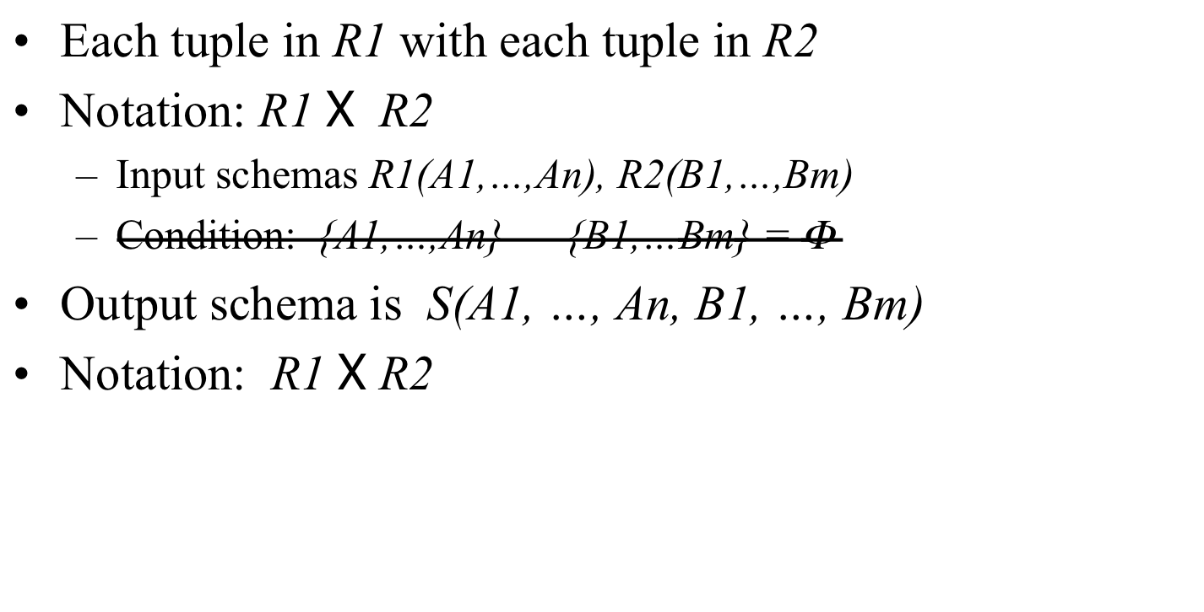
Cartesian Product
If Ai is same as Bj, rename them as R1.Ai, R2.Ai

Slide 29
Renaming
Does not change the relational instance
Changes the relational schema only
Notation: ρ _{S(B1,…,Bn)} (R)
Input schema: R(A1, …, An)
Output schema: S(B1, …, Bn)
Example: rename Employee(Name, SSN)
    ρRenamedEmployee(LastName, SocSocNo) (Employee)

Slide 30
Renaming Example
Employee
Name
SSN
John
999999999
Tony
777777777
ρRenamedEmployee(LastName, SocSocNo) (Employee)
LastName
SocSocNo
John
999999999
Tony
777777777

Slide 31
Derived RA Operations
1) Intersection
2) Most importantly: Join

Slide 32
Set Operations: Intersection
Difference: all tuples both in R1 and in R2
Notation: R1 R2
  R1, R2 must have the same schema
Output: R1 R2 has the same schema as R1, R2
Example
  UnionizedEmployees RetiredEmployees
Intersection is derived:
  R1 R2 = R1 – (R1 – R2)

Slide 33
Joins
Theta join
Natural join
Equi-join
etc.

Slide 34
Theta Join
A cartesian product followed by a selection
Notation: R1 _{θ} R2 where θ is a condition
Input schemas: R1(A1,…,An), R2(B1,…,Bm)
Output schema: S(A1,…,An,B1,…,Bm)
Derived operator:
R1 _{θ} R2 = σ _{θ} (R1 x R2)
Note that in output schema, if an attribute of R1 has the same name as an attribute of R2, we need renaming, as in Cartesian Product.

Slide 35
Example
Sells( bar, beer, price ) Bars( name, addr )
Joe’s Bud 2.50 Joe’s Maple St.
Joe’s Miller 2.75 Sue’s River Rd.
Sue’s Bud 2.50
Sue’s Coors 3.00
BarInfo := Sells _{Sells.bar = Bars.name} Bars
BarInfo( bar, beer, price, name, addr )
Joe’s Bud 2.50 Joe’s Maple St.
Joe’s Miller 2.75 Joe’s Maple St.
Sue’s Bud 2.50 Sue’s River Rd.
Sue’s Coors 3.00 Sue’s River Rd.

Slide 36

Natural Join
Notation: R1 R2
Input Schema: R1(A1, …, An), R2(B1, …, Bm)
Output Schema: S(C1,…,Cp)
  Where {C1, …, Cp} = {A1, …, An} U {B1, …, Bm}
Meaning: combine all pairs of tuples in R1 and R2 that agree on the attributes:
  {A1,…,An} {B1,…, Bm} (called the join attributes)
Equivalent to a cross product followed by selection
Example Employee Dependents

Slide 37
Natural Join Example
Employee
Name
SSN
John
999999999
Tony
777777777
Dependents
SSN
Dname
999999999
Emily
777777777
Joe
Employee Dependents =
Π_{Name, SSN, Dname}(σ _{SSN=SSN2}(Employee x ρ_{SSN2, Dname}(Dependents))
Name
SSN
Dname
John
999999999
Emily
Tony
777777777
Joe

Slide 38
Natural Join
R= S=
R S =
A | B
X | Y
X | Z
Y | Z
Z | V
B | C
Z | U
V | W
Z | V
A | B | C
X | Z | U
X | Z | V
Y | Z | U
Y | Z | V
Z | V | W

Slide 39
Natural Join
Given the schemas R(A, B, C, D), S(A, C, E), what is the schema of R S ?
Given R(A, B, C), S(D, E), what is R S ?
Given R(A, B), S(A, B), what is R S ?
Notes:
Answers: (1) A, B, C, D, E (2) By convention: Cartesian Product (3) R \intersect S

Slide 40
Equi-join
A generalization of Natural Joins, or special case of theta joins where C = equality predicate
R1 _{Α=Β} R2
A lot of research on how to do it efficiently

Slide 41
Summary of Relational Algebra
Basic primitives:
  E ::= R
  | σ_{C}(E)
  | Π _{A1, A2, ..., An} (E)
  | E1 X E2
  | E1 U E2
  | E1 - E2
  |
  |ρ_{S(A1, A2, …, An)}(E)
Abbreviations:
  | E1 E2
  | E1 _{C} E2
  | E1 ∩ E2

Slide 42
Relational Algebra
Six basic operators, many derived
Combine operators in order to construct queries: relational algebra expressions

Slide 43
Building Complex Expressions
Algebras allow us to express sequences of operations in a natural way.
Example
  in arithmetic algebra: (x + 4)*(y - 3)
Relational algebra allows the same.
Three notations:
    Sequences of assignment statements.
    Expressions with several operators.
    Expression trees.

Slide 44
1. Sequences of Assignments
Create temporary relation names.
Renaming can be implied by giving relations a list of attributes.
  R3(X, Y) := R1
Example: R3 := R1 _{C} R2 can be written:
  R4 := R1 x R2
  R3 := σ_{C} (R4)

Slide 45
2. Expressions with Several Operators
Precedence of relational operators:
    Unary operators --- select, project, rename --- have highest precedence, bind first.
    Then come products and joins.
    Then intersection.
    Finally, union and set difference bind last.
But you can always insert parentheses to force the order you desire.

Slide 46
3. Expression Trees
Leaves are operands (relations).
Interior nodes are operators, applied to their child or children.

Slide 47
Example
Given Bars(name, addr), Sells(bar, beer, price), find the names of all the bars that are either on Maple St. or sell Bud for less than $3.

Slide 48
As a Tree:
UNION
RENAME_{R(name)}
PROJECT_{name}
PROJECT_{bar}
SELECT_{addr = “Maple St.”}
SELECT _{price<3 AND beer=“Bud”}
Bars
Sells

Slide 49
Q: How would we do this?
Using Sells(bar, beer, price), find the bars that sell two different beers at the same price.

Slide 50
Q: How would we do this?
Using Sells(bar, beer, price), find the bars that sell two different beers at the same price.
R1:= RENAME _{Sells1(bar, beer1, price)} Sells
R2:= SELECT_{NOT (beer1 = beer)} R1 NATJ Sells
R3:= PROJECT _{bar} R2

Slide 51
More Queries
Product ( pid, name, price, category, maker-cid)
Purchase (buyer-ssn, salesperson-ssn, store, pid)
Company (cid, name, stock price, country)
Person (ssn, name, phone number, city)
Find phone numbers of all individuals who have made a sale.

Slide 52
More Queries
Product ( pid, name, price, category, maker-cid)
Purchase (buyer-ssn, salesperson-ssn, store, pid)
Company (cid, name, stock price, country)
Person (ssn, name, phone number, city)
Find phone numbers of people who bought gizmos from Fred.

Slide 53
Expression Tree
Π _{numbers}
ssn=buyer-ssn
pid=pid
salesperson-ssn=ssn
Π _{ssn}
Π _{pid}
σ_{name=fred}
σ_{category=gizmo}
Person Purchase Person Product

Slide 54
Sets vs. Bags
So far, we have considered set-oriented relational algebra
There’s an equivalent bag-oriented relational algebra
  Multisets instead of sets
Relational databases actually use bags as opposed to sets…
  Most operations are more efficient

Slide 55
Operations on Bags
Selection: preserve the number of occurrences
  Same speed as sets
Projection: preserve the number of occurrences
  Faster than sets: no duplicate elimination
Cartesian product, join
  Every copy joins with every copy
  Faster than sets: no duplicate elimination

Slide 56
Operations on Bags
Union: {a,b,b,c} U {a,b,b,b,e,f,f} = {a,a,b,b,b,b,b,c,e,f,f}
  add the number of occurrences
  Faster than sets, no need to look for duplicates
Difference: {a,b,b,b,c,c} – {b,c,c,c,d} = {a,b,b}
  subtract the number of occurrences
  Similar speed
Intersection: {a,b,b,b,c,c} {b,b,c,c,c,c,d} = {b,b,c,c}
  minimum of the two numbers of occurrences
  Similar speed
Read the book for more details: Some non-intuitive behavior

Slide 57
Summary of Relational Algebra
Why bother ? Can write any RA expression directly in C++/Java, seems easy.
Two reasons:
  Succinct: Each operator admits sophisticated implementations (think of , σ _{C}) but can be declared rather than implemented
  Expressions in relational algebra can be rewritten: optimized

