Slide 1
CS411
Database Systems
06d: SQL-4
Constraints and Triggers

Slide 2
Constraints and Triggers
Constraints and Triggers are used to make sure that the data in the database “makes sense”, that is: important real-world properties are kept valid
  Via continuous maintenance of “assertions”
    Constraints
  Via book-keeping done via special commands
    Triggers

Slide 3
Constraints and Triggers
A constraint is a relationship among data elements that the DBMS is required to enforce.
  Example: key constraints.
Triggers are only executed when a specified condition occurs, e.g., insertion of a tuple.
  Easier to implement than many constraints.

Slide 4
Kinds of Constraints
Keys.
Foreign-key, or referential-integrity.
Value-based constraints.
  Constrain values of a particular attribute.
Tuple-based constraints.
  Relationship among components.
Assertions: any SQL boolean expression.

Slide 5
Foreign Keys
Consider Relation Sells(bar, beer, price).
We might expect that a beer value is a real beer --- something appearing in Beers.name
A constraint that requires a beer in Sells to be a beer in Beers is called a foreign-key constraint.

Slide 6
Expressing Foreign Keys
Use the keyword REFERENCES, either:
  Within the declaration of an attribute, when only one attribute is involved.
  As an element of the schema, as:
FOREIGN KEY ( <list of attributes> )
REFERENCES <relation> ( <attributes> )
Referenced attributes must be declared PRIMARY KEY or UNIQUE. Why?

Slide 7
Example: With Attribute
CREATE TABLE Beers (
name CHAR(20) PRIMARY KEY,
manf CHAR(20) );
CREATE TABLE Sells (
bar CHAR(20),
beer CHAR(20) REFERENCES Beers(name),
price REAL );

Slide 8
Example: As Element
CREATE TABLE Beers (
name CHAR(20) PRIMARY KEY,
manf CHAR(20) );
CREATE TABLE Sells (
bar CHAR(20),
beer CHAR(20),
price REAL,
FOREIGN KEY(beer) REFERENCES Beers(name));

Slide 9
Enforcing Foreign-Key Constraints
If there is a foreign-key constraint from attributes of relation R to the primary key of relation S, two violations are possible:
  An insert or update to R introduces values not found in S.
  A deletion or update to S causes some tuples of R to “dangle.”
  Why are the other two cases (insert to S and delete of R) not important?

Slide 10
Actions Taken for Changes
Suppose R = Sells, S = Beers.
Referencing relation changes:
  An insert or update to Sells that introduces a nonexistent beer must be rejected.
Referenced relation changes:
  A deletion or update to Beers that removes a beer value found in some tuples of Sells can be handled in three ways.

Slide 11
Actions Taken for Updates to Beers
The three possible ways to handle beers that suddenly cease to exist are:
  Default : Reject the modification.
  Cascade : Make the same changes in Sells.
    Deleted beer: delete Sells tuple.
    Updated beer: change value in Sells.
  Set NULL : Change the beer to NULL.

Slide 12
Example: Cascade
Suppose we delete the Bud tuple from Beers.
  Then delete all tuples from Sells that have beer = ’Bud’.
Suppose we update the Bud tuple by changing ’Bud’ to ’Budweiser’.
  Then change all Sells tuples with beer = ’Bud’ so that beer = ’Budweiser’.

Slide 13
Example: Set NULL
Suppose we delete the Bud tuple from Beers.
  Change all tuples of Sells that have beer = ’Bud’ to have beer = NULL.
Suppose we update the Bud tuple by changing ’Bud’ to ’Budweiser’.
  Same change.

Slide 14
Choosing a Policy
When we declare a foreign key, we may choose policies SET NULL or CASCADE independently for deletions and updates to S (the referenced relation).
Follow the foreign-key declaration by:
ON [UPDATE, DELETE][SET NULL, CASCADE]
Two such clauses may be used.
Otherwise, the default (reject) is used.

Slide 15
Example
CREATE TABLE Sells (
bar CHAR(20),
beer CHAR(20),
price REAL,
FOREIGN KEY(beer)
REFERENCES Beers(name)
ON DELETE SET NULL
ON UPDATE CASCADE );

Slide 16
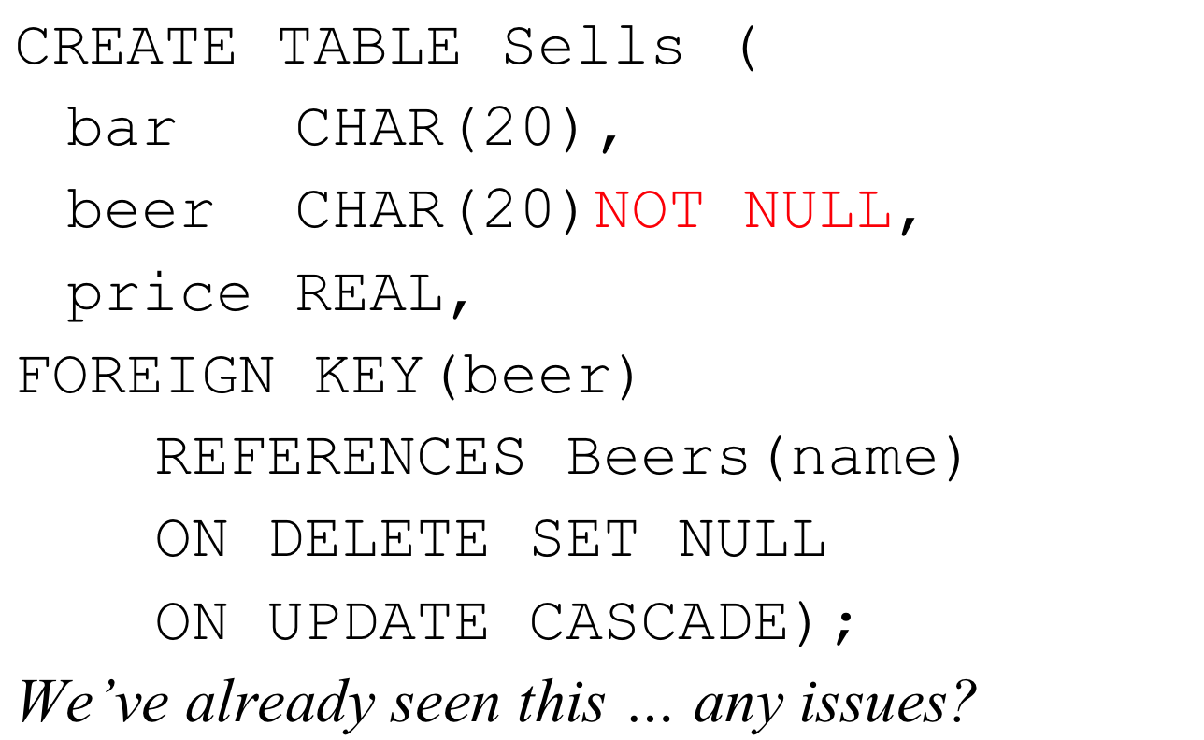
Interference with NOT NULL

Slide 17
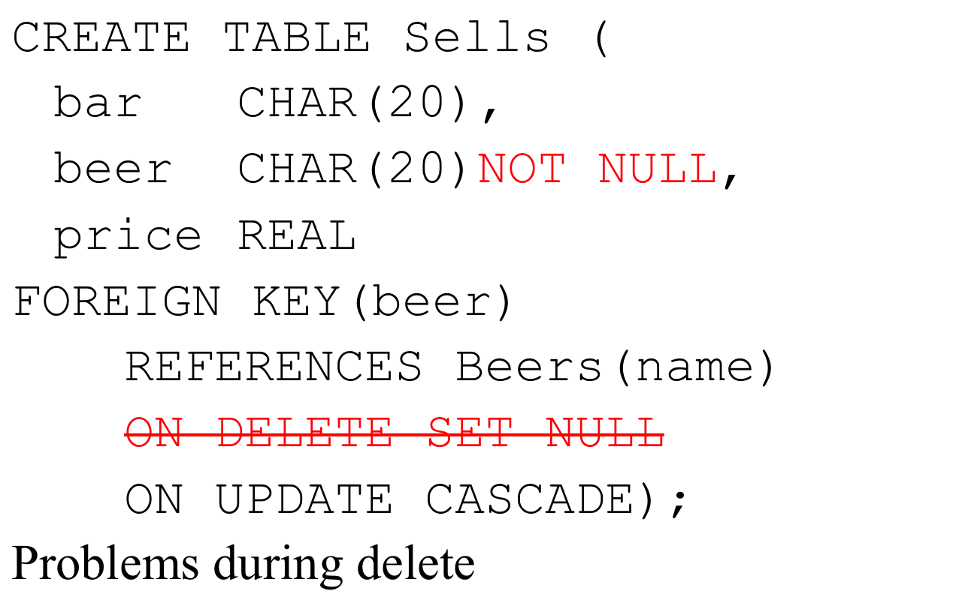
Interference with NOT NULL

Slide 18
Checks
Attribute-based
  NOT NULL is one of them ...
  We’ll see other more general types of checks
Tuple-based

Slide 19
Attribute-Based Checks
Place a constraint on the value of a particular attribute.
CHECK( <condition> ) must be added to the declaration for the attribute.
The condition may use the name of the attribute, but any other relation or attribute name must be in a subquery.

Slide 20
Example
CREATE TABLE Sells (
bar CHAR(20),
beer CHAR(20) CHECK ( beer IN
(SELECT name FROM Beers)),
price REAL CHECK ( price <= 5.00 )
);

Slide 21
How is Check different from Foreign Key?
… beer CHAR(20) CHECK ( beer IN
(SELECT name FROM Beers))
The beer check seems similar to Foreign Key constraints.
However, the timing of enforcement is different.

Slide 22
Timing of Checks
An attribute-based check is checked only when a value for that attribute is inserted or updated.
  Example: CHECK (price <= 5.00) checks every new price and rejects it if it is more than $5.
  Example: CHECK (beer IN (SELECT name FROM Beers)) not checked if a beer is deleted from Beers or updated (unlike foreign-keys).
    Only checked during inserts/updates of that attribute

Slide 23
Tuple-Based Checks
CHECK ( <condition> ) may be added as another element of a schema definition.
The condition may refer to any attribute of the relation, but any other attributes or relations require a subquery.
Checked on insert or update only.

Slide 24
Example: Tuple-Based Check
Only Joe Bar can sell beer for more than $5:
CREATE TABLE Sells (
bar CHAR(20),
beer CHAR(20),
price REAL,
CHECK (bar = ’Joe Bar’ OR
price <= 5.00)
);

Slide 25
Q: Why do we need tuple-level check?
We can do attribute-based check, why tuple level?
Reason 1: If the check involves more than one attribute of the tuple, we need the tuple-level check.
Reason 2: Tuple-level constraints are checked more frequently.
  Whenever there are any inserts or updates to any of the concerned attributes

Slide 26
Assertions
These are database-schema elements, like relations or views.
Defined by:
CREATE ASSERTION <name>
CHECK ( <condition> );
Condition may refer to any relation or attribute in the database schema.
Must be true at all times

Slide 27
Example: Assertion
In Sells(bar, beer, price), no bar may charge an average of more than $5.
CREATE ASSERTION NoRipoffBars
CHECK (
NOT EXISTS (
SELECT bar FROM Sells
GROUP BY bar
HAVING 5.00 < AVG(price)
));
Bars with an
average price
above $5

Slide 28
Example: Assertion
In Drinkers(name, addr, phone) and Bars(name, addr, license), there cannot be more bars than drinkers.
CREATE ASSERTION FewBar CHECK (
(SELECT COUNT(*) FROM Bars) <=
(SELECT COUNT(*) FROM Drinkers)
);

Slide 29
Timing of Assertion Checks
In principle, we must check every assertion after every modification to any relation of the database.
A clever system can observe that only certain changes could cause a given assertion to be violated.
CREATE ASSERTION FewBar CHECK (
(SELECT COUNT(*) FROM Bars) <=
(SELECT COUNT(*) FROM Drinkers)
);
Can a change to Beers affect FewBar?
Can a deletion from Bars?
Can an insertion into Bars?

Slide 30
Triggers: Motivation
Attribute- and tuple-based checks have limited capabilities.
Assertions are sufficiently general for most constraint applications, but they are hard to implement efficiently.
  The DBMS must have real intelligence to avoid checking assertions that couldn’t possibly have been violated.

Slide 31
Triggers: Solution
A trigger allows the user to specify when the check occurs.
Like an assertion, a trigger has a general-purpose condition, but can also can perform any sequence of SQL database modifications.

Slide 32
Event-Condition-Action Rules
Another name for “trigger” is ECA rule, or event-condition-action rule.
  Event : typically a type of database modification, e.g., “insert on Sells.”
  Condition : Any SQL boolean-valued expression.
  Action : Any SQL statements.

Slide 33
Example: A Trigger
There are many details to learn about triggers.
Here is an example to set the stage.
  Recall that with a foreign-key constraint, we ended up rejecting any insertions into Sells(bar, beer, price) with unknown beers
  Here, a trigger can add that beer to Beers, with a NULL manufacturer.

Slide 34
Example: Trigger Definition
CREATE TRIGGER BeerTrig
AFTER INSERT ON Sells
REFERENCING
NEW ROW AS NewTuple
FOR EACH ROW
WHEN (NewTuple.beer NOT IN
(SELECT name FROM Beers))
INSERT INTO Beers(name)
VALUES(NewTuple.beer);
The event
The condition
The action

Slide 35
Options: The Event
CREATE TRIGGER BeerTrig
AFTER INSERT ON Sells
REFERENCING
NEW ROW AS NewTuple
FOR EACH ROW
WHEN (NewTuple.beer NOT IN
(SELECT name FROM Beers))
INSERT INTO Beers(name)
VALUES(NewTuple.beer);
AFTER can be BEFORE.
Also, INSTEAD OF
  A great way to execute view modifications: have triggers translate to appropriate modifs on the base tables.
INSERT can be DELETE or UPDATE.
  And UPDATE can be UPDATE OF <tablename> ON <attributename>.

Slide 36
Options: FOR EACH ROW
CREATE TRIGGER BeerTrig
AFTER INSERT ON Sells
REFERENCING
NEW ROW AS NewTuple
FOR EACH ROW
WHEN (NewTuple.beer NOT IN
(SELECT name FROM Beers))
INSERT INTO Beers(name)
VALUES(NewTuple.beer);
Triggers are either row-level or statement-level.
FOR EACH ROW indicates row-level; its absence indicates statement-level.
Row level triggers are executed once for each modified tuple.
Statement-level triggers execute once for an SQL statement, regardless of how many tuples are modified.

Slide 37
Options: REFERENCING
CREATE TRIGGER BeerTrig
AFTER INSERT ON Sells
REFERENCING
NEW ROW AS NewTuple
FOR EACH ROW
WHEN (NewTuple.beer NOT IN
(SELECT name FROM Beers))
INSERT INTO Beers(name)
VALUES(NewTuple.beer);
INSERT statements imply a new tuple (for row-level) or new set of tuples (for statement-level).
DELETE implies an old tuple or set of tuples.
UPDATE implies both.
Refer to these by
[NEW OLD][ROW TABLE] AS <name>
row = tuple modified
table = set of tuples modified

Slide 38
Options: Condition
CREATE TRIGGER BeerTrig
AFTER INSERT ON Sells
REFERENCING
NEW ROW AS NewTuple
FOR EACH ROW
WHEN (NewTuple.beer NOT IN
(SELECT name FROM Beers))
INSERT INTO Beers(name)
VALUES(NewTuple.beer);
Any boolean-valued condition is appropriate.
It is evaluated before or after the triggering event, depending on whether BEFORE or AFTER is used in the event.
Access the new/old tuple or set of tuples through the names declared in the REFERENCING clause.

Slide 39
Options: The Action
CREATE TRIGGER BeerTrig
AFTER INSERT ON Sells
REFERENCING
NEW ROW AS NewTuple
FOR EACH ROW
WHEN (NewTuple.beer NOT IN
(SELECT name FROM Beers))
INSERT INTO Beers(name)
VALUES(NewTuple.beer);
There can be more than one SQL statement in the action.
  Surround by BEGIN . . . END if there is more than one.
But queries make no sense in an action, so we are really limited to modifications.

Slide 40
Another Example
Using Sells(bar, beer, price) and a unary relation RipoffBars(bar) created for the purpose, maintain a list of bars that raise the price of any beer by more than $1.

Slide 41
The Trigger
The event –
only changes
to prices
CREATE TRIGGER PriceTrig
AFTER UPDATE OF price ON Sells
REFERENCING
OLD ROW as old
NEW ROW as new
FOR EACH ROW
WHEN(new.price > old.price + 1.00)
INSERT INTO RipoffBars
VALUES(new.bar);
Updates let us
talk about old
and new tuples
Condition:
a raise in
price > $1
We need to consider
each price change
When the price change
is great enough, add
the bar to RipoffBars
Using Sells(bar, beer, price) and a unary relation RipoffBars(bar) created for the purpose, maintain a list of bars that raise the price of any beer by more than $1.

Slide 42
Triggers on Views
Generally, it is tricky to modify a view, because it “doesn’t exist”.
But an INSTEAD OF trigger lets us interpret view modifications in a way that makes sense.
Example: We’ll design a view Synergy that has (drinker, beer, bar) triples such that the bar serves the beer, the drinker frequents the bar and likes the beer.

Slide 43
Example: The View
Pick one copy of
each attribute
except price
CREATE VIEW Synergy AS
SELECT Likes.drinker, Likes.beer, Sells.bar
FROM Likes, Sells, Frequents
WHERE Likes.drinker = Frequents.drinker
AND Likes.beer = Sells.beer
AND Sells.bar = Frequents.bar;
Natural join of Likes,
Sells, and Frequents

Slide 44
Interpreting a View Insertion
We cannot insert into Synergy --- it is a view.
But we can use an INSTEAD OF trigger to turn a (drinker, beer, bar) triple into three insertions of projected pairs, one for each of Likes, Sells, and Frequents.
  The Sells.price will have to be NULL.

Slide 45
The Trigger
CREATE TRIGGER ViewTrig
INSTEAD OF INSERT ON Synergy
REFERENCING NEW ROW AS n
FOR EACH ROW
BEGIN
INSERT INTO LIKES VALUES(n.drinker, n.beer);
INSERT INTO SELLS(bar, beer) VALUES(n.bar, n.beer);
INSERT INTO FREQUENTS VALUES(n.drinker, n.bar);
END;

