Slide 1
BSCS · DEEP LEARNING SEMESTER PROJECT
AquaClass AI
Fish Species Classification System
Deep Learning-Based Automated Fish Species Recognition Using MobileNetV2
Student: Najamul Hassan
Roll No.: SU92-BSCSM-F23-665
University: Superior University Lahore
Course: Deep Learning
Instructor: Dr. Munir Ahmad
Notes:
Good morning, Dr. Munir Ahmad. My name is Najamul Hassan and this is my Deep Learning project, AquaClass AI. It is a system that looks at a photo of a fish and tells us which species it is.
I used a model called MobileNetV2 and built a web application, with a React frontend and a FastAPI backend, so anyone can try it online. In the next few minutes I will explain the problem, the dataset, the model, the results and the application.

Slide 2





Project Overview
AI Classification
MobileNetV2
Identifies the fish species from a single image
Lightweight CNN using transfer learning
94.69%
5 Marine Species
Web Application
test accuracy on 3,750 unseen images
Reef fish classes from Fish4Knowledge
Full-stack React + FastAPI app; frontend calls a deployed backend
Notes:
AquaClass AI has four main parts. First, it is an AI image classifier: you give it a fish picture and it predicts the species. Second, the model is MobileNetV2, a small and efficient convolutional neural network. Third, it recognises five reef fish species from the Fish4Knowledge dataset. Fourth, it is a full-stack web application: a React frontend and a FastAPI backend. The frontend sends the uploaded image to the deployed backend, and the backend runs the model and returns the prediction.
The big number on the right is the accuracy on the test set: 94.69 percent. The test set is data the model never saw during training, so it is an honest measure of performance.
Simple term: a CNN (convolutional neural network) is a type of neural network designed to understand images.
Note: the fish drawing is only an illustration, not a photo from the dataset.

Slide 3


Problem Statement
Manual identification
AI-assisted identification
Takes a lot of time
Needs domain expertise
Large image collections are hard to process by hand
Fast automated prediction
Learns species patterns from labeled images
Scales to large image collections
VS
Goal: support faster species identification with automated image classification
Notes:
Marine biologists and aquaculture teams often need to know which fish species appear in their images. Doing this by hand has three problems: it takes time, it needs expert knowledge, and it does not scale when you have thousands of images.
Automated image classification can help. A trained model can look at an image and suggest the species quickly and consistently. It does not replace experts, it supports them.
Simple term: image classification means giving an image a single label, here the species name.

Slide 4





Project Objectives
01
02
03
Develop an automated fish species classifier
Train a deep learning model on marine fish images
Achieve reliable classification performance
04
05
Integrate the trained model into a web application
Provide an accessible, interactive user experience
Notes:
I set five objectives for this project.
1. Build an automated classifier for fish species.
2. Train a deep learning model using marine fish images.
3. Reach reliable performance, which I measured on a separate test set.
4. Connect the trained model to a web application.
5. Make that application easy and interactive for users.
All five are completed: the model is trained, evaluated, and used by the web application.

Slide 5
Dataset Overview: Fish4Knowledge
24,971
5
Images per species
Imbalanced: D. reticulatus is about 48.5% of all images
Total images
Classes (species)
17,478
3,743
Training (70%)
Validation (15%)
3,750
Fish4Knowledge
Testing (15%)
Reef fish ground truth
Notes:
The dataset is Fish4Knowledge, a public collection of reef fish images from the University of Edinburgh. I used 24,971 images from five species.
The data is split 70 percent for training (17,478 images), 15 percent for validation (3,743) and 15 percent for testing (3,750). Training teaches the model, validation helps us monitor it during training, and testing gives the final unbiased score.
The five species are Amphiprion clarkii, Chaetodon lunulatus, Chromis chrysura, Dascyllus reticulatus and Plectroglyphidodon dickii.
Important point: the classes are imbalanced. Dascyllus reticulatus has 12,112 images, about 48.5 percent of the data. That is why I report precision, recall and F1 per class later, not only accuracy.
Note: I did not paste photos here because the dataset images are not in the project repository.

Slide 6
Image Preprocessing
Original image
Resize
Normalize
Model input
Any size, RGB
224 × 224 pixels
ImageNet mean and std
Tensor 3 × 224 × 224
Inference workflow (FastAPI /predict)
Why these numbers?
ImageNet mean and std, matching the pretrained weights. The backend applies them before inference.
1. User uploads an RGB fish image in the React frontend
2. Frontend sends the image to the FastAPI /predict endpoint
3. Backend preprocesses the image to 224 × 224
4. Image is normalized with ImageNet mean and std
5. The processed tensor is passed to the ONNX model
Notes:
Neural networks need all inputs to have the same shape and scale. Fish photos come in different sizes, so every image goes through the same steps. In AquaClass AI these steps are done by the FastAPI backend.
1. The user uploads an RGB fish image through the React frontend.
2. The frontend sends the image to the FastAPI /predict endpoint.
3. The backend preprocesses the image to 224 by 224 pixels, the size MobileNetV2 expects.
4. It normalizes the image using the ImageNet mean and standard deviation. These are the values the pretrained weights were trained with, so using them keeps our input consistent.
5. The processed tensor, 3 channels by 224 by 224, is passed to the ONNX model.
Simple term: a tensor is just a multi-dimensional array of numbers.
Note: the boxes at the top are diagrams, not fish photos. The training preprocessing is unchanged; only the place where inference preprocessing runs is the backend.

Slide 7






Why MobileNetV2?
Simplified MobileNetV2
Lightweight CNN
Efficient features
Input 224×224×3
Small and fast network
Depthwise separable convolutions
Conv 3×3, stride 2
17 inverted residual blocks
Inverted residuals
Linear bottlenecks
Thin → wide → thin blocks
Keep information in thin layers
Conv 1×1 → 1280 features
Global average pooling
Transfer learning
Efficient deployment
Classifier → 5 classes
Starts from ImageNet weights
Lightweight and fast to serve
Notes:
I chose MobileNetV2 for practical reasons.
- It is a lightweight CNN: small and fast, which makes it suitable for efficient image classification and for deployment in a web application.
- It uses depthwise separable convolutions, which split a normal convolution into two cheaper steps. This keeps accuracy good with far fewer calculations.
- Its main building block is the inverted residual: it expands the data to a wider shape, filters it, then squeezes it back. A skip connection helps information and gradients flow.
- Linear bottlenecks avoid destroying information in the thin layers.
- It comes pretrained on ImageNet, so I could use transfer learning instead of training from zero.
Because the model is small, it is also efficient to load and run in the backend.
The diagram on the right is a simplified view: input, first convolution, 17 inverted residual blocks, a final 1 by 1 convolution giving 1280 features, pooling, and the classifier.

Slide 8



Model Architecture
1
2
3
4
5
6
Input image
Preprocessing
MobileNetV2 feature extractor
Classification layer
Softmax probabilities
Predicted species
ImageNet pretrained
Frozen feature layers
New 5-class classifier
Starts from weights learned on a large image dataset
The convolutional backbone is kept fixed; the new head learns
Dropout (0.2) + Linear (1280 → 5)
Notes:
This is the full model workflow.
1. The input image goes through preprocessing.
2. MobileNetV2 acts as a feature extractor: it turns the image into 1280 numbers that describe shapes, colors and patterns.
3. The classification layer converts those 1280 features into 5 scores, one per species.
4. Softmax turns the scores into probabilities that add up to 100 percent.
5. The species with the highest probability is the prediction.
Three design choices: I used ImageNet pretrained weights (transfer learning), I kept the feature extraction layers frozen so only the new classifier is trained, and I replaced the final layer with a Linear layer of 1280 inputs and 5 outputs. In the code (model.py) this is: model.classifier[1] = nn.Linear(num_features, 5).
Simple term: transfer learning means reusing knowledge a model already learned from a big dataset.

Slide 9






Training Configuration & Model Export
Framework
Model
Input size
Optimizer
PyTorch
MobileNetV2
224 × 224
Adam
Learning rate
Loss function
Epochs
Output classes
0.001
CrossEntropyLoss
10
5
Also: batch size 32 · augmentation: RandomHorizontalFlip, RandomRotation(15) · best validation epoch: 7
Model export & deployment
PyTorch training (.pth)
ONNX export (.onnx)
FastAPI backend
ONNX Runtime
Response to React frontend
Notes:
Here are the training settings.
- Framework: PyTorch.
- Model: MobileNetV2 with a new 5-class output.
- Input size: 224 by 224.
- Optimizer: Adam, with a learning rate of 0.001. The optimizer updates the weights to reduce the error.
- Loss function: CrossEntropyLoss, the standard loss for multi-class classification.
- Epochs: 10. One epoch means the model has seen the whole training set once.
- Output classes: 5.
The grey strip lists extra details from my project documentation: batch size 32, simple augmentation (random horizontal flip and a rotation up to 15 degrees), and the best validation accuracy came at epoch 7.
Model export: the training was done in PyTorch, which gives a .pth file. After training I exported the model to the ONNX format (.onnx). ONNX is an open model format that many runtimes can read. The .onnx file is loaded by the FastAPI backend, which runs it with ONNX Runtime. When the React frontend sends an image, the backend returns the prediction as a response.
So the pipeline is: PyTorch training, ONNX export, FastAPI backend, ONNX Runtime, and the prediction response to the React frontend.
Simple term: ONNX Runtime is a library that runs ONNX models efficiently, here on the server.

Slide 10
Training and Evaluation Results
95.03%
F1-score per species (test set)
Validation accuracy
94.69%
Test accuracy
Weighted P / R / F1 94.66 / 94.69 / 94.66%
Weakest class: C. chrysura. 77 of 540 test images were predicted as D. reticulatus.
Notes:
These are the main results. Validation accuracy is 95.03 percent (best epoch, epoch 7) and test accuracy is 94.69 percent. They are close, differing by 0.34 percentage points, which suggests the model is not overfitting to the validation set.
The weighted precision, recall and F1 are all about 94.7 percent.
The chart shows F1-score for each species. Four species are between 93.9 and 98.7 percent. The weakest is Chromis chrysura at 86.23 percent. From the confusion matrix, 77 of its 540 test images were predicted as Dascyllus reticulatus. Both are damselfish with similar body shape, and Dascyllus reticulatus has many more training images, so the model leans towards it.
Simple terms: precision means "when the model says this species, how often is it right"; recall means "of all real images of this species, how many did the model find"; F1 combines both.

Slide 11

System Architecture
CLIENT · REACT + VITE FRONTEND (Vercel)
SERVER · FASTAPI BACKEND (Vercel)
1
User uploads a fish image
3
FastAPI backend (/predict)
HTTP API request
4
Image preprocessing: 224 × 224, ImageNet normalization
2
React frontend: image upload
5
ONNX Runtime
6
MobileNetV2 ONNX model
8
Display prediction to the user
JSON API response
7
Predicted species + confidence (JSON response)
Separate deployment: frontend and backend are deployed separately on Vercel and communicate over HTTP
Notes:
This slide shows the full architecture. AquaClass AI uses a client-server architecture. The frontend and the backend are two separate applications, both deployed on Vercel.
1. The user uploads a fish image in the browser.
2. The React and Vite frontend receives the image and sends it to the backend as an HTTP API request.
3. The FastAPI backend receives the request on the /predict endpoint.
4. The backend preprocesses the image: it resizes it to 224 by 224 and normalizes it with the ImageNet mean and standard deviation.
5. ONNX Runtime executes the model.
6. The model is MobileNetV2, exported to ONNX format.
7. The backend returns the predicted species and the confidence as a JSON API response.
8. The React frontend receives the response and displays the prediction to the user.
The backend also has two other endpoints: /health checks the backend and whether the model is loaded, and /classes returns the five supported species. The frontend finds the backend through the environment variable VITE_API_URL.
Simple term: an API is a way for one program, here the frontend, to ask another program, here the backend, to do work and send back a result.

Slide 12
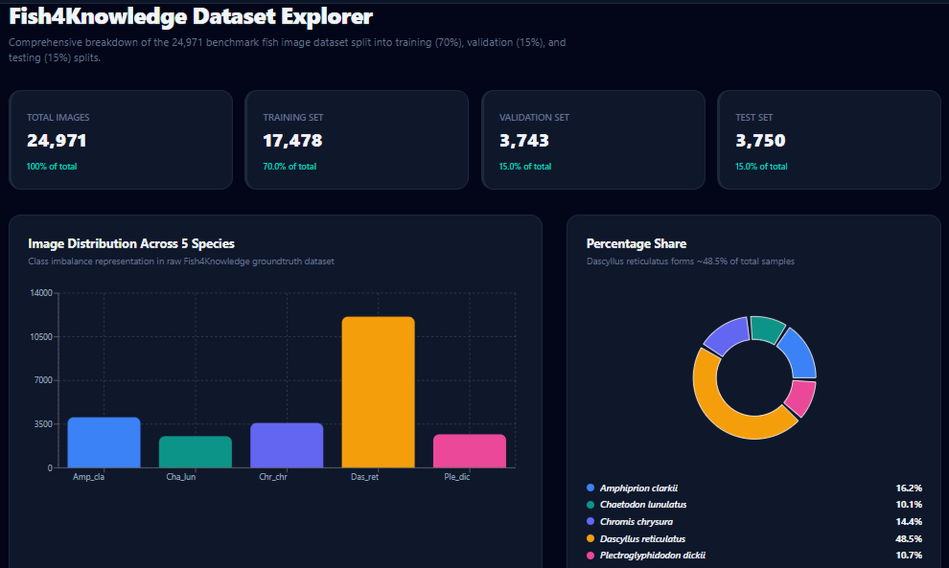
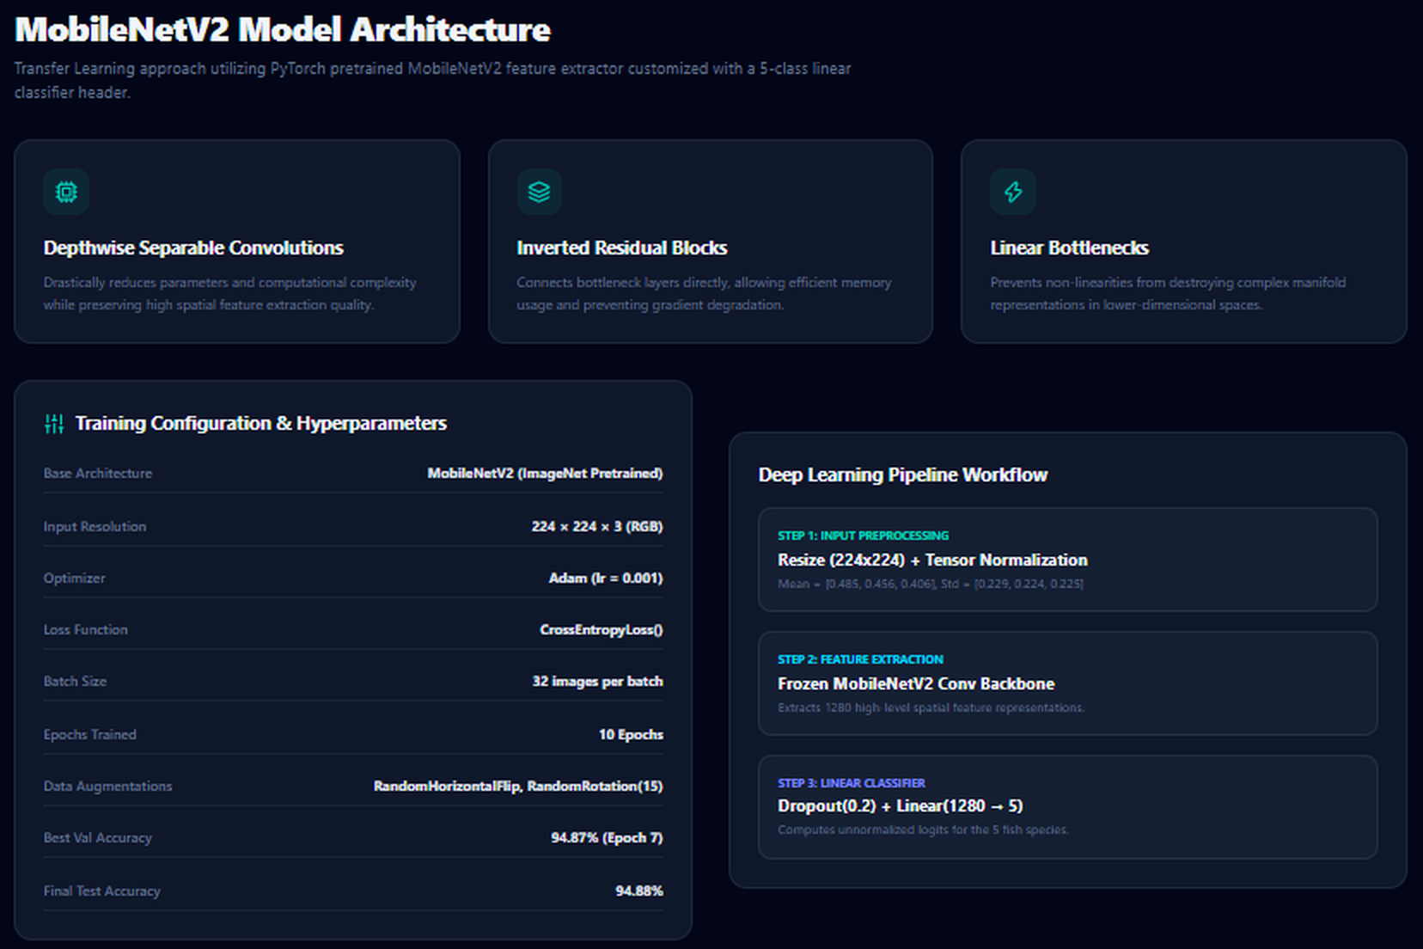
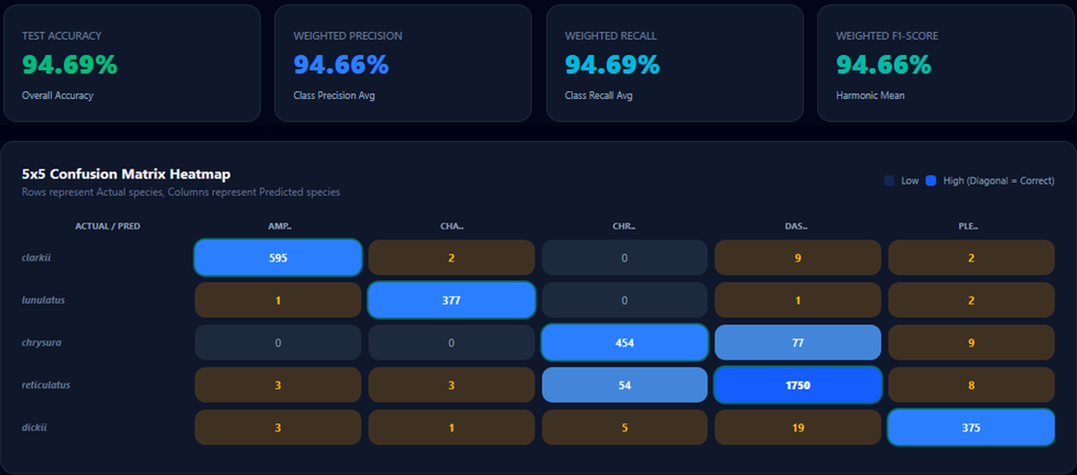



Web Application Features
Dataset Explorer
Model Architecture and configuration
Evaluation: metrics and confusion matrix
Home dashboard
Image upload
Prediction results
Dataset explorer
Model info
Evaluation
Screenshots captured from the live AquaClass AI web application (aquaclass-aii.vercel.app).
Notes:
The web application has six areas.
- Home: a dashboard with the key numbers and the five species.
- AI Classifier: upload a fish image and get the predicted species, confidence and the top three probabilities.
- Dataset Explorer: charts of the dataset split and species distribution.
- Model Architecture: the MobileNetV2 design and training configuration.
- Evaluation: accuracy, precision, recall, F1, a per-class table and the confusion matrix.
- Resources and About: project links and a short summary.
The three screenshots show the Dataset Explorer, the Model Architecture page and the Evaluation page. The screenshots were taken from the live site at https://aquaclass-aii.vercel.app/. On the AI Classifier page, the uploaded image is sent to the FastAPI backend for prediction. You can open the live site during your talk to show it.

Slide 13
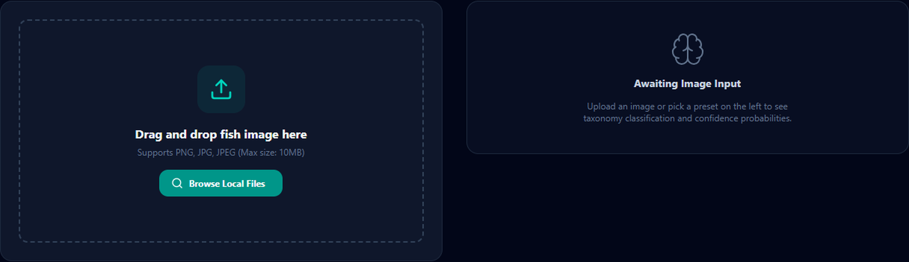
Live Classification Workflow
1
User opens the AquaClass AI website
2
User uploads a fish image
3
React frontend sends the image to the FastAPI /predict endpoint
AI Classifier: upload area and result panel
4
FastAPI backend receives and preprocesses the image
Backend API endpoints (FastAPI)
5
ONNX Runtime executes the MobileNetV2 ONNX model
/health backend and model status
6
Backend returns the prediction and confidence in an API response
/classes the five supported species
/predict upload image, get species + confidence
7
React frontend displays the result
Frontend reaches the backend through VITE_API_URL
Notes:
This is the main user journey, step by step.
1. The user opens the AquaClass AI website.
2. They upload a fish image, by drag and drop or by choosing a file.
3. The React frontend sends the image to the FastAPI /predict endpoint.
4. The FastAPI backend receives the image and preprocesses it: resize to 224 by 224 and normalize with the ImageNet mean and standard deviation.
5. ONNX Runtime executes the MobileNetV2 ONNX model.
6. The backend returns the predicted species and the confidence through an API response.
7. The React frontend displays the result.
The box on the right lists the three backend endpoints: /health, /classes and /predict. The frontend finds the backend through the environment variable VITE_API_URL. Live image upload and prediction have been tested on the deployed website.
Simple term: inference means using a trained model to make a prediction.

Slide 14














Technology Stack
Frontend
React
Vite
Tailwind CSS
JavaScript
Recharts
Backend & Inference
Training
Deployment & Version Control
Python
PyTorch
Vercel (Frontend)
FastAPI
Torchvision
Vercel (Backend)
ONNX Runtime
MobileNetV2
GitHub
ONNX Model (.onnx)
Notes:
Here are the tools I used, in four groups.
Frontend: React with Vite for the build tooling, Tailwind CSS for styling, JavaScript (JSX) for the code and Recharts for the charts.
Backend and inference: the backend is written in Python with FastAPI. It loads the ONNX model (.onnx) and runs it with ONNX Runtime.
Training: the model was trained with PyTorch and Torchvision. Torchvision provides the MobileNetV2 architecture and the image transforms. After training, the model was exported to ONNX.
Deployment and version control: the frontend and the backend are deployed separately on Vercel, and the code is on GitHub: https://github.com/chnajamulhassan/aquaclass-aii.

Slide 15


Challenges and Solutions
Technical considerations
Images come in different sizes
Standardized preprocessing: resize to 224 × 224 and normalize
Imbalanced classes (D. reticulatus ≈ 48.5%)
Report precision, recall and F1 per class, not only accuracy
Integrating the trained model into a web application
Exported the PyTorch model to ONNX and integrated it with a FastAPI backend using ONNX Runtime; the React frontend calls its API endpoints
Connecting frontend and backend
Deployed separately on Vercel; the frontend reaches the backend API through VITE_API_URL
Notes:
These are the main technical considerations in the project and how I handled each one.
1. Fish images have different sizes. I solved it with standard preprocessing: every image is resized to 224 by 224 and normalized.
2. The dataset is imbalanced, with one species making up about half of the images. So I looked at precision, recall and F1 for each species, not only overall accuracy.
3. The challenge was to integrate the trained deep learning model into a web application. I exported the PyTorch model to ONNX and integrated it with a FastAPI backend using ONNX Runtime. The React frontend communicates with the backend through API endpoints.
4. The frontend and the backend are separate applications, so they are deployed separately on Vercel, and the frontend reaches the backend API through the environment variable VITE_API_URL.
This slide is titled technical considerations, so you can speak about it from your own experience of building the project. Add one or two real problems you faced if you want.

Slide 16






Future Enhancements
More species
Larger datasets
Model optimization
Go beyond the current five classes
More diverse marine images
Smaller and faster inference
Mobile app
Richer species info
Faster loading
Identify fish from a phone camera
Habitat, size and depth details
Smaller, quantized ONNX model
Notes:
There are many ways to improve AquaClass AI.
- Add more fish species, since the system currently knows five.
- Use larger and more diverse marine datasets to make the model stronger in real conditions.
- Optimize the model so it is smaller and faster.
- Build a mobile app so users can identify fish from a phone camera.
- Show more detailed species information such as habitat, size and depth.
- Make the page load faster, for example with a smaller quantized ONNX model.
These are ideas for future work, not features that exist today.

Slide 17


Thank You!
AquaClass AI – Making Fish Species Identification Smarter with Deep Learning.
Live frontend
https://aquaclass-aii.vercel.app/
Questions & Discussion
Backend (FastAPI)
https://aquaclass-ai-backend.vercel.app
GitHub repository
https://github.com/chnajamulhassan/aquaclass-aii
Notes:
Thank you for listening. To summarize: AquaClass AI uses MobileNetV2 with transfer learning to classify five reef fish species with 94.69 percent test accuracy. The model was trained in PyTorch and exported to ONNX format. A FastAPI backend uses ONNX Runtime to make the prediction, and the React frontend communicates with the backend through API requests. The frontend and the backend are deployed on Vercel.
The live frontend, the backend and the GitHub repository are on this slide. I am happy to answer your questions.
Possible questions to prepare:
- Why MobileNetV2 and not a bigger model? (Lightweight and efficient, suitable for image classification and deployment.)
- Why is Chromis chrysura the weakest class? (Looks similar to Dascyllus reticulatus, and has fewer training images.)
- What is transfer learning? (Reusing ImageNet knowledge.)
- Why ONNX? (An open format that lets a PyTorch model run in other runtimes, here ONNX Runtime in the backend.)
- Where does the prediction run? (On the FastAPI backend with ONNX Runtime; the frontend only uploads the image and shows the result.)
- Does the image leave the device? (Yes, the uploaded image is sent to the backend through the /predict API.)
- What do the API endpoints do? (/health checks the backend and model status, /classes returns the five species, /predict returns the prediction.)
- How does the frontend find the backend? (Through the environment variable VITE_API_URL.)

