Slide 1
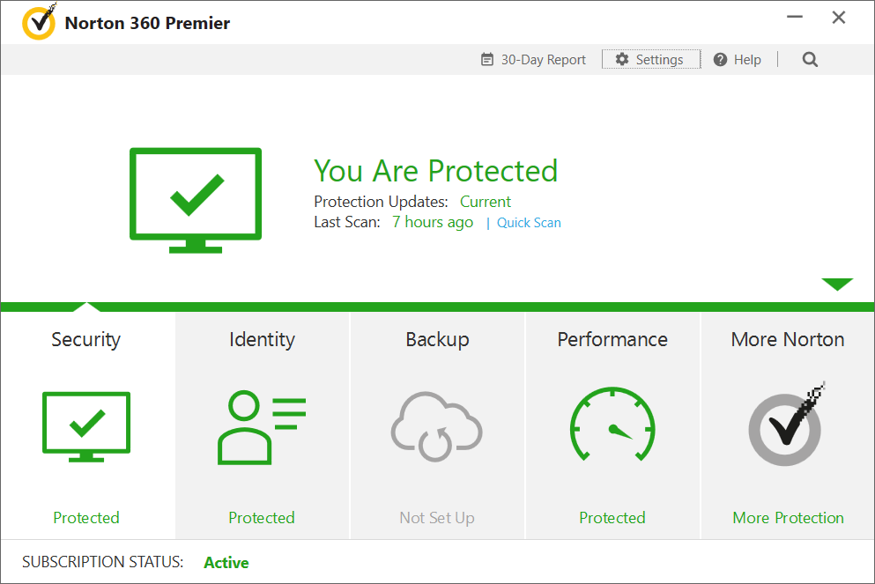

Want to know how to use your anti-virus properly?
Tired of VIRUS on your computer?
Join the anti-virus Course NOW!

