Slide 1


IBM COURSERA ADVANCED DATA SCIENCE CAPSTONE
RACIAL DETERMINATION IN NYC SCHOOL ENROLLMENT PROFILE
Camilo Navarrete (ch.navarrete.lineros@gmail.com)

Slide 2
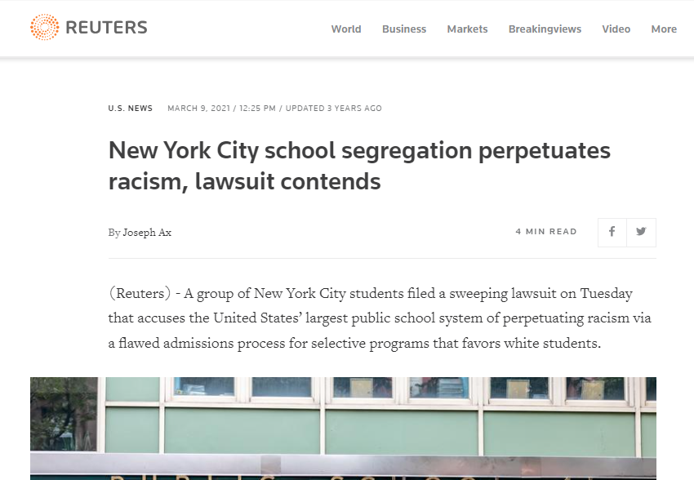
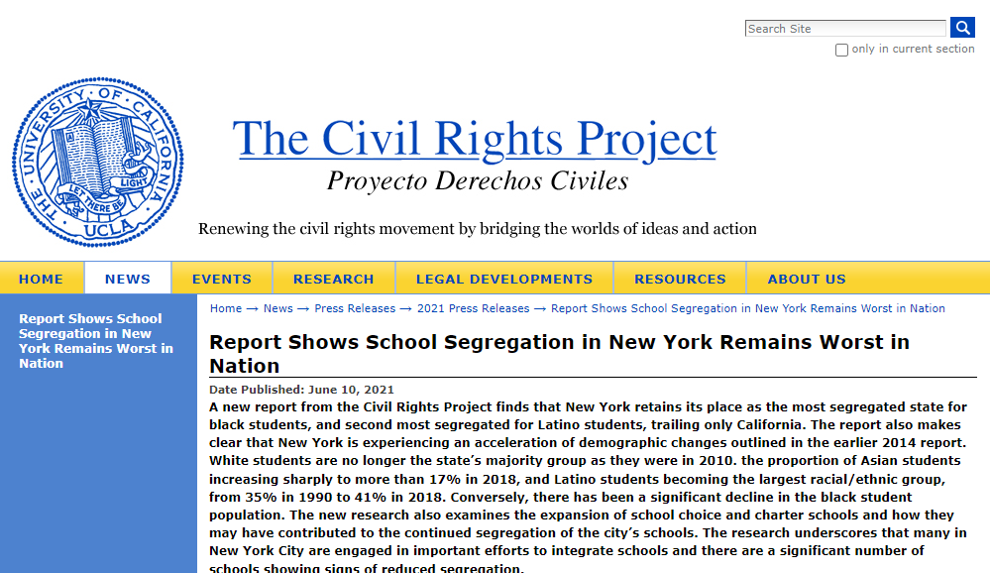
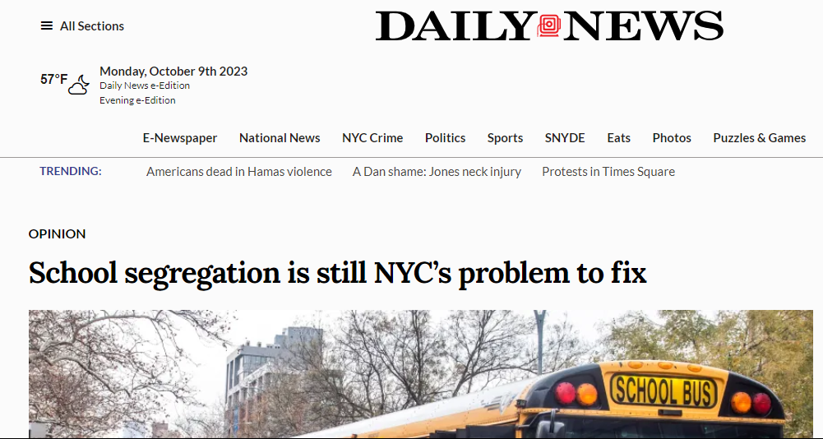
INTRODUCTION
"What is the composition in the NYC public schools?
Disclaimer: The USA Census Bureau thub.com/IBM/skillsnetwork/wiki/Watson-Studio-Setup uses the term “Black”, “Asian”, “White”, “Hispanic”. Also, the official data from the NYC uses the same term. It´s far from the author the intention to make any discriminatory statement using these words.

Slide 3
METHODOLOGY
EDA
Download CSV
Select features
Dimension
reduction
PCA
T-SNE
Clustering
K-Means
Spectral
Make correlation matrix
Convert date year
DBSCAN
DEEP LEARNING
Dimension reduction
PCA
T-SNE
Clustering
K-Means
Spectral
DBSCAN

Slide 4
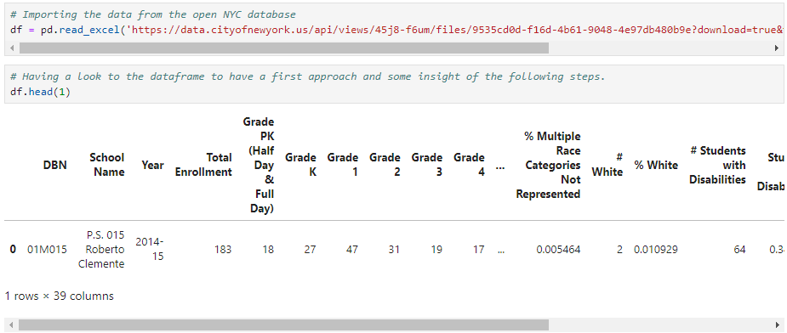
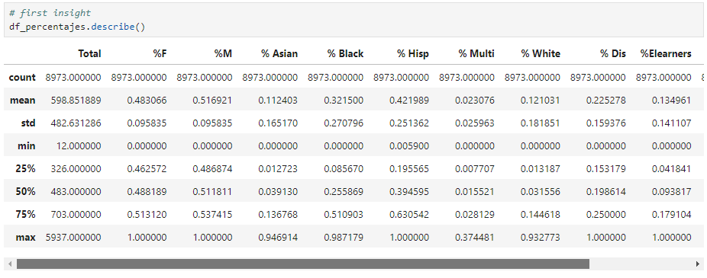
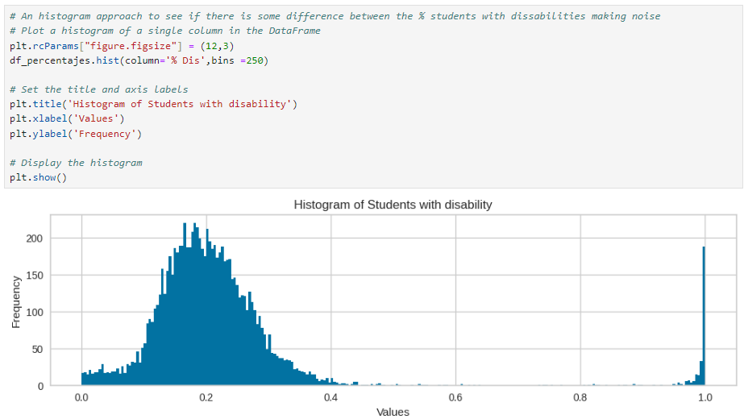
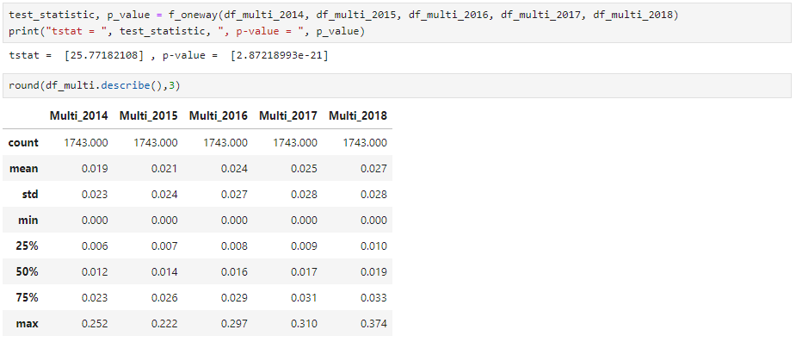
METHODOLOGY: Exploratory Data Analysis (1/2)

Slide 5
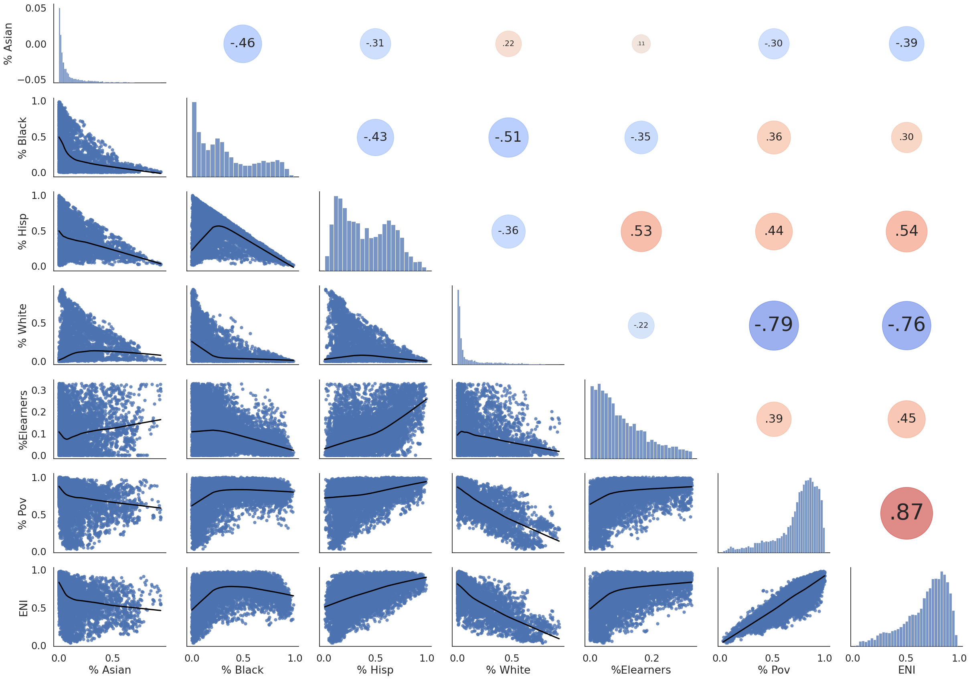
METHODOLOGY: Exploratory Data Analysis (2/2)

Slide 6
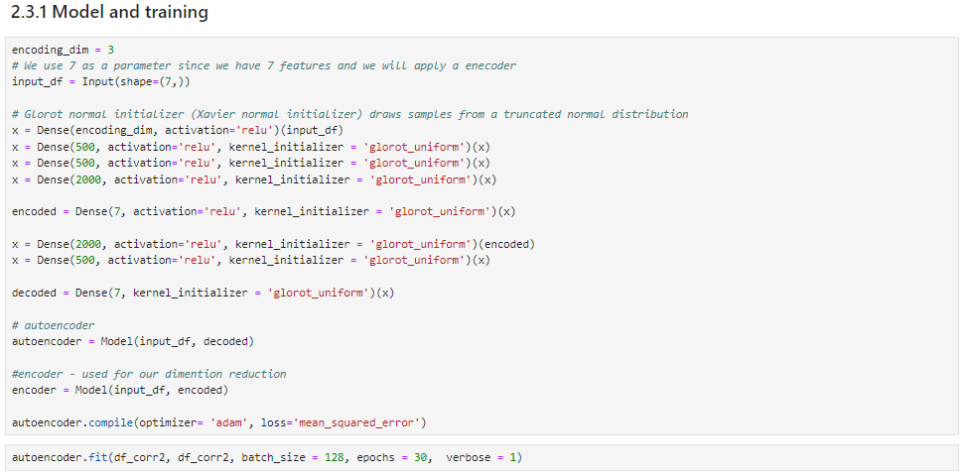
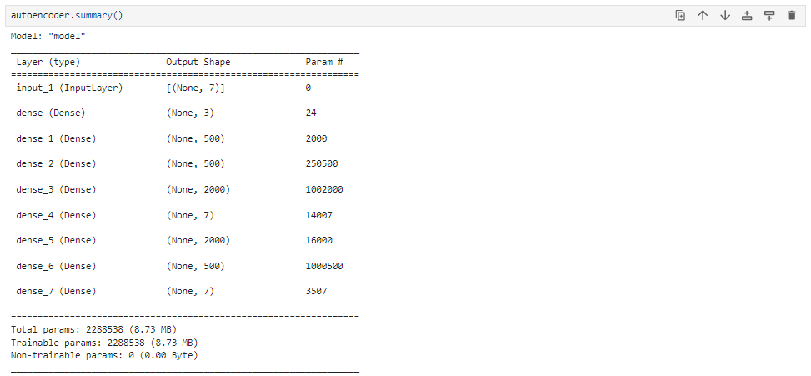
METHODOLOGY: Deep-Learning, Autoencoder

Slide 7
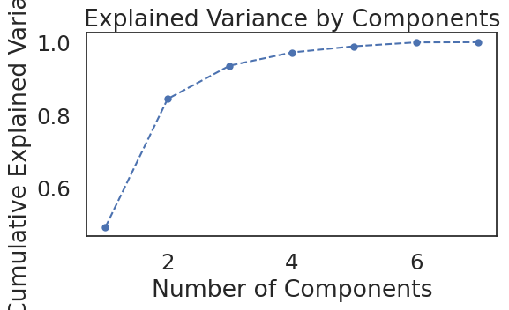
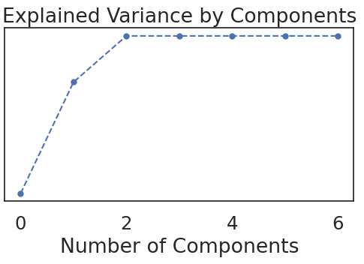
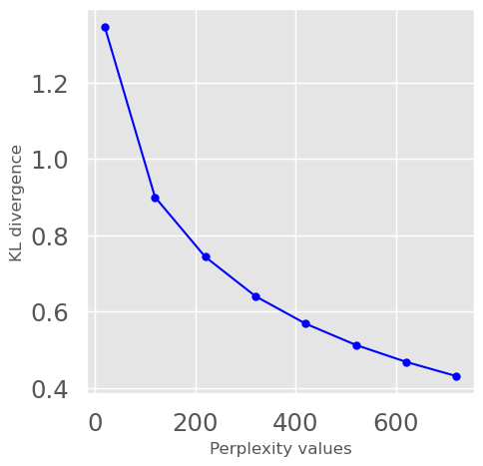
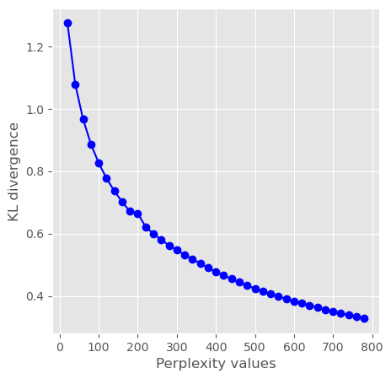
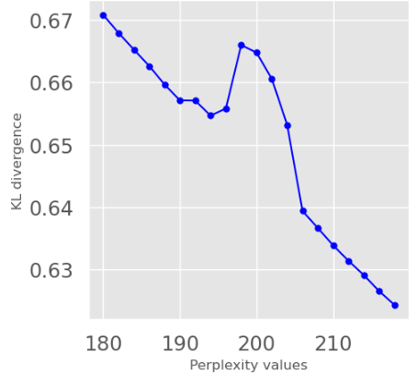
METHODOLOGY: Comparing the results (1/3)
Original data
After Autoencoder
Cumulative Explained Value

Slide 8
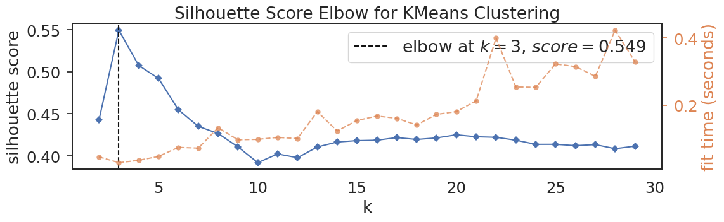
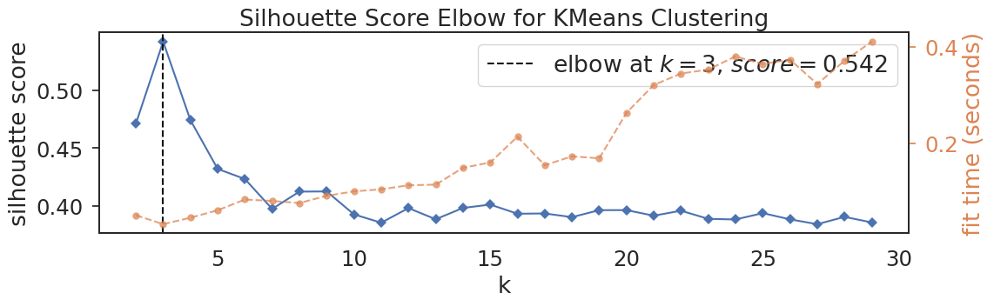
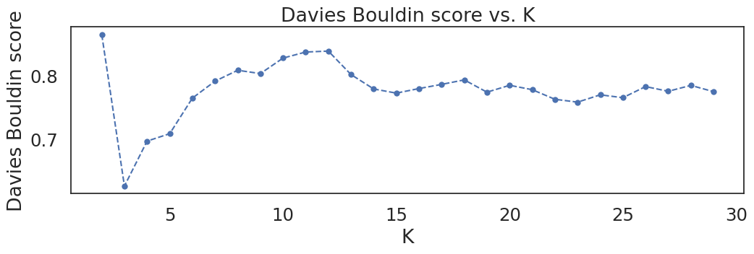
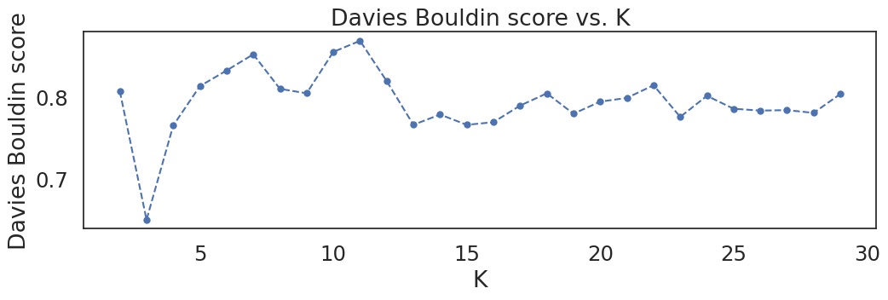
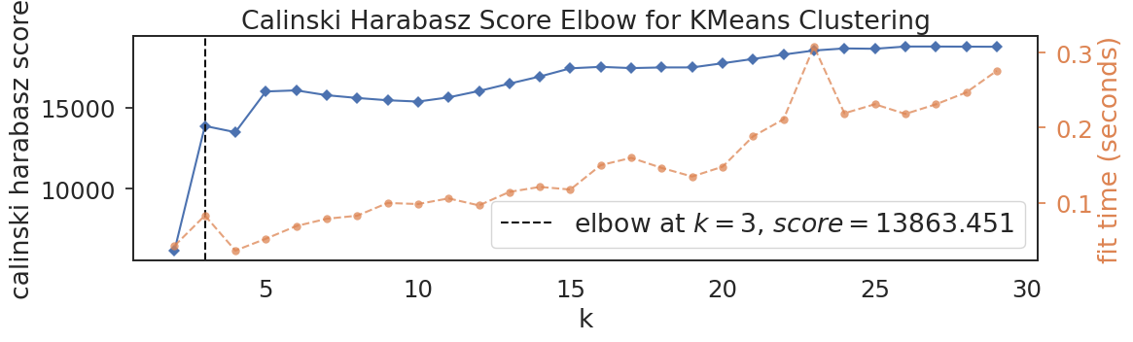
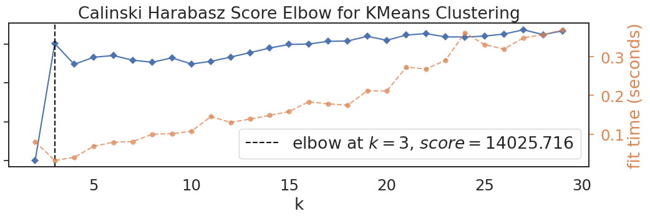
METHODOLOGY: Comparing the results (2/3)
Original data
After Autoencoder

Slide 9
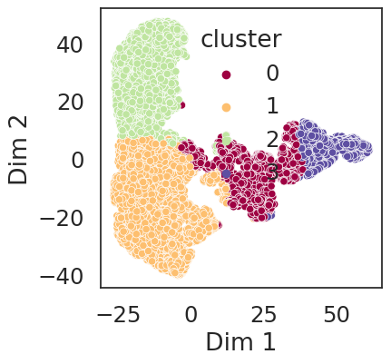
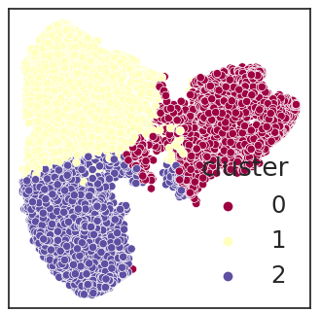
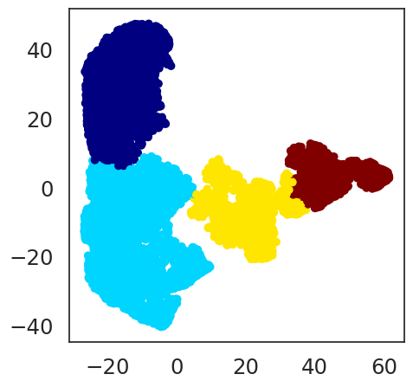
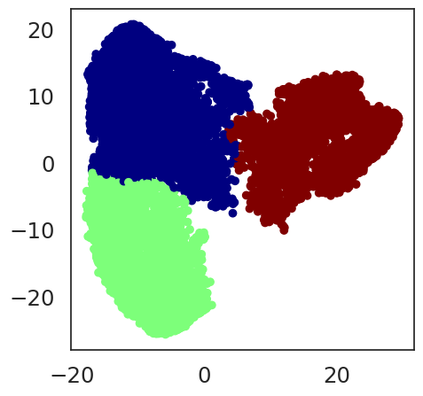
METHODOLOGY: Comparing the results (3/3)
Original data
After Autoencoder
K-Means
Spectral

Slide 10
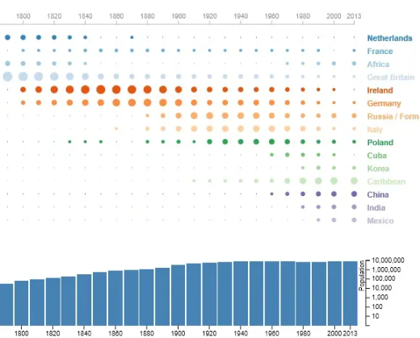
DISCUSION

Slide 11
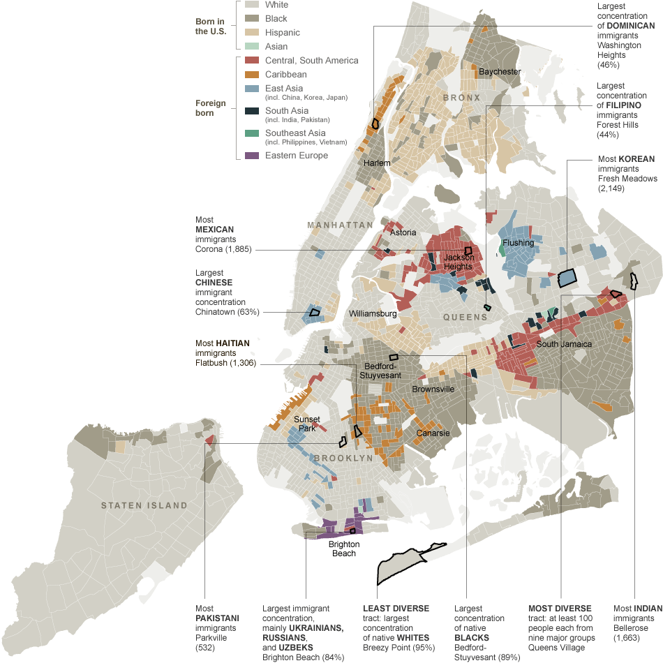
DISCUSION

Slide 12

CONCLUSION
English language learners
"What is the composition in the NYC public schools?
This clusters reflect the geographic distribution of the ethnics in NYC caused by the migration.
I strongly suggest a profile including cultural features to correlate better with the population neighborhoods.
Economical needs
Economical needs

