Slide 1
WEB

Slide 2
INDEX
What is WEB?
HTML, CSS, Javascript
Web Server

Slide 3
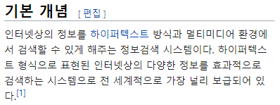
What is WEB?

Slide 4
HTML, CSS, Javascript
HyperText Markup Language

Slide 5
Web Server
Apache
Nginx
…

Slide 6

Before Github
~.html

Slide 7

After Github
Upload
~.html
~.html

Slide 8
EOF

