Slide 1


Inkscape l10n
Kukuh Syafaat
k@syafaat.id
Gimpscape Artweek 2020

Slide 2
l10n = Localization
"Localization refers to the adaptation of a product, application or document content to meet the language, cultural and other requirements of a specific target market (a locale)."
(source: w3.org)

Slide 3
Tools
Online
Offline
Weblate
Transifex
Pootle
Zanata
Poedit
Gtranslator
Lokalize
See also: "Translating Open Source Apps" - openSUSE Virtual Summit 2020
https://events.opensuse.org/conferences/oSvirtsmt/program/proposals/3080

Slide 4
Content

Slide 5
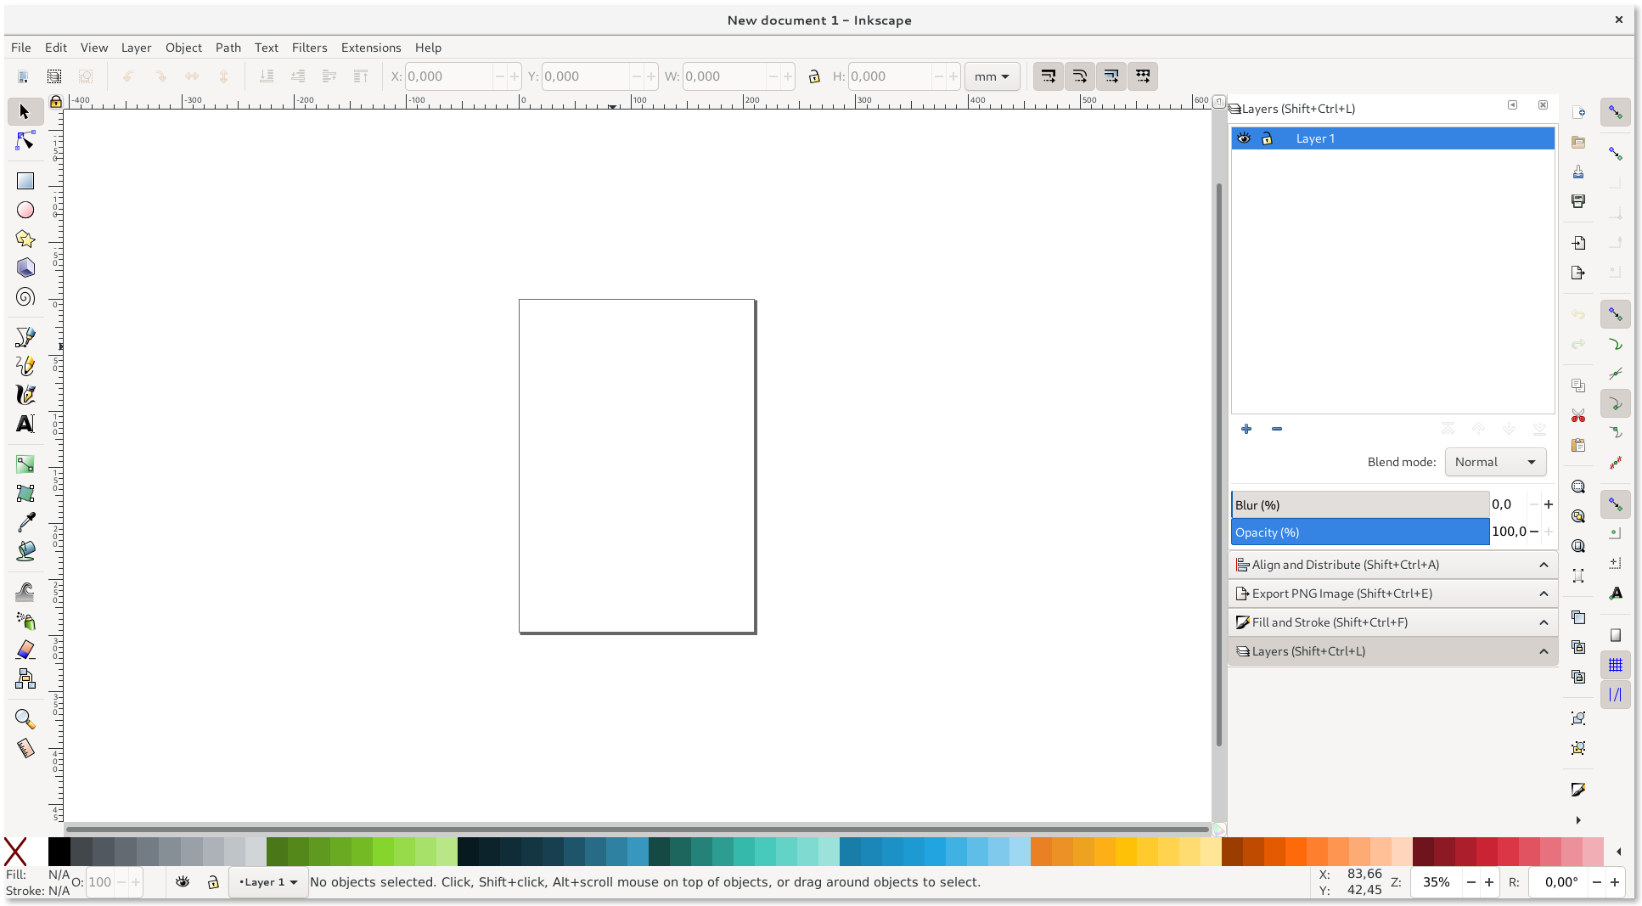
User Interface
Wiki: https://wiki.inkscape.org/wiki/index.php/Interface_translation#Interface_Translation
Source: https://gitlab.com/inkscape/inkscape/tree/master/po

Slide 6
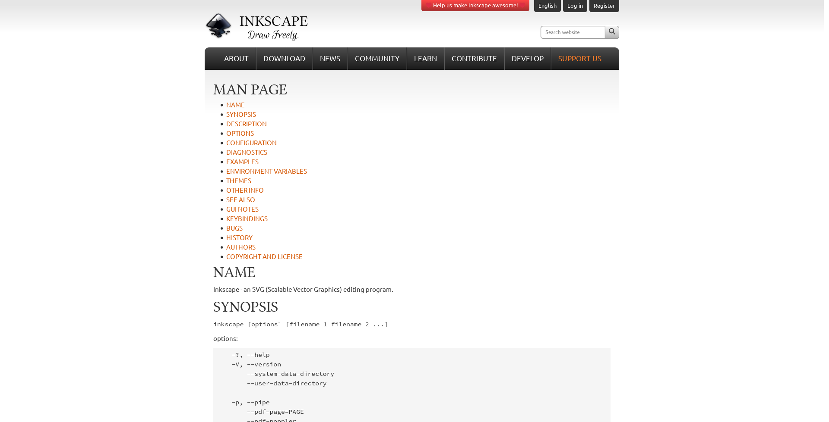
Man Pages
Wiki: -
Source: https://gitlab.com/inkscape/inkscape-docs/documentation/-/tree/master/man

Slide 7
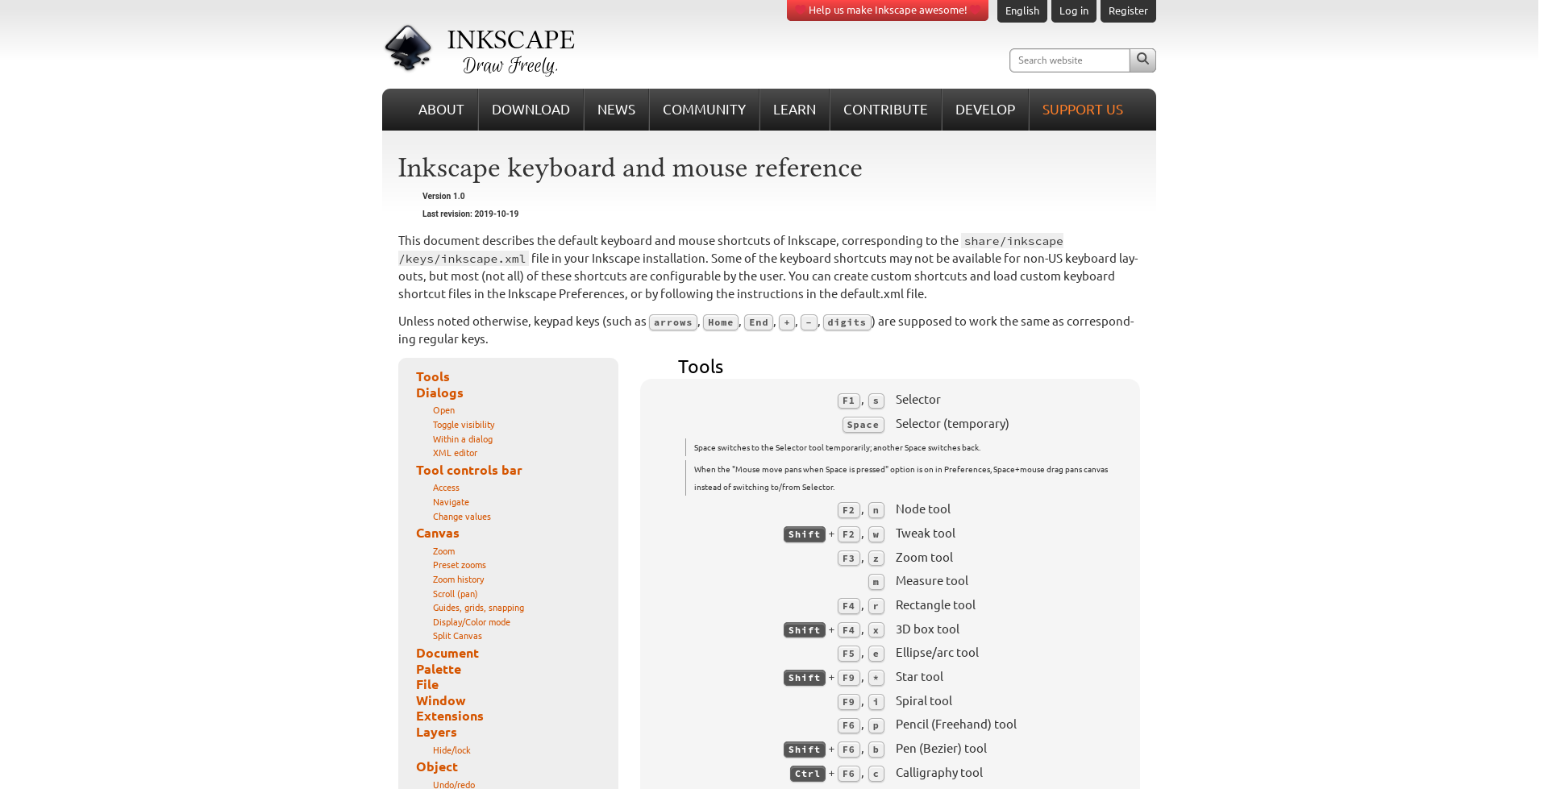
Keys and Mouse Preferences
Wiki: -
Source: https://gitlab.com/inkscape/inkscape-docs/documentation/-/tree/master/keys

Slide 8
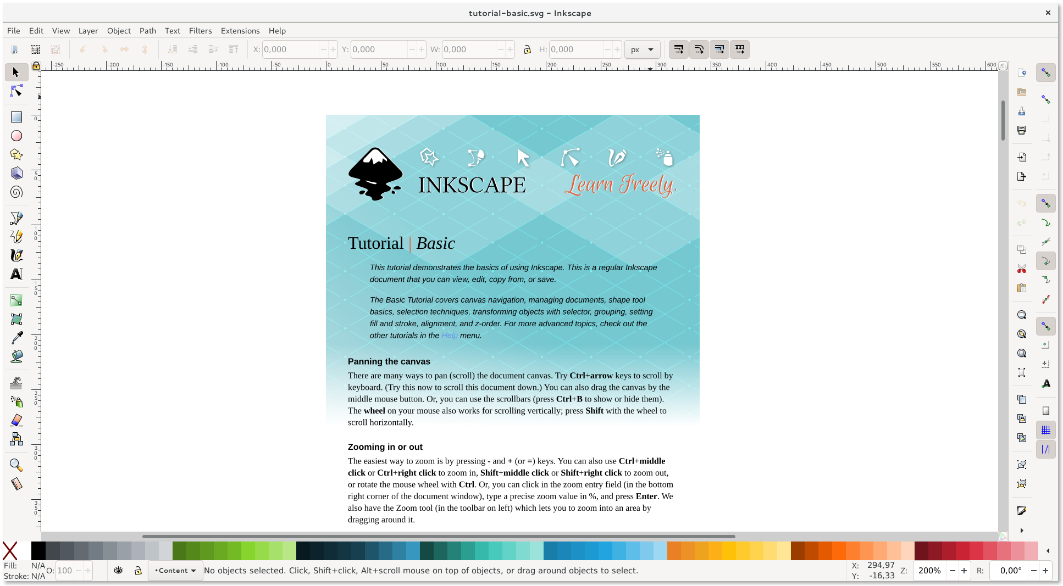
Tutorials
Advanced
Basic
Calligraphy
Elements of design
Interpolate
Shapes
Tips
Tracing
Tracing pixel art
Wiki: -
Source: https://gitlab.com/inkscape/inkscape-docs/documentation/-/tree/master/tutorials/

Slide 9
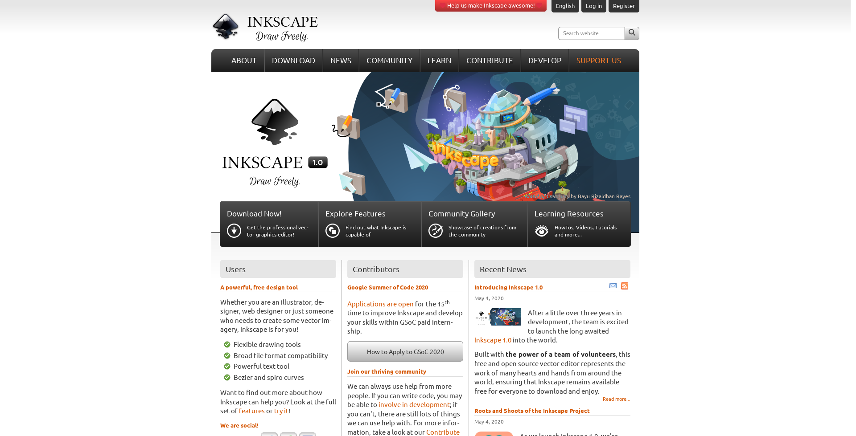
Website
Translating CMS contents
Translating News
Translating Download contents
Translating other parts of the website
Wiki: https://wiki.inkscape.org/wiki/index.php/WebSite
Source: Translating other parts of the website https://gitlab.com/inkscape/inkscape-web-i18n

Slide 10
Misc
Windows Installer
  Wiki: https://wiki.inkscape.org/wiki/index.php/Interface_translation#Windows_installer_translation
  Source: https://gitlab.com/inkscape/inkscape/tree/master/po
Templates
  Wiki: https://wiki.inkscape.org/wiki/index.php/Interface_translation#Default_template_translation
  Source: https://gitlab.com/inkscape/inkscape/tree/master/po
Release Notes

Slide 11
Status

Slide 12
Status
Master: https://inkscape.org/doc/devel/translations-statistics-master.html
1.0.x: https://inkscape.org/doc/devel/translations-statistics100.html

Slide 13
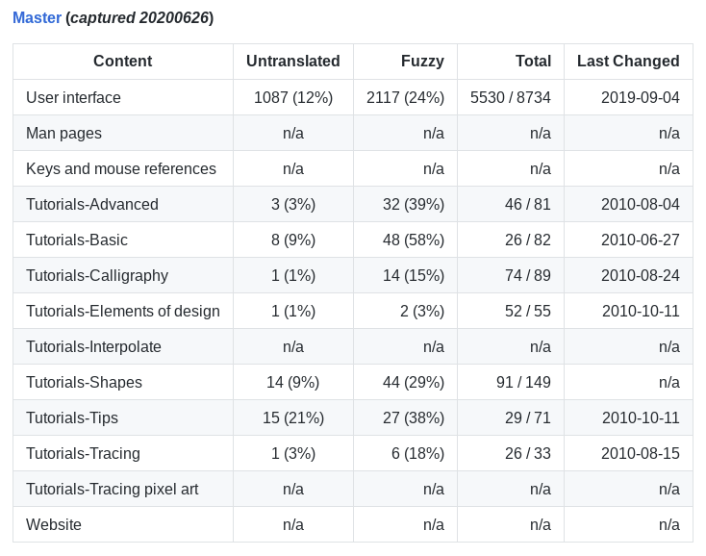
ID Status – Master

Slide 14
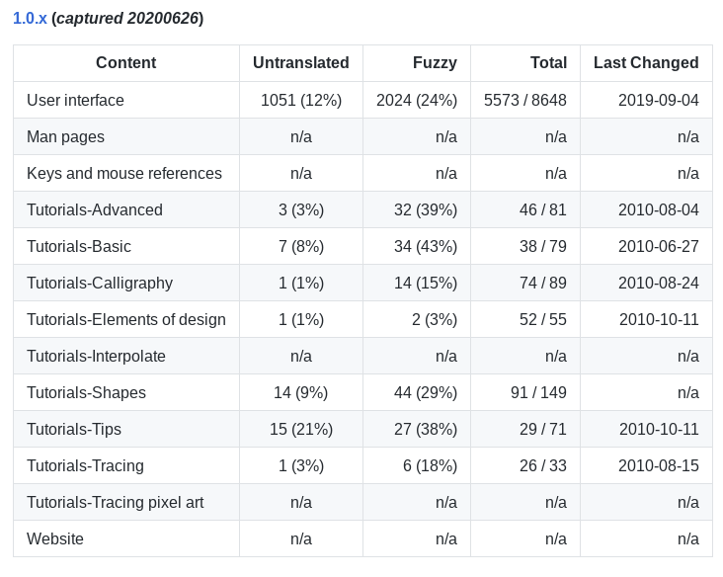
ID Status – 1.0.x

Slide 15
Perlukah Inkscape Ditranslasikan ke ID?

Slide 16
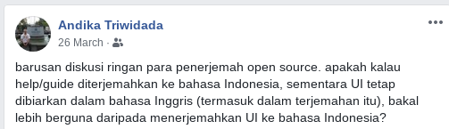

Slide 17
Survei Pengguna Inkscape
https://s.klas.or.id/mau-survei-dong

Slide 18
Contribute to Inkscape Translations
https://inkscape.org/contribute/translations/

