Slide 1



Contributing to FOSS with Inkscape
Kukuh Syafaat
(syafaatkukuh@gmail.com)
FOSS ASIA
Singapore, March 18th - 20th 2016

Slide 2

Hello ...
Kukuh Syafaat
  GNU/Linux Enthusiast
  UI/UX Designer @ KodeKreatif (KodeKreatif.co.id)
  Artwork Team @ BlankOn (BlankOn.id)
  FOSS Contributor

Slide 3
Contributing to FOSS with Inkscape
Contributing to GNU/Linux Distribution
Contributing to Community
Contributing to FOSS Contest
Contributing to FOSS Event

Slide 4

Contributing to GNU/Linux Distribution
Local Distribution: BlankOn (2004-now)
Long-time user since 2007 (BlankOn 1.0 then 2.0)
Artwork team since 2011 (BlankOn 7.0)
Doing: icons, wallpapers, splash, marketing materials

Slide 5

Komodo Icon Theme (2014)
Forking from Faenza
+3000 icons

Slide 6
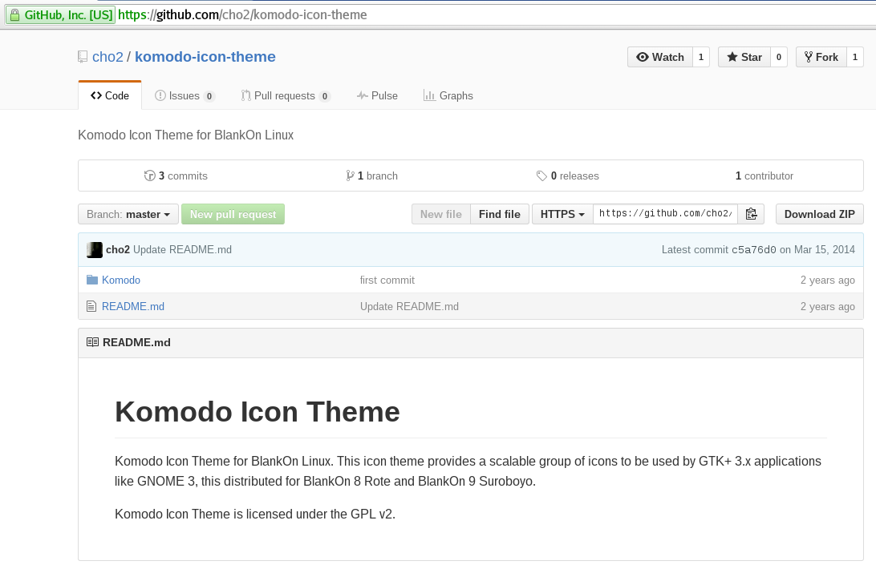

Slide 7


Tebu Icon Theme (2015)
Forking from Faenza
+19000 icons (.svg & .png)
Will be available on BlankOn X (proposed 2016)
Collaborating with
  @herpiko
  @winardiaris

Slide 8
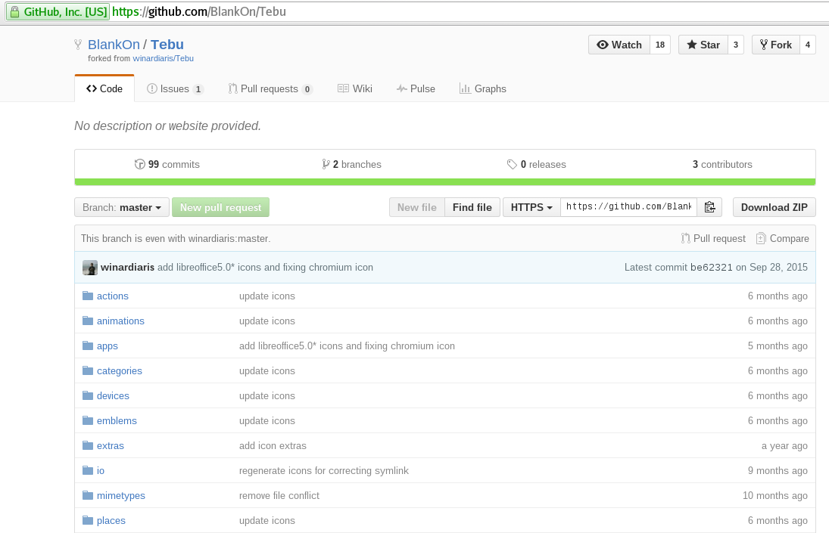

Slide 9

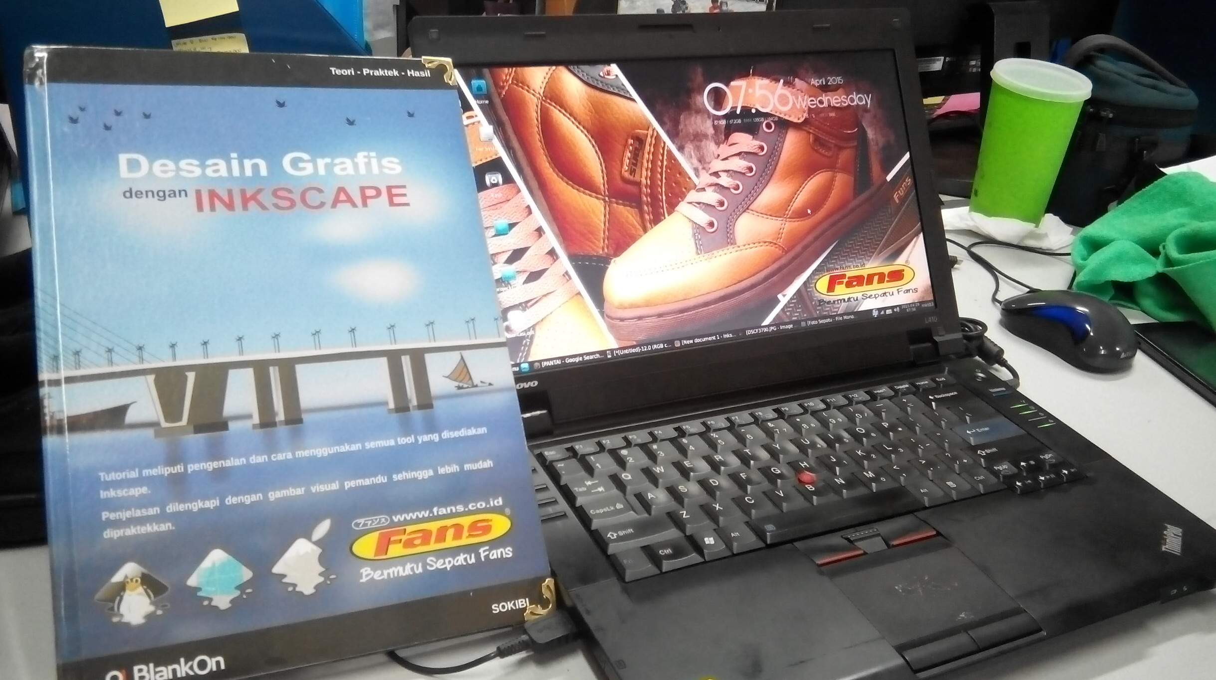
Contributing to Community
Sokibi ( /sokhibi.imgos) writing a book “Graphic Design with Inkscape” (EN)/ “Desain Grafis dengan Inkscape” (ID)

Slide 10
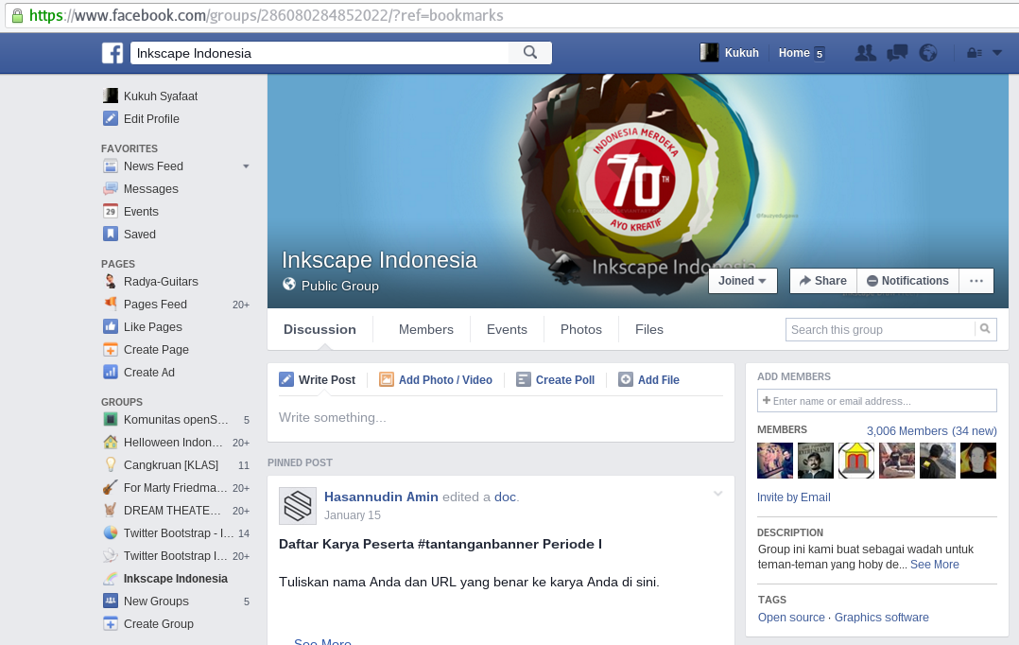
Inkscape Indonesia Facebook Groups

Slide 11
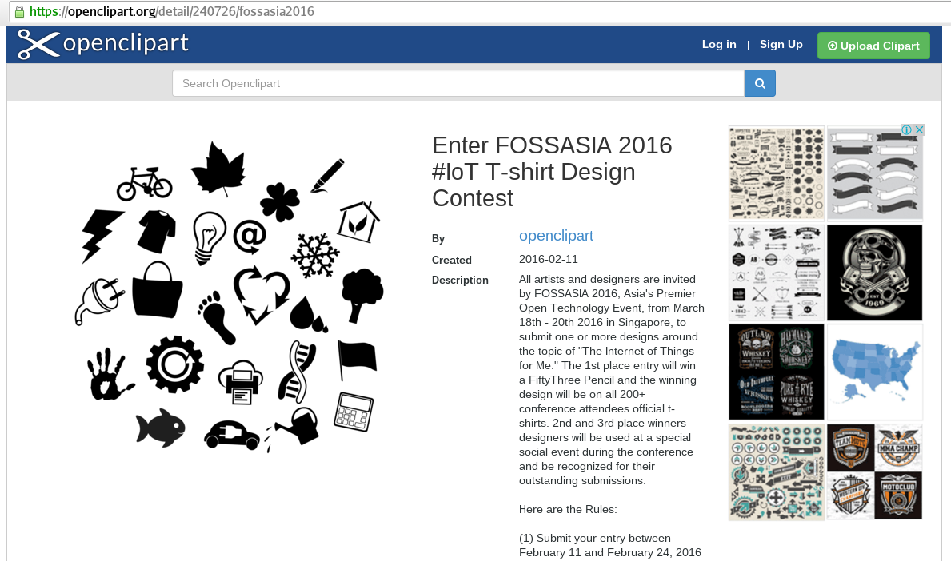
Contributing to FOSS Contest

Slide 12
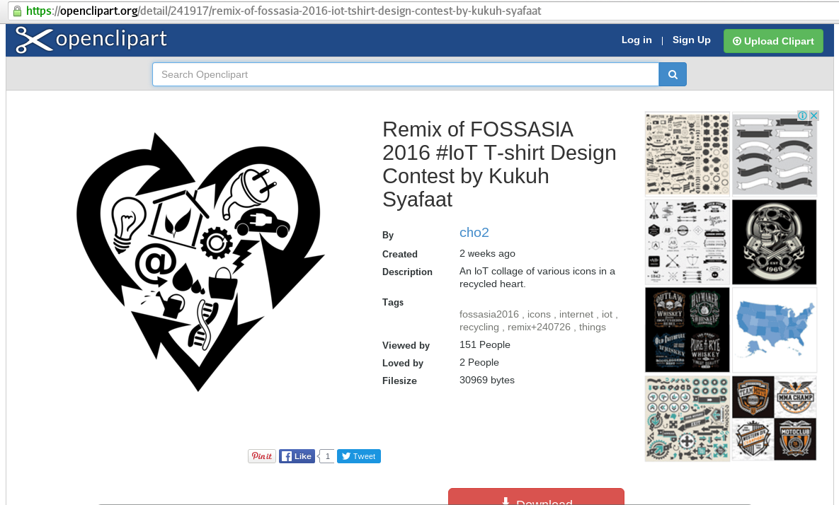
Contributing to FOSS Contest

Slide 13
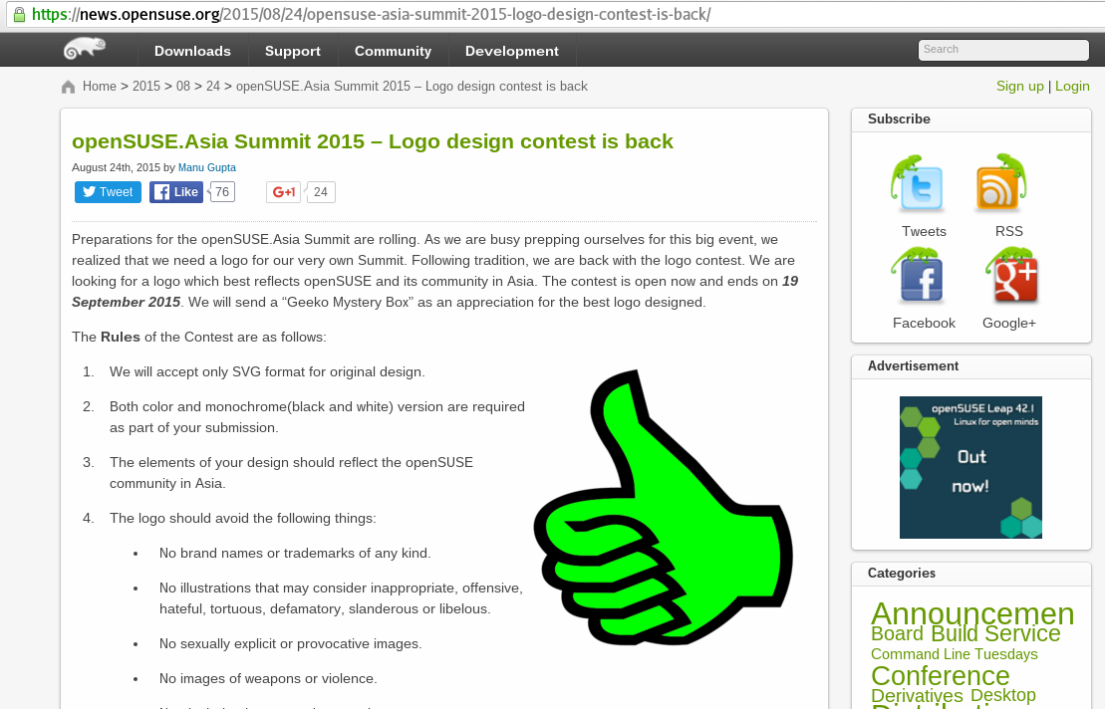
Contributing to FOSS Contest

Slide 14
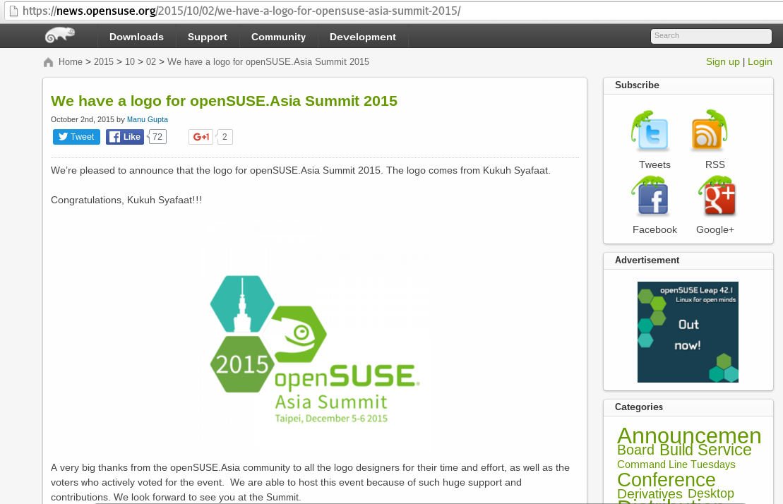
Contributing to FOSS Contest

Slide 15
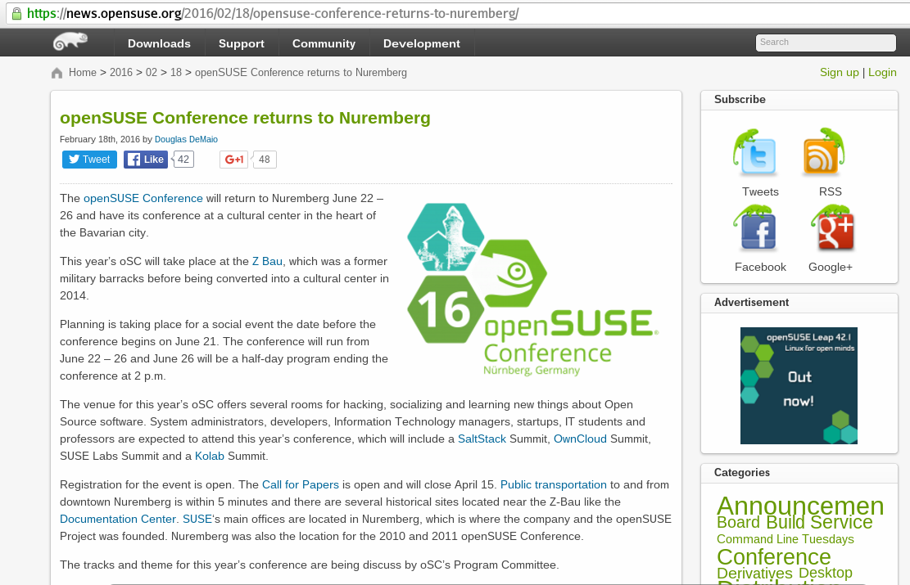
Contributing to FOSS Contest

Slide 16
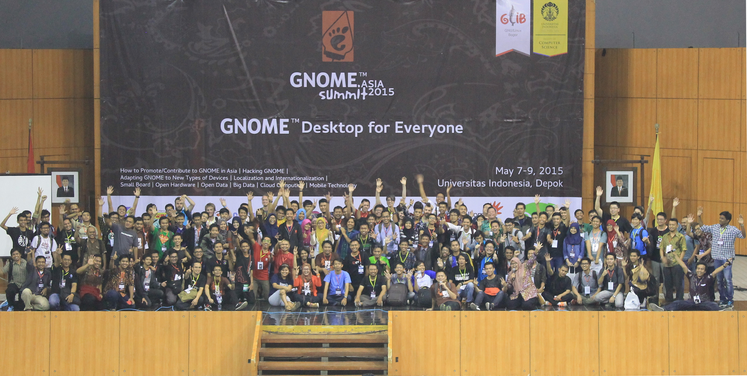
Contributing to FOSS Event

Slide 17

Contributing to FOSS Event (as sponsor)

Slide 18
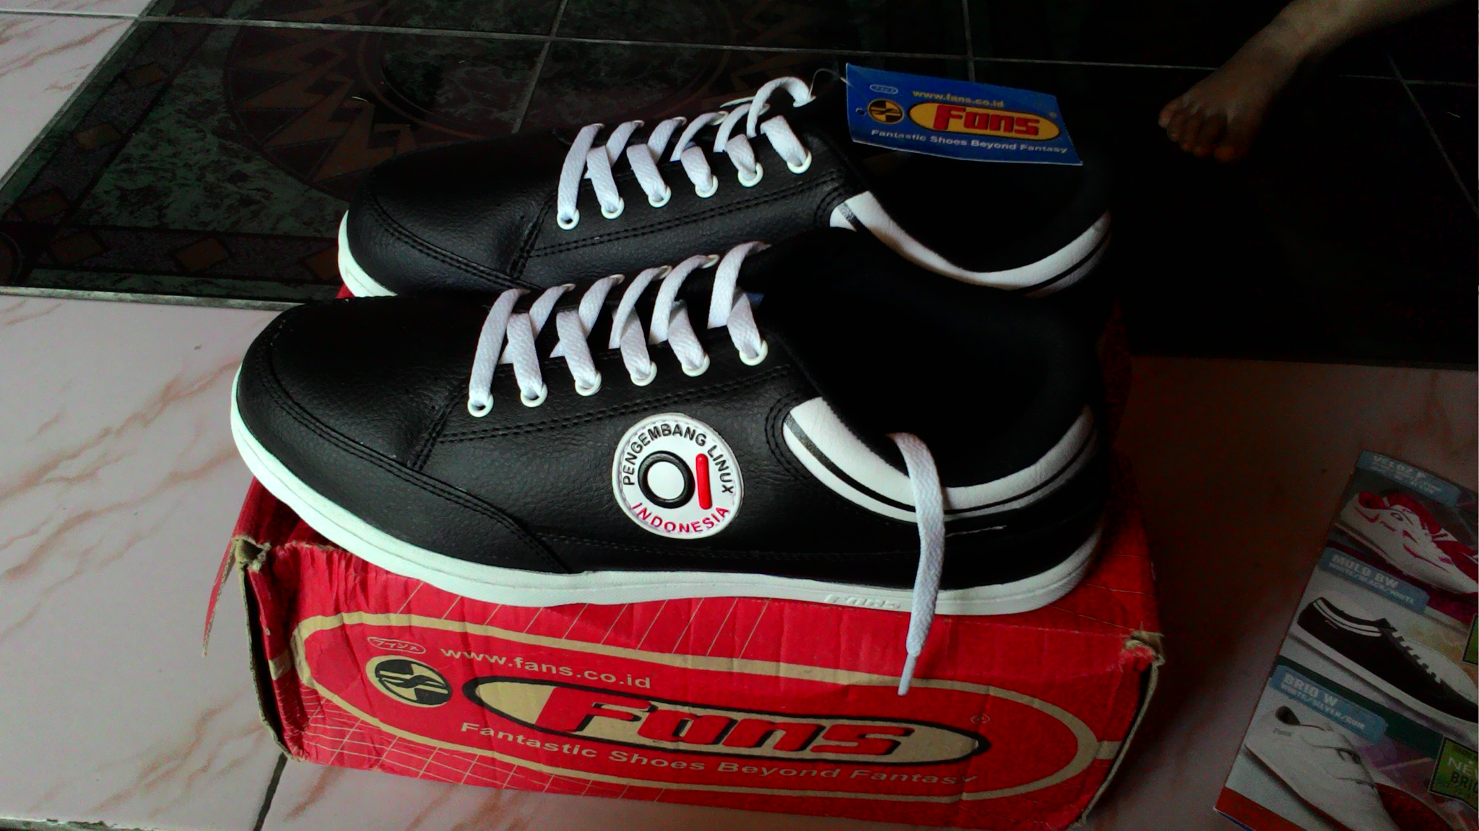
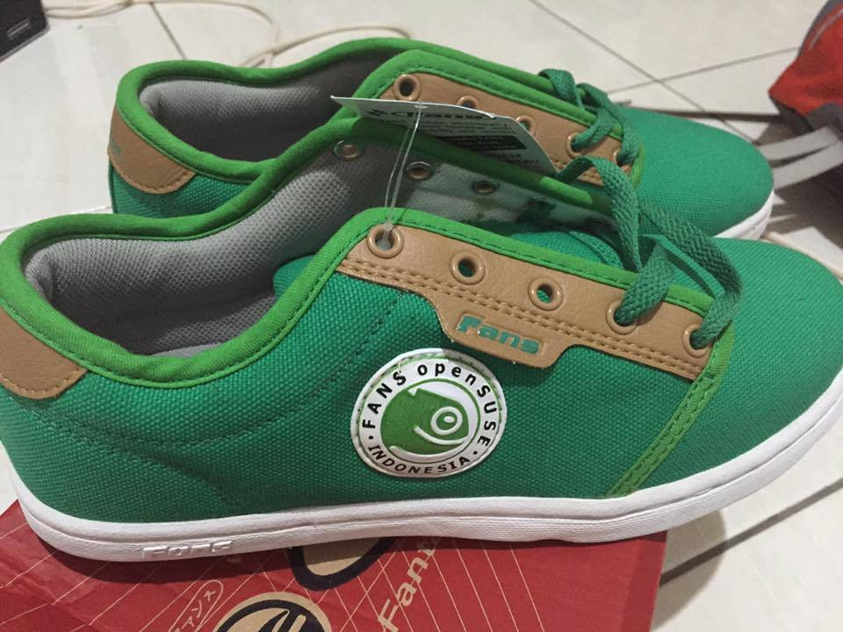
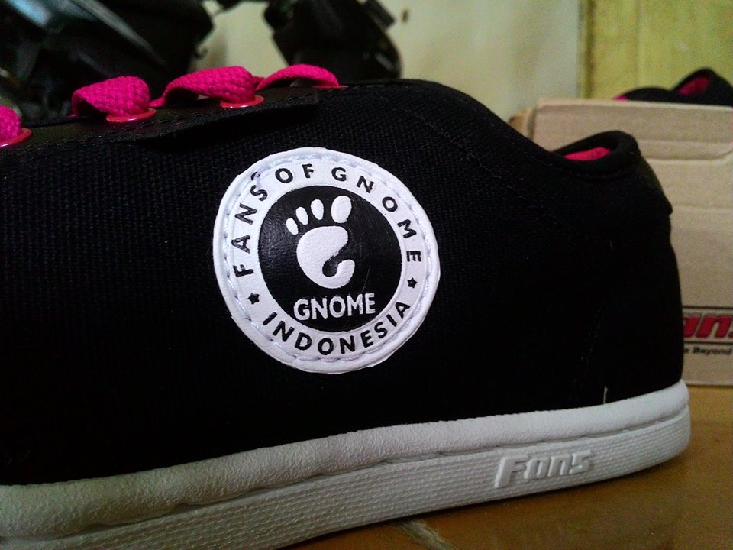
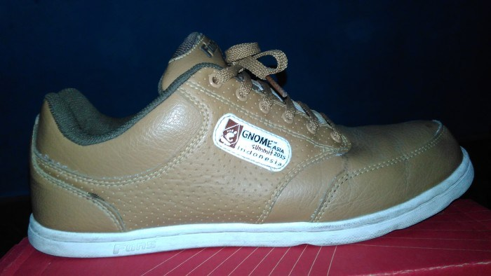

Slide 19
THANK YOU

