Slide 1

GUI Prototyping / Wireframing with Pencil on openSUSE Leap
Kukuh Syafaat
cho2@opensuse.id

Slide 2
Hello ...
Kukuh Syafaat
FOSS enthusiast

Slide 3
Design
Prototype
Draw
Sketch
Wireframe
Mockup

Slide 4
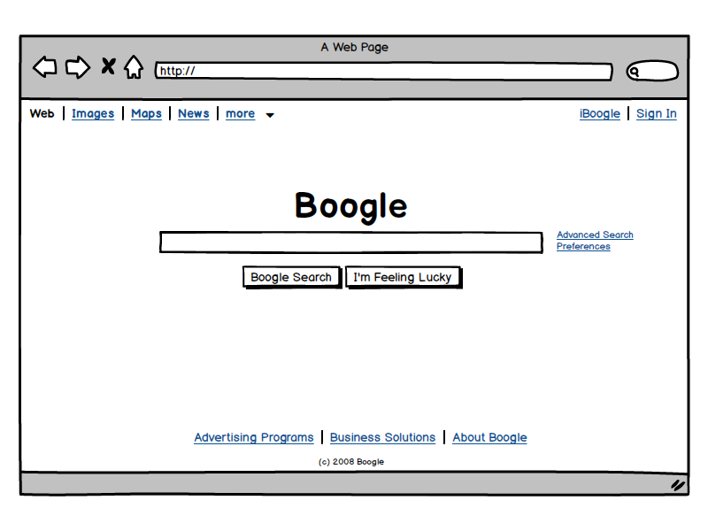

Slide 5
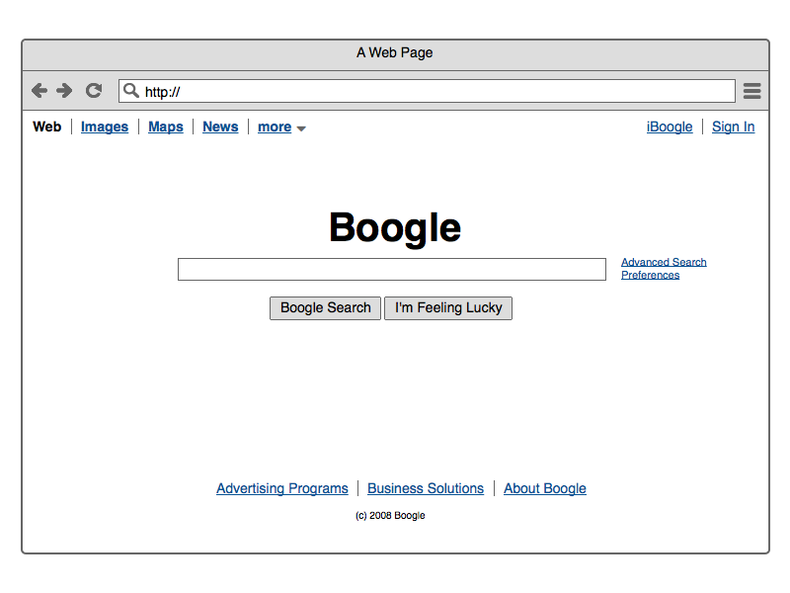

Slide 6
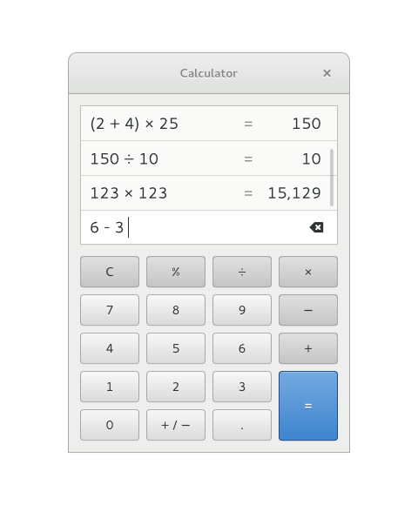

Slide 7
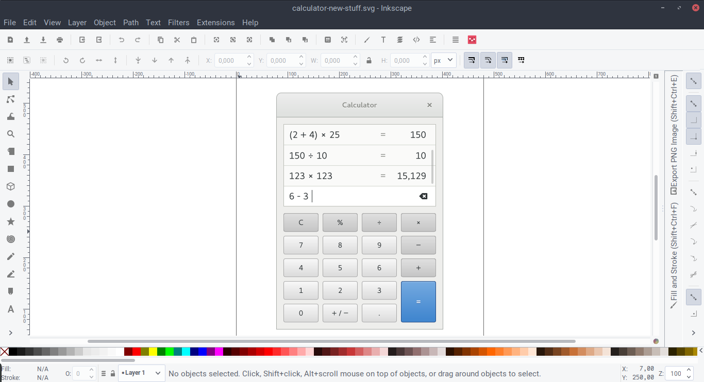

Slide 8
GNOME mockups
https://github.com/gnome-design-team/gnome-mockups/blob/master/calculator/src/calculator-new-stuff.svg

Slide 9
Pencil

Slide 10
Pencil
http://pencil.evolus.vn/
https://github.com/evolus/pencil
https://software.opensuse.org/package/pencil
Stable : 2.0.5
Unstable : 2.0.18
Next release : 3.0.0 (RC1)

Slide 11
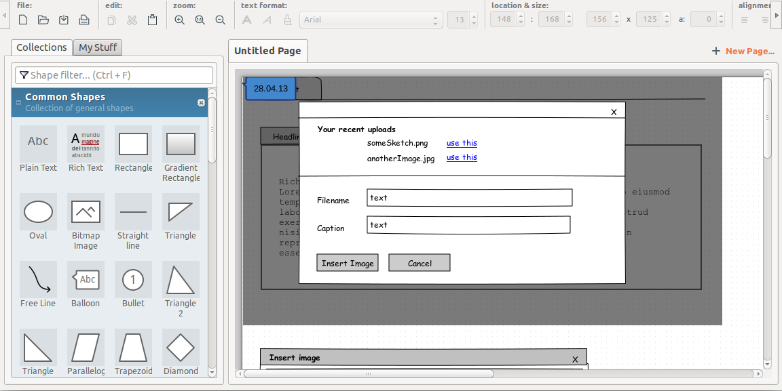

Slide 12
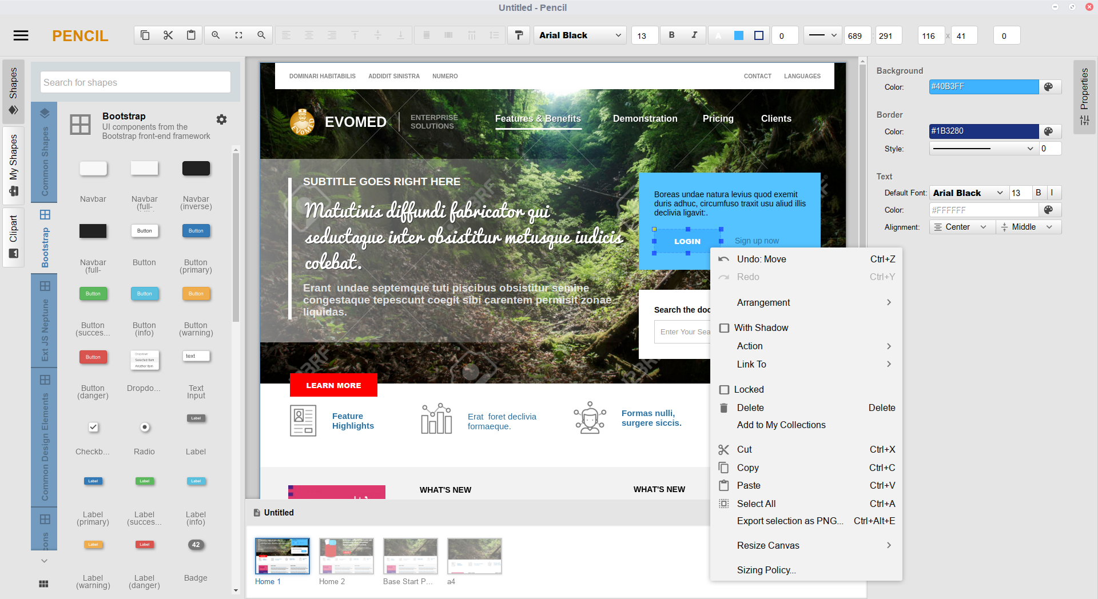

Slide 13



Slide 14
Pencil v3
Pencil V3 uses Electron instead of Mozilla XULRunner as the runtime.
A new, zip-based file format (.epz).
New UI approach.
… and so on

Slide 15
Setting up (using NodeJS)
$ git clone https://github.com/evolus/pencil.git
$ npm install
$ npm start

Slide 16
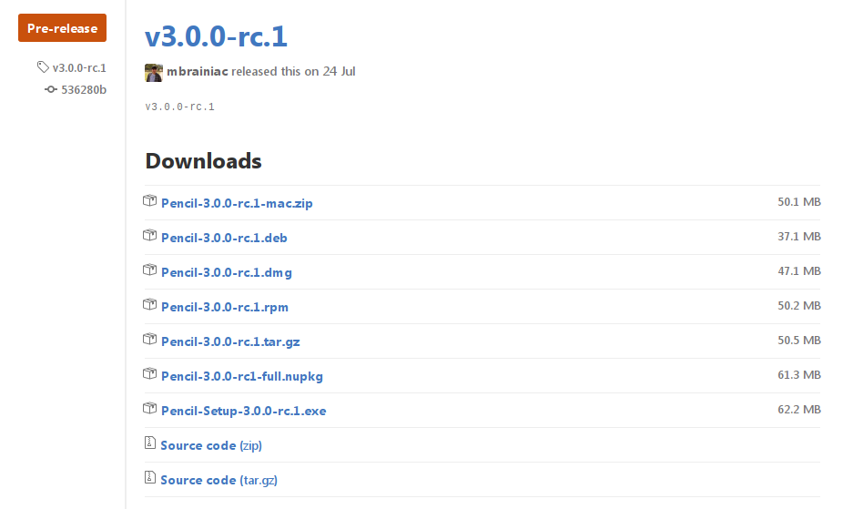
https://github.com/evolus/pencil/releases

Slide 17
Demo

Slide 18
Questions?

Slide 19
Join the conversation,
contribute & have a lot of fun!
www.opensuse.org

Slide 21
License
This slide deck is licensed under the Creative Commons Attribution-ShareAlike 4.0 International license. It can be shared and adapted for any purpose (even commercially) as long as Attribution is given and any derivative work is distributed under the same license.
Details can be found at https://creativecommons.org/licenses/by-sa/4.0/
Credits
Template
Richard Brown
rbrown@opensuse.org
Design & Inspiration
openSUSE Design Team
http://opensuse.github.io/branding-guidelines/

