Slide 1
GNOMETM
Desktop for Everyone
Kukuh Syaafat cho2@di.blankon.in
Parade Software Merdeka, 30 Agustus 2015

Slide 2
Kenalan dulu ...
Kukuh Syafaat
  Pengembang dan pengguna BlankOn (blankon.id)
  GNU/Linux enthusiast

Slide 3
Apa itu GNOMETM?
Lingkungan destop yang berjalan diatas sistem operasi GNU/Linux (GNOME Shell)
Dikembangkan oleh GNOME Projects
Ditulis dalam bahasa C, C++, Vala, Python dan JavaScript
Rilis stabil terakhir versi 13.6.3

Slide 4
Kenapa GNOMETM?
Digunakan oleh distribusi GNU/Linux yang populer seperti Debian, Fedora, OpenSUSE dan Arch Linux.
Sebagian besar distribusi GNU/Linux juga menggunakan GNOMETM sebagai desktop-nya http://distrowatch.com/search.php?desktop=GNOME
Lisensi GPL, LGPL
Lokalisasi lebih dari 40 bahasa
Dukungan komunitas yang luas

Slide 5
Rilis GNOMETM
2.2: 2003-02-06
...
2.24:2008-09-24
2.26:2009-03-18
2.28:2009-09-23
2.30:2010-03-31
2.32:2010-09-29
3.0: 2011-04-06
3.2: 2011-09-28
3.4: 2012-03-28
3.6: 2012-09-26
3.8: 2013-03-27
3.10:2013-09-25
3.12:2014-03-26
3.14:2014-09-24
3.16:2015-03-25

Slide 6
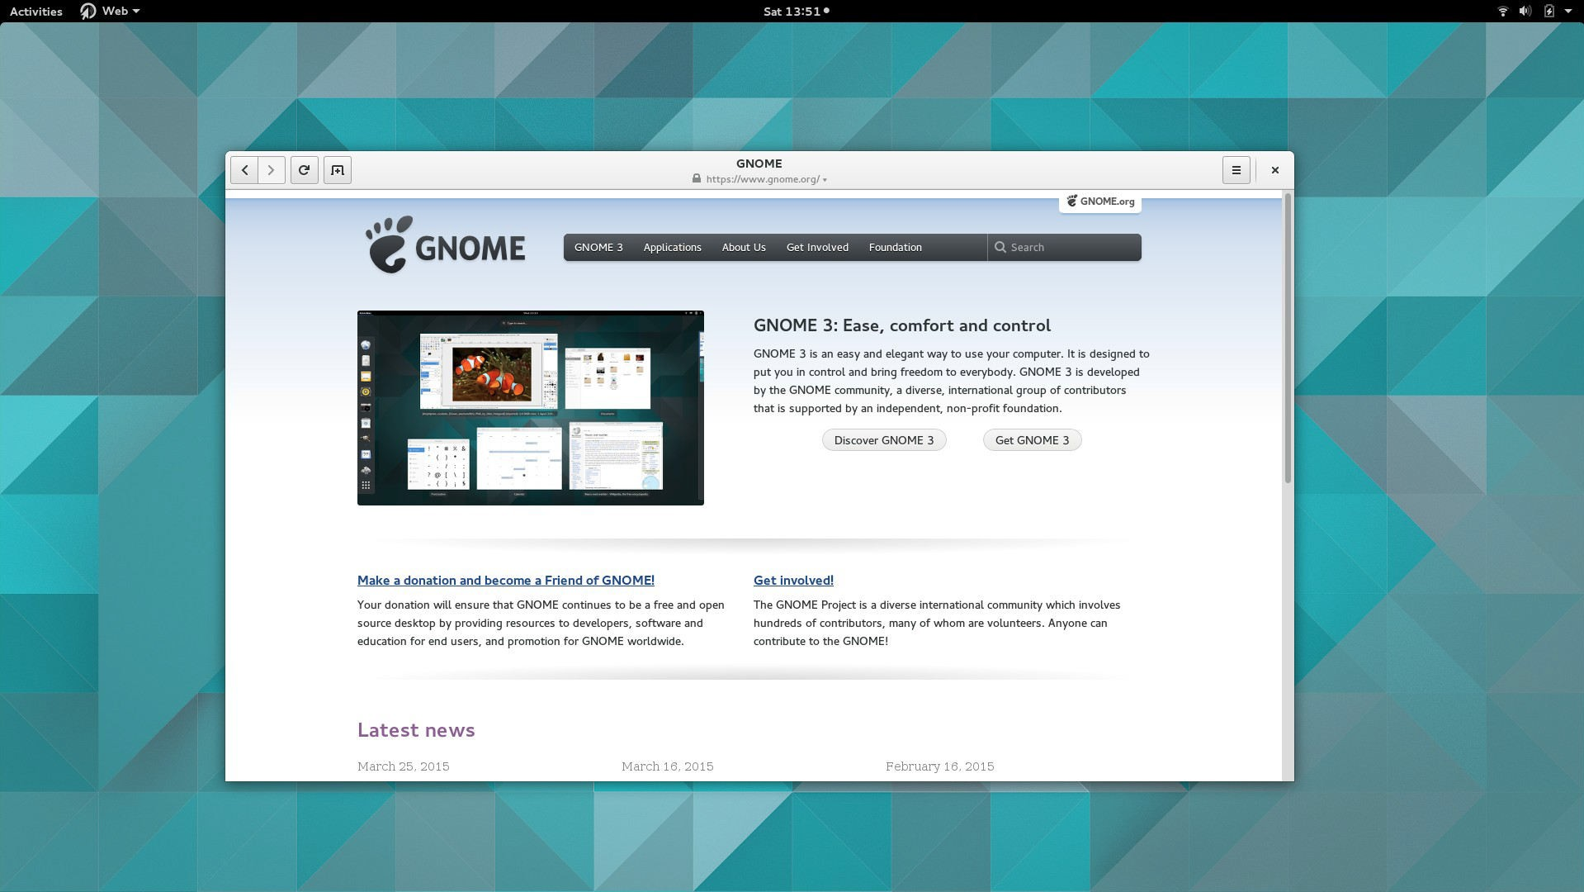

Slide 7
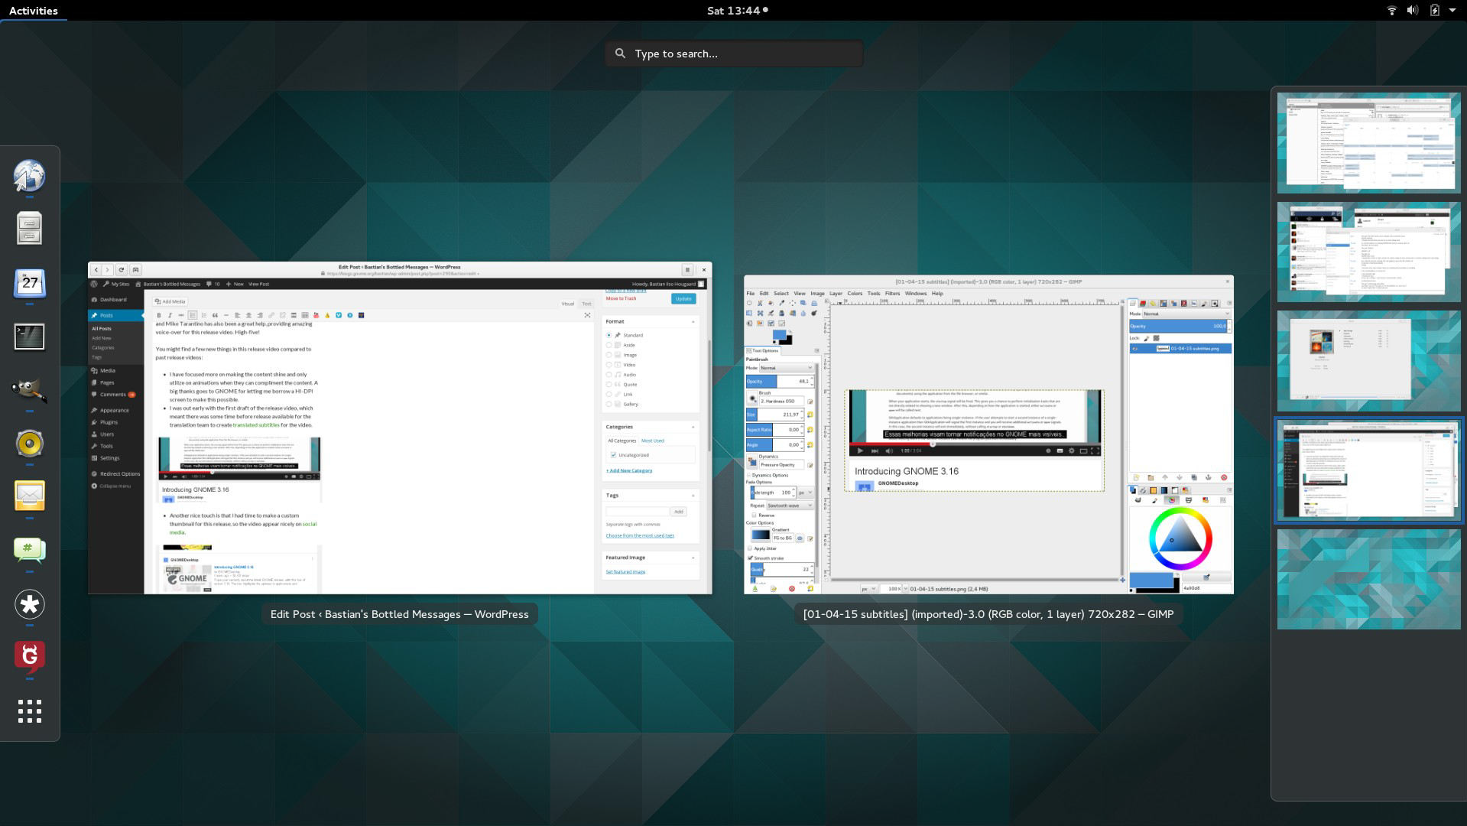

Slide 8
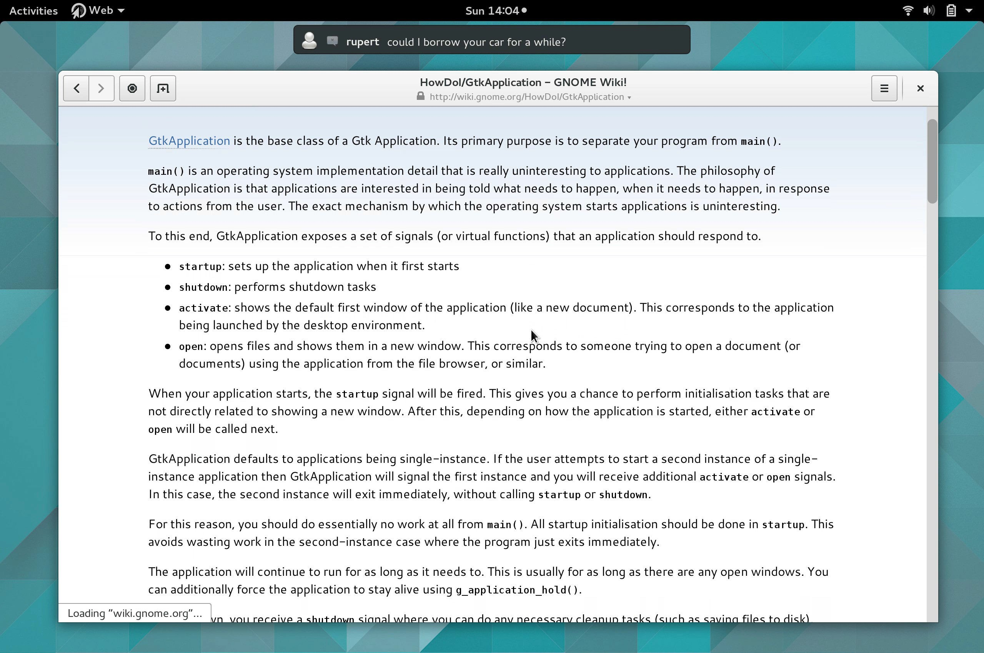

Slide 9
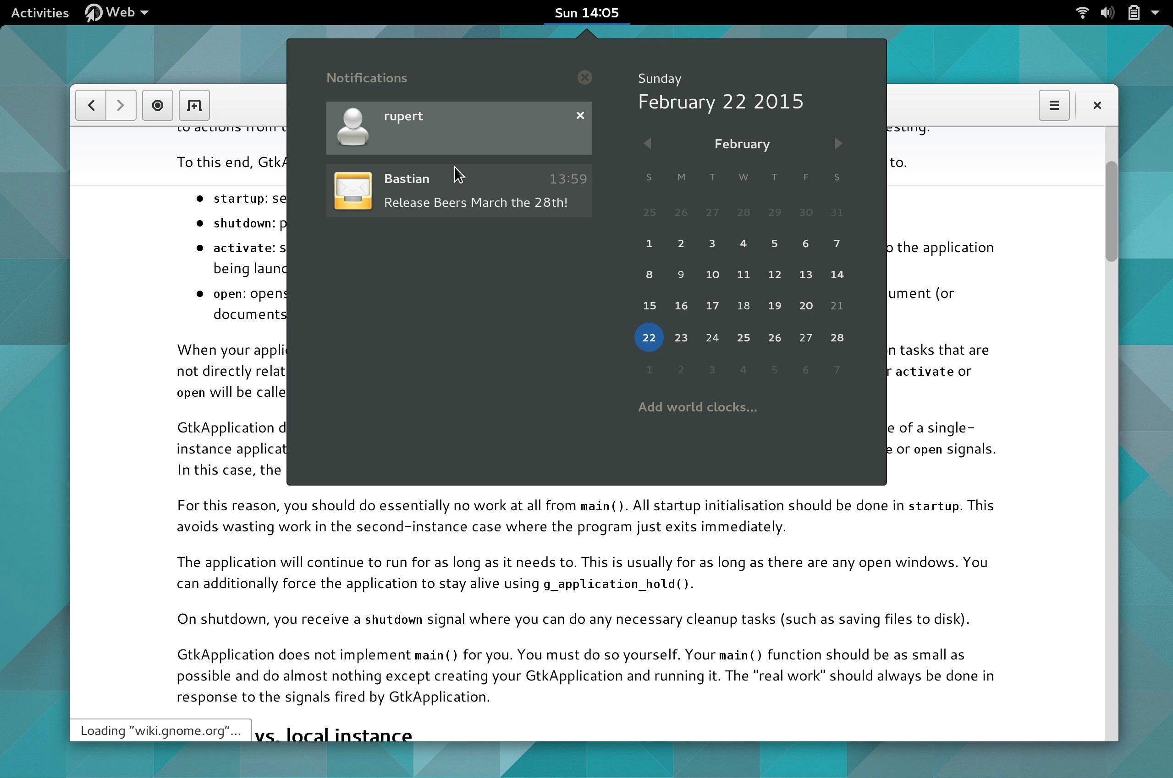

Slide 10
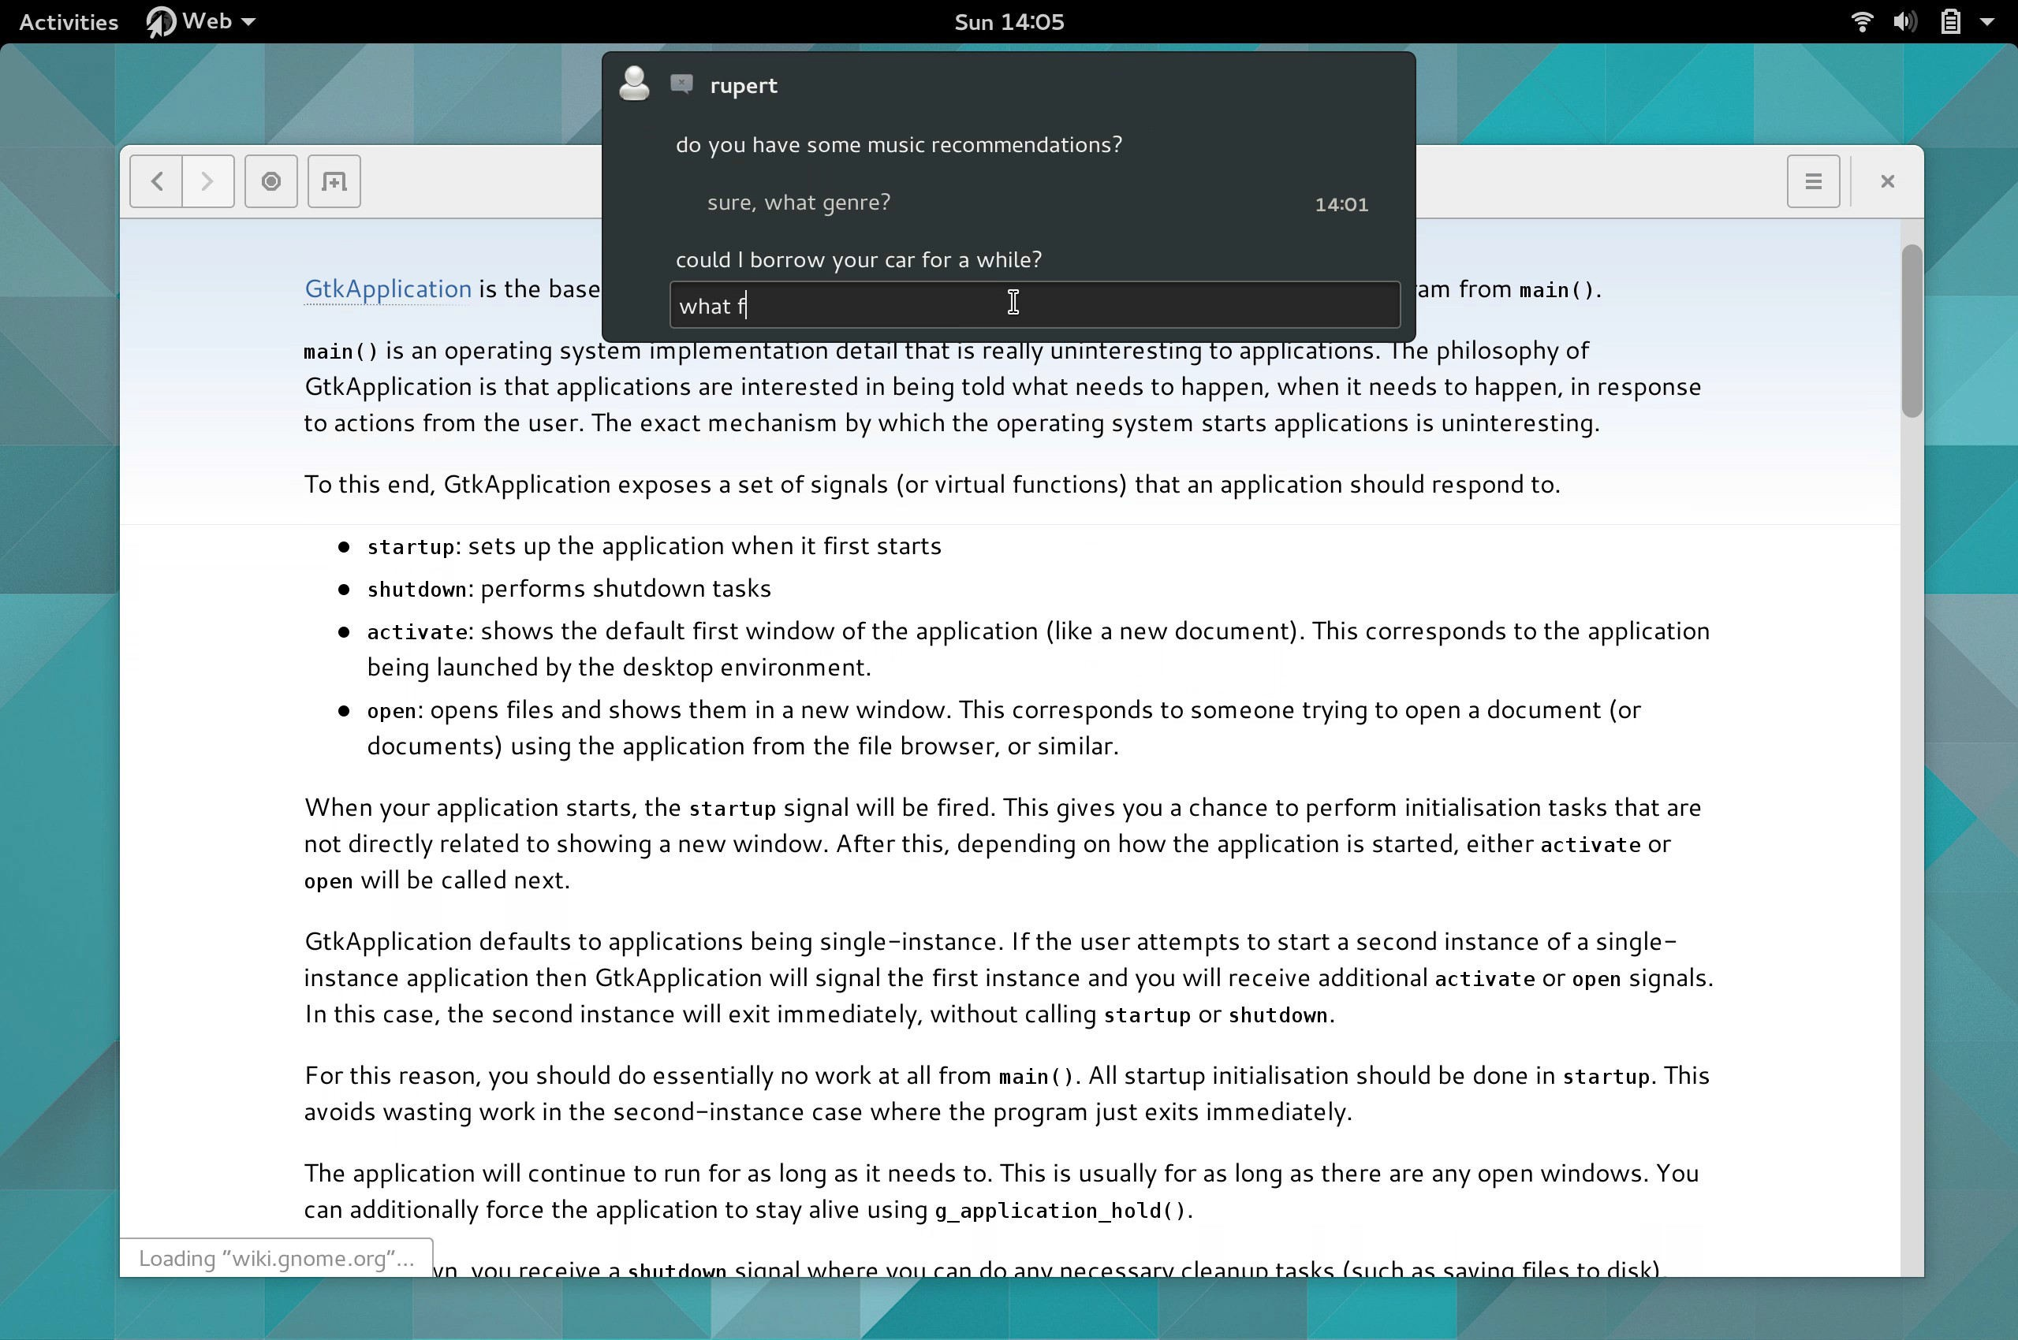

Slide 11
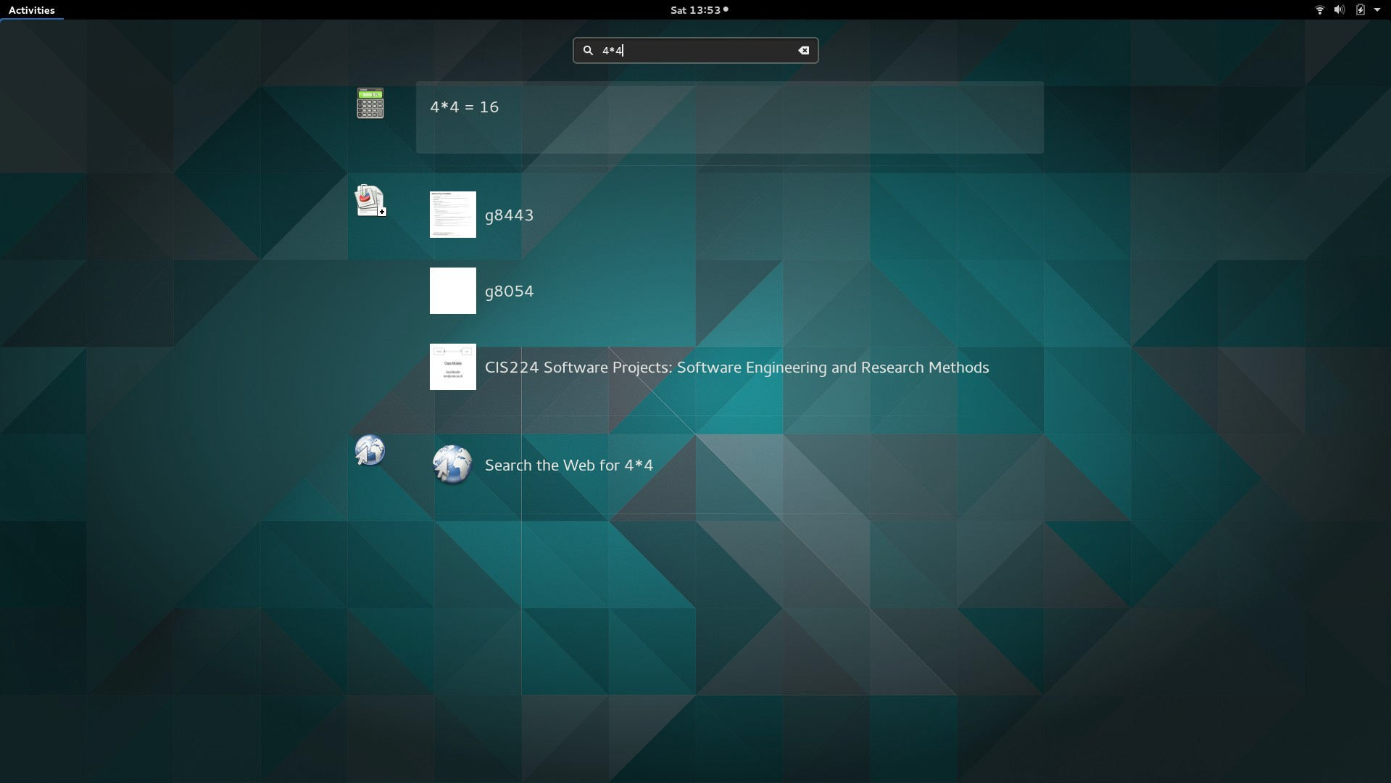

Slide 12
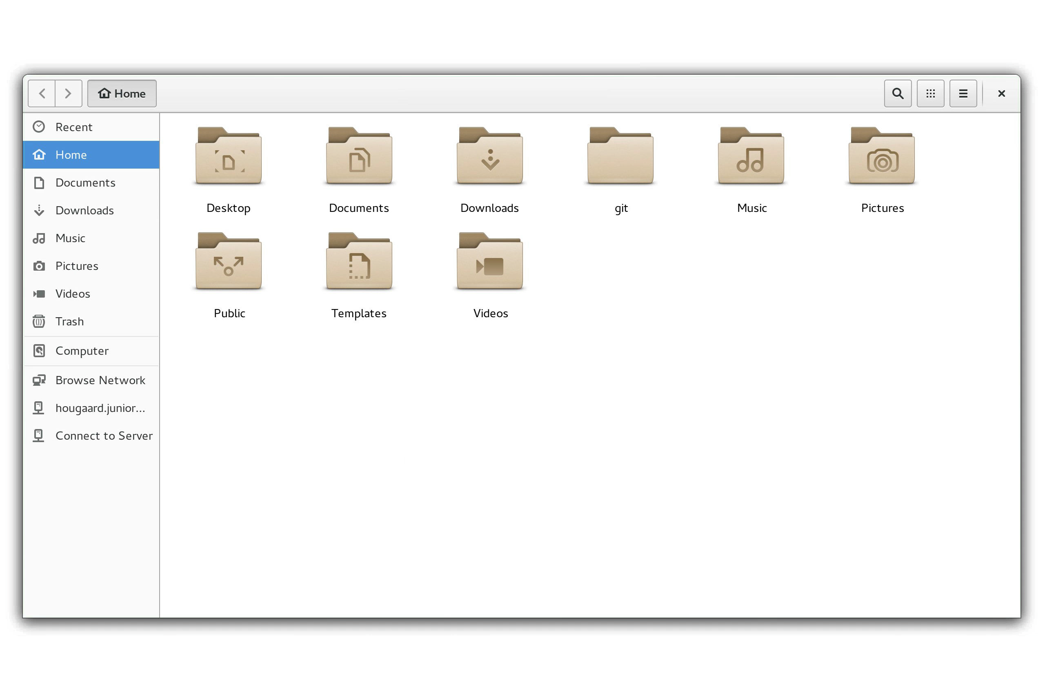

Slide 13
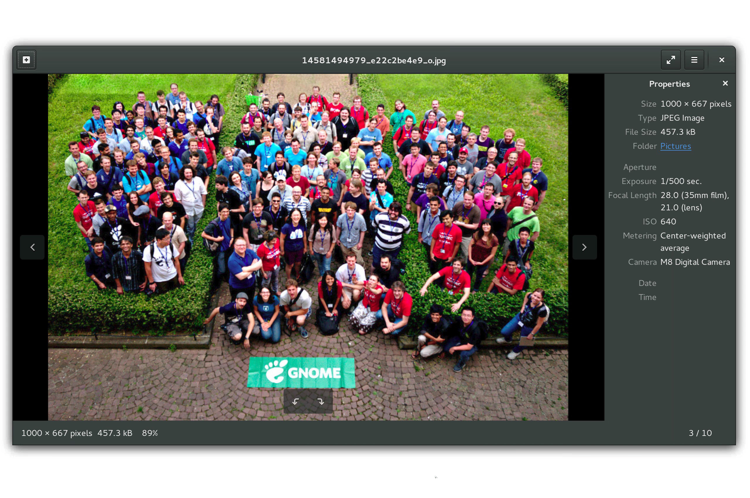

Slide 14
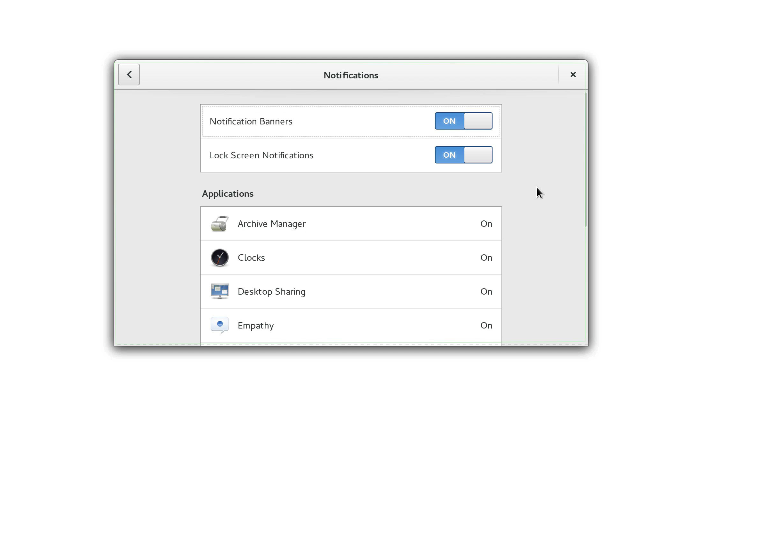
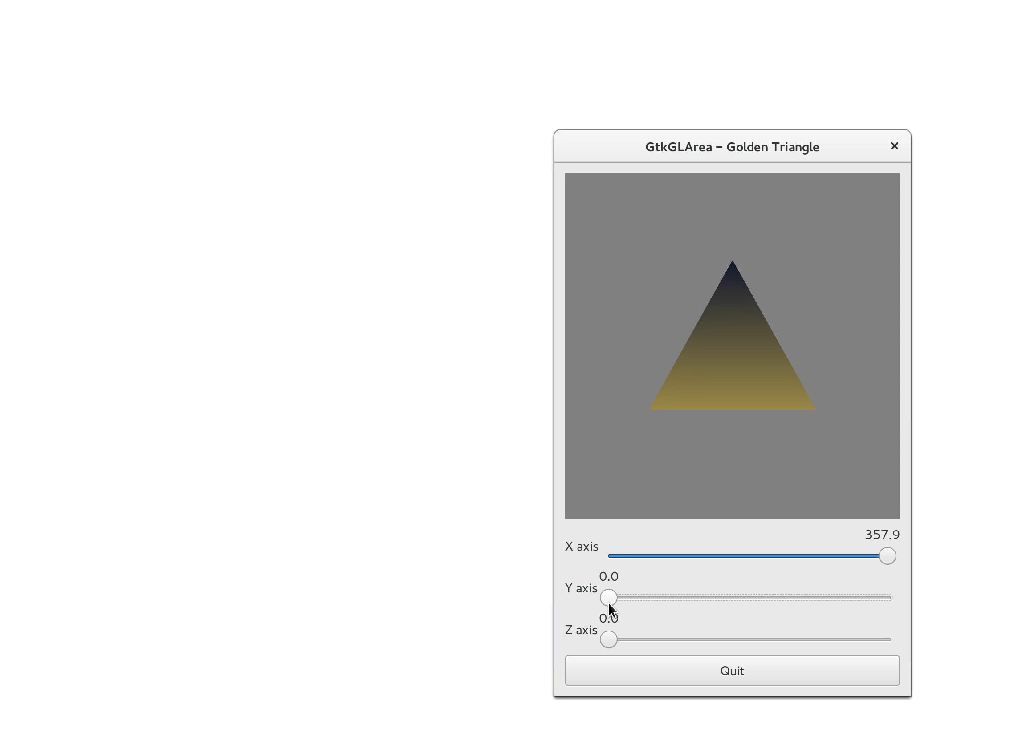
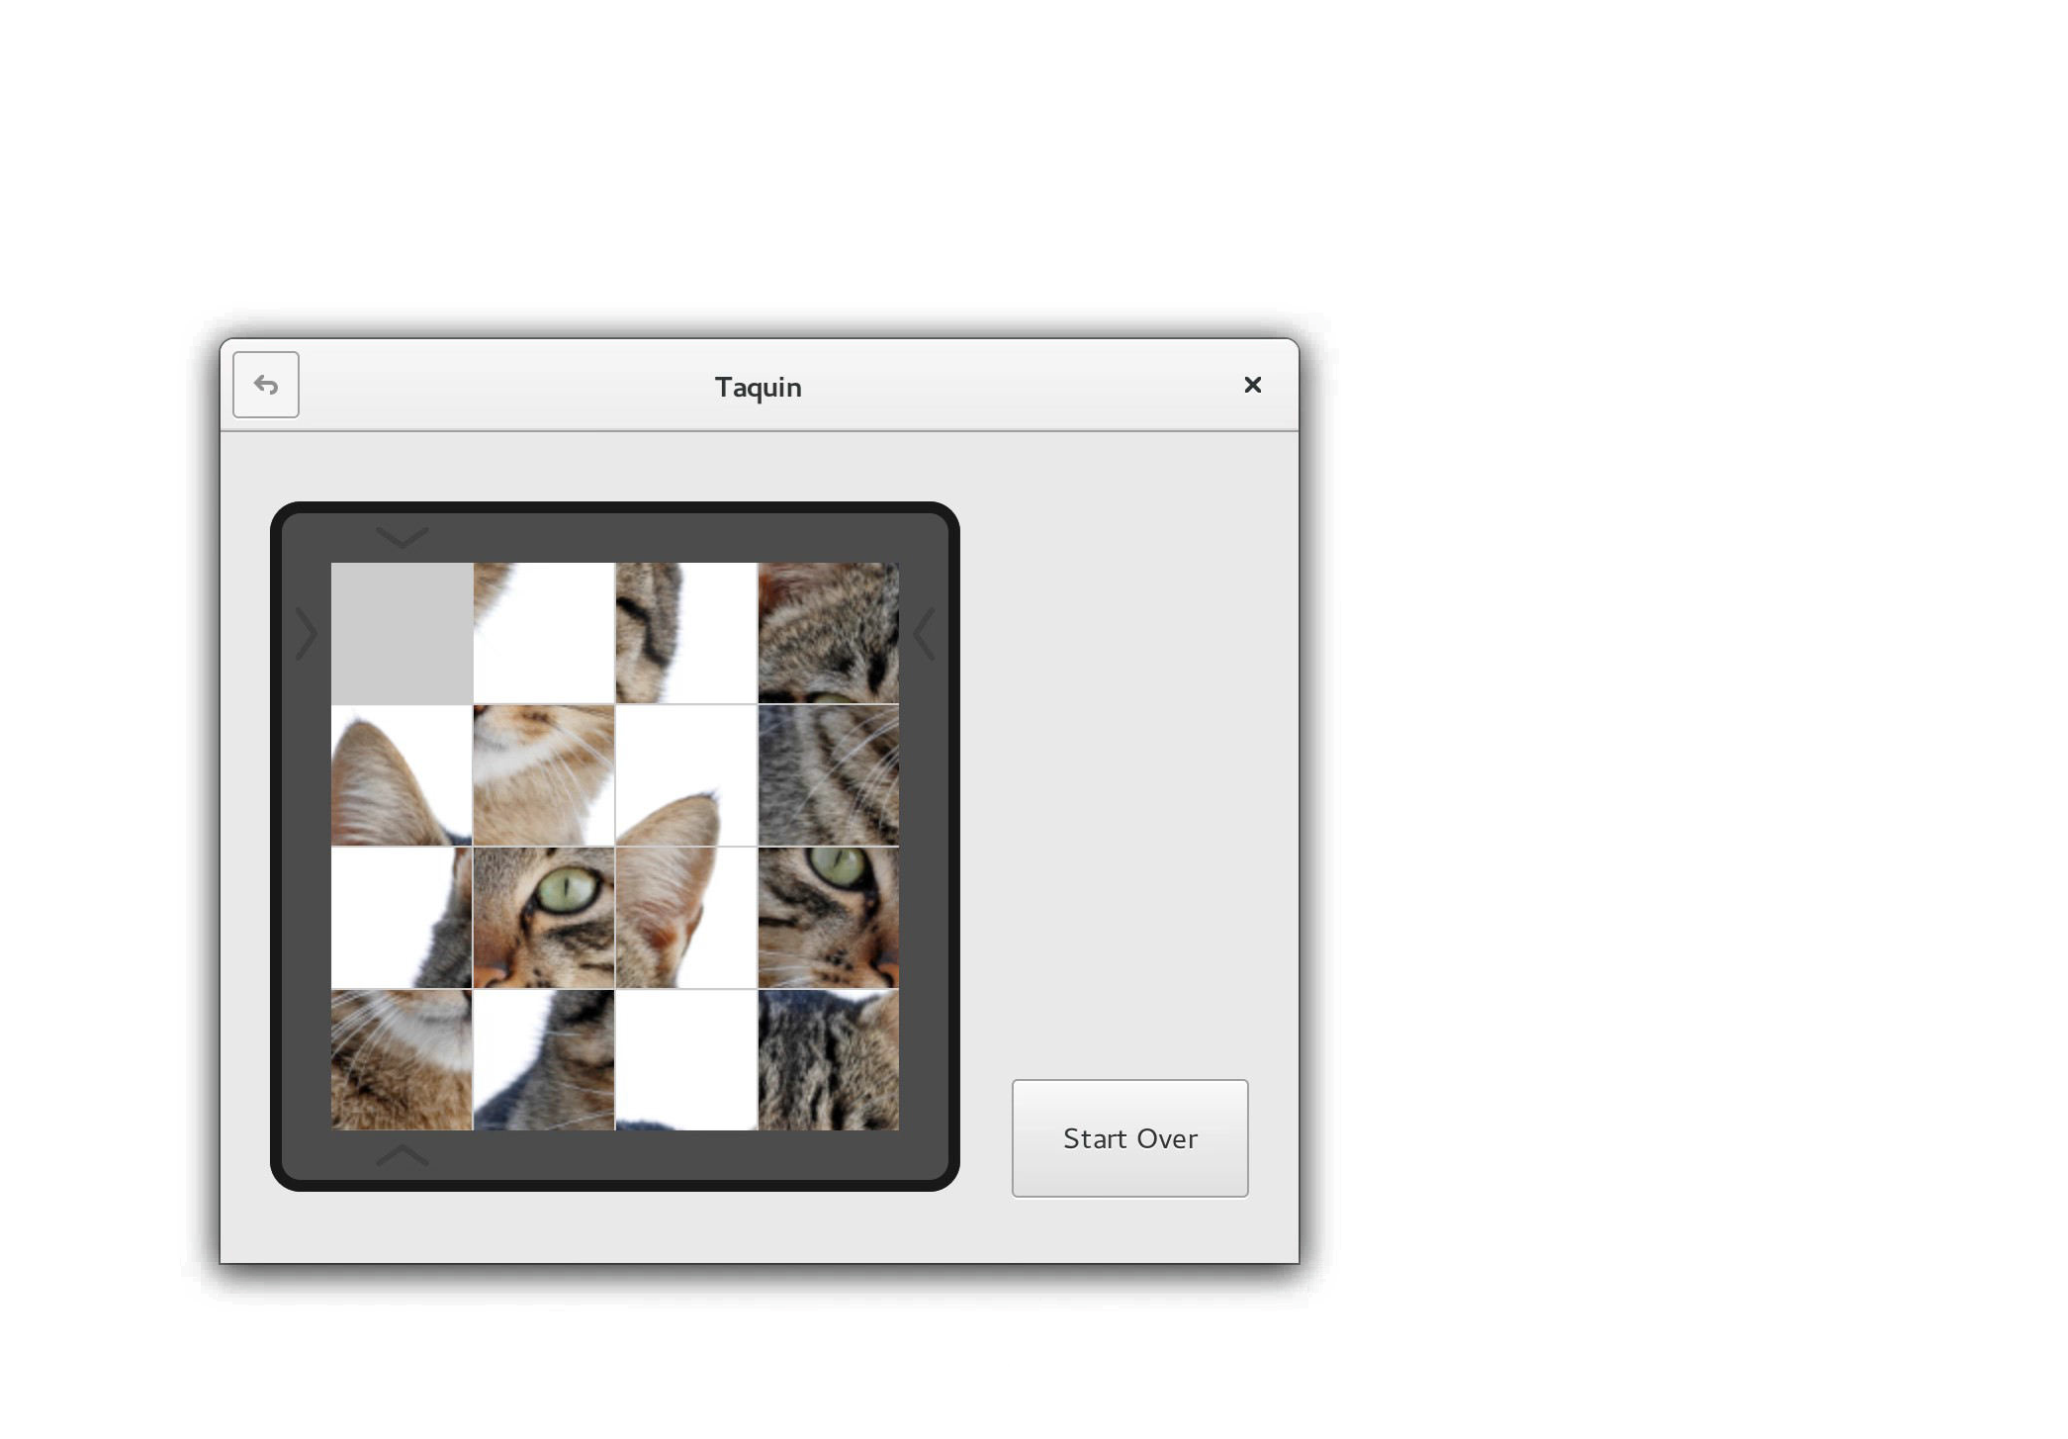

Slide 15
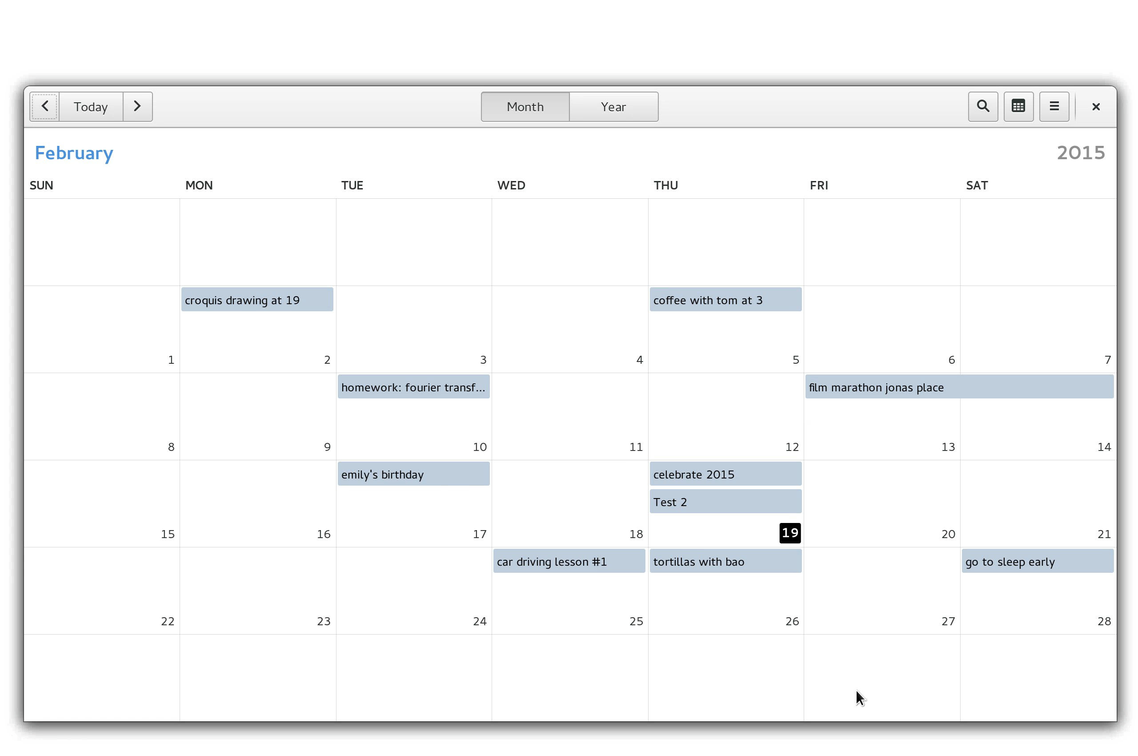

Slide 16
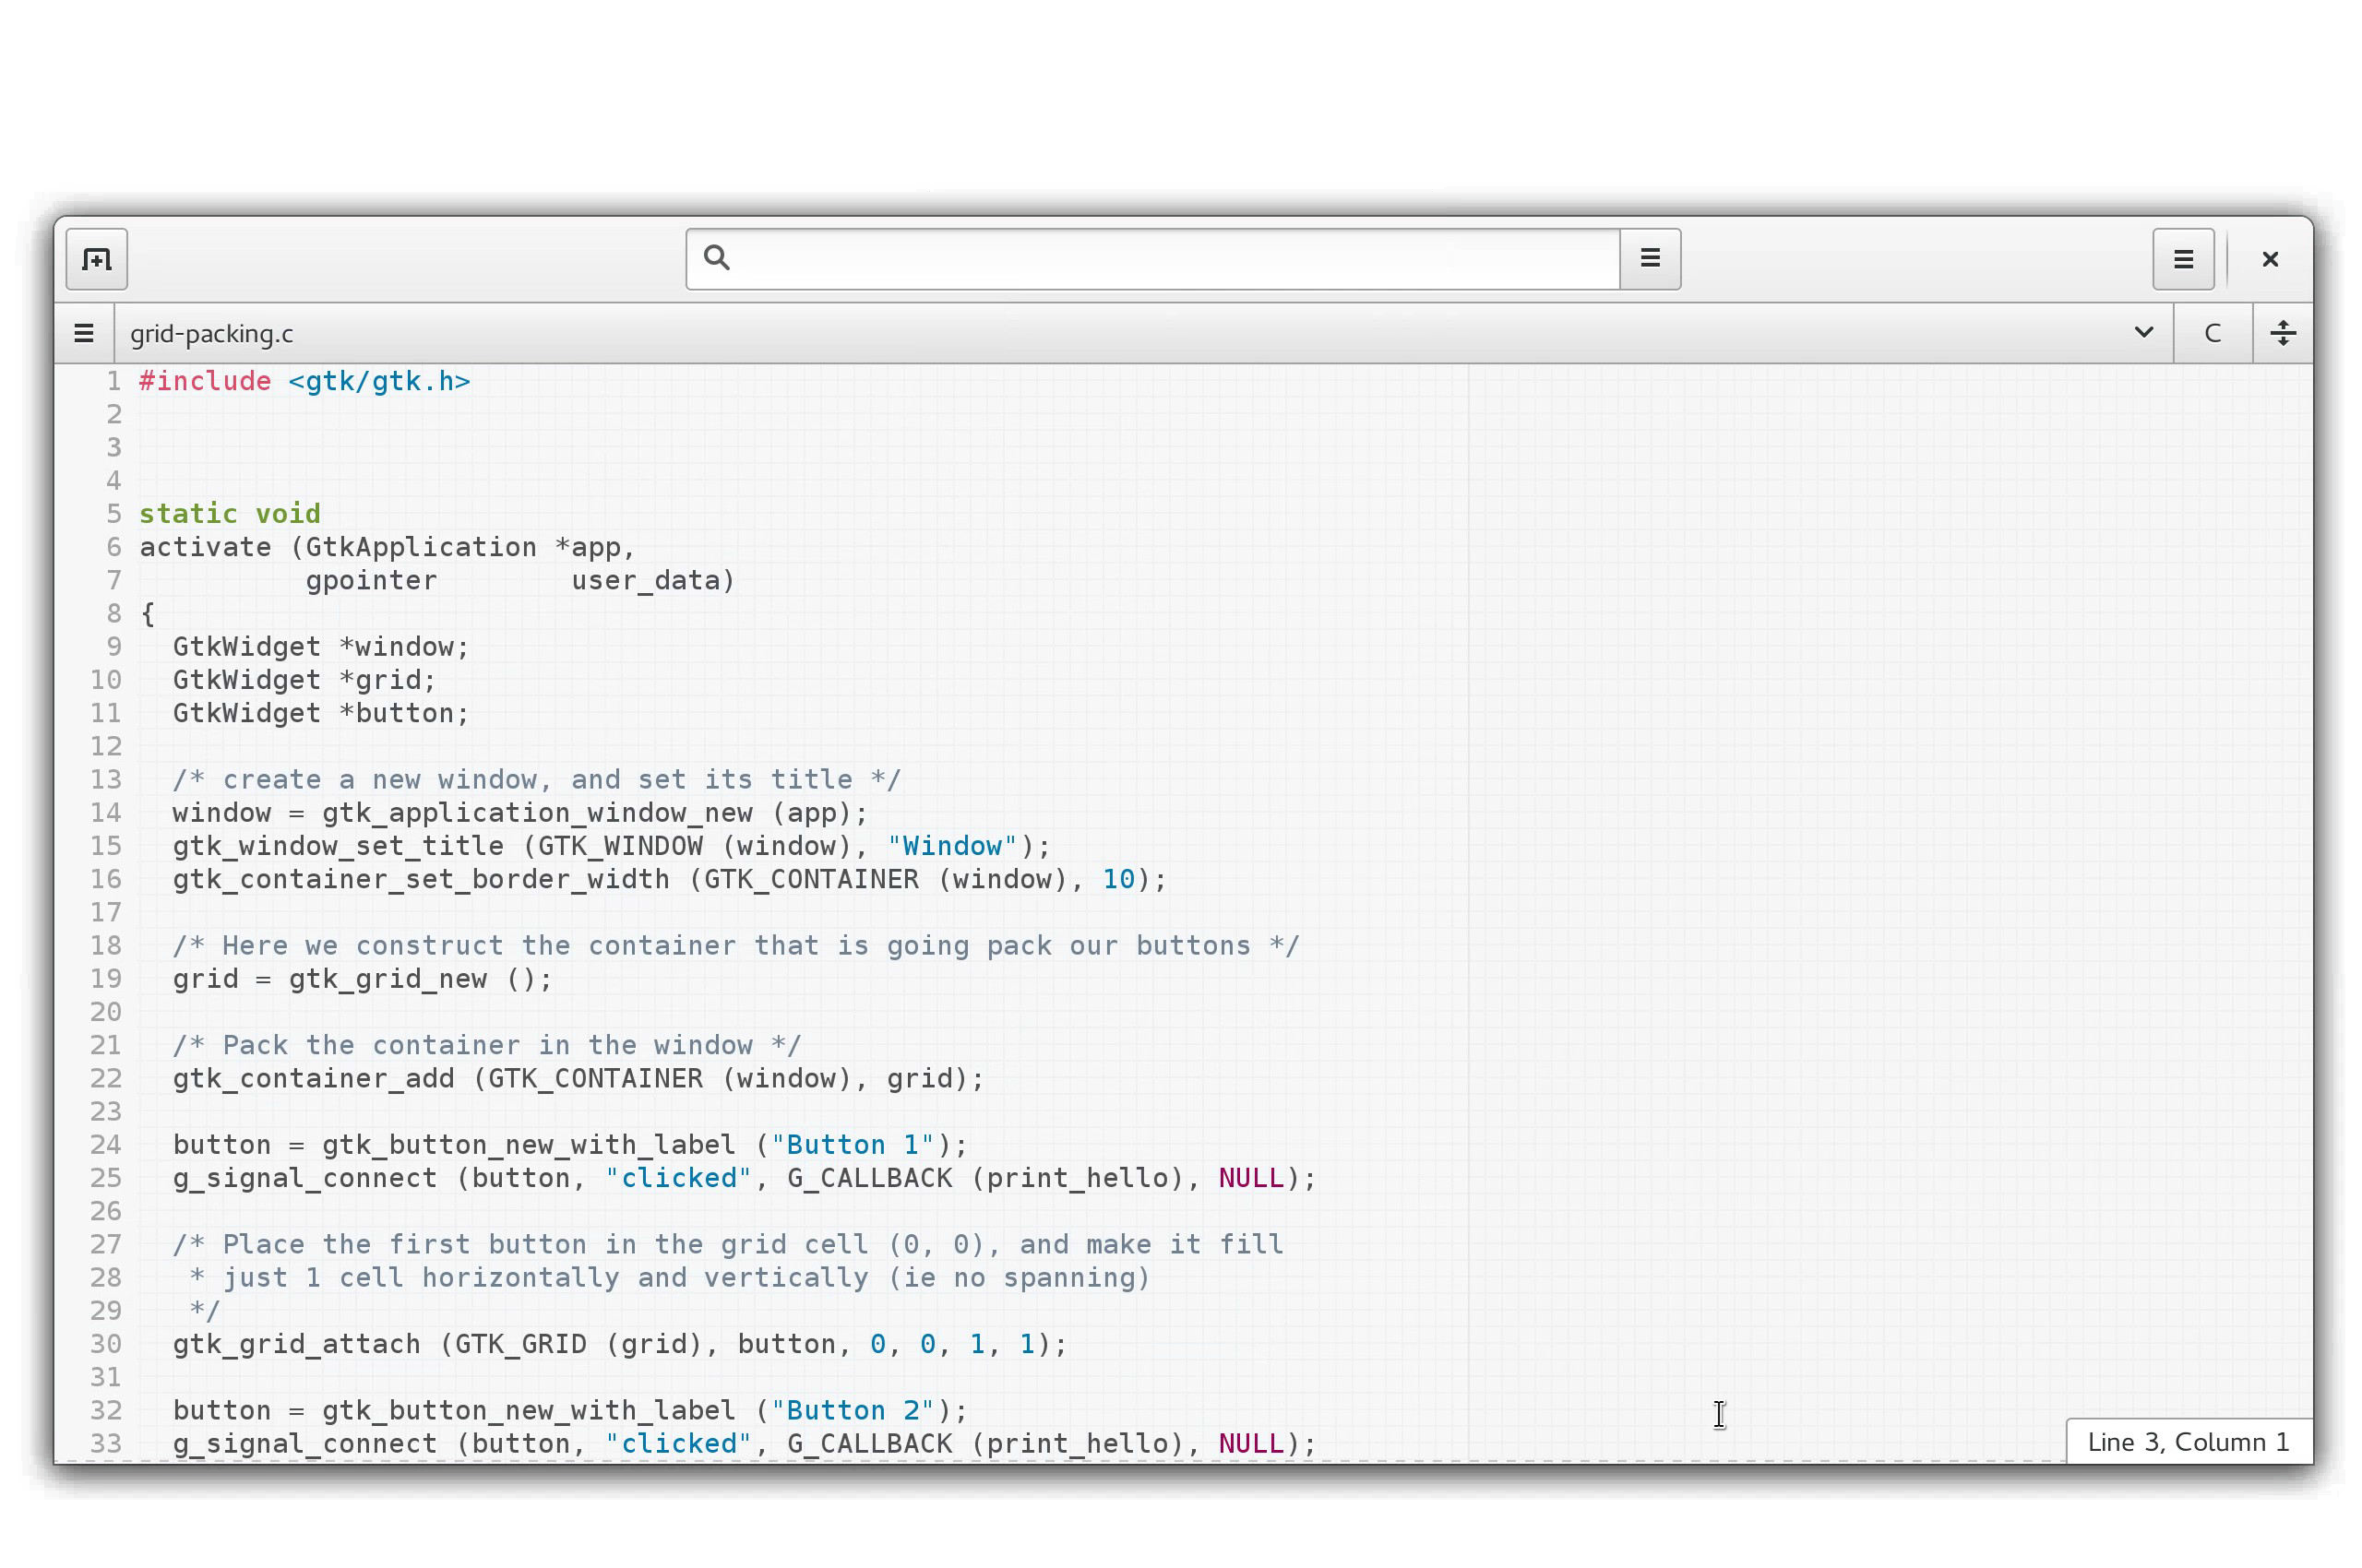

Slide 17
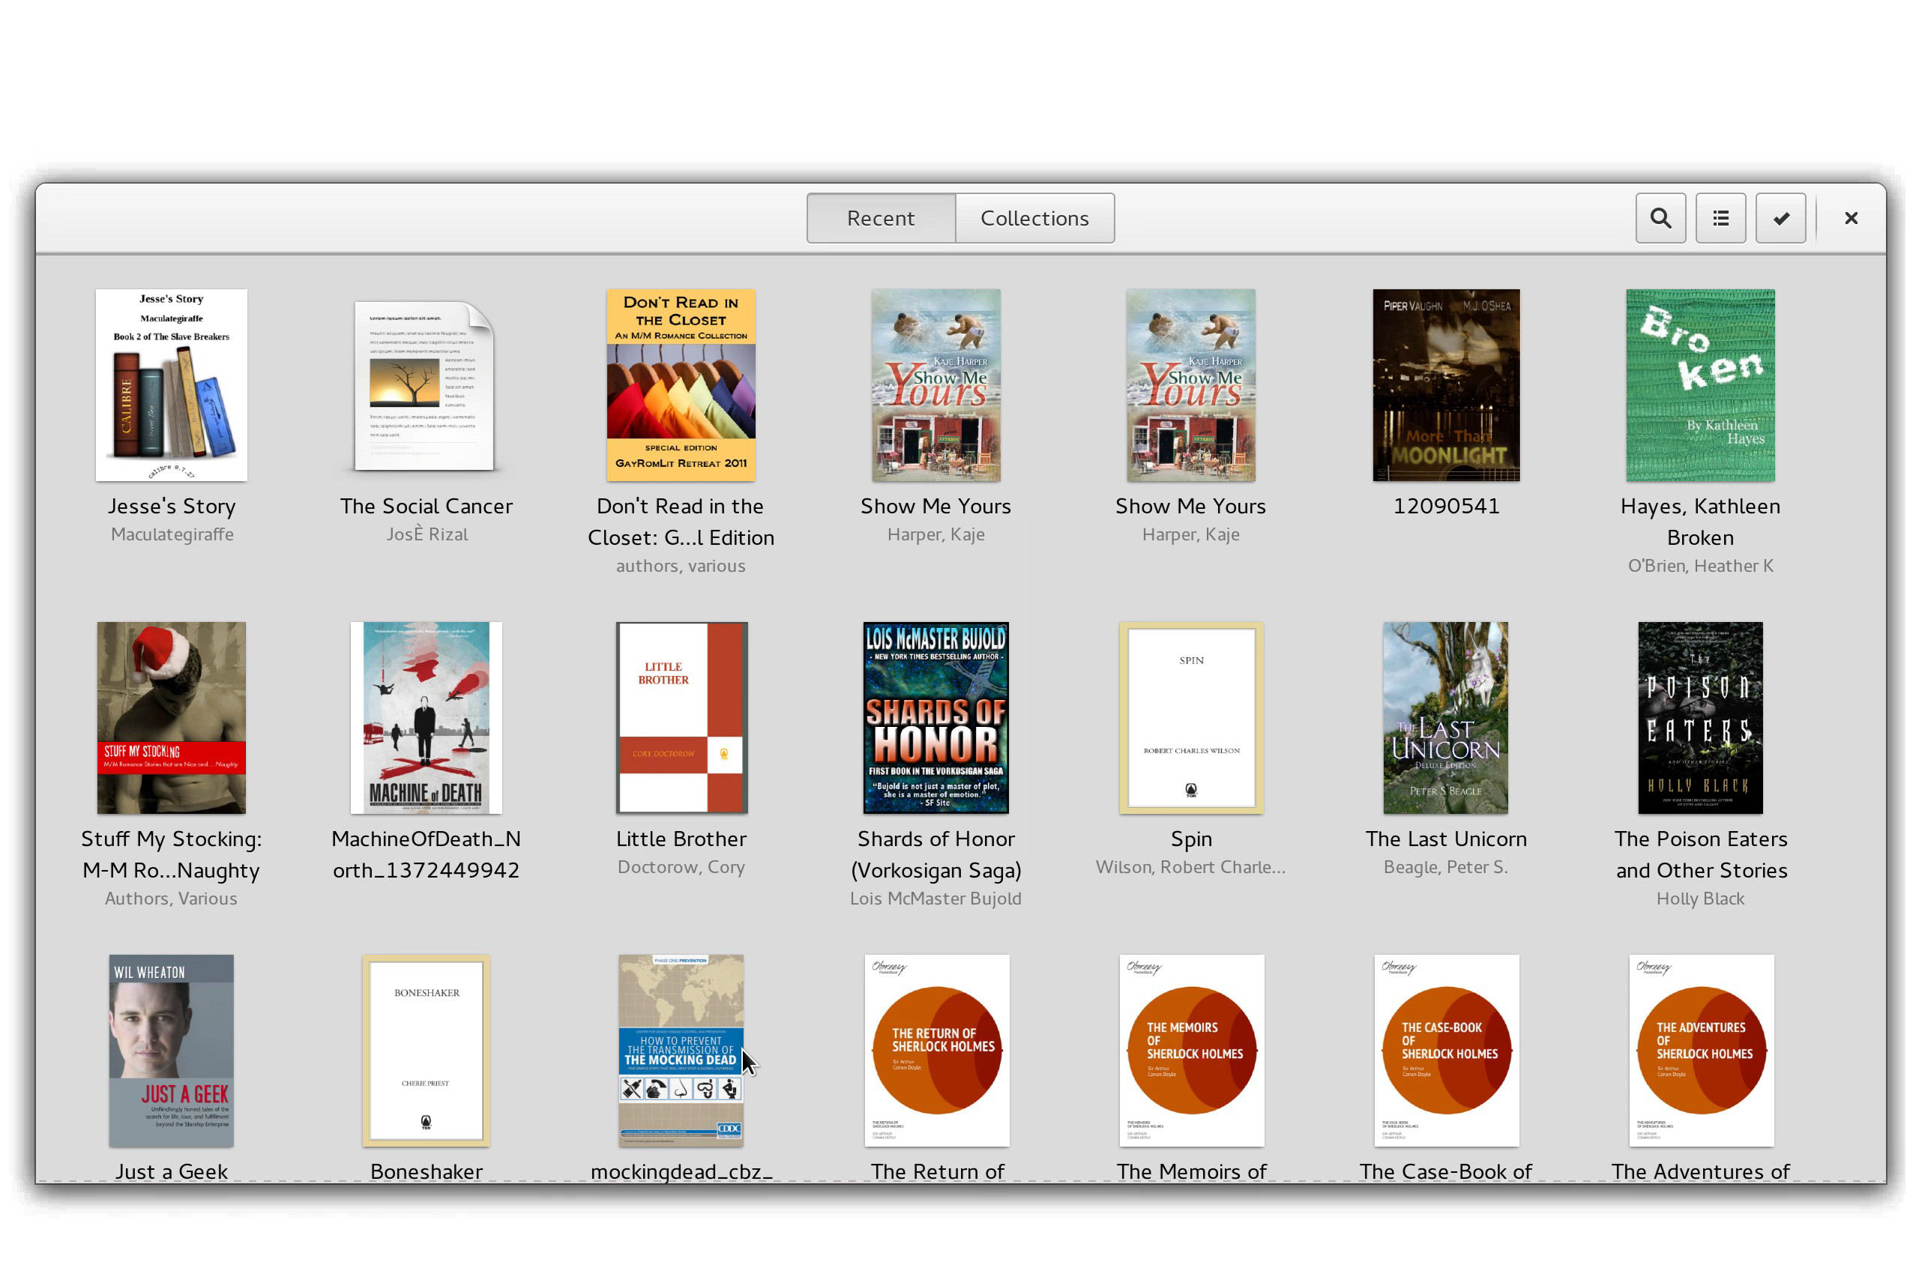

Slide 18
Aplikasi yang Dikembangkan GNOMETM
https://wiki.gnome.org/Apps
Abiword
Banshee
Cheese
Dia
Evince
File Roller
Gedit
Hot SSH
Iagno
Klotski
Logs
...

Slide 19
Proyek yang Dikembangkan GNOMETM
https://wiki.gnome.org/Project
Cantarell
GSstreamer
GTK +
Jhbuild
Vala
...

Slide 20
GNOMETM Versi Berikutnya
GNOME 3.17.x Development Series
  https://wiki.gnome.org/ThreePointSeventeen
GNOME 3.18
  Rencana 23 September 2015

Slide 21
Tim dan Aktivitas di GNOMETM
https://wiki.gnome.org/Teams
  Accessibility - works to make GNOME accessible to anyone, irrespective of their physical abilities.
  Accounts - manages access to GNOME development systems.
  Design - GNOME user interface and UX design.
  Documentation - writes and maintains GNOME user and developer documentation.
  Engagement - GNOME websites, blogging, press, marketing & promotion activities.
  Foundation Board
  Membership & Elections Committee - organizes the annual GNOME Foundation elections.
  Maintainers Team - for App or Project maintainers
  Moderators - stewards of the GNOME mailing lists.
  Outreach - GNOME Outreach
  QA - GNOME QA team
  Bugsquad - maintains and manages the GNOME Bug Tracker.
  Release Team - organizes and manages GNOME development.
  Safety - User safety and privacy working group.
  Sysadmin - maintain and develop GNOME's infrastructure.
  Web Development
  Translation - translates GNOME user interfaces and documentation into different languages.
  User Groups - Regional GNOME user groups.

Slide 22
GNOMETM di Asia
https://wiki.gnome.org/GnomeAsia
Acara tahunan: GNOME.Asia Summit

Slide 23
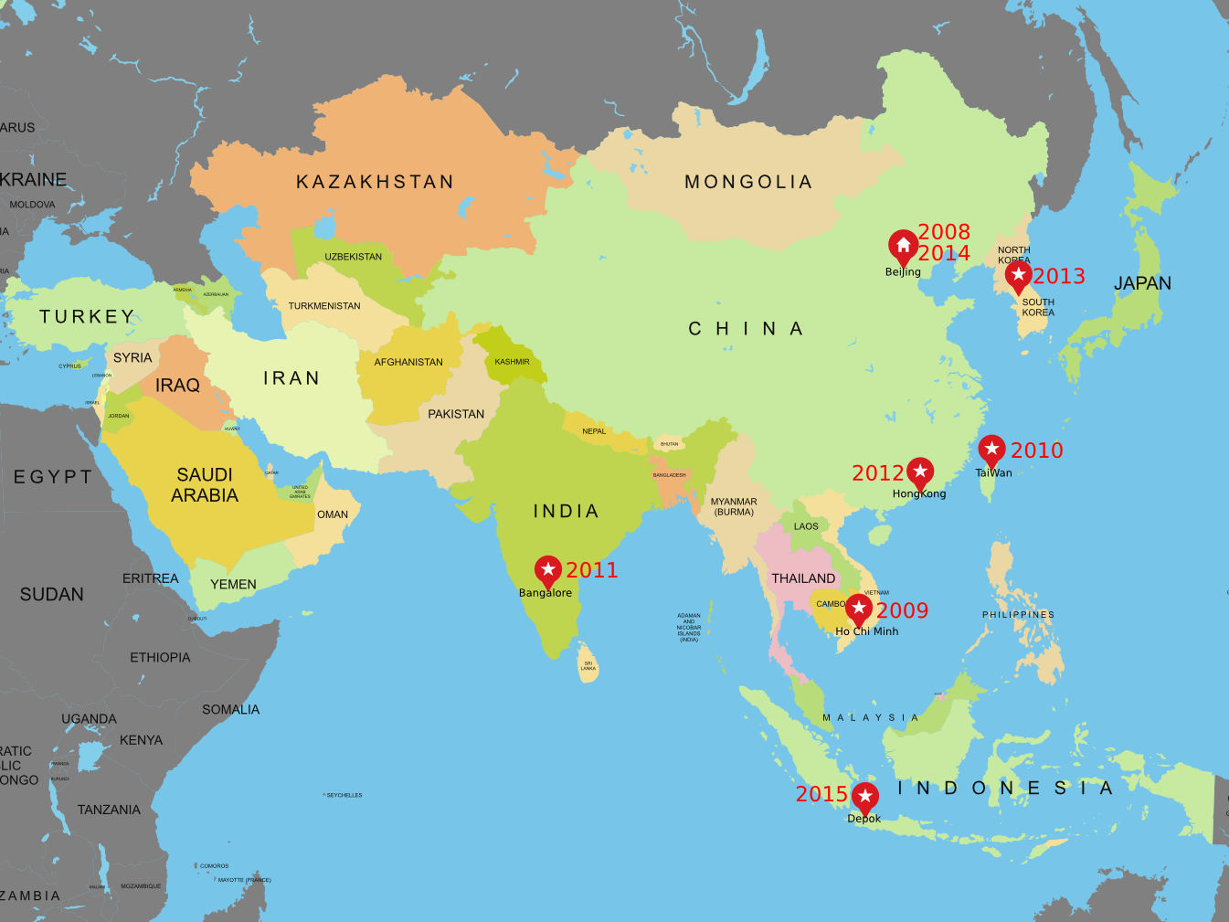

Slide 24
GNOMETM Asia Summit
Beijing, China (2008)
Ho-Chi-Minh, Vietnam (2009)
Taipei, Taiwan (2010)
Bangalore, India (2011)
Hong Kong (2012)
Seoul, South Korea (2013)
Beijing, China (2014)
Depok, Indonesia (2015)

Slide 25

GNOMETM Asia Summit 2015
http://2015.gnome.asia/
322 peserta
48 pembicara
28 diantaranya pembicara lokal

Slide 26
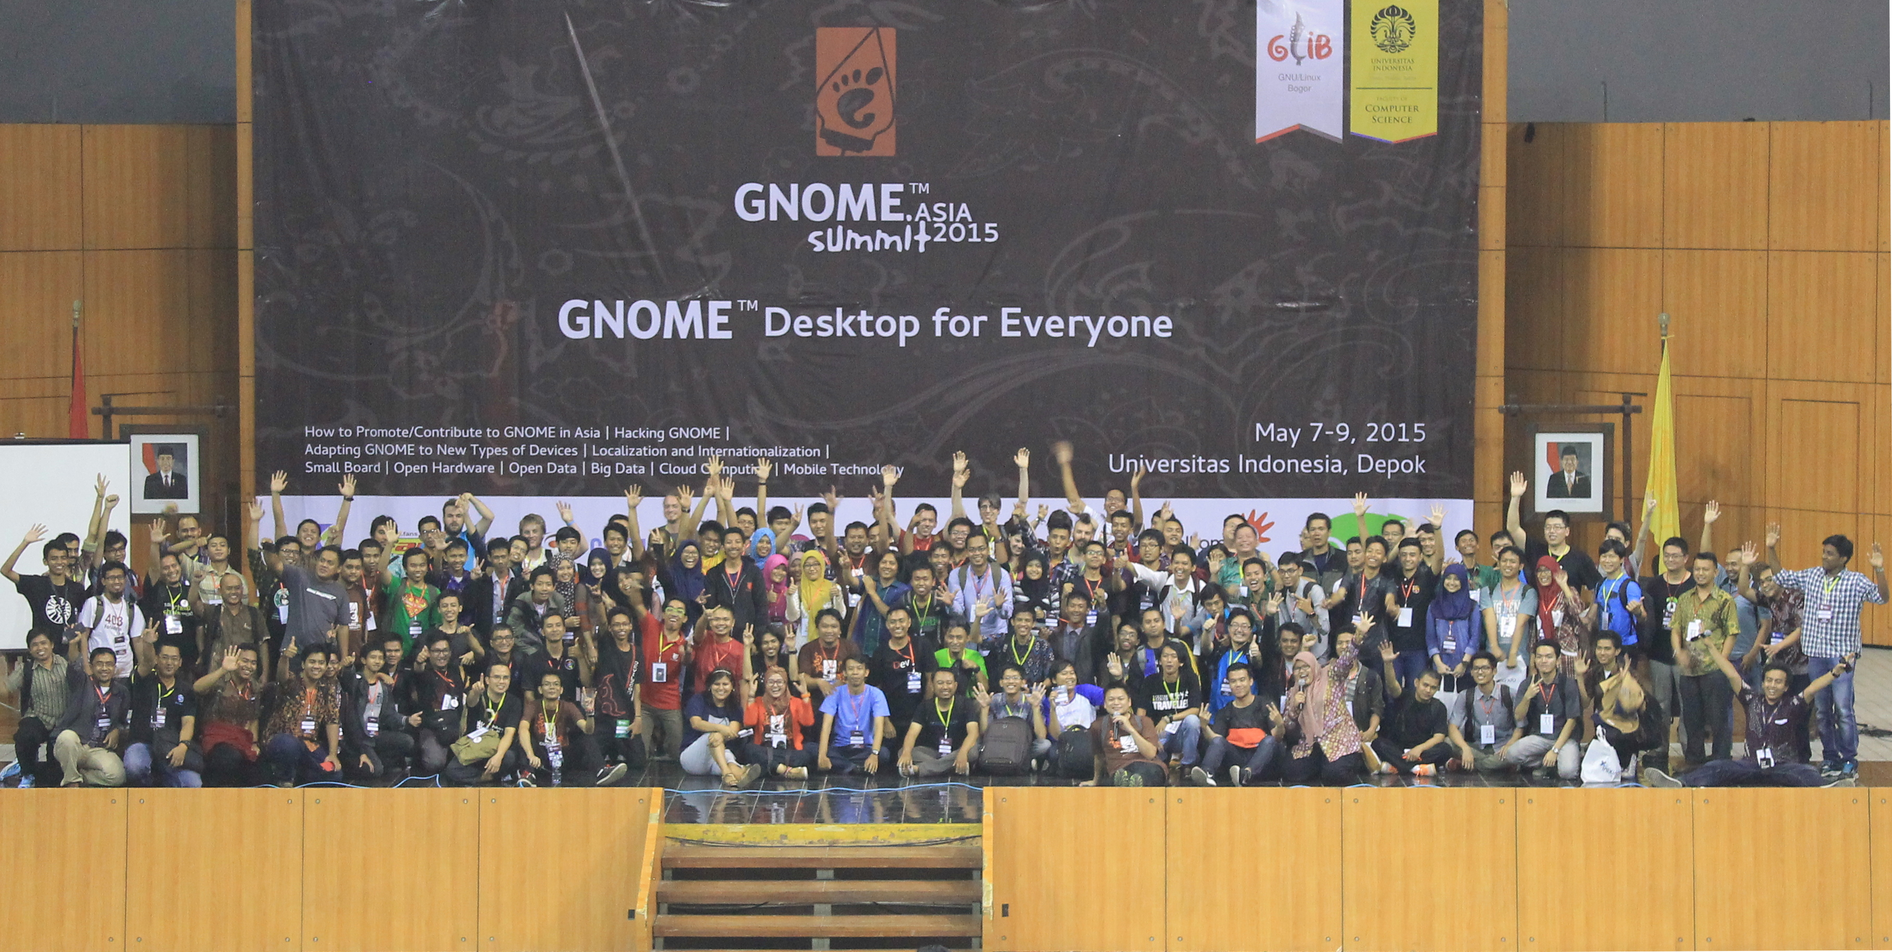
GNOMETM Asia Summit 2015

Slide 27
TERIMA KASIH

