Slide 1

Customizing GNOME Desktop
Pesta Rilis Ubuntu 16.04
Kementerian Komunikasi dan Informatika
Republik Indonesia
14 Mei 2016
Kukuh Syafaat
cho2@gnome.id

Slide 2
Kenalan Dulu
Kukuh Syafaat
FOSS enthusiast
Pengembang @blankonlinux
Pengguna destop @gnome

Slide 3
“GNOME”?
“GNOME 3”?
“GNOME 3.0”?
“GNOME 3.20”?

Slide 4
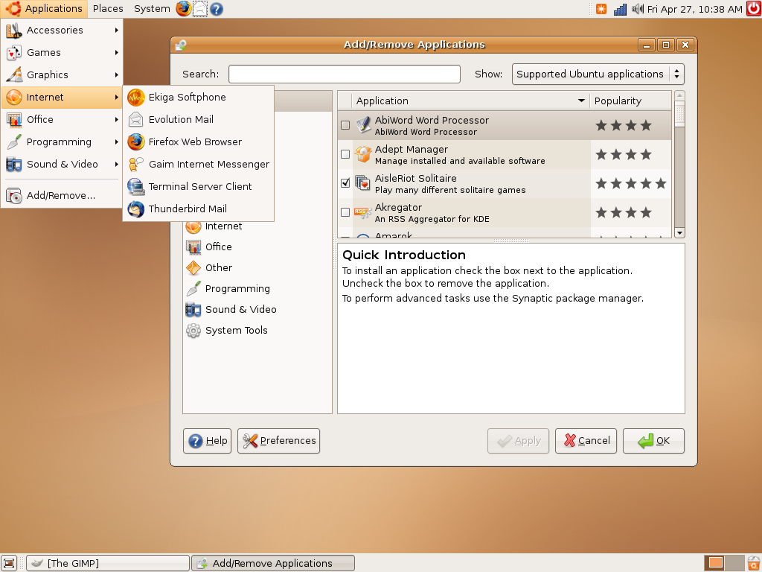

Slide 5
Ubuntu 7.04 (Feisty Fawn)

Slide 6
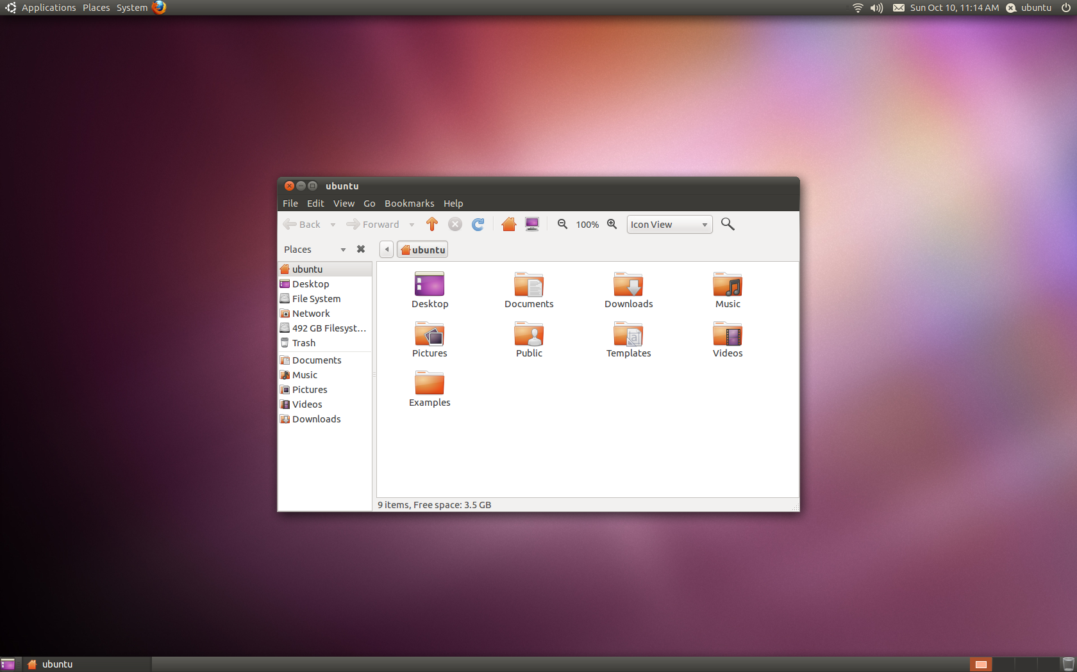

Slide 7
Ubuntu 10.10 (Maverick Meerkat)

Slide 8
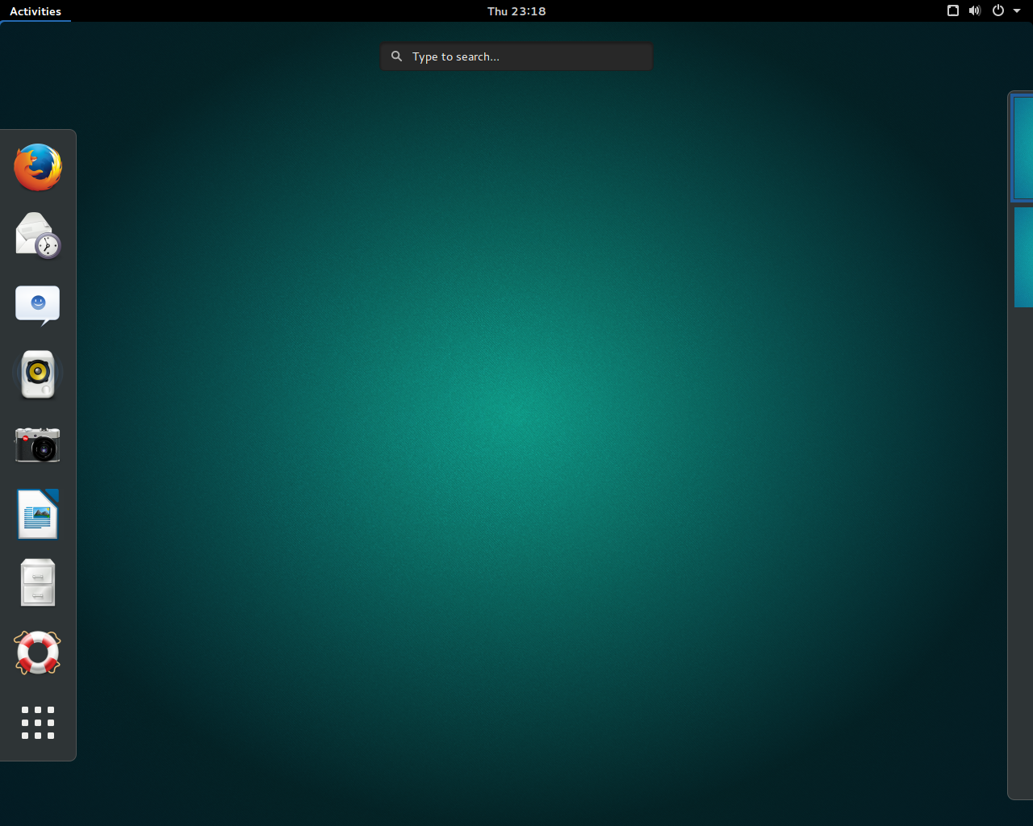

Slide 9


https://ubuntugnome.org/
https://wiki.ubuntu.com/UbuntuGNOME
Ubuntu is a trademark of Canonical
GNOME is a trademark of the GNOME Foundation
Used by permission

Slide 10
Ubuntu GNOME is an official flavor of Ubuntu, featuring the GNOME desktop environment.
Ubuntu GNOME (formerly Ubuntu GNOME Remix) is a mostly pure GNOME desktop experience built from the Ubuntu repositories.

Slide 11
Minimum System Requirements
1 GHz processor (for example Intel Celeron) or better.
1.5 GB RAM (system memory).
7 GB of free hard drive space for installation.
Either a CD/DVD drive or a USB port for the installer media.
Internet access is helpful (for installing updates during the installation process).

Slide 12
Features of Ubuntu GNOME 16.04 LTS
GNOME 3.18
Fixes to Language pack installation (gnome-control-center) and ibus support
GNOME Software has replaced Ubuntu Software Center
GNOME Calendar and GNOME Logs are installed by default
GNOME Builder (IDE) is now available in the archives
Support for installing Snappy packages.

Slide 13
Applications in Ubuntu GNOME 16.04 LTS
GNOME Shell
Nautilus (File Manager)
Firefox Web Browser
LibreOffice
gedit (Text Editor)
GNOME Software
Tweak Tool

Slide 14
GNOME 3 (3.20)
We’ve come a long way

Slide 15
Elegant design

Slide 16
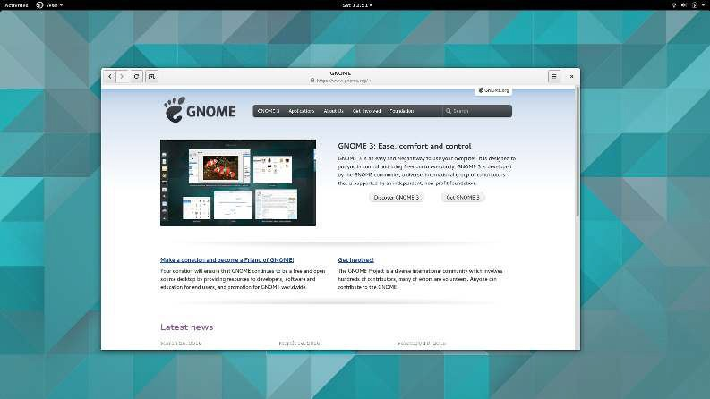

Slide 17
Activities overview

Slide 18
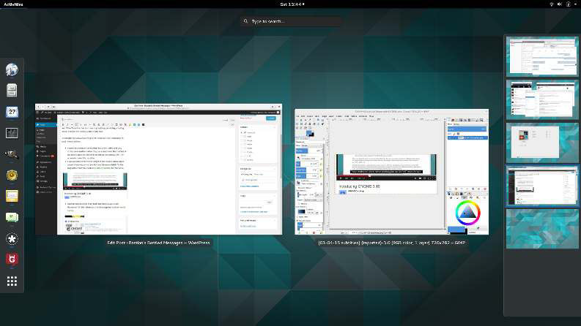

Slide 19
Notifications

Slide 20
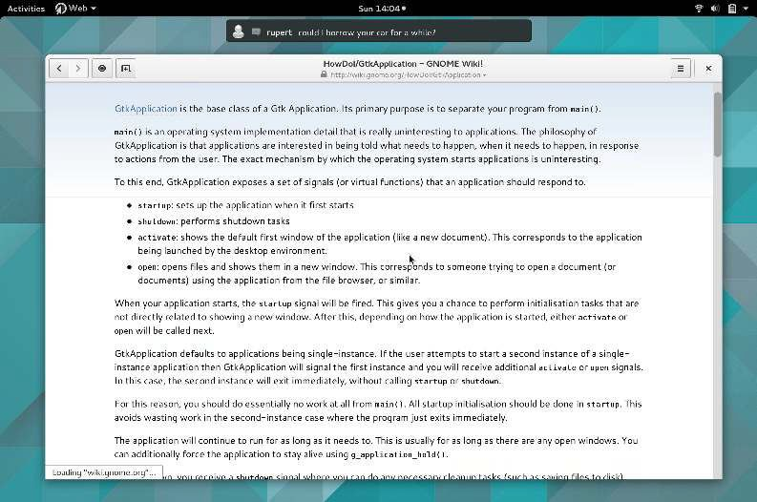

Slide 21
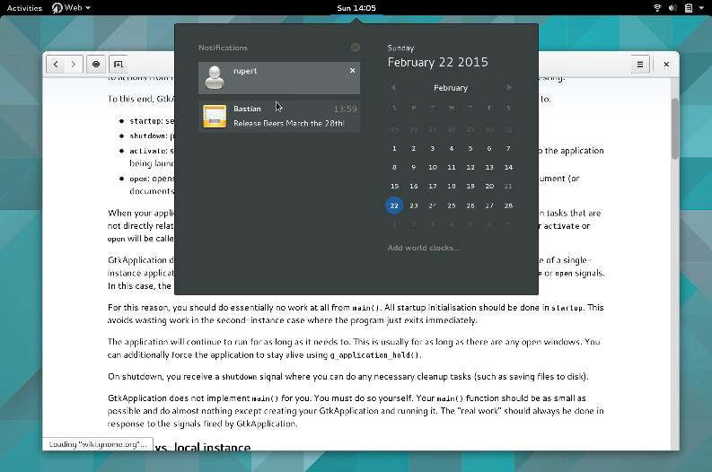

Slide 22
Integrated messaging

Slide 23
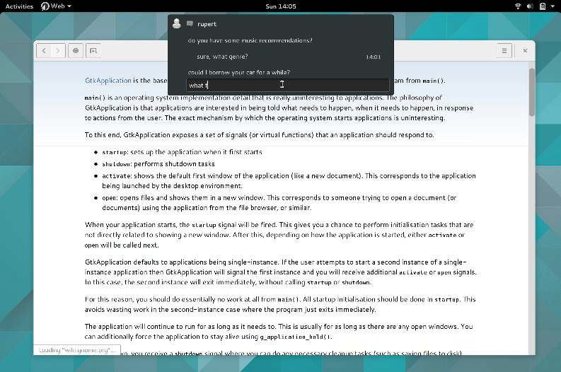

Slide 24
Desktop search
with search providers

Slide 25
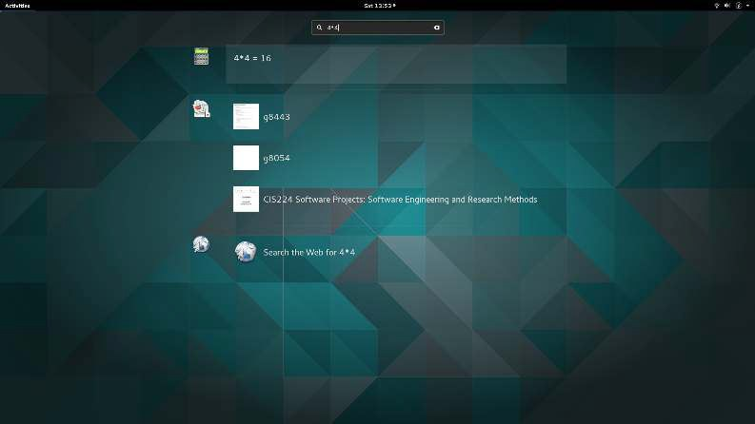

Slide 26
And more!
Topic-oriented help
Intuitive system settings
…
Many small features to improve
your experience!

Slide 27
GNOME releases
2.2: 2003-02-06
...
2.26: 2009-03-18
2.28: 2009-09-23
2.30: 2010-03-31
2.32: 2010-09-29
3.0: 2011-04-06
3.2: 2011-09-28
3.4: 2012-03-26
3.6: 2012-09-26
3.8: 2013-03-27
3.10: 2013-09-25
3.12: 2014-03-25
3.14: 2014-09-24
3.16: 2015-03-25
3.18 (G’burg): 2015-09-21
3.20 (Delhi): 2016-03-21

Slide 28
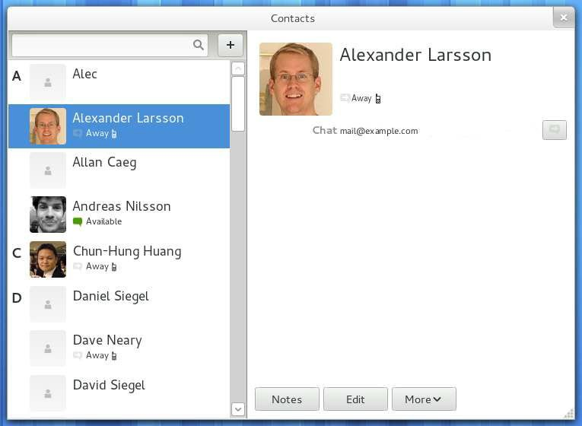
Thestoryofcontacts(3.2)

Slide 29
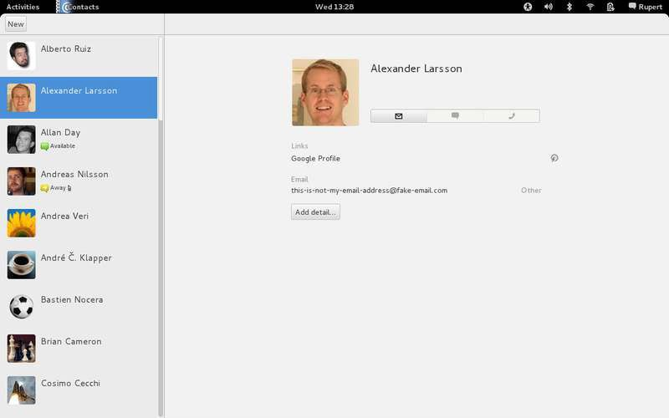
Thestoryofcontacts(3.4)

Slide 30
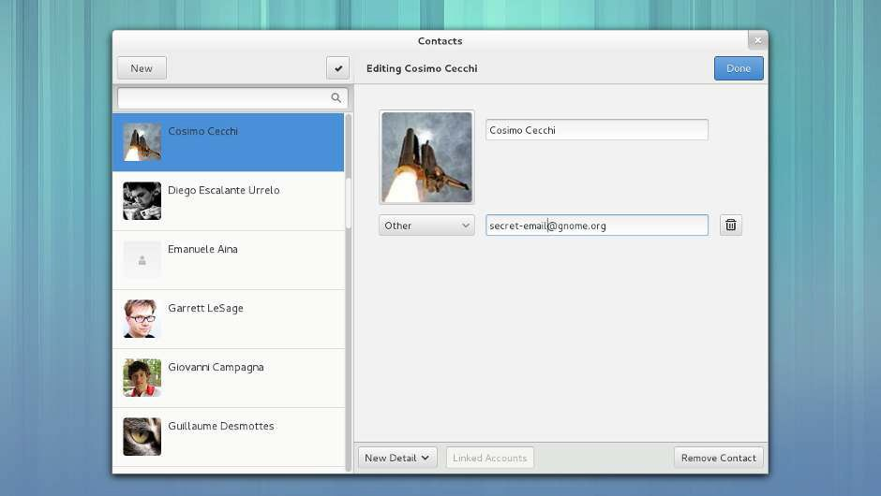
Thestoryofcontacts(3.8)

Slide 31
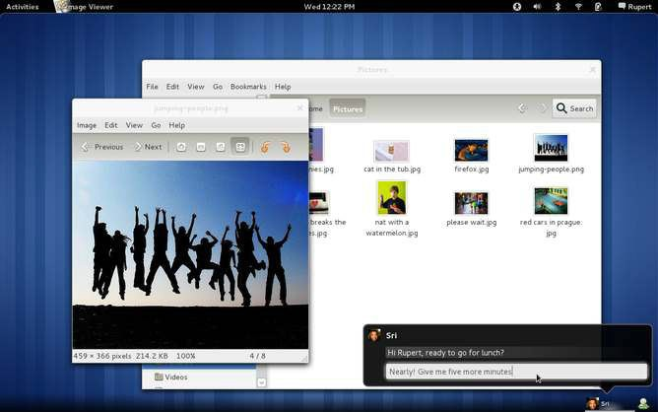
The story of notifications

Slide 32
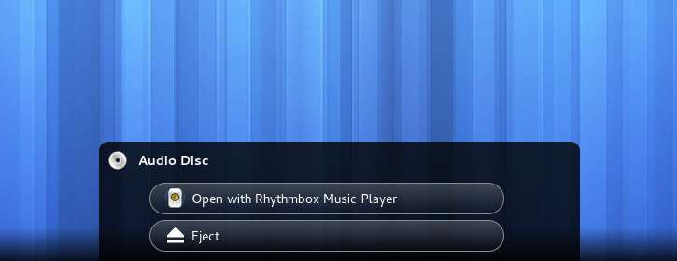
The story of notifications

Slide 33
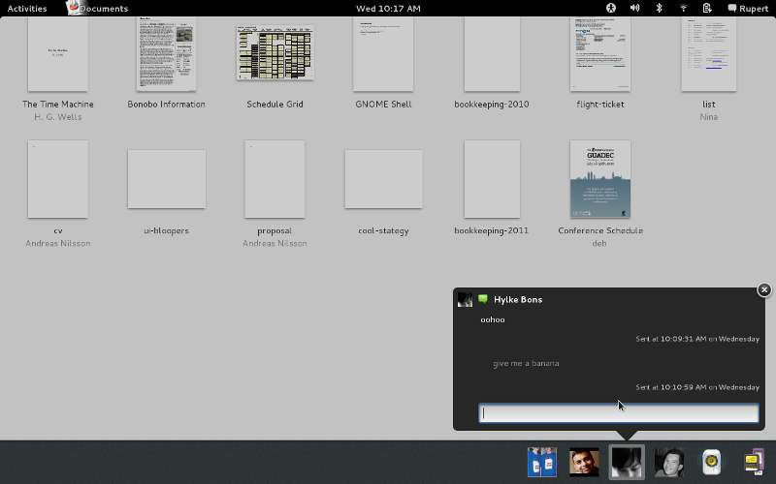
The story of notifications

Slide 34
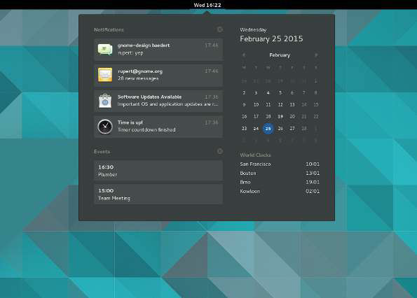
The story of notifications

Slide 35
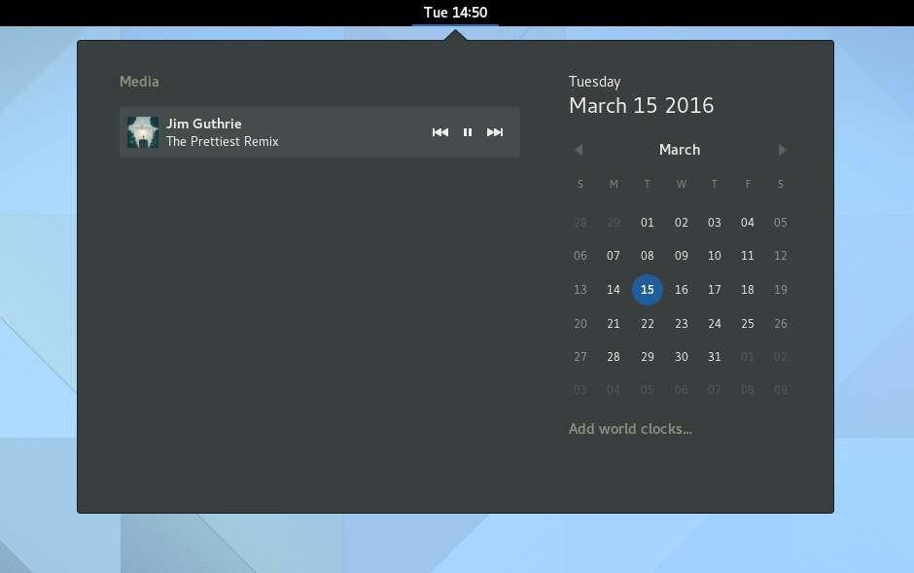
The story of notifications

Slide 36
GNOME 3.20
Approximately 772 people made about 25112
changes to GNOME
New notifications system
Updated shell visuals
Improved developer experience
...

Slide 37
GNOME 3 on Ubuntu PPA
GNOME3 Stable PPA - This is the stable version, and contains updates for any packages that didn't make it into the Ubuntu archives for the current stable cycle.
GNOME3 Staging PPA - staging is for the things that have known regressions and/or bugs. Basically a place to get the bleeding edge packages that are still a work in progress and under testing.

Slide 38
GNOME3 Stable PPA
https://launchpad.net/~gnome3-team/+archive/ubuntu/gnome3
deb http://ppa.launchpad.net/gnome3-team/gnome3/ubuntu xenial main
deb-src http://ppa.launchpad.net/gnome3-team/gnome3/ubuntu xenial main

Slide 39
GNOME3 Staging PPA
https://launchpad.net/~gnome3-team/+archive/ubuntu/gnome3-staging
deb http://ppa.launchpad.net/gnome3-team/gnome3-staging/ubuntu xenial main
deb-src http://ppa.launchpad.net/gnome3-team/gnome3-staging/ubuntu xenial main

Slide 40
GNOME 3.20 on Ubuntu GNOME 16.04
Upgrade to GNOME 3.20
sudo add-apt-repository ppa:gnome3-team/gnome3-staging
sudo apt-get update
sudo apt-get dist-upgrade

Slide 41
GNOME 3.20 on Ubuntu GNOME 16.04
Downgrade to GNOME 3.18
sudo apt-get install ppa-purge
sudo ppa-purge ppa:gnome3-team/gnome3-staging

Slide 42
GNOME 3.20 on Ubuntu 16.04
sudo add-apt-repository ppa:gnome3-team/gnome3-staging
sudo apt-get update
sudo apt-get install ubuntu-gnome-desktop

Slide 43
Evolving GNOME 3
http://extension.gnome.org
GNOME Tweak Tool

Slide 44
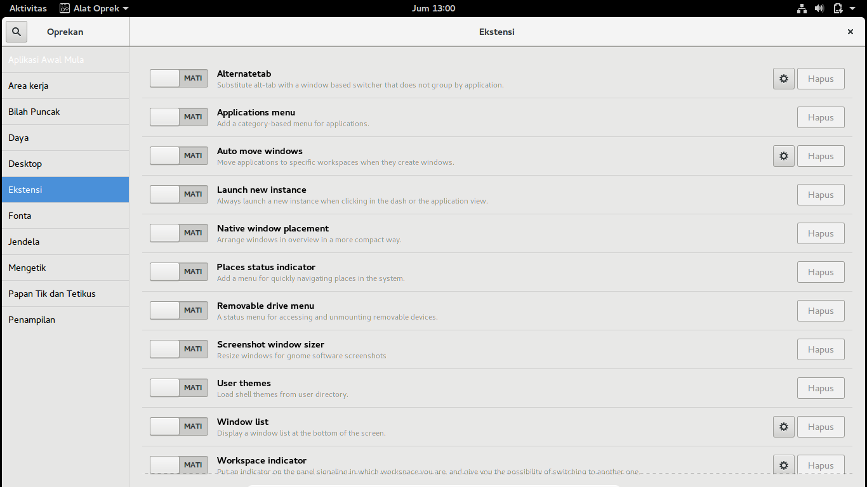

Slide 45
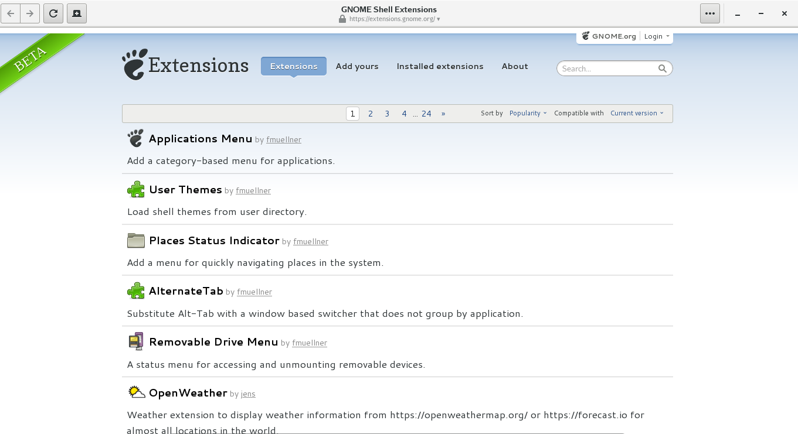

Slide 46
Web
https://wiki.gnome.org/Apps/Web
Web is the WebKit based web browser for GNOME. It offers a simple, clean, beautiful view of the Web. Its code name is Epiphany
sudo apt-get install epiphany-browser

Slide 47
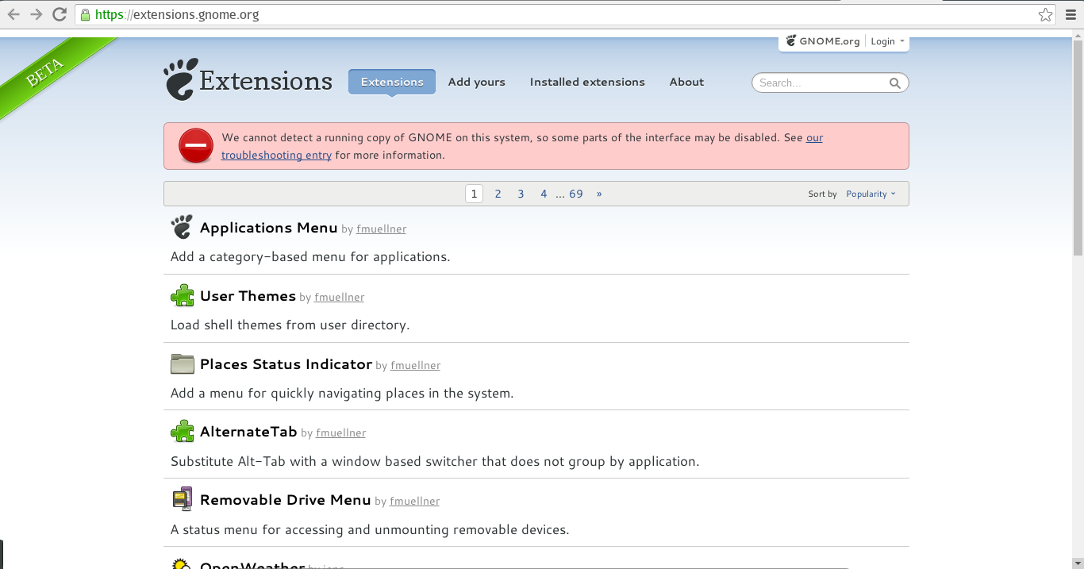

Slide 48
Custom
GTK+ Theme
Icon

Slide 49
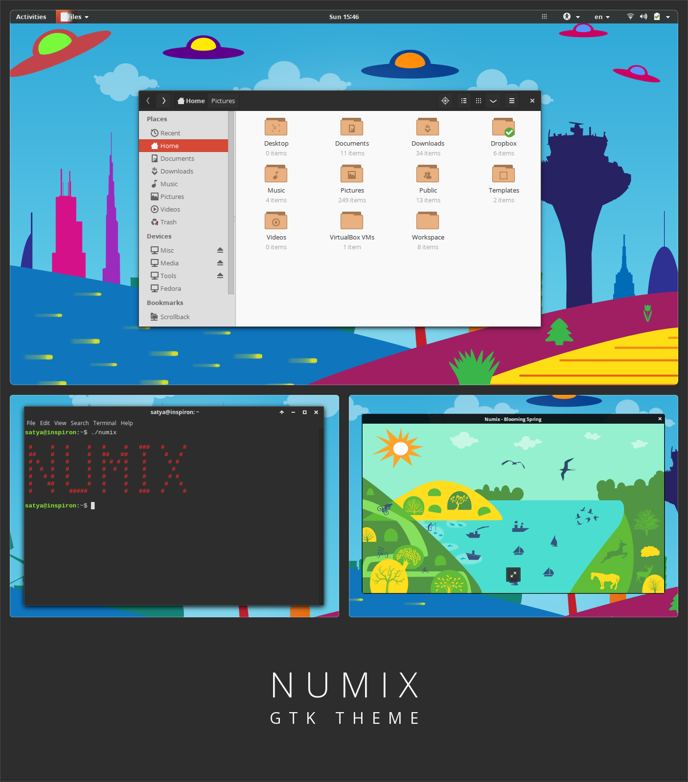

Slide 50
Numix
https://launchpad.net/~numix/+archive/ubuntu/ppa
deb http://ppa.launchpad.net/numix/ppa/ubuntu xenial main
deb-src http://ppa.launchpad.net/numix/ppa/ubuntu xenial main

Slide 51
Numix
https://numixproject.org/
sudo add-apt-repository ppa:numix/ppa

Slide 52
Numix GTK Theme
https://github.com/numixproject/numix-gtk-theme
sudo apt-get install numix-gtk-theme

Slide 53
Numix Icon Theme
https://github.com/numixproject/numix-icon-theme
sudo apt-get install numix-icon-theme

Slide 54
Numix Icon Theme Circle
https://github.com/numixproject/numix-icon-theme-circle
sudo apt-get install numix-icon-theme-circle

Slide 55
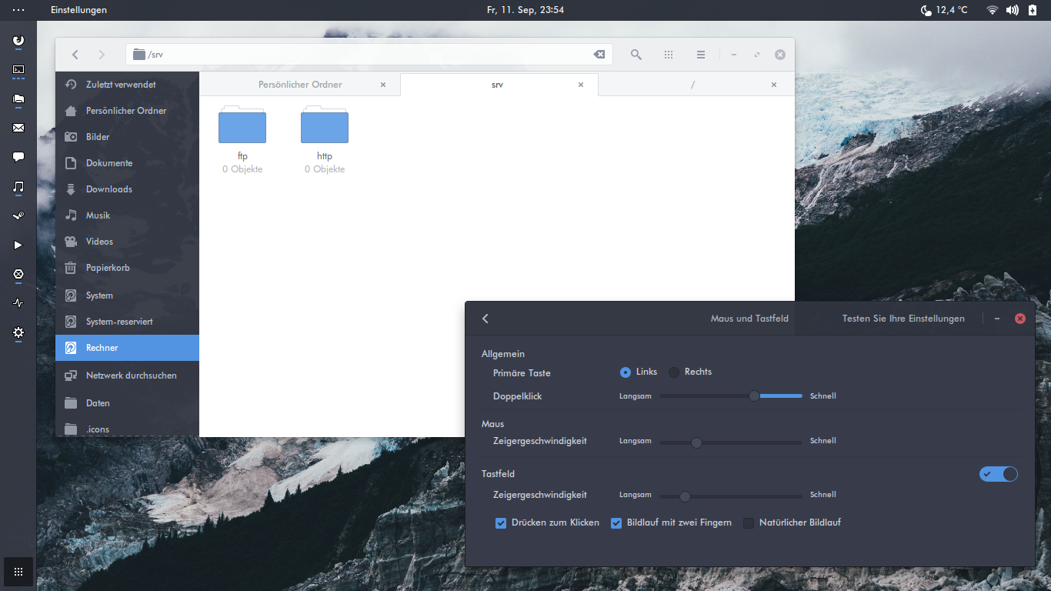

Slide 56
Arc Theme
https://github.com/horst3180/arc-theme
git clone https://github.com/horst3180/arc-theme --depth 1 && cd arc-theme
./autogen.sh --prefix=/usr
sudo make install

Slide 57
Arc Theme
https://software.opensuse.org/download.html?project=home%3AHorst3180&package=arc-theme
sudo sh -c "echo 'deb http://download.opensuse.org/repositories/home:/Horst3180/xUbuntu_16.04/ /' >> /etc/apt/sources.list.d/arc-theme.list"
sudo apt-get update
sudo apt-get install arc-theme

Slide 58
THANK YOU

