Slide 1



From To In 5 Minutes
Kukuh Syafaat
kukuh.syafaat@citra.digital
kukuh@syafaat.id
FOSS ASIA 2021

Slide 2

If you are a Docker user, you understand that there is a daemon process that must be run to service all of your Docker commands.
https://developers.redhat.com/blog/2019/02/21/podman-and-buildah-for-docker-users

Slide 3
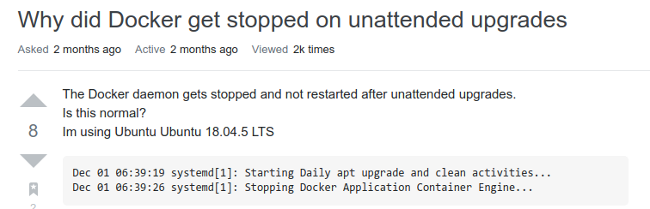
Daemon Problem
https://askubuntu.com/questions/1296583/why-did-docker-get-stopped-on-unattended-upgrades

Slide 4
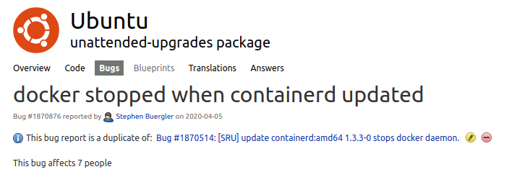
Daemon Problem
https://bugs.launchpad.net/ubuntu/+source/unattended-upgrades/+bug/1870876

Slide 5
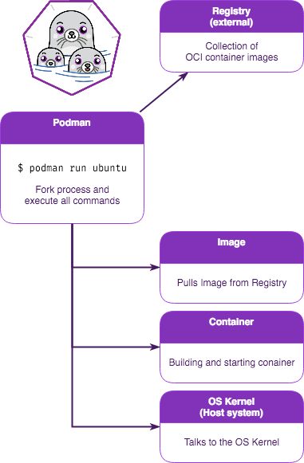
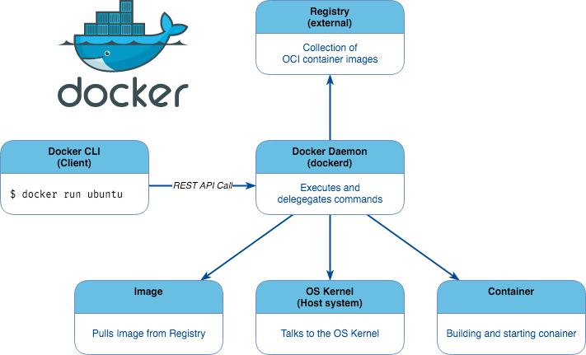
https://www.nine.ch/en/blog/lets-have-some-fun-with-containers-on-nine-managed-servers

Slide 6

DAEMONLESS
Podman is a daemonless container engine for developing, managing, and running OCI Containers on your Linux System. Containers can either be run as root or in rootless mode.
https://podman.io

Slide 7

alias docker=podman

Slide 8
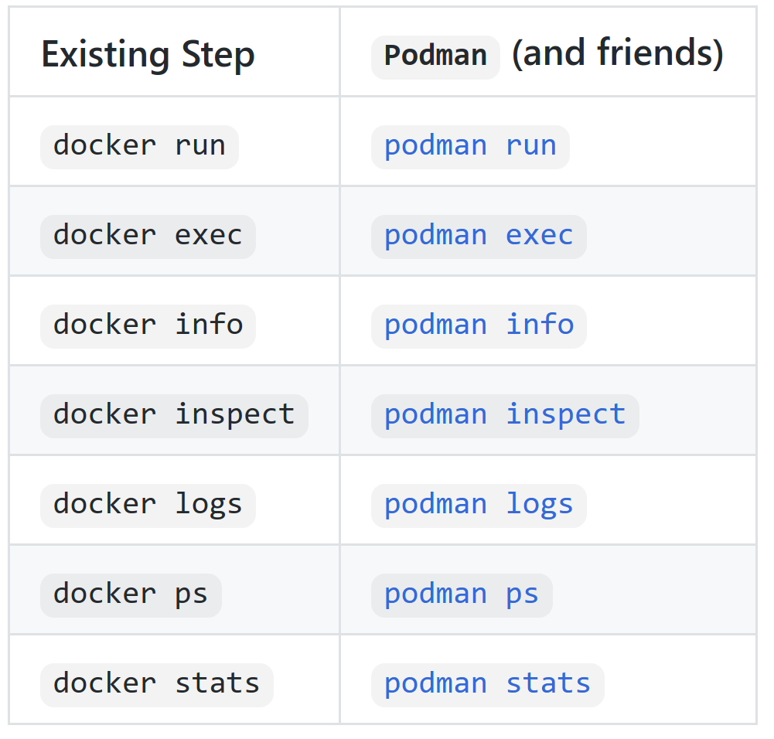
https://github.com/containers/podman/blob/master/transfer.md

Slide 9

...but...

Slide 10
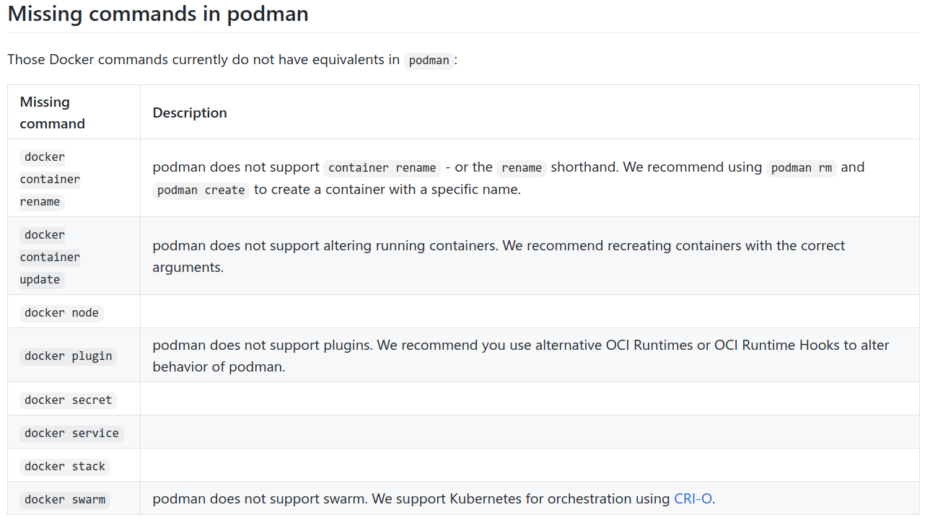
https://github.com/containers/podman/blob/master/transfer.md

Slide 11

docker-compose = podman-compose
?

Slide 12
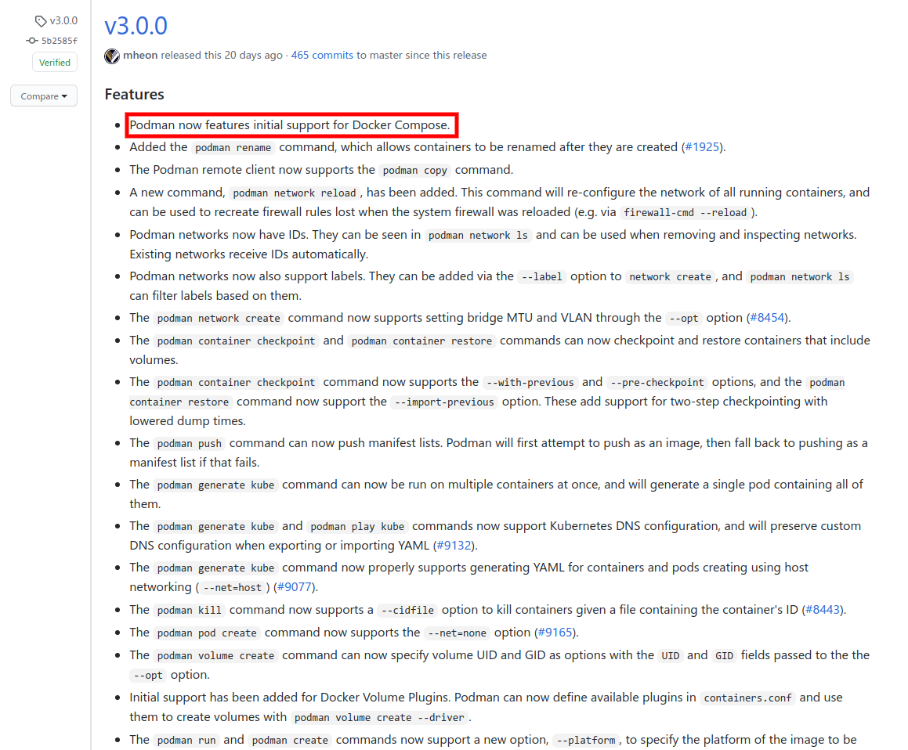
https://github.com/containers/podman/releases/tag/v3.0.0

Slide 13

Podman and Docker Compose

Slide 14
Start the Podman System Service
Be sure the podman-docker and docker-compose packages are installed
Enable and start the Podman systemd socket-activated service
Verify the service
$ sudo systemctl enable --now start podman.socket
$ sudo curl -H "Content-Type: application/json" --unix-socket /var/run/docker.sock http://localhost/_ping OK
https://www.redhat.com/sysadmin/podman-docker-compose
https://www.redhat.com/sysadmin/compose-kubernetes-podman

Slide 15

Run Compose
For example, using compose from https://github.com/docker/awesome-compose/tree/master/wordpress-mysql
Bring up the containers
Verify the containers running
Verify WordPress is running using the localhost and port 80
$ sudo docker-compose up -d
$ sudo podman ps
https://www.redhat.com/sysadmin/podman-docker-compose
https://www.redhat.com/sysadmin/compose-kubernetes-podman

Slide 16
Acknowledgement
Rifki Affandi (Awan Sakti, openSUSE-ID) "Daemonless with Podman" on Btech Bicara #20 https://www.youtube.com/watch?v=TXFLDQ3SS0I

Slide 17




Thank You
We are hiring
joinus@citra.digital

