Slide 1
Flatpak & AppImage Usage on openSUSE. Which One Suitable for openSUSE Users? openSUSE Asia Summit 2017
Chofu, Tokyo, Japan
October 21 - 22, 2017
Kukuh Syafaat
kukuh@syafaat.id

Slide 2

Hello (world)
Kukuh Syafaat
  インドネシア
  FOSS Enthusiast
  openSUSE-ID
  Translator
    https://l10n.opensuse.org
    https://l10n.gnome.org
    Some FOSS projects at transifex.com
  Endless Ambassador

Slide 3
アプリケーションコンテナ技術の Flatpak と AppImage どちらを使うべきか?
  アプリケーション、ライブラリを1つのコンテナ(パッケージ)にして どのディストリでも動くように

Slide 4
Cross Distribution Packages/Containerised
Applications

Slide 5
Snap, AppImage, Flatpak
Feature | Snap | AppImage | Flatpak
No software necessary to install a package | No | Yes | No
Shared runtimes | Basic | No | Full
Sandboxing | AppArmor | Yes | Custom
Repository support | Yes | No | Yes
Central repo | Yes | No | Yes
Updates | Automatic | Yes | Automatic
Source: https://www.devpy.me/snapcraft-appimage-flatpak/ with some changes

Slide 6
Snap
https://snapcraft.io/
The installation (on distros other than Ubuntu) of Snapcraft have a lot more difficult and buggy

Slide 7
Flatpak

Slide 8

Flatpak
Flatpak (formerly xdg-app) is a software utility for software deployment, package management, and application virtualization for Linux desktop computers.
http://flatpak.org/

Slide 9
Why Flatpak?
Access a wide variety of applications
Get new versions faster
Safely update your apps without having to reboot
Install different versions of the same application
Secure, sandboxed applications

Slide 10
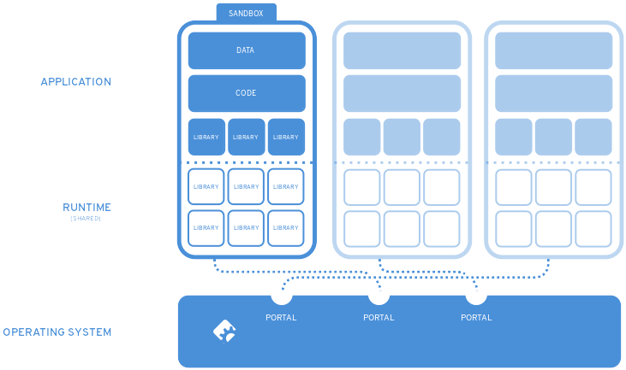

Slide 11
Install Flatpak on openSUSE
$ sudo zypper install flatpak
Current Version
Tumbleweed: 0.9.8
Leap 42.3: 0.8.6

Slide 12
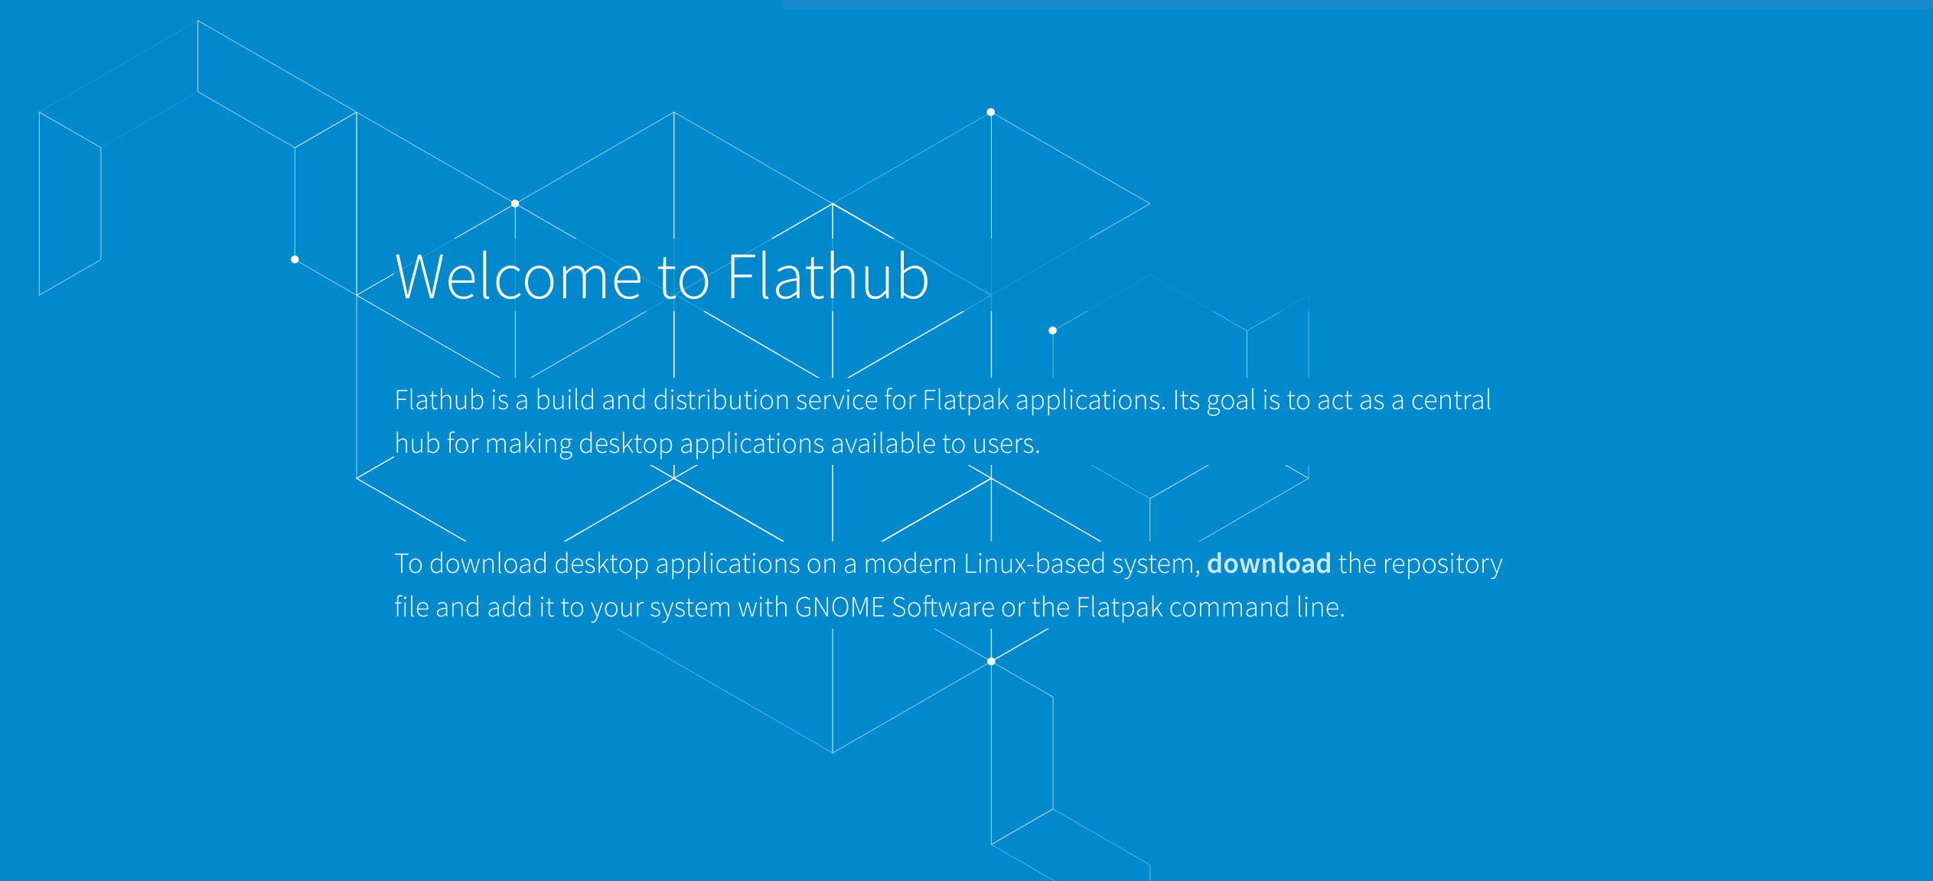
https://flathub.org/

Slide 13
Flatpak Repositories
Flathub
$ flatpak remote-add --if-not-exists flathub https://flathub.org/repo/flathub.flatpakrepo
GNOME
$ flatpak remote-add --if-not-exists gnome-nightly https://sdk.gnome.org/gnome-nightly.flatpakrepo
$ flatpak remote-add --if-not-exists gnome-apps-nightly https://sdk.gnome.org/gnome-apps-nightly.flatpakrepo

Slide 14
Flatpak
Case Study

Slide 15


Slide 16
LibreOffice in openSUSE
Current Version
  Tumbleweed: 5.4.2
  Leap 42.3: 5.3.6

Slide 17
LibreOffice Flatpak
http://www.libreoffice.org/download/flatpak/
http://download.documentfoundation.org/libreoffice/flatpak/
$ wget http://download.documentfoundation.org/libreoffice/flatpak/latest/LibreOffice.flatpak
$ flatpak install --user --bundle LibreOffice.flatpak
$ flatpak run org.libreoffice.LibreOffice

Slide 18


Slide 19
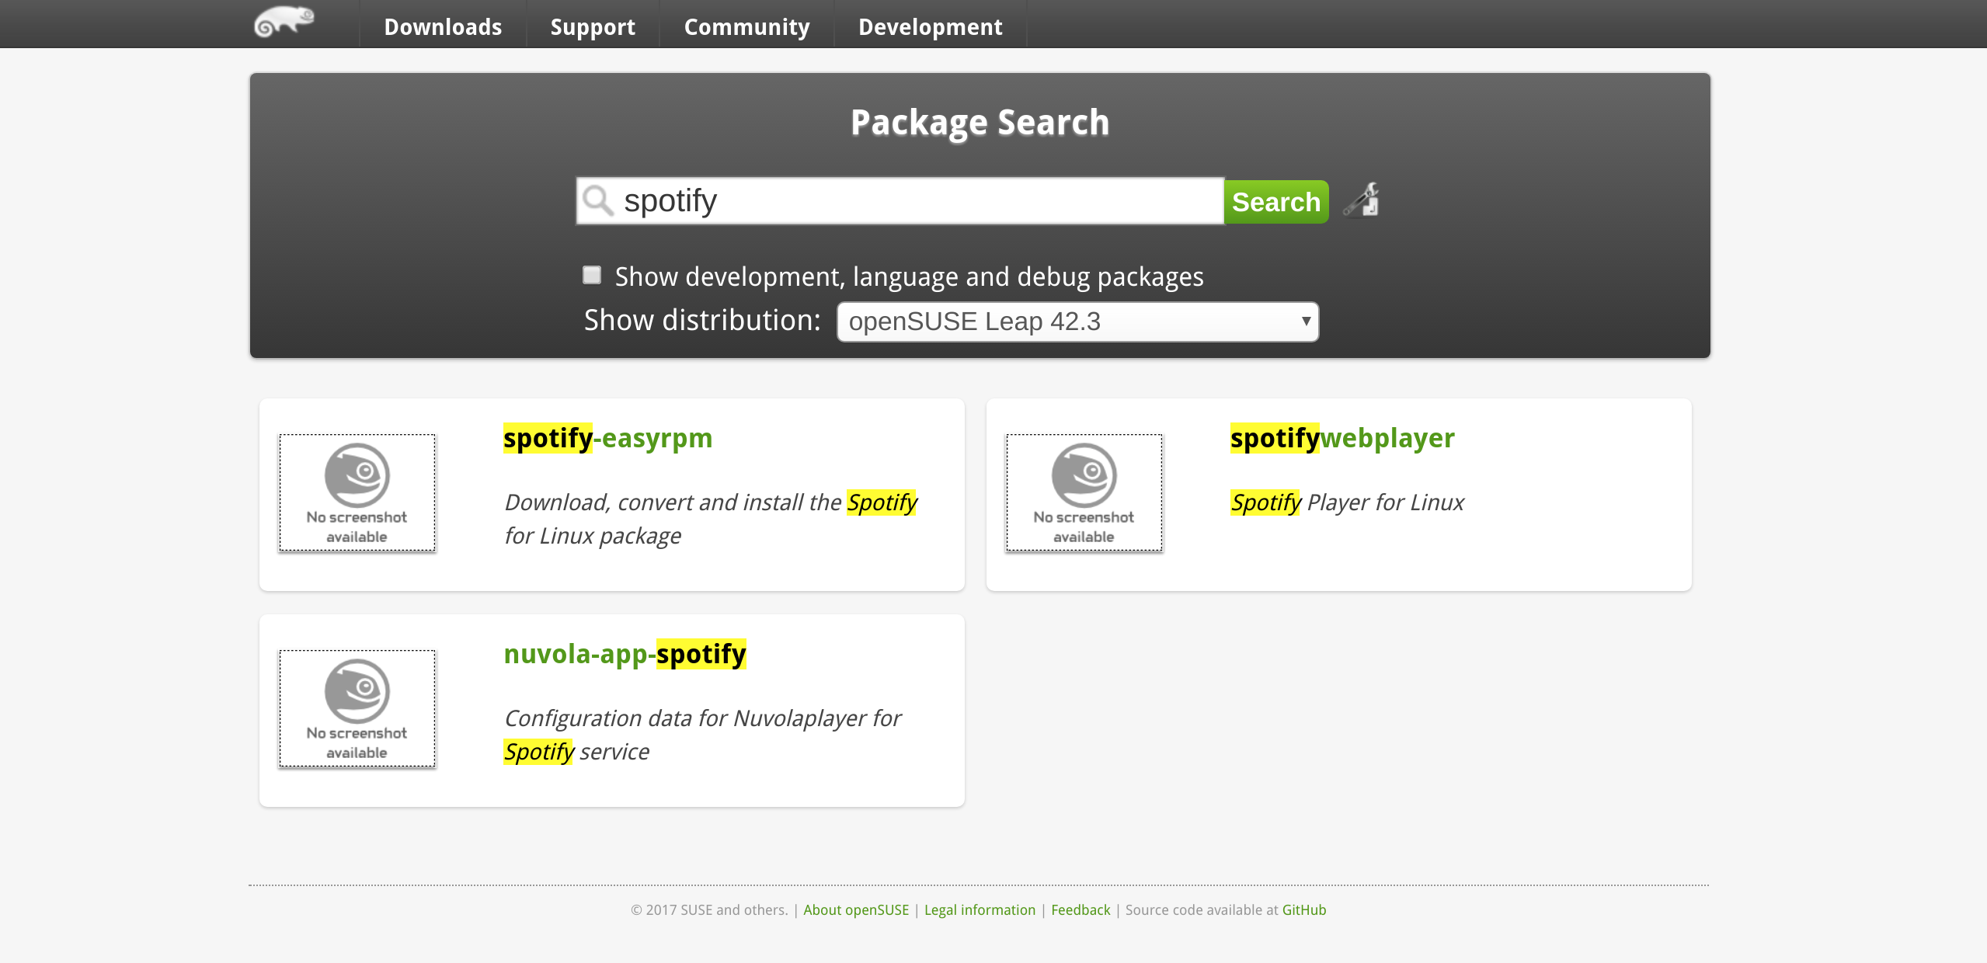

Slide 20
Spotify Flatpak
$ flatpak install --from https://flathub.org/repo/appstream/com.spotify.Client.flatpakref
$ flatpak run com.spotify.Client

Slide 21
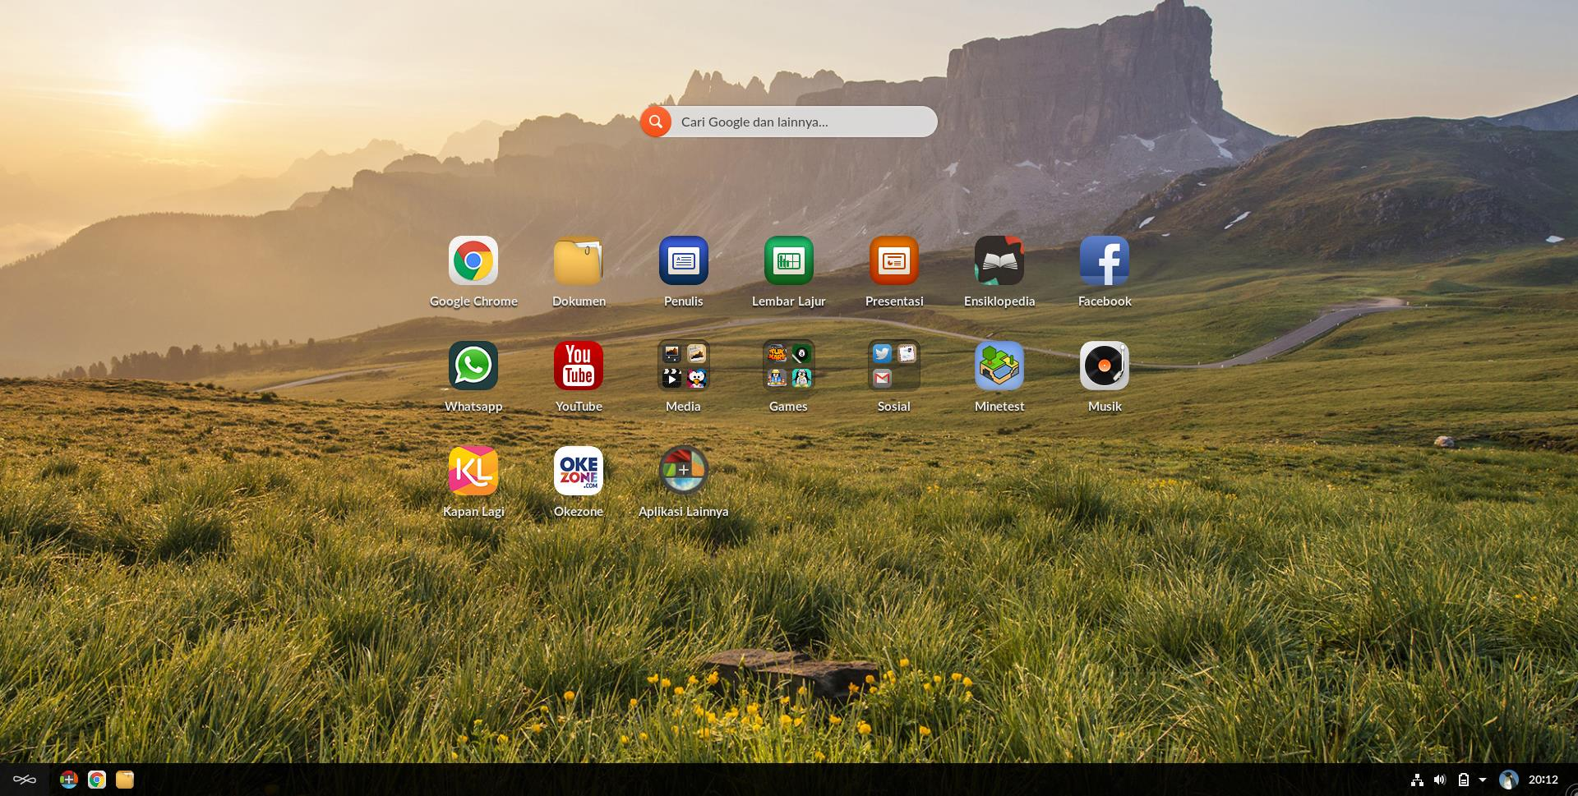
https://endlessos.com/

Slide 22

= Flatpak + GNOME + OSTree

Slide 23
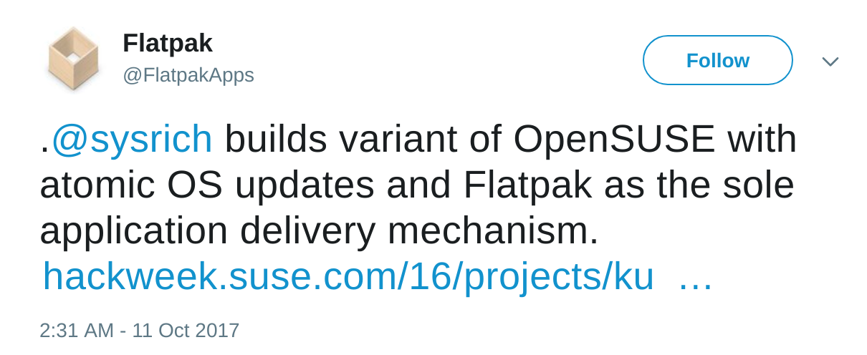
Source: https://twitter.com/FlatpakApps/status/918046440231964672

Slide 24
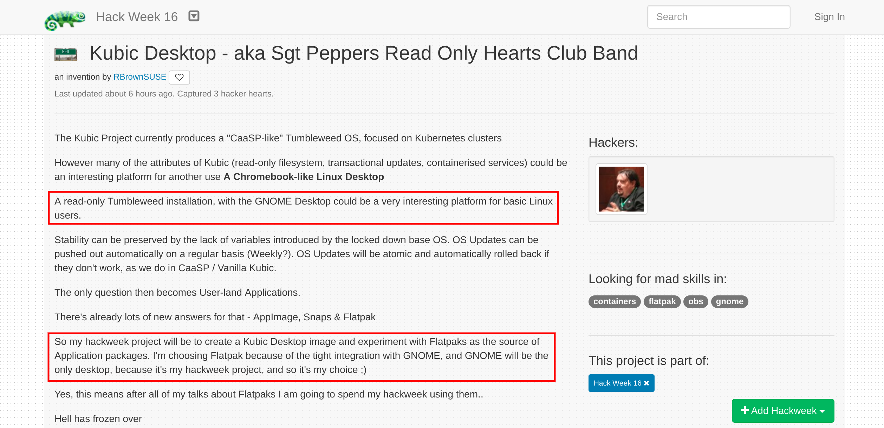

Slide 25
AppImage

Slide 26
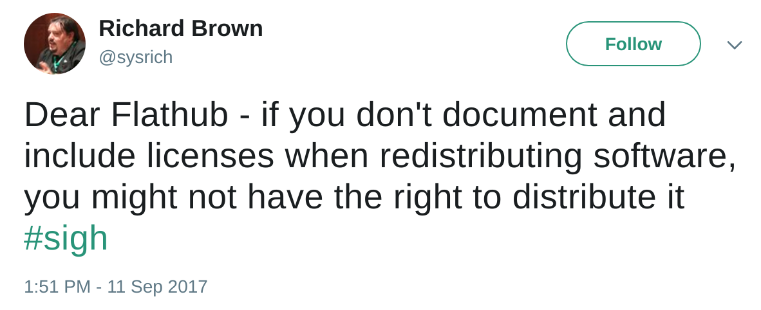
Flatpak/Flathub Issues
Source: https://twitter.com/sysrich/status/907134588941729792

Slide 27

AppImage
Format for distributing portable software on Linux without needing superuser permissions to install the application.
https://appimage.org/

Slide 28
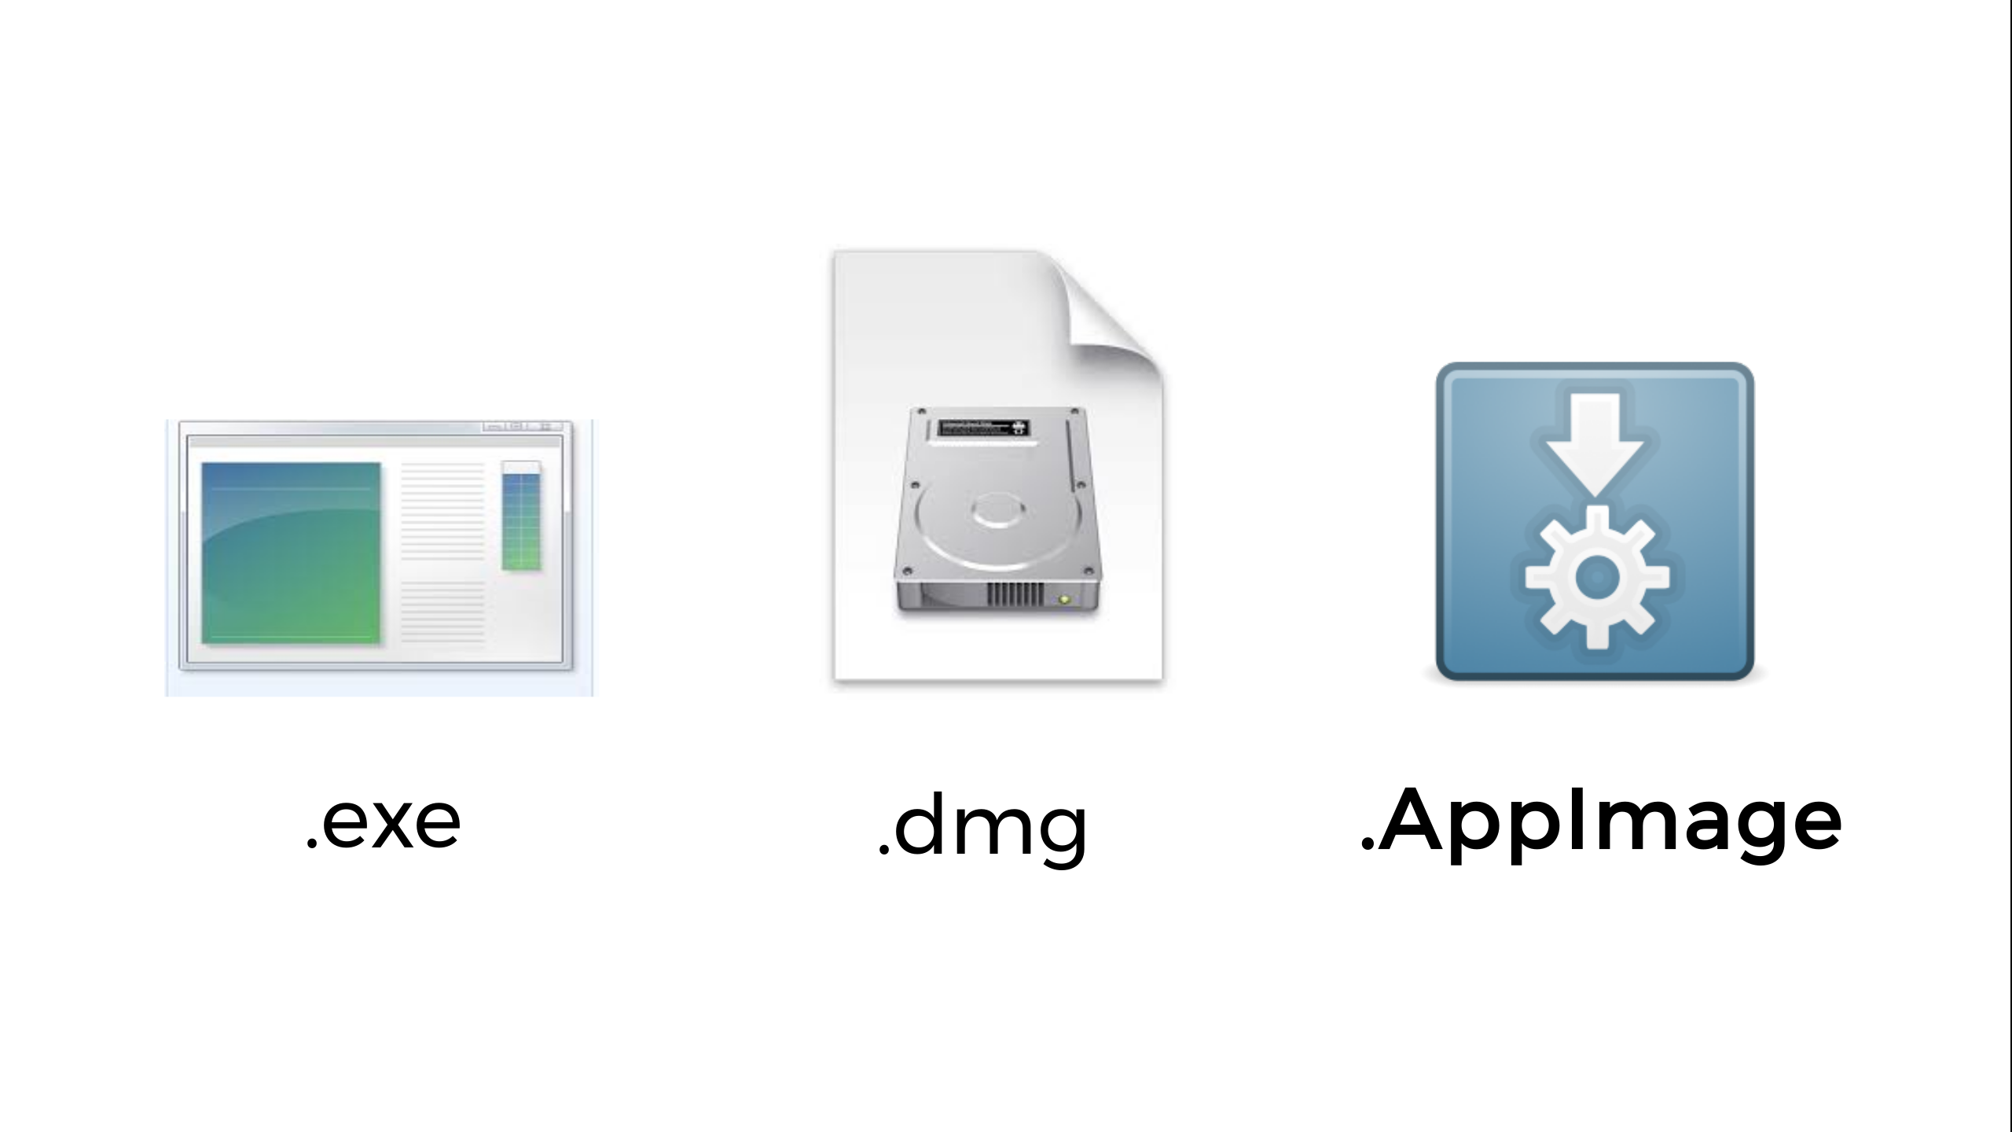
Source: https://speakerdeck.com/probonopd/opensuse-conference-2017-obs-b-appimage

Slide 29
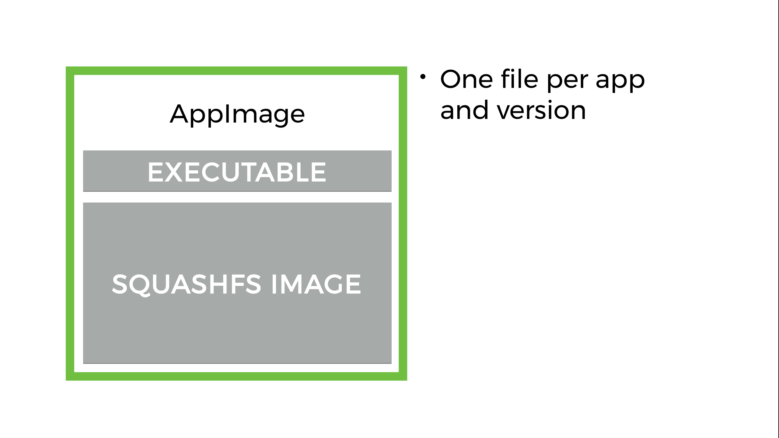
Source: https://speakerdeck.com/probonopd/opensuse-conference-2017-obs-b-appimage

Slide 30
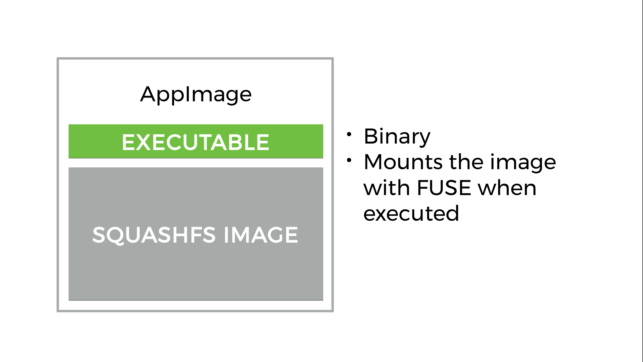
Source: https://speakerdeck.com/probonopd/opensuse-conference-2017-obs-b-appimage

Slide 31
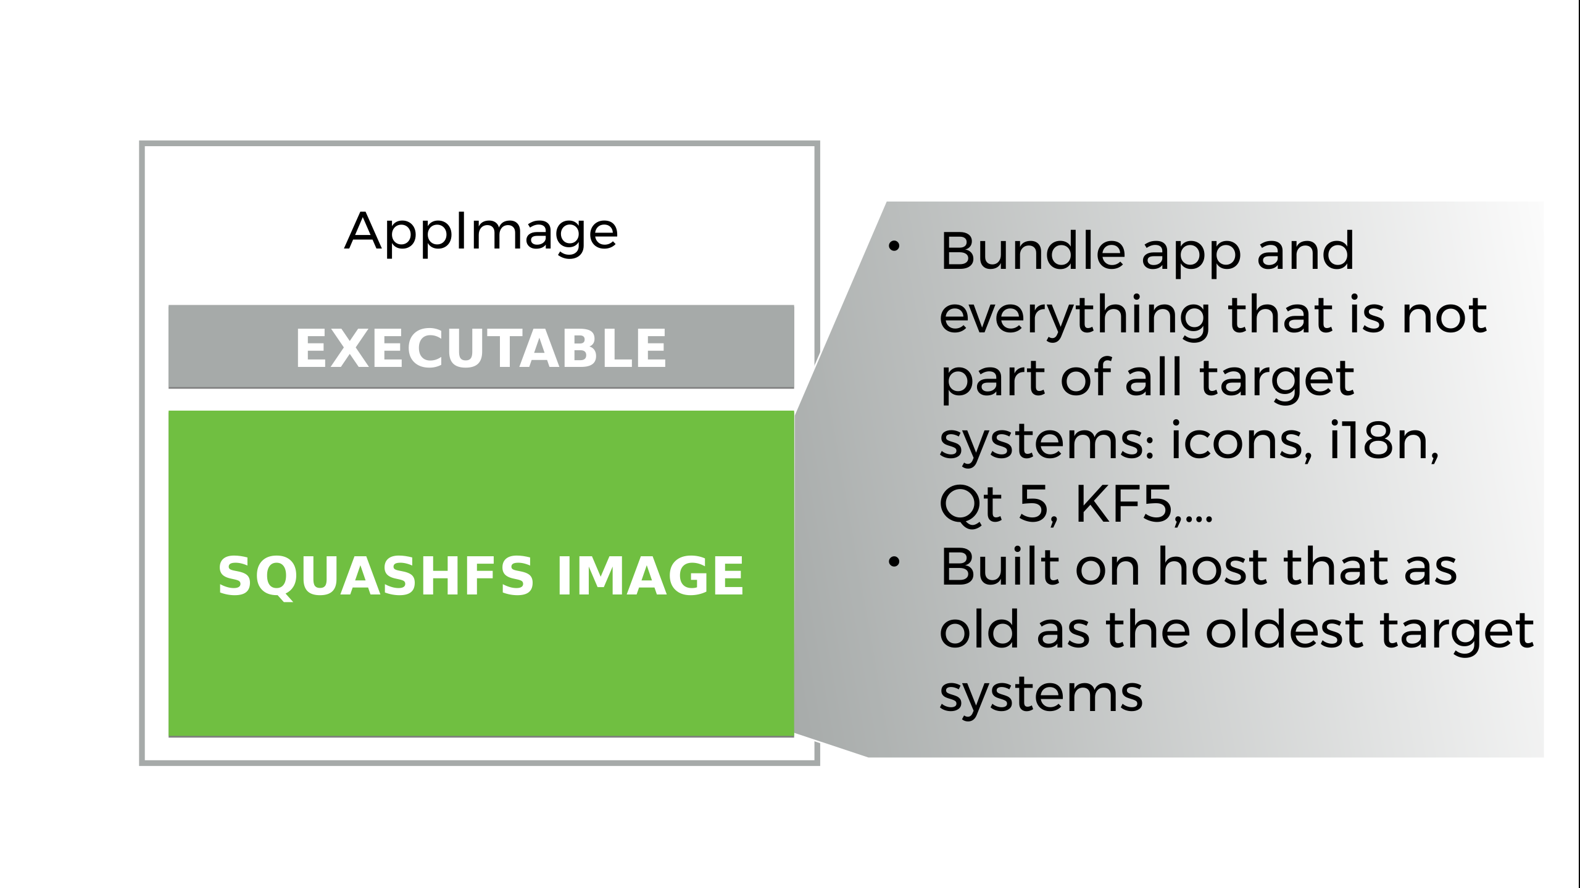
Source: https://speakerdeck.com/probonopd/opensuse-conference-2017-obs-b-appimage

Slide 32
Running AppImage
Make it executable
$ chmod a+x YourApp.AppImage
Run
$ ./YourApp.AppImage

Slide 33
AppImage
Case Study

Slide 34
LibreOffice AppImage
http://libreoffice.soluzioniopen.com/
  Stable
    LibreOffice-5.3.6
    LibreOffice-5.4.1
  Pre-Releases
    LibreOffice-5.4.2.2
  Daily
    LibreOfficeDev-6.0.0

Slide 35

Kdenlive
https://kdenlive.org/download/
  Latest AppImage 17.08.1

Slide 36

OpenShot
http://www.openshot.org/download/
  Latest AppImage v2.4.0

Slide 37

Krita
https://krita.org/en/download/krita-desktop/
  Latest AppImage v3.3.0

Slide 38
AppImageHub
Crowd-sourced central AppImage directory
https://appimage.github.io/apps/

Slide 39
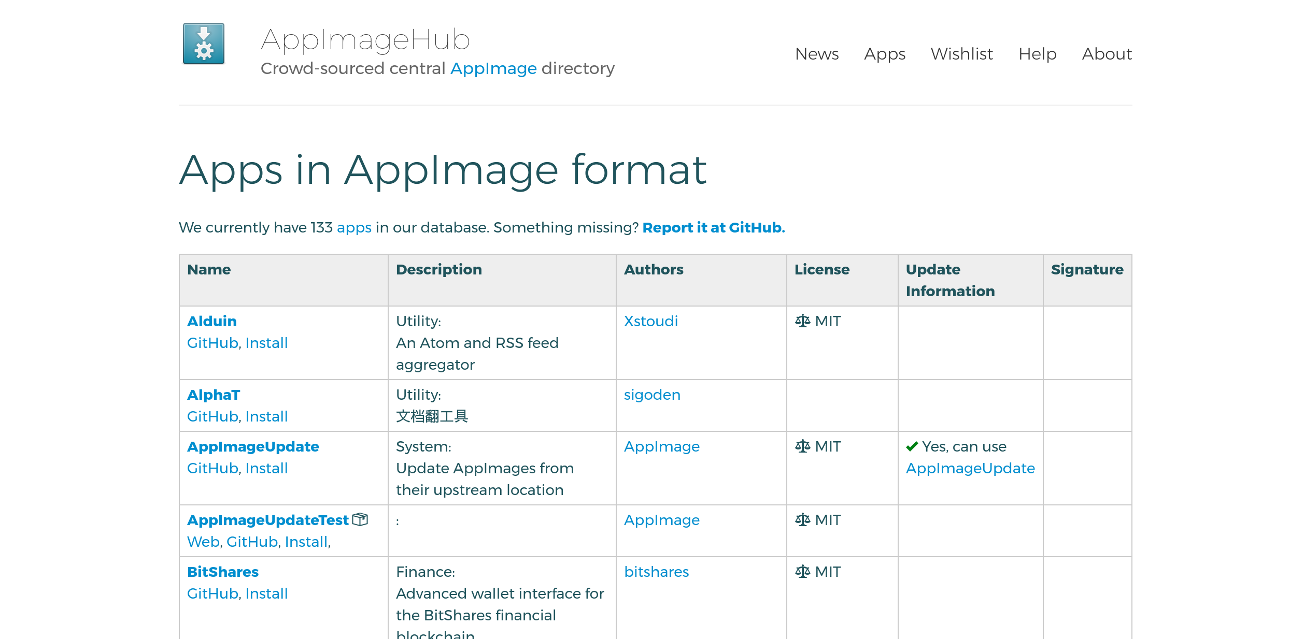

Slide 40
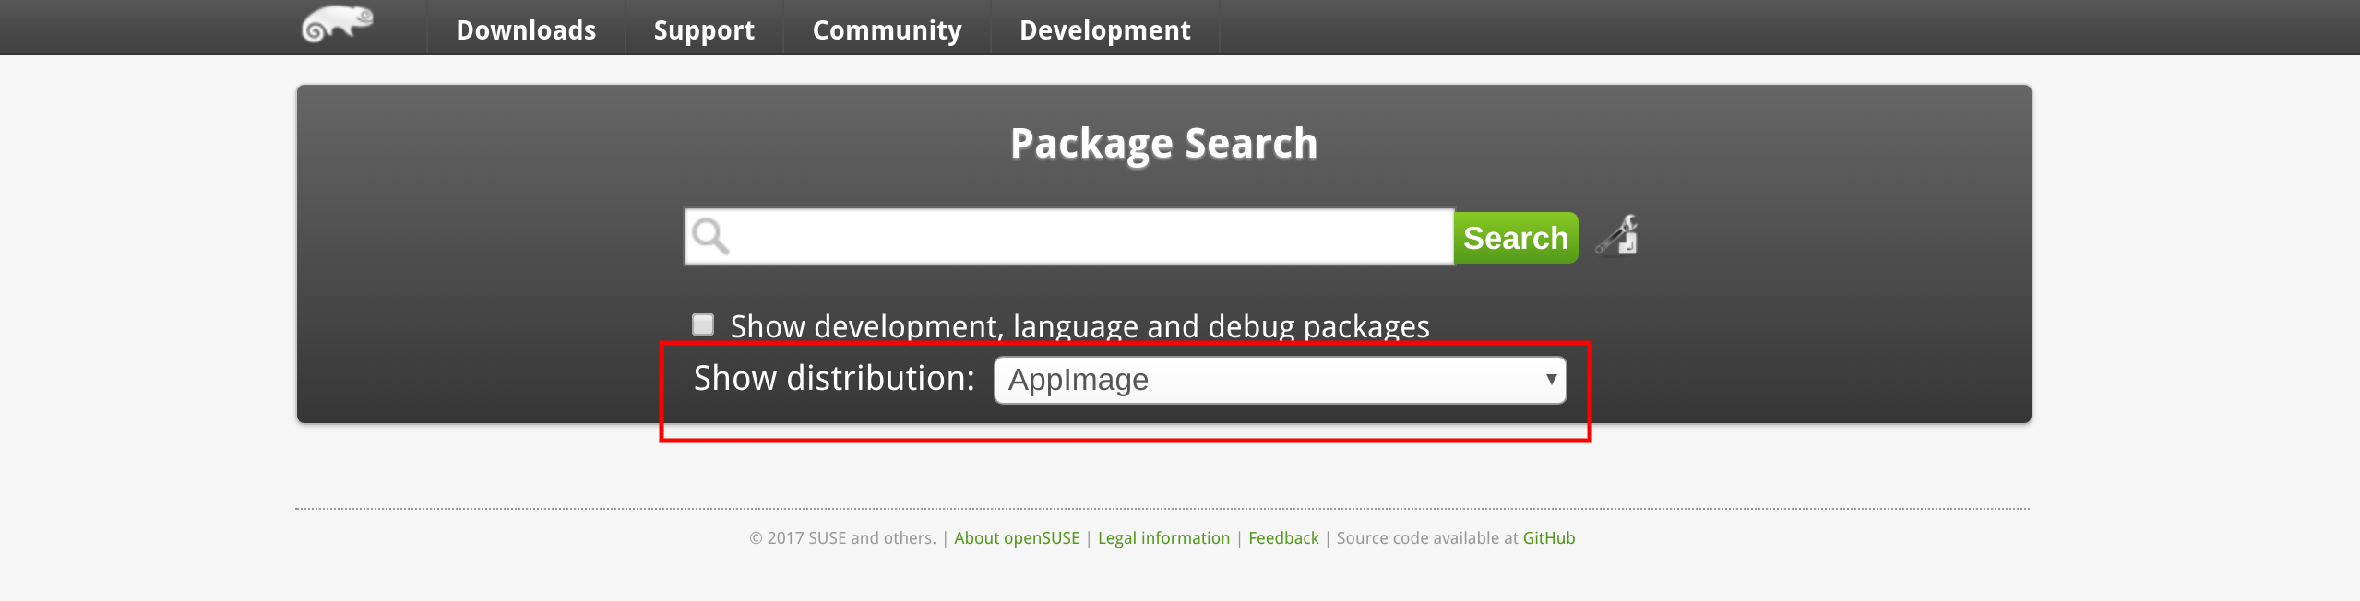

Slide 41
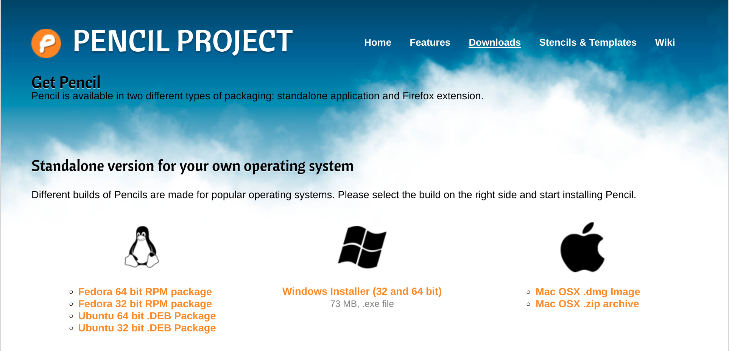

Slide 42
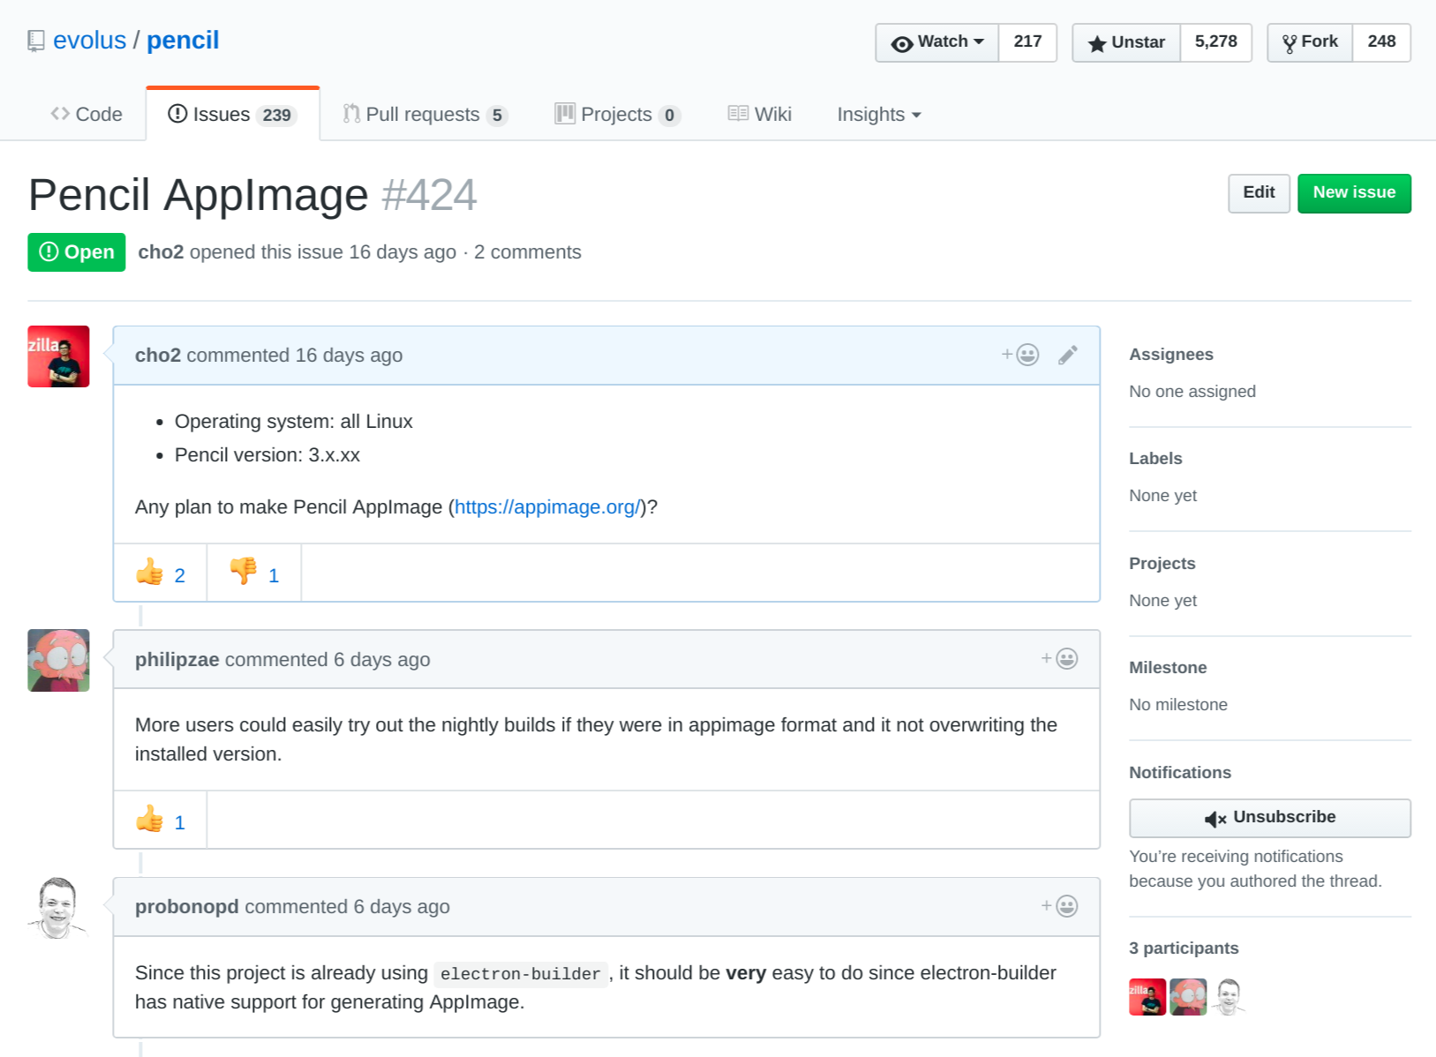

Slide 43
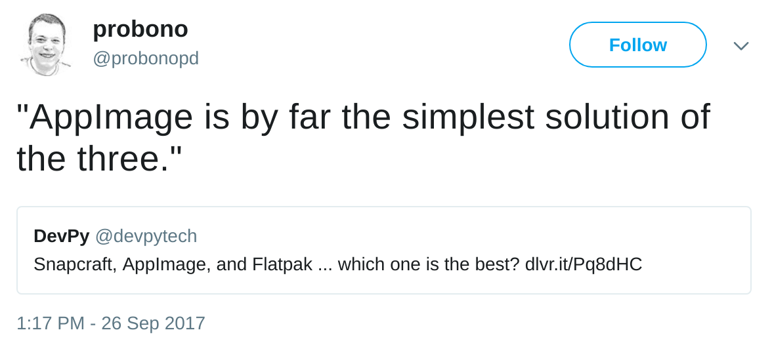
Source: https://twitter.com/probonopd/status/912561641316847616

Slide 44
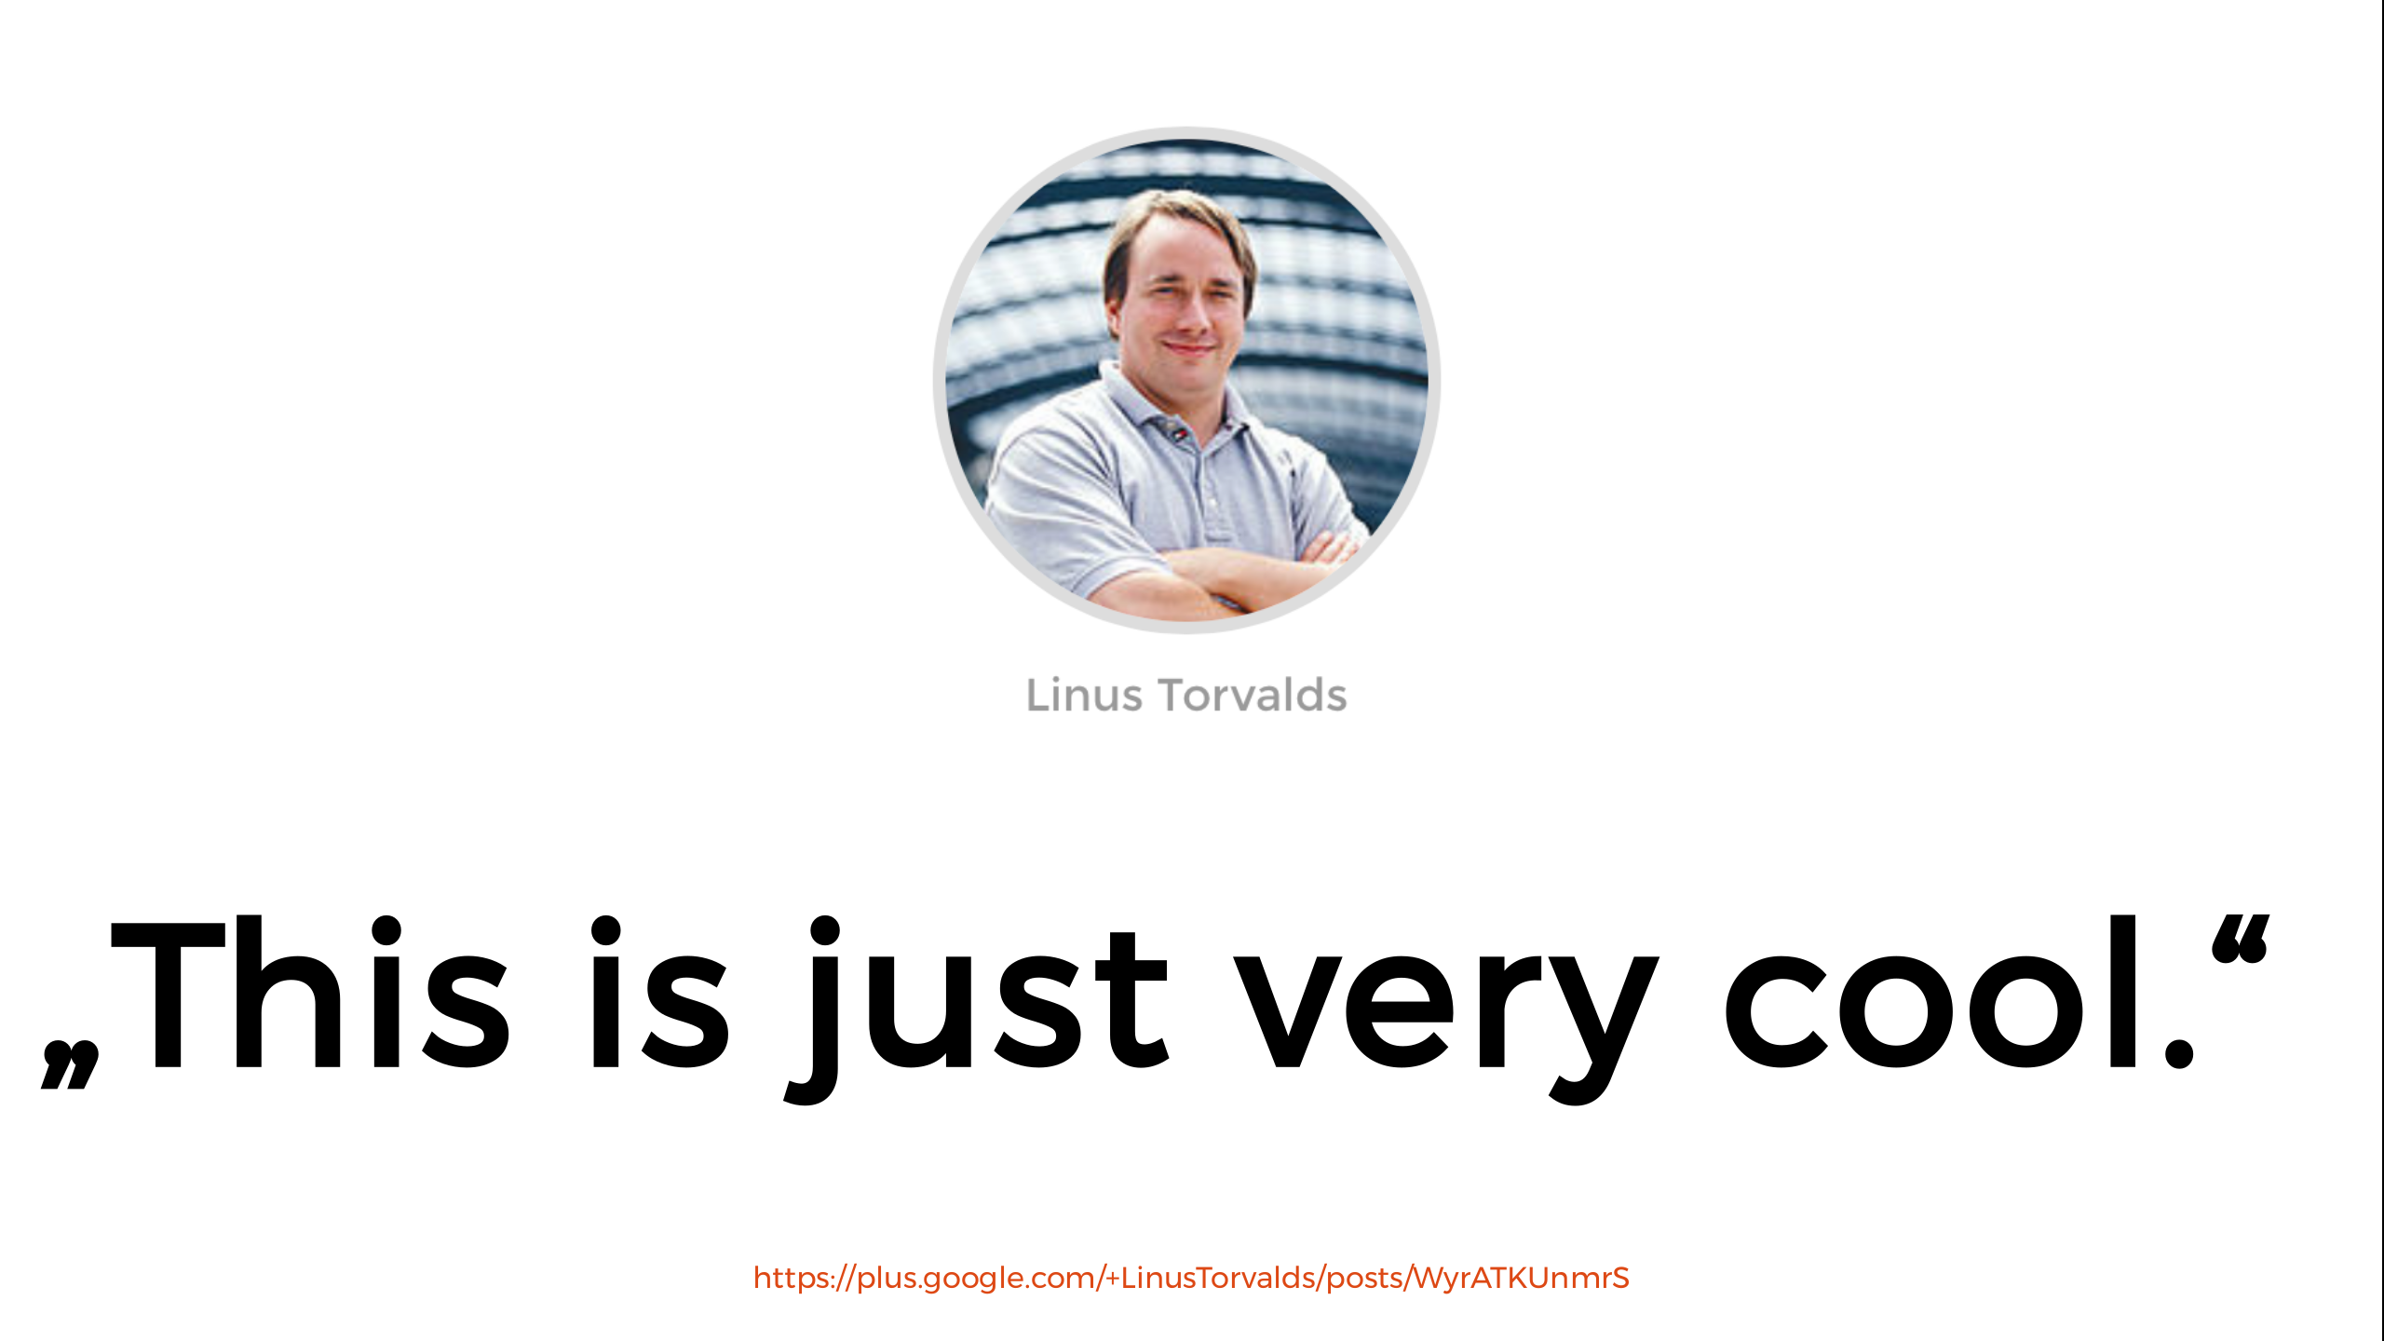
Source: https://speakerdeck.com/probonopd/opensuse-conference-2017-obs-b-appimage

Slide 45
AppImage & Flatpak
Feature | AppImage | Flatpak
No software necessary to install a package | Yes | No
Shared runtimes | No | Full
Sandboxing | Yes | Custom
Repository support | No | Yes
Central repo | No | Yes
Updates | Yes | Automatic
Source: https://www.devpy.me/snapcraft-appimage-flatpak/ with some changes

Slide 46

Next session:
Using OBS to Build Containerised Application Image
Learn How To Generate AppImage

Slide 47
Q&A

Slide 48
THANK YOU
ありがとうございました

