Slide 1
Translating
Open Source
Apps
openSUSE Virtual Summit 2020
Kukuh Syafaat
openSUSE-ID
cho2@opensuse.{org,id}

Slide 2
Agenda
l10n vs i18n
Online vs Offline Translations
Problems on Translations
Tips

Slide 3
l10n vs i18n

Slide 4
l10n
Localization
  Localization refers to the adaptation of a product, application or document content to meet the language, cultural and other requirements of a specific target market (a locale). (source: w3.org)

Slide 5
i18n
Internationalization
  Internationalization is the design and development of a product, application or document content that enables easy localization for target audiences that vary in culture, region, or language. (source: w3.org)

Slide 6
Online
vs
Offline
Translations

Slide 7
Online Translations
Using web, e.g.
  Weblate
    Weblate: https://hosted.weblate.org
    openSUSE: https://l10n.opensuse.org
    LibreOffice: https://translations.documentfoundation.org
    Elementary: https://l10n.elementary.io

Slide 8
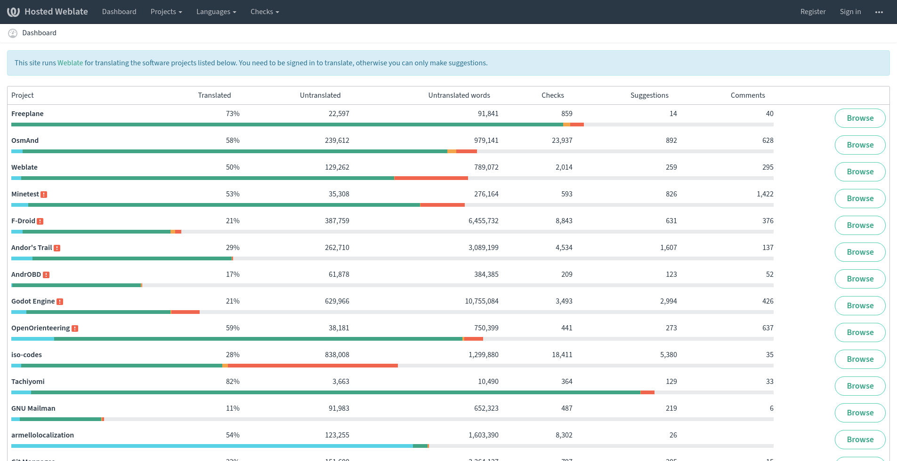
Weblate

Slide 9
Online Translations (2)
Using web, e.g.
  Transifex
    MATE: https://www.transifex.com/mate
    Xfce: https://www.transifex.com/xfce
    Endless OS: https://www.transifex.com/endless-os

Slide 10
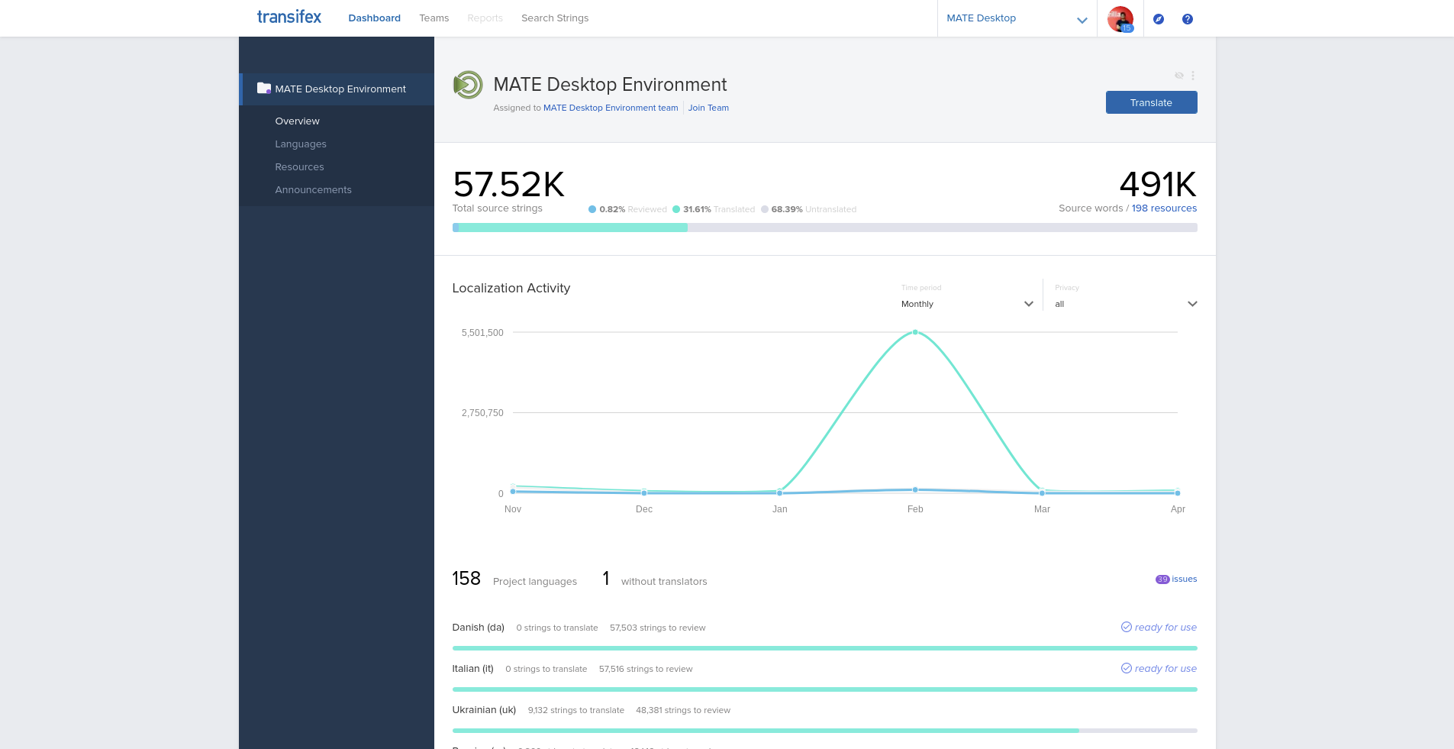
Transifex

Slide 11
Online Translations (3)
Using web, e.g.
  Pootle
    Gajim: https://translate.gajim.org/
  Zanata
    Openstack: https://translate.openstack.org
    Fedora: https://fedora.zanata.org

Slide 12
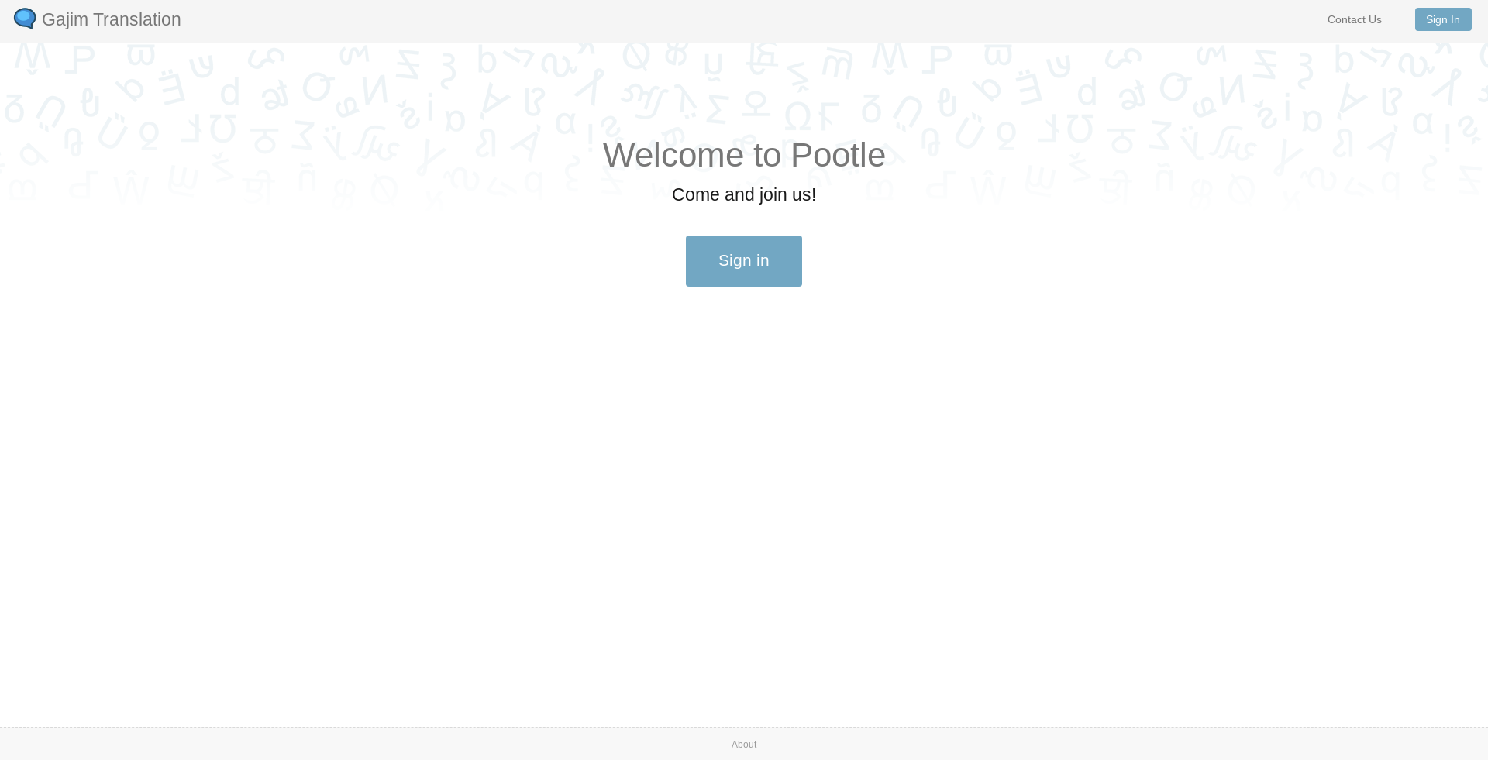
Pootle

Slide 13
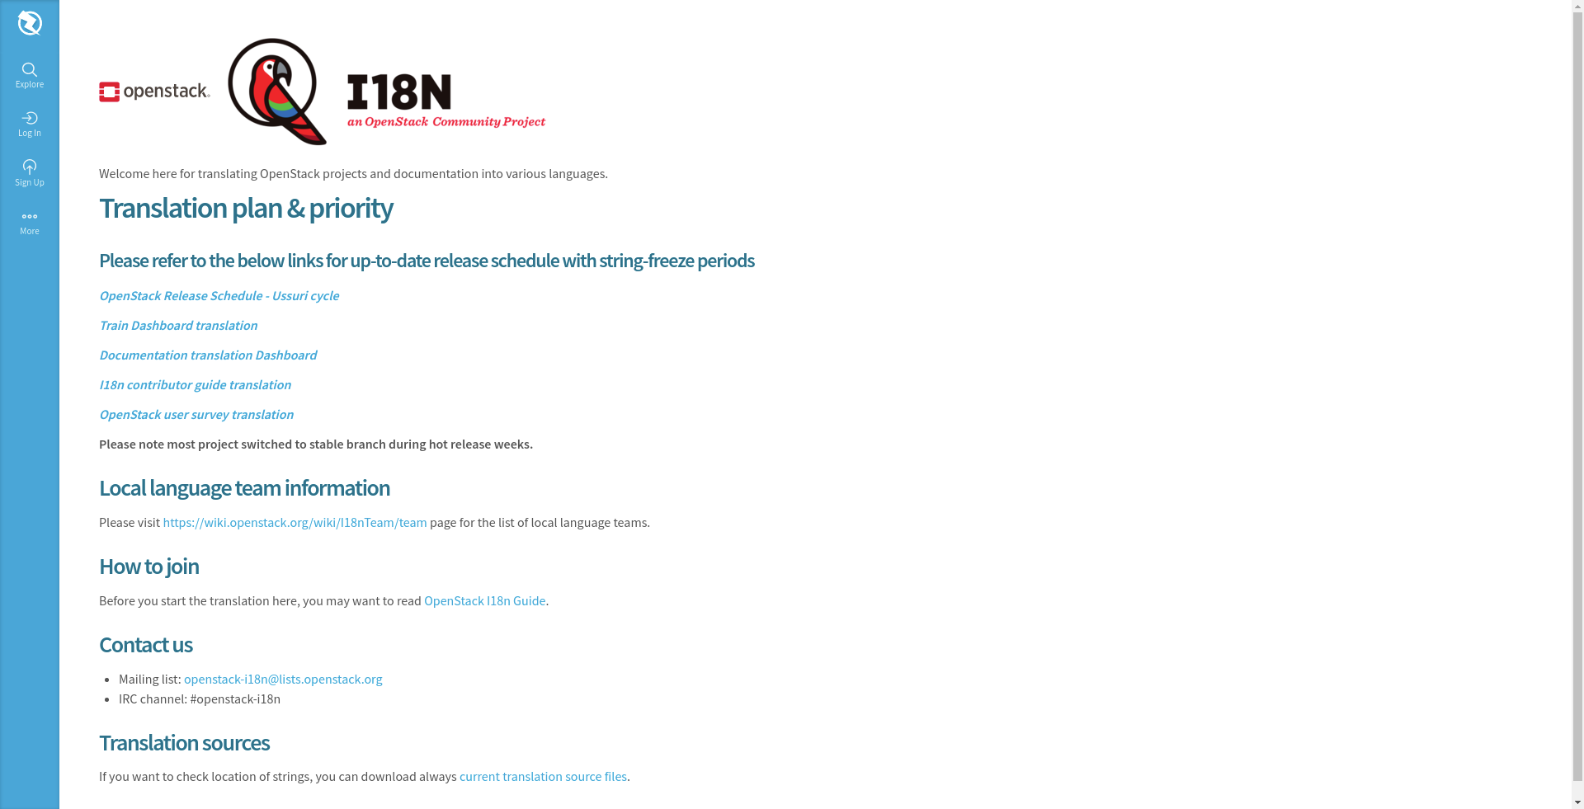
Zanata

Slide 14
Offline Translations
Using desktop apps, e.g.
  Poedit
  Gtranslator (GNOME)
  Lokalize (KDE)

Slide 15
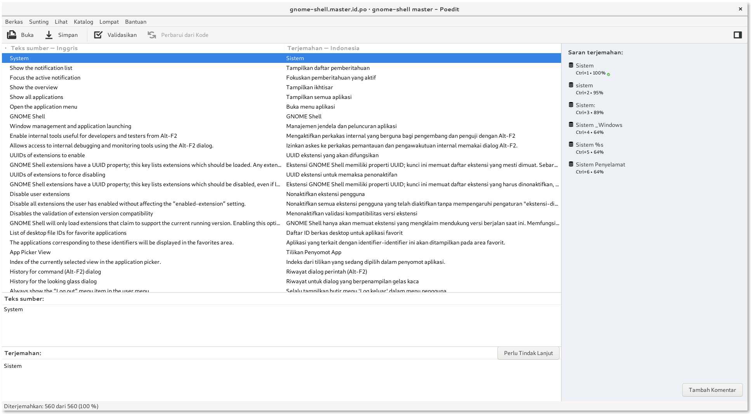
Poedit

Slide 16
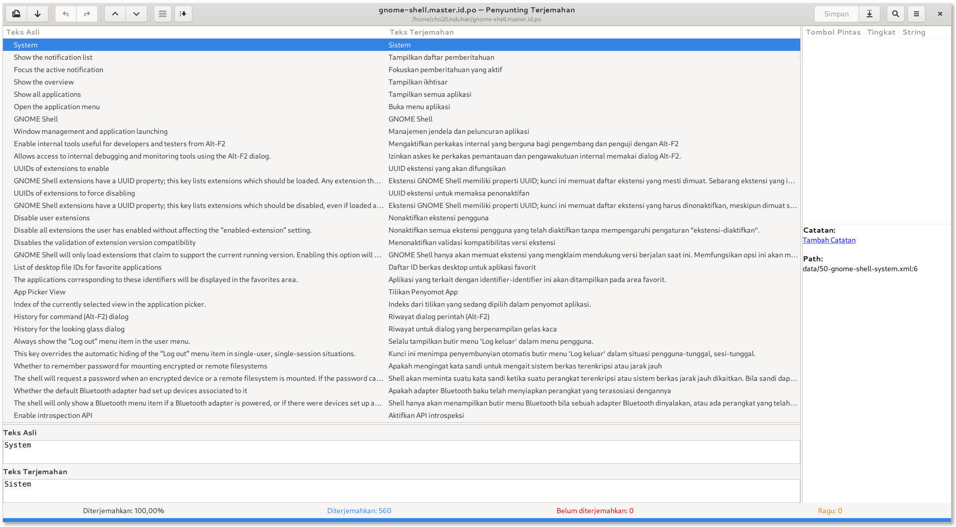
Gtranslator

Slide 17
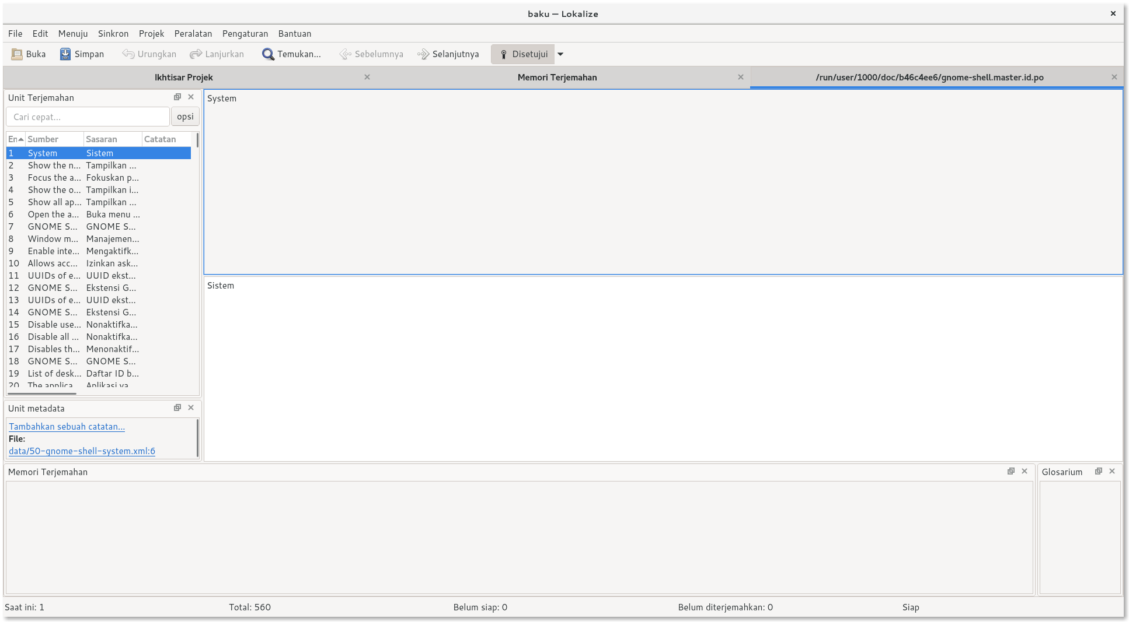
Lokalize

Slide 18
Offline Translations (2)
Download po files, translate locally, then upload it.
  GNOME - Damned Lies: https://l10n.gnome.org
  KDE - SVN: https://l10n.kde.org

Slide 19
Problems on
Translations

Slide 20
Shortcut & Access Keys
Trigger letters are marked with special characters
  & (https://en.wikipedia.org/wiki/Ampersand)
  _ (https://en.wikipedia.org/wiki/Underscore)
  ...

Slide 21
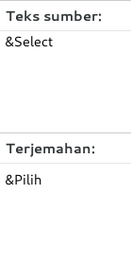

Shortcut & Access Keys (2)

Slide 22
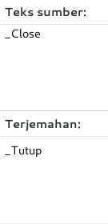
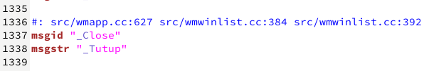
Shortcut & Access Keys (3)

Slide 23
Shortcut & Access Keys (4)
It should be noted that the uniqueness of the trigger letters at each level is parallel, not the position of the trigger letters on the translated string
As much as possible keep the triggers in the original language

Slide 24
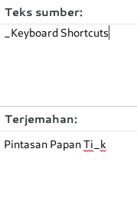
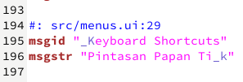
Shortcut & Access Keys (5)

Slide 25
Variable Placeholder
The translation line may contain dynamic variables, which will be processed when the program is run

Slide 26
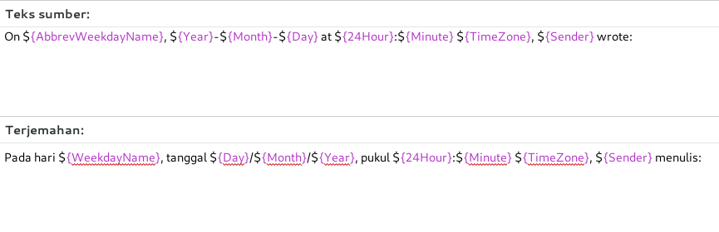
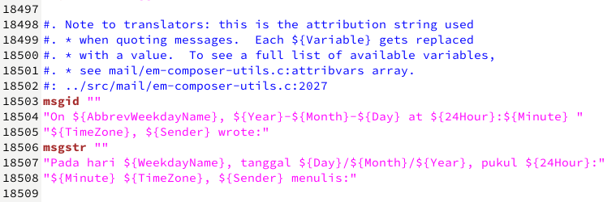
Variable Placeholder (2)

Slide 27
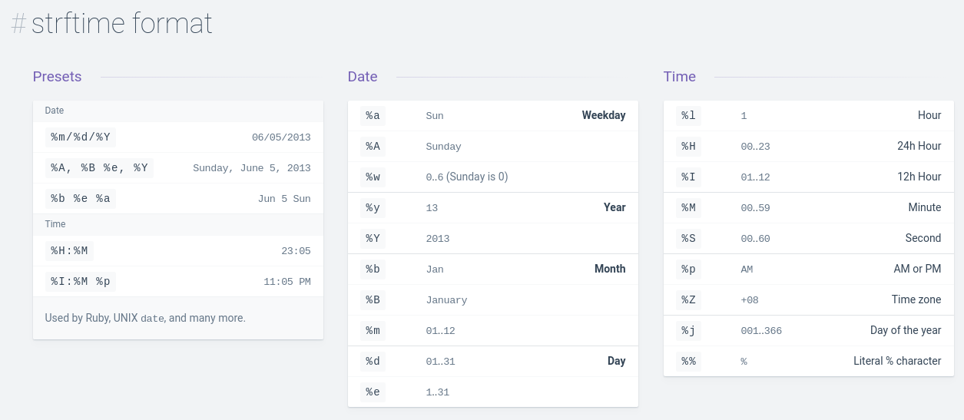
Date and Time Format
https://devhints.io/datetime

Slide 28
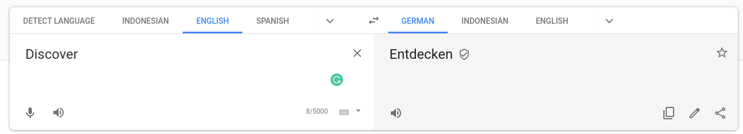
Context
Example: “Discover”

Slide 29
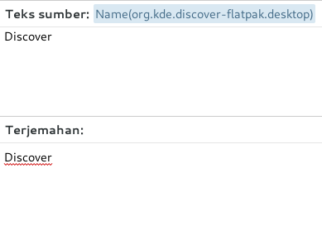
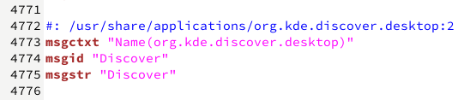
Context (2)

Slide 30
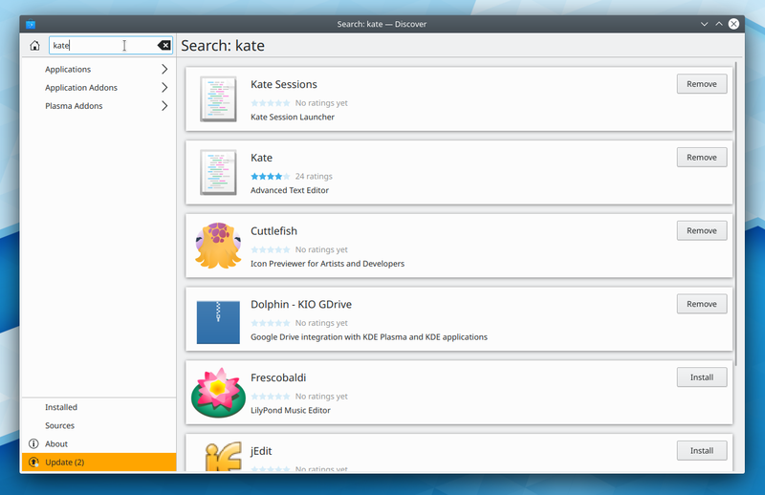
Context (3)

Slide 31
Tips

Slide 32
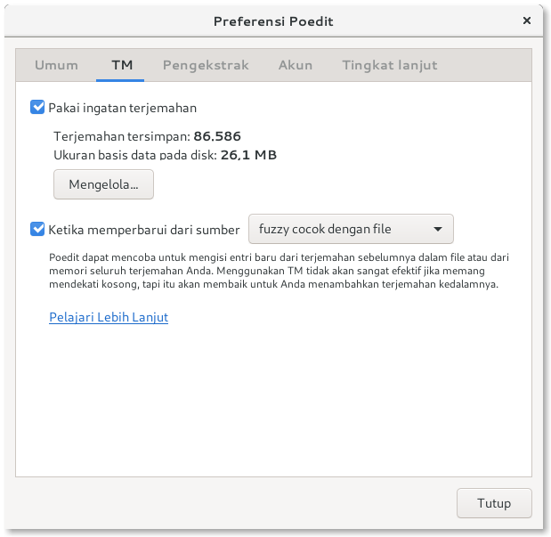
Tips
Use Translation Memory
  Can be initialized from another translation
  Need to pay attention to the license

Slide 33
THANK YOU

