Slide 1

Building Upstream Contribution in Local FOSS Community
Based on openSUSE and LibreOffice Community in Indonesia
Kukuh Syafaat
FOSS Enthusiast
cho2@{opensuse, libreoffice}.id

Slide 2
Building Upstream Contribution in Local FOSS Community
Based on openSUSE and LibreOffice Community in Indonesia

Slide 3

Building Upstream Contribution in Local FOSS Community
Based on openSUSE and LibreOffice Community in Indonesia
Kukuh Syafaat – cho2@{opensuse,libreoffice}.id

Slide 4
Background
01
02
People
People in the community are end-user and tech savvy
People
Not all people in the community willing to contribute
03
04
Contribute
Some people in the community who willing to contribute not doing the technical stuff
Contribute
Some people in the community that have technical background contribute to non-technical stuff

Slide 5
Background
05
06
Community
Some people involved in more than one local and upstream community
Project
Some people involved in more than one FLOSS project
07
08
People
People in the community, easy come, easy go
Contribute
Starting a contribution is easy, the continuous contribution is hard

Slide 6
Upstream Contribution
From Local Community in ID
openSUSE
LibreOffice
<>
Other FLOSS Project
(Inkscape, GCompris)
GNOME
KDE
Upstream

Slide 7


Slide 8
openSUSE in Indonesia
openSUSE Indonesia Community, a.k.a openSUSE-ID, established in July 23, 2007
The one and only openSUSE Community in Indonesia

Slide 9
openSUSE-ID in Numbers (per 20201016)
Item | Numbers
openSUSE Members | 13
Telegram group members | 901
Twitter followers | 487
Facebook group members | 4479
Facebook page likes | 1548
YouTube subscribers | 119

Slide 10
Local Contribution to Upstream
Mirror
Election
Committee
Heroes
l10n
Artwork
Conference

Slide 11
Mirror
repo.opensuse.id
iso
repo
packman
Serve SEA, mostly ID region
openSUSE-ID maintaining
Leap & Tumbleweed mirror as listed on mirrors.opensuse.org
There are 3 another openSUSE mirror in ID
twrepo.opensuse.id
iso
repo
Serve SEA (ID, MY, SG region)



Slide 12
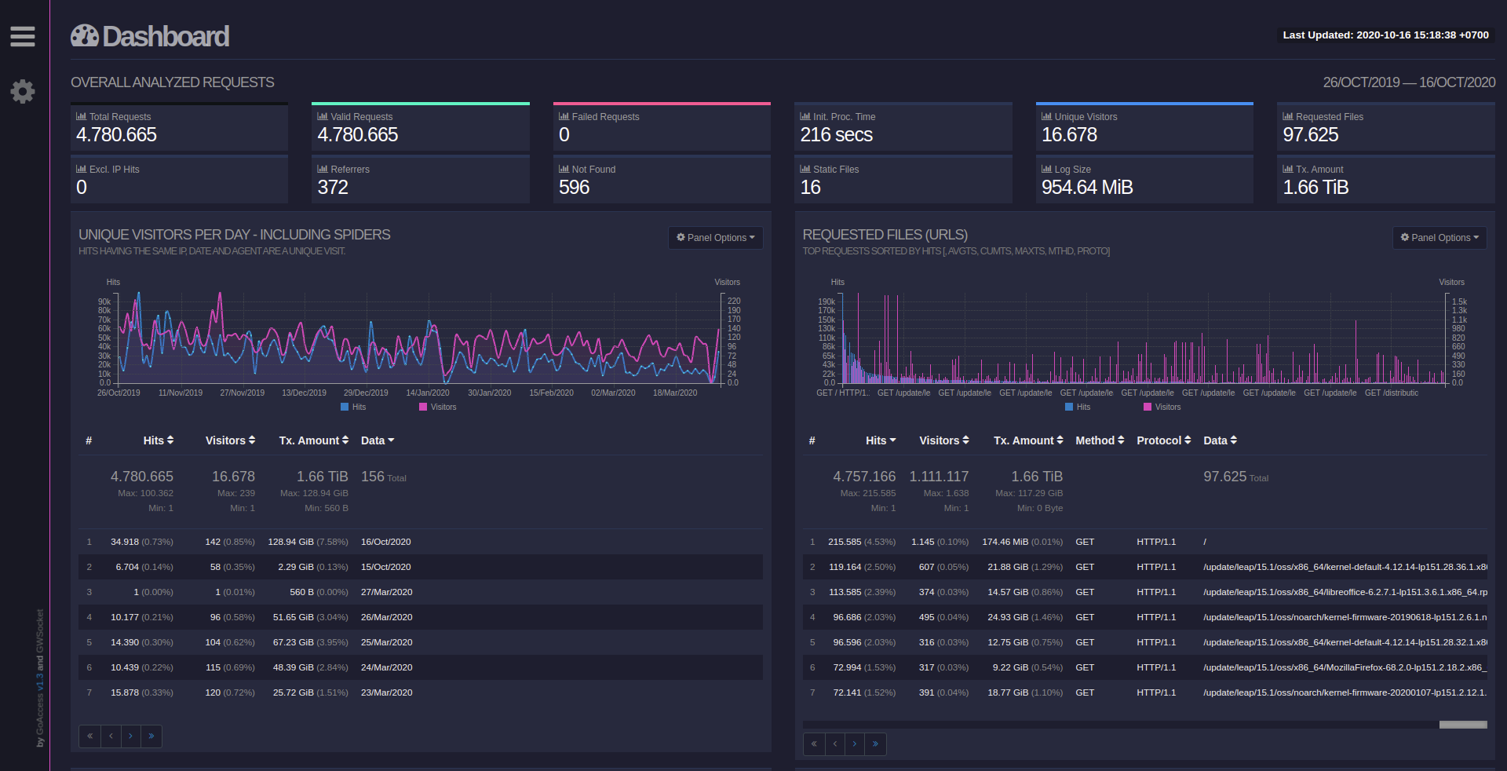
https://repo-stat.opensuse.id/report.html

Slide 13
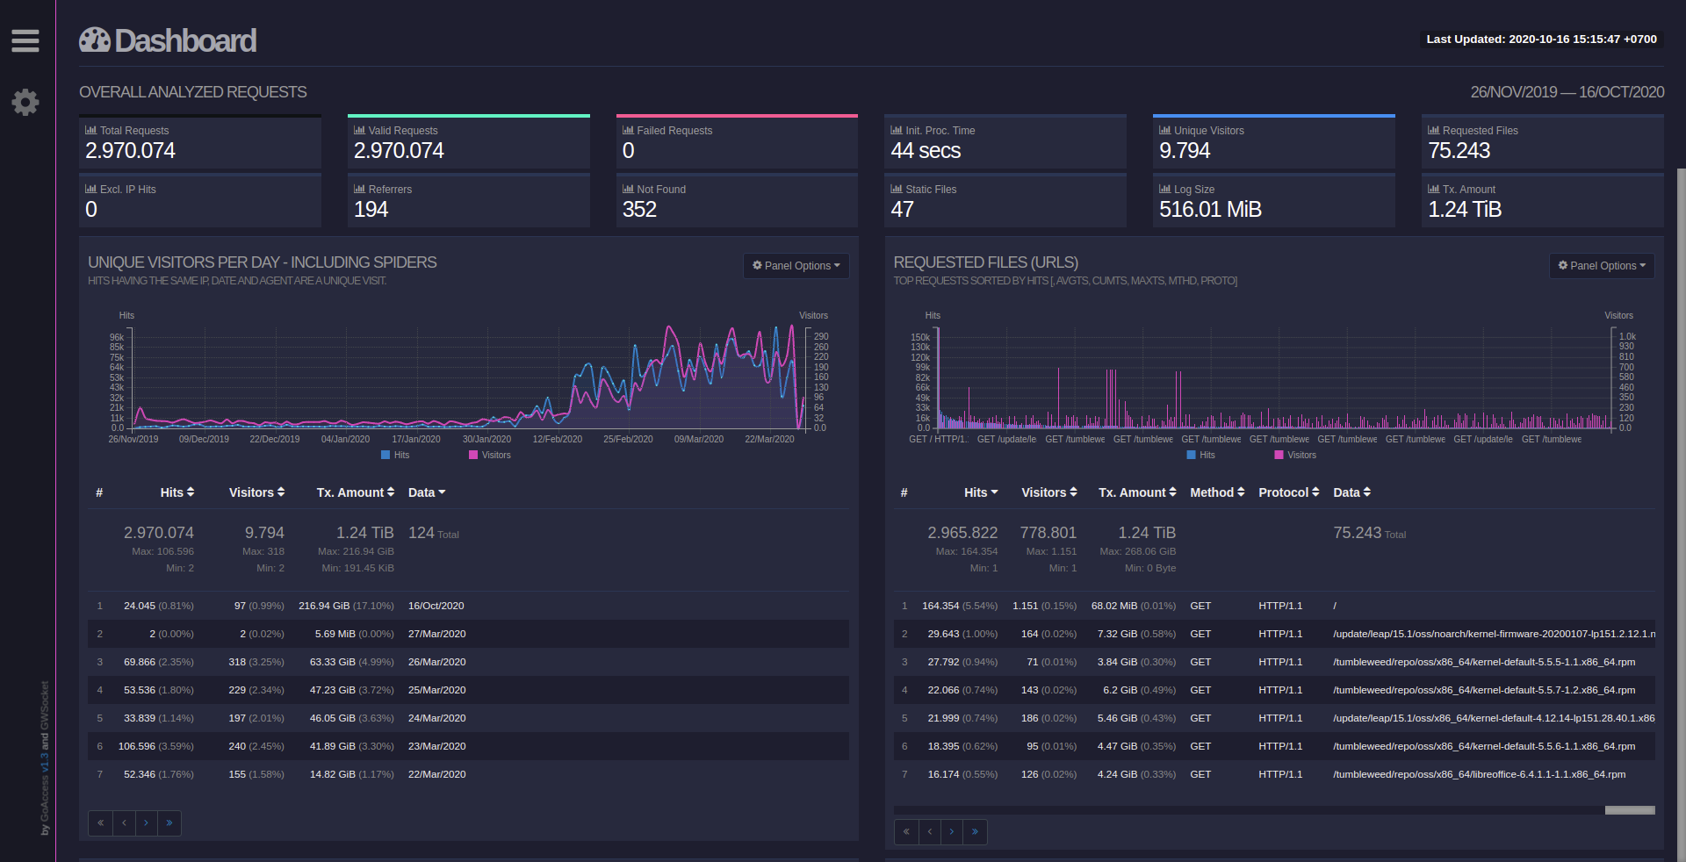
https://twrepo-stat.opensuse.id/report.html

Slide 14
Election Committee
Election Committee on openSUSE Board Election consists of three peoples. Edwin Zakaria was part of them on last three Board Election
2018-2019
2019-2020
2020 Ad-Hoc

Slide 15

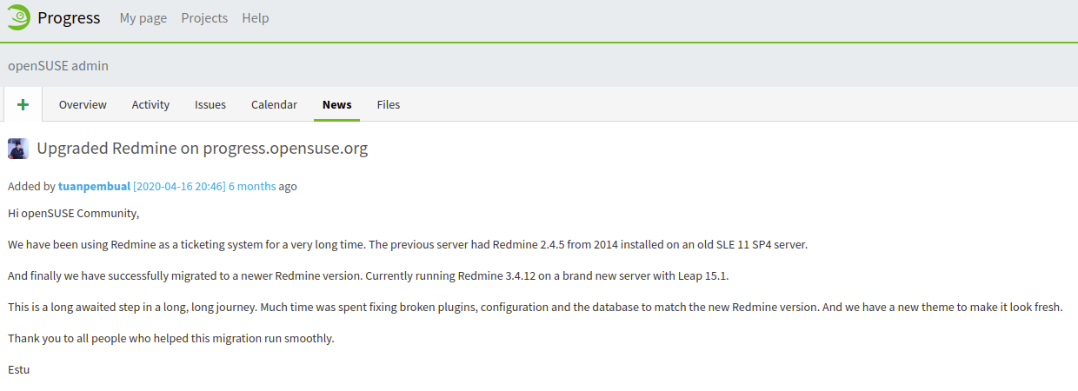
Heroes
Upgraded Redmine on progress.opensuse.org
Estu Fardani successfully migrated Redmine from 2.4.5 to 3.4.12 including fixing broken plugins and config db

Slide 16

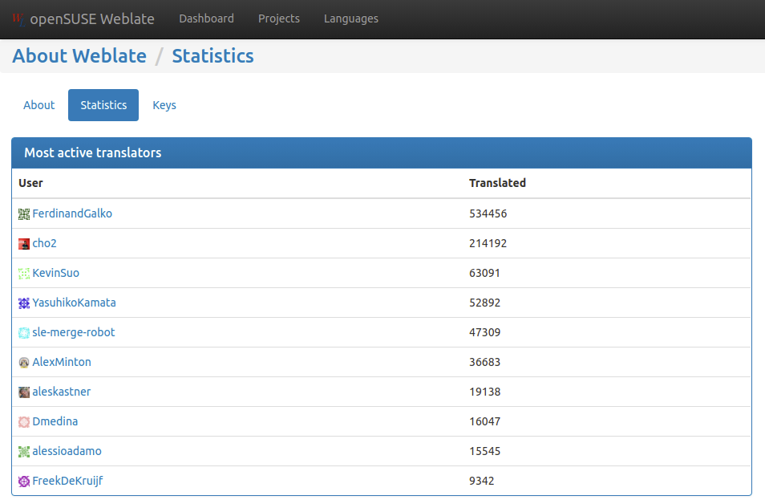
l10n
Translation on l10n.opensuse.org
Kukuh Syafaat (cho2) is one of the most active translators on l10n.opensuse.org. Translated more than 200K strings.

Slide 17



Artwork

Slide 18
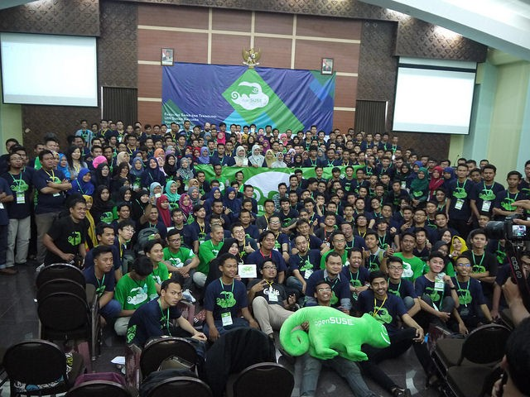
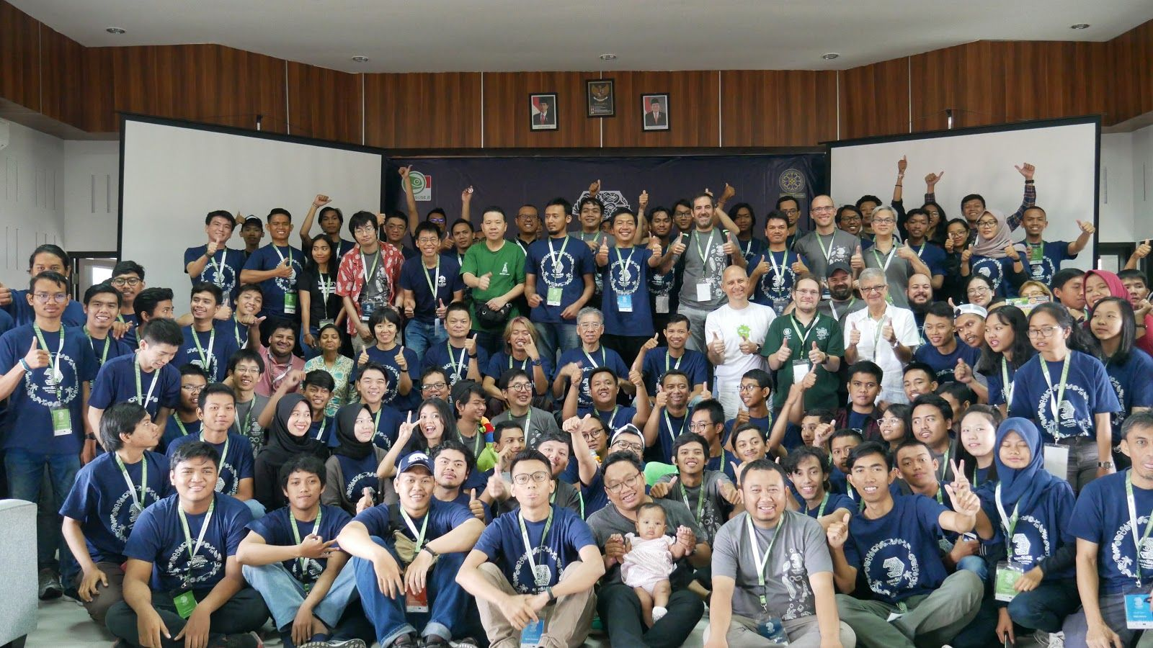
Conference
openSUSE.Asia Summit 2016
Yogyakarta, Sep 30-Oct 2 2016
446 attendees
openSUSE.Asia Summit 2019
Bali, Oct 5-6 2019
192 attendees

Slide 19


Slide 20
LibreOffice in Indonesia
It’s ambiguous since there are:
LibreOffice Indonesia Facebook Group
  Created in 2011
LibreOffice-ID, including web (libreoffice.id), telegram group (LibreOffice.ID), and Twitter (@LibreOfficeID)
  Established in 2018
Learn LibreOffice Indonesia (Belajar LibreOffice Indonesia/BLOI)
  Established in 2016
Others

Slide 21
LibreOffice-ID in Numbers (per 20201016)
Item | Numbers
TDF Members | 12
Telegram group members (LibreOffice.ID) | 751
Telegram group members (Belajar LibreOffice Indonesia) | 1505
Twitter followers (@LibreOfficeID) | 290
Facebook group members (LibreOffice Indonesia) | 3900

Slide 22
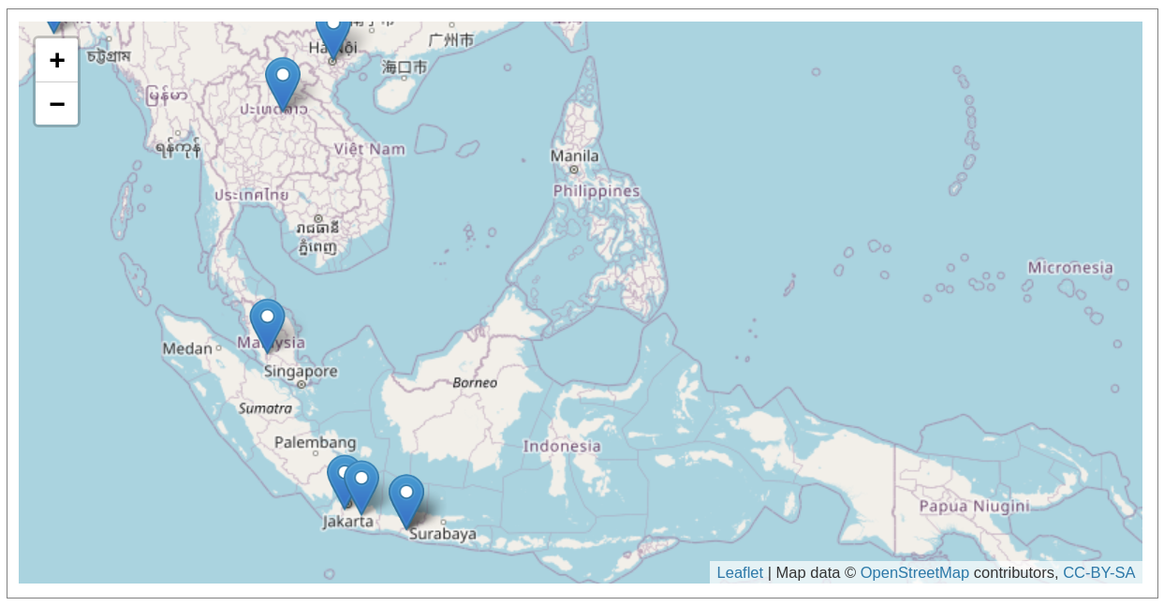
TDF Members in ID (https://www.libreoffice.org/community/community-map/)
Ahmad Haris
Ahmad Romadhon Hidayatullah
Andik Nur Achmad
Andika Triwidada
Darian Rizaludin
Faiq Aminuddin
Hervy Qurrotul
Iwan Suryanto Tahari
Rizal Muttaqin
Sofyan Sugianto
Sokibi Imgos
Stanislaus J.Pinasthika

Slide 23
Local Contribution to Upstream
Translation
Design
QA
Template
Donate

Slide 24
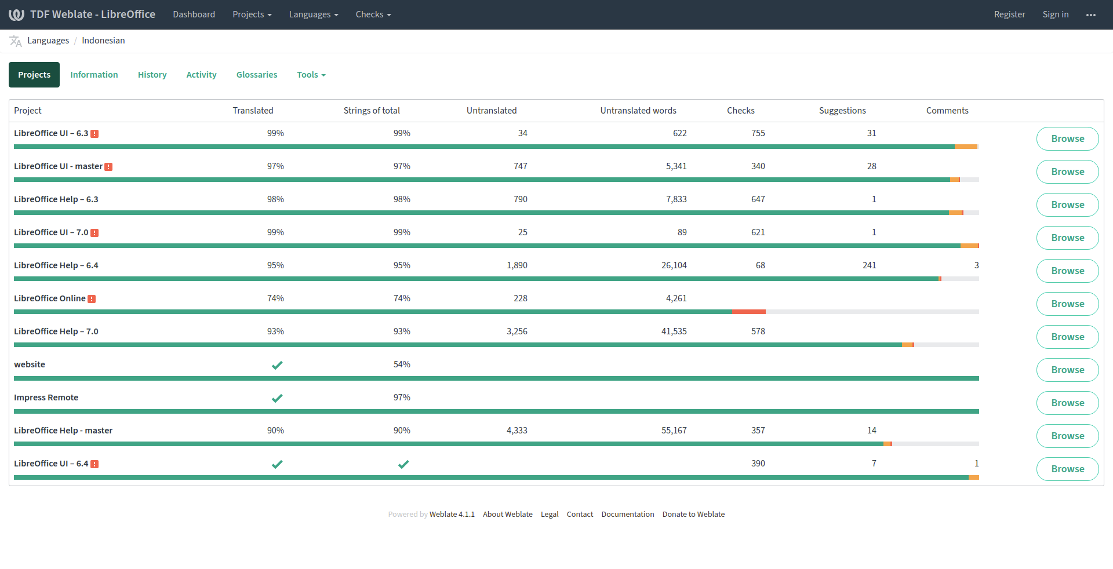
Translation

Slide 25
Translation Hackathon (Translathon)
Gresik
Nov 2018
Yogyakarta
Dec 2018
Malang
Jan 2019
Surabaya
Jan 2019
Pasuruan
Jan 2019
Solo
Jan 2019
Malang
Feb 2019
Jember
Feb 2019

Slide 26
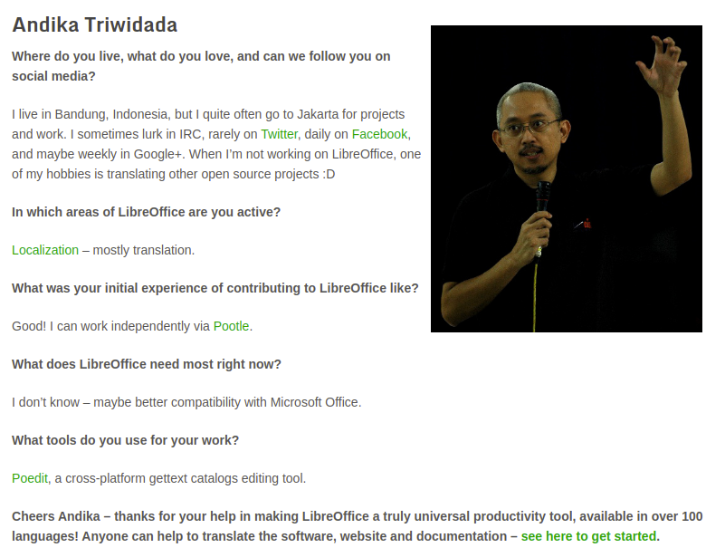
Translation
Andika Triwidada (LibreOffice Translator)
“When I’m not working on LibreOffice, one of my hobbies is translating other open source projects :D”

Slide 27
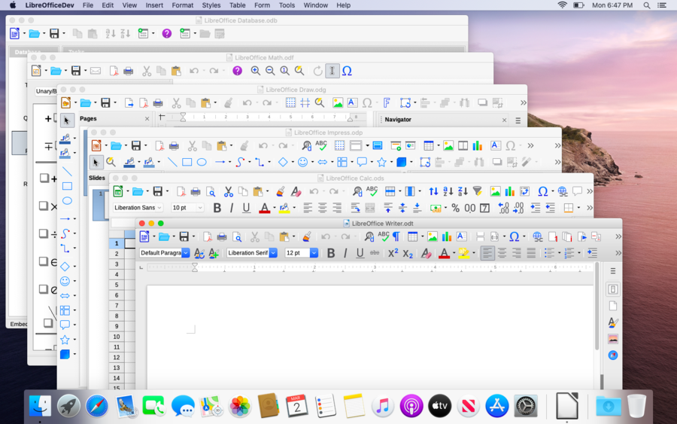
Design
Sukapura and Karasa Jaga icons created by Rizal Muttaqin
He also updating Elementary, Colibre, Sifr, and Breeze icons.

Slide 28
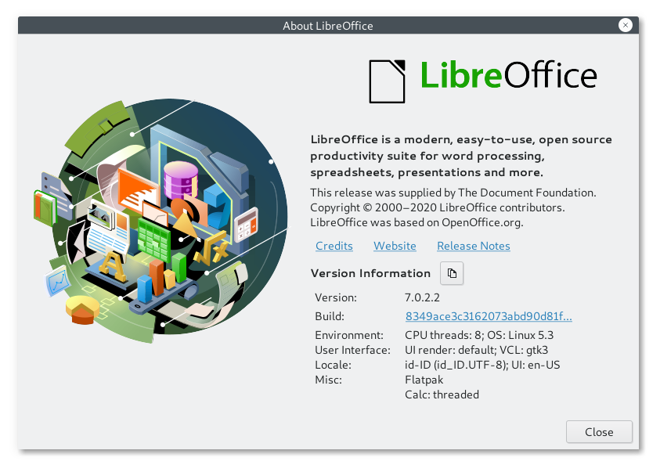
Design
Image on about dialog by Bayu Rizaldhan Rayes.
He also the winner of Inkscape About Screen Contest.

Slide 29
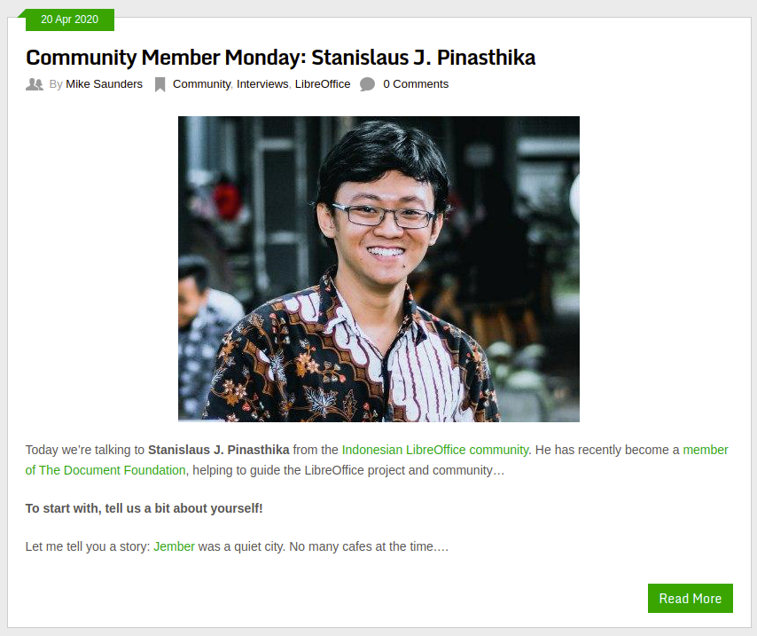
QA
Stanislaus J. Pinasthika (LibreOffice QA)
“In the QA community, we make sure that all reports are clarified as bugs or not, so that these reports help to improve the quality of LibreOffice. I also give a hand with translating into Bahasa Indonesia. But, QA is my first priority.”

Slide 30
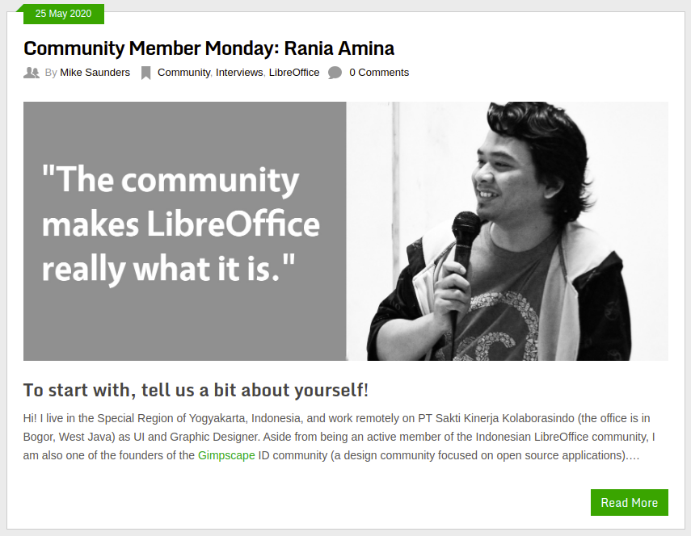
Ahmad Romadhon Hidayatullah aka Rania Amina (LibreOffice multiple contributor)
“By becoming a member, I think I can do things related to contributing to LibreOffice better than before. Being a member is a responsibility, in my opinion. Because it means I have to do my best from time to time for the LibreOffice community, both in Indonesia and outside. LibreOffice will get better if the community ecosystem is also good. Well, one of the tasks of members (in my mind) is to ensure that these communities can actively give feedback to LibreOffice, so that they can grow and develop better.”

Slide 31
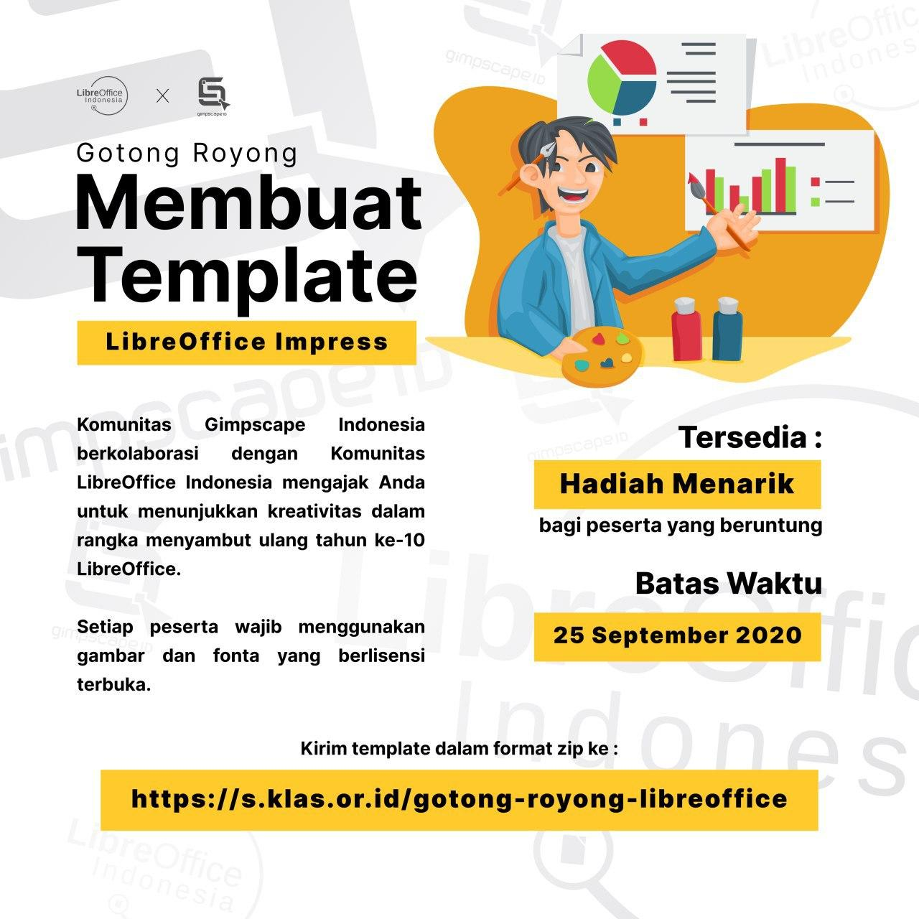
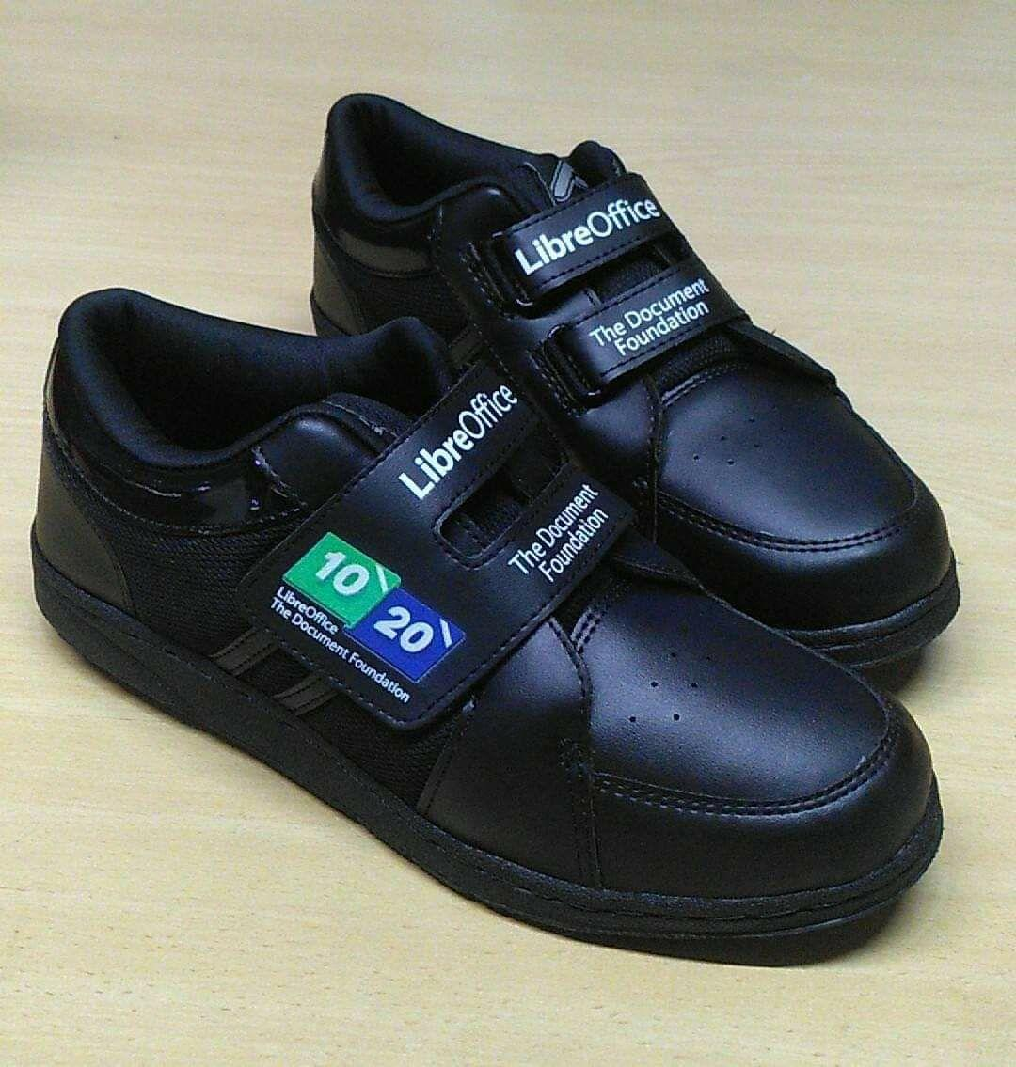
Template
To celebrate the 10th anniversary of LibreOffice, LibreOffice-ID held Impress competition. The participant creates Impress template, the winner will get a prize.

Slide 32
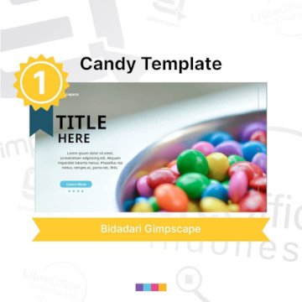
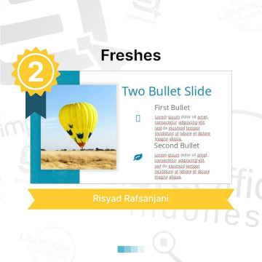

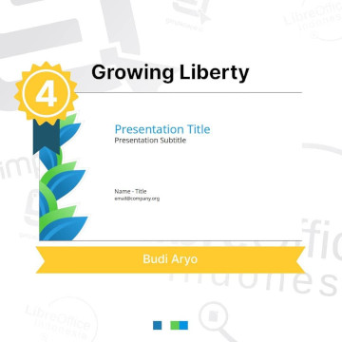
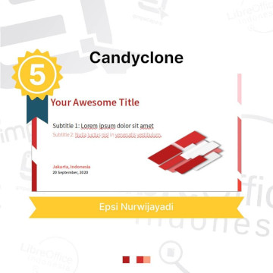

Template https://lumbung.libreoffice.id/

Slide 33
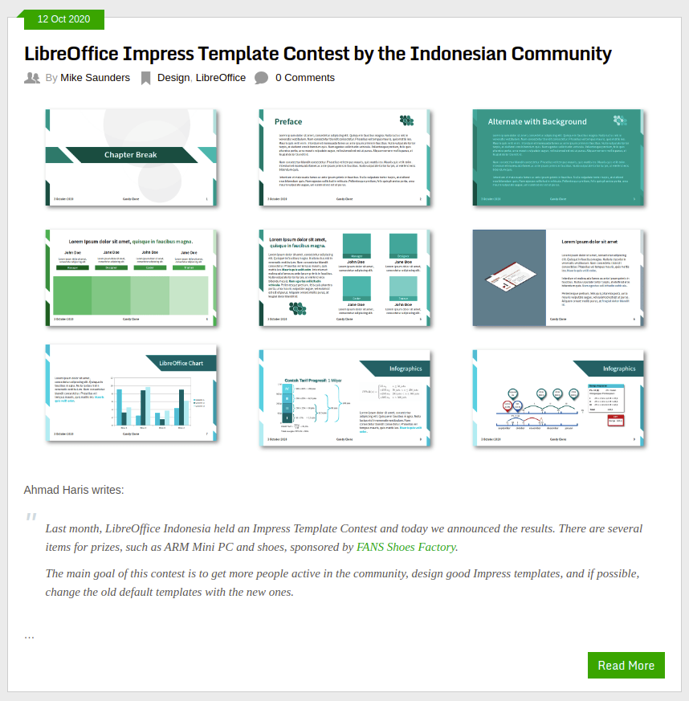
Template

Slide 34
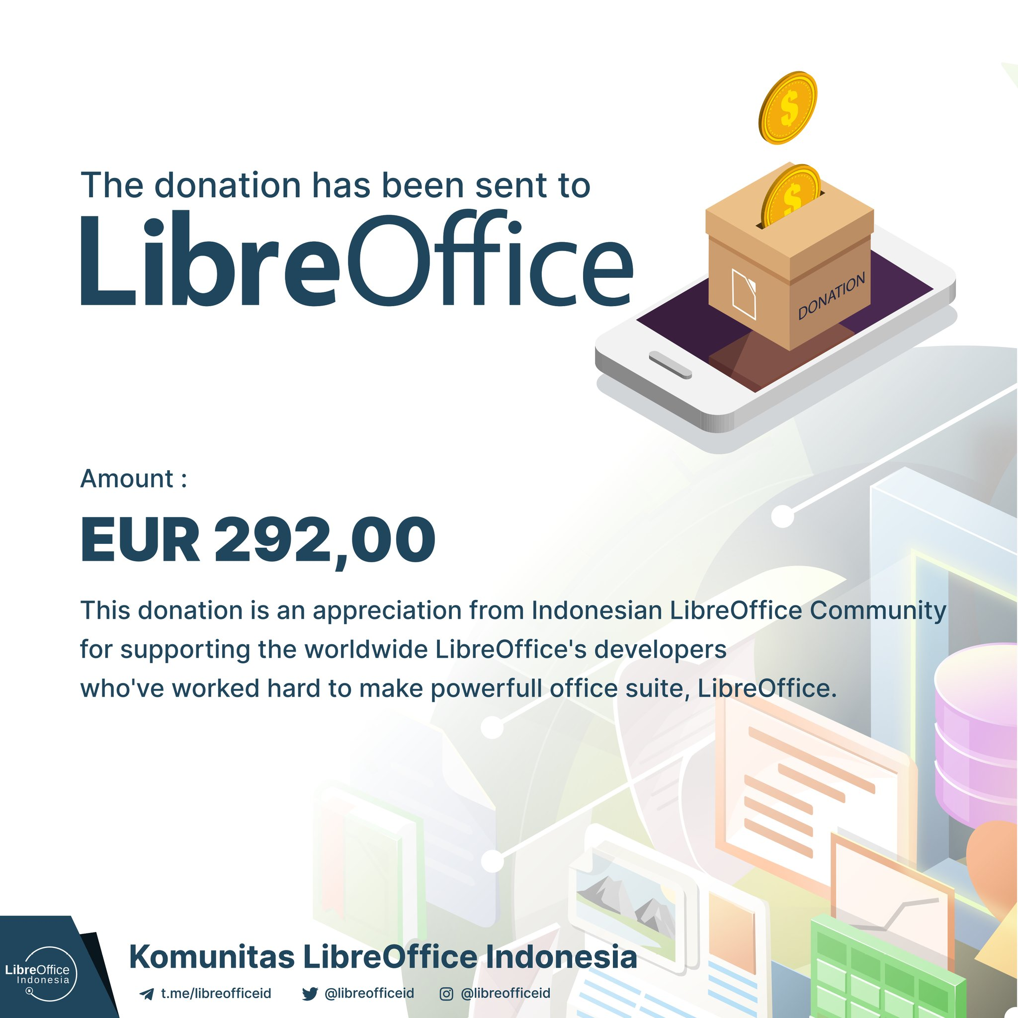
Donate

Slide 35

Finish
Thank You

Slide 36
Thank You

