Slide 1

LibreOffice Flatpak, Snap and AppImage
Kukuh Syafaat
kukuh@syafaat.id
Tokyo, 25 May 2019

Slide 2
Hello (world)
Kukuh Syafaat
  インドネシア
  FOSS Enthusiast
  Contributor @gnome @openSUSE
  @LibreOfficeID team

Slide 3
Agenda
Intro: Universal Linux Package
Survey of Flatpak, Snap, and AppImage Usage in Indonesia
Comparisons

Slide 4
Intro: Universal Linux Package

Slide 5
Flatpak

Slide 6
Flatpak
Flatpak is a system for building, distributing, and running sandboxed desktop applications on Linux.
http://flatpak.org/
Linux distribution example:
  Endless OS (https://endlessos.com) only use Flatpak for their apps

Slide 7
Why Flatpak?
Access a wide variety of applications
Get new versions faster
Safely update your apps without having to reboot
Install different versions of the same application
Secure, sandboxed applications

Slide 8
LibreOffice Flatpak
https://www.libreoffice.org/download/flatpak/
LibreOffice Flatpak source code https://github.com/flathub/org.libreoffice.LibreOffice
Available on Flathub
  https://flathub.org/apps/details/org.libreoffice.LibreOffice
  Install with command flatpak install flathub org.libreoffice.LibreOffice or through GNOME Software/KDE Discover

Slide 9
Snap

Slide 10
Snap
Snaps are app packages for desktop, cloud and IoT that are easy to install, secure, cross-platform and dependency-free.
https://snapcraft.io/
Developed by Canonical
Linux distribution example:
  By default, Ubuntu use snap beside apt

Slide 11
Why Snap?
Auto-updating
Secure
Channels, e.g.
  Stable
  Candidate
  Beta
  Daily/Nightly

Slide 12
LibreOffice Snap
https://www.libreoffice.org/download/snap
Available on Snap Store
  https://snapcraft.io/libreoffice
  Install with command snap install libreoffice or through Ubuntu Software Center

Slide 13
AppImage

Slide 14
AppImage
Format for distributing portable software on Linux without needing superuser permissions to install the application.
https://appimage.org/
Linux distribution example:
  Nitrux (https://nxos.org/) use AppImage on their NX Software Center

Slide 15
Why AppImage?
Run on various Linux distributions
Click and run
No need root
Portability

Slide 16
LibreOffice AppImage
https://www.libreoffice.org/download/appimage/
https://libreoffice.soluzioniopen.com/
Available in (fresh & still)
  Basic version (only en_US)
  Standard version (en_US, en_GB, ar, zh_CN, fr, de, etc...)
  Full version (all languages)
  also
  Stable Version
  Daily Version (recent build)
  Old Version (since 3.3.0)
  Pre-Release Version (upcoming release)

Slide 17
Survey of Flatpak, Snap, and AppImage Usage In Indonesia
April-May 2019

Slide 18
Using LibreOffice in Linux?
n = 45

Slide 19
Using LibreOffice Flatpak/Snap/AppImage?
n = 39

Slide 20
Using Which? Flatpak/Snap/AppImage?
n = 19

Slide 21
Linux Distributions
n = 19

Slide 22
Comparisons
Tested on openSUSE Tumbleweed, May 2019
LibreOffice 6.2.3.2 on Flatpak, Snap, and AppImage

Slide 23

App Size (Installed)
Flatpak
Snap
AppImage

Slide 24
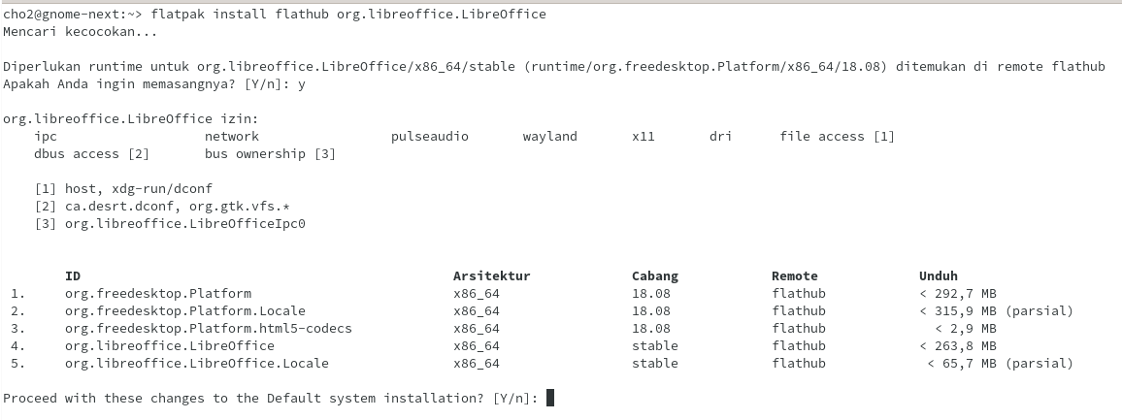
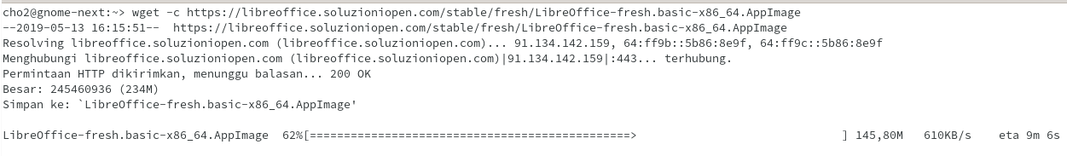
App Size (Installation/Download)
Flatpak
Snap
AppImage

Slide 25
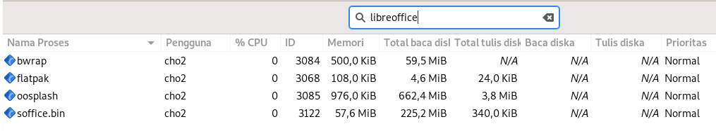
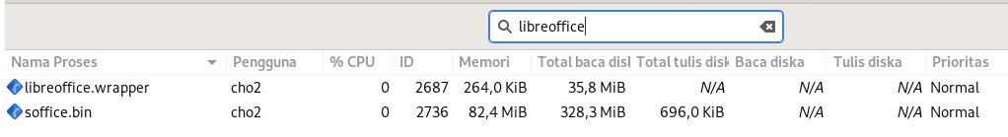
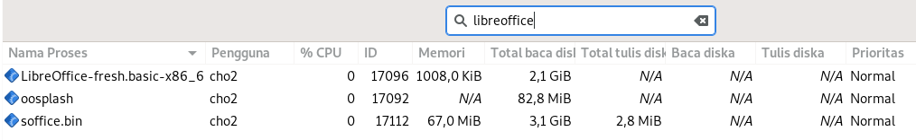
Memory Usage
Flatpak
Snap
AppImage

Slide 26
Extension
Tested with ChordDiagrams 1.1.1 https://extensions.libreoffice.org/extensions/chorddiagrams
Flatpak | ☑
Snap | ☑
AppImage | ☑

Slide 27
Fonts
Tested with Google Fonts (Cabin)
https://fonts.google.com/specimen/Cabin
sudo zypper in google-cabin-fonts
Installed on /usr/share/fonts/truetype
Flatpak | ☑
Snap | ☑
AppImage | ☑

Slide 28
Limitations
Result may be vary in
  Other Linux distributions
  Other LibreOffice Versions
  Other Extensions

Slide 29
Thank you
ありがとうございました

