Slide 1



Welcome to
Asia Summit 2019

Slide 2
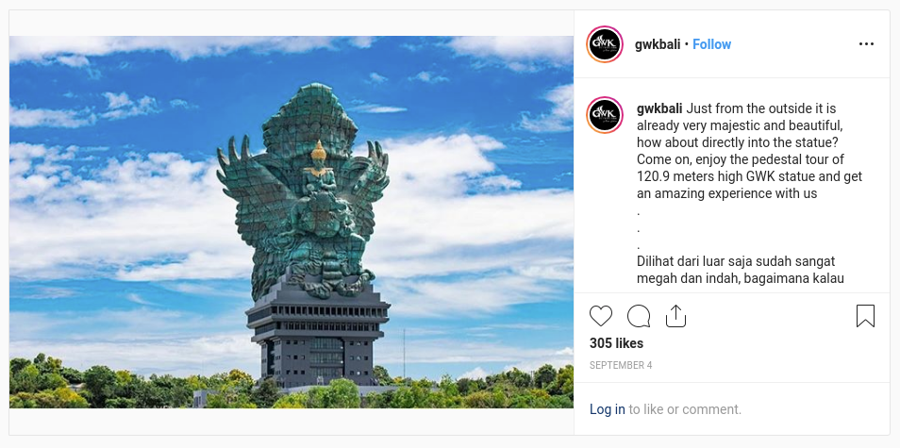
Welcome to Bali
Garuda Wisnu Kencana
We just 3,9 km from GWK :D
https://www.instagram.com/gwkbali/

Slide 3
Video

Slide 4
Talk Statistics
Call for Papers
Call for Lightning Talks
91
Submissions
52
Papers Accepted
5
Submissions
3
Talks Accepted

Slide 5
Speakers Statistics
31
Local speakers
22
Foreigner
speakers

Slide 6
Foreigner Speakers
Country | Number
Australia, Czech Republic, France, Mauritius, India, Spain, US | 1
China | 2
Germany | 2
Japan | 5
Taiwan | 6

Slide 7
Participants
182
Local participants
10
Foreigner
participants
141 of local participants are students

Slide 8
Foreigner Participant
Country | Number
Australia, Czech Republic, India, Japan, Laos, Sri Lanka | 1
UK | 2
US | 2

Slide 9
Volunteers
40
Volunteers

Slide 10


Slide 11
Logo Competition
18
Submissions
https://opensuse.id/2019/06/16/opensuse-asia-summit-2019-logo-competition-the-submissions/

Slide 12
Congratulations to Hervy Qurrotul
https://news.opensuse.org/2019/07/09/opensuse-asia-summit-2019-logo-competition-winner/

Slide 13


Thank You

Slide 14



Thank You

Slide 15
Thank You

Slide 16

Join the conversation,
contribute & have a lot of fun!
www.opensuse.org

Slide 17
Finish
Thank You

