Slide 1

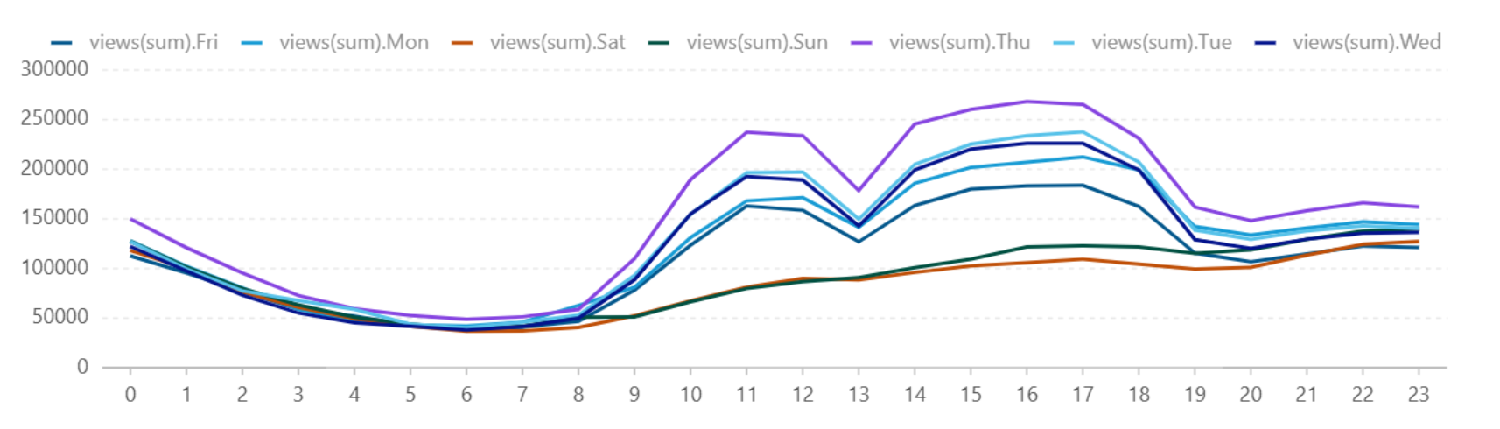
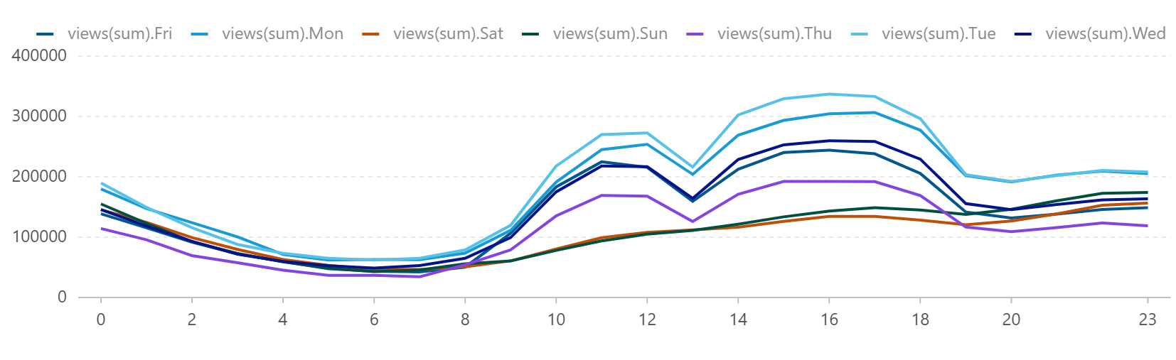
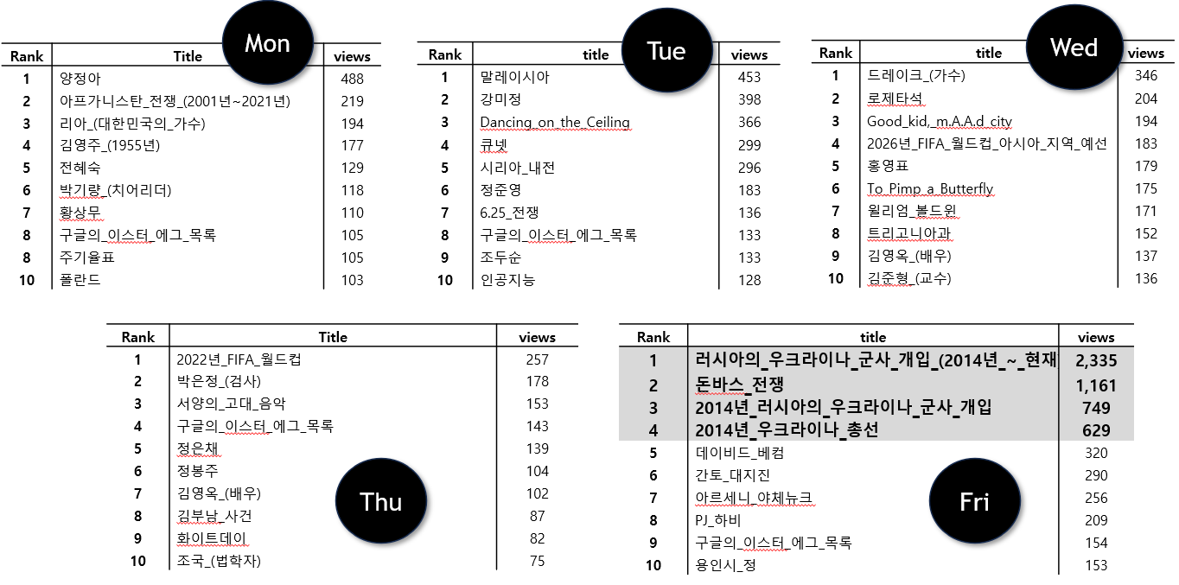
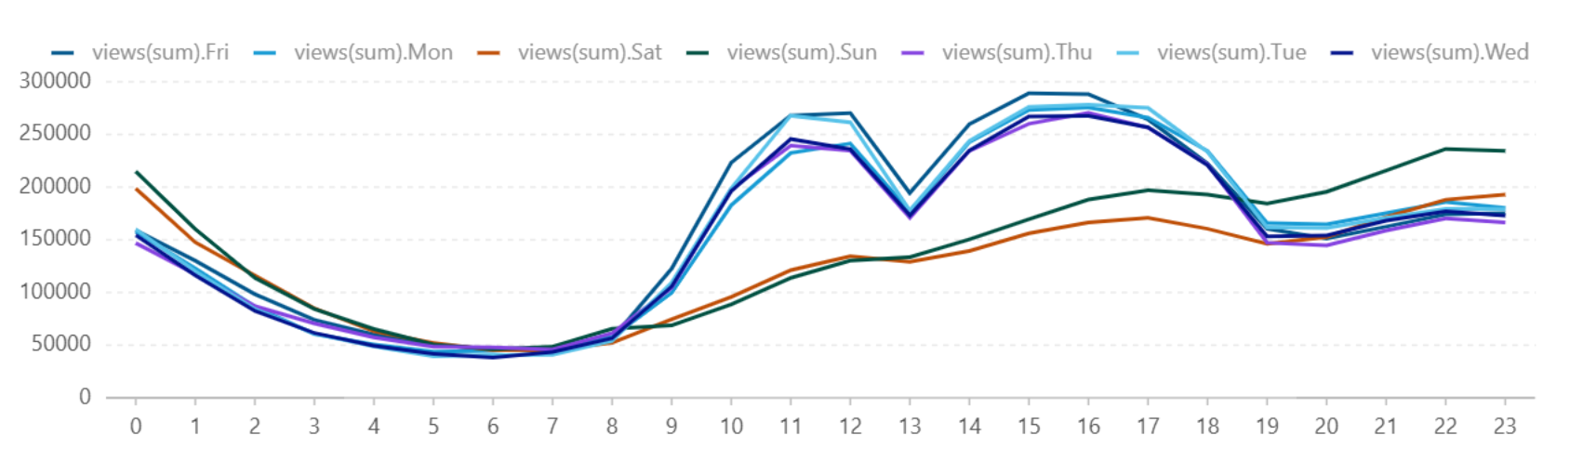
Wikipedia Data Analysis : Focusing on User & Behavior Patterns
By nunininu, lucas-hub12, cho0619
WHEN they view
- Analysis: Total views by day and hour
WHO make view
- Analysis: Total views by day and hour
Total views by day and hour
Jan
WHAT they view - Analysis: Titles by views and day
Feb
Mar

