Slide 1
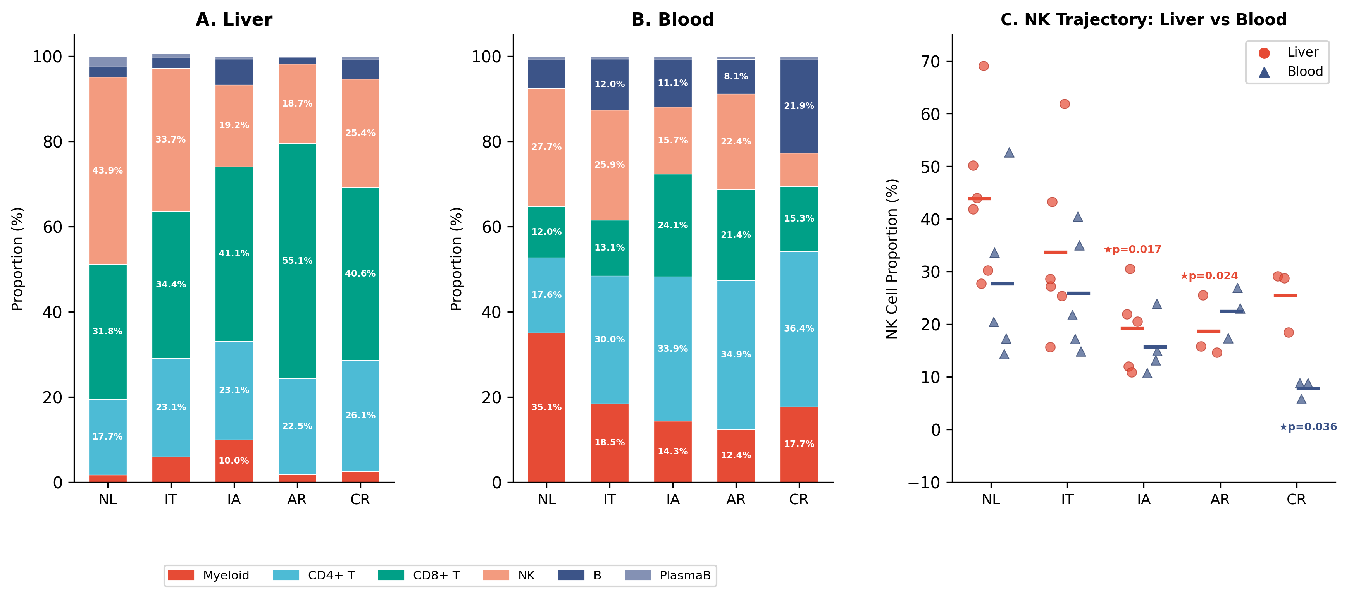
Notes:
Figure 1. Tissue-Separated Immune Cell Composition Across the HBV Disease Spectrum. (A) Stacked bar plots showing immune cell lineage proportions in liver across NL, IT, IA, AR, and CR groups (donor-level means, 6 lineages). (B) Same for blood. Liver is dominated by NK cells (43.9% at NL) while blood is dominated by myeloid cells (35.1% at NL). (C) NK cell proportions shown separately for liver (red circles) and blood (blue triangles). Individual donor values with group means (horizontal bars). Liver NK shows progressive decline with partial CR recovery; blood NK shows severe CR depletion. Mann-Whitney U test; ★p<0.05. Panels: 3 (A, B, C)

Slide 2
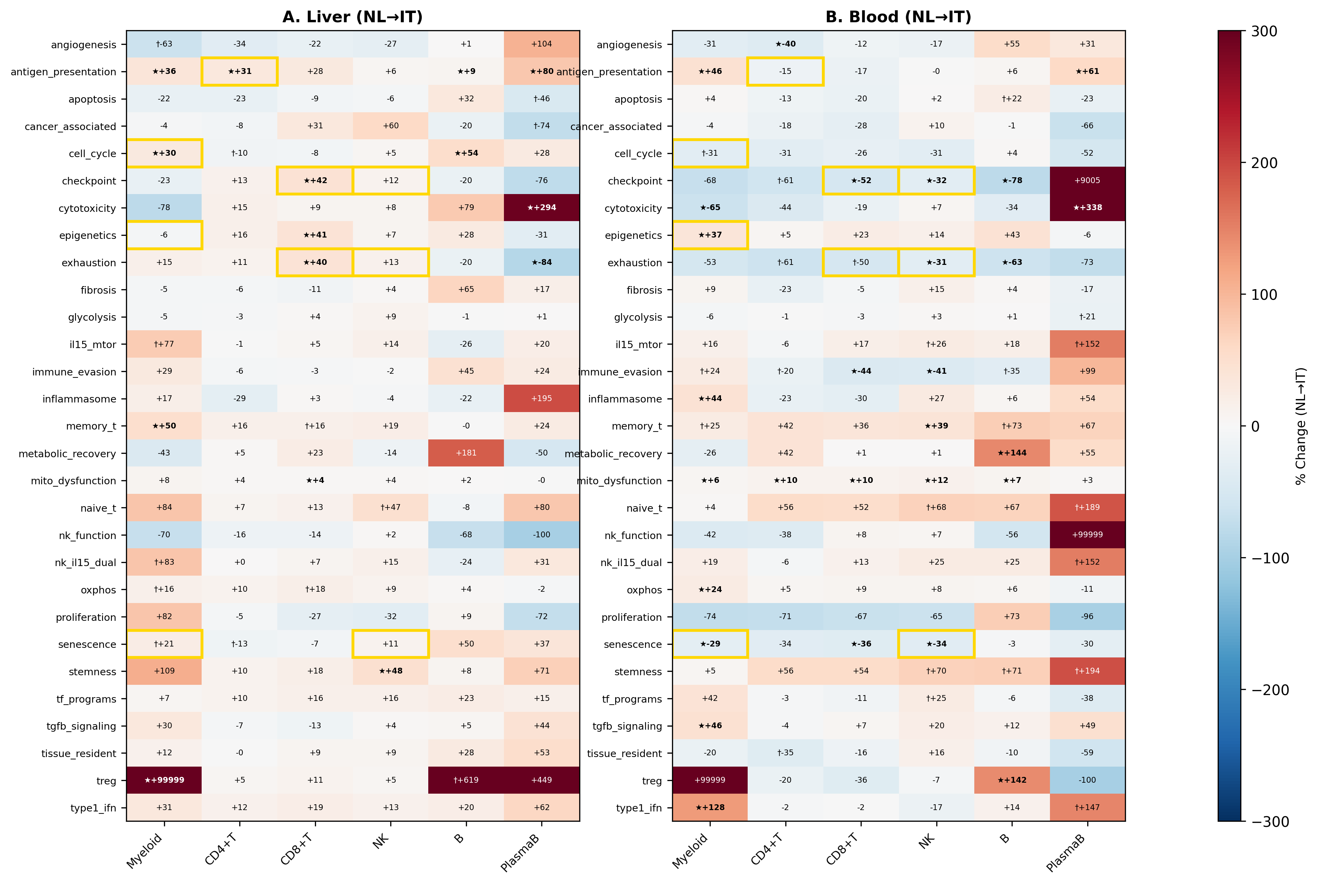
Notes:
Figure 2. Pathway-Level Tissue Discordance in IT Phase. (A) Heatmap of 29 pathway AUCell scores (rows) across 6 lineages (columns) showing NL→IT percent change in liver. Red: upregulation; blue: downregulation. ★p<0.05, †p<0.10. (B) Same for blood. Gold borders: 9 tissue-opposite pathway-lineage combinations (Table 2) showing significant change in one tissue with opposite direction in the other. Panels: 2 (A, B)

Slide 3
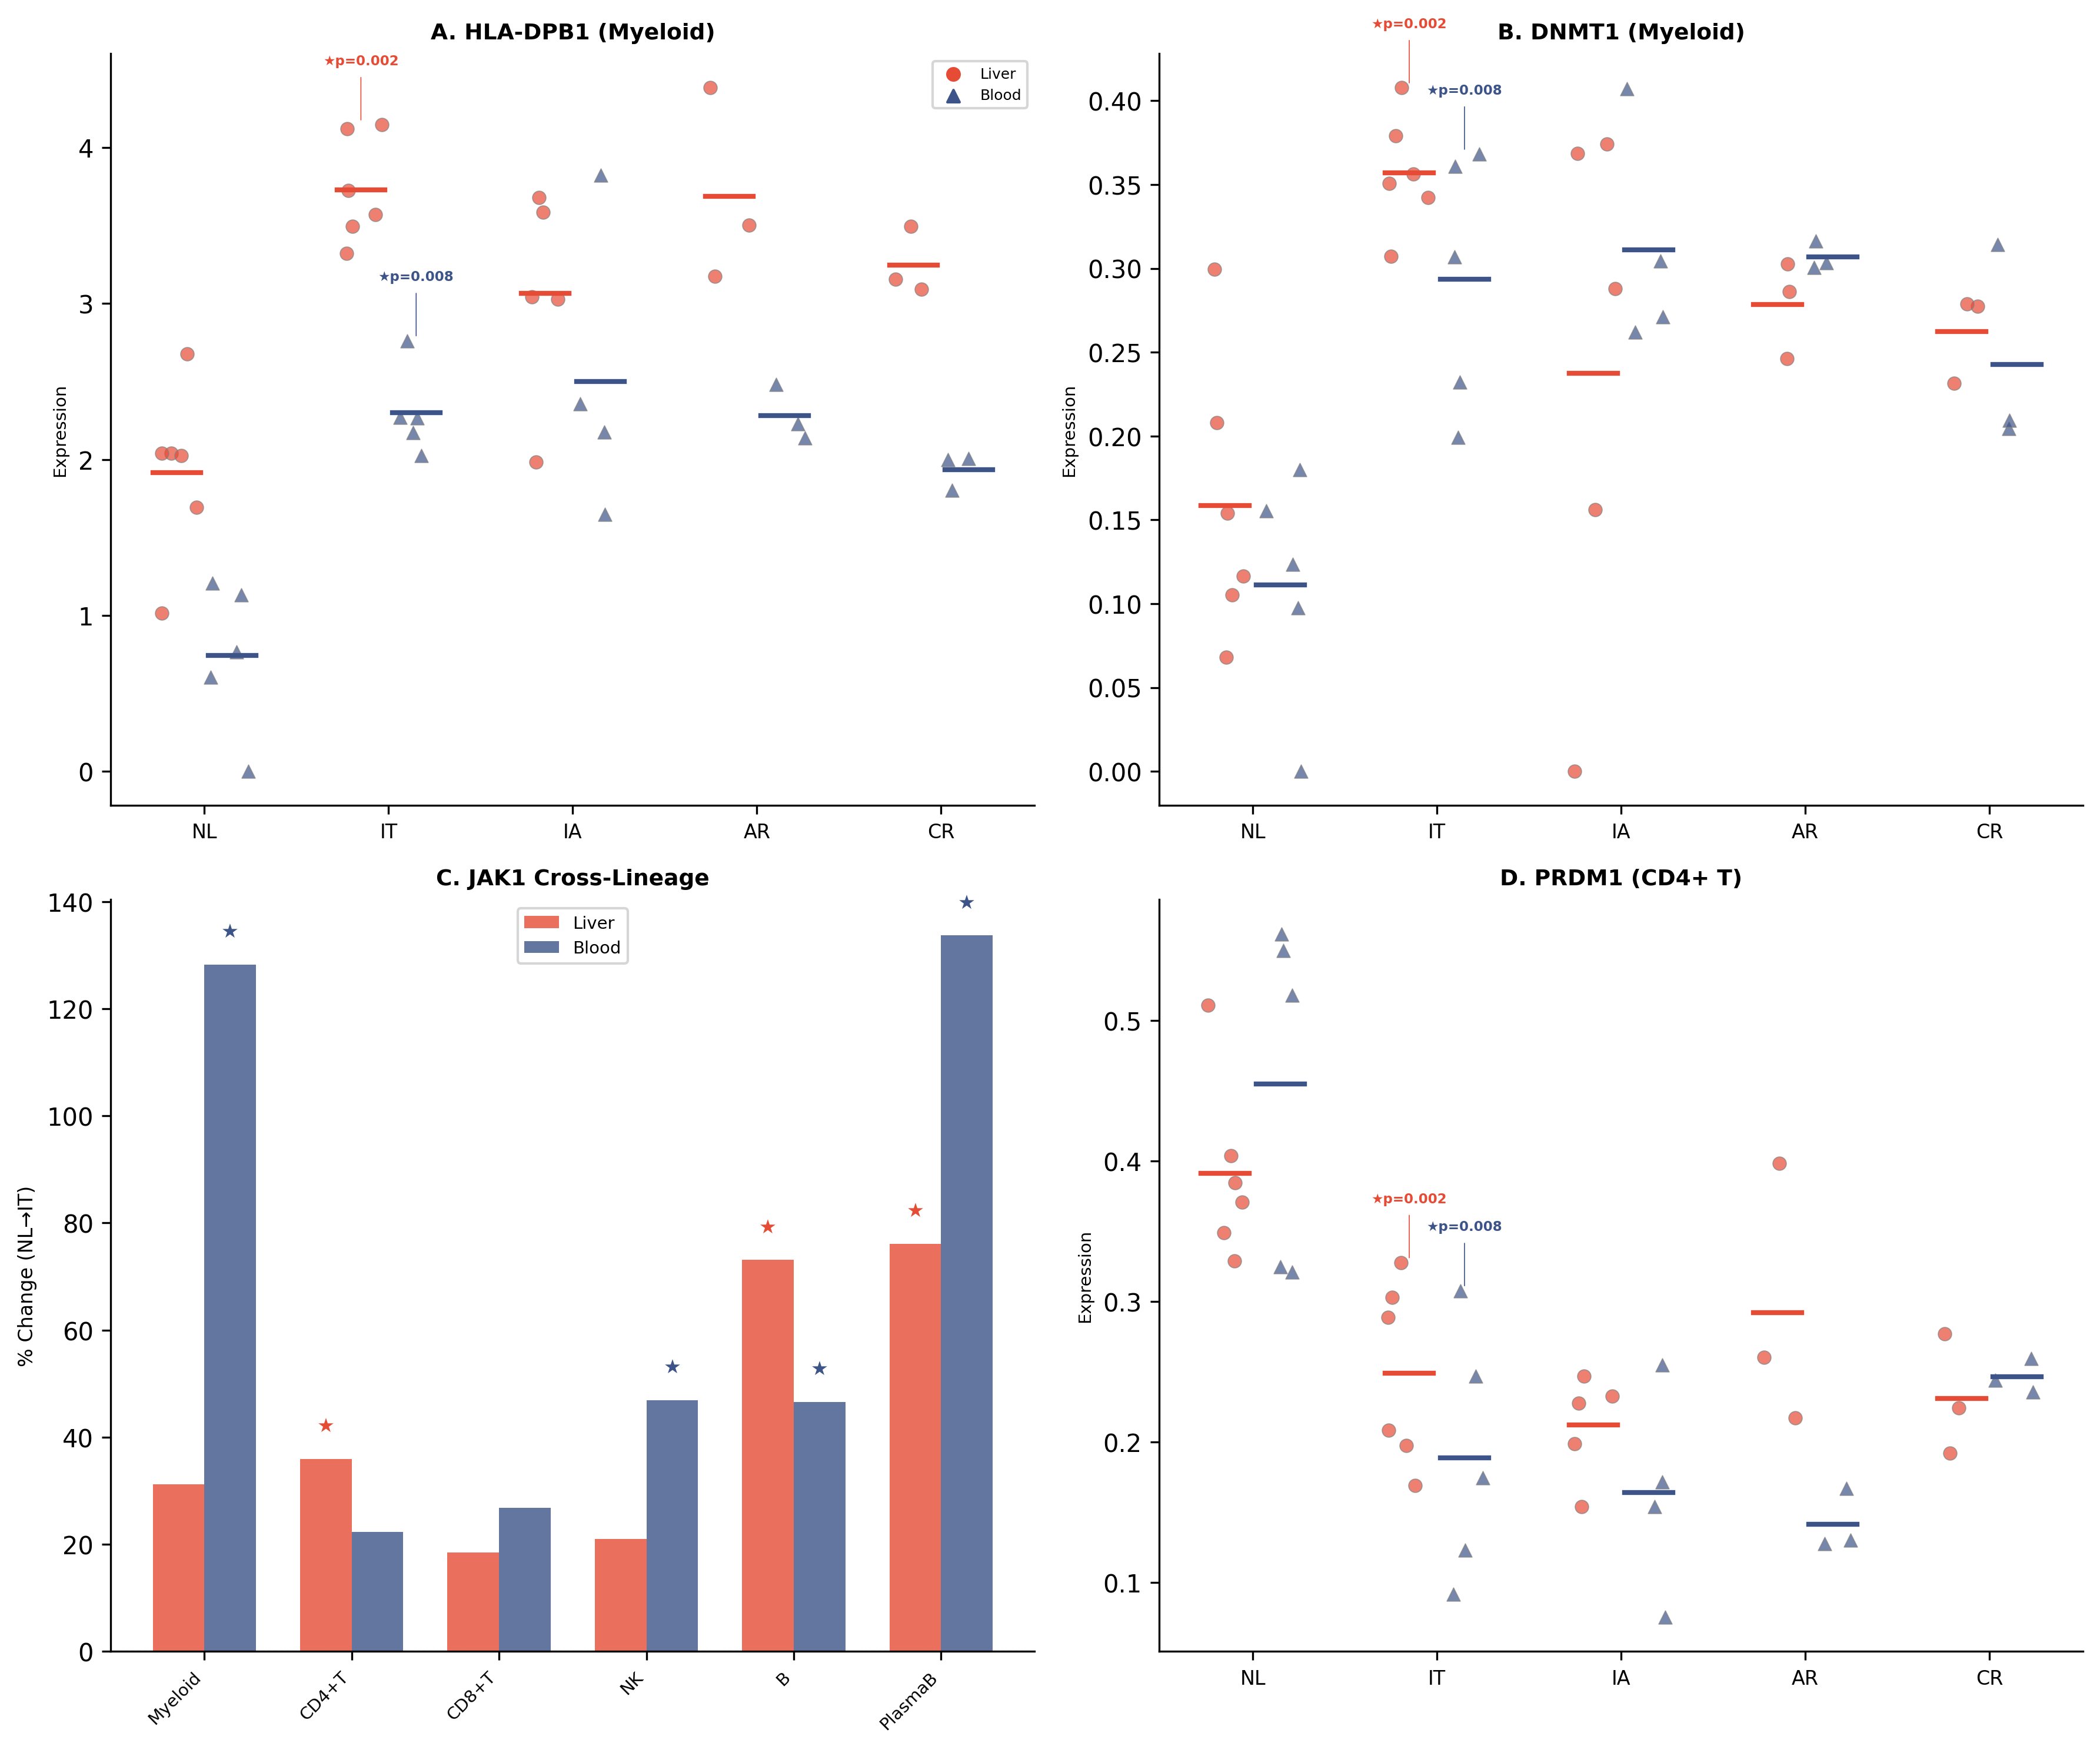
Notes:
Figure 3. IT Gene Signatures Significant in Both Liver and Blood. (A) HLA-DPB1 donor-level dot plots across disease groups in myeloid cells, shown for liver (red circles) and blood (blue triangles). (B) DNMT1 myeloid donor-level dot plots. (C) JAK1 cross-lineage NL→IT percent change in liver and blood, showing pan-lineage elevation. ★p<0.05. (D) PRDM1 downregulation in CD4+ T cells in both liver and blood. Panels: 4 (A–D)

Slide 4
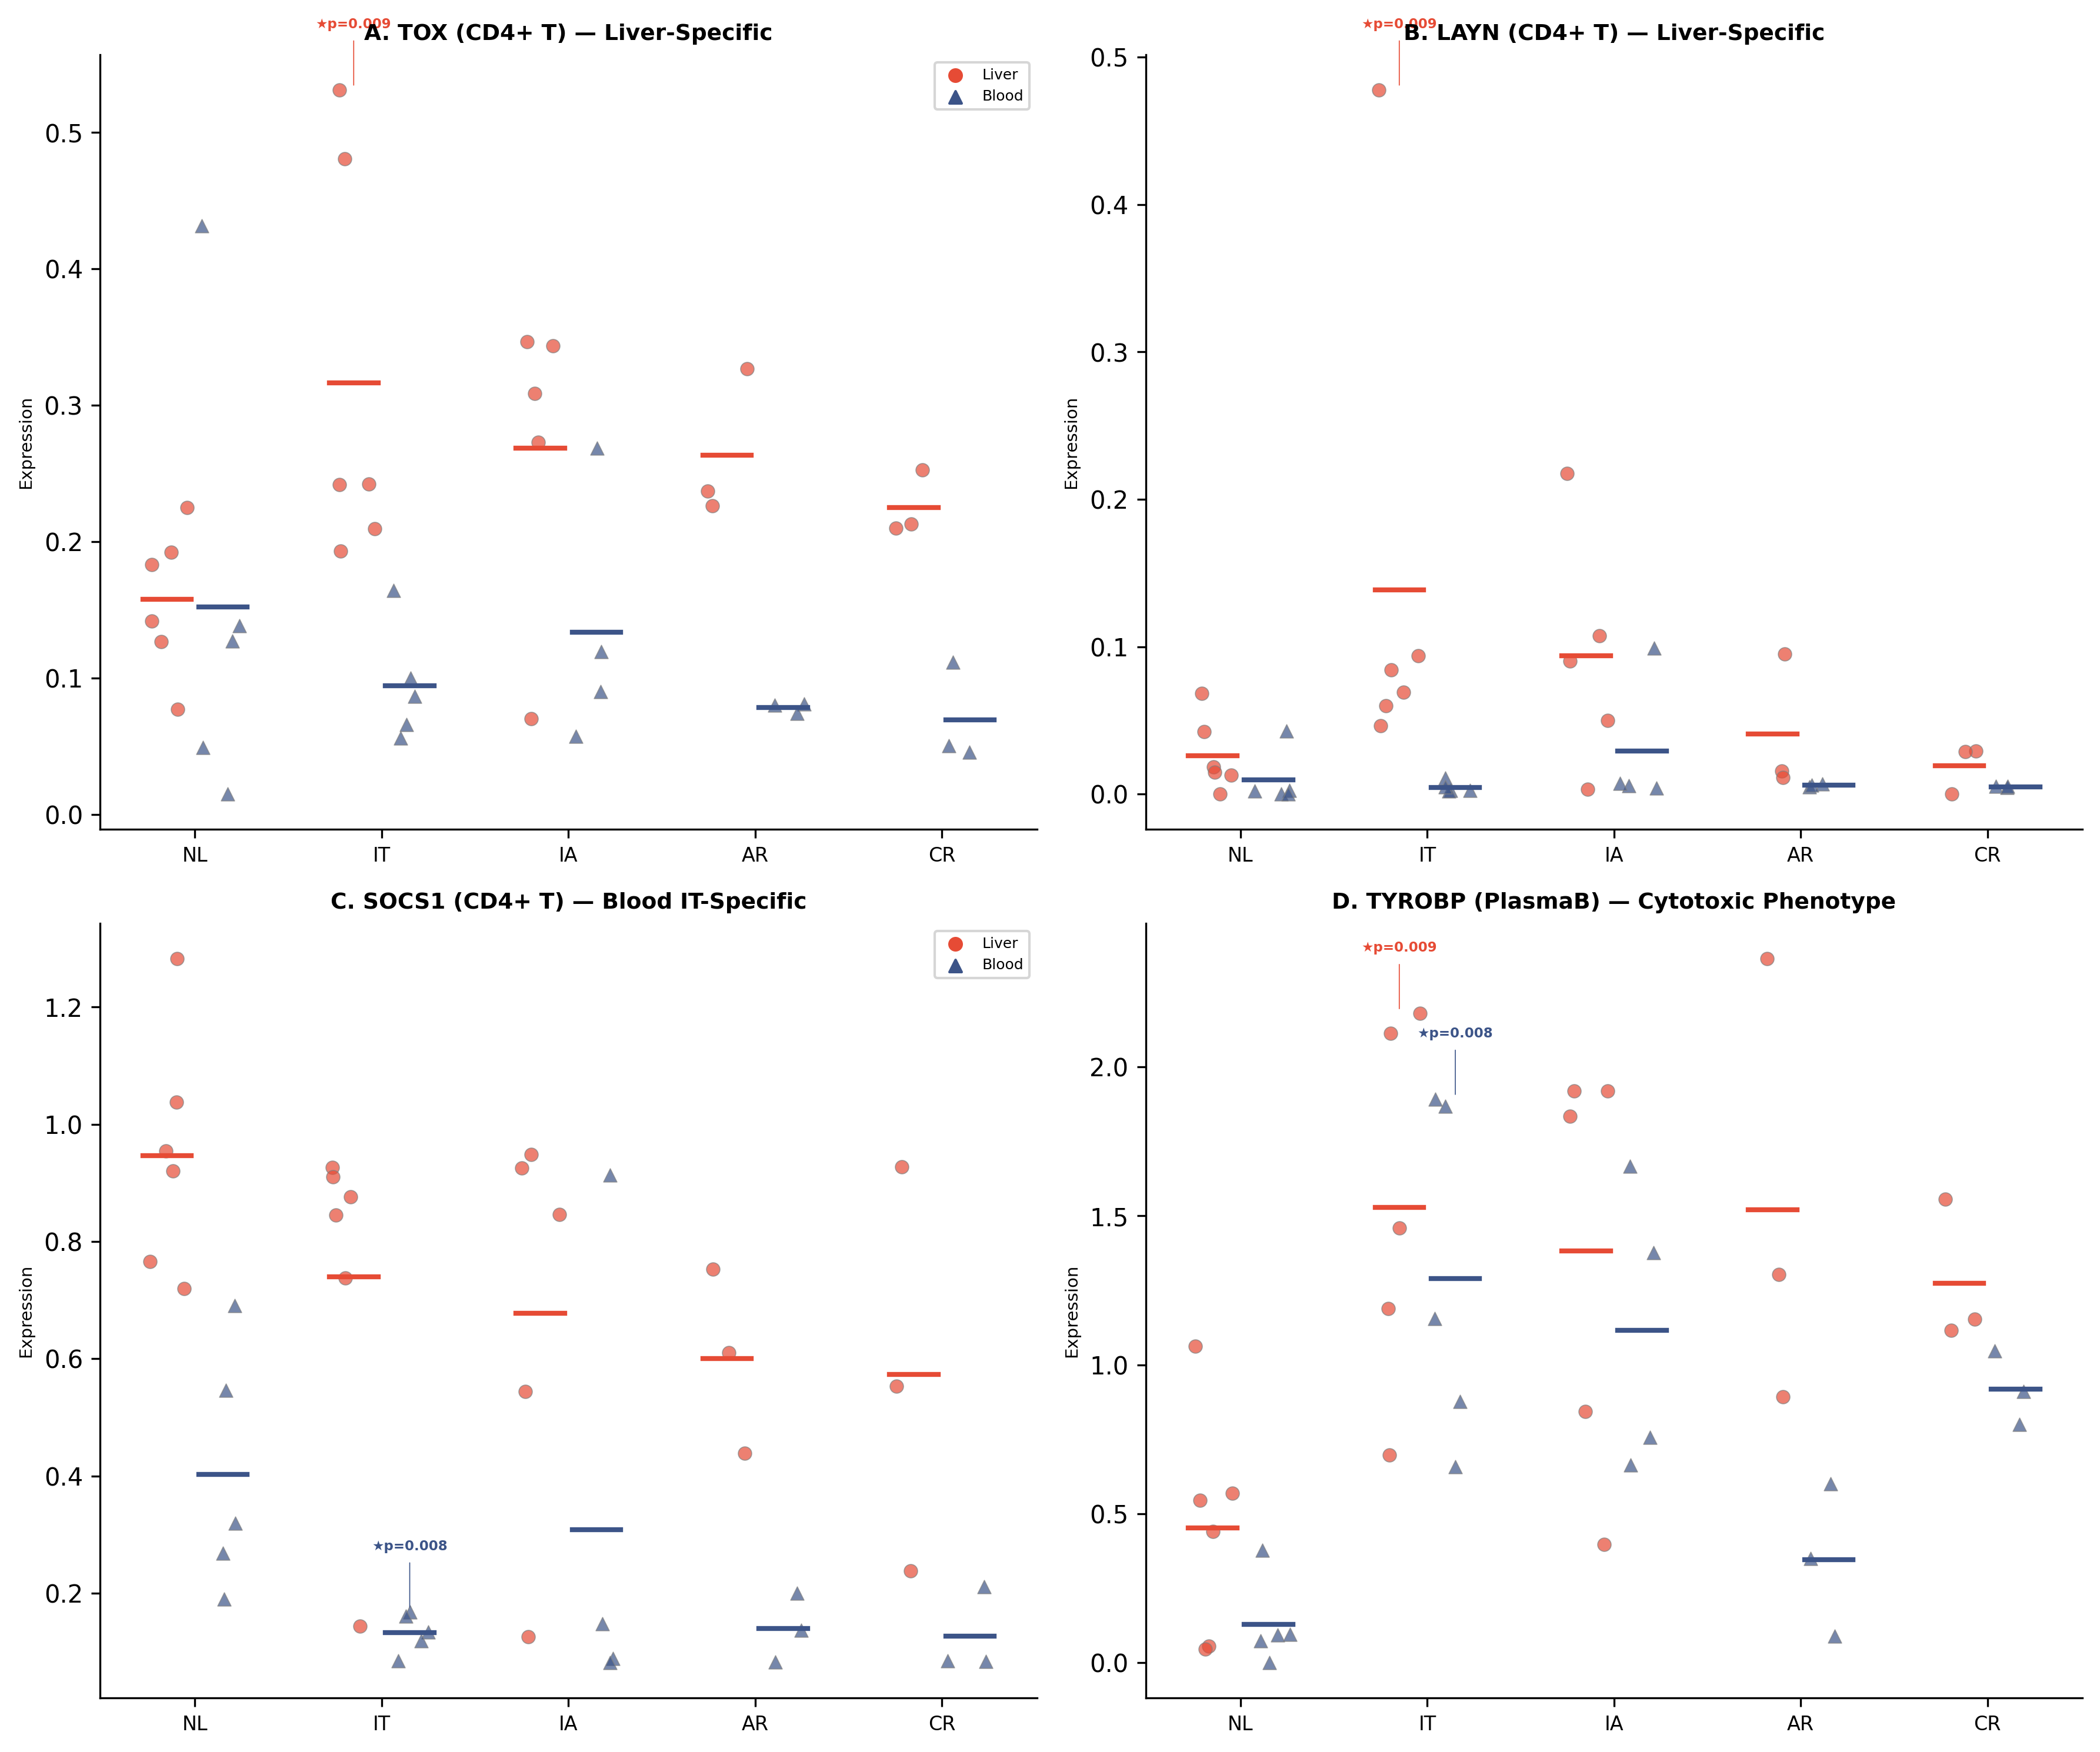
Notes:
Figure 4. IT-Specific Gene Signatures by Tissue Compartment. (A) TOX in CD4+ T cells showing liver-specific upregulation (★p=0.009) with blood non-significant (tissue-opposite). (B) LAYN in CD4+ T cells, same liver-specific pattern (★p=0.009). (C) SOCS1 in CD4+ T cells showing blood-specific IT downregulation (★p=0.008; JAK-STAT brake release). (D) TYROBP in plasma B cells showing cytotoxic phenotype acquisition in both liver (★p=0.009) and blood (★p=0.008). Panels: 4 (A–D)

Slide 5
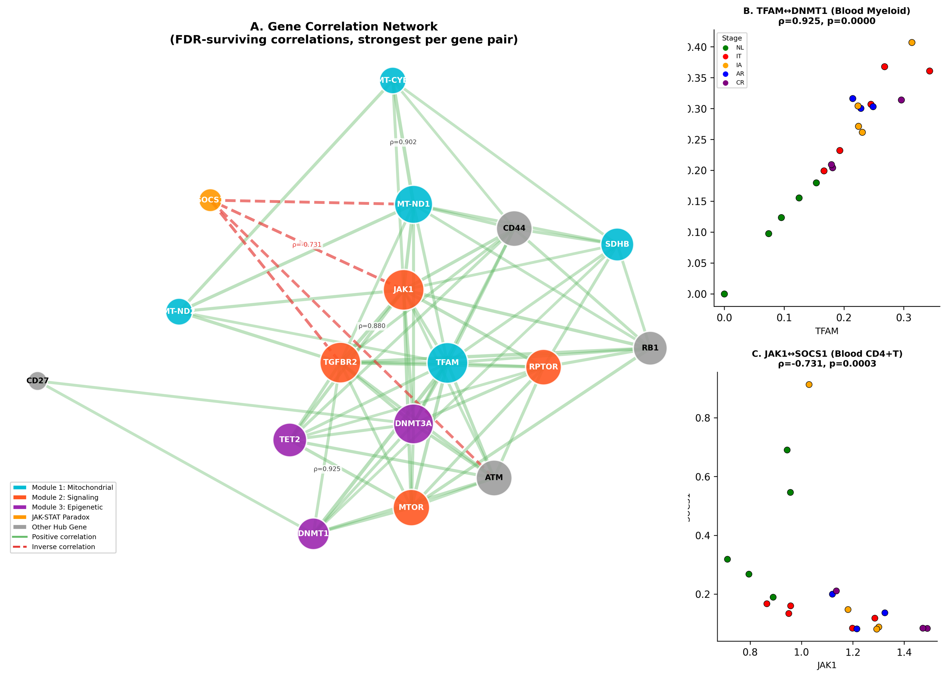
Notes:
Figure 5. Gene-to-Gene Correlation Networks Reveal Coordinated Immune Reprogramming in IT. (A) Gene correlation network constructed from donor-level Spearman correlations (FDR q<0.05, |ρ|≥0.7, strongest per gene pair across all tissue-lineage combinations). Nodes represent the 15 hub genes (Table 4) plus TET2 and SOCS1. Node colors indicate functional modules: Mitochondrial (cyan; MT-CYB, MT-ND1, MT-ND2, TFAM, SDHB), Signaling (orange; JAK1, TGFBR2, MTOR, RPTOR), Epigenetic (purple; DNMT1, DNMT3A, TET2), and Other Hub Genes (grey; CD44, CD27, ATM, RB1). SOCS1 (amber) is included to illustrate the JAK-STAT paradox. Green solid lines indicate positive correlations; red dashed lines indicate inverse correlations. Edge thickness is proportional to |ρ|. Key ρ values are annotated. (B) TFAM↔DNMT1 correlation in Blood Myeloid cells (ρ=0.925, p<0.001), demonstrating mito-epigenetic coupling. (C) JAK1↔SOCS1 inverse correlation in Blood CD4+ T cells (ρ=−0.731, p=0.0003), illustrating the JAK-STAT paradox. In B and C, each dot represents one donor, colored by disease group (NL, green; IT, red; IA, orange; AR, blue; CR, purple).

Slide 6
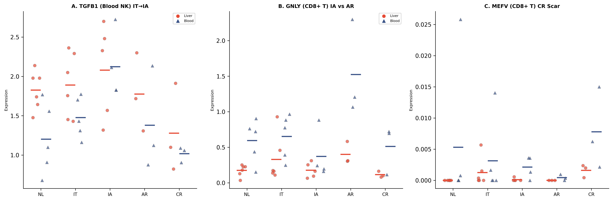
Notes:
Figure 6. Disease Trajectory: IT→IA Transition and CR Scar. (A) TGFB1 in blood NK cells across disease spectrum, showing IT→IA transition with NK suppressive conversion. (B) GNLY in CD8+ T cells, showing preserved cytotoxicity in AR versus diminished in IA. (C) MEFV in CD8+ T cells, showing aberrant inflammasome expression unique to CR (immunologic scar). Panels: 3 (A-C)

Slide 7
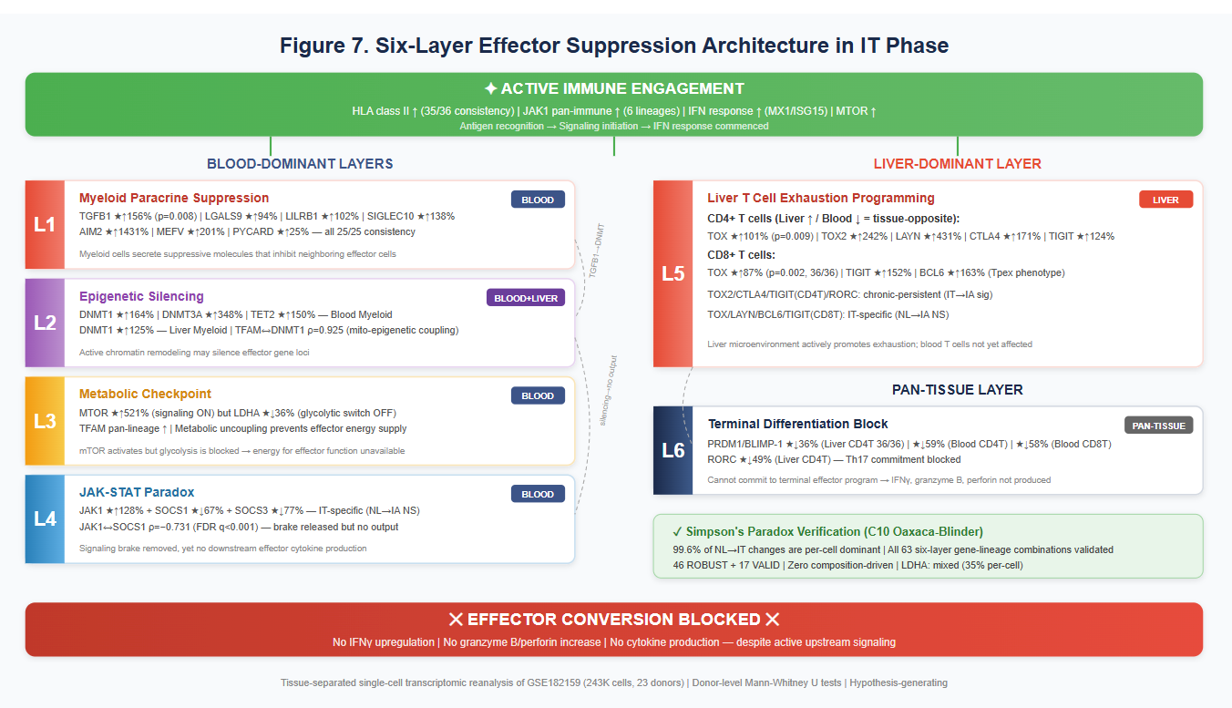

Slide 8
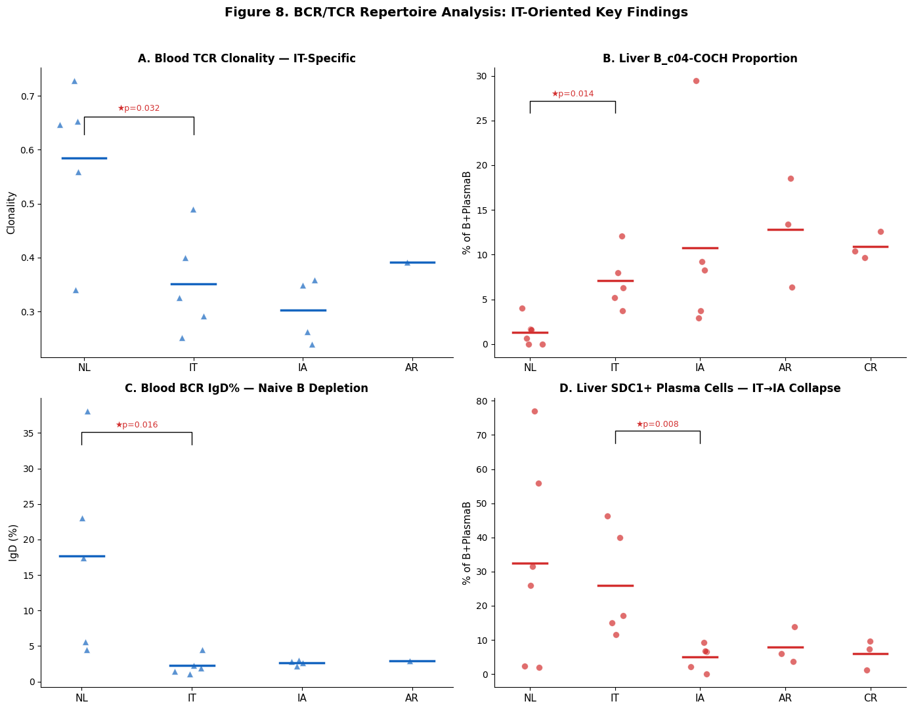
Notes:
Figure 8. BCR/TCR Repertoire Analysis Reveals Clonal Arrest with Active B Cell Engagement in IT. (A) TCR clonality (1 − normalized Shannon entropy) in blood across disease groups. IT showed significantly reduced clonal diversity compared with NL (NL 0.585 → IT 0.351, ★p=0.032, 23/25 donor-pair consistency), representing the only IT-specific BCR/TCR finding (NL→IA p=0.064, NS). Each dot represents one donor; horizontal bars indicate group means. Blue triangles = blood. Mann-Whitney U test; ★p<0.05. (B) B_c04-COCH proportion within B+PlasmaB cells in liver. COCH+ B cells showed chronic-persistent expansion from IT (NL 1.3% → IT 7.1%, ★p=0.014, 29/30; NL→IA ★p=0.022), indicating active B cell engagement beginning in IT and persisting through IA. Red circles = liver. (C) IgD isotype percentage among BCR+ cells in blood. IgD+ (naive/unswitched) B cells showed chronic-persistent depletion (NL 17.7% → IT 2.2%, ★p=0.016, 24/25; NL→IA ★p=0.016), indicating accelerated transition from naive to activated B cell compartment. (D) plasmaB_c01-SDC1 proportion within B+PlasmaB cells in liver. Mature plasma cells (SDC1/CD138+) were maintained in IT (NL 32.5% vs IT 26.0%, NS) but collapsed at the IT→IA transition (IT 26.0% → IA 5.0%, ★p=0.008, 25/25 consistency), representing a transition event rather than an IT-specific feature. Panels: 4 (A–D)

Slide 9
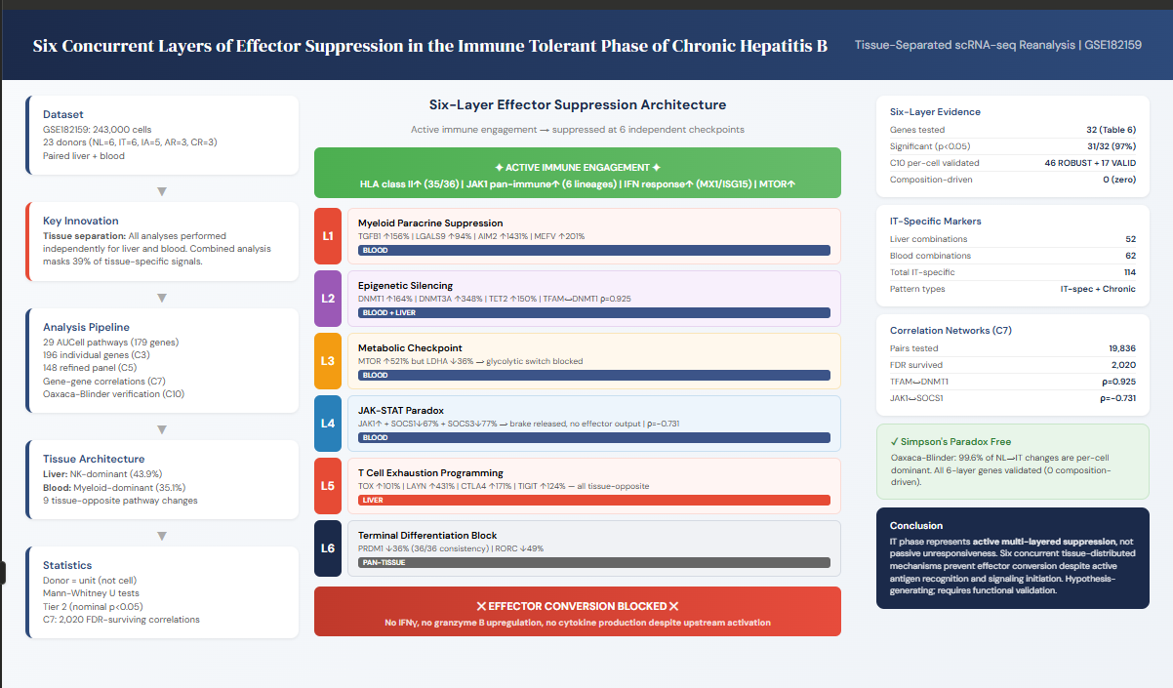
Notes:
Figure 7. Six-Layer Effector Suppression Architecture in IT Phase. Schematic model illustrating six concurrent transcriptomic patterns preventing effector function despite active immune engagement. Blood-dominant layers (L1-L4): myeloid paracrine suppression (TGFB1/LGALS9), epigenetic silencing (DNMT1/DNMT3A/TET2), metabolic checkpoint (MTOR↑/LDHA↓), JAK-STAT paradox (SOCS1/3↓). Liver-dominant layer (L5): T cell exhaustion (TOX/LAYN). Both-tissue layer (L6): terminal differentiation block (PRDM1↓). [Schematic — generated separately] Panel: 1

Slide 10
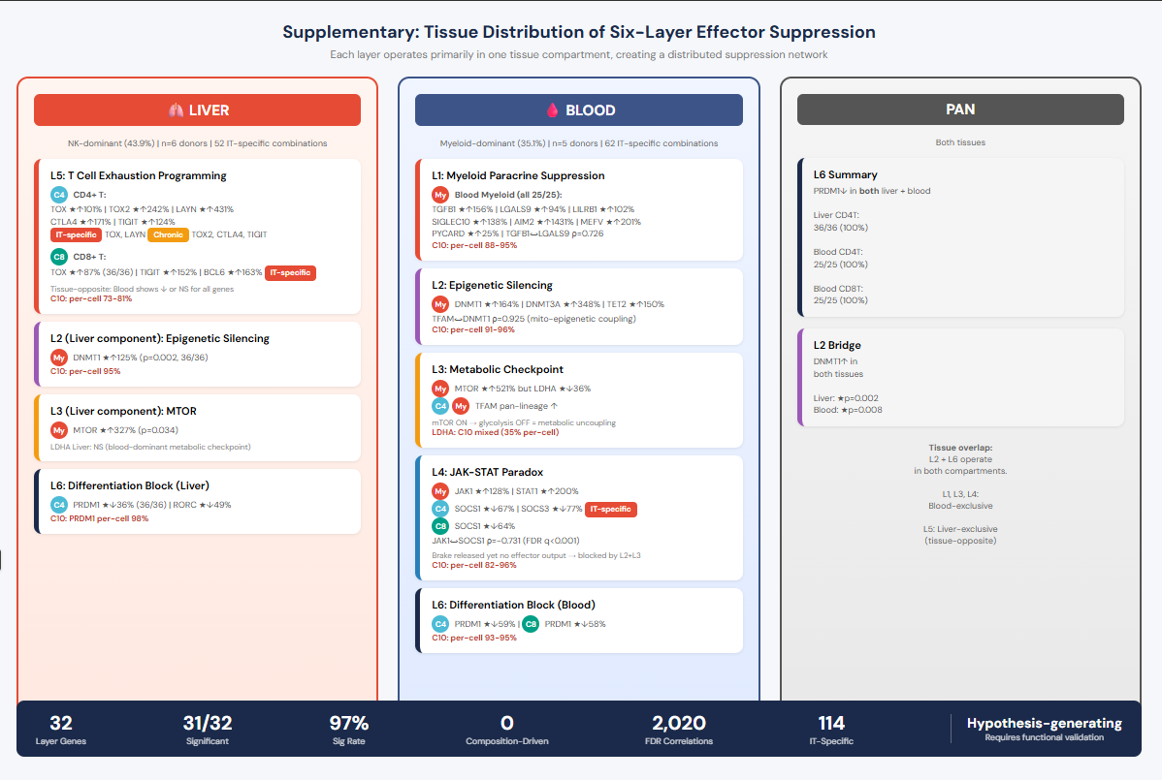

Slide 11
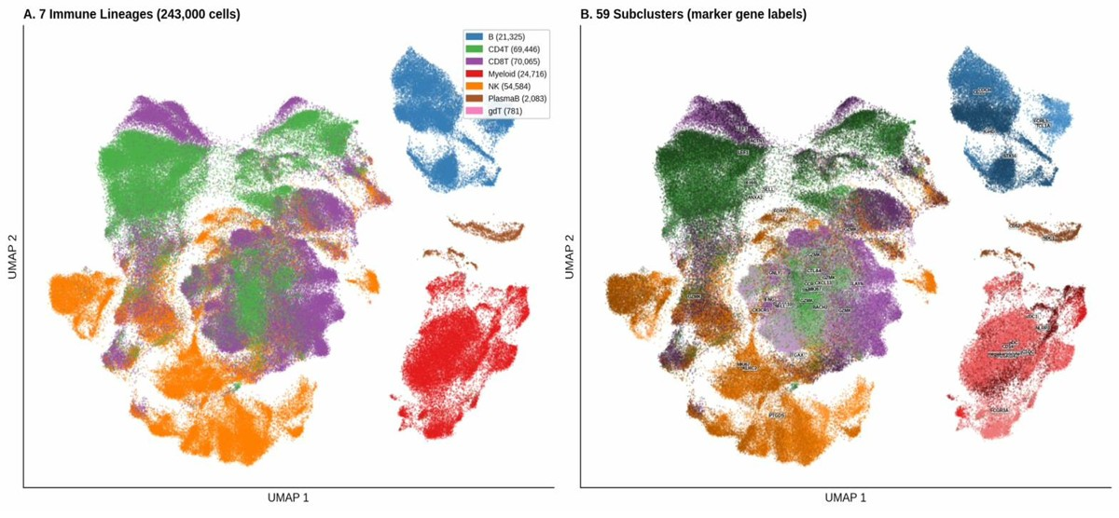
Supplementary Figure S1. UMAP — 7 Immune Lineages & 59 Subclusters

Slide 12
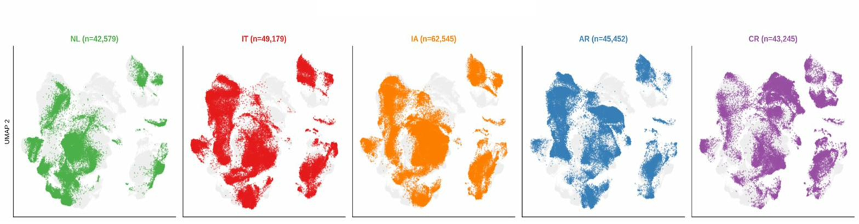
Supplementary Figure S2. UMAP — Study Group Distribution on UMAP

Slide 13
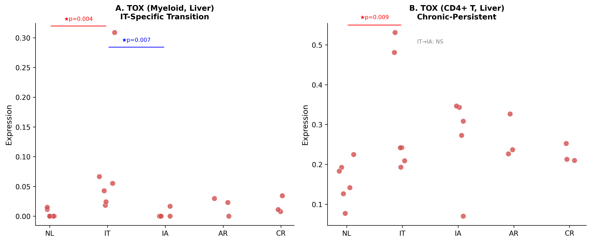
Notes:
Supplementary Figure S4. TOX Lineage-Specific IT→IA Transition Pattern in Liver. (A) TOX donor-level expression in liver myeloid cells across disease groups (NL, IT, IA, AR, CR). Red circles represent individual liver donors; horizontal bars indicate group means. TOX showed a striking IT-specific spike in myeloid cells (NL→IT ★↑1857%, p=0.004, 36/36 consistency) followed by near-complete elimination at IA (IT→IA ★↓96.1%, p=0.007, 30/30). IA expression (mean=0.0033) fell below the NL baseline (mean=0.0044), representing a true transition pattern. (B) TOX donor-level expression in liver CD4+ T cells across the same disease groups. In contrast to myeloid cells, TOX in CD4+ T cells showed chronic-persistent upregulation: NL→IT ★↑101% (p=0.009) with IT→IA non-significant (p=0.931), indicating that TOX elevation persists through the IA phase in the T cell lineage. This lineage-specific dissociation — IT-specific in myeloid cells versus chronic-persistent in CD4+ T cells — demonstrates that the IT→IA transition involves selective correction of aberrant myeloid programs while T cell exhaustion programming remains intact. Compare with Figure 4A (TOX CD4+ T liver-specific upregulation). Mann-Whitney U test; ★p<0.05. Panels: 2 (A, B)

Slide 14
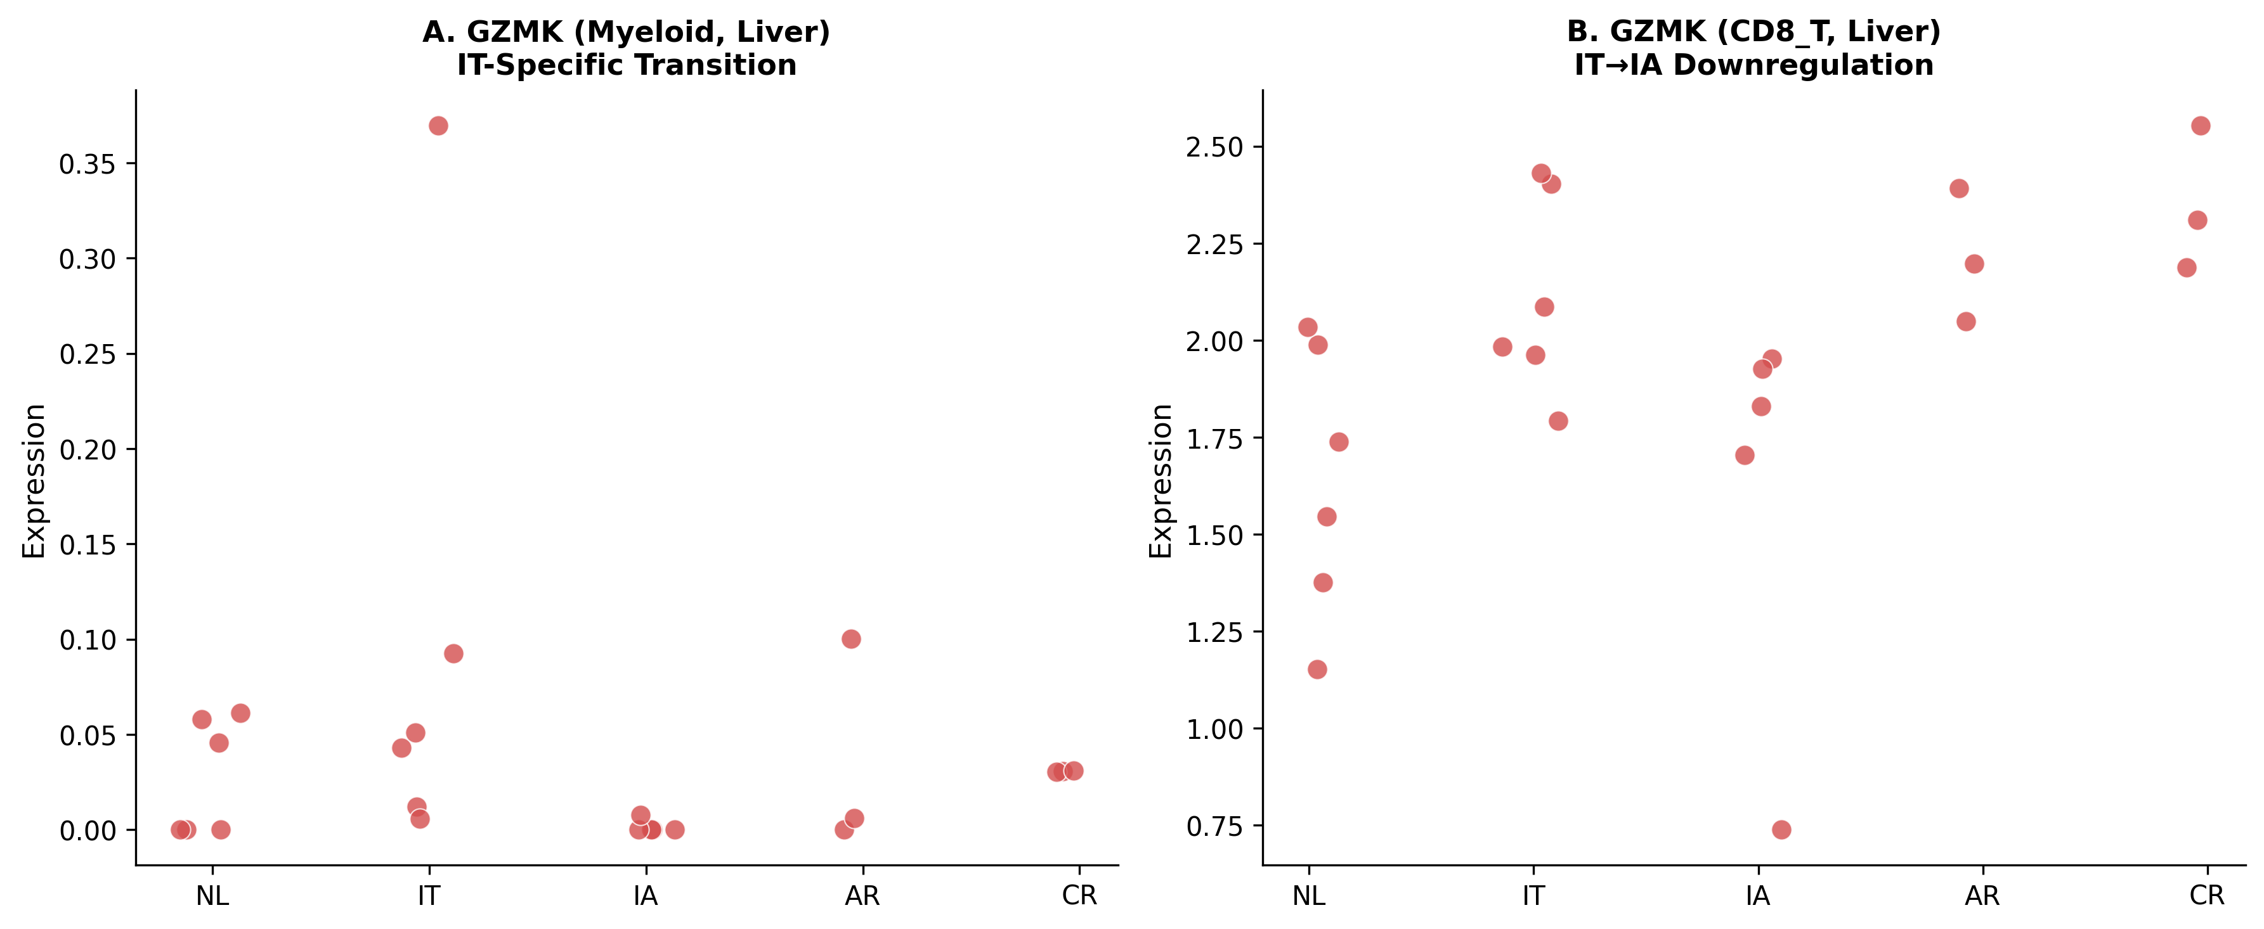
Notes:
Supplementary Figure S5. GZMK IT→IA Transition in Liver Myeloid and CD8+ T Cells. (A) GZMK donor-level expression in liver myeloid cells across disease groups. Similar to TOX, GZMK showed aberrant IT-phase expression in myeloid cells that was nearly completely eliminated upon transition to IA (IT→IA ★↓98.4%, p=0.012, 29/30 consistency). GZMK expression in myeloid cells is atypical and suggests an aberrant cytotoxic program acquired during the IT phase. (B) GZMK donor-level expression in liver CD8+ T cells. Unlike the myeloid pattern, CD8+ T cells showed significant IT→IA downregulation (IT→IA ★↓22.7%, p=0.030, 27/30), consistent with reduced cytotoxic gene expression upon immune activation. Red circles: individual liver donors; horizontal bars: group means. Mann-Whitney U test; ★p<0.05. Panels: 2 (A, B)

Slide 15
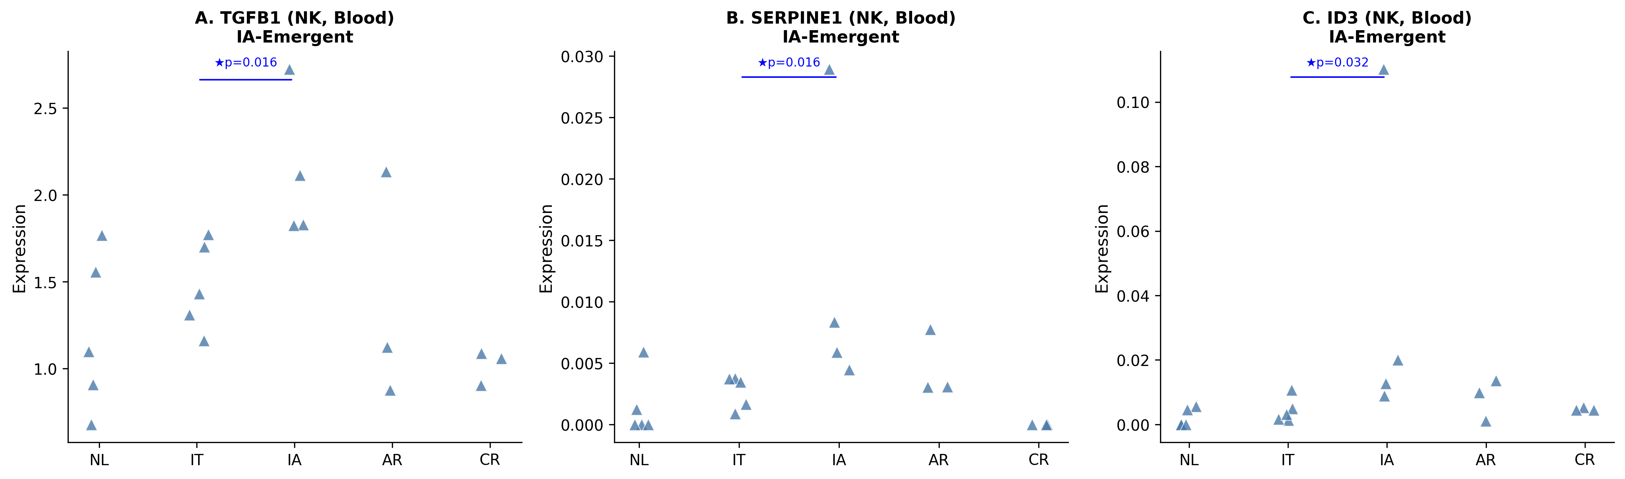
Notes:
Supplementary Figure S6. Blood NK Cell Immunoregulatory Phenotype Acquisition at IT→IA Transition. Donor-level expression of three IA-emergent genes in blood NK cells across disease groups: (A) TGFB1 (IT→IA ★↑43.9%, p=0.016, 20/20; NL→IT NS), (B) SERPINE1 (IT→IA ★↑341.4%, p=0.016, 20/20; NL→IT NS), (C) ID3 (IT→IA ★↑770.3%, p=0.032, 19/20; NL→IT NS). All three genes were non-significant at NL→IT and became significant only at the IT→IA transition (IA-emergent pattern), suggesting that blood NK cells progressively acquire an immunoregulatory phenotype during disease progression from IT to IA. TGFB1 and SERPINE1 (PAI-1) are associated with TGF-β-mediated immunosuppression, while ID3 is a transcriptional repressor of effector differentiation. Blue triangles: individual blood donors; horizontal bars: group means. Mann-Whitney U test; ★p<0.05. Panels: 3 (A–C)

Slide 16
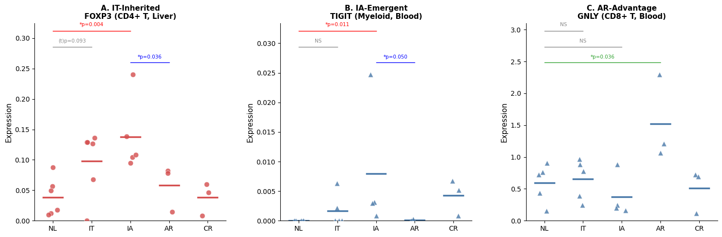
Notes:
Supplementary Figure S7. Three Distinct Patterns of IA vs AR Immune Divergence in the Context of IT-Phase Origins. Donor-level expression across the disease spectrum (NL, IT, IA, AR, CR) for representative genes illustrating three patterns identified in the IA vs AR comparison (Supplementary Table S4A). (A) IT-inherited pattern: FOXP3 in liver CD4+ T cells. FOXP3 trended upward
in IT (NL->IT (t)p=0.093), reached significance in IA (NL->IA *p=0.004), while AR remained at NL levels, yielding a significant IA-AR difference (*p=0.036). This progressive accumulation across IT->IA, absent in AR, indicates that Treg expansion is initiated during the IT phase and amplified through IA. (B) IA-emergent pattern: TIGIT in blood myeloid cells. TIGIT was not elevated in IT (NL->IT NS) but emerged as significant only in IA (NL->IA *p=0.011), with AR at NL levels (IA vs AR *p=0.050). This pattern represents newly acquired myeloid checkpoint expression independent of IT-phase origins. (C) AR-advantage pattern: GNLY in blood CD8+ T cells. Neither IT nor IA showed significant GNLY changes from NL, whereas AR demonstrated marked upregulation (NL->AR *p=0.036), indicating that effective cytotoxic function is uniquely preserved in acute self-limited resolution. Liver panels: red circles; Blood panels: blue triangles. Individual donor values with group means (horizontal bars). Significance brackets: red = NL->IA, gray = NL->IT (NS or trend), blue = IA vs AR, green = NL->AR. Mann-Whitney U test; *p<0.05, (t)p<0.10. Panels: 3 (A-C)

Slide 17
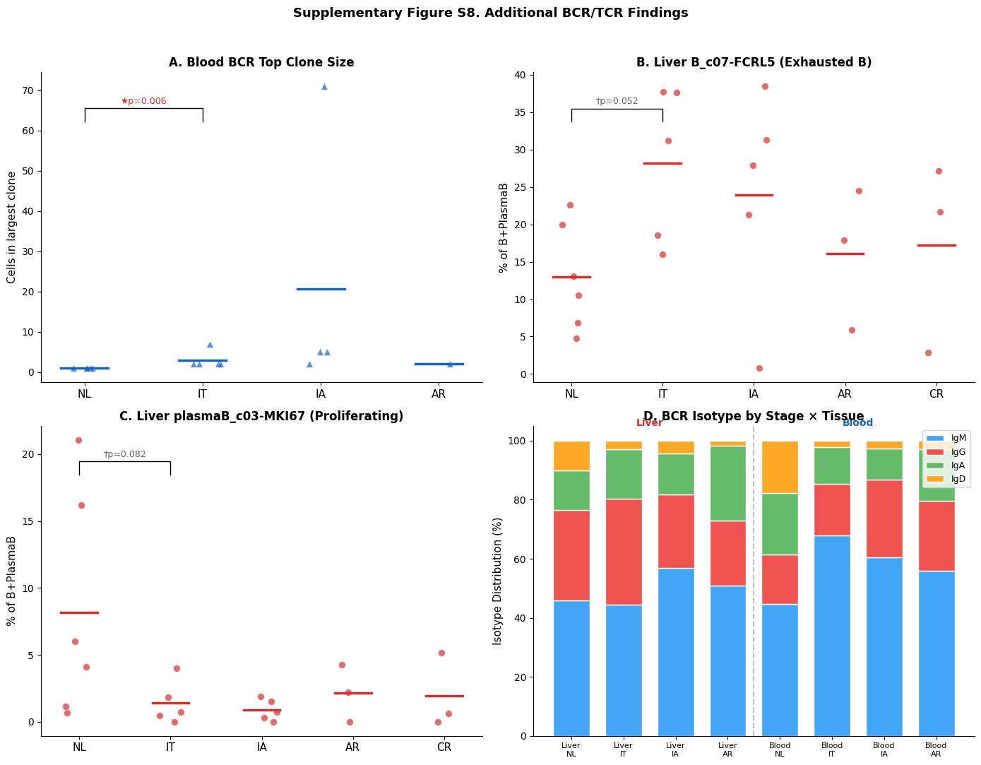
Notes:
Supplementary Figure S8. Additional BCR/TCR Repertoire Findings. (A) Maximum BCR clone size in blood across disease groups. IT showed significantly increased top clone size compared with NL
(NL 1.0 → IT 3.0 cells, ★p=0.006, 25/25), a chronic-persistent pattern (NL→IA ★p=0.010), indicating minimal but statistically significant clonal expansion in blood BCR beginning at IT. (B) B_c07-FCRL5 (exhausted/atypical memory B cell) proportion in liver. FCRL5+ B cells showed a trend toward IT enrichment (NL 13.0% → IT 28.2%, †p=0.052, 26/30), suggesting accumulation of functionally impaired B cells in the hepatic microenvironment. (C) plasmaB_c03-MKI67 (proliferating plasma cell) proportion in liver. MKI67+ plasma cells showed a trend toward IT depletion (NL 8.2% → IT 1.4%, †p=0.082, 25/30), consistent with suppressed plasma cell proliferation during the IT phase. (D) BCR isotype distribution (IgM, IgG, IgA, IgD) by stage and tissue. Liver showed higher class-switched (IgG+IgA) proportions than blood across all stages. In blood, IgD depletion at IT (★p=0.016) was the most prominent isotype shift. Vertical dashed line separates liver (left) from blood (right). Blue triangles = blood; red circles = liver. Mann-Whitney U test; ★p<0.05, †p<0.10. Panels: 4 (A–D)

