Slide 1
jeforth615
Silicon Valley
Forth Interest Group
Chen-Hanson Ting
August 28, 2021

Slide 2
Summary
jeforth
jeforth613
jeforth615
Virtual Forth Machine
Outer interpreter
Inner interpreter
Demo
Conclusion

Slide 3
jeforth
jeforth was originally written in 2010 by Cheahshen Yap in Taiwan FIG as a minimal Forth.
Sam Chen added eForth words as primitives and a few graphic demos in 2011.

Slide 4
jeforth613
jeforth613 was the released and documented version.
jeforth623 was used to explore different applications:
  Karaoke
  DTMF dial tones
  Mandelbrot set
  Interactive Globe

Slide 5
jeforth615
jeforth615 is a core version of jeForth with only a minimal set of 116 words.
jeforth614.js was integrate into jeforth615.html.
jeforth615.html has the essence of Forth.

Slide 6
jeforth Objects
All jeforth words are objects with the following fields:
  Name field
  Code field with an executable function
  Optional parameter field with a token list
  Optional data field
  Optional immediate flag field

Slide 7
6 Types of Words
Code or primitive word
Colon words with token lists
Constant
Variable
Array
create-does defined words

Slide 8
Virtual Forth Machine
A dictionary of Forth words
An outer interpreter
An inner interpreter
A return stack
A data stack
A terminal

Slide 9
Virtual Forth Machine
All primitive words are written in JavaScript.
Outer and inner interpreters are written in JavaScript.
The entire FVM is contained in a small HTML file.

Slide 10
Outer Interpreter
function evaluate(){ // interpreter/compiler
var n=parseFloat(idiom); // convert to number
var nword=find(idiom); // name?
if (base!=10) {n=parseInt(idiom,base);}
if (nword>-1) { // valid token
if (compiling && !words[nword].immediate)compile(nword);
else {execute(nword);}} // compile/execute
else // number?
if (n || idiom==0) { // idiom is a number
if (compiling) {compile("dolit");compile(n);}
else {stack.push(n);}} // compile/push
else { // error
if (compiling)words.pop();// delete defective word
stack=[];throw("&nbsp;"+idiom+" ? ");
}
}

Slide 11
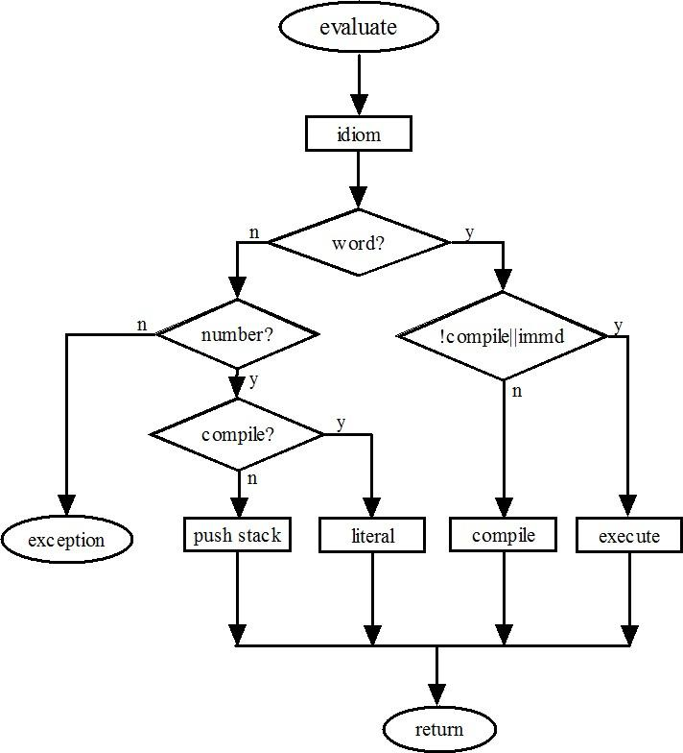
Outer Interpreter

Slide 12
Inner Interpreter
function execute(n){w=n;words[n].xt();}
function nest(){
rstack.push(wp);rstack.push(ip);
wp=w;ip=0;
while
(ip>=0){w=words[wp].pf[ip++];words[w].xt();}
ip=rstack.pop();
wp=rstack.pop();}
function exit(){ip=-1;}
function dovar(){stack.push(w);}
function docon(){stack.push(words[w].qf[0]);}

Slide 13
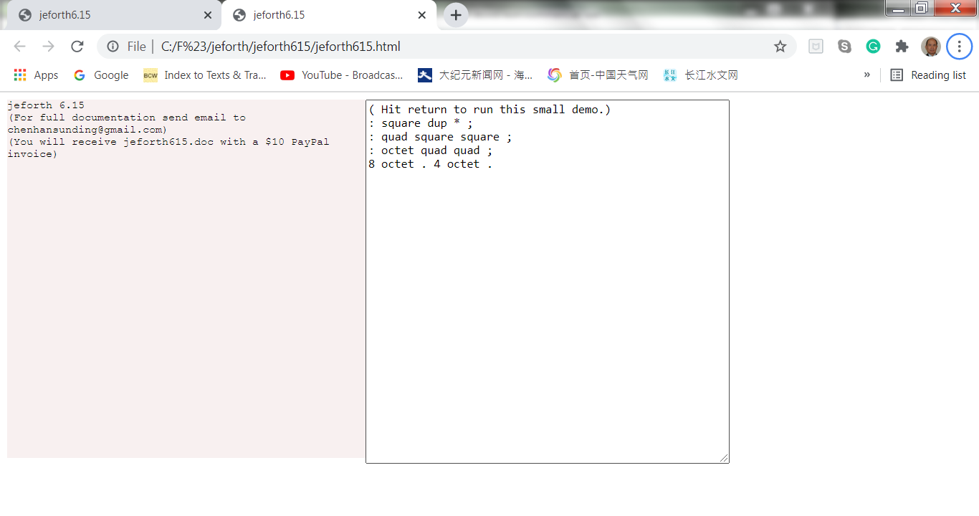
Jeforth615 Demo

Slide 14
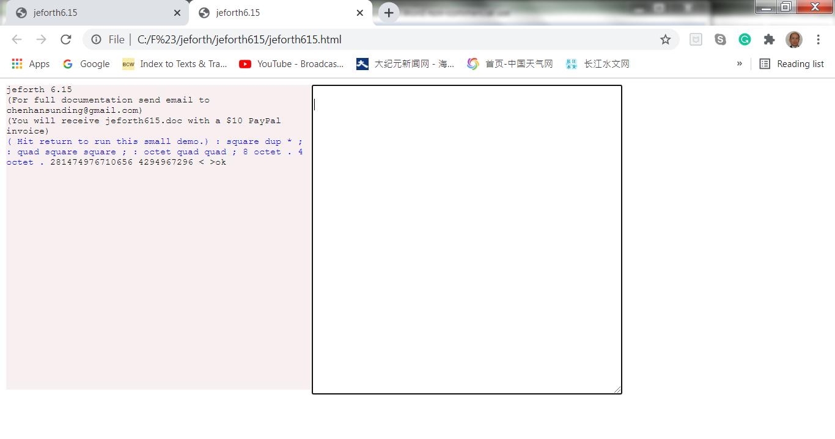
Boot up Demo

Slide 15
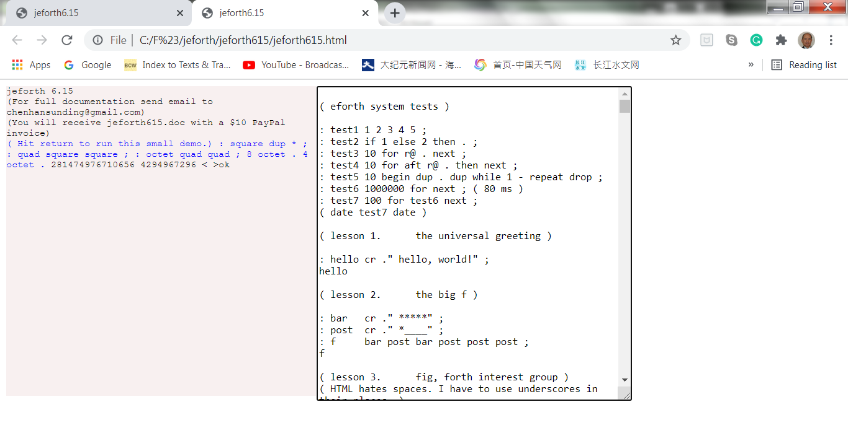
Lessons615.txt

Slide 16
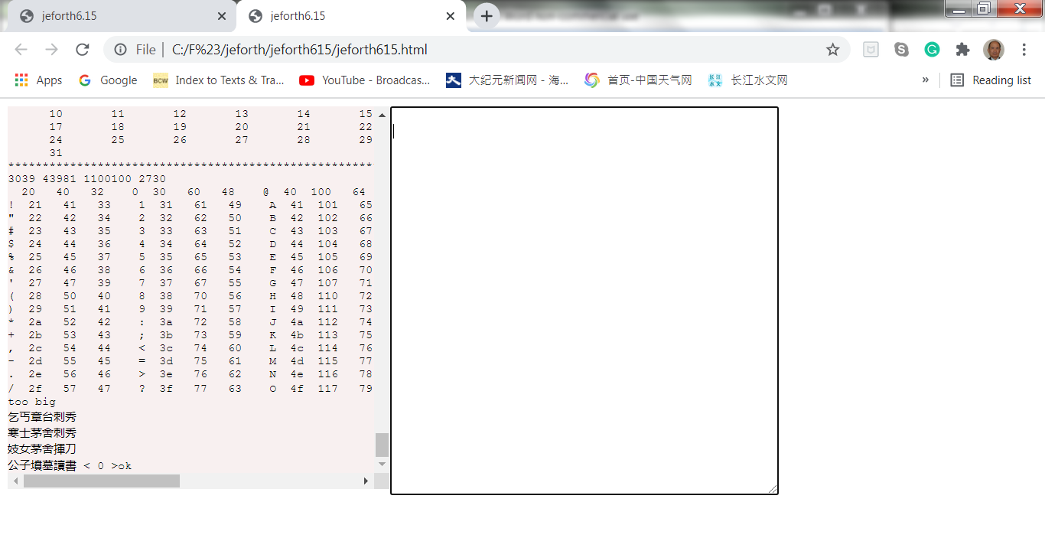
Lessons615.txt

Slide 17
Conclusions
We all need a Forth for modern browsers.
jeforth615.html has the simplest Forth in a single HTML file.
It has floating-point transcendental functions.
It can build significant browser applications.

Slide 18
Thank You!

