Slide 1
jeforth 6.14
Forth2020
Chen-Hanson Ting
May 8, 2021

Slide 2
Jeforth 6.14
Jeforth 6.13 was the released and documented version.
Jeforth 6.23 was used to explore different applications:
  Karaoke
  DTMF dial tones
  Mandelbrot set
  Interactive Globe

Slide 3
Jeforth 6.14
Jeforth 6.14 is a core version of eForth with only a minimal word set of 125 words.
Jeforth614.js was reduced to 306 lines and 15,350 bytes.
Jeforth 6.14 is the essence of Forth.

Slide 4
Jeforth Word Objects
Object Fields | Name Field | Code Field | Token Field | Data Field | Immediate Field
Code words | name | function |  |  | optional
Colon words | name | nest() | token list |  | optional
Constant | name | docon(), |  | data
Variable | name | dovar() |  | data
Array | name | dovar() |  | data array
Do-Does | name | nest() | token list | data array

Slide 5
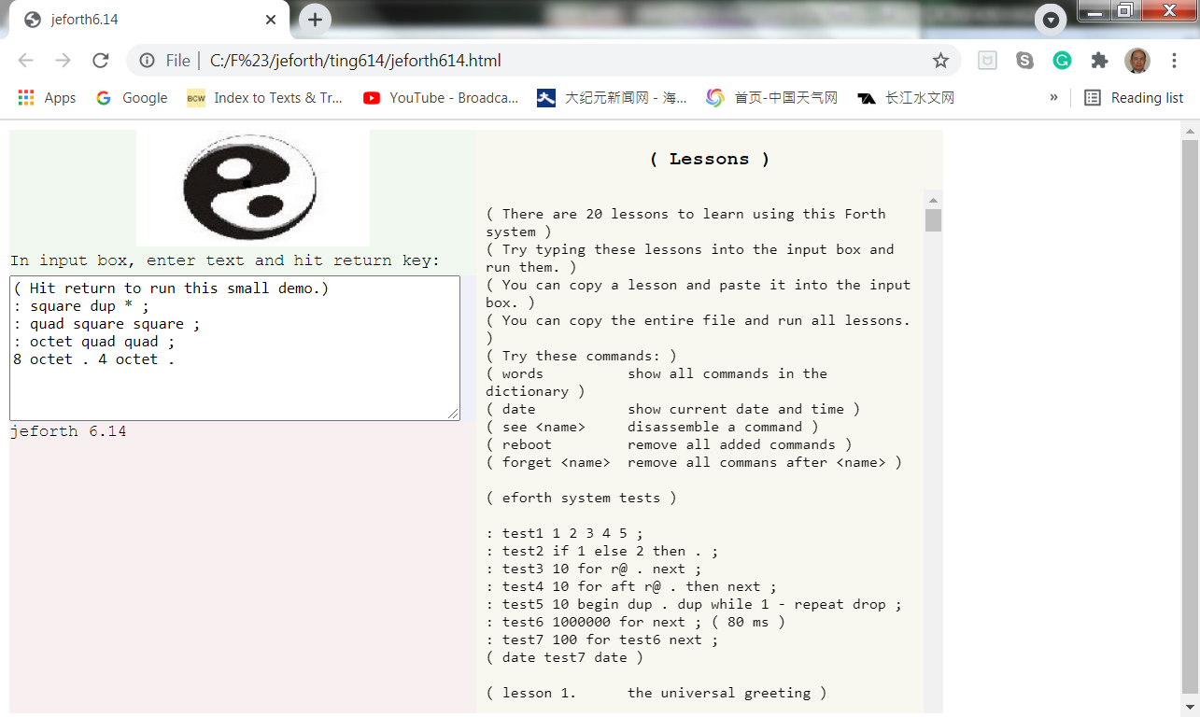
Jeforth614 Bootup

Slide 6
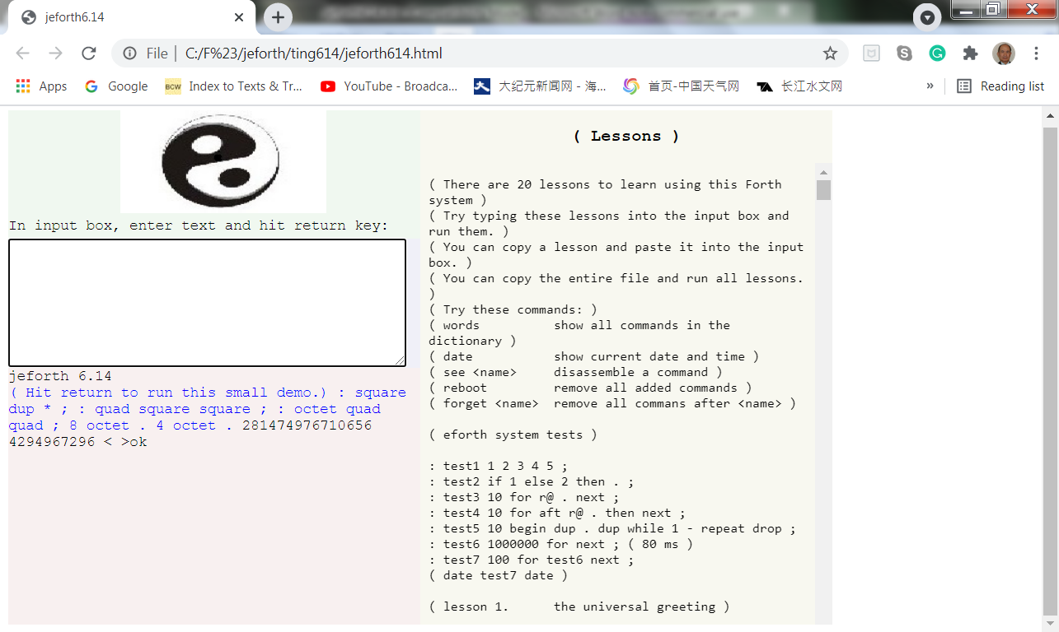
Boot up Demo

Slide 7
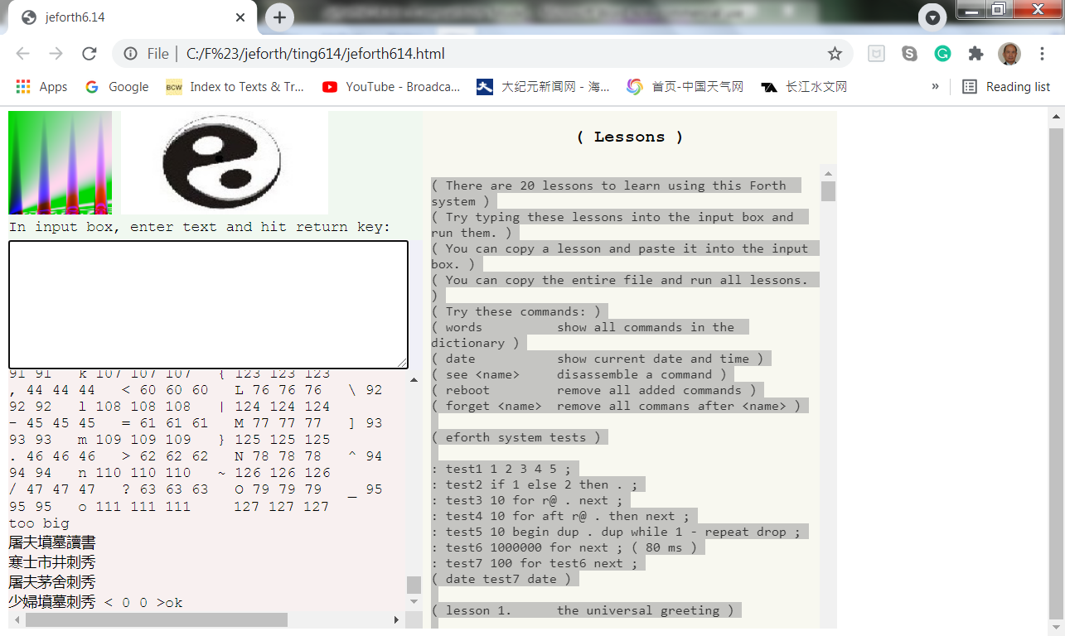
Lessons614.txt

Slide 8
Conclusions
Jeforth 6.14 is a Forth in its simplest and purest form.
HTML5 provides an ideal GUI.
Huge text files can be loaded. No blocks.
It uses floating point numbers and has all the transcendental functions provided by JavaScript.

Slide 9
Thank You!

