Slide 1
esp32forth_85
Forth2020 Group
Chen-Hanson Ting
Chochain Lee
October 9, 2021

Slide 2
esp32forth_85
Chochain Lee ported wineforth_502 to ESP32 and it became esp32forth_82.
Streamlined design of the Forth Virtual Machine.
Improved GUI and memory footprint in esp32forth_85.

Slide 3
Forth Virtual Machine
A set of Forth words stored in a dictionary
An outer interpreter
An inner interpreter
A return stack
A parameter stack
A terminal

Slide 4
Forth Virtual Machine
The outer and inner interpreters are coded in C++.
All 118 primitives words are also coded in C++.
Applications words will all be colon words.
A conventional dictionary is constructed at runtime.

Slide 5
esp32forth_85
Arduino Serial Monitor is the principal user interface.
An alternate web page can control and program ESP32 remotely.
Application programs in Forth is stored in a SPIFFS file which is loaded on boot for a turnkey system.

Slide 6
esp32forth_85
In this short presentation I will only show you the extremely tight outer interpreter that is Forth itself.
4 principal cartoon characters in Starting Forth live happily in this small code house of forth_outer().

Slide 7
Outer Interpreter
void forth_outer() {
while (fin >> idiom) { int token = find(idiom);
if(token){if(compile&&((cData[nfa]&IMMD_FLAG)==0))
comma(token); else run(token); }
else { char* p;
int n = (int)strtol(idiom.c_str(), &p, base);
if (*p != '\0') { fout << idiom << "? " << ENDL;
compile = 0; getline(fin, idiom, '\n'); }
else{if(compile){comma(find("dolit"));comma(n);}
else { push n; } } } }
if (!compile) ss_dump();}

Slide 8
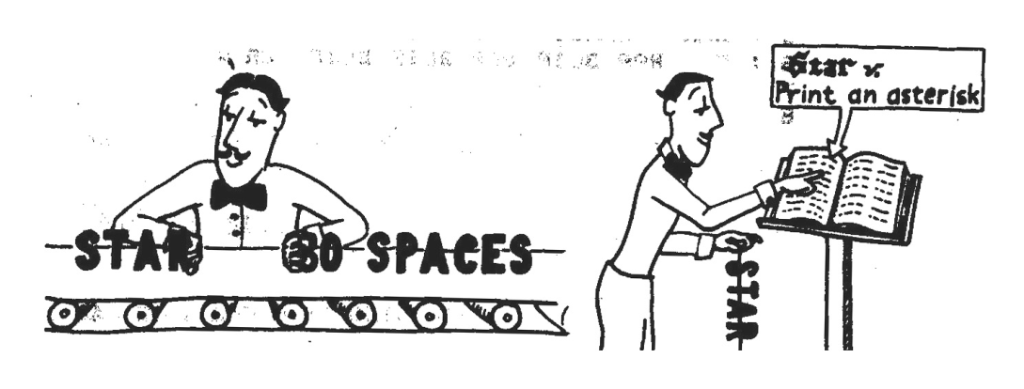
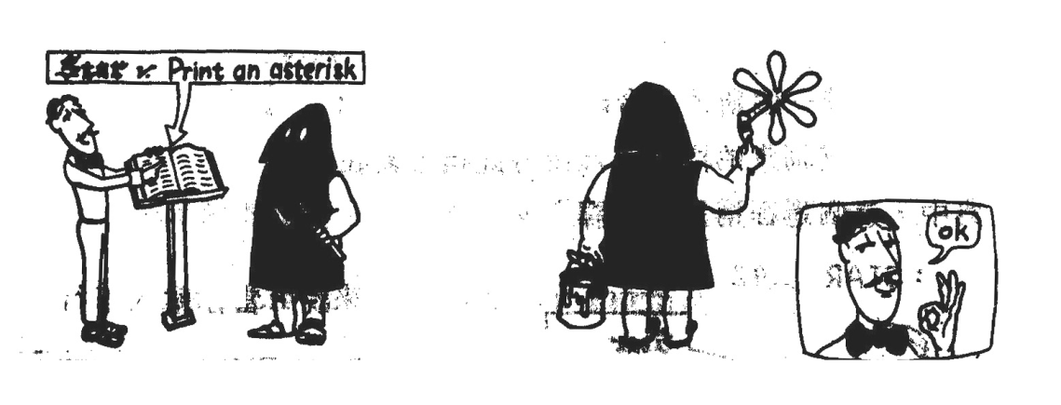
Interpreter/Executor
fin>>idiom; token=find(idiom);
Token=find(idiom); run(token);

Slide 9
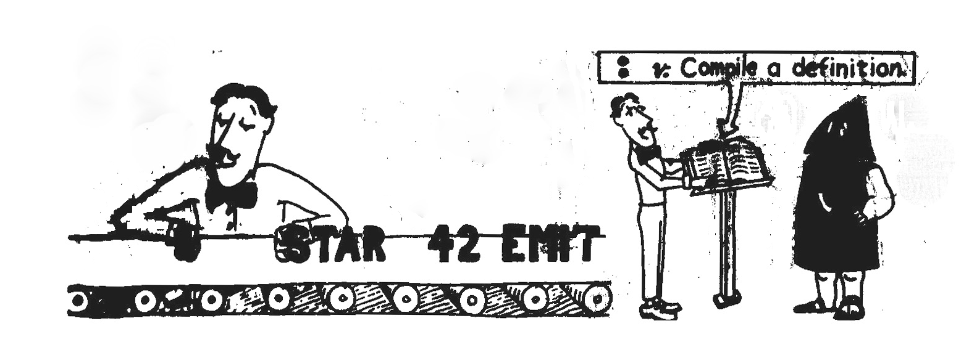

Interpreter/Compiler
fin>>idiom; token=find(idiom);
if(token&&compile)) comma(token);

Slide 10
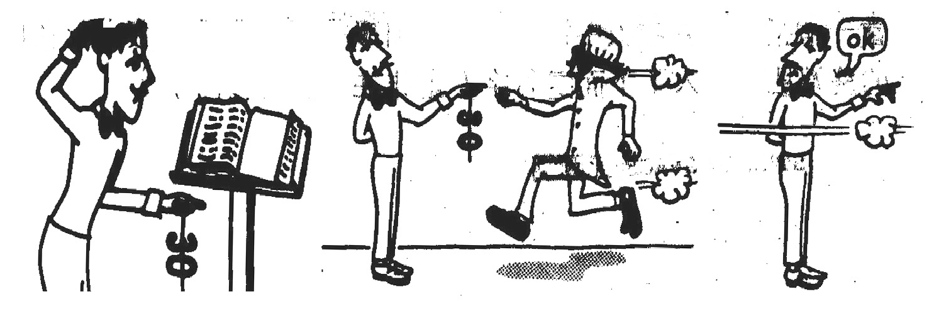
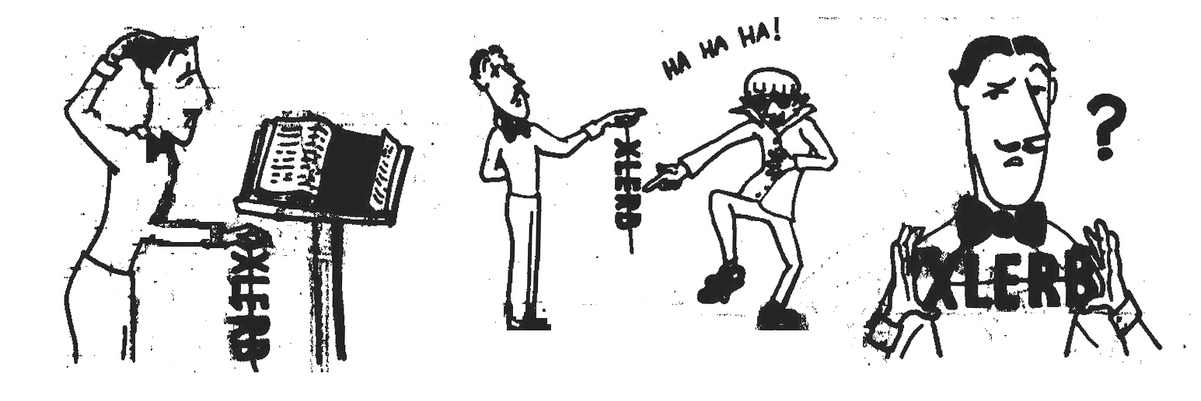
Interpreter/Runner
n=strtol(idiom); push(n);
if (idiom not number) fout<<idiom <<"? ";

Slide 11
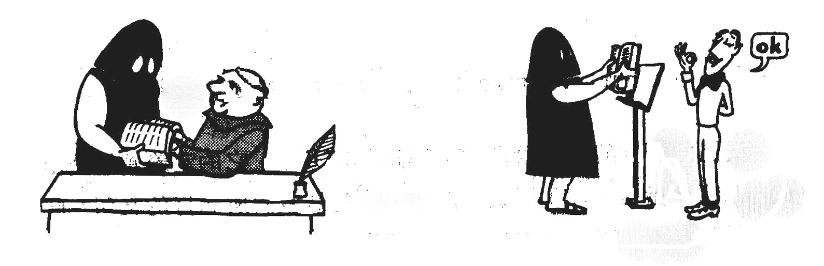
OK
n=strtol(idiom); push(n);
if (end-of-line) fout<<” ok\n”;

Slide 12
Primitives
CODE("+", int n = top; pop; top += n),
CODE("-", int n = top; pop; top -= n),
CODE("*", int n = top; pop; top *= n),
CODE("/", int n = top; pop; top /= n),
CODE("mod", int n = top; pop; top %= n),
CODE("and", top &= stack[S--]),
CODE("or", top |= stack[S--]),
CODE("xor", top ^= stack[S--]),
CODE("abs", top = abs(top)),
CODE("negate",top = -top),
CODE("max", int n = top; pop; top = max(top, n)),
CODE("min", int n = top; pop; top = min(top, n)),
CODE("2*", top *= 2),
CODE("2/", top /= 2),
CODE("1+", top += 1),
CODE("1-", top += -1),

Slide 13
Demo
ESP32S Devkit
Arduino IDE
WiFi cpnnection
Motor drives
LEDs
Small speaker

Slide 14
Conclusion
ESP32S Devkit is by far the most powerful and the cheapest microcontroller kit.
Esp32forth_85 is the smallest and cleanest Forth for ESP32 kits.
It is targeted for robotic and turnkey applications on ESP32.

Slide 15
Thank You!

