Slide 1
ooeForth 2.04
SVFIG
Chen-Hanson Ting
July 24, 2021

Slide 2
Authors
Xuyang (Shawn) Chen
Brad Nelson
Chochain Lee
Chen-Hanson Ting

Slide 3
ooeForth
I wanted a simple Forth in Java modeled after jeforth614.
Forth words, integer literals, string literals, and address literals should all be objects.
All colon words should have linear object lists.
A true object-oriented Forth.

Slide 4
ooeEforth 2.04
There are only two types of words:
  Primitive words
  Colon words
All system words are primitive objects.
All user defined words are colon objects.

Slide 5
ooeForth 2.04
A single Class Code constructs all Forth words as objects.
All primitive objects are stored in a dictionary using their names as keys.
Colon objects are sequentially added to the dictionary.

Slide 6
ooeForth 2.04
All colon objects contain linear object lists.
All colon objects are executed by this very simple inner interpreter:
nest(){for(var w:pf) w.xt();}

Slide 7
Eforth204 Class
Stack
Rstack
Dictionary
  Primitive objects + Colon objects
Methods
  main(), setup)dictionary(), outerInterpreter()
Class ForthList manages the dictionary
Class Code constructs all objects

Slide 8
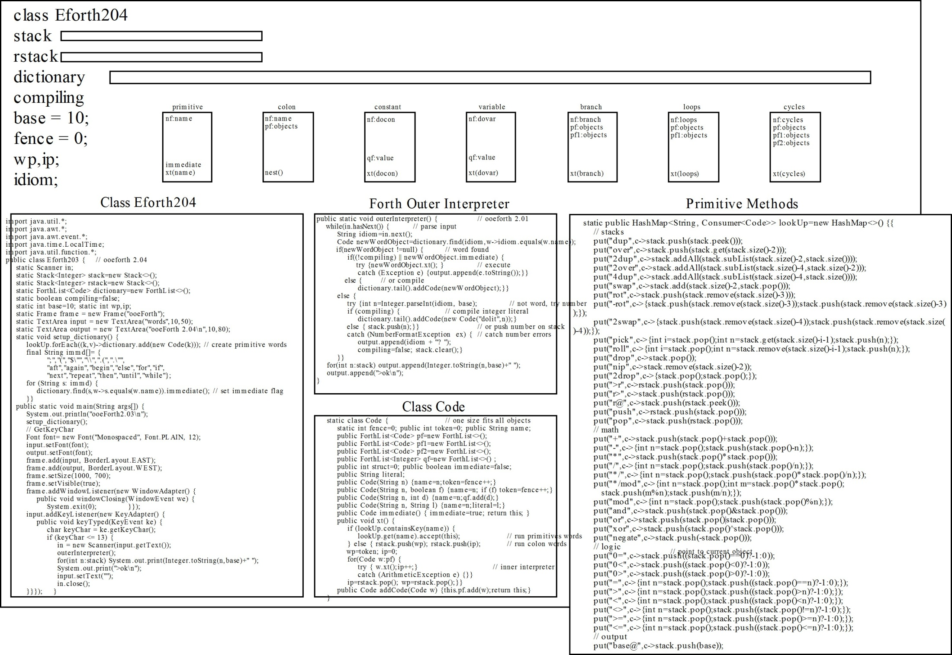

Slide 9
Forth Objects
Primitive objects
Colon Objects
  Integer literal objects
  String literal objects
  Control structure objects
    Branch objects
    Loops objects
    Cycles objects

Slide 10
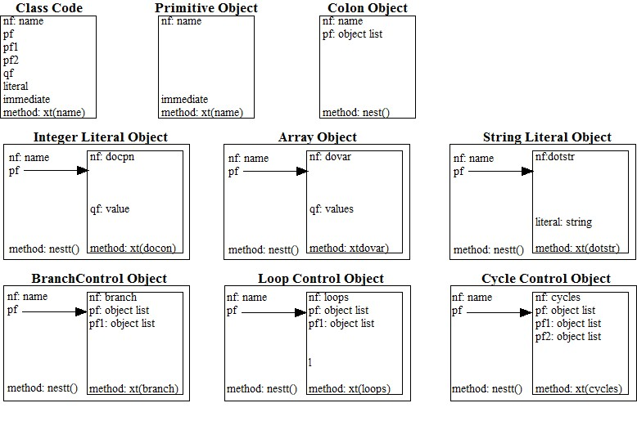

Slide 11
Primitive Object
nf: name
token: id
pf
pf1
pf2
qf
immidiate: flag
method: xt(name)

Slide 12
Colon Object
nf: name
token: id
pf: object list
pf1
pf2
qf
immidiate
method: next()

Slide 13
Integer Object
nf: docon
token: id
pf:
pf1
pf2
qf: value
immidiate
method: xt(docon)

Slide 14
String Object
nf: dostr[dotstr]
token: id
pf:
pf1
pf2
literal: string
immidiate
method: xt(dostr[dotstr])
Usage: $” xxx” , .” yyy”

Slide 15
Control Structures
There are branches and loops in an object list.
5 control structures are colon objects with alternate paths:
  if pf else pf1 then
  begin pf again
  begin pf until
  begin pf while pf1 repeat
  for pf aft pf1 then pf2 next

Slide 16
Branch Object
nf: branch
token: id
pf: object list
pf1: object list
pf2
qf
immidiate
method: xt(branch)
Usage: if pf else pf1 then

Slide 17
Loops Object
nf: loops
token: id
pf: object list
pf1: object list
pf2
qf
immidiate
method: xt(loops)
Usage: begin pf while pf1 repeat

Slide 18
Cycles Object
nf: cycles
token: id
pf: object list
pf1: object list
pf2: object list
qf
immidiate
method: xt(cycles)
Usage: for pf aft pf1 then pf2 next

Slide 19
Windows Interface
Methods in java.awt class are used to built the Windows interface:
  Frame frame is a container
  TextArea input receives text input
  TextArea output displays output text

Slide 20
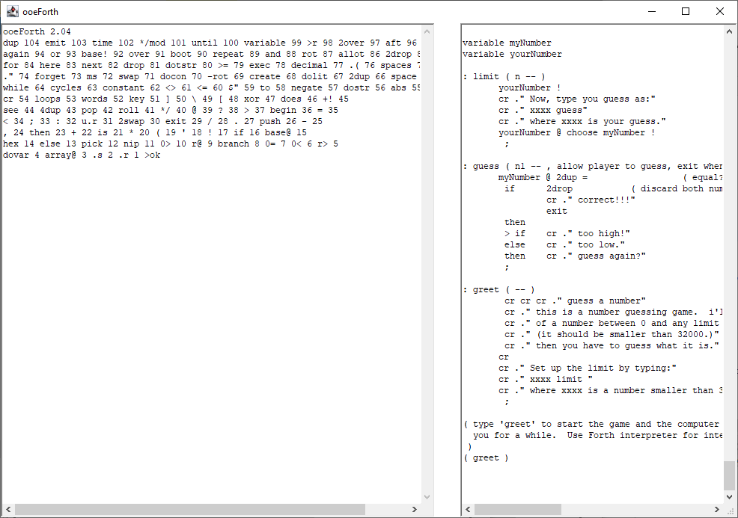

Slide 21
Outer Interpreter
The Forth outerInterpreter() is called by a key event when the return key is pressed to evaluate text entered in the input box.
The parser is simply a Java method: Scanner.in.next().

Slide 22
Inner Interpreter
Object lists in colon objects are all linear object lists.
Linear object lists can be executed by this very simple inner interpreter:
nest(){for(var w:pf) w.xt();}
Linear object lists can be terminated early by throwing an ArithmeticException.

Slide 23
Linear Object Lists
Colon objects compile linear object lists in their pf fields.
Linear lists can be nested indefinitely to solve complicated problems.

Slide 24
Conclusions
Eforth204 implements Forth words as true objects.
Eforth204 has only 405 lines of source code.
It is the second smallest Forth after jeforth614 with 379 lines.
It is the smallest Windows Forth ever.

Slide 25
Windows Forth
I documented figForth, polyForth, F83, and F-PC.
I gave up on Win32Forth, because it was too complicated.
For my own sanity, I started eForth.
Cheahsin Yap gave me F# and I survived on it.

Slide 26
Windows Forth
Windows might be complicated, but Windows interface should not.
Eforth204 is simple because it uses only text input and output.
If you got into files, menus, and buttons, things quickly became orders of magnitude more complicated.

Slide 27
Link to Eforth204
Link to Eforth204:
  Please watch this presentation on Zoom and get the link
Email comments to me:
  chenhansunding@gmail.com

Slide 28
Demo

Slide 29
Thank You!

