Slide 1
wineforth_502
Silicon Valley
Forth Interest Group
Chen-Hanson Ting
August 28, 2021

Slide 2
wineForth
It should be pronounced
win-e-Forth
It could also be pronounced
wine-Forth

Slide 3
ceForth
ceForth was eForth written in C.
ceForth_21 in Cygwin cpp used a dictionary meta-complied by weForth.
ceForth_33 in Visual Studio 2017 had a meta-compiler to build Forth dictionary in runtime.

Slide 4
ceforth_403
It was written by Chochain Lee as a C++ console application in Visual Studio 2019 Community.
It runs in a console window like an old-fashion Forth program with a DOS terminal.

Slide 5
wineforth_502
Chochain changes ceforth_403 to wineforth_502.
A simple Windows interface allows text in an input window to be evaluated and output characters are sent to an output window.

Slide 6
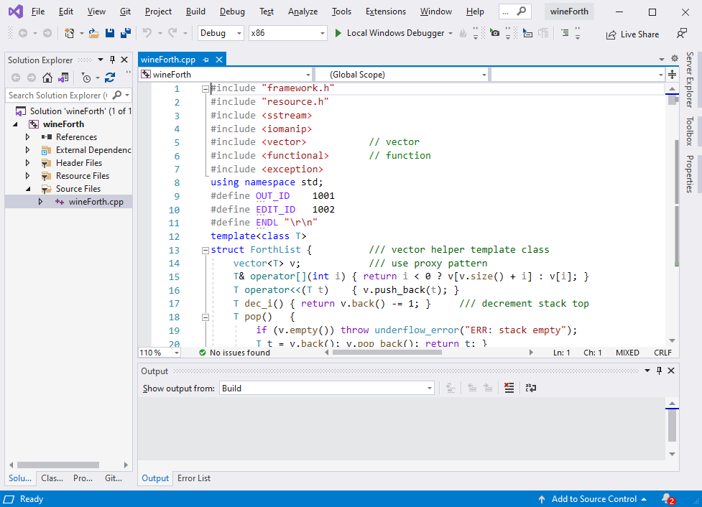

Slide 7
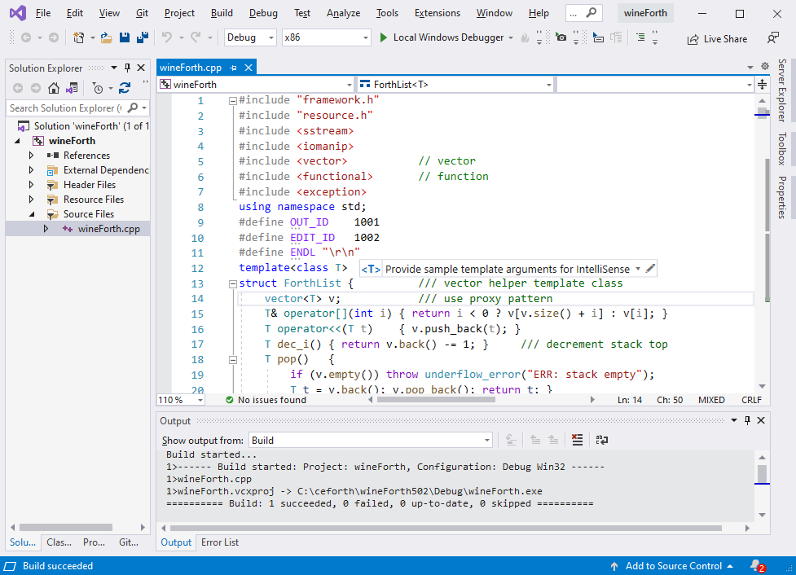

Slide 8
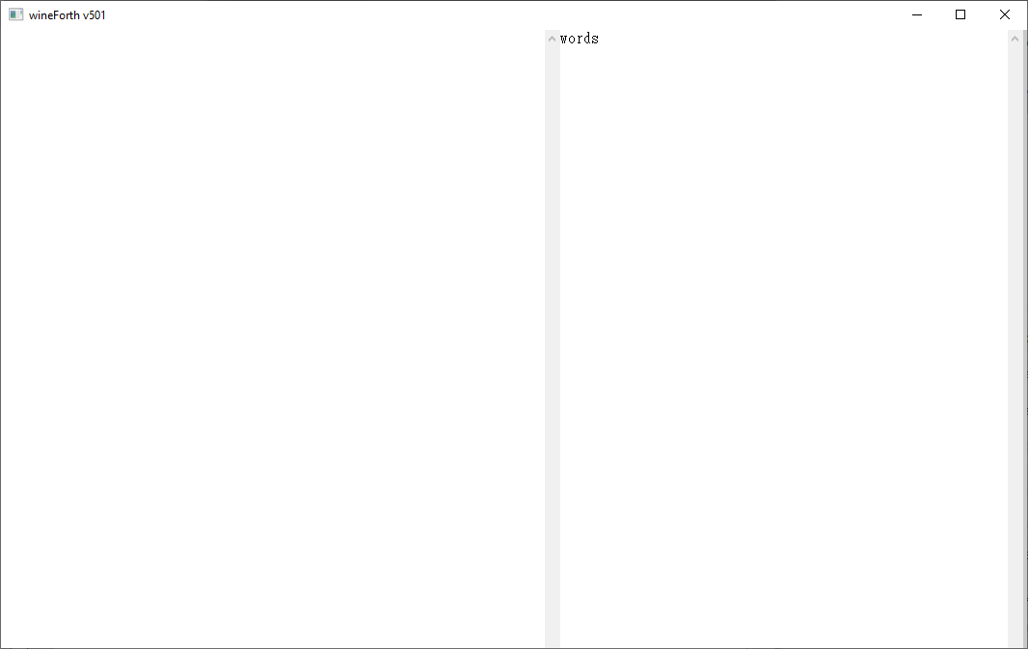
Boot ceForth

Slide 9
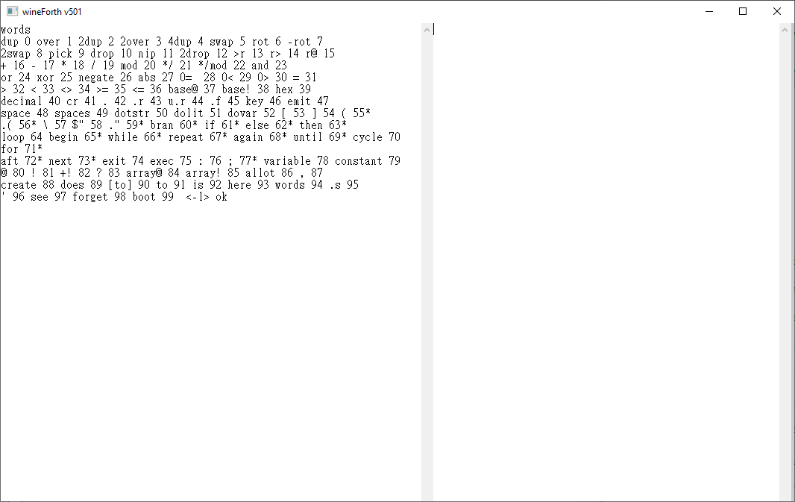
words

Slide 10
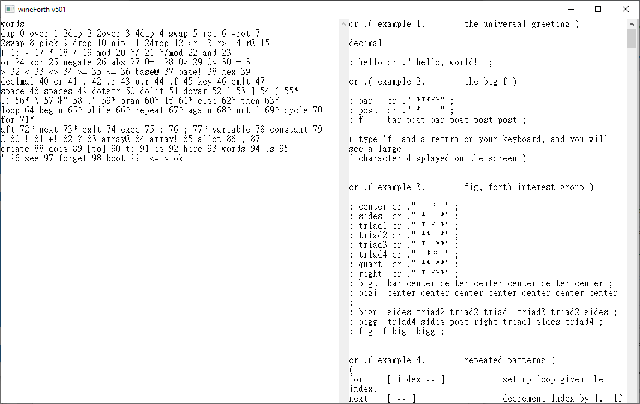
Numbers

Slide 11
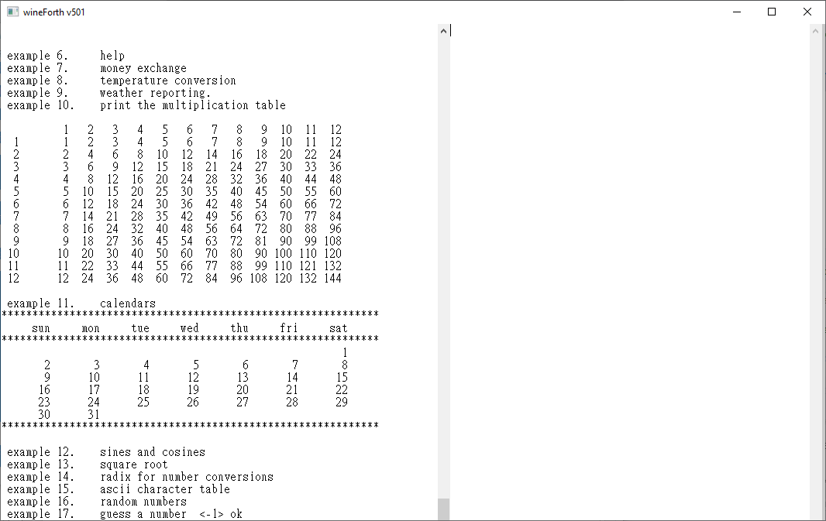
Error Exception

Slide 12
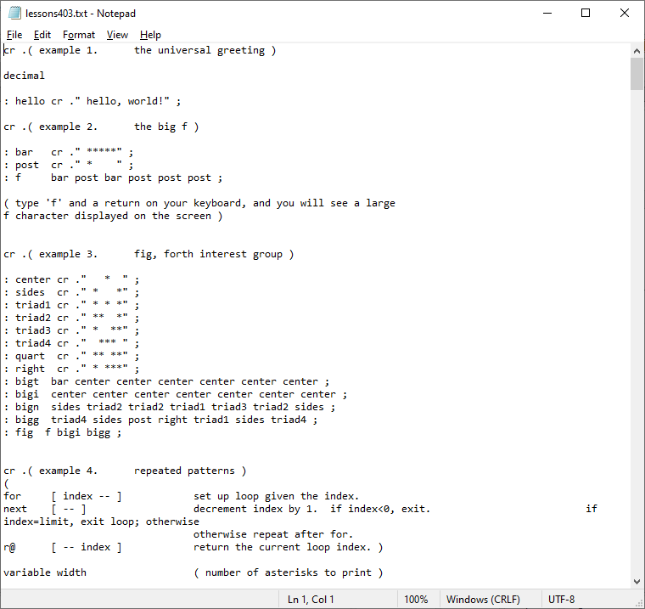
Lesons502.txt

Slide 13
Forth Virtual Machine
A dictionary
An outer interpreter
An inner interpreter
A return stack
A parameter stack
An IO device

Slide 14
Forth Virtual Machine
Forth words are objects.
Primitive words, outer interpreter, and inner interpreter can be written in object-oriented languages.
jeforth, ooeforth, ceforth, and wineforth are poetry.

Slide 15
ESP32eforth
A goal of ceforth_403 was to replace the ESP32eforth running in ESP32 chips.
Chochain had already ported eforth_403 to ESP8266 and ESP32.

Slide 16
Windows Forth Saga
Two quarrelsome frogs lived in a deep well.
They heatedly debated how big the sky was.
With objective observation and accurate measurements, they finally agreed that the sky was circular and 5 feet in diameter.

Slide 17
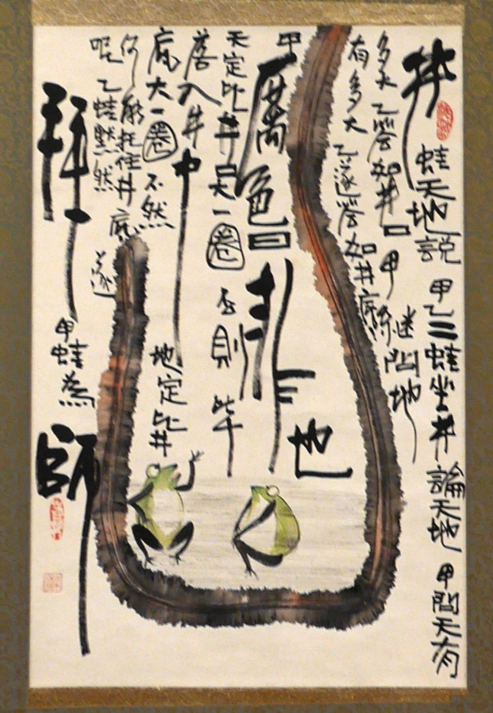

Slide 18
Windows Forth Saga
Me and Chochain were these frogs.
We argued how big the sky was.
After all the work, we decided the sky was 1080 pixels wide and 680 pixels high.

Slide 19
Thank You!

