Slide 1
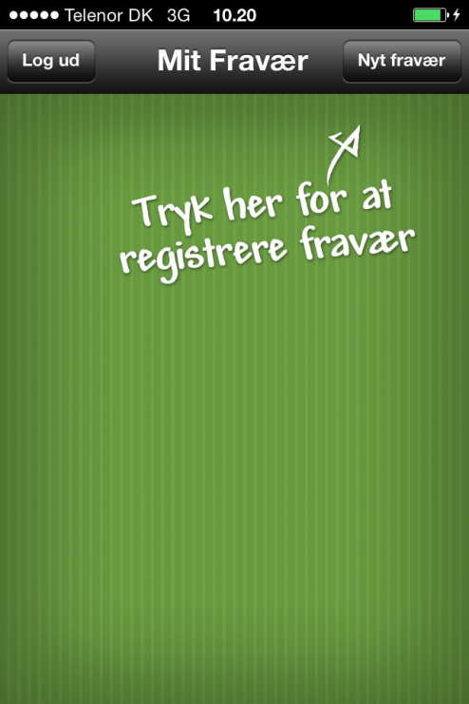
Nyt fravær
If the user enters the app and has no registrations of absence this screen should be displayed.
With the options to log out and the option ‘Create new’ (Nyt fravær) in the top menu.
Exact color code will be supplied next week.

Slide 2
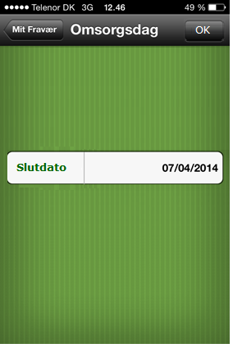
If there is a registration of absence with no end date (open to high date) the first thing the user sees when entering the app should be a screen with the option to set the end data.
It is possible for the user to navigate back to the overview page, but the same screen should be displayed again next time the user logs in (until the user set an end date for the absence)…
Raskmelding
OK
Du har et fravær med ukendt
slutdato.
Vælg din sidste fraværsdag:
Exact color code will be supplied next week.

Slide 3
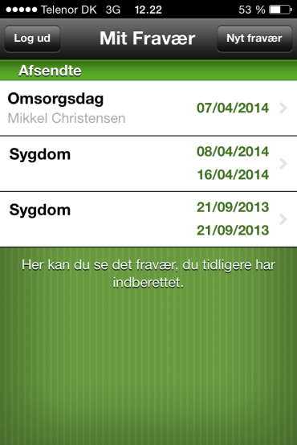
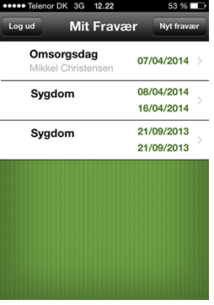


Overview
Exact color code will be supplied next week.
The overview contains all registrations of absence made by the employee.
The list is sorted by the start date of the absence date – new to old. If there is more that one registration on the same date it will further be sorted alphabetically a->z.
The headline ‘Afsendte’ should be removed and the text below should also be removed.
It should be possible to click on the individual list items and navigate to details.
Add an icon to the individual list item to show the status of the workflow. We will supply the icons, so just use a placeholder (We will get our graphic designer to make them)
Nyt fravær

Slide 4
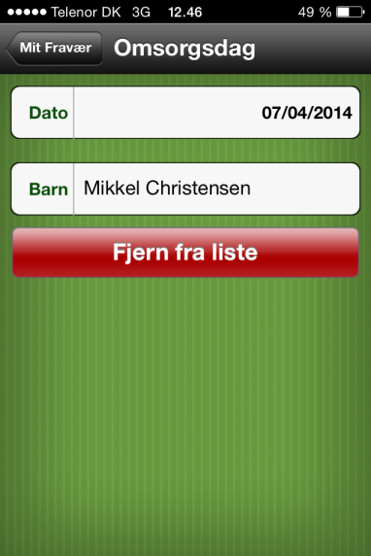
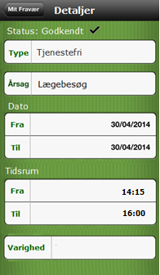
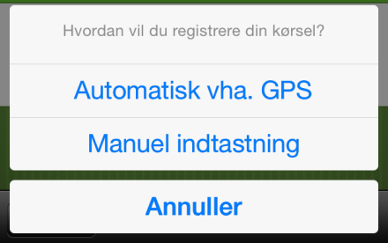
Details
2
Change (Ret) will present the user with 2 options:
Ret (Change) Exact color code will be supplied next week.
Slet (Delete)
Delete will present the user with a pop up.
”Er du sikker på at du ønsker at slette registreringen” (Are you sure wou want to delete)
Options: Fortryd (cancel) OK (Delete)
Ret will make the fields active. The top bar now contains 2 buttons; Fortryd (Back) and Send (Send has same behavior as send in the create new absence screen).
Overall, there are five categories of absences: Normal, ‘Omsorgsdage’, ‘Tjenestefri’, ‘Arbejdsskade’and ‘Barsel’. The normal category does not have an extra field, but the others do, see below for the assignment of category based on leave type:
Omsorgsdage: OS + OOS: Children (part of current solution).
Tjenestefri: TJ + TJUL + TJUP: Reason codes (part of current solution).
Arbejdsskade: AS: Work-related injury cases (NEW).
Barsel: BA + BAF + BD + BG + BU + BUD + GG + NSG (NEW).
Ret
Text will say ”Hvad ønsker du at gøre ved din registrering?”
Ret
Slet
1
Headline is know ‘Details’ and not the absence type.
Details are always shown with all fields locked!
Information added:
Status (display)
Type (field)
Course (Field)
Date From – to
Time From – to
Duration
Options:
Back to overview
Change (Ret)

Slide 5
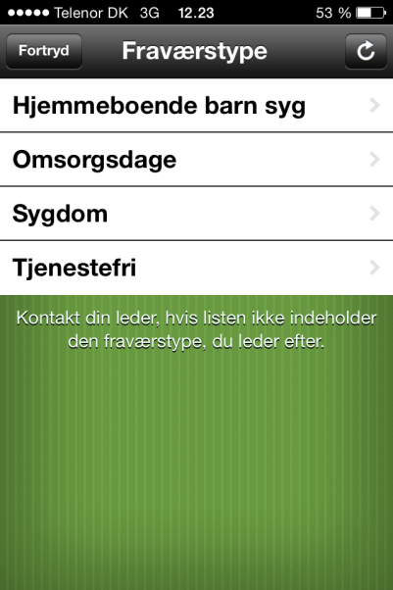
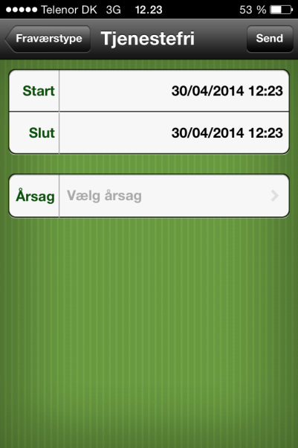
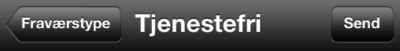
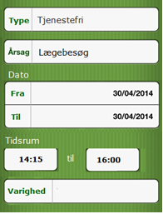
Create new
Send
Exact color code will be supplied next week.
Overall, there are five categories of absences: Normal, ‘Omsorgsdage’, ‘Tjenestefri’, ‘Arbejdsskade’and ‘Barsel’. The normal category does not have an extra field, but the others do, see below for the assignment of category based on leave type:
Omsorgsdage: OS + OOS: Children (part of current solution).
Tjenestefri: TJ + TJUL + TJUP: Reason codes (part of current solution).
Arbejdsskade: AS: Work-related injury cases (NEW).
Barsel: BA + BAF + BD + BG + BU + BUD + GG + NSG (NEW).
Send works as today.

