Slide 1
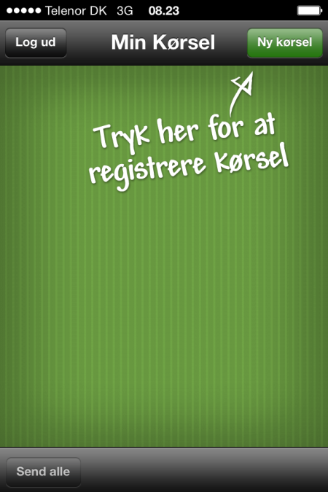
No changes to this screen:
If the user enters the app and has no registrations of milage this screen should be displayed.
With the options to log out and the option ‘Create new’ (Ny kørsel) in the top menu.

Slide 2
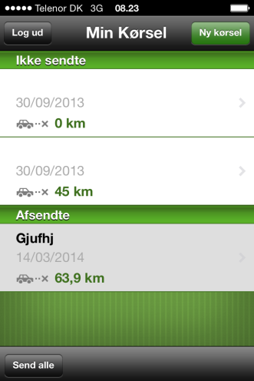
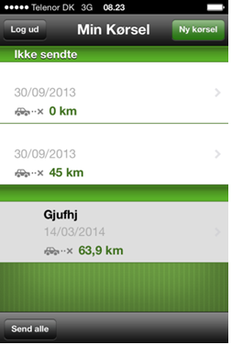



Overview
As is. No changes to the category ‘Not sent’
New headline; “Sendte”.
This section shows all workflows on the employee. The status of the workflow is displayed with an icon. It is possible to click on the individual registration and navigate to details.
Remove grey tone on background…
Icons is supplied seperately:
Approved:
Rejected:
Waiting:
Sendte
Send all (see next slide for this).

Slide 3
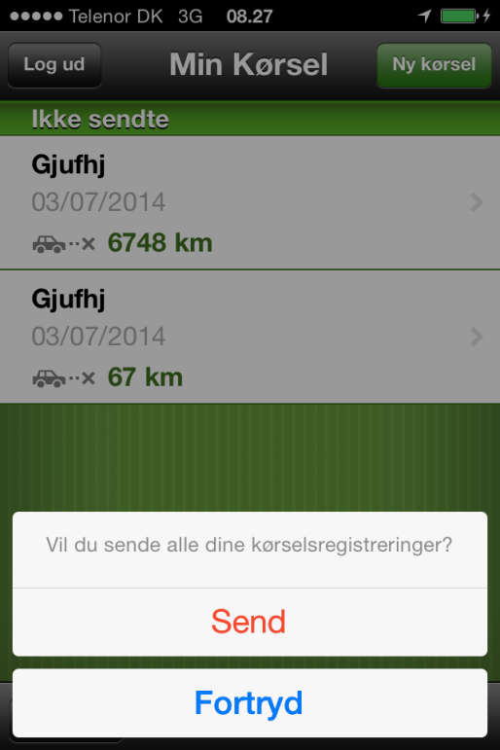
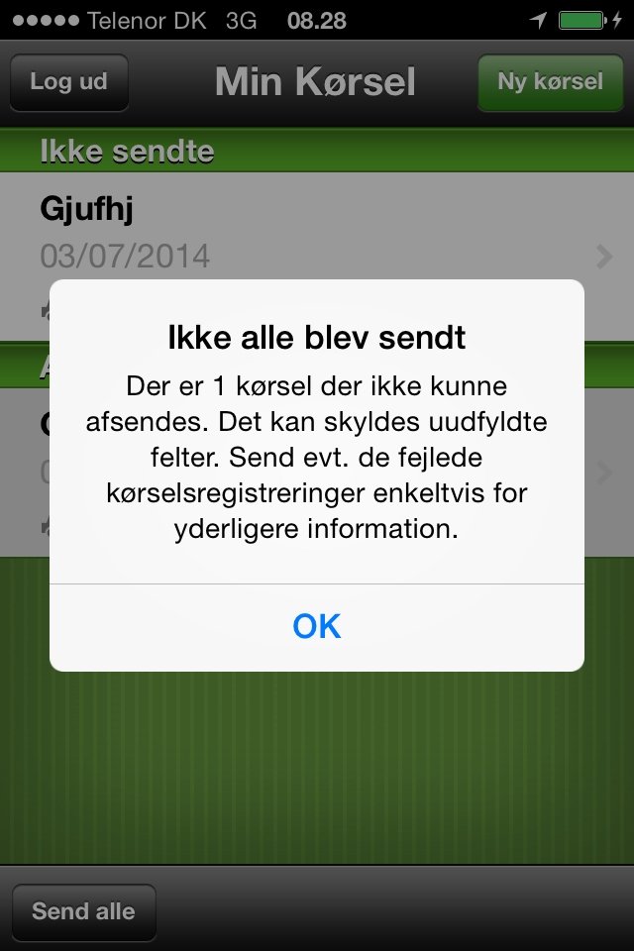
Send all
Registrerede
Send all
Send
Cancel
If some of the registrations are incomplete/contains errors, the user gets a message saying (the number being the number of incomplete registrations – in this case 1):
Ikke alle blev sendt
Der er 1 kørsel, der ikke kunne afsendes. Det kan skyldes, at du mangler at udfylde nogle felter. Send de fejlede kørselsregistreringer enkeltvis for yderligere information.
If the registrations go through no popup is shown but they are moved to the ‘second part of the list (updated with status).

Slide 4
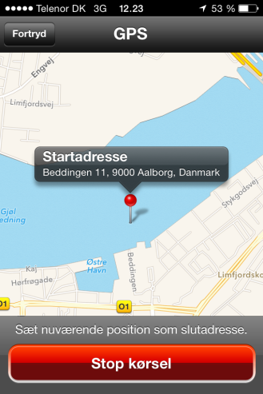
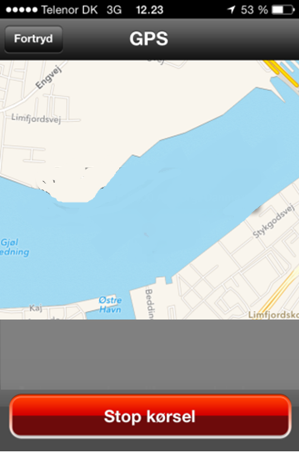
Create new registration – gps/map
When the user presses ‘Start’ 2 buttons will appear:
Set via point
Stop
The start address should be shown in top after the user presses start. And if the user adds a via point that address should also be shown and so forth. We will show the latest 3 addresses and hide the rest. When ever and address is added the list will animate/roll up… The oldest registration of the 3 shown should appear a faded. Whether the address is also shown by the ‘pin’ (as today) does not matter.
Fra: Lauritzens Plads 1, 9240 Nibe
Via 1: Vejen 7, 9674 Byen
Via 2: Adressen 87, 7899
Sæt via-punkt

Slide 5
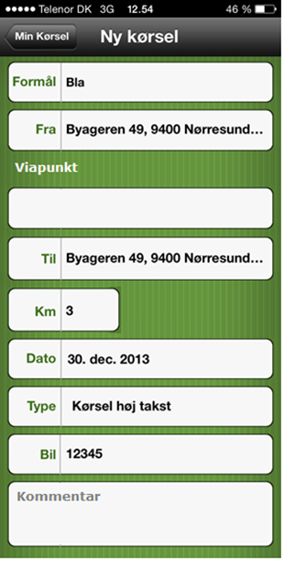
Create new registration - Details
Everything in this screen can be filled out manually if the users enters it directly by choosing ‘Create new’ -> manual from the overview page.
If the users chooses ‘Create new -> GPS’ the registrations done by the GPS should prefill the fields: From, To (including Via-punkter) and KM (in addition to the fields normally pre-filled.
Address fields (Til, Fra, Via) should use google maps to suggest the correct address while the user fills out the field.
‘Beregn km’ (calculate km) should also use google maps to calculate the route from start, via the via points, to end.
We need a way to handle errors in the addresses/addresses unknown to google maps (if they are entered manually and the data connection is poor or something???). And what if the users add a via point and forgets to press Beregn before pressing OK? (Talk to Peter/PH about this)
The user should be able to manually overwrite the calculated km. But if the users again presses ‘Beregn’ the calculated km should overwrite previous input.
OK
Via points to be added
Function of via points described on separate slide!!
Beregn km
Option to recalculate route (same button type as ‘+’)
Comment field added

Slide 6
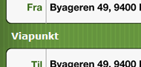
Via points in detail screen
Via Points will be placed between ‘From’ and ‘To’.
The icon + will add a via point and it should be possible to delete an via point (in field) and change the order of them by dragging them up and down (like in a list).
OK
No via point added yet
Beregn km

Slide 7
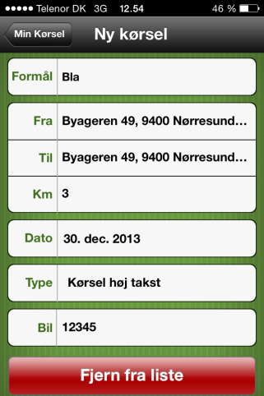
Details (clicking on a registration in the overview)
NB!: In general, details and create new is the same screen
When viewing details from ‘Registered’ workflows
Red change button is to be removed.
Change (Ret) will present the user with 2 options:
Ret (Change)
Slet (Delete)
Delete will present the user with a pop up.
”Er du sikker på, du ønsker at slette registreringen?” (Are you sure you want to delete)
Options: Fortryd (cancel), OK (Delete)
Ret will make the fields active.
The top bar now contains 2 buttons; Fortryd (Back) and Send (Send has same behavior as send in the create new mileage registration screen).
When viewing details from ‘Ikke sendte’ (Not sent/draft) registrations (As today).
The details will be editable from start, which allows the user to fill in missing or wrong information.
The button will be ‘OK’ and not ‘Ret’
Pressing OK will give the options:
Send
Cancel
(as today)
Ret
OK
Adressen 7, 9240 Ni…
Beregn km
‘+’ and ‘Beregn km’ is removed if the screen is ‘inactive’ (not in edit mode)

