Slide 1

Paypal Javascript
Group Memebers: Chisato Sakat, Alec Tanner,
Stephanie Caliwag, Middy Esmail

Slide 2
Introduction
Big companies around the world use Node JS in building most of their applications. PayPal being one of the applications. The range of such companies cuts across various industries including payments, B2B, social networking, entertainment, and many more. If big companies can use NODE JS for flagship apps, then one can tell that it performs very well.

Slide 3
What is PayPal?
PayPal is a service for online money transfers, launched in 1998 and released publicly in 2002.
Nowadays, PayPal operates in over 200 countries/regions.
PayPal can be used as a digital wallet, the funds in which can be used to make online purchases or sent to other users directly. It can also operate as a “middle-man” for debit/credit card transactions, adding an extra layer of security.
PayPal is a free service, but certain transfers cost a small fee of varying amount.
International conversion rates are handled directly within PayPal.

Slide 4
What does it do?
PayPal opens another path to process payment transactions without having to reveal your financial information.
It simplifies shopping, spending, transferring and receiving money.
Whether you’re buying or shopping online or in person, this platform enables you to skip entering sensitive info from your card each time a purchase is made. This helps you shop with confidence. Most people on card machines or ATMs use their hand to cover the pin pad, with PayPal, it takes away the fear of having someone look over your shoulder by skipping that process.
When receiving and collecting funds, it’s easy to receive from friends, family, and anyone if they are using the same PayPal platform. A me link or QR code comes in handy.

Slide 5
Why is it useful?
PayPal uses end-to-end encryption to keep your payment information secure.
No need to enter all your financial information every time you shop.
You can also send money to family and friends
Very useful for small businesses and freelance work

Slide 6
Currency Exchange
With PayPal being used all around the world. When paying money between people from different countries, the currency would change. In my opinion this is a much easier way to transfer or pay people across the world.
If on a personal account, no fees. You will only be charged 3-4% for the currency conversion.
If receiving money through a merchant account, there is an additional processing fee of 1.5%
From Canadian dollars ($1) to USA dollars would be $0.76

Slide 7
Original Purpose and Fun Facts
PayPal history begins all the way back in 1998 when it was establish as Confinity by Mac Levchin and Peter Theil.
In the year 1999 it was launched as a platform for transferring money and received its initial public offering 2002. It’s rise to fame when eBay acquired PayPal in 2002 for $1.5bn.
After this, PayPal started to grow across the world, and was accepted by many online merchants.
For the next couple of years, since PayPal was under eBay, it grew it’s reach internationally.
In 2006, the payment added 10 currencies to it’s platform, including the Singapore dollar and the Swiss franc.
This platform has 28 million merchants and 361 customers with active accounts.

Slide 8
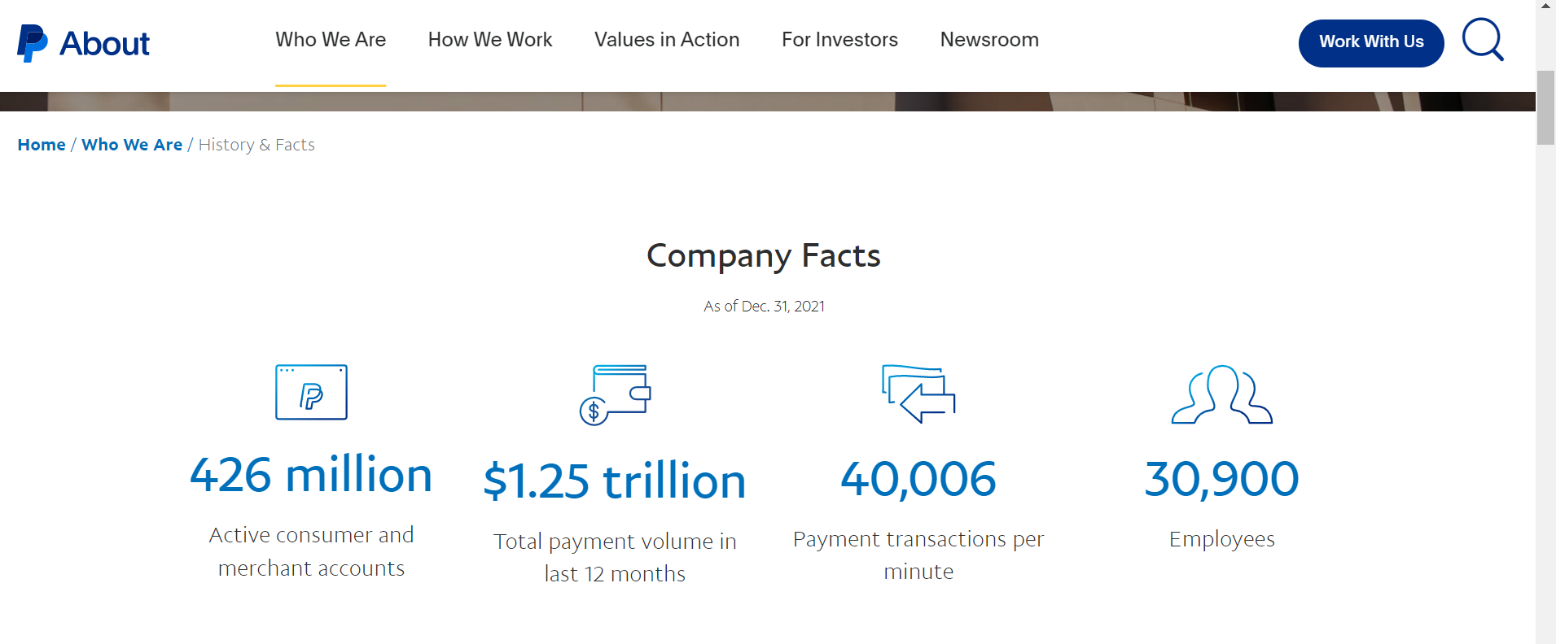
Fun Facts cont.

Slide 9
PayPal APIs
LETS GO LOOK AT THIS COOL LINK TOGETHER SHALL WE???
https://developer.paypal.com/api/rest/
CLICK HERE (if you want I guess)
(if you don’t you might not know how to build the PayPal API)
(your choice)
ENJOY

Slide 10
Next Part!
This will be it for part 1 of our presentation…
Next part will be taken over by Middy and Chisato.
They will be explaining our PayPal application version.
ENJOY!

Slide 11
Any Questions? (Don’t be shy ask questions I dare you)

