Slide 1
Bonin Teamone Saengkinun Sangsangham

Slide 2
But it never happened...

Slide 3
Ddong Game
Very Hard
Rhythm
Game

Slide 4
Demo FIRST!

Slide 5
How to roll the cube
How to move steps
How to synchronize with music

Slide 6
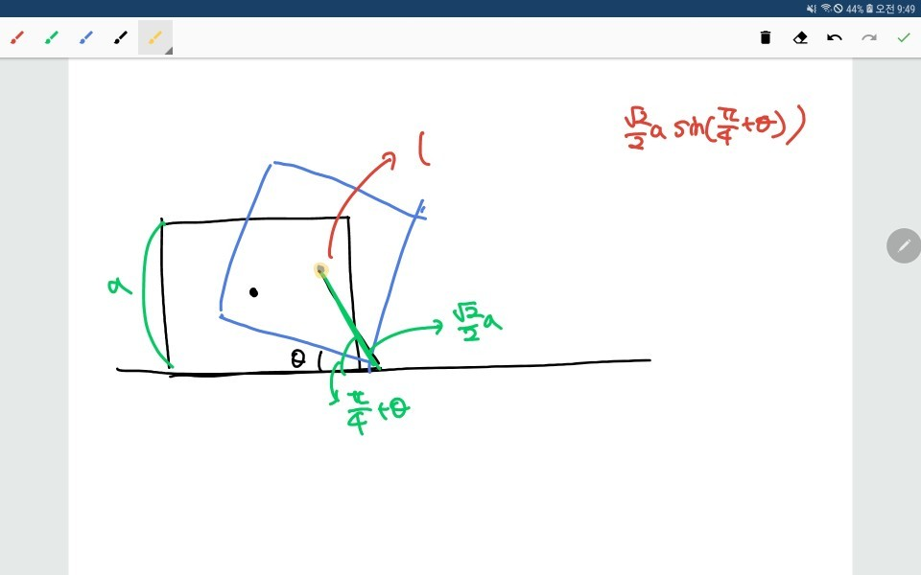
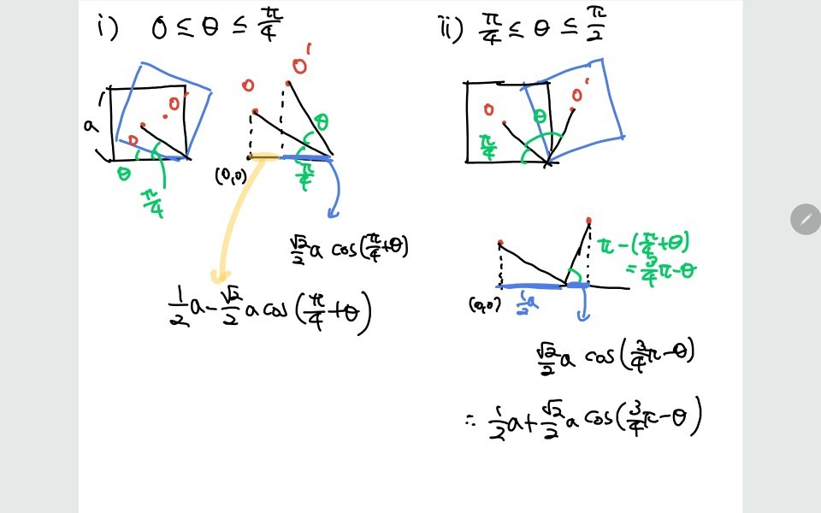
How to roll the cube

Slide 7
How to move steps

Slide 8
How to move steps

Slide 9
How to move steps

Slide 10

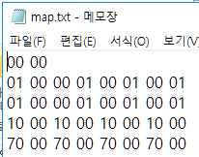
How to move steps
01
Tokens
(0, 1, 2)
70
Angle
(0~7)

Slide 11
How to move steps
Angle
Real Angle = Angle / (2 * PI)
(0~7)
--
++

Slide 12

Synchronization
174 bpm
60 / 174 = 0.344827586…

Slide 13
Synchronization
60 / 174 = 0.344827586…
For 8-bit rhythm game…
Frame per 0.005 sec
Rolling in 35 frames
1 rolling = 0.005 * 35 = 0.175

Slide 14
Synchronization
During 35 frames…
0
34
+3

Slide 15
Synchronization
For interactive
movement
0
1
6
34
+6

Slide 16
Synchronization
0
Key entered
34
+3
Check token & angle

Slide 17
Do not make rhythm game!

