Slide 1

Username
Password
Login
Register
Notes:
When a user opens the app, they may either login or create a new account. The Register button is clearly differentiated from the login button.

Slide 2
Name
Phone Number
Username
Password
Register
Notes:
The phone number during registration is used for sending notifications. It will also probably be used as user verification, for authenticity.

Slide 3
Are you a dog owner?
Yes
No
Notes:
People using this app are either honorable dog owners or honorable regular denizens of earth. If they happen to be a dog owner, they will be prompted to set up their dog’s profile immediately.

Slide 4
Set up your dog’s profile!
Your dog’s name
Enter

Slide 5
Set up your dog’s profile!
Upload a picture of your dog!
Skip this step
Notes:
The user may upload a picture of them and their dog, or purely their dog, or who knows what else..

Slide 6
Set up your dog’s profile!
Your dog’s gender
Your dog’s breed
Your dog’s temperament
Enter
Skip this step

Slide 7
Would you like to add another dog’s profile?
Yes
No
Notes:
This page will redirect back to the “What is your dog’s name? Upload a picture!” sequence.

Slide 8
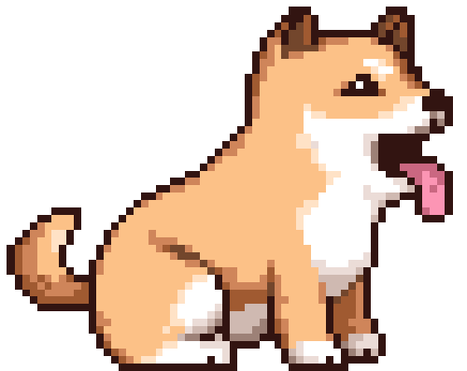
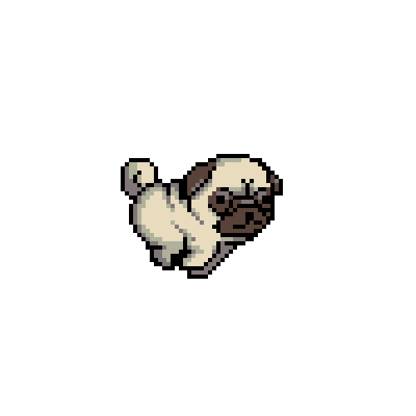

pet my pet
Owner: Stan
Distance: 100 ft
Playtime Left: 25 min
Pucky
Owner: Chan
Distance: 500 ft
Playtime Left: 160 min
Mucky
Owner: Nan
Distance: 100 ft
Playtime Left: 25 min
Lucky
Owner: Dan
Distance: 500 ft
Playtime Left: 160 min
Ducky
Owner: Fran
Find dogs in your area
Start playtime
Notes:
This is what users will typically see when they enter the app, after logging in. The Pet My Pet logo will be relocated to a small bar on the top to make room for the dog listing, along with a settings button for dog owners to manage their dogs’ profiles. When users open the app, the “Find dogs in your area” button will open a listing of dogs in their vicinity, showing the dog’s profile picture, their name under it, and next to that, their owner’s name, the distance of the dog away from the user, and the amount of “playtime” remaining. The “Start playtime button” is meant for the use of dog owners.

Slide 9
pet my pet
How long would you like to play?
Enter desired playtime in minutes
Enter
Find dogs in your area
Start playtime
Notes:
Pressing the “Start playtime” button will activate a window that asks the user to enter the amount of play time they plan to make their dog available to play with other users. If the user is not yet a dog owner, then it will show an option to become a registered dog owner, after which being pressed will take them through the process of setting up their dog’s profile.

