Slide 1
Healthcare ROE — quantitative working draft
Question: Are high returns driven by margins, asset efficiency, or the equity base?
Fiscal years 2020–2025; SEC Company Facts and filing evidence.
Descriptive study of selected S&P 500 companies; no causal or stock-return claims.

Slide 2
Define the sample before interpreting the results
59 companies requested; 49 have at least five matched financial years.
43 meet the five-year and equity-screen rules; 40 have all six years.
2025 ranking uses 41 companies: two cohort members lack a usable 2025 observation.
Year-end assets/equity; latest matched comparative data by September 23, 2026.
This differs from the earlier average-balance research panel.

Slide 3
The math: Amgen fiscal 2025
ROE = net income / year-end equity = $7.711bn / $8.658bn = 89.06%.
DuPont: profit margin × asset turnover × equity multiplier.
Amgen: 20.98% × 0.4057 × 10.4627 ≈ 89.06%.
Equity is only 9.56% of assets. A high ROE is not automatically superior operations.
The identity allocates accounting quantities; it does not identify causal effects.

Slide 4
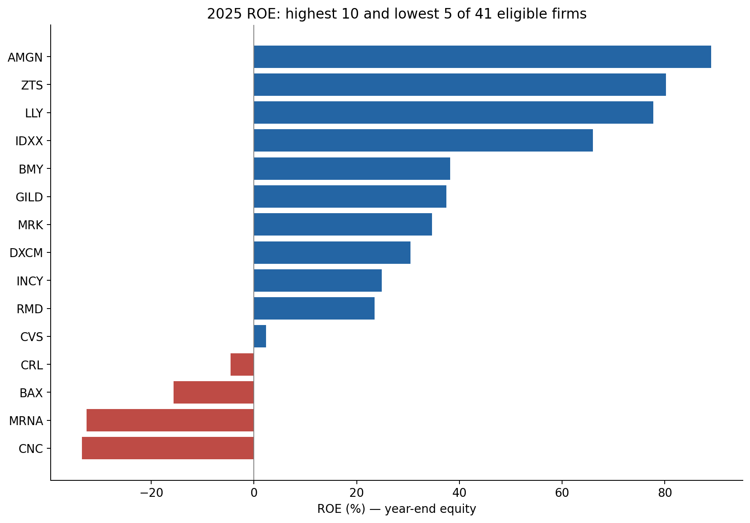
Who has the highest and lowest ROE?
Eligible 2025 sample only; values use year-end equity.

Slide 5
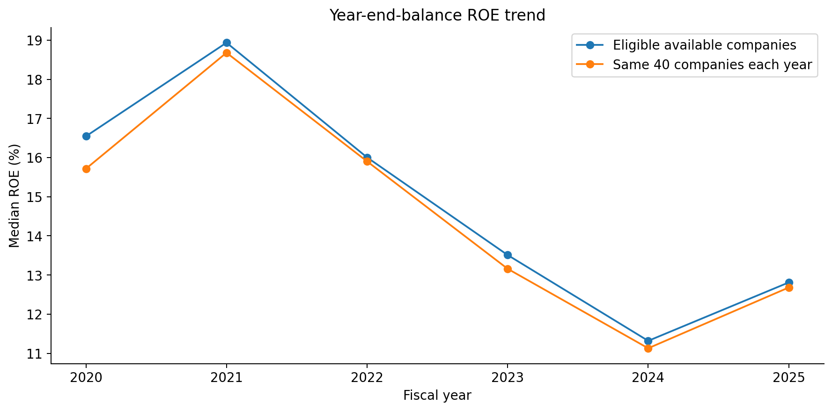
What changes when company membership is fixed?
Compare the same 40 companies over time; this reduces changing-membership effects, not selection bias.

Slide 6
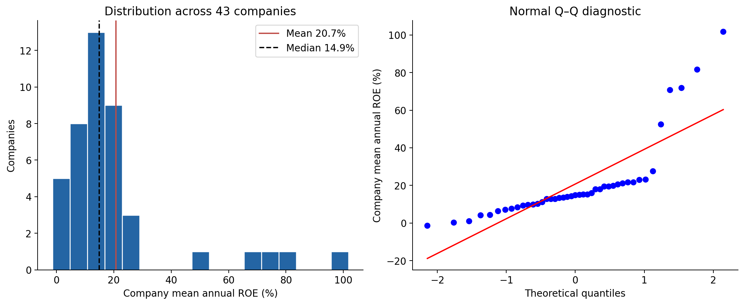
Distribution: do not assume a bell curve
Company means are right-skewed (skewness 2.37). Report medians/IQR as well as means/sample SD.

Slide 7
Negative equity: a positive profit can produce negative ROE
HCA fiscal 2025: net income +$6.784bn; equity −$6.027bn.
ROE = −112.56%, despite positive earnings.
Mettler-Toledo: positive earnings divided by very small negative equity produces an extreme ratio.
Keep these companies in an equity case study; do not rank these ratios as ordinary profitability.
Buybacks, distributions, accumulated losses and acquisitions require statement-level investigation.

Slide 8
Dispersion and historical frequency
2025: mean ROE 17.73%; median 12.81%; sample SD 24.86 percentage points.
Middle half: approximately 6.88% to 21.18%.
4 of 41 eligible companies had a net loss: observed frequency 9.76%.
That is not an estimated probability of next-year loss for an investor.
Repeated years from one company are not independent observations.

Slide 9
Events: connect numbers to documented disclosures
Pfizer 2023: reduced COVID-product demand and inventory write-offs are disclosed mechanisms.
Bristol Myers Squibb 2024: $13.4bn acquired IPRD expense, including $12.1bn for Karuna.
Reconcile charges, taxes, acquisitions and denominators before assigning causation.
Item 1A describes risks; MD&A and financial notes explain realized events.
Fiscal 2025 filings may be published in 2026. There is no full fiscal-2026 panel here.

Slide 10
Conclusions we can defend
ROE contains several different economic and accounting mechanisms.
Low or negative book equity can dominate ratio interpretation.
Distributions and company-specific events deserve more attention than a single sector average.
Draft subsectors and clusters generate questions; they do not establish causal groups.
Next evidence needed: verified classifications and consistently screened industrial financials.

