Slide 1
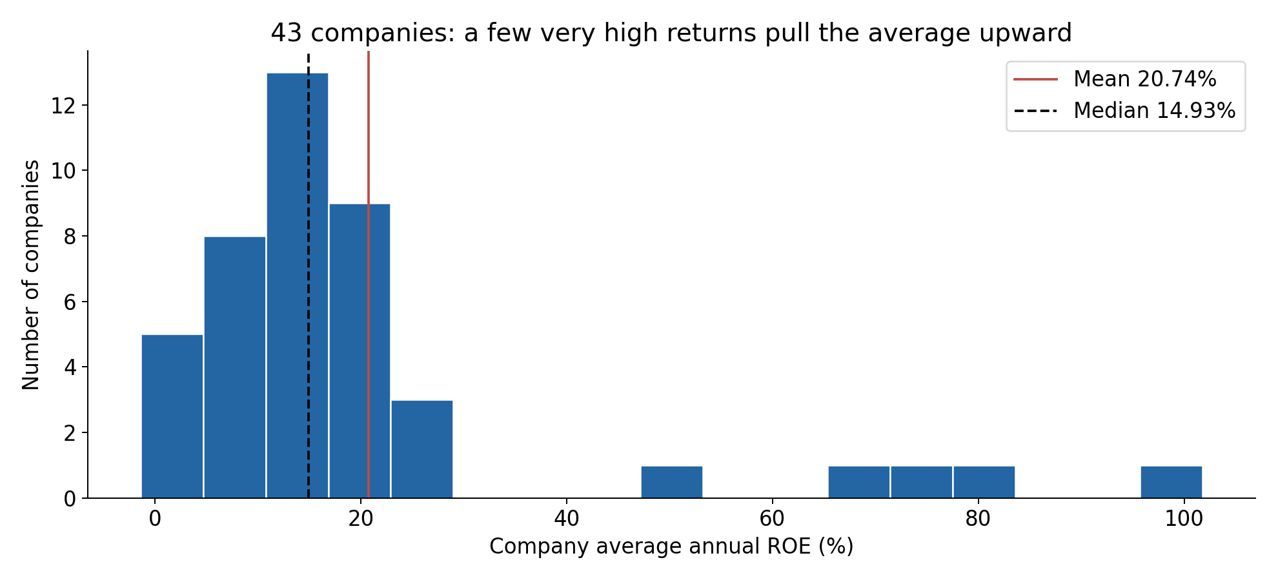
1 | High ROE is concentrated in a few companies
Mean 20.74% vs median 14.93%: the average is sensitive to unusually high returns.
Question: are those returns driven by earnings, asset use, or a small equity base?
SEC-derived panel • 2020–2025 company averages • 43 eligible firms • Year-end balance basis
1
Notes:
Opening question: Why do healthcare companies differ in ROE and what does that imply for sustainable performance? ROE = annual net income / year-end book equity ×100. 20% means 20 cents annual profit per dollar of book equity, not stock return. Chart uses each of 43 firms’ average across five or six usable fiscal years. Sample SD of these company averages is 21.90 percentage points. IQR=Q3−Q1; ROE outliers beyond Q1−1.5IQR or Q3+1.5IQR are ABBV, AMGN, IDXX, LLY, ZTS. Excluding them gives mean13.50%, n38; this is sensitivity, not proof of bad data. Distribution is right-skewed; do not assume normality. We omitted the Q–Q graphic to keep the presentation focused.

Slide 2
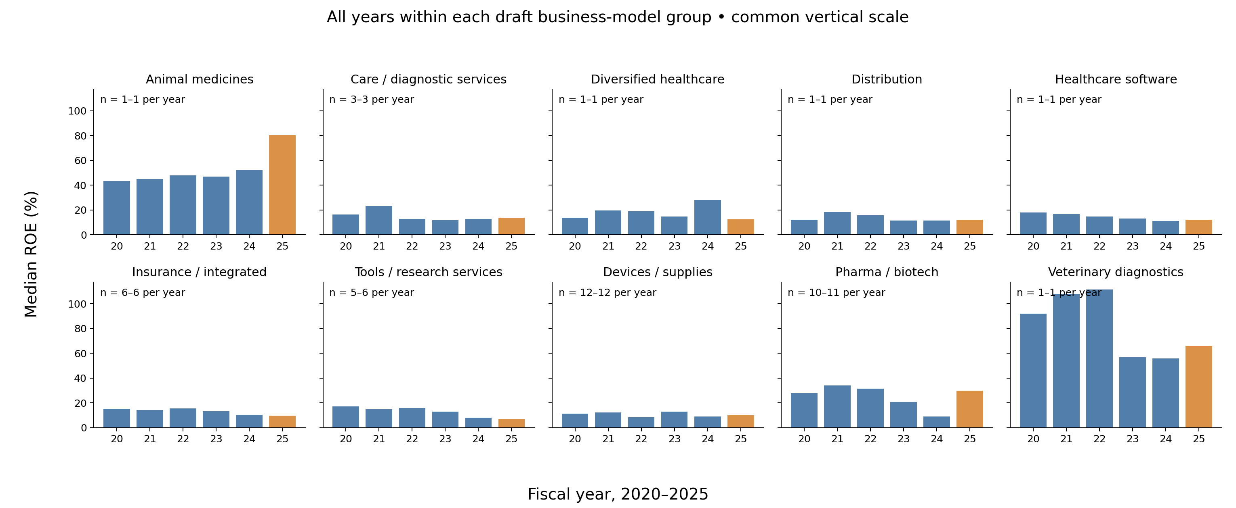
2 | Business-model groups follow different ROE paths
Compare each group over all six years. Different revenue models warrant different explanations.
Groups with n=1 describe one company—not an entire subsector.
Draft classifications • Available-firm medians • n shown per panel • Descriptive, not a causal subsector test
2
Notes:
Each bar is the median ROE of available eligible firms in that draft group and fiscal year. All charts share one vertical scale. Labels give minimum–maximum annual sample count. Group mapping is provisional, not an independently validated classification. Company membership can vary by year. Pharma revenue depends on product sales, competition and patent protection; providers sell care/services; insurers receive premiums or service fees while bearing medical/admin costs; tools/device firms sell equipment, consumables or services. These are contextual business-model descriptions, not causal estimates from these bars. Care/diagnostic services mixes UHS with diagnostic laboratories: do not call this a hospitals-only comparison. The CSV provides every bar and count; avoid significance claims for small selected groups.

Slide 3
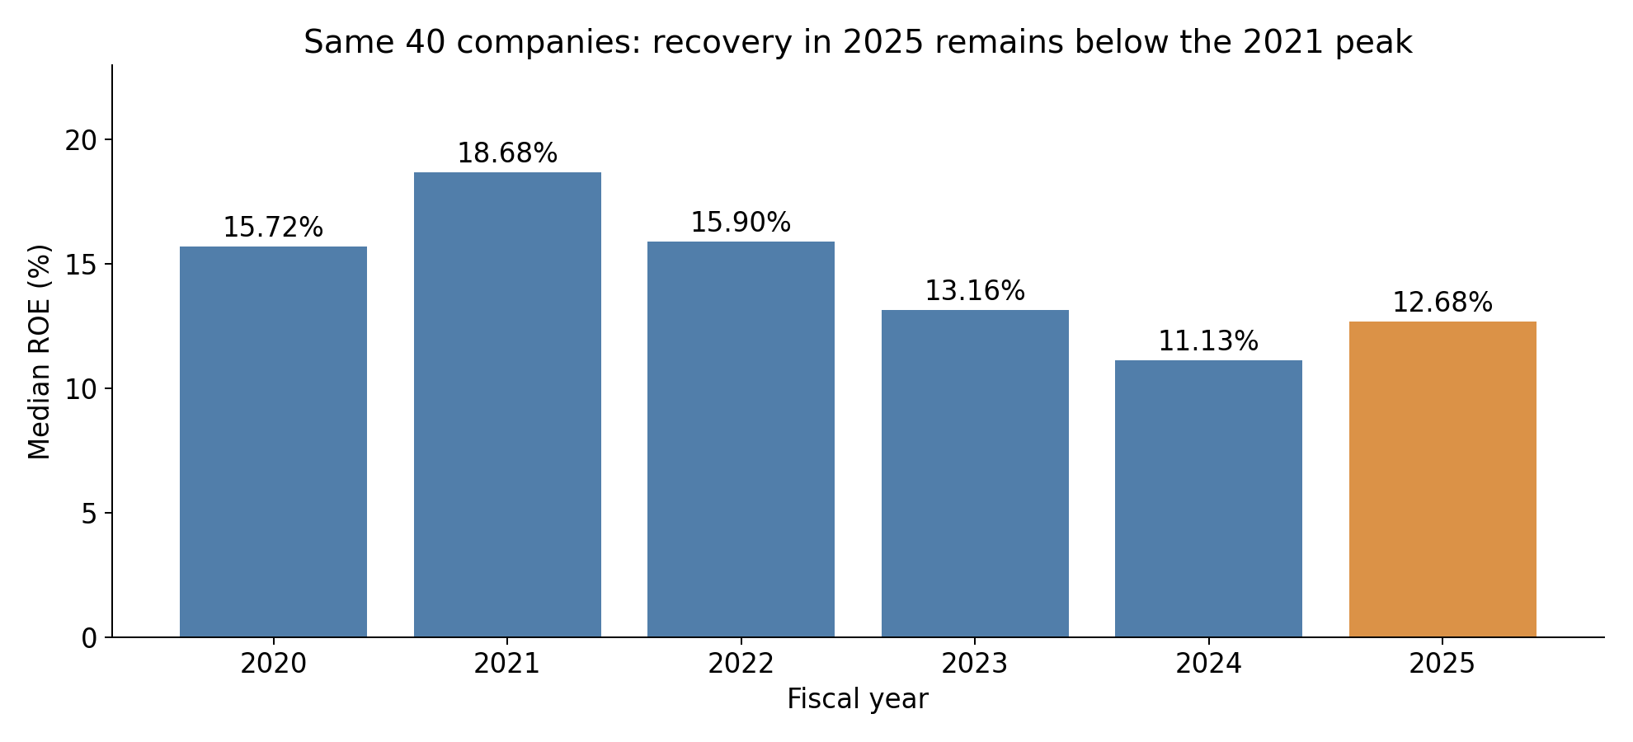
3 | ROE fell after 2021; 2025 recovered only partly
Median ROE: 18.68% in 2021 → 11.13% in 2024 → 12.68% in 2025.
Holding the same 40 companies fixed makes the year-to-year comparison clearer.
Fixed 40-company panel • Median, not mean • Fiscal years 2020–2025
3
Notes:
This replaces the loss-frequency graphic. The old 4/41 label meant four observed firms reported a loss out of 41, not a forecast probability. This chart directly answers the ROE trend question. Panel has 40 firms with all six unflagged years. The broader sample has43 firms/255 observations. Excluded from fixed panel only: Agilent lacks matched2020, Bio-Techne lacks matched2025, AbbVie2025 has negative equity−$3.27bn. Missing matched rows do not establish missing filings. Balanced selection removes changing membership in this plot but not survivorship or selection bias. The professor45 benchmark is not our verified43 count.

Slide 4
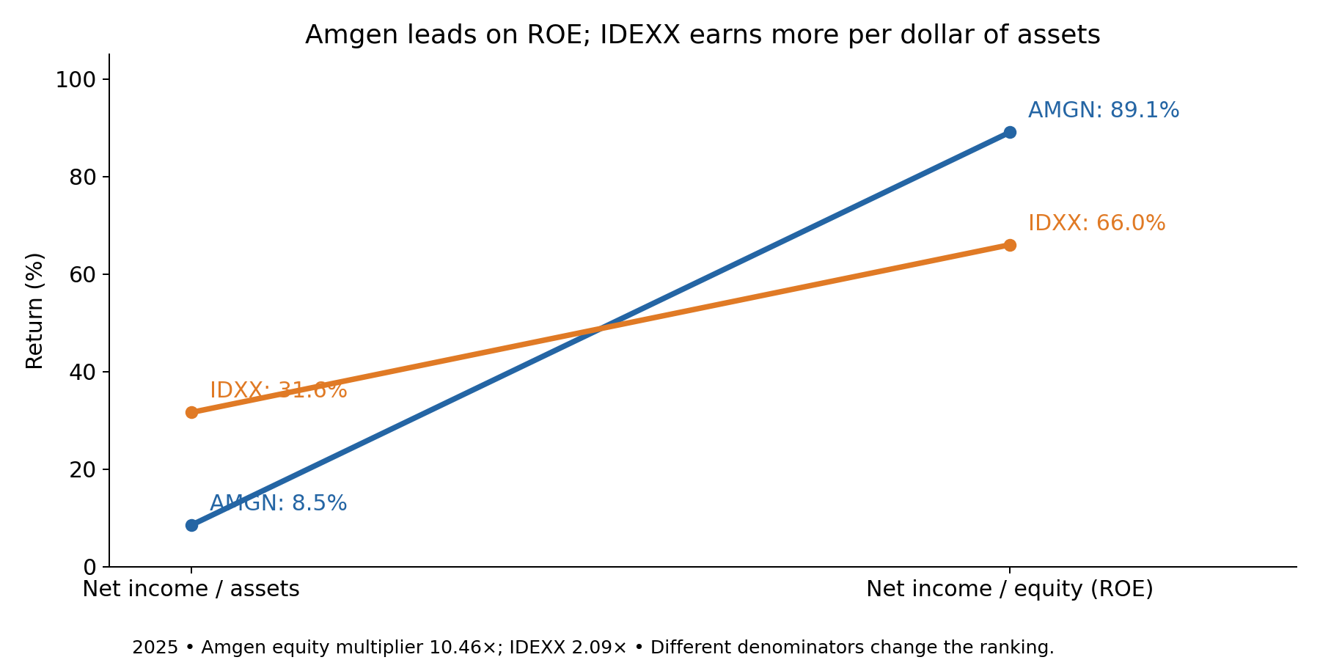
4 | High ROE can reflect a small equity denominator
2025: Amgen has higher ROE, but IDEXX earns more per dollar of assets.
ROE = profit margin × asset turnover × equity multiplier.
2025 illustrative comparison • Both ratios use net income • Full-company data supplied separately
4
Notes:
This is a close-up chosen after the full-sample analysis, not a claim that only two firms were studied. Amgen: 20.98% margin ×0.4057 turnover ×10.4627 multiplier=89.06% ROE. IDEXX:24.62%×1.2844×2.0872=65.99%. Net income/assets is8.51% versus31.62%. Equity multiplier=assets/equity, not debt/equity. Higher multiplier magnifies positive asset return; it does not by itself prove superior operations. To determine why equity is small, inspect equity rollforwards, buybacks, losses and distributions. These are accounting identities, not independent causal predictors.

Slide 5
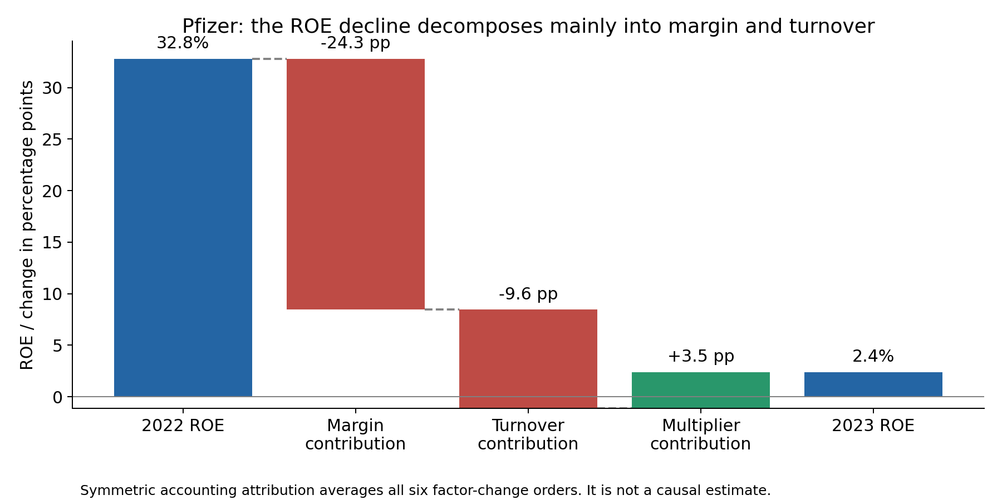
5 | Pfizer: the filing gives context for the ROE decline
The 2023 filing reports weaker COVID demand and inventory write-offs; Seagen changed the asset base.
Monitor sales mix, inventory charges and recurring earnings before calling returns sustainable.
Source: Pfizer 2023 10-K + financial panel • Accounting attribution, not causality • AI comparison not validated
5
Notes:
Verified source: https://www.sec.gov/Archives/edgar/data/78003/000007800324000039/0000078003-24-000039.txt . The 2023 10-K discusses reduced COVID-product demand, excess inventory and significant Paxlovid/Comirnaty write-offs. This filing evidence provides context, not an estimated causal effect. Item1A risk disclosures identify potential exposures; business/MD&A supplies reported events. ROE32.795% in2022 to2.381% in2023; margin contribution−24.350pp, turnover−9.585pp, multiplier+3.520pp. Symmetric attribution averages all six factor replacement orders; sums to ROE change. Acquisition of Seagen is an additional asset-base issue. Management expected at least$4bn net cost savings primarily2023–24; realized savings not verified here. No validated all-years AI risk comparison is claimed: outputs failed quote checks. Close: high ROE alone cannot establish sustainability; use accounting decomposition plus source-backed business evidence. This healthcare half covers five slides; coordinate remaining team requirements with the industrial half.

