Slide 1
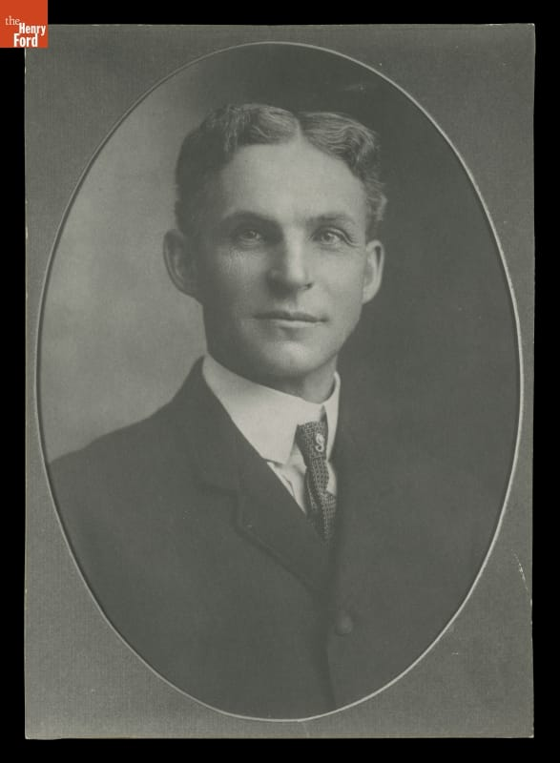
Henry Ford
Mass production, people, and the limits of control
Andy Johnson & Slade McClain
MGT 210, Section T01
1
Notes:
RUN OF SHOW 0:00–0:30 (30 sec)
Andy | 30 seconds
CUES: Cars / management system / tradeoffs
SAY IN YOUR OWN WORDS
“Ford did not invent the automobile. His company helped make it affordable by changing how work was organized. We’ll examine how those gains affected workers—and ask whether efficiency alone makes someone a good manager.”
BACKUP RESEARCH — NOT A SCRIPT
Andy | 30 seconds
CUES: Cars / system / central question
Most of us connect Henry Ford with cars and assembly lines. Today we are going to look at the management behind them. Ford did not invent the automobile. His company helped make an expensive product practical for a mass market by changing how work happened.
Our argument is that his greatest contribution was an integrated system. Product design, factory organization, employee pay, and supply decisions reinforced one another. But that system also created human problems, and Ford made serious ethical failures. Our question is: what happens when efficiency becomes the organizing idea of an entire company?
RESEARCH (accessed October 19, 2026):
[A] The Henry Ford, “Henry Ford” biography and interview transcript
https://www.thehenryford.org/collections/explore/videos/henry-ford
[G] Bob Casey, “Henry Ford: Case Study of an Innovator” (2021)
https://www.thehenryford.org/collections/explore/articles/henry-ford-case-study-of-an-innovator
IMAGE CREDIT: First official Ford Motor Company portrait, 1904, THF97952. The Henry Ford, image reproduced from source G.
REHEARSAL PLAN
Planned spoken content plus activity: 22:25. Q&A follows separately. Andy: slides 1–10 and 21–23; Slade: 11 and 13–20; Andy facilitates slide 12 while Slade times reports. The activity stays after the staffing problem; Detroit prices remain removed. Use cue sections; do not read backup research aloud. Seven groups of four discuss for two minutes; take three reports of twenty seconds. Any separate Detroit-cost discussion needs sources and must fit within the 20–25-minute total. Target 22–23 minutes in rehearsal.

Slide 2
The management question
How do you make a complicated product affordable to millions?
Ford connected the product, the production process, and the people doing the work.
Efficiency: fewer resources per car
Effectiveness: cars buyers want and workers can sustain
Management connection: efficiency and effectiveness
2
Notes:
RUN OF SHOW 0:30–1:15 (45 sec)
Andy | 45 seconds
CUES: Efficiency / effectiveness / people
SAY IN YOUR OWN WORDS
“Efficiency means using fewer resources per car. Effectiveness means achieving the right goals. A fast factory still has a problem if customers don’t want its cars or workers won’t stay. We’ll use both ideas to evaluate Ford.”
BACKUP RESEARCH — NOT A SCRIPT
Andy | 45 seconds
CUES: Problem / linked decisions / evaluate
Chapter 1 defines management around getting results through people. Efficiency asks how economically we use resources. Effectiveness asks whether we achieve the right goals. They are related, but they are not identical.
Imagine a factory building the wrong product twice as fast. It has improved one measure while making its larger business problem worse. Keep that distinction in mind as we follow Ford.
We will first explain his background and influences, then the production system, then the employment decisions it required. Finally, we will examine its limitations and where we see related ideas today. The goal is to evaluate management choices, rather than simply collect interesting facts about an automobile executive.
COURSE CONNECTION: Chapter 1, slides 10–11, management and efficiency/effectiveness. History Module, systems approach.

Slide 3
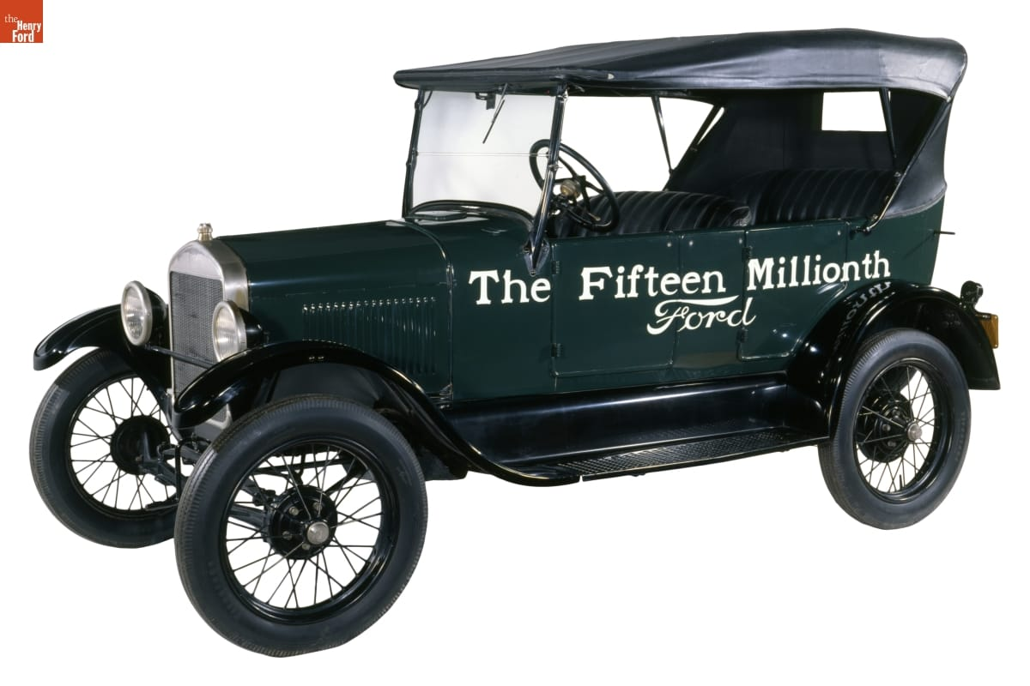
The mechanic behind the manager
1863–1947
Raised on a Michigan farm
1903
Ford Motor Company founded
1908
Model T introduced
The fifteen-millionth Ford, a 1927 Model T
3
Notes:
RUN OF SHOW 1:15–1:50 (35 sec)
Andy | 35 seconds
CUES: Farm / engineering / Model T
SAY IN YOUR OWN WORDS
“Ford’s practical background and engineering work shaped his approach, but success took experimentation and a team. The Model T targeted a broad market. That goal required a different production system from building luxury cars in small numbers.”
BACKUP RESEARCH — NOT A SCRIPT
Andy | 35 seconds
CUES: Machinery / experience / broad market
Ford grew up around farm work but pursued machinery. Before the successful company, he worked as an engineer and experimented with gasoline vehicles. His career included failed automobile ventures, which matters because the familiar success story can make his outcome look inevitable.
The company founded in 1903 and the Model T introduced in 1908 were parts of a longer learning process. The Model T aimed at durability, simple operation, and affordability.
Think about the connection between a customer's needs and a manager's choices. A car designed for a broad market needs a different business system from a luxury car assembled in small numbers. Ford's background helps explain his practical approach, but the business depended on a team as well as its founder.
RESEARCH (accessed October 19, 2026):
[A] The Henry Ford, “Henry Ford” biography and interview transcript
https://www.thehenryford.org/collections/explore/videos/henry-ford
[C] Ford Motor Company, “The Model T” (2020)
https://corporate.ford.com/articles/history/the-model-t/
IMAGE CREDIT: 1927 Model T Touring Car, THF135450, The Henry Ford. Source K; collections-media.thehenryford.org/CollectionImages/_detail/photos/thf135450.jpg

Slide 4
Ford’s influences and collaborators
Direct influences
Management context
Edison encouraged Ford’s automotive work.
Meatpacking suggested moving work past fixed stations.
Smith: division of labor
Taylor: measured, standardized tasks
Ford’s team integrated these principles at scale.
Management connection: division of labor and scientific management
4
Notes:
RUN OF SHOW 1:50–2:45 (55 sec)
Andy | 55 seconds
CUES: Edison / earlier methods / team effort
SAY IN YOUR OWN WORDS
“Edison encouraged Ford’s automotive work. Industrial precedents, including meatpacking, informed moving production methods. Smith and Taylor help us interpret specialization and standardization; we aren’t claiming they personally taught Ford. His team’s contribution was adapting and coordinating these ideas at scale.”
BACKUP RESEARCH — NOT A SCRIPT
Andy | 55 seconds
CUES: Edison / borrowing / team credit
Edison was a personal encouragement to Ford. That is different from saying Edison designed Ford's factories. The production methods also drew on earlier industrial practices. The museum documents Ford engineers adapting the moving disassembly principle used in meatpacking.
The course history module takes division of labor back to Adam Smith and describes Taylor's search for a scientifically defined method of doing each job. Ford operated in that wider efficiency movement. That is a conceptual relationship, not proof that Taylor personally taught Ford his system.
Ford's engineers and managers deserve credit for implementation. Management innovation often means recognizing useful ideas elsewhere and coordinating people to make them work at scale. The genius-in-a-garage version leaves out a lot of the actual management.
COURSE CONNECTION: History Module, Adam Smith and scientific management sections. Chapter 6, slide 24, creativity and innovation.
RESEARCH (accessed October 19, 2026):
[L] The Henry Ford, authenticated Henry Ford quotations, Edison recollections
https://www.thehenryford.org/collections/explore/popular-research-topics/henry-ford-quotations
[K] The Henry Ford, “Our Most-Viewed Digitized Artifacts of All Time”
https://www.thehenryford.org/collections/explore/sets/detail/our-most-viewed-digitized-artifacts-of-all-time
DISCUSSION DEPTH
Name the collaborators rather than crediting a lone inventor. Ford’s breakthrough was coordinating existing ideas and experimentation. Treat the Taylor connection as a comparison of management principles, not a documented personal mentorship.

Slide 5
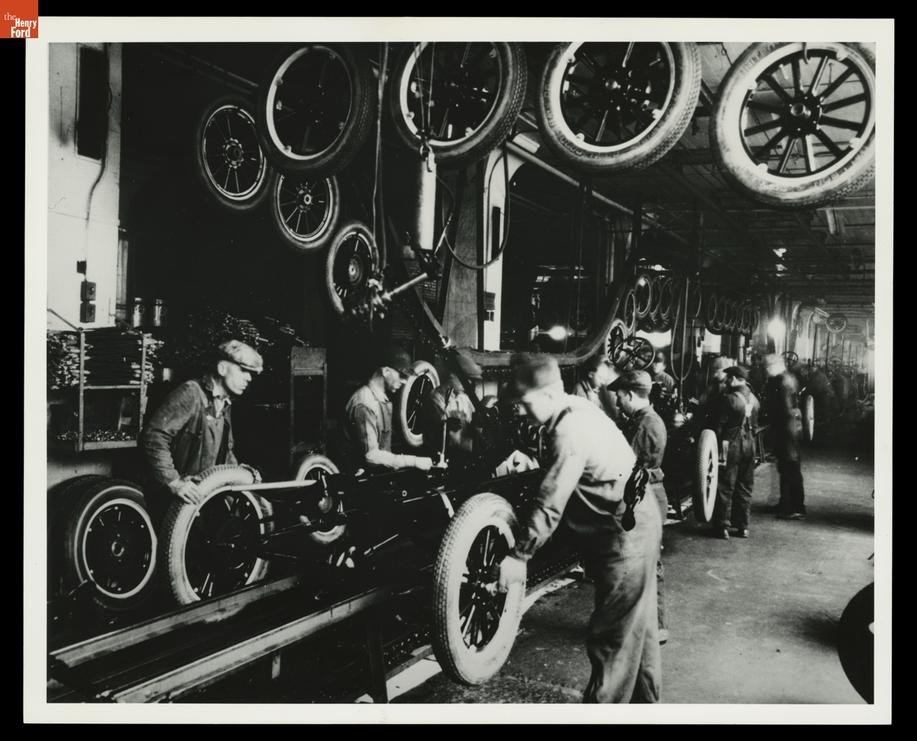
The production system
Interchangeable parts reduced fitting, rework, and dependence on craft skill.
Narrow jobs shortened training but reduced worker autonomy.
A moving chassis coordinated task order and imposed a common pace.
Tire installation at Highland Park, circa 1925
Management connection: work specialization and formalization
5
Notes:
RUN OF SHOW 2:45–3:40 (55 sec)
Andy | 55 seconds
CUES: Standard parts / narrow jobs / common pace
SAY IN YOUR OWN WORDS
“Three decisions worked together: interchangeable parts, specialized tasks, and moving work past employees. That reduced fitting and travel, but workers had less choice about their task and pace. A stoppage or missing worker could affect the whole flow.”
BACKUP RESEARCH — NOT A SCRIPT
Andy | 55 seconds
CUES: Parts / jobs / movement / dependence
Look at how the workers and materials are arranged. The sequence of tasks matters as much as any individual machine. Standard parts reduce the need to custom fit a component. Specialized jobs make the work easier to repeat and train. Bringing the chassis past workers reduces travel around the factory.
Chapter 8 calls dividing work into specific tasks work specialization. Formalization concerns how much rules and procedures guide a job. Ford's production system used both heavily.
The tradeoff is dependence between stations. A problem at one point can interrupt work elsewhere. A well-designed line therefore needs reliable parts and dependable staffing. This is why we should study the whole system instead of giving all the credit to a conveyor belt. The belt cannot solve a missing-parts problem by moving more enthusiastically.
COURSE CONNECTION: Chapter 8, slides 4–5 and 15, specialization and formalization.
RESEARCH (accessed October 19, 2026):
[B] Library of Congress, “Ford Implements the Moving Assembly Line”
https://guides.loc.gov/this-month-in-business-history/october/ford
[K] The Henry Ford, “Our Most-Viewed Digitized Artifacts of All Time”
https://www.thehenryford.org/collections/explore/sets/detail/our-most-viewed-digitized-artifacts-of-all-time
IMAGE CREDIT: Workers Installing Tires on Ford Model T Assembly Line, circa 1925, THF94827. The Henry Ford, source K.

Slide 6
Assembly time fell dramatically
12½ hours 93 minutes
Approximate Model T chassis assembly time
After the moving-line experiments of 1913–1914
About 88% less elapsed assembly time
93 minutes is assembly duration, not the gap between completed vehicles
6
Notes:
RUN OF SHOW 3:40–4:25 (45 sec)
Andy | 45 seconds
CUES: 750 minutes / 93 minutes / measure carefully
SAY IN YOUR OWN WORDS
“Reported chassis assembly time fell from roughly 12½ hours to 93 minutes—about an 88 percent reduction. That’s time spent assembling a chassis, not a claim that only one car came off the line every 93 minutes. Many chassis could be in progress together.”
BACKUP RESEARCH — NOT A SCRIPT
Andy | 45 seconds
CUES: Same measure / calculation / throughput distinction
These are commonly reported figures for the reduction in assembly time as Ford refined the line. Converting twelve and a half hours to seven hundred fifty minutes lets us compare the same units. The decrease to ninety-three minutes is roughly eighty-eight percent.
Be careful about what that number means. Several chassis can be on the line at once. Ninety-three minutes does not mean the factory finished only one vehicle every ninety-three minutes. The interval between completions is a separate throughput measure. It also is not a measure of every upstream operation needed to make an automobile.
For a manager, the important question is which metric the process improves and which costs remain elsewhere. Use the numbers as evidence of a major process change without turning them into a claim they cannot support.
RESEARCH (accessed October 19, 2026):
[B] Library of Congress, “Ford Implements the Moving Assembly Line”
https://guides.loc.gov/this-month-in-business-history/october/ford
[D] Matt Anderson, “Ford’s Five-Dollar Day,” The Henry Ford (2014)
https://www.thehenryford.org/collections/explore/articles/fords-five-dollar-day
DISCUSSION DEPTH
Calculation: (750 − 93) / 750 = 87.6%, rounded to about 88%. These figures concern approximate chassis assembly duration across experiments, not total labor content or the interval between finished cars. Greater output also depended on materials, capacity, and sales.

Slide 7
Efficiency expanded the market
$850 as low as $260
Model T prices over its production life, in nominal dollars
More than 15 million Model Ts built and sold
A broad market supported a strategy built around low cost.
Management connection: competitive strategy and cost leadership
7
Notes:
RUN OF SHOW 4:25–5:05 (40 sec)
Andy | 40 seconds
CUES: Price / volume / broader market
SAY IN YOUR OWN WORDS
“Model T prices ranged from $850 to as low as $260 over its production life. Those are nominal prices from different years and configurations. Standardization and scale supported affordability, alongside other changes. More than 15 million Model Ts were built and sold.”
BACKUP RESEARCH — NOT A SCRIPT
Andy | 40 seconds
CUES: Price range / volume / strategy
Ford reports a Model T price range from eight hundred fifty dollars down to as little as two hundred sixty dollars, and more than fifteen million built and sold. These are nominal prices from different years and configurations, not an inflation-adjusted comparison of identical vehicles.
The broader pattern fits a cost-leadership interpretation. A standardized offering and high production volume helped Ford compete through low cost for a broad market. That is our application of Chapter 5, not a claim Ford used today's textbook label.
We should also avoid saying the assembly line alone caused the price decline. Product changes, purchasing, factory learning, and other decisions mattered. The strategic lesson is that operations can change what customers can afford, which can in turn change the size of a market.
COURSE CONNECTION: Chapter 5, strategic management and competitive strategies, slides 9 and 19.
RESEARCH (accessed October 19, 2026):
[C] Ford Motor Company, “The Model T” (2020)
https://corporate.ford.com/articles/history/the-model-t/
DISCUSSION DEPTH
Cost leadership is our application of Chapter 5 terminology to the historical case. A low selling price is not itself proof of low unit cost. Explain how standardization and volume could support both, and why sales demand matters. Model T prices varied by body style and year, so $850 and $260 are illustrative endpoints rather than identical configurations.

Slide 8
Fordism as a management system
Reinforcing decisions
The system depends on people
A standard product simplifies repeated tasks.
High sales volume spreads factory costs across more units.
Lower costs can support lower prices and wider demand.
Turnover interrupts the flow. Changing tastes challenge standardization.
Management connection: systems thinking and organizational design
8
Notes:
RUN OF SHOW 5:05–5:50 (45 sec)
Andy | 45 seconds
CUES: Reinforcing choices / dependence / limits
SAY IN YOUR OWN WORDS
“The product, factory, costs, and market reinforced one another. But a highly standardized system depended on steady demand and workers willing to do the jobs. Next, we’ll look at who worked in that system and how company policies shaped their opportunities.”
BACKUP RESEARCH — NOT A SCRIPT
Andy | 45 seconds
CUES: Connections / assumptions / handoff
Fordism is a useful label for the connection between standardized mass production and a mass market. For this presentation, treat it as an analytical summary rather than a claim that every part appeared at once.
The decisions reinforce each other. A wider product range would make the production system more complicated. A highly standardized product makes repeated tasks easier. High volume can spread equipment and facility costs across more units, but only if customers buy the output.
The model depends on its assumptions. It works less well when buyers want more variety or when the people operating it will not stay. Systems thinking means following those relationships. Before Slade explains turnover and pay, Andy will look at women entering this factory system and how company rules shaped their work.
COURSE CONNECTION: History Module, systems approach. Chapters 5 and 8, strategy and organizational structure.
DISCUSSION DEPTH
Use a failure example: a cheaper process creates little value if customers reject the product or the workforce cannot sustain output. The systems view connects the production gains to retention and later resistance to change.

Slide 9
Women at Ford: factory work and pay
WORK
FACTORY LIFE
PAY ACCESS
By circa 1913, women made magneto components at Highland Park.
Specialized, repeatable tasks within a closely managed production system.
Early profit sharing was conditional. Broader pay access followed in 1916.
Women’s factory employment preceded World War II. Pay access was conditional.
Job design and compensation shaped the experience of factory life.
9
Notes:
RUN OF SHOW 5:50–7:05 (75 sec)
Andy | 75 seconds
CUES: Women before WWII / component work / unequal access
SAY IN YOUR OWN WORDS
“Women were doing factory work at Ford before World War II. A circa-1913 photograph documents women making magneto components. It shows a specific production role—not equal access to every job. Their experience also depended on company rules about compensation and family circumstances. We’ll return to the wage policy after the class activity.”
BACKUP RESEARCH — NOT A SCRIPT
Andy | 75 seconds
CUES: Factory evidence / conditional pay / broader minimum
Ford did not introduce women to factory work generally. For this company, The Henry Ford's circa-1913 photograph documents women in the coil-manufacturing department winding wire around iron cores and boxing magneto parts. This is specific evidence of factory work, not proof that women had access to every production occupation.
The pay structure requires care. In chapter VIII of his 1922 account, Ford describes ordinary wages plus a conditional share of profits for workers with at least six months' service. One eligible category included women who were the sole support of relatives. Therefore, saying that all women were excluded until 1916 would be too absolute. Conversely, the 1914 headline does not show that every female worker immediately received five dollars.
An October 26, 1916 New York Times editorial discusses Ford's announcement that women as well as men would have a minimum of five dollars a day. This supports the broader extension in 1916. It does not provide a complete wage schedule for every job or prove equal lifetime earnings. Distinguish minimum compensation from occupational access and advancement.
[O] The Henry Ford, Women Workers Assembling Magnetos at the Highland Park Plant, circa 1913, THF99642, object 84.1.1660.P.833.158. https://www.thehenryford.org/collections/explore/artifact/4461
[P] Henry Ford with Samuel Crowther, My Life and Work (1922), chapter VIII, Wages. A retrospective primary account that presents Ford's own justification. https://www.gutenberg.org/cache/epub/7213/pg7213-images.html
[Q] The New York Times, October 26, 1916, editorial For Every Woman, $5 a Day, digitized by the Library of Congress. https://tile.loc.gov/storage-services/service/sgp/sgpbatches/batch_dlc_1zubrowka_ver01/data/2004540423/print00192511057/1916102201/0129.pdf
Accessed October 19, 2026.
DELIVERY: Explain what factory life involved: assigned, repeatable component work within a standardized system. The photograph documents the task, not a complete account of women’s experiences. Do not invent a special women-only training program or suggest that all women held assembly-line jobs.

Slide 10
How Ford managed women’s employment
ORGANIZE THE WORK
REGULATE ACCESS
Standardized tasks
Company-defined jobs and rules
Family status shaped eligibility
Ford reported 82 dismissals in 1919
His account says the women were dismissed because their husbands worked.
Later wartime hiring widened roles at Willow Run; it did not prove equal opportunity.
10
Notes:
RUN OF SHOW 7:05–8:20 (75 sec)
Andy | 75 seconds
CUES: Tasks / family-status rules / evaluate fairly
SAY IN YOUR OWN WORDS
“Ford organized work through standardized tasks, but also regulated who could hold a job. In his own account, he reported dismissing 82 women in 1919 because their husbands worked. Treat that as his reported figure and policy. Later wartime hiring widened roles, but access to work, pay, and advancement are separate questions. Slade will now explain the staffing problem this system created.”
BACKUP RESEARCH — NOT A SCRIPT
Andy | 75 seconds
CUES: Job design / family status / later wartime expansion
Women did industrial work inside the same broader system of task specialization and managerial discipline. Beyond the shop floor, eligibility rules and company assessments of household circumstances made family status relevant to employment and compensation. The Sociological Department's visits extended managerial influence into workers' homes. This was paternalism, meaning that the employer claimed authority to direct private conduct for workers' supposed benefit.
Ford's own chapter VII states that eighty-two women were discharged in 1919 because their husbands worked, and describes a policy of not employing married women with employed husbands. Cite this as Ford's reported figure and policy for that period, not an independently audited count or a rule for every Ford plant throughout its history. His account is especially useful evidence of the assumptions management publicly defended. A higher minimum wage could coexist with exclusion from employment.
For a brief contrast, The Henry Ford's Rosie the Riveter guide describes women as approximately one-third of Willow Run's wartime workforce, including riveting and welding roles. Labor shortages and recruitment widened access. This is a later wartime development, not evidence of broad equality in 1914.
Ask rhetorically: can a pay policy be generous while the hiring system is unfair? Under the course's justice and rights approaches, the answer can be yes.
[P] Ford and Crowther, My Life and Work (1922), chapters VII and VIII. https://www.gutenberg.org/cache/epub/7213/pg7213-images.html
[R] The Henry Ford, K-12 Research Guide: Rosie the Riveter. https://askus.thehenryford.org/K12/faq/429559
[E] The Henry Ford, Ford Motor Company Sociological Department & English School. https://www.thehenryford.org/collections/explore/popular-research-topics/ford-motor-company-sociological-department-english-school
Accessed October 19, 2026.
HANDOFF TO SLADE: “Ford’s rules shaped who could work and who qualified for pay. Slade will now explain why the company struggled to keep workers—and what the five-dollar day actually changed.”

Slide 11
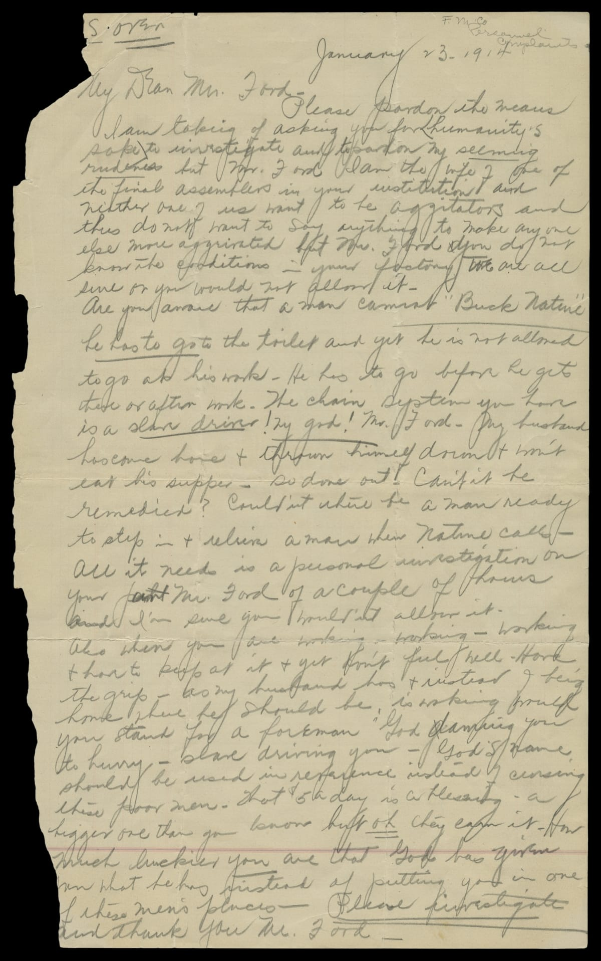
The staffing problem
Line work reduced worker freedom while enforcing a relentless pace.
Workers leaving forced repeated recruitment and training.
Retention became an operating problem as well as an HR problem.
A worker’s wife complained to Ford in 1914
Management connection: retention and job design
11
Notes:
RUN OF SHOW 8:20–9:05 (45 sec)
Slade | 45 seconds
CUES: Human consequences / retention / primary evidence
The museum's biography describes Ford hiring fifty-three thousand people in a year to keep fourteen thousand jobs filled. We are using that description rather than mixing turnover percentages that different accounts report differently.
On the right is a primary document: a worker's wife wrote to Ford in January 1914 about treatment on the assembly line. It gives us an individual perspective, not a statistical sample of every worker. But it reminds us that output figures leave out lived experience.
Workers weren’t allowed to use the restroom
Has to work even when he doesn't feel well
Workers had to buy their own tools
Tools and personal items were being stolen due to no lockers/locks
Chapter 9 includes keeping competent employees as part of HR management. If a job is easy to learn but workers leave constantly, that job still creates organizational costs. Here the production solution generated an employment problem. The machines stayed where management put them. The people had other options.
COURSE CONNECTION: Chapter 9, slides 5 and 20, HRM and retention. Chapter 8, work specialization.
RESEARCH (accessed October 19, 2026):
[A] The Henry Ford, “Henry Ford” biography and interview transcript
https://www.thehenryford.org/collections/explore/videos/henry-ford
[K] The Henry Ford, “Our Most-Viewed Digitized Artifacts of All Time”
https://www.thehenryford.org/collections/explore/sets/detail/our-most-viewed-digitized-artifacts-of-all-time
IMAGE CREDIT: Letter to Henry Ford from the Wife of an Assembly Line Worker, January 23, 1914, THF94994. The Henry Ford, source K.

Slide 12
You manage the factory. Workers are leaving.
Your employees work nine-hour days for about $2.34 per day.
The work is repetitive, physically demanding, and paced by the line.
Moving machinery creates safety risks. Workers are quitting.
Every departure means recruiting and training another replacement.
In groups of four, agree on at least one change you would make.
How would your plan help workers stay? What would they cost?
How would you tell whether your plan worked?
12
Notes:
RUN OF SHOW 9:05–12:35 (210 sec)
Andy facilitates; Slade times and invites reports | 210 seconds
CUES: Seven groups / at least one change / why and cost / listen
0:00–0:30: “You manage this factory. The line makes production faster, but workers keep leaving. Your task is to keep workers while keeping the business operating. You may change more than one thing.” Arrange roughly 28 students into seven groups of four; neighboring students can remain seated.
0:30–2:30: Groups agree on at least one change, how they help retention, their likely costs, and a measure of success. Slade gives a 30-second warning. Do not reveal Ford’s answer or limit groups to a single choice. If a group is stuck, ask whether its plan changes pay, hours, safety, supervision, breaks, or the work itself. These are possible proposals, not claims of policies Ford implemented.
2:30–3:30: Hear three groups for 20 seconds each. Slade invites volunteers; Andy briefly repeats the proposed change(s). Acknowledge combined proposals without declaring a winner.
The situation is a simplified classroom scenario based on early Ford assembly work and turnover. General machinery hazards are context; do not invent accident rates or claim a specific undocumented injury occurred. $2.34 is dollars for a whole workday, not cents, an hourly rate, or a legal minimum wage. Set the management decision immediately before the January 1914 announcement.
Listen for costs of raises, lost production from shorter shifts, training costs, equipment or safety changes, and potential benefits from retention. Useful measures include quits, absences, injuries, quality, and recruitment/training effort. Do not imply higher wages guarantee retention or solve unsafe work.
Sources retained from the deck: The Henry Ford biography [A] and “Ford’s Five-Dollar Day” [D]; full URLs in the reference slides. These source links were not newly verified online.
TRANSITION: “Let’s compare your ideas with the changes Ford actually announced.”

Slide 13
Ford's Announcement in January 1914
BEFORE
NEW PLAN
About $2.34 per day
9-hour workday
$5 per day for eligible workers
8-hour workday
$2.66 more per day • About 114% more • One hour less at work
The initial $5 package included wages plus conditional profit sharing.
How does this compare with your plan? What problems might remain?
13
Notes:
RUN OF SHOW 12:35–13:50 (75 sec)
Slade | 75 seconds
CUES: January 5 / daily pay / hours / conditions / compare
Say: “Ford chose a combination, just as your groups could. On January 5, 1914, Ford and James Couzens announced a five-dollar day and an eight-hour workday. Compare that with about $2.34 for nine hours.”
“The daily package rose by $2.66—about 114 percent—while the workday became an hour shorter. That is $5 for the day, not per hour. And the original package combined ordinary wages with a conditional share of profits. It was not automatically available to everyone.”
Ask for one quick show of hands: “Who proposed both pay and hours?” Then: “Higher compensation could help attract and retain workers. But did it remove repetition, safety concerns, or lack of control over the work?” Take one brief answer if time allows. Do not imply that this pay announcement implemented every safety or job-design proposal students suggested.
The policy responded in part to staffing instability; avoid saying exhaustion was its only cause or that every departing worker left for the same reason. The eligibility rules and intrusive checks receive fuller treatment later. Do not confuse the 1914 eight-hour day with the later five-day workweek.
Arithmetic: (5 − 2.34)/2.34 × 100 = 113.675%, rounded to 114%. Hourly equivalents: 2.34/9 = $0.26; 5/8 = $0.625. Conditional daily compensation is the relevant historical comparison, not a universal unconditional base rate.
SOURCE: [D] Matt Anderson, “Ford’s Five-Dollar Day,” The Henry Ford (2014), https://www.thehenryford.org/collections/explore/articles/fords-five-dollar-day . Retained from the supplied presentation; live retrieval was blocked.
TRANSITION: “We have compared the headline pay and hours. Now let’s examine the conditions attached to that offer—and what money alone did not change.”

Slide 14
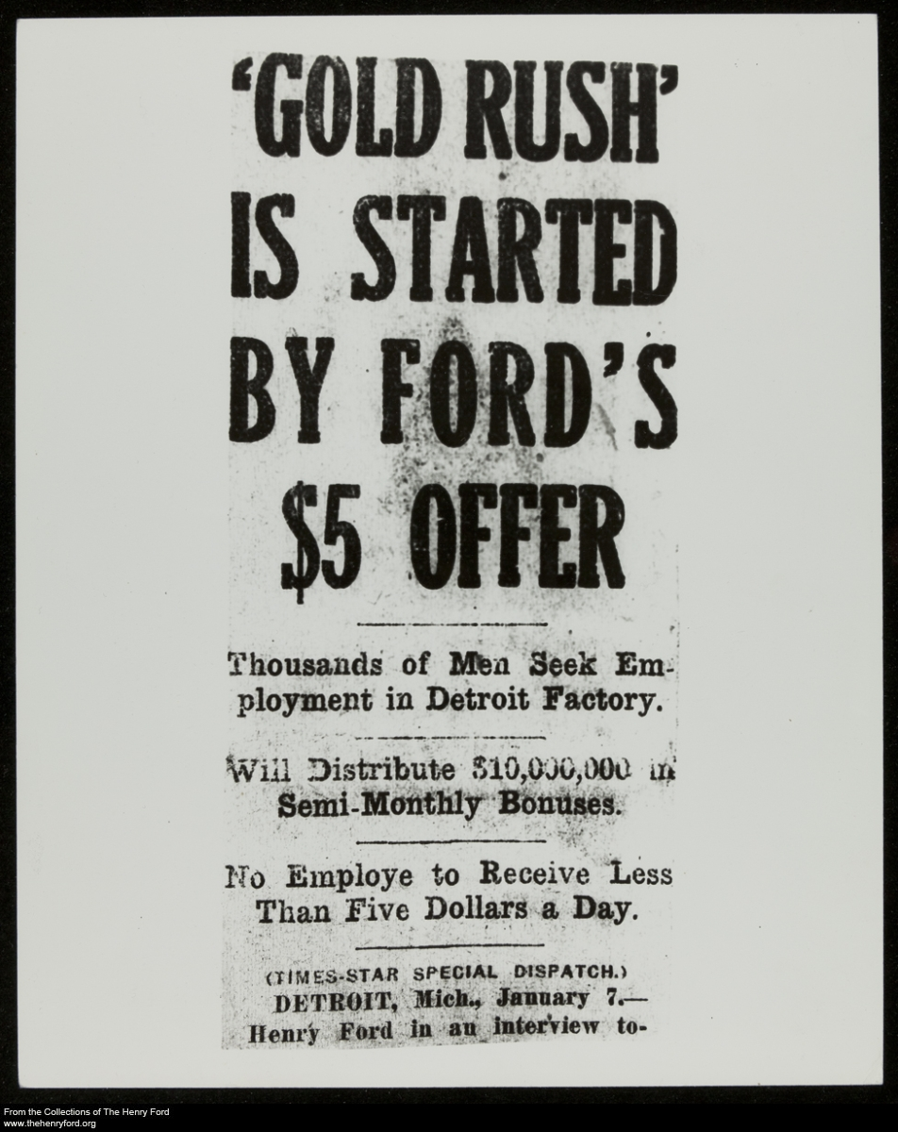
The $5 day, with conditions
January 5, 1914
Ford and James Couzens (VP) announced the plan.
$5 for an 8-hour day
Previous rate: $2.34 for 9 hours
Ordinary wages + conditional profit sharing
Eligibility rules limited access.
Contemporary coverage of the wage announcement
Management connection: compensation and employee retention
14
Notes:
RUN OF SHOW 13:50–14:50 (60 sec)
Slade | 60 seconds
CUES: Compensation / retention / eligibility
The five-dollar announcement made compensation part of the production strategy. Higher total pay could make repetitive work more attractive and help stabilize staffing. The plan also brought extraordinary publicity.
The fine print matters. The original arrangement combined ordinary wages with a conditional profit-sharing payment. It was not an automatic five-dollar base wage for every worker. Eligibility depended on company requirements, including expectations about personal conduct.
Our management interpretation is that a higher pay bill can still be economically sensible if it reduces costly turnover. That does not establish the exact savings from this program, and it does not mean money fixes every job-design problem. Pay can influence whether people stay while leaving monotony and lack of voice unresolved. Next, look at how the company decided who qualified.
COURSE CONNECTION: Chapter 9, slides 25–28, retaining and compensating employees.
RESEARCH (accessed October 19, 2026):
[D] Matt Anderson, “Ford’s Five-Dollar Day,” The Henry Ford (2014)
https://www.thehenryford.org/collections/explore/articles/fords-five-dollar-day
IMAGE CREDIT: The Henry Ford, THF204872, contemporary newspaper coverage, reproduced from source D (flyer-5day.jpg).
DISCUSSION DEPTH
Make the unit explicit: five dollars for an eight-hour DAY. The previous cited rate was $2.34 for nine hours. Do not describe the package as five dollars an hour or universal unconditional base pay. Higher wages and shorter shifts were complementary staffing and capacity decisions.

Slide 15
Two labor stories, separated by time
1913–1914
JANUARY 1914
LATER: 1920s–1930s
Repetitive line work
High worker turnover
$5 per eight-hour DAY
Conditional pay package
Bennett’s enforcers
Anti-union intimidation
15
Notes:
RUN OF SHOW 14:50–15:55 (65 sec)
Slade | 65 seconds
CUES: Per day / sequence / strength of evidence
There are two different periods here. First, repetitive assembly work created a staffing problem. In January 1914, Ford and James Couzens announced five dollars for an eight-hour day—not five dollars an hour. The package initially included conditional profit sharing.
Later, Harry Bennett’s security organization used intimidation against organized labor. The Detroit Historical Society describes recruits including former criminals and other enforcers. Its chronology puts Bennett’s Ford career after the 1914 pay announcement and his leadership of the security organization in 1926.
So we should not say hired gangsters caused the turnover that led to the five-dollar day. The documented chronology does not support that chain. What we can say is that Ford’s management combined an early effort to stabilize staffing through pay with a later coercive approach to employee voice. Higher compensation did not make the later intimidation acceptable.
[D] Matt Anderson, Ford's Five-Dollar Day, The Henry Ford, January 3, 2014. https://www.thehenryford.org/collections/explore/articles/fords-five-dollar-day
[N] Detroit Historical Society, Bennett, Harry. https://www.detroithistorical.org/learn/online-research/encyclopedia-of-detroit/bennett-harry
Accessed October 19, 2026.

Slide 16
When employee welfare became control
Company support
Company intrusion
Health and household advice
Financial and legal assistance
English-language education
Unannounced home visits
Checks on savings and family life
Pay eligibility tied to conduct
Management connection: stakeholder interests, culture, and ethics
16
Notes:
RUN OF SHOW 15:55–16:50 (55 sec)
Slade | 55 seconds
CUES: Benefits / privacy / founder culture
The Sociological Department connected employee benefits to Ford's preferred way of living. Its investigators examined private life while the company also offered practical support. Both sides belong in the account.
This is paternalism: an employer claims to act for workers' benefit while reserving authority over decisions workers might prefer to make themselves. We can recognize useful services without accepting the intrusion that accompanied them.
Imagine the email: congratulations on your compensation package, and someone from work would like to inspect your kitchen. Pause briefly, then return to the issue. Chapter 2 explains how a founder can shape organizational culture. Chapter 3 asks us to consider rights as well as outcomes. An employment relationship gives a company influence, but it does not automatically justify authority over an employee's whole life.
COURSE CONNECTION: Chapter 2, slide 21, founder influence on culture. Chapter 3, slides 20–24, ethics and ethical leadership.
RESEARCH (accessed October 19, 2026):
[E] The Henry Ford, “Henry Ford: Sociological Department”
https://www.thehenryford.org/collections/explore/sets/detail/henry-ford-sociological-department
DISCUSSION DEPTH
Separate the ethical frameworks. A utilitarian argument might emphasize stable income and reliable production. A rights view asks whether an employer can inspect private life. A justice view asks who qualifies and who is excluded. Do not let useful services settle the separate question of consent.

Slide 17
River Rouge and vertical integration
Ford brought more stages of production under company control.
At Rouge: ore docks, steelmaking, glassmaking, and vehicle assembly
The complex achieved “ore to assembly” with the Model A in 1927.
Management connection: vertical integration as a growth strategy
17
Notes:
RUN OF SHOW 16:50–17:30 (40 sec)
Slade | 40 seconds
CUES: Definition / chronology / tradeoff
Vertical integration means expanding into other stages of a production or distribution chain. At Rouge, Ford pursued control over materials and manufacturing instead of relying entirely on outside suppliers. The museum dates the ore-to-assembly achievement to the Model A in 1927. This came after the early Model T assembly-line breakthrough at Highland Park.
The attraction is coordination. A manager can align schedules and specifications across stages under common ownership. But ownership also requires capital and expertise. If needs change, a company may be stuck with facilities that are difficult to redeploy.
Think of a restaurant deciding whether to buy ingredients or own the farm. Control can solve some problems and create others. Chapter 5 lists vertical integration as a growth strategy, which makes Rouge a concrete historical example rather than just a large factory.
COURSE CONNECTION: Chapter 5, slide 16, growth strategies including vertical integration.
RESEARCH (accessed October 19, 2026):
[F] The Henry Ford, “Ford Rouge Factory” research guide
https://askus.thehenryford.org/K12/faq/405833
DISCUSSION DEPTH
Vertical integration changes organizational boundaries. It can coordinate supply and reduce dependence on outside firms, but it commits capital and makes management more complex. This is an application of Chapter 5, not proof that integration is always superior.

Slide 18
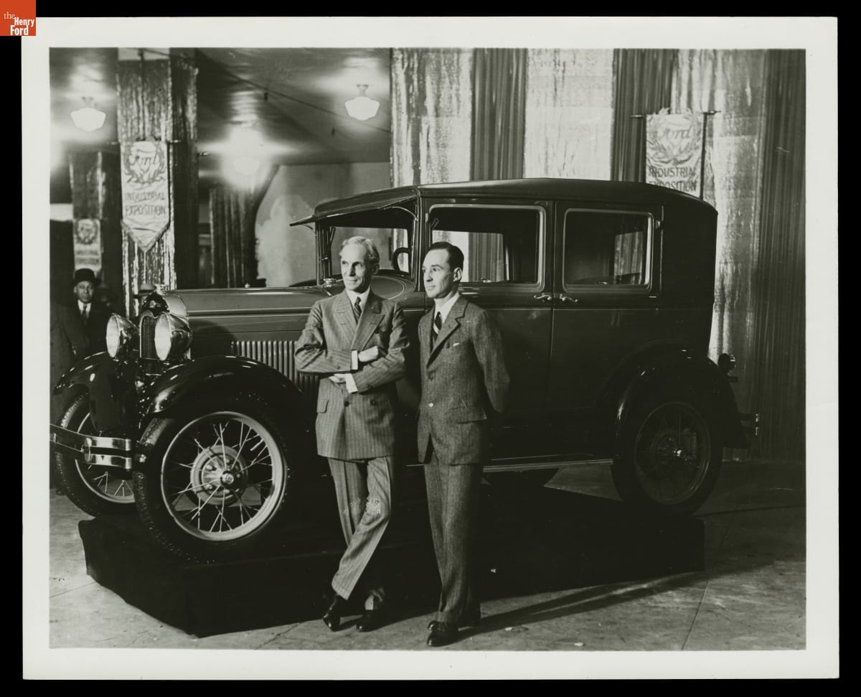
The innovator resisted change
Buyers wanted more comfort, styling, and choice.
Commitment to the Model T delayed adaptation to the market.
The Model A arrived in 1927 after Ford shut down to retool.
Edsel and Henry Ford with a Model A, 1928
Management connection: environmental scanning and resistance to change
18
Notes:
RUN OF SHOW 17:30–18:20 (50 sec)
Slade | 50 seconds
CUES: Success / rigidity / environment
Ford's earlier success created a dangerous confidence in the existing formula. Buyers increasingly valued style and comfort. His reluctance to replace the Model T left the company responding late, before the new Model A appeared in 1927.
That is a useful tension for an introduction to management. A person can drive radical innovation in one period and resist it later. Centralized authority can accelerate decisions when the leader understands the problem, then slow adaptation when the leader rejects unwelcome information.
The course's warning about planning reinforcing today's success fits this case. Managers need feedback that can challenge the plan, not simply help execute it faster. The takeaway is not that standardization is bad. It is that a strategy needs to change when the market on which it depends changes.
COURSE CONNECTION: Chapter 5, slide 6, rigidity and the limits of planning. Chapter 6, managing change and innovation.
RESEARCH (accessed October 19, 2026):
[G] Bob Casey, “Henry Ford: Case Study of an Innovator” (2021)
https://www.thehenryford.org/collections/explore/articles/henry-ford-case-study-of-an-innovator
IMAGE CREDIT: Henry Ford and Edsel Ford with Ford Model A Fordor Sedan, New York Industrial Exposition, 1928, THF91597. The Henry Ford, source G.
DISCUSSION DEPTH
Connect Chapter 2 external environment to Chapter 4 escalation of commitment and Chapter 6 resistance to change. A method that succeeded under one set of customer preferences can become rigid when conditions change. Present these as analytical lenses, not a clinical diagnosis of Ford.

Slide 19
Labor relations and worker voice
1937: Ford security personnel attacked union organizers at the Battle of the Overpass.
1941: Ford accepted union representation.
High pay did not settle questions of power, dignity, or employee voice.
Management connection: stakeholders and ethical leadership
19
Notes:
RUN OF SHOW 18:20–19:05 (45 sec)
Slade | 45 seconds
CUES: No humor / evidence / power
The Battle of the Overpass shows why a pay policy cannot stand in for an evaluation of labor relations. In 1937, Ford security personnel assaulted union organizers distributing material near the Rouge complex. Photographs made the violence visible to a wider public. Ford accepted union representation in 1941.
The ethical issue is not whether higher wages were valuable. Workers could value pay and still seek collective voice over working conditions. Those interests can exist together.
For management, this raises the question of whose concerns leadership hears and how employees can challenge decisions without fear. It also shows how conduct inside an organization can become a public stakeholder problem. Treat this episode seriously. We can evaluate an important operational achievement while also naming the coercion associated with the organization that produced it.
COURSE CONNECTION: Chapters 2–3, stakeholder environment and ethics. Chapter 9, legal environment and employee relations.
RESEARCH (accessed October 19, 2026):
[I] Michigan Supreme Court Learning Center, “Right of Assembly: Battle of the Overpass”
https://www.courts.michigan.gov/49b296/siteassets/msc-learning-center/scrapbook-fordbattleoverpass1937.pdf
DISCUSSION DEPTH
Keep the later coercion distinct from the 1914 turnover story. Bennett’s enforcers and the 1937 attack demonstrate that higher pay did not eliminate conflict over organizing and dignity. If asked about gangs, refer back to the chronology and the narrower documented description of former criminals and enforcers.

Slide 20
A balanced evaluation of Ford
Contributions
Limits and failures
Mass production expanded access
Product and process choices reinforced each other
Pay helped support staffing
Control invaded private life
Gender rules restricted opportunity
Rigidity, coercion, and antisemitism
Management connection: efficiency, effectiveness, and ethical responsibility
20
Notes:
RUN OF SHOW 19:05–19:50 (45 sec)
Slade | 45 seconds
CUES: Separate achievements / ethical judgment / handoff
These are different dimensions of evaluation. A production method can be effective at reducing assembly time while leadership fails ethically. We do not have to choose between pretending Ford contributed nothing and treating his contribution as permission to ignore his conduct.
The course asks us to understand management theory and practice. Ford helps explain both the power of designing an organization around a clear goal and the risk of letting the founder define every boundary.
For a manager today, a reasonable evaluation would examine output, quality, employee experience, and consequences for other stakeholders. A single attractive measure cannot capture the whole organization. Andy will now connect those lessons to familiar workplaces and close with what managers can use from this case.
COURSE CONNECTION: Chapter 1 and Chapter 3, effectiveness and ethical conduct.
RESEARCH (accessed October 19, 2026):
[C] Ford Motor Company, “The Model T” (2020)
https://corporate.ford.com/articles/history/the-model-t/
[D] Matt Anderson, “Ford’s Five-Dollar Day,” The Henry Ford (2014)
https://www.thehenryford.org/collections/explore/articles/fords-five-dollar-day
[E] The Henry Ford, “Henry Ford: Sociological Department”
https://www.thehenryford.org/collections/explore/sets/detail/henry-ford-sociological-department
[G] Bob Casey, “Henry Ford: Case Study of an Innovator” (2021)
https://www.thehenryford.org/collections/explore/articles/henry-ford-case-study-of-an-innovator
[H] U.S. Holocaust Memorial Museum, “Antisemitism and Henry Ford’s ‘The International Jew’”
https://encyclopedia.ushmm.org/content/en/article/antisemitism-and-henry-fords-international-jew
[I] Michigan Supreme Court Learning Center, “Right of Assembly: Battle of the Overpass”
https://www.courts.michigan.gov/49b296/siteassets/msc-learning-center/scrapbook-fordbattleoverpass1937.pdf
DISCUSSION DEPTH
Evaluate practices separately. Expanded affordability does not excuse coercion. The women’s employment evidence shows why a favorable pay headline cannot stand in for an assessment of equal opportunity.
EVIDENCE FOR THE ANTISEMITISM POINT: Ford’s newspaper circulated antisemitic conspiracy theories beginning in 1920; the articles circulated as The International Jew. Explain this briefly if using the evaluation slide’s claim. Source: United States Holocaust Memorial Museum, https://encyclopedia.ushmm.org/content/en/article/antisemitism-and-henry-fords-international-jew . The user removed the separate slide; do not silently restore it or treat the claim as self-explanatory.

Slide 21
Where we still see related ideas
Manufacturing
Services and logistics
Standard work and coordinated flow remain central.
Toyota adds pull production and stopping to address defects.
Kitchens and fulfillment centers also divide work into stations.
These are comparisons of methods, not claims of direct descent.
Management connection: organizational design and continuous improvement
21
Notes:
RUN OF SHOW 19:50–20:35 (45 sec)
Andy | 45 seconds
CUES: Standards / Toyota’s differences / everyday comparisons
SAY IN YOUR OWN WORDS
“Modern manufacturing still uses standard work and coordinated flow. Toyota adds important differences, including pull production and stopping to address defects. Kitchens and warehouses offer familiar comparisons, but we aren’t claiming Ford invented them. The lesson is to adapt methods to the job and listen to the people doing it.”
BACKUP RESEARCH — NOT A SCRIPT
Andy | 45 seconds
CUES: Historical influence / analogies / evolution
Ford's production methods spread across manufacturing. Modern factories still coordinate specialized work and material movement, but they have evolved substantially. Toyota describes its system around just-in-time production and jidoka, which means detecting problems and stopping to prevent defects from continuing.
The service examples are comparisons, not a claim that Ford directly invented modern kitchens or warehouses. A kitchen's stations and a fulfillment operation's standard procedures make the same general questions easy to see: how should work flow, how much should a job repeat, and who can improve the process?
The modern lesson is selective adaptation. Stable, repeatable work can benefit from standards. Changing demand and complex problems also require feedback and employee judgment. Ford gives us a useful starting point for those questions, not a complete operating manual.
COURSE CONNECTION: Chapter 8, job design. Chapter 6, innovation. Service and logistics examples are contemporary analytical comparisons.
RESEARCH (accessed October 19, 2026):
[G] Bob Casey, “Henry Ford: Case Study of an Innovator” (2021)
https://www.thehenryford.org/collections/explore/articles/henry-ford-case-study-of-an-innovator
[J] Toyota Motor Corporation, “Toyota Production System”
https://global.toyota/en/company/plant-tours/production-system/
DISCUSSION DEPTH
Toyota’s own description emphasizes just-in-time and jidoka, including stopping when abnormalities occur. Avoid presenting Toyota as simply copying Ford. Services examples are conceptual comparisons of work organization.

Slide 22
One company, four management functions
Planning: align affordability with demand, then revisit assumptions
Organizing: specialize jobs while coordinating the whole flow
Leading: combine fair incentives with employee voice
Controlling: track output, quality, turnover, and ethical boundaries
Management connection: planning, organizing, leading, and controlling
22
Notes:
RUN OF SHOW 20:35–21:30 (55 sec)
Andy | 55 seconds
CUES: Plan / organize / lead / control
SAY IN YOUR OWN WORDS
“Ford’s case connects the four functions. Planning linked affordability to the market. Organizing coordinated tasks and resources. Leading involved pay, treatment, and employee voice. Controlling should examine quality and turnover as well as output. These are our course concepts applied to Ford, not four theories he invented.”
BACKUP RESEARCH — NOT A SCRIPT
Andy | 55 seconds
CUES: Apply the course / distinguish metrics / whole system
Here is the case in the course's four-function framework. Planning links the desired market to product and cost choices. Organizing assigns work and coordinates resources. Leading concerns the people carrying out the plan. Controlling compares performance with expectations and responds to gaps.
Ford shows that these functions interact. The production plan created a need for staffing stability. Compensation addressed part of that need. Yet intrusive oversight and coercion damaged the relationship with employees.
If we were advising a manager facing a similar problem, we would ask for more than an output target. We would ask how often employees leave, whether quality improves, what customers want, and whether people can report problems. That is how the historical case becomes a way to think through a present management decision rather than a list of vocabulary words.
COURSE CONNECTION: Chapter 1, slide 19, four management functions. Chapters 4–6, 8–9 support these applications.
DISCUSSION DEPTH
Chapter map: Ch. 1 four functions and efficiency/effectiveness. Ch. 2 environment and culture. Ch. 3 ethics and justice. Ch. 4 alternatives, evidence, and commitment bias. Ch. 5 cost leadership and vertical integration. Ch. 6 innovation and resistance. Ch. 8 specialization, formalization, and centralization. Ch. 9 retention, compensation, and inclusion. History Module: Smith, scientific management, systems and contingency views. The chapter concepts are analytical frameworks applied to Ford, not theories he personally authored.

Slide 23
What Ford changed about management
Ford made product design, production, and staffing one management problem.
High pay could support retention while leaving monotony and exclusion unresolved.
His legacy asks managers to pursue efficiency with adaptation and accountability.
23
Notes:
RUN OF SHOW 21:30–22:25 (55 sec)
Andy | 55 seconds
CUES: Linked system / human consequences / return to activity
SAY IN YOUR OWN WORDS
“Our main point is that product design, production, and staffing form one management problem. Ford’s methods changed industry, but efficiency didn’t excuse exclusion, coercion, or other harms. Think back to your factory plan: what would you keep, and what would you change? We’re ready for your questions.”
BACKUP RESEARCH — NOT A SCRIPT
Andy | 55 seconds
CUES: Thesis / consequences / invite Q&A
Ford's durable contribution was the integration of decisions that managers sometimes treat separately. The product affected the process. The process affected jobs. Jobs affected staffing, and staffing affected output. At enormous scale, those connections changed industrial practice.
The same case shows why efficiency alone cannot define good management. An organization also has to adapt to customers and treat people responsibly. Ford could see a different future for production while failing to see the limits of his own authority and beliefs.
Our conclusion is that his methods deserve study and his conduct deserves judgment. Managers can learn from both. Thank you. We are ready for questions about the assembly line, employment policies, influences, or the legacy of his approach.
RESEARCH (accessed October 19, 2026):
[B] Library of Congress, “Ford Implements the Moving Assembly Line”
https://guides.loc.gov/this-month-in-business-history/october/ford
[D] Matt Anderson, “Ford’s Five-Dollar Day,” The Henry Ford (2014)
https://www.thehenryford.org/collections/explore/articles/fords-five-dollar-day
[G] Bob Casey, “Henry Ford: Case Study of an Innovator” (2021)
https://www.thehenryford.org/collections/explore/articles/henry-ford-case-study-of-an-innovator
[H] U.S. Holocaust Memorial Museum, “Antisemitism and Henry Ford’s ‘The International Jew’”
https://encyclopedia.ushmm.org/content/en/article/antisemitism-and-henry-fords-international-jew

Slide 24
Questions and discussion
Would you change your factory plan now?
Which Ford practice would you keep?
Which would you change—and why?
24
Notes:
Q&A — after the timed presentation; allow 3–5 minutes or follow the instructor.
Andy: production, influences, women’s work, modern relevance. Slade: turnover, wages, conditions, labor relations. Both should answer at least one question.
Return to the class activity: ask whether a group would change its original recommendation after hearing the evidence.
If asked: the $5 plan was daily compensation for eligible workers, initially wages plus conditional profit sharing. Ford’s production system adapted earlier industrial methods. The Bennett/enforcer chronology belongs to a later period and does not establish the cause of the 1914 wage decision. Women worked at Ford before WWII, but pay access and employment rules were unequal.
If a question exceeds the sources, acknowledge the limit rather than guessing. Reference slides are submission material, not a second conclusion.

Slide 25
References: production and strategy
[A] The Henry Ford, “Henry Ford” biography and interview transcript
https://www.thehenryford.org/collections/explore/videos/henry-ford
[B] Library of Congress, “Ford Implements the Moving Assembly Line”
https://guides.loc.gov/this-month-in-business-history/october/ford
[C] Ford Motor Company, “The Model T” (2020)
https://corporate.ford.com/articles/history/the-model-t/
[F] The Henry Ford, “Ford Rouge Factory” research guide
https://askus.thehenryford.org/K12/faq/405833
[G] Bob Casey, “Henry Ford: Case Study of an Innovator” (2021)
https://www.thehenryford.org/collections/explore/articles/henry-ford-case-study-of-an-innovator
[L] The Henry Ford, authenticated Henry Ford quotations, Edison recollections
https://www.thehenryford.org/collections/explore/popular-research-topics/henry-ford-quotations
Sources carried over from the supplied revision; live links not reverified. Full citations also appear in the relevant slide notes.
25
Notes:
[A] The Henry Ford, “Henry Ford” biography and interview transcript
https://www.thehenryford.org/collections/explore/videos/henry-ford
[B] Library of Congress, “Ford Implements the Moving Assembly Line”
https://guides.loc.gov/this-month-in-business-history/october/ford
[C] Ford Motor Company, “The Model T” (2020)
https://corporate.ford.com/articles/history/the-model-t/
[F] The Henry Ford, “Ford Rouge Factory” research guide
https://askus.thehenryford.org/K12/faq/405833
[G] Bob Casey, “Henry Ford: Case Study of an Innovator” (2021)
https://www.thehenryford.org/collections/explore/articles/henry-ford-case-study-of-an-innovator
[L] The Henry Ford, authenticated Henry Ford quotations, Edison recollections
https://www.thehenryford.org/collections/explore/popular-research-topics/henry-ford-quotations

Slide 26
References: employees and legacy
[D] Matt Anderson, “Ford’s Five-Dollar Day,” The Henry Ford (2014)
https://www.thehenryford.org/collections/explore/articles/fords-five-dollar-day
[E] The Henry Ford, “Henry Ford: Sociological Department”
https://www.thehenryford.org/collections/explore/sets/detail/henry-ford-sociological-department
[H] U.S. Holocaust Memorial Museum, “Antisemitism and Henry Ford’s ‘The International Jew’”
https://encyclopedia.ushmm.org/content/en/article/antisemitism-and-henry-fords-international-jew
[I] Michigan Supreme Court Learning Center, “Right of Assembly: Battle of the Overpass”
https://www.courts.michigan.gov/49b296/siteassets/msc-learning-center/scrapbook-fordbattleoverpass1937.pdf
[J] Toyota Motor Corporation, “Toyota Production System”
https://global.toyota/en/company/plant-tours/production-system/
[M] The Henry Ford, “Henry Ford and Anti-Semitism”
https://www.thehenryford.org/collections/explore/popular-research-topics/henry-ford-and-anti-semitism
Sources carried over from the supplied revision; live links not reverified. Full citations also appear in the relevant slide notes.
26
Notes:
[D] Matt Anderson, “Ford’s Five-Dollar Day,” The Henry Ford (2014)
https://www.thehenryford.org/collections/explore/articles/fords-five-dollar-day
[E] The Henry Ford, “Henry Ford: Sociological Department”
https://www.thehenryford.org/collections/explore/sets/detail/henry-ford-sociological-department
[H] U.S. Holocaust Memorial Museum, “Antisemitism and Henry Ford’s ‘The International Jew’”
https://encyclopedia.ushmm.org/content/en/article/antisemitism-and-henry-fords-international-jew
[I] Michigan Supreme Court Learning Center, “Right of Assembly: Battle of the Overpass”
https://www.courts.michigan.gov/49b296/siteassets/msc-learning-center/scrapbook-fordbattleoverpass1937.pdf
[J] Toyota Motor Corporation, “Toyota Production System”
https://global.toyota/en/company/plant-tours/production-system/
[M] The Henry Ford, “Henry Ford and Anti-Semitism”
https://www.thehenryford.org/collections/explore/popular-research-topics/henry-ford-and-anti-semitism

Slide 27
References: women and the fact check
[N] Detroit Historical Society, “Bennett, Harry”
[O] The Henry Ford, women assembling magnetos, circa 1913 (THF99642)
[P] Ford & Crowther, My Life and Work (1922), chapters VII–VIII
[Q] The New York Times, “For Every Woman, $5 a Day” (Oct. 26, 1916)
[R] The Henry Ford, K–12 Research Guide: Rosie the Riveter
Full URLs and source limitations appear in these slide notes.
Primary accounts reflect their authors’ views; distinguish them from independent evidence.
Source access dates carried over from the supplied revision; live links not reverified.
27
Notes:
REFERENCE MATERIAL — not part of the timed presentation.
https://www.thehenryford.org/collections/explore/articles/fords-five-dollar-day
https://www.detroithistorical.org/learn/online-research/encyclopedia-of-detroit/bennett-harry
https://www.thehenryford.org/collections/explore/artifact/4461
https://www.gutenberg.org/cache/epub/7213/pg7213-images.html
https://tile.loc.gov/storage-services/service/sgp/sgpbatches/batch_dlc_1zubrowka_ver01/data/2004540423/print00192511057/1916102201/0129.pdf
https://askus.thehenryford.org/K12/faq/429559
https://www.thehenryford.org/collections/explore/popular-research-topics/ford-motor-company-sociological-department-english-school
[N] Bennett biography: evidence for the later security apparatus, not the cause of the 1914 wage plan.
[O] Photograph: women manufacturing magneto components circa 1913; does not prove access to every factory role.
[P] Ford’s retrospective primary account: conditional profit sharing and his reported marriage-related employment restrictions. Treat his explanations critically.
[Q] Contemporary editorial: broader $5 daily minimum for women in 1916.
[R] Later wartime roles at Willow Run; do not project these back to 1914.
These citations were supplied in the proposed revision. Live retrieval returned network-proxy 403 errors during this edit; they were not independently reverified online.

Slide 28
Course materials and visual credits
Fundamentals of Management, 11th ed.
Uploaded Pearson chapter slides 1–6, 8, and 9 (2020)
History Module-1.pdf
Uploaded Prentice Hall management-history module (2005)
The Henry Ford digital collections
Historical photographs and documents identified in slide notes
28
Notes:
Andy / Slade
CUES: Course materials and visual credits
COURSE MATERIALS USED:
Chapter 1: management, efficiency/effectiveness, four functions (slides 10–11, 19).
Chapter 2: stakeholders and organizational culture, including founder influence (slide 21).
Chapter 3: ethical approaches and leadership (slides 20–24).
Chapter 4: identifying problems and evaluating management decisions.
Chapter 5: strategy, planning rigidity, competitive strategies, vertical integration (slides 6, 9, 16, 19–20).
Chapter 6: change and innovation (slide 24 and related sections).
Chapter 8: structure, specialization, centralization, formalization (slides 4–5, 14–15).
Chapter 9: HRM, retention, compensation (slides 5, 20, 25–28).
History Module-1.pdf: Adam Smith, Taylor, systems and contingency approaches.
Visuals: slide 1 THF97952; slide 3 THF135450; slide 5 THF94827; slide 11 THF94994; slide 14 THF204872; slide 18 THF91597. All The Henry Ford. Source credits remain in the corresponding slide notes. Source O is a discussed artifact, not an image added to the slide.
Rubric supplied by the user: 20–25 minutes plus Q&A, management contributions, influences, contemporary evidence, professional visual aids, research and information submission. The course name follows the user's correction to MGT 210, Section T01.
RESEARCH (accessed October 19, 2026):
[K] The Henry Ford, “Our Most-Viewed Digitized Artifacts of All Time”
https://www.thehenryford.org/collections/explore/sets/detail/our-most-viewed-digitized-artifacts-of-all-time

