Slide 1
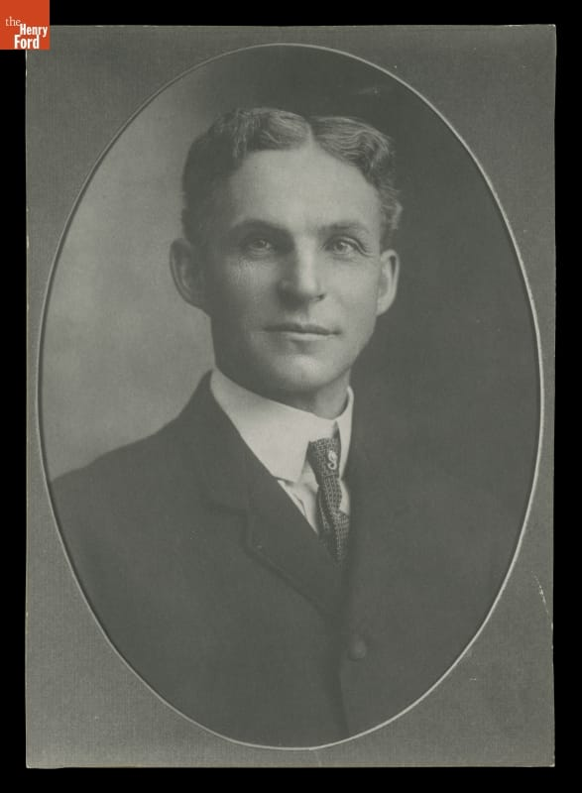
Henry Ford
The man who changed how the world works
Andy Johnson & Slade McClain
MGT 210, Section T01
[A] [G]
01
Notes:
Andy | Target 45 seconds
CUES: Cars / system / central question
Most of us connect Henry Ford with cars and assembly lines. Today we are going to look at the management behind them. Ford did not invent the automobile. His company helped make an expensive product practical for a mass market by changing how work happened.
Our argument is that his greatest contribution was an integrated system. Product design, factory organization, employee pay, and supply decisions reinforced one another. But that system also created human problems, and Ford made serious ethical failures. Our question is: what happens when efficiency becomes the organizing idea of an entire company?
RESEARCH (accessed October 19, 2026):
[A] The Henry Ford, “Henry Ford” biography and interview transcript
https://www.thehenryford.org/collections/explore/videos/henry-ford
[G] Bob Casey, “Henry Ford: Case Study of an Innovator” (2021)
https://www.thehenryford.org/collections/explore/articles/henry-ford-case-study-of-an-innovator
IMAGE CREDIT: First official Ford Motor Company portrait, 1904, THF97952. The Henry Ford, image reproduced from source G.

Slide 2
The management question
How do you make a complicated product affordable to millions?
Ford connected the product, the production process, and the people doing the work.
The test: efficiency, effectiveness, and consequences
Management connection: efficiency and effectiveness
02
Notes:
Andy | Target 65 seconds
CUES: Problem / linked decisions / evaluate
Chapter 1 defines management around getting results through people. Efficiency asks how economically we use resources. Effectiveness asks whether we achieve the right goals. They are related, but they are not identical.
Imagine a factory building the wrong product twice as fast. It has improved one measure while making its larger business problem worse. Keep that distinction in mind as we follow Ford.
We will first explain his background and influences, then the production system, then the employment decisions it required. Finally, we will examine its limitations and where we see related ideas today. The goal is to evaluate management choices, rather than simply collect interesting facts about an automobile executive.
COURSE CONNECTION: Chapter 1, slides 10–11, management and efficiency/effectiveness. History Module, systems approach.

Slide 3
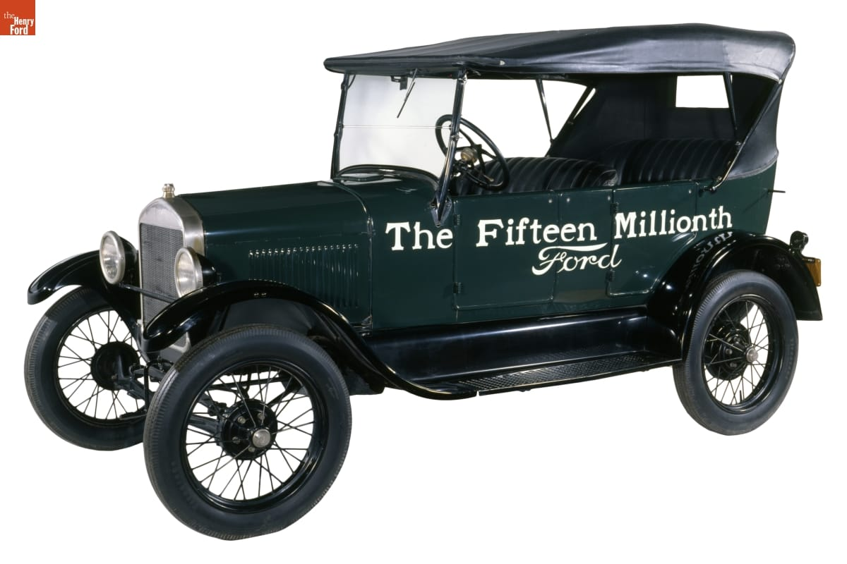
The mechanic behind the manager
1863–1947
Raised on a Michigan farm
1903
Ford Motor Company founded
1908
Model T introduced
The fifteen-millionth Ford, a 1927 Model T
[A] [C]
03
Notes:
Andy | Target 65 seconds
CUES: Machinery / experience / broad market
Ford grew up around farm work but pursued machinery. Before the successful company, he worked as an engineer and experimented with gasoline vehicles. His career included failed automobile ventures, which matters because the familiar success story can make his outcome look inevitable.
The company founded in 1903 and the Model T introduced in 1908 were parts of a longer learning process. The Model T aimed at durability, simple operation, and affordability.
Think about the connection between a customer's needs and a manager's choices. A car designed for a broad market needs a different business system from a luxury car assembled in small numbers. Ford's background helps explain his practical approach, but the business depended on a team as well as its founder.
RESEARCH (accessed October 19, 2026):
[A] The Henry Ford, “Henry Ford” biography and interview transcript
https://www.thehenryford.org/collections/explore/videos/henry-ford
[C] Ford Motor Company, “The Model T” (2020)
https://corporate.ford.com/articles/history/the-model-t/
IMAGE CREDIT: 1927 Model T Touring Car, THF135450, The Henry Ford. Source K; collections-media.thehenryford.org/CollectionImages/_detail/photos/thf135450.jpg

Slide 4
Ford’s influences and collaborators
Direct influences
Management context
Thomas Edison encouraged his automotive work.
Other industries supplied methods for moving materials.
Division of labor long predated Ford.
Taylor’s scientific management shared an emphasis on measured, standardized work.
Management connection: division of labor and scientific management
[L] [K]
04
Notes:
Andy | Target 70 seconds
CUES: Edison / borrowing / team credit
Edison was a personal encouragement to Ford. That is different from saying Edison designed Ford's factories. The production methods also drew on earlier industrial practices. The museum documents Ford engineers adapting the moving disassembly principle used in meatpacking.
The course history module takes division of labor back to Adam Smith and describes Taylor's search for a scientifically defined method of doing each job. Ford operated in that wider efficiency movement. That is a conceptual relationship, not proof that Taylor personally taught Ford his system.
Ford's engineers and managers deserve credit for implementation. Management innovation often means recognizing useful ideas elsewhere and coordinating people to make them work at scale. The genius-in-a-garage version leaves out a lot of the actual management.
COURSE CONNECTION: History Module, Adam Smith and scientific management sections. Chapter 6, slide 24, creativity and innovation.
RESEARCH (accessed October 19, 2026):
[L] The Henry Ford, authenticated Henry Ford quotations, Edison recollections
https://www.thehenryford.org/collections/explore/popular-research-topics/henry-ford-quotations
[K] The Henry Ford, “Our Most-Viewed Digitized Artifacts of All Time”
https://www.thehenryford.org/collections/explore/sets/detail/our-most-viewed-digitized-artifacts-of-all-time

Slide 5
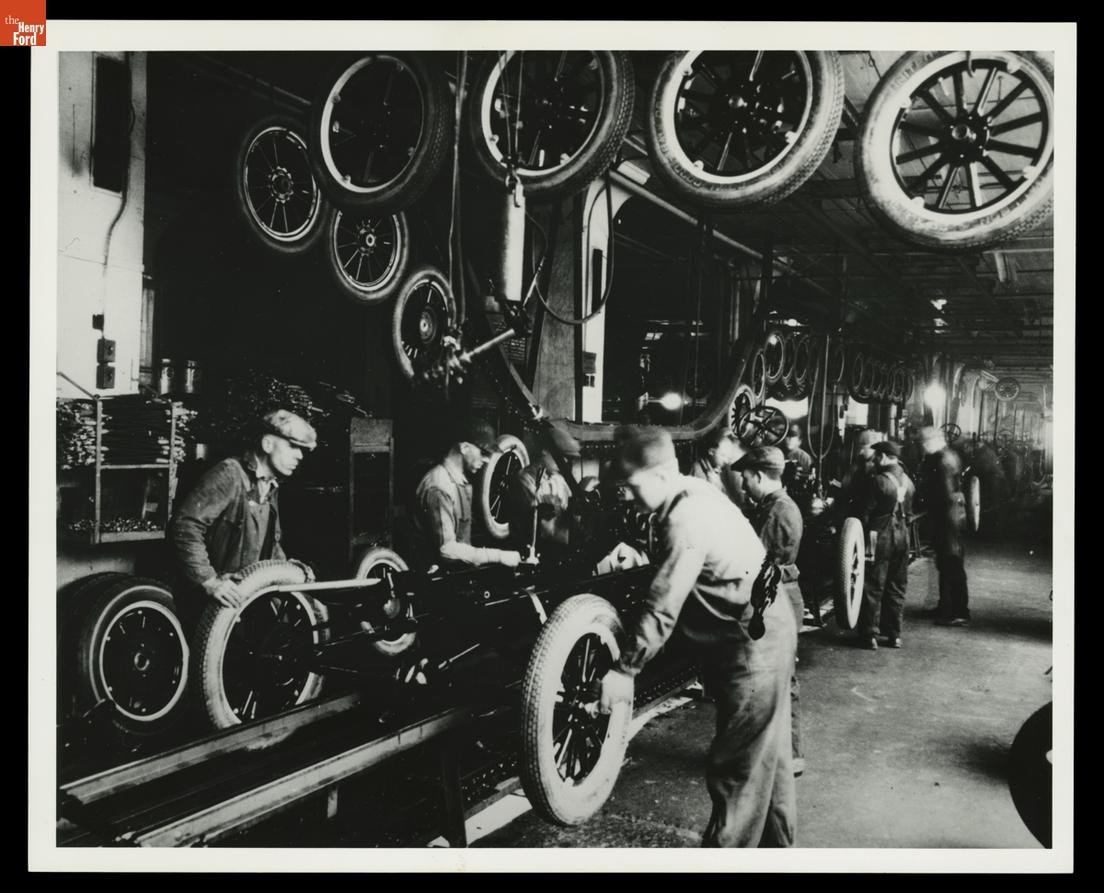
The production system
Standardized parts reduced fitting and adjustment.
Specialized jobs divided a complex task.
A moving chassis brought work to stationary workers.
Tire installation at Highland Park, circa 1925
Management connection: work specialization and formalization
[B] [K]
05
Notes:
Andy | Target 80 seconds
CUES: Parts / jobs / movement / dependence
Look at how the workers and materials are arranged. The sequence of tasks matters as much as any individual machine. Standard parts reduce the need to custom fit a component. Specialized jobs make the work easier to repeat and train. Bringing the chassis past workers reduces travel around the factory.
Chapter 8 calls dividing work into specific tasks work specialization. Formalization concerns how much rules and procedures guide a job. Ford's production system used both heavily.
The tradeoff is dependence between stations. A problem at one point can interrupt work elsewhere. A well-designed line therefore needs reliable parts and dependable staffing. This is why we should study the whole system instead of giving all the credit to a conveyor belt. The belt cannot solve a missing-parts problem by moving more enthusiastically.
COURSE CONNECTION: Chapter 8, slides 4–5 and 15, specialization and formalization.
RESEARCH (accessed October 19, 2026):
[B] Library of Congress, “Ford Implements the Moving Assembly Line”
https://guides.loc.gov/this-month-in-business-history/october/ford
[K] The Henry Ford, “Our Most-Viewed Digitized Artifacts of All Time”
https://www.thehenryford.org/collections/explore/sets/detail/our-most-viewed-digitized-artifacts-of-all-time
IMAGE CREDIT: Workers Installing Tires on Ford Model T Assembly Line, circa 1925, THF94827. The Henry Ford, source K.

Slide 6
A 60-second factory challenge
Imagine four stations: frame, wheels, engine, inspection.
Station times: 10, 20, 10, and 10 seconds per unit.
Which station limits output? Would faster frame work help?
Class activity: illustrative numbers, not historical Ford data
06
Notes:
Andy leads; Slade fields one answer | Target 65 seconds
CUES: 10 seconds think / one answer / explain bottleneck
Give everyone about ten seconds to think. Ask for one answer, then ask why. The wheels station takes twenty seconds, so under these simplified assumptions it limits the line to one unit every twenty seconds. Making the frame station faster will mostly create waiting work in front of wheels.
The assumptions are one worker at each station, no parallel capacity, sufficient materials, and a stable process. This is a classroom example, not a reconstruction of Highland Park.
The management lesson is to improve the constraint in the whole process rather than celebrate local speed. Add help at wheels or redesign that task, then check where the next constraint appears. Efficiency requires coordination. Thank the person who answered and move to Ford's historical results.
COURSE CONNECTION: Chapter 1, efficiency. Chapter 4, identifying and evaluating a management problem.

Slide 7
Assembly time fell dramatically
12½ hours 93 minutes
Approximate Model T chassis assembly time
After the moving-line experiments of 1913–1914
About 88% less elapsed assembly time
93 minutes is assembly duration, not the gap between completed vehicles
[B] [D]
07
Notes:
Andy | Target 75 seconds
CUES: Same measure / calculation / throughput distinction
These are commonly reported figures for the reduction in assembly time as Ford refined the line. Converting twelve and a half hours to seven hundred fifty minutes lets us compare the same units. The decrease to ninety-three minutes is roughly eighty-eight percent.
Be careful about what that number means. Several chassis can be on the line at once. Ninety-three minutes does not mean the factory finished only one vehicle every ninety-three minutes. The interval between completions is a separate throughput measure. It also is not a measure of every upstream operation needed to make an automobile.
For a manager, the important question is which metric the process improves and which costs remain elsewhere. Use the numbers as evidence of a major process change without turning them into a claim they cannot support.
RESEARCH (accessed October 19, 2026):
[B] Library of Congress, “Ford Implements the Moving Assembly Line”
https://guides.loc.gov/this-month-in-business-history/october/ford
[D] Matt Anderson, “Ford’s Five-Dollar Day,” The Henry Ford (2014)
https://www.thehenryford.org/collections/explore/articles/fords-five-dollar-day

Slide 8
Efficiency expanded the market
$850 as low as $260
Model T prices over its production life, in nominal dollars
More than 15 million Model Ts built and sold
A broad market supported a strategy built around low cost.
Management connection: competitive strategy and cost leadership
[C]
08
Notes:
Andy | Target 70 seconds
CUES: Price range / volume / strategy
Ford reports a Model T price range from eight hundred fifty dollars down to as little as two hundred sixty dollars, and more than fifteen million built and sold. These are nominal prices from different years and configurations, not an inflation-adjusted comparison of identical vehicles.
The broader pattern fits a cost-leadership interpretation. A standardized offering and high production volume helped Ford compete through low cost for a broad market. That is our application of Chapter 5, not a claim Ford used today's textbook label.
We should also avoid saying the assembly line alone caused the price decline. Product changes, purchasing, factory learning, and other decisions mattered. The strategic lesson is that operations can change what customers can afford, which can in turn change the size of a market.
COURSE CONNECTION: Chapter 5, strategic management and competitive strategies, slides 9 and 19.
RESEARCH (accessed October 19, 2026):
[C] Ford Motor Company, “The Model T” (2020)
https://corporate.ford.com/articles/history/the-model-t/

Slide 9
Fordism as a management system
Reinforcing decisions
The system depends on people
A standardized product supports repeatable work.
High volume spreads fixed costs across more units.
Affordable prices can widen demand.
Stable staffing helps sustain the production plan.
Management connection: systems thinking and organizational design
09
Notes:
Andy | Target 65 seconds
CUES: Connections / assumptions / handoff
Fordism is a useful label for the connection between standardized mass production and a mass market. For this presentation, treat it as an analytical summary rather than a claim that every part appeared at once.
The decisions reinforce each other. A wider product range would make the production system more complicated. A highly standardized product makes repeated tasks easier. High volume can spread equipment and facility costs across more units, but only if customers buy the output.
The model depends on its assumptions. It works less well when buyers want more variety or when the people operating it will not stay. Systems thinking means following those relationships. That leads to the next question, which Slade will take: what happens when the factory runs beautifully and employees keep leaving?
COURSE CONNECTION: History Module, systems approach. Chapters 5 and 8, strategy and organizational structure.

Slide 10
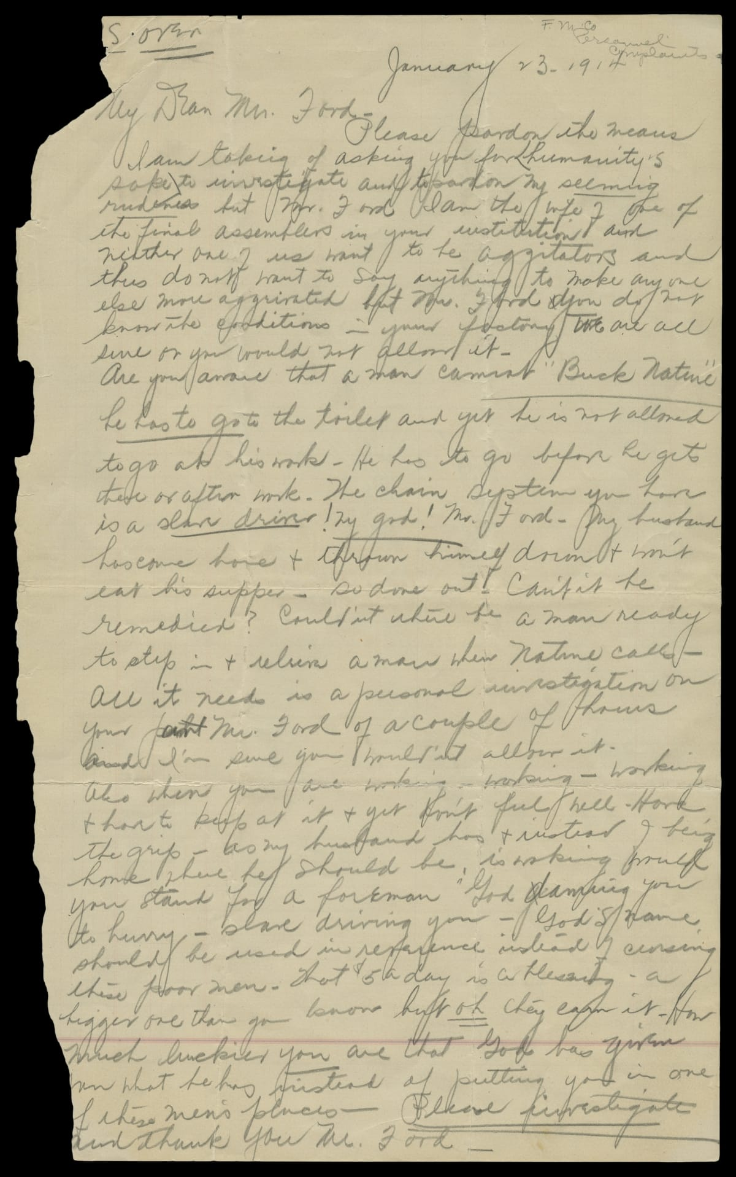
The staffing problem
Repetitive work reduced autonomy and variety.
Turnover threatened reliable production.
Recruiting and training replacements carried costs.
A worker’s wife complained to Ford in 1914
Management connection: retention and job design
[A] [K]
10
Notes:
Slade | Target 80 seconds
CUES: Human consequences / retention / primary evidence
The museum's biography describes Ford hiring fifty-three thousand people in a year to keep fourteen thousand jobs filled. We are using that description rather than mixing turnover percentages that different accounts report differently.
On the right is a primary document: a worker's wife wrote to Ford in January 1914 about treatment on the assembly line. It gives us an individual perspective, not a statistical sample of every worker. But it reminds us that output figures leave out lived experience.
Chapter 9 includes keeping competent employees as part of HR management. If a job is easy to learn but workers leave constantly, that job still creates organizational costs. Here the production solution generated an employment problem. The machines stayed where management put them. The people had other options.
COURSE CONNECTION: Chapter 9, slides 5 and 20, HRM and retention. Chapter 8, work specialization.
RESEARCH (accessed October 19, 2026):
[A] The Henry Ford, “Henry Ford” biography and interview transcript
https://www.thehenryford.org/collections/explore/videos/henry-ford
[K] The Henry Ford, “Our Most-Viewed Digitized Artifacts of All Time”
https://www.thehenryford.org/collections/explore/sets/detail/our-most-viewed-digitized-artifacts-of-all-time
IMAGE CREDIT: Letter to Henry Ford from the Wife of an Assembly Line Worker, January 23, 1914, THF94994. The Henry Ford, source K.

Slide 11
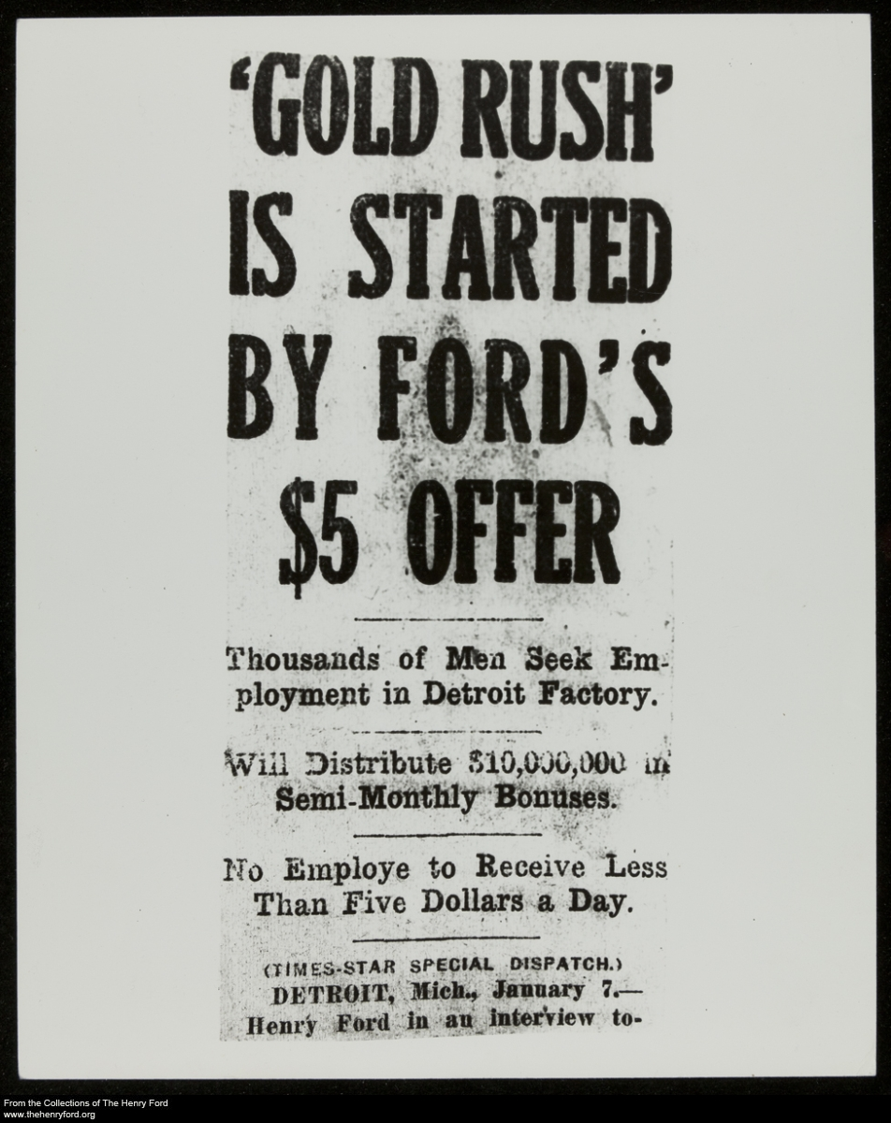
The $5 day, with conditions
January 5, 1914
Ford and James Couzens announced the plan.
Eligible workers could receive $5 per day.
The package included conditional profit sharing.
Contemporary coverage of the wage announcement
Management connection: compensation and employee retention
[D]
11
Notes:
Slade | Target 80 seconds
CUES: Compensation / retention / eligibility
The five-dollar announcement made compensation part of the production strategy. Higher total pay could make repetitive work more attractive and help stabilize staffing. The plan also brought extraordinary publicity.
The fine print matters. The original arrangement combined ordinary wages with a conditional profit-sharing payment. It was not an automatic five-dollar base wage for every worker. Eligibility depended on company requirements, including expectations about personal conduct.
Our management interpretation is that a higher pay bill can still be economically sensible if it reduces costly turnover. That does not establish the exact savings from this program, and it does not mean money fixes every job-design problem. Pay can influence whether people stay while leaving monotony and lack of voice unresolved. Next, look at how the company decided who qualified.
COURSE CONNECTION: Chapter 9, slides 25–28, retaining and compensating employees.
RESEARCH (accessed October 19, 2026):
[D] Matt Anderson, “Ford’s Five-Dollar Day,” The Henry Ford (2014)
https://www.thehenryford.org/collections/explore/articles/fords-five-dollar-day
IMAGE CREDIT: The Henry Ford, THF204872, contemporary newspaper coverage, reproduced from source D (flyer-5day.jpg).

Slide 12
When employee welfare became control
Company support
Company intrusion
Hygiene instruction
Financial and legal advice
English-language education
Home inspections
Bank-deposit checks
Monitoring family life
Management connection: stakeholder interests, culture, and ethics
[E]
12
Notes:
Slade | Target 70 seconds
CUES: Benefits / privacy / founder culture
The Sociological Department connected employee benefits to Ford's preferred way of living. Its investigators examined private life while the company also offered practical support. Both sides belong in the account.
This is paternalism: an employer claims to act for workers' benefit while reserving authority over decisions workers might prefer to make themselves. We can recognize useful services without accepting the intrusion that accompanied them.
Imagine the email: congratulations on your compensation package, and someone from work would like to inspect your kitchen. Pause briefly, then return to the issue. Chapter 2 explains how a founder can shape organizational culture. Chapter 3 asks us to consider rights as well as outcomes. An employment relationship gives a company influence, but it does not automatically justify authority over an employee's whole life.
COURSE CONNECTION: Chapter 2, slide 21, founder influence on culture. Chapter 3, slides 20–24, ethics and ethical leadership.
RESEARCH (accessed October 19, 2026):
[E] The Henry Ford, “Henry Ford: Sociological Department”
https://www.thehenryford.org/collections/explore/sets/detail/henry-ford-sociological-department

Slide 13
River Rouge and vertical integration
Ford brought more stages of production under company control.
At Rouge: ore docks, steelmaking, glassmaking, and vehicle assembly
The complex achieved “ore to assembly” with the Model A in 1927.
Management connection: vertical integration as a growth strategy
[F]
13
Notes:
Slade | Target 70 seconds
CUES: Definition / chronology / tradeoff
Vertical integration means expanding into other stages of a production or distribution chain. At Rouge, Ford pursued control over materials and manufacturing instead of relying entirely on outside suppliers. The museum dates the ore-to-assembly achievement to the Model A in 1927. This came after the early Model T assembly-line breakthrough at Highland Park.
The attraction is coordination. A manager can align schedules and specifications across stages under common ownership. But ownership also requires capital and expertise. If needs change, a company may be stuck with facilities that are difficult to redeploy.
Think of a restaurant deciding whether to buy ingredients or own the farm. Control can solve some problems and create others. Chapter 5 lists vertical integration as a growth strategy, which makes Rouge a concrete historical example rather than just a large factory.
COURSE CONNECTION: Chapter 5, slide 16, growth strategies including vertical integration.
RESEARCH (accessed October 19, 2026):
[F] The Henry Ford, “Ford Rouge Factory” research guide
https://askus.thehenryford.org/K12/faq/405833

Slide 14
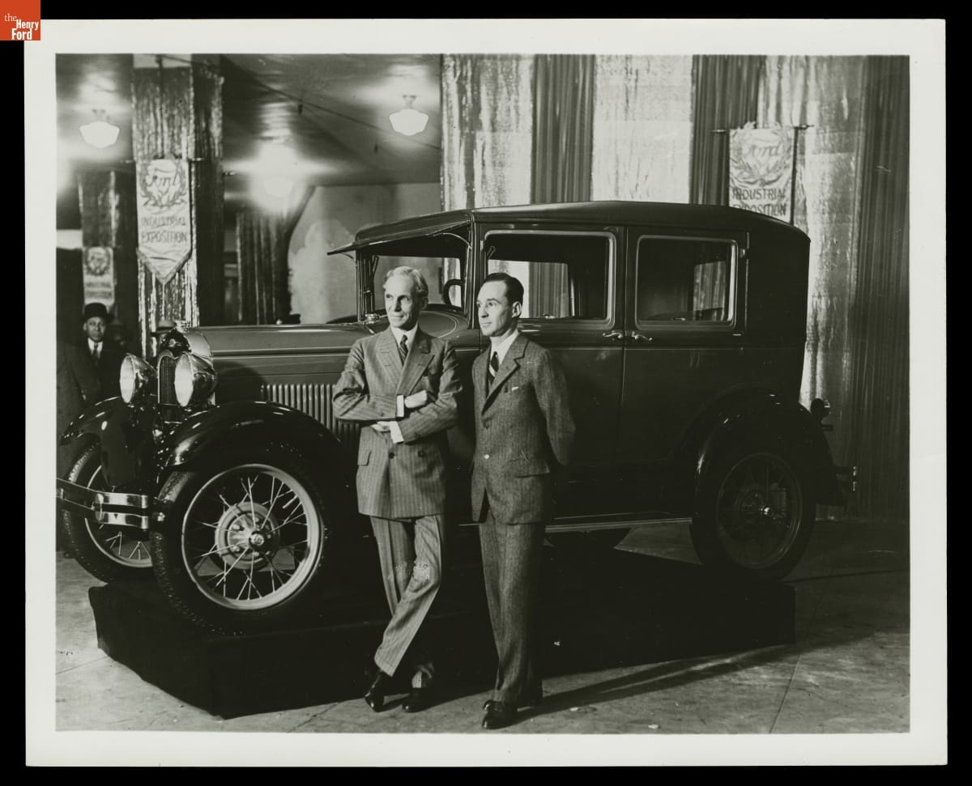
The innovator resisted change
Customer preferences moved beyond the Model T.
Ford delayed a major product replacement.
The Model A arrived in 1927.
Edsel and Henry Ford with a Model A, 1928
Management connection: environmental scanning and resistance to change
[G]
14
Notes:
Slade | Target 75 seconds
CUES: Success / rigidity / environment
Ford's earlier success created a dangerous confidence in the existing formula. Buyers increasingly valued style and comfort. His reluctance to replace the Model T left the company responding late, before the new Model A appeared in 1927.
That is a useful tension for an introduction to management. A person can drive radical innovation in one period and resist it later. Centralized authority can accelerate decisions when the leader understands the problem, then slow adaptation when the leader rejects unwelcome information.
The course's warning about planning reinforcing today's success fits this case. Managers need feedback that can challenge the plan, not simply help execute it faster. The takeaway is not that standardization is bad. It is that a strategy needs to change when the market on which it depends changes.
COURSE CONNECTION: Chapter 5, slide 6, rigidity and the limits of planning. Chapter 6, managing change and innovation.
RESEARCH (accessed October 19, 2026):
[G] Bob Casey, “Henry Ford: Case Study of an Innovator” (2021)
https://www.thehenryford.org/collections/explore/articles/henry-ford-case-study-of-an-innovator
IMAGE CREDIT: Henry Ford and Edsel Ford with Ford Model A Fordor Sedan, New York Industrial Exposition, 1928, THF91597. The Henry Ford, source G.

Slide 15
Labor relations and worker voice
1937: Ford security personnel attacked union organizers at the Battle of the Overpass.
1941: Ford accepted union representation.
High pay did not settle questions of power, dignity, or employee voice.
Management connection: stakeholders and ethical leadership
[I]
15
Notes:
Slade | Target 80 seconds
CUES: No humor / evidence / power
The Battle of the Overpass shows why a pay policy cannot stand in for an evaluation of labor relations. In 1937, Ford security personnel assaulted union organizers distributing material near the Rouge complex. Photographs made the violence visible to a wider public. Ford accepted union representation in 1941.
The ethical issue is not whether higher wages were valuable. Workers could value pay and still seek collective voice over working conditions. Those interests can exist together.
For management, this raises the question of whose concerns leadership hears and how employees can challenge decisions without fear. It also shows how conduct inside an organization can become a public stakeholder problem. Treat this episode seriously. We can evaluate an important operational achievement while also naming the coercion associated with the organization that produced it.
COURSE CONNECTION: Chapters 2–3, stakeholder environment and ethics. Chapter 9, legal environment and employee relations.
RESEARCH (accessed October 19, 2026):
[I] Michigan Supreme Court Learning Center, “Right of Assembly: Battle of the Overpass”
https://www.courts.michigan.gov/49b296/siteassets/msc-learning-center/scrapbook-fordbattleoverpass1937.pdf

Slide 16
Antisemitism and the use of influence
Ford’s newspaper spread antisemitic conspiracy theories beginning in 1920.
The articles circulated internationally as The International Jew.
He issued an apology in 1927. The propaganda’s harm continued.
Management connection: leader accountability and organizational culture
[H] [M]
16
Notes:
Slade | Target 80 seconds
CUES: Clear language / responsibility / no equivalence
Ford used the Dearborn Independent to circulate false claims about Jewish people. Collections of those articles reached audiences abroad. The Holocaust Museum documents admiration for Ford among Nazi leaders, including Hitler. Ford later issued a public apology in 1927, but the material continued circulating.
This matters to a management presentation because wealth, reputation, and distribution networks gave his prejudice organizational reach. It was more than a private opinion. The conduct also faced criticism in his own time, so we should not dismiss it as simply normal for the era.
There is no need to reproduce the propaganda to explain its harm. Innovation does not cancel responsibility for spreading hatred. A balanced evaluation means including the evidence necessary to understand the person and his influence, not giving ethical abuses a numerical offset against production gains.
COURSE CONNECTION: Chapter 3, slides 20–24, ethics and ethical leadership. Chapter 2, founder influence on culture.
RESEARCH (accessed October 19, 2026):
[H] U.S. Holocaust Memorial Museum, “Antisemitism and Henry Ford’s ‘The International Jew’”
https://encyclopedia.ushmm.org/content/en/article/antisemitism-and-henry-fords-international-jew
[M] The Henry Ford, “Henry Ford and Anti-Semitism”
https://www.thehenryford.org/collections/explore/popular-research-topics/henry-ford-and-anti-semitism

Slide 17
A balanced evaluation of Ford
Contributions
Limits and failures
Affordable mass production
A coordinated operating system
Compensation as a staffing decision
Intrusive employee oversight
Resistance to product change
Labor coercion and antisemitism
Management connection: efficiency, effectiveness, and ethical responsibility
[C] [D] [E] [G] [H] [I]
17
Notes:
Slade | Target 70 seconds
CUES: Separate achievements / ethical judgment / handoff
These are different dimensions of evaluation. A production method can be effective at reducing assembly time while leadership fails ethically. We do not have to choose between pretending Ford contributed nothing and treating his contribution as permission to ignore his conduct.
The course asks us to understand management theory and practice. Ford helps explain both the power of designing an organization around a clear goal and the risk of letting the founder define every boundary.
For a manager today, a reasonable evaluation would examine output, quality, employee experience, and consequences for other stakeholders. A single attractive measure cannot capture the whole organization. Andy will now connect those lessons to familiar workplaces and close with what managers can use from this case.
COURSE CONNECTION: Chapter 1 and Chapter 3, effectiveness and ethical conduct.
RESEARCH (accessed October 19, 2026):
[C] Ford Motor Company, “The Model T” (2020)
https://corporate.ford.com/articles/history/the-model-t/
[D] Matt Anderson, “Ford’s Five-Dollar Day,” The Henry Ford (2014)
https://www.thehenryford.org/collections/explore/articles/fords-five-dollar-day
[E] The Henry Ford, “Henry Ford: Sociological Department”
https://www.thehenryford.org/collections/explore/sets/detail/henry-ford-sociological-department
[G] Bob Casey, “Henry Ford: Case Study of an Innovator” (2021)
https://www.thehenryford.org/collections/explore/articles/henry-ford-case-study-of-an-innovator
[H] U.S. Holocaust Memorial Museum, “Antisemitism and Henry Ford’s ‘The International Jew’”
https://encyclopedia.ushmm.org/content/en/article/antisemitism-and-henry-fords-international-jew
[I] Michigan Supreme Court Learning Center, “Right of Assembly: Battle of the Overpass”
https://www.courts.michigan.gov/49b296/siteassets/msc-learning-center/scrapbook-fordbattleoverpass1937.pdf

Slide 18
Where we still see related ideas
Manufacturing
Services and logistics
Repeated work and coordinated material flow remain central.
Toyota adds pull production and built-in quality.
A kitchen divides work into stations.
A fulfillment operation standardizes picking and packing.
Management connection: organizational design and continuous improvement
[G] [J]
18
Notes:
Andy | Target 70 seconds
CUES: Historical influence / analogies / evolution
Ford's production methods spread across manufacturing. Modern factories still coordinate specialized work and material movement, but they have evolved substantially. Toyota describes its system around just-in-time production and jidoka, which means detecting problems and stopping to prevent defects from continuing.
The service examples are comparisons, not a claim that Ford directly invented modern kitchens or warehouses. A kitchen's stations and a fulfillment operation's standard procedures make the same general questions easy to see: how should work flow, how much should a job repeat, and who can improve the process?
The modern lesson is selective adaptation. Stable, repeatable work can benefit from standards. Changing demand and complex problems also require feedback and employee judgment. Ford gives us a useful starting point for those questions, not a complete operating manual.
COURSE CONNECTION: Chapter 8, job design. Chapter 6, innovation. Service and logistics examples are contemporary analytical comparisons.
RESEARCH (accessed October 19, 2026):
[G] Bob Casey, “Henry Ford: Case Study of an Innovator” (2021)
https://www.thehenryford.org/collections/explore/articles/henry-ford-case-study-of-an-innovator
[J] Toyota Motor Corporation, “Toyota Production System”
https://global.toyota/en/company/plant-tours/production-system/

Slide 19
One company, four management functions
Planning: a broad market and an affordable product
Organizing: specialized jobs and coordinated production
Leading: incentives, founder influence, and employee voice
Controlling: production measures and the boundaries of oversight
Management connection: planning, organizing, leading, and controlling
19
Notes:
Andy | Target 80 seconds
CUES: Apply the course / distinguish metrics / whole system
Here is the case in the course's four-function framework. Planning links the desired market to product and cost choices. Organizing assigns work and coordinates resources. Leading concerns the people carrying out the plan. Controlling compares performance with expectations and responds to gaps.
Ford shows that these functions interact. The production plan created a need for staffing stability. Compensation addressed part of that need. Yet intrusive oversight and coercion damaged the relationship with employees.
If we were advising a manager facing a similar problem, we would ask for more than an output target. We would ask how often employees leave, whether quality improves, what customers want, and whether people can report problems. That is how the historical case becomes a way to think through a present management decision rather than a list of vocabulary words.
COURSE CONNECTION: Chapter 1, slide 19, four management functions. Chapters 4–6, 8–9 support these applications.

Slide 20
What Ford changed about management
Production became a coordinated system designed for scale.
Pay and job design affected whether that system could work.
Effective management also requires adaptation and ethical limits.
[B] [D] [G] [H]
20
Notes:
Andy | Target 60 seconds
CUES: Thesis / consequences / invite Q&A
Ford's durable contribution was the integration of decisions that managers sometimes treat separately. The product affected the process. The process affected jobs. Jobs affected staffing, and staffing affected output. At enormous scale, those connections changed industrial practice.
The same case shows why efficiency alone cannot define good management. An organization also has to adapt to customers and treat people responsibly. Ford could see a different future for production while failing to see the limits of his own authority and beliefs.
Our conclusion is that his methods deserve study and his conduct deserves judgment. Managers can learn from both. Thank you. We are ready for questions about the assembly line, employment policies, influences, or the legacy of his approach.
RESEARCH (accessed October 19, 2026):
[B] Library of Congress, “Ford Implements the Moving Assembly Line”
https://guides.loc.gov/this-month-in-business-history/october/ford
[D] Matt Anderson, “Ford’s Five-Dollar Day,” The Henry Ford (2014)
https://www.thehenryford.org/collections/explore/articles/fords-five-dollar-day
[G] Bob Casey, “Henry Ford: Case Study of an Innovator” (2021)
https://www.thehenryford.org/collections/explore/articles/henry-ford-case-study-of-an-innovator
[H] U.S. Holocaust Memorial Museum, “Antisemitism and Henry Ford’s ‘The International Jew’”
https://encyclopedia.ushmm.org/content/en/article/antisemitism-and-henry-fords-international-jew

Slide 21
Questions and discussion
Where should control end?
Which Ford practice would you keep?
Which would you change first, and why?
[B] [D] [H]
21
Notes:
Andy and Slade
CUES: Andy: production/strategy. Slade: HR/ethics. Both: legacy.
Q&A follows the approximately 23½-minute presentation and is not counted toward its target.
Likely questions and concise answers:
Did Ford invent the assembly line? Earlier methods existed. Ford and his team developed and scaled moving automobile assembly.
Why pay more for repetitive work? Compensation can help attract and retain workers, although it does not replace humane job design.
Was the $5 day universal? The initial plan included conditional profit sharing, so avoid describing it as an unconditional wage for everyone.
Did workers get a five-day week in 1914? Do not conflate the eight-hour day associated with the wage program with Ford's later five-day workweek.
Did Taylor personally teach Ford? The ideas overlap, but we have not established that direct relationship.
Why study a leader who spread antisemitism? To understand real influence and evaluate it responsibly, including its harms.
If uncertain, say what the sources establish and what they do not. Do not guess.
RESEARCH (accessed October 19, 2026):
[B] Library of Congress, “Ford Implements the Moving Assembly Line”
https://guides.loc.gov/this-month-in-business-history/october/ford
[D] Matt Anderson, “Ford’s Five-Dollar Day,” The Henry Ford (2014)
https://www.thehenryford.org/collections/explore/articles/fords-five-dollar-day
[H] U.S. Holocaust Memorial Museum, “Antisemitism and Henry Ford’s ‘The International Jew’”
https://encyclopedia.ushmm.org/content/en/article/antisemitism-and-henry-fords-international-jew

Slide 22
References: production and strategy
[A] The Henry Ford, “Henry Ford” biography and interview transcript
https://www.thehenryford.org/collections/explore/videos/henry-ford
[B] Library of Congress, “Ford Implements the Moving Assembly Line”
https://guides.loc.gov/this-month-in-business-history/october/ford
[C] Ford Motor Company, “The Model T” (2020)
https://corporate.ford.com/articles/history/the-model-t/
[F] The Henry Ford, “Ford Rouge Factory” research guide
https://askus.thehenryford.org/K12/faq/405833
[G] Bob Casey, “Henry Ford: Case Study of an Innovator” (2021)
https://www.thehenryford.org/collections/explore/articles/henry-ford-case-study-of-an-innovator
[L] The Henry Ford, authenticated Henry Ford quotations, Edison recollections
https://www.thehenryford.org/collections/explore/popular-research-topics/henry-ford-quotations
All websites accessed October 19, 2026. Full citations also appear in the relevant slide notes.
Notes:
[A] The Henry Ford, “Henry Ford” biography and interview transcript
https://www.thehenryford.org/collections/explore/videos/henry-ford
[B] Library of Congress, “Ford Implements the Moving Assembly Line”
https://guides.loc.gov/this-month-in-business-history/october/ford
[C] Ford Motor Company, “The Model T” (2020)
https://corporate.ford.com/articles/history/the-model-t/
[F] The Henry Ford, “Ford Rouge Factory” research guide
https://askus.thehenryford.org/K12/faq/405833
[G] Bob Casey, “Henry Ford: Case Study of an Innovator” (2021)
https://www.thehenryford.org/collections/explore/articles/henry-ford-case-study-of-an-innovator
[L] The Henry Ford, authenticated Henry Ford quotations, Edison recollections
https://www.thehenryford.org/collections/explore/popular-research-topics/henry-ford-quotations

Slide 23
References: employees and legacy
[D] Matt Anderson, “Ford’s Five-Dollar Day,” The Henry Ford (2014)
https://www.thehenryford.org/collections/explore/articles/fords-five-dollar-day
[E] The Henry Ford, “Henry Ford: Sociological Department”
https://www.thehenryford.org/collections/explore/sets/detail/henry-ford-sociological-department
[H] U.S. Holocaust Memorial Museum, “Antisemitism and Henry Ford’s ‘The International Jew’”
https://encyclopedia.ushmm.org/content/en/article/antisemitism-and-henry-fords-international-jew
[I] Michigan Supreme Court Learning Center, “Right of Assembly: Battle of the Overpass”
https://www.courts.michigan.gov/49b296/siteassets/msc-learning-center/scrapbook-fordbattleoverpass1937.pdf
[J] Toyota Motor Corporation, “Toyota Production System”
https://global.toyota/en/company/plant-tours/production-system/
[M] The Henry Ford, “Henry Ford and Anti-Semitism”
https://www.thehenryford.org/collections/explore/popular-research-topics/henry-ford-and-anti-semitism
All websites accessed October 19, 2026. Full citations also appear in the relevant slide notes.
Notes:
[D] Matt Anderson, “Ford’s Five-Dollar Day,” The Henry Ford (2014)
https://www.thehenryford.org/collections/explore/articles/fords-five-dollar-day
[E] The Henry Ford, “Henry Ford: Sociological Department”
https://www.thehenryford.org/collections/explore/sets/detail/henry-ford-sociological-department
[H] U.S. Holocaust Memorial Museum, “Antisemitism and Henry Ford’s ‘The International Jew’”
https://encyclopedia.ushmm.org/content/en/article/antisemitism-and-henry-fords-international-jew
[I] Michigan Supreme Court Learning Center, “Right of Assembly: Battle of the Overpass”
https://www.courts.michigan.gov/49b296/siteassets/msc-learning-center/scrapbook-fordbattleoverpass1937.pdf
[J] Toyota Motor Corporation, “Toyota Production System”
https://global.toyota/en/company/plant-tours/production-system/
[M] The Henry Ford, “Henry Ford and Anti-Semitism”
https://www.thehenryford.org/collections/explore/popular-research-topics/henry-ford-and-anti-semitism

Slide 24
Course materials and visual credits
Fundamentals of Management, 11th ed.
Uploaded Pearson chapter slides 1–6, 8, and 9 (2020)
History Module-1.pdf
Uploaded Prentice Hall management-history module (2005)
The Henry Ford digital collections
Historical photographs and documents identified in slide notes
[K]
24
Notes:
Andy / Slade
CUES: Course materials and visual credits
COURSE MATERIALS USED:
Chapter 1: management, efficiency/effectiveness, four functions (slides 10–11, 19).
Chapter 2: stakeholders and organizational culture, including founder influence (slide 21).
Chapter 3: ethical approaches and leadership (slides 20–24).
Chapter 4: identifying problems and evaluating management decisions.
Chapter 5: strategy, planning rigidity, competitive strategies, vertical integration (slides 6, 9, 16, 19–20).
Chapter 6: change and innovation (slide 24 and related sections).
Chapter 8: structure, specialization, centralization, formalization (slides 4–5, 14–15).
Chapter 9: HRM, retention, compensation (slides 5, 20, 25–28).
History Module-1.pdf: Adam Smith, Taylor, systems and contingency approaches.
Visuals: slide 1 THF97952; slide 3 THF135450; slide 5 THF94827; slide 10 THF94994; slide 11 THF204872; slide 14 THF91597. All The Henry Ford. Each image's original title and source appear in that slide's notes.
Rubric supplied by the user: 20–25 minutes plus Q&A, management contributions, influences, contemporary evidence, professional visual aids, research and information submission. The course name follows the user's correction to MGT 210, Section T01.
RESEARCH (accessed October 19, 2026):
[K] The Henry Ford, “Our Most-Viewed Digitized Artifacts of All Time”
https://www.thehenryford.org/collections/explore/sets/detail/our-most-viewed-digitized-artifacts-of-all-time

