Slide 1
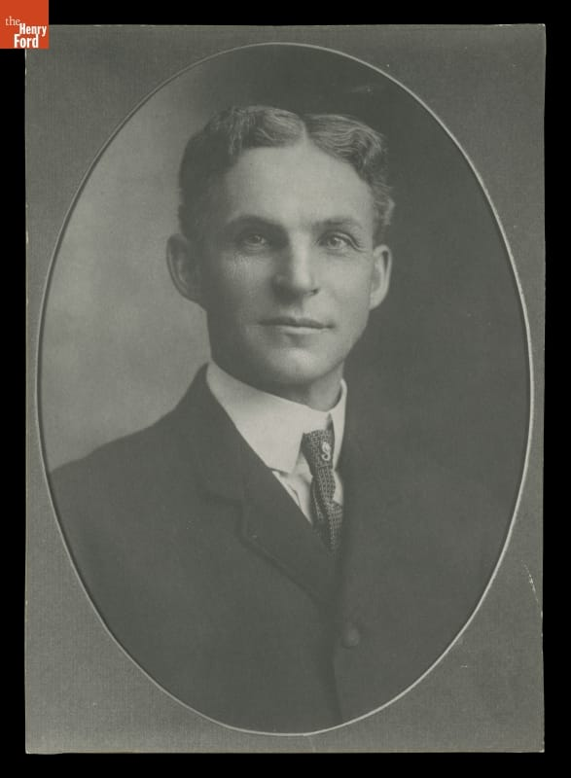
Henry Ford
Mass production, people, and the limits of control
Andy Johnson & Slade McClain
MGT 210, Section T01
[A] [G]
01
Notes:
RUN OF SHOW 0:00–0:30 (30 sec)
Andy | Target 30 seconds
CUES: Cars / system / central question
Most of us connect Henry Ford with cars and assembly lines. Today we are going to look at the management behind them. Ford did not invent the automobile. His company helped make an expensive product practical for a mass market by changing how work happened.
Our argument is that his greatest contribution was an integrated system. Product design, factory organization, employee pay, and supply decisions reinforced one another. But that system also created human problems, and Ford made serious ethical failures. Our question is: what happens when efficiency becomes the organizing idea of an entire company?
RESEARCH (accessed October 19, 2026):
[A] The Henry Ford, “Henry Ford” biography and interview transcript
https://www.thehenryford.org/collections/explore/videos/henry-ford
[G] Bob Casey, “Henry Ford: Case Study of an Innovator” (2021)
https://www.thehenryford.org/collections/explore/articles/henry-ford-case-study-of-an-innovator
IMAGE CREDIT: First official Ford Motor Company portrait, 1904, THF97952. The Henry Ford, image reproduced from source G.
REHEARSAL PLAN
Timed presentation: 21 minutes 25 seconds including the 3-minute activity and 1-minute debrief. Q&A follows separately. Andy introduces the production system and facilitates the activity. Andy covers women’s factory work and management restrictions before handing off to Slade for staffing, pay, and labor relations. Andy leads the final course synthesis. Agree who handles the antisemitism section before class. Practice to these cues rather than reading the full research notes. Reference slides are submission material and need not be read aloud. Keep eye contact during the opening question and the vote. If ahead of time, use one additional team explanation and the ethics comparison, without shortening the substantive content below 20 minutes. If behind, limit team reports to two and keep Q&A after the timed conclusion.

Slide 2
The management question
How do you make a complicated product affordable to millions?
Ford connected the product, the production process, and the people doing the work.
Efficiency: fewer resources per car
Effectiveness: cars buyers want and workers can sustain
Management connection: efficiency and effectiveness
02
Notes:
RUN OF SHOW 0:30–1:15 (45 sec)
Andy | Target 45 seconds
CUES: Problem / linked decisions / evaluate
Chapter 1 defines management around getting results through people. Efficiency asks how economically we use resources. Effectiveness asks whether we achieve the right goals. They are related, but they are not identical.
Imagine a factory building the wrong product twice as fast. It has improved one measure while making its larger business problem worse. Keep that distinction in mind as we follow Ford.
We will first explain his background and influences, then the production system, then the employment decisions it required. Finally, we will examine its limitations and where we see related ideas today. The goal is to evaluate management choices, rather than simply collect interesting facts about an automobile executive.
COURSE CONNECTION: Chapter 1, slides 10–11, management and efficiency/effectiveness. History Module, systems approach.

Slide 3
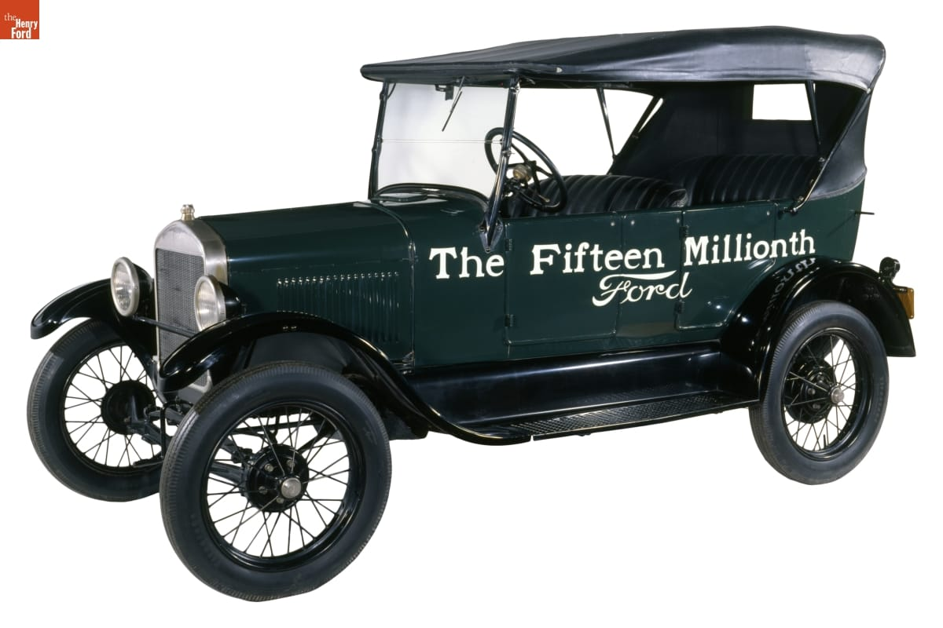
The mechanic behind the manager
1863–1947
Raised on a Michigan farm
1903
Ford Motor Company founded
1908
Model T introduced
The fifteen-millionth Ford, a 1927 Model T
[A] [C]
03
Notes:
RUN OF SHOW 1:15–1:50 (35 sec)
Andy | Target 35 seconds
CUES: Machinery / experience / broad market
Ford grew up around farm work but pursued machinery. Before the successful company, he worked as an engineer and experimented with gasoline vehicles. His career included failed automobile ventures, which matters because the familiar success story can make his outcome look inevitable.
The company founded in 1903 and the Model T introduced in 1908 were parts of a longer learning process. The Model T aimed at durability, simple operation, and affordability.
Think about the connection between a customer's needs and a manager's choices. A car designed for a broad market needs a different business system from a luxury car assembled in small numbers. Ford's background helps explain his practical approach, but the business depended on a team as well as its founder.
RESEARCH (accessed October 19, 2026):
[A] The Henry Ford, “Henry Ford” biography and interview transcript
https://www.thehenryford.org/collections/explore/videos/henry-ford
[C] Ford Motor Company, “The Model T” (2020)
https://corporate.ford.com/articles/history/the-model-t/
IMAGE CREDIT: 1927 Model T Touring Car, THF135450, The Henry Ford. Source K; collections-media.thehenryford.org/CollectionImages/_detail/photos/thf135450.jpg

Slide 4
Ford’s influences and collaborators
Direct influences
Management context
Edison encouraged Ford’s automotive work.
Meatpacking suggested moving work past fixed stations.
Smith: division of labor
Taylor: measured, standardized tasks
Ford’s team integrated these principles at scale.
Management connection: division of labor and scientific management
[L] [K]
04
Notes:
RUN OF SHOW 1:50–2:45 (55 sec)
Andy | Target 55 seconds
CUES: Edison / borrowing / team credit
Edison was a personal encouragement to Ford. That is different from saying Edison designed Ford's factories. The production methods also drew on earlier industrial practices. The museum documents Ford engineers adapting the moving disassembly principle used in meatpacking.
The course history module takes division of labor back to Adam Smith and describes Taylor's search for a scientifically defined method of doing each job. Ford operated in that wider efficiency movement. That is a conceptual relationship, not proof that Taylor personally taught Ford his system.
Ford's engineers and managers deserve credit for implementation. Management innovation often means recognizing useful ideas elsewhere and coordinating people to make them work at scale. The genius-in-a-garage version leaves out a lot of the actual management.
COURSE CONNECTION: History Module, Adam Smith and scientific management sections. Chapter 6, slide 24, creativity and innovation.
RESEARCH (accessed October 19, 2026):
[L] The Henry Ford, authenticated Henry Ford quotations, Edison recollections
https://www.thehenryford.org/collections/explore/popular-research-topics/henry-ford-quotations
[K] The Henry Ford, “Our Most-Viewed Digitized Artifacts of All Time”
https://www.thehenryford.org/collections/explore/sets/detail/our-most-viewed-digitized-artifacts-of-all-time
DISCUSSION DEPTH
Name the collaborators rather than crediting a lone inventor. Ford’s breakthrough was coordinating existing ideas and experimentation. Treat the Taylor connection as a comparison of management principles, not a documented personal mentorship.

Slide 5
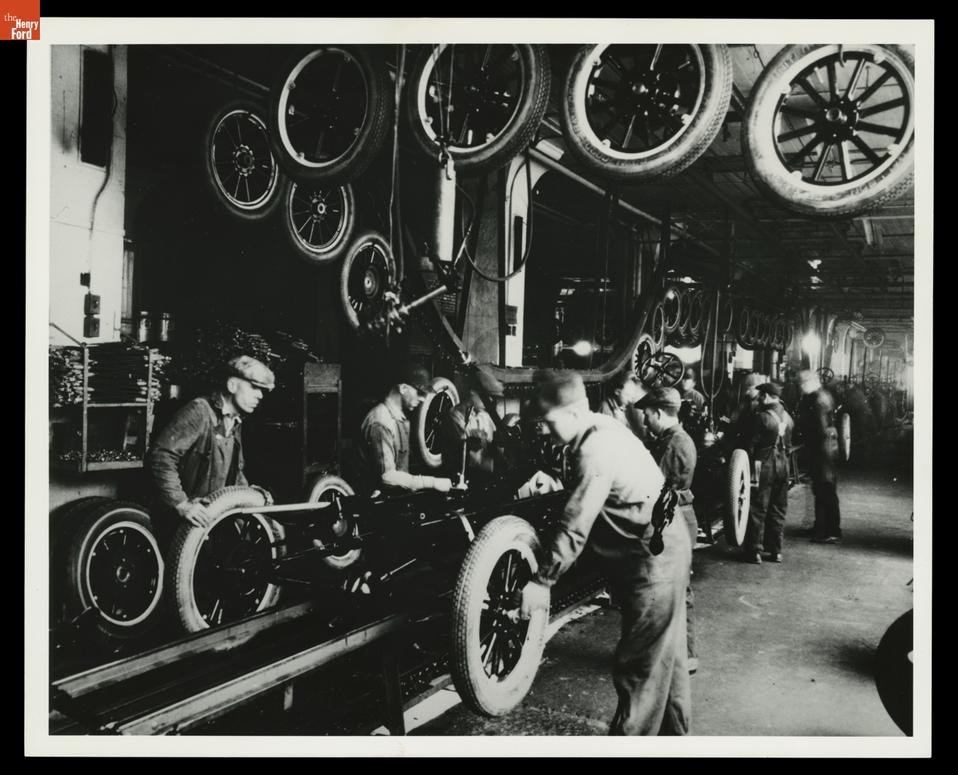
The production system
Interchangeable parts reduced fitting, rework, and dependence on craft skill.
Narrow jobs shortened training but reduced worker autonomy.
A moving chassis coordinated task order and imposed a common pace.
Tire installation at Highland Park, circa 1925
Management connection: work specialization and formalization
[B] [K]
05
Notes:
RUN OF SHOW 2:45–3:40 (55 sec)
Andy | Target 55 seconds
CUES: Parts / jobs / movement / dependence
Look at how the workers and materials are arranged. The sequence of tasks matters as much as any individual machine. Standard parts reduce the need to custom fit a component. Specialized jobs make the work easier to repeat and train. Bringing the chassis past workers reduces travel around the factory.
Chapter 8 calls dividing work into specific tasks work specialization. Formalization concerns how much rules and procedures guide a job. Ford's production system used both heavily.
The tradeoff is dependence between stations. A problem at one point can interrupt work elsewhere. A well-designed line therefore needs reliable parts and dependable staffing. This is why we should study the whole system instead of giving all the credit to a conveyor belt. The belt cannot solve a missing-parts problem by moving more enthusiastically.
COURSE CONNECTION: Chapter 8, slides 4–5 and 15, specialization and formalization.
RESEARCH (accessed October 19, 2026):
[B] Library of Congress, “Ford Implements the Moving Assembly Line”
https://guides.loc.gov/this-month-in-business-history/october/ford
[K] The Henry Ford, “Our Most-Viewed Digitized Artifacts of All Time”
https://www.thehenryford.org/collections/explore/sets/detail/our-most-viewed-digitized-artifacts-of-all-time
IMAGE CREDIT: Workers Installing Tires on Ford Model T Assembly Line, circa 1925, THF94827. The Henry Ford, source K.

Slide 6
Class activity: the factory decision
Teams of 3: operations, worker, finance. One worker per station.
Frame / wheels / engine / inspection: 10 / 20 / 10 / 10 sec.
Choose one: A) frame time falls to 5 sec
B) wheels gets a second worker
C) higher pay aims to reduce quitting
Report: bottleneck, units/minute, and one worker concern.
Then respond: one wheels worker quits. Does your choice hold?
Hypothetical case. 3 minutes: discuss, staffing shock, vote, and compare.
06
Notes:
RUN OF SHOW 3:40–6:40 (180 sec)
Andy facilitates, Slade times and calls on teams | 180 seconds
CUES: Roles / capacity / worker leaves / vote
Before class: no handouts or props required. Ask students to work in neighboring groups of three. A pair can combine worker and finance roles. Students may write their answer on paper or a phone. Announce that all numbers are invented for the exercise, not Ford production records. Assume enough material, no defects, no transfer delays, and steady-state production after startup.
0:00–0:20 Explain roles and the three choices. Operations argues for output, the worker for sustainable work, finance for total cost. Ask for a calculation and a reason everyone can accept.
0:20–1:00 Teams discuss. Ask the worker to speak before the manager chooses.
1:00–1:30 Announce the shock: one wheels worker quits. Under A or C, the station has no worker until reassignment or replacement. Under B, one remains. C promises no guaranteed retention result. Teams revise their decision and name the missing evidence they would want.
1:30–2:30 Show-of-hands vote for A, B, or C. Call on two teams with different answers. Each has twenty seconds to give capacity, worker concern, and response to the shock.
2:30–3:00 Compare assumptions. A speeds the wrong station. B adds capacity and coverage, but adds cost. C may improve staffing stability but leaves the physical bottleneck unchanged. Ask: what would convince you that higher wages pay for themselves?
Advance to the answer slide after the reports, not during discussion.
COURSE: Ch. 1 efficiency, Ch. 4 problem definition/group decisions, Ch. 8 specialization, Ch. 9 retention. Exercise created for this class.

Slide 7
Activity debrief: capacity and retention
Baseline: wheels limits steady-state output to 3 units/min.
A) faster frames still yields 3 units/min.
B) parallel wheels workers can support 6 units/min.
After one quits, capacity returns to 3 units/min.
C) higher pay may reduce quitting. It does not raise the 3-unit physical limit.
A decision needs evidence on cost, retention, quality, and workload.
Ch. 4: evaluate alternatives. Ch. 9: assess retention rather than assume it.
Classroom model. All values and policy choices are hypothetical.
07
Notes:
RUN OF SHOW 6:40–7:40 (60 sec)
Andy | 60 seconds
CUES: 60/20 / parallel capacity / evidence
The original line can finish one unit every twenty seconds after startup, or three per minute. Total time through the stations is fifty seconds, which is different from the steady-state completion interval. Speeding frames alone produces waiting work.
With two equivalent wheels stations operating in parallel, each worker handles three units per minute, for six combined. The other stations can each handle six, so the line can sustain six under our ideal assumptions. After one wheels worker leaves, output falls to three. No staffing arrangement guarantees this output in real operations.
A higher wage changes a possible cause of staffing instability, not a machine or task time. We cannot calculate its financial return without the wage cost and an estimate of the reduction in quitting, training costs, and disruption. A strong team can defend B for capacity and resilience or C for retention, if it identifies the evidence needed. Give credit for reasoning rather than only a letter choice.
This exercise models a tension in Ford's history without pretending to reproduce it. The next slides return to documented evidence.
COURSE: Chapter 4 decision criteria and evaluation, Chapter 8 job design, Chapter 9 compensation and retention.

Slide 8
Assembly time fell dramatically
12½ hours 93 minutes
Approximate Model T chassis assembly time
After the moving-line experiments of 1913–1914
About 88% less elapsed assembly time
93 minutes is assembly duration, not the gap between completed vehicles
[B] [D]
08
Notes:
RUN OF SHOW 7:40–8:25 (45 sec)
Andy | Target 45 seconds
CUES: Same measure / calculation / throughput distinction
These are commonly reported figures for the reduction in assembly time as Ford refined the line. Converting twelve and a half hours to seven hundred fifty minutes lets us compare the same units. The decrease to ninety-three minutes is roughly eighty-eight percent.
Be careful about what that number means. Several chassis can be on the line at once. Ninety-three minutes does not mean the factory finished only one vehicle every ninety-three minutes. The interval between completions is a separate throughput measure. It also is not a measure of every upstream operation needed to make an automobile.
For a manager, the important question is which metric the process improves and which costs remain elsewhere. Use the numbers as evidence of a major process change without turning them into a claim they cannot support.
RESEARCH (accessed October 19, 2026):
[B] Library of Congress, “Ford Implements the Moving Assembly Line”
https://guides.loc.gov/this-month-in-business-history/october/ford
[D] Matt Anderson, “Ford’s Five-Dollar Day,” The Henry Ford (2014)
https://www.thehenryford.org/collections/explore/articles/fords-five-dollar-day
DISCUSSION DEPTH
Calculation: (750 − 93) / 750 = 87.6%, rounded to about 88%. These figures concern approximate chassis assembly duration across experiments, not total labor content or the interval between finished cars. Greater output also depended on materials, capacity, and sales.

Slide 9
Efficiency expanded the market
$850 as low as $260
Model T prices over its production life, in nominal dollars
More than 15 million Model Ts built and sold
A broad market supported a strategy built around low cost.
Management connection: competitive strategy and cost leadership
[C]
09
Notes:
RUN OF SHOW 8:25–9:05 (40 sec)
Andy | Target 40 seconds
CUES: Price range / volume / strategy
Ford reports a Model T price range from eight hundred fifty dollars down to as little as two hundred sixty dollars, and more than fifteen million built and sold. These are nominal prices from different years and configurations, not an inflation-adjusted comparison of identical vehicles.
The broader pattern fits a cost-leadership interpretation. A standardized offering and high production volume helped Ford compete through low cost for a broad market. That is our application of Chapter 5, not a claim Ford used today's textbook label.
We should also avoid saying the assembly line alone caused the price decline. Product changes, purchasing, factory learning, and other decisions mattered. The strategic lesson is that operations can change what customers can afford, which can in turn change the size of a market.
COURSE CONNECTION: Chapter 5, strategic management and competitive strategies, slides 9 and 19.
RESEARCH (accessed October 19, 2026):
[C] Ford Motor Company, “The Model T” (2020)
https://corporate.ford.com/articles/history/the-model-t/
DISCUSSION DEPTH
Cost leadership is our application of Chapter 5 terminology to the historical case. A low selling price is not itself proof of low unit cost. Explain how standardization and volume could support both, and why sales demand matters. Model T prices varied by body style and year, so $850 and $260 are illustrative endpoints rather than identical configurations.

Slide 10
Fordism as a management system
Reinforcing decisions
The system depends on people
A standard product simplifies repeated tasks.
High sales volume spreads factory costs across more units.
Lower costs can support lower prices and wider demand.
Turnover interrupts the flow. Changing tastes challenge standardization.
Management connection: systems thinking and organizational design
10
Notes:
RUN OF SHOW 9:05–9:50 (45 sec)
Andy | Target 45 seconds
CUES: Connections / assumptions / handoff
Fordism is a useful label for the connection between standardized mass production and a mass market. For this presentation, treat it as an analytical summary rather than a claim that every part appeared at once.
The decisions reinforce each other. A wider product range would make the production system more complicated. A highly standardized product makes repeated tasks easier. High volume can spread equipment and facility costs across more units, but only if customers buy the output.
The model depends on its assumptions. It works less well when buyers want more variety or when the people operating it will not stay. Systems thinking means following those relationships. Before Slade explains turnover and pay, Andy will look at women entering this factory system and how company rules shaped their work.
COURSE CONNECTION: History Module, systems approach. Chapters 5 and 8, strategy and organizational structure.
DISCUSSION DEPTH
Use a failure example: a cheaper process creates little value if customers reject the product or the workforce cannot sustain output. The systems view connects the production gains to retention and later resistance to change.

Slide 11
Women entering Ford’s factory system
By circa 1913: women made magneto components at Highland Park.
They worked in Ford factories long before World War II.
Factory life meant specialized, repeatable production tasks.
Management assigned the work and controlled access to pay.
1914: conditional profit sharing; some women could qualify.
1916: the $5 daily minimum extended more broadly to women.
Andy • Ch. 8: job design. Ch. 9: compensation and access to work.
[O] [P] [Q]
11
Notes:
RUN OF SHOW 9:50–10:55 (65 sec)
Andy | 65 seconds
CUES: Factory evidence / conditional pay / broader minimum
Ford did not introduce women to factory work generally. For this company, The Henry Ford's circa-1913 photograph documents women in the coil-manufacturing department winding wire around iron cores and boxing magneto parts. This is specific evidence of factory work, not proof that women had access to every production occupation.
The pay structure requires care. In chapter VIII of his 1922 account, Ford describes ordinary wages plus a conditional share of profits for workers with at least six months' service. One eligible category included women who were the sole support of relatives. Therefore, saying that all women were excluded until 1916 would be too absolute. Conversely, the 1914 headline does not show that every female worker immediately received five dollars.
An October 26, 1916 New York Times editorial discusses Ford's announcement that women as well as men would have a minimum of five dollars a day. This supports the broader extension in 1916. It does not provide a complete wage schedule for every job or prove equal lifetime earnings. Distinguish minimum compensation from occupational access and advancement.
[O] The Henry Ford, Women Workers Assembling Magnetos at the Highland Park Plant, circa 1913, THF99642, object 84.1.1660.P.833.158. https://www.thehenryford.org/collections/explore/artifact/4461
[P] Henry Ford with Samuel Crowther, My Life and Work (1922), chapter VIII, Wages. A retrospective primary account that presents Ford's own justification. https://www.gutenberg.org/cache/epub/7213/pg7213-images.html
[Q] The New York Times, October 26, 1916, editorial For Every Woman, $5 a Day, digitized by the Library of Congress. https://tile.loc.gov/storage-services/service/sgp/sgpbatches/batch_dlc_1zubrowka_ver01/data/2004540423/print00192511057/1916102201/0129.pdf
Accessed October 19, 2026.
DELIVERY: Explain what factory life involved: assigned, repeatable component work within a standardized system. The photograph documents the task, not a complete account of women’s experiences. Do not invent a special women-only training program or suggest that all women held assembly-line jobs.

Slide 12
How Ford managed women’s employment
Standardized jobs organized factory work.
Company rules also made family status relevant to employment.
Ford reported dismissing 82 women in 1919 because their husbands worked.
His policy favored the male-breadwinner household.
World War II later widened women’s roles at Willow Run.
Higher pay and more factory jobs did not establish equal opportunity.
Andy • Management lesson: pay, job access, and fair treatment all matter.
[P] [R] [E]
12
Notes:
RUN OF SHOW 10:55–12:00 (65 sec)
Andy | 65 seconds
CUES: Job design / family status / later wartime expansion
Women did industrial work inside the same broader system of task specialization and managerial discipline. Beyond the shop floor, eligibility rules and company assessments of household circumstances made family status relevant to employment and compensation. The Sociological Department's visits extended managerial influence into workers' homes. This was paternalism, meaning that the employer claimed authority to direct private conduct for workers' supposed benefit.
Ford's own chapter VII states that eighty-two women were discharged in 1919 because their husbands worked, and describes a policy of not employing married women with employed husbands. Cite this as Ford's reported figure and policy for that period, not an independently audited count or a rule for every Ford plant throughout its history. His account is especially useful evidence of the assumptions management publicly defended. A higher minimum wage could coexist with exclusion from employment.
For a brief contrast, The Henry Ford's Rosie the Riveter guide describes women as approximately one-third of Willow Run's wartime workforce, including riveting and welding roles. Labor shortages and recruitment widened access. This is a later wartime development, not evidence of broad equality in 1914.
Ask rhetorically: can a pay policy be generous while the hiring system is unfair? Under the course's justice and rights approaches, the answer can be yes.
[P] Ford and Crowther, My Life and Work (1922), chapters VII and VIII. https://www.gutenberg.org/cache/epub/7213/pg7213-images.html
[R] The Henry Ford, K-12 Research Guide: Rosie the Riveter. https://askus.thehenryford.org/K12/faq/429559
[E] The Henry Ford, Ford Motor Company Sociological Department & English School. https://www.thehenryford.org/collections/explore/popular-research-topics/ford-motor-company-sociological-department-english-school
Accessed October 19, 2026.
HANDOFF TO SLADE: “Ford’s rules shaped who could work and who qualified for pay. Slade will now explain why the company struggled to keep workers—and what the five-dollar day actually changed.”

Slide 13
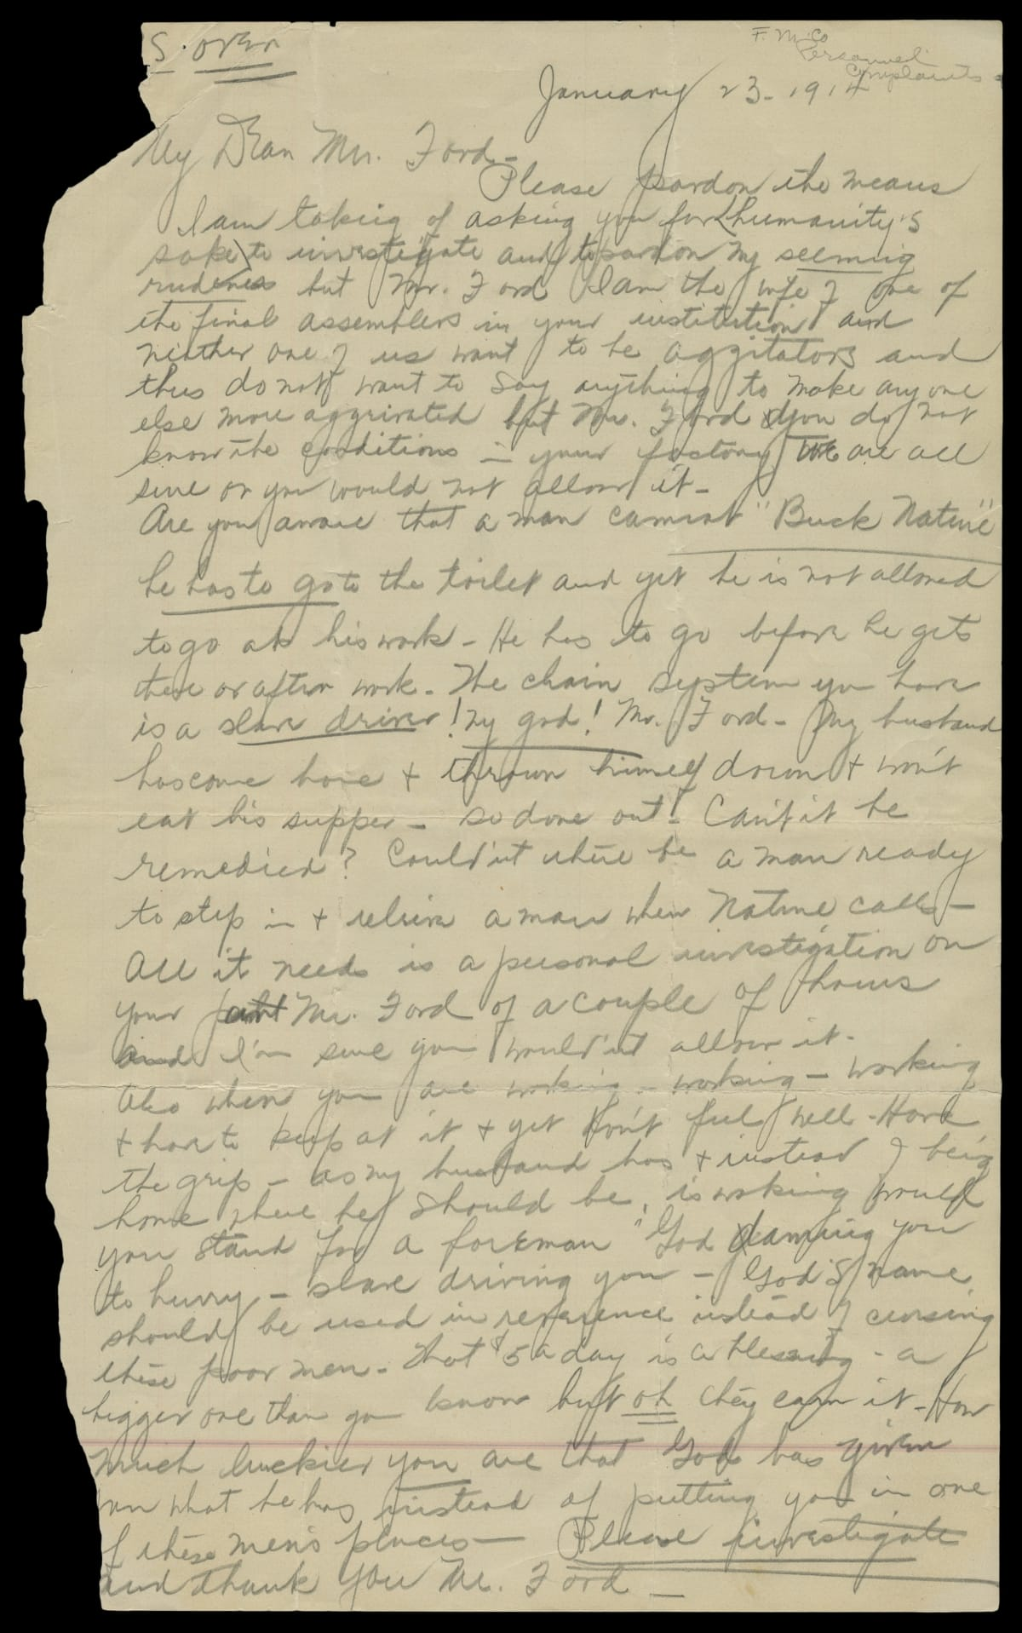
The staffing problem
Line work reduced autonomy and variety while enforcing a relentless pace.
Workers leaving forced repeated recruitment and training.
Retention became an operating problem as well as an HR problem.
A worker’s wife complained to Ford in 1914
Management connection: retention and job design
[A] [K]
13
Notes:
RUN OF SHOW 12:00–12:45 (45 sec)
Slade | Target 45 seconds
CUES: Human consequences / retention / primary evidence
The museum's biography describes Ford hiring fifty-three thousand people in a year to keep fourteen thousand jobs filled. We are using that description rather than mixing turnover percentages that different accounts report differently.
On the right is a primary document: a worker's wife wrote to Ford in January 1914 about treatment on the assembly line. It gives us an individual perspective, not a statistical sample of every worker. But it reminds us that output figures leave out lived experience.
Chapter 9 includes keeping competent employees as part of HR management. If a job is easy to learn but workers leave constantly, that job still creates organizational costs. Here the production solution generated an employment problem. The machines stayed where management put them. The people had other options.
COURSE CONNECTION: Chapter 9, slides 5 and 20, HRM and retention. Chapter 8, work specialization.
RESEARCH (accessed October 19, 2026):
[A] The Henry Ford, “Henry Ford” biography and interview transcript
https://www.thehenryford.org/collections/explore/videos/henry-ford
[K] The Henry Ford, “Our Most-Viewed Digitized Artifacts of All Time”
https://www.thehenryford.org/collections/explore/sets/detail/our-most-viewed-digitized-artifacts-of-all-time
IMAGE CREDIT: Letter to Henry Ford from the Wife of an Assembly Line Worker, January 23, 1914, THF94994. The Henry Ford, source K.

Slide 14
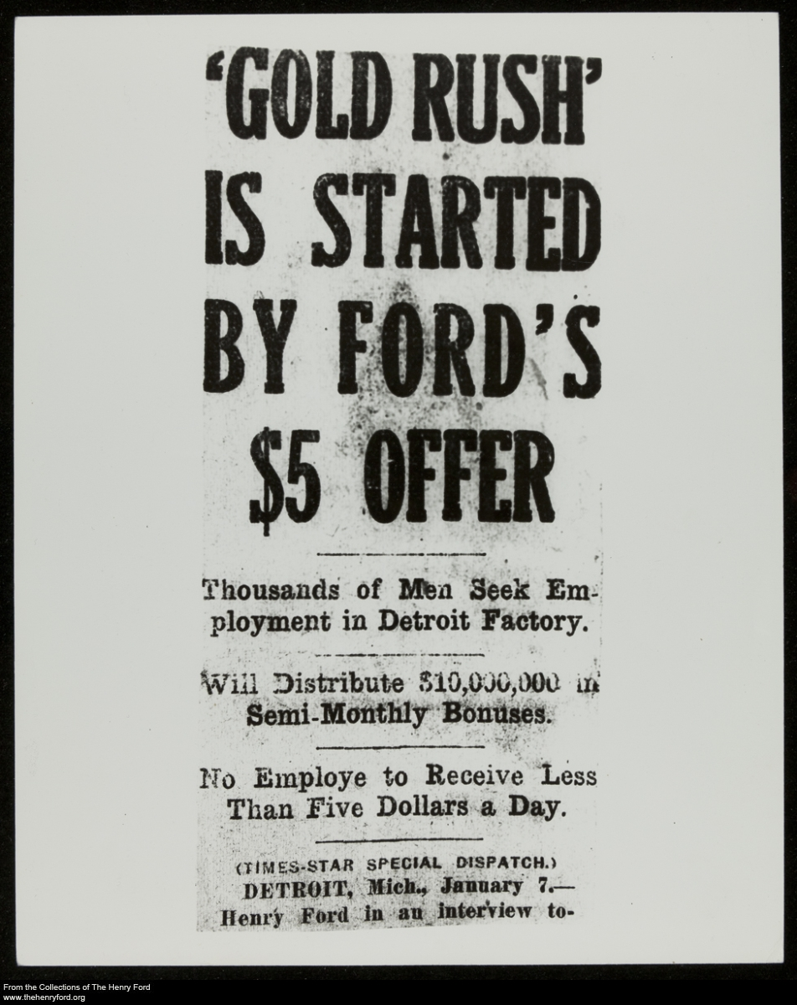
The $5 day, with conditions
January 5, 1914
Ford and James Couzens announced the plan.
$5 for an 8-hour day
Previous rate: $2.34 for 9 hours
Ordinary wages + conditional profit sharing
Eligibility rules limited access.
Contemporary coverage of the wage announcement
Management connection: compensation and employee retention
[D]
14
Notes:
RUN OF SHOW 12:45–13:45 (60 sec)
Slade | Target 60 seconds
CUES: Compensation / retention / eligibility
The five-dollar announcement made compensation part of the production strategy. Higher total pay could make repetitive work more attractive and help stabilize staffing. The plan also brought extraordinary publicity.
The fine print matters. The original arrangement combined ordinary wages with a conditional profit-sharing payment. It was not an automatic five-dollar base wage for every worker. Eligibility depended on company requirements, including expectations about personal conduct.
Our management interpretation is that a higher pay bill can still be economically sensible if it reduces costly turnover. That does not establish the exact savings from this program, and it does not mean money fixes every job-design problem. Pay can influence whether people stay while leaving monotony and lack of voice unresolved. Next, look at how the company decided who qualified.
COURSE CONNECTION: Chapter 9, slides 25–28, retaining and compensating employees.
RESEARCH (accessed October 19, 2026):
[D] Matt Anderson, “Ford’s Five-Dollar Day,” The Henry Ford (2014)
https://www.thehenryford.org/collections/explore/articles/fords-five-dollar-day
IMAGE CREDIT: The Henry Ford, THF204872, contemporary newspaper coverage, reproduced from source D (flyer-5day.jpg).
DISCUSSION DEPTH
Make the unit explicit: five dollars for an eight-hour DAY. The previous cited rate was $2.34 for nine hours. Do not describe the package as five dollars an hour or universal unconditional base pay. Higher wages and shorter shifts were complementary staffing and capacity decisions.

Slide 15
The $5 day came before Bennett’s enforcers
1913–1914: repetitive work and rapid turnover strained staffing.
January 5, 1914: Ford and Couzens announced the $5 DAY.
Later: Harry Bennett built an anti-union security organization.
Its recruits included former criminals and other enforcers.
The dates do not support “gangsters drove workers out, then Ford raised pay.”
The later intimidation story belongs to Ford’s labor-relations record.
Slade • Management lesson: incentives and coercion are different responses to labor problems.
[D] [N]
15
Notes:
RUN OF SHOW 13:45–14:40 (55 sec)
Slade | 55 seconds
CUES: Per day / sequence / strength of evidence
There are two different periods here. First, repetitive assembly work created a staffing problem. In January 1914, Ford and James Couzens announced five dollars for an eight-hour day—not five dollars an hour. The package initially included conditional profit sharing.
Later, Harry Bennett’s security organization used intimidation against organized labor. The Detroit Historical Society describes recruits including former criminals and other enforcers. Its chronology puts Bennett’s Ford career after the 1914 pay announcement and his leadership of the security organization in 1926.
So we should not say hired gangsters caused the turnover that led to the five-dollar day. The documented chronology does not support that chain. What we can say is that Ford’s management combined an early effort to stabilize staffing through pay with a later coercive approach to employee voice. Higher compensation did not make the later intimidation acceptable.
[D] Matt Anderson, Ford's Five-Dollar Day, The Henry Ford, January 3, 2014. https://www.thehenryford.org/collections/explore/articles/fords-five-dollar-day
[N] Detroit Historical Society, Bennett, Harry. https://www.detroithistorical.org/learn/online-research/encyclopedia-of-detroit/bennett-harry
Accessed October 19, 2026.

Slide 16
When employee welfare became control
Company support
Company intrusion
Health and household advice
Financial and legal assistance
English-language education
Unannounced home visits
Checks on savings and family life
Pay eligibility tied to conduct
Management connection: stakeholder interests, culture, and ethics
[E]
16
Notes:
RUN OF SHOW 14:40–15:35 (55 sec)
Slade | Target 55 seconds
CUES: Benefits / privacy / founder culture
The Sociological Department connected employee benefits to Ford's preferred way of living. Its investigators examined private life while the company also offered practical support. Both sides belong in the account.
This is paternalism: an employer claims to act for workers' benefit while reserving authority over decisions workers might prefer to make themselves. We can recognize useful services without accepting the intrusion that accompanied them.
Imagine the email: congratulations on your compensation package, and someone from work would like to inspect your kitchen. Pause briefly, then return to the issue. Chapter 2 explains how a founder can shape organizational culture. Chapter 3 asks us to consider rights as well as outcomes. An employment relationship gives a company influence, but it does not automatically justify authority over an employee's whole life.
COURSE CONNECTION: Chapter 2, slide 21, founder influence on culture. Chapter 3, slides 20–24, ethics and ethical leadership.
RESEARCH (accessed October 19, 2026):
[E] The Henry Ford, “Henry Ford: Sociological Department”
https://www.thehenryford.org/collections/explore/sets/detail/henry-ford-sociological-department
DISCUSSION DEPTH
Separate the ethical frameworks. A utilitarian argument might emphasize stable income and reliable production. A rights view asks whether an employer can inspect private life. A justice view asks who qualifies and who is excluded. Do not let useful services settle the separate question of consent.

Slide 17
River Rouge and vertical integration
Ford brought more stages of production under company control.
At Rouge: ore docks, steelmaking, glassmaking, and vehicle assembly
The complex achieved “ore to assembly” with the Model A in 1927.
Management connection: vertical integration as a growth strategy
[F]
17
Notes:
RUN OF SHOW 15:35–16:15 (40 sec)
Slade | Target 40 seconds
CUES: Definition / chronology / tradeoff
Vertical integration means expanding into other stages of a production or distribution chain. At Rouge, Ford pursued control over materials and manufacturing instead of relying entirely on outside suppliers. The museum dates the ore-to-assembly achievement to the Model A in 1927. This came after the early Model T assembly-line breakthrough at Highland Park.
The attraction is coordination. A manager can align schedules and specifications across stages under common ownership. But ownership also requires capital and expertise. If needs change, a company may be stuck with facilities that are difficult to redeploy.
Think of a restaurant deciding whether to buy ingredients or own the farm. Control can solve some problems and create others. Chapter 5 lists vertical integration as a growth strategy, which makes Rouge a concrete historical example rather than just a large factory.
COURSE CONNECTION: Chapter 5, slide 16, growth strategies including vertical integration.
RESEARCH (accessed October 19, 2026):
[F] The Henry Ford, “Ford Rouge Factory” research guide
https://askus.thehenryford.org/K12/faq/405833
DISCUSSION DEPTH
Vertical integration changes organizational boundaries. It can coordinate supply and reduce dependence on outside firms, but it commits capital and makes management more complex. This is an application of Chapter 5, not proof that integration is always superior.

Slide 18
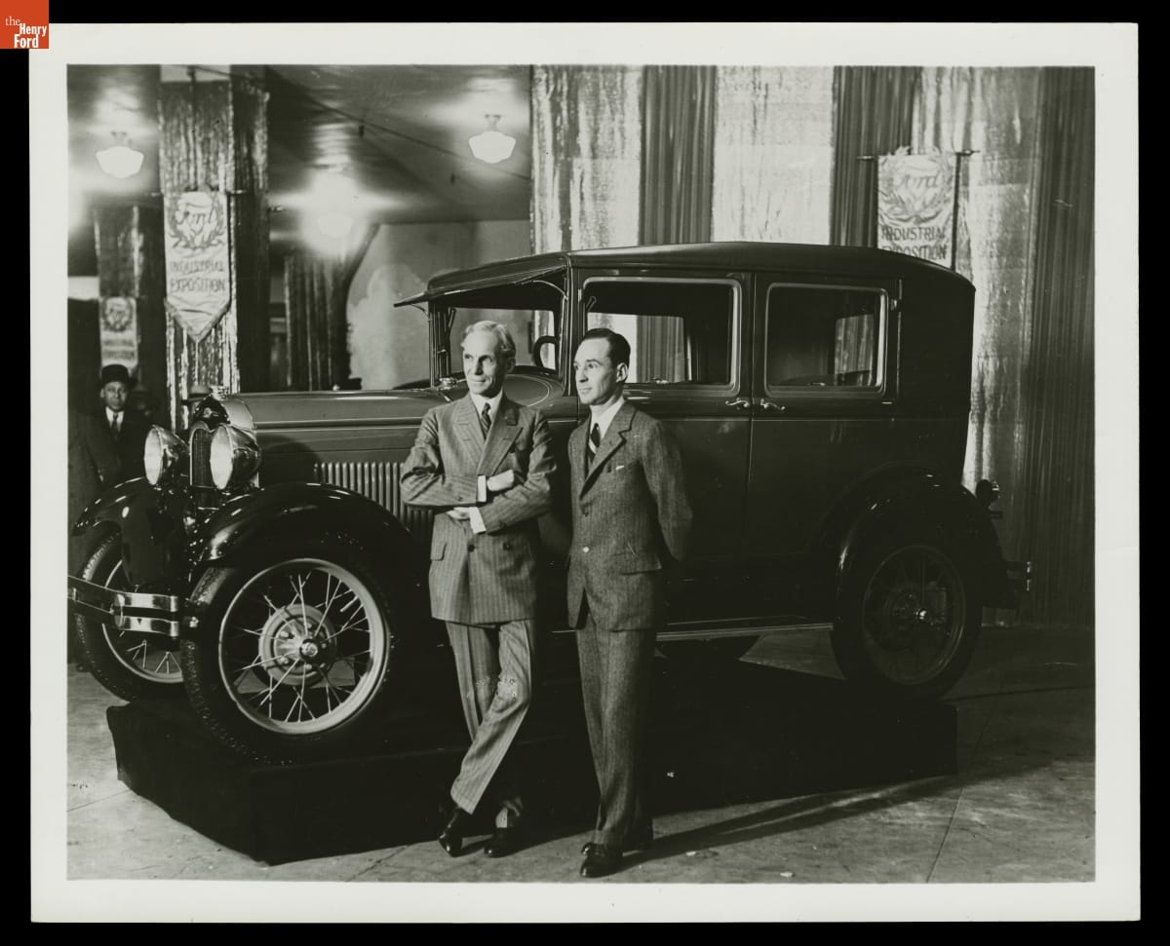
The innovator resisted change
Buyers wanted more comfort, styling, and choice.
Commitment to the Model T delayed adaptation to the market.
The Model A arrived in 1927 after Ford shut down to retool.
Edsel and Henry Ford with a Model A, 1928
Management connection: environmental scanning and resistance to change
[G]
18
Notes:
RUN OF SHOW 16:15–17:05 (50 sec)
Slade | Target 50 seconds
CUES: Success / rigidity / environment
Ford's earlier success created a dangerous confidence in the existing formula. Buyers increasingly valued style and comfort. His reluctance to replace the Model T left the company responding late, before the new Model A appeared in 1927.
That is a useful tension for an introduction to management. A person can drive radical innovation in one period and resist it later. Centralized authority can accelerate decisions when the leader understands the problem, then slow adaptation when the leader rejects unwelcome information.
The course's warning about planning reinforcing today's success fits this case. Managers need feedback that can challenge the plan, not simply help execute it faster. The takeaway is not that standardization is bad. It is that a strategy needs to change when the market on which it depends changes.
COURSE CONNECTION: Chapter 5, slide 6, rigidity and the limits of planning. Chapter 6, managing change and innovation.
RESEARCH (accessed October 19, 2026):
[G] Bob Casey, “Henry Ford: Case Study of an Innovator” (2021)
https://www.thehenryford.org/collections/explore/articles/henry-ford-case-study-of-an-innovator
IMAGE CREDIT: Henry Ford and Edsel Ford with Ford Model A Fordor Sedan, New York Industrial Exposition, 1928, THF91597. The Henry Ford, source G.
DISCUSSION DEPTH
Connect Chapter 2 external environment to Chapter 4 escalation of commitment and Chapter 6 resistance to change. A method that succeeded under one set of customer preferences can become rigid when conditions change. Present these as analytical lenses, not a clinical diagnosis of Ford.

Slide 19
Labor relations and worker voice
1937: Ford security personnel attacked union organizers at the Battle of the Overpass.
1941: Ford accepted union representation.
High pay did not settle questions of power, dignity, or employee voice.
Management connection: stakeholders and ethical leadership
[I]
19
Notes:
RUN OF SHOW 17:05–17:50 (45 sec)
Slade | Target 45 seconds
CUES: No humor / evidence / power
The Battle of the Overpass shows why a pay policy cannot stand in for an evaluation of labor relations. In 1937, Ford security personnel assaulted union organizers distributing material near the Rouge complex. Photographs made the violence visible to a wider public. Ford accepted union representation in 1941.
The ethical issue is not whether higher wages were valuable. Workers could value pay and still seek collective voice over working conditions. Those interests can exist together.
For management, this raises the question of whose concerns leadership hears and how employees can challenge decisions without fear. It also shows how conduct inside an organization can become a public stakeholder problem. Treat this episode seriously. We can evaluate an important operational achievement while also naming the coercion associated with the organization that produced it.
COURSE CONNECTION: Chapters 2–3, stakeholder environment and ethics. Chapter 9, legal environment and employee relations.
RESEARCH (accessed October 19, 2026):
[I] Michigan Supreme Court Learning Center, “Right of Assembly: Battle of the Overpass”
https://www.courts.michigan.gov/49b296/siteassets/msc-learning-center/scrapbook-fordbattleoverpass1937.pdf
DISCUSSION DEPTH
Keep the later coercion distinct from the 1914 turnover story. Bennett’s enforcers and the 1937 attack demonstrate that higher pay did not eliminate conflict over organizing and dignity. If asked about gangs, refer back to the chronology and the narrower documented description of former criminals and enforcers.

Slide 20
Antisemitism and the use of influence
Ford’s newspaper spread antisemitic conspiracy theories beginning in 1920.
The articles circulated internationally as The International Jew.
He issued an apology in 1927. The propaganda’s harm continued.
Management connection: leader accountability and organizational culture
[H] [M]
20
Notes:
RUN OF SHOW 17:50–18:30 (40 sec)
Slade | Target 40 seconds
CUES: Clear language / responsibility / no equivalence
Ford used the Dearborn Independent to circulate false claims about Jewish people. Collections of those articles reached audiences abroad. The Holocaust Museum documents admiration for Ford among Nazi leaders, including Hitler. Ford later issued a public apology in 1927, but the material continued circulating.
This matters to a management presentation because wealth, reputation, and distribution networks gave his prejudice organizational reach. It was more than a private opinion. The conduct also faced criticism in his own time, so we should not dismiss it as simply normal for the era.
There is no need to reproduce the propaganda to explain its harm. Innovation does not cancel responsibility for spreading hatred. A balanced evaluation means including the evidence necessary to understand the person and his influence, not giving ethical abuses a numerical offset against production gains.
COURSE CONNECTION: Chapter 3, slides 20–24, ethics and ethical leadership. Chapter 2, founder influence on culture.
RESEARCH (accessed October 19, 2026):
[H] U.S. Holocaust Memorial Museum, “Antisemitism and Henry Ford’s ‘The International Jew’”
https://encyclopedia.ushmm.org/content/en/article/antisemitism-and-henry-fords-international-jew
[M] The Henry Ford, “Henry Ford and Anti-Semitism”
https://www.thehenryford.org/collections/explore/popular-research-topics/henry-ford-and-anti-semitism
DISCUSSION DEPTH
Speak directly and avoid treating antisemitism as a minor personality flaw. Leadership influence helped distribute harmful propaganda. The management implication is accountability for the organization’s messages and culture, even when a leader achieves commercial success.

Slide 21
A balanced evaluation of Ford
Contributions
Limits and failures
Mass production expanded access
Product and process choices reinforced each other
Pay helped support staffing
Control invaded private life
Gender rules restricted opportunity
Rigidity, coercion, and antisemitism
Management connection: efficiency, effectiveness, and ethical responsibility
[C] [D] [E] [G] [H] [I]
21
Notes:
RUN OF SHOW 18:30–19:15 (45 sec)
Slade | Target 45 seconds
CUES: Separate achievements / ethical judgment / handoff
These are different dimensions of evaluation. A production method can be effective at reducing assembly time while leadership fails ethically. We do not have to choose between pretending Ford contributed nothing and treating his contribution as permission to ignore his conduct.
The course asks us to understand management theory and practice. Ford helps explain both the power of designing an organization around a clear goal and the risk of letting the founder define every boundary.
For a manager today, a reasonable evaluation would examine output, quality, employee experience, and consequences for other stakeholders. A single attractive measure cannot capture the whole organization. Andy will now connect those lessons to familiar workplaces and close with what managers can use from this case.
COURSE CONNECTION: Chapter 1 and Chapter 3, effectiveness and ethical conduct.
RESEARCH (accessed October 19, 2026):
[C] Ford Motor Company, “The Model T” (2020)
https://corporate.ford.com/articles/history/the-model-t/
[D] Matt Anderson, “Ford’s Five-Dollar Day,” The Henry Ford (2014)
https://www.thehenryford.org/collections/explore/articles/fords-five-dollar-day
[E] The Henry Ford, “Henry Ford: Sociological Department”
https://www.thehenryford.org/collections/explore/sets/detail/henry-ford-sociological-department
[G] Bob Casey, “Henry Ford: Case Study of an Innovator” (2021)
https://www.thehenryford.org/collections/explore/articles/henry-ford-case-study-of-an-innovator
[H] U.S. Holocaust Memorial Museum, “Antisemitism and Henry Ford’s ‘The International Jew’”
https://encyclopedia.ushmm.org/content/en/article/antisemitism-and-henry-fords-international-jew
[I] Michigan Supreme Court Learning Center, “Right of Assembly: Battle of the Overpass”
https://www.courts.michigan.gov/49b296/siteassets/msc-learning-center/scrapbook-fordbattleoverpass1937.pdf
DISCUSSION DEPTH
Evaluate practices separately. Expanded affordability does not excuse coercion. The women’s employment evidence shows why a favorable pay headline cannot stand in for an assessment of equal opportunity.

Slide 22
Where we still see related ideas
Manufacturing
Services and logistics
Standard work and coordinated flow remain central.
Toyota adds pull production and stopping to address defects.
Kitchens and fulfillment centers also divide work into stations.
These are comparisons of methods, not claims of direct descent.
Management connection: organizational design and continuous improvement
[G] [J]
22
Notes:
RUN OF SHOW 19:15–20:00 (45 sec)
Andy | Target 45 seconds
CUES: Historical influence / analogies / evolution
Ford's production methods spread across manufacturing. Modern factories still coordinate specialized work and material movement, but they have evolved substantially. Toyota describes its system around just-in-time production and jidoka, which means detecting problems and stopping to prevent defects from continuing.
The service examples are comparisons, not a claim that Ford directly invented modern kitchens or warehouses. A kitchen's stations and a fulfillment operation's standard procedures make the same general questions easy to see: how should work flow, how much should a job repeat, and who can improve the process?
The modern lesson is selective adaptation. Stable, repeatable work can benefit from standards. Changing demand and complex problems also require feedback and employee judgment. Ford gives us a useful starting point for those questions, not a complete operating manual.
COURSE CONNECTION: Chapter 8, job design. Chapter 6, innovation. Service and logistics examples are contemporary analytical comparisons.
RESEARCH (accessed October 19, 2026):
[G] Bob Casey, “Henry Ford: Case Study of an Innovator” (2021)
https://www.thehenryford.org/collections/explore/articles/henry-ford-case-study-of-an-innovator
[J] Toyota Motor Corporation, “Toyota Production System”
https://global.toyota/en/company/plant-tours/production-system/
DISCUSSION DEPTH
Toyota’s own description emphasizes just-in-time and jidoka, including stopping when abnormalities occur. Avoid presenting Toyota as simply copying Ford. Services examples are conceptual comparisons of work organization.

Slide 23
One company, four management functions
Planning: align affordability with demand, then revisit assumptions
Organizing: specialize jobs while coordinating the whole flow
Leading: combine fair incentives with employee voice
Controlling: track output, quality, turnover, and ethical boundaries
Management connection: planning, organizing, leading, and controlling
23
Notes:
RUN OF SHOW 20:00–20:45 (45 sec)
Andy | Target 45 seconds
CUES: Apply the course / distinguish metrics / whole system
Here is the case in the course's four-function framework. Planning links the desired market to product and cost choices. Organizing assigns work and coordinates resources. Leading concerns the people carrying out the plan. Controlling compares performance with expectations and responds to gaps.
Ford shows that these functions interact. The production plan created a need for staffing stability. Compensation addressed part of that need. Yet intrusive oversight and coercion damaged the relationship with employees.
If we were advising a manager facing a similar problem, we would ask for more than an output target. We would ask how often employees leave, whether quality improves, what customers want, and whether people can report problems. That is how the historical case becomes a way to think through a present management decision rather than a list of vocabulary words.
COURSE CONNECTION: Chapter 1, slide 19, four management functions. Chapters 4–6, 8–9 support these applications.
DISCUSSION DEPTH
Chapter map: Ch. 1 four functions and efficiency/effectiveness. Ch. 2 environment and culture. Ch. 3 ethics and justice. Ch. 4 alternatives, evidence, and commitment bias. Ch. 5 cost leadership and vertical integration. Ch. 6 innovation and resistance. Ch. 8 specialization, formalization, and centralization. Ch. 9 retention, compensation, and inclusion. History Module: Smith, scientific management, systems and contingency views. The chapter concepts are analytical frameworks applied to Ford, not theories he personally authored.

Slide 24
What Ford changed about management
Ford made product design, production, and staffing one management problem.
High pay could support retention while leaving monotony and exclusion unresolved.
His legacy asks managers to pursue efficiency with adaptation and accountability.
[B] [D] [G] [H]
24
Notes:
RUN OF SHOW 20:45–21:25 (40 sec)
Andy | Target 40 seconds
CUES: Thesis / consequences / invite Q&A
Ford's durable contribution was the integration of decisions that managers sometimes treat separately. The product affected the process. The process affected jobs. Jobs affected staffing, and staffing affected output. At enormous scale, those connections changed industrial practice.
The same case shows why efficiency alone cannot define good management. An organization also has to adapt to customers and treat people responsibly. Ford could see a different future for production while failing to see the limits of his own authority and beliefs.
Our conclusion is that his methods deserve study and his conduct deserves judgment. Managers can learn from both. Thank you. We are ready for questions about the assembly line, employment policies, influences, or the legacy of his approach.
RESEARCH (accessed October 19, 2026):
[B] Library of Congress, “Ford Implements the Moving Assembly Line”
https://guides.loc.gov/this-month-in-business-history/october/ford
[D] Matt Anderson, “Ford’s Five-Dollar Day,” The Henry Ford (2014)
https://www.thehenryford.org/collections/explore/articles/fords-five-dollar-day
[G] Bob Casey, “Henry Ford: Case Study of an Innovator” (2021)
https://www.thehenryford.org/collections/explore/articles/henry-ford-case-study-of-an-innovator
[H] U.S. Holocaust Memorial Museum, “Antisemitism and Henry Ford’s ‘The International Jew’”
https://encyclopedia.ushmm.org/content/en/article/antisemitism-and-henry-fords-international-jew

Slide 25
Questions and discussion
Where should control end?
Which Ford practice would you keep?
Which would you change first, and why?
[B] [D] [H]
25
Notes:
Q&A AFTER THE TIMED PRESENTATION. Allow approximately 3–5 minutes or follow the instructor.
Andy and Slade
CUES: Andy: production/strategy. Slade: HR/ethics. Both: legacy.
Q&A follows the 21-minute 25-second presentation and is not counted toward its target.
Likely questions and concise answers:
Did Ford invent the assembly line? Earlier methods existed. Ford and his team developed and scaled moving automobile assembly.
Why pay more for repetitive work? Compensation can help attract and retain workers, although it does not replace humane job design.
Was the $5 day universal? The initial plan included conditional profit sharing, so avoid describing it as an unconditional wage for everyone.
Did workers get a five-day week in 1914? Do not conflate the eight-hour day associated with the wage program with Ford's later five-day workweek.
Did Taylor personally teach Ford? The ideas overlap, but we have not established that direct relationship.
Why study a leader who spread antisemitism? To understand real influence and evaluate it responsibly, including its harms.
If uncertain, say what the sources establish and what they do not. Do not guess.
RESEARCH (accessed October 19, 2026):
[B] Library of Congress, “Ford Implements the Moving Assembly Line”
https://guides.loc.gov/this-month-in-business-history/october/ford
[D] Matt Anderson, “Ford’s Five-Dollar Day,” The Henry Ford (2014)
https://www.thehenryford.org/collections/explore/articles/fords-five-dollar-day
[H] U.S. Holocaust Memorial Museum, “Antisemitism and Henry Ford’s ‘The International Jew’”
https://encyclopedia.ushmm.org/content/en/article/antisemitism-and-henry-fords-international-jew
Q&A PREPARATION
Did Ford invent the assembly line? His team adapted earlier industrial methods to automobile mass production.
Why pay more? Retention and reliable operation are supported explanations, alongside publicity and other motives. Avoid claiming a single proven cause or a precise return on the policy.
Did every woman receive $5 in 1914? No universal entitlement is established. Ford describes an early exception for women supporting relatives, and broader access followed in 1916.
Was Ford an equal-opportunity employer? The marriage restriction in his own account shows why higher minimum pay is not enough to establish that.
Did hired gangs cause the 1914 raise? The documented later Bennett story cannot establish that causal sequence.
What would you keep today? Coordinated flow and evidence-based process improvement, with fair pay, employee voice, and limits on managerial intrusion.
If a question exceeds the evidence, say what the sources establish and what remains uncertain. Each presenter takes at least one answer.

Slide 26
References: production and strategy
[A] The Henry Ford, “Henry Ford” biography and interview transcript
https://www.thehenryford.org/collections/explore/videos/henry-ford
[B] Library of Congress, “Ford Implements the Moving Assembly Line”
https://guides.loc.gov/this-month-in-business-history/october/ford
[C] Ford Motor Company, “The Model T” (2020)
https://corporate.ford.com/articles/history/the-model-t/
[F] The Henry Ford, “Ford Rouge Factory” research guide
https://askus.thehenryford.org/K12/faq/405833
[G] Bob Casey, “Henry Ford: Case Study of an Innovator” (2021)
https://www.thehenryford.org/collections/explore/articles/henry-ford-case-study-of-an-innovator
[L] The Henry Ford, authenticated Henry Ford quotations, Edison recollections
https://www.thehenryford.org/collections/explore/popular-research-topics/henry-ford-quotations
All websites accessed October 19, 2026. Full citations also appear in the relevant slide notes.
Notes:
[A] The Henry Ford, “Henry Ford” biography and interview transcript
https://www.thehenryford.org/collections/explore/videos/henry-ford
[B] Library of Congress, “Ford Implements the Moving Assembly Line”
https://guides.loc.gov/this-month-in-business-history/october/ford
[C] Ford Motor Company, “The Model T” (2020)
https://corporate.ford.com/articles/history/the-model-t/
[F] The Henry Ford, “Ford Rouge Factory” research guide
https://askus.thehenryford.org/K12/faq/405833
[G] Bob Casey, “Henry Ford: Case Study of an Innovator” (2021)
https://www.thehenryford.org/collections/explore/articles/henry-ford-case-study-of-an-innovator
[L] The Henry Ford, authenticated Henry Ford quotations, Edison recollections
https://www.thehenryford.org/collections/explore/popular-research-topics/henry-ford-quotations

Slide 27
References: employees and legacy
[D] Matt Anderson, “Ford’s Five-Dollar Day,” The Henry Ford (2014)
https://www.thehenryford.org/collections/explore/articles/fords-five-dollar-day
[E] The Henry Ford, “Henry Ford: Sociological Department”
https://www.thehenryford.org/collections/explore/sets/detail/henry-ford-sociological-department
[H] U.S. Holocaust Memorial Museum, “Antisemitism and Henry Ford’s ‘The International Jew’”
https://encyclopedia.ushmm.org/content/en/article/antisemitism-and-henry-fords-international-jew
[I] Michigan Supreme Court Learning Center, “Right of Assembly: Battle of the Overpass”
https://www.courts.michigan.gov/49b296/siteassets/msc-learning-center/scrapbook-fordbattleoverpass1937.pdf
[J] Toyota Motor Corporation, “Toyota Production System”
https://global.toyota/en/company/plant-tours/production-system/
[M] The Henry Ford, “Henry Ford and Anti-Semitism”
https://www.thehenryford.org/collections/explore/popular-research-topics/henry-ford-and-anti-semitism
All websites accessed October 19, 2026. Full citations also appear in the relevant slide notes.
Notes:
[D] Matt Anderson, “Ford’s Five-Dollar Day,” The Henry Ford (2014)
https://www.thehenryford.org/collections/explore/articles/fords-five-dollar-day
[E] The Henry Ford, “Henry Ford: Sociological Department”
https://www.thehenryford.org/collections/explore/sets/detail/henry-ford-sociological-department
[H] U.S. Holocaust Memorial Museum, “Antisemitism and Henry Ford’s ‘The International Jew’”
https://encyclopedia.ushmm.org/content/en/article/antisemitism-and-henry-fords-international-jew
[I] Michigan Supreme Court Learning Center, “Right of Assembly: Battle of the Overpass”
https://www.courts.michigan.gov/49b296/siteassets/msc-learning-center/scrapbook-fordbattleoverpass1937.pdf
[J] Toyota Motor Corporation, “Toyota Production System”
https://global.toyota/en/company/plant-tours/production-system/
[M] The Henry Ford, “Henry Ford and Anti-Semitism”
https://www.thehenryford.org/collections/explore/popular-research-topics/henry-ford-and-anti-semitism

Slide 28
References: women and the fact check
[N] Detroit Historical Society, “Bennett, Harry”
[O] The Henry Ford, women assembling magnetos, circa 1913 (THF99642)
[P] Ford & Crowther, My Life and Work (1922), chapters VII–VIII
[Q] The New York Times, “For Every Woman, $5 a Day” (Oct. 26, 1916)
[R] The Henry Ford, K–12 Research Guide: Rosie the Riveter
Full URLs and source limitations appear in these slide notes.
Primary accounts reflect their authors’ views; distinguish them from independent evidence.
Source access dates carried over from the supplied revision; live links not reverified.
28
Notes:
REFERENCE MATERIAL — not part of the timed presentation.
https://www.thehenryford.org/collections/explore/articles/fords-five-dollar-day
https://www.detroithistorical.org/learn/online-research/encyclopedia-of-detroit/bennett-harry
https://www.thehenryford.org/collections/explore/artifact/4461
https://www.gutenberg.org/cache/epub/7213/pg7213-images.html
https://tile.loc.gov/storage-services/service/sgp/sgpbatches/batch_dlc_1zubrowka_ver01/data/2004540423/print00192511057/1916102201/0129.pdf
https://askus.thehenryford.org/K12/faq/429559
https://www.thehenryford.org/collections/explore/popular-research-topics/ford-motor-company-sociological-department-english-school
[N] Bennett biography: evidence for the later security apparatus, not the cause of the 1914 wage plan.
[O] Photograph: women manufacturing magneto components circa 1913; does not prove access to every factory role.
[P] Ford’s retrospective primary account: conditional profit sharing and his reported marriage-related employment restrictions. Treat his explanations critically.
[Q] Contemporary editorial: broader $5 daily minimum for women in 1916.
[R] Later wartime roles at Willow Run; do not project these back to 1914.
These citations were supplied in the proposed revision. Live retrieval returned network-proxy 403 errors during this edit; they were not independently reverified online.

Slide 29
Course materials and visual credits
Fundamentals of Management, 11th ed.
Uploaded Pearson chapter slides 1–6, 8, and 9 (2020)
History Module-1.pdf
Uploaded Prentice Hall management-history module (2005)
The Henry Ford digital collections
Historical photographs and documents identified in slide notes
[K]
29
Notes:
Andy / Slade
CUES: Course materials and visual credits
COURSE MATERIALS USED:
Chapter 1: management, efficiency/effectiveness, four functions (slides 10–11, 19).
Chapter 2: stakeholders and organizational culture, including founder influence (slide 21).
Chapter 3: ethical approaches and leadership (slides 20–24).
Chapter 4: identifying problems and evaluating management decisions.
Chapter 5: strategy, planning rigidity, competitive strategies, vertical integration (slides 6, 9, 16, 19–20).
Chapter 6: change and innovation (slide 24 and related sections).
Chapter 8: structure, specialization, centralization, formalization (slides 4–5, 14–15).
Chapter 9: HRM, retention, compensation (slides 5, 20, 25–28).
History Module-1.pdf: Adam Smith, Taylor, systems and contingency approaches.
Visuals: slide 1 THF97952; slide 3 THF135450; slide 5 THF94827; slide 10 THF94994; slide 11 THF204872; slide 14 THF91597. All The Henry Ford. Each image's original title and source appear in that slide's notes.
Rubric supplied by the user: 20–25 minutes plus Q&A, management contributions, influences, contemporary evidence, professional visual aids, research and information submission. The course name follows the user's correction to MGT 210, Section T01.
RESEARCH (accessed October 19, 2026):
[K] The Henry Ford, “Our Most-Viewed Digitized Artifacts of All Time”
https://www.thehenryford.org/collections/explore/sets/detail/our-most-viewed-digitized-artifacts-of-all-time

