Slide 1


Sai Vidya Institute of technology Dept of Information science and Engineering
Object oriented concept project
on
GYM MANAGEMENT SYSTEM
Done by:
Pooja Guttal

Slide 2

Index
Introduction to project
Project Goal
Project scope
Context level diagram of project
Code
Output
conclusion

Slide 3

Introduction

Slide 4
INTRODUCTION
Now a days online service is a best competitive edge for any organization which makes it differ from other organizations.
The gym management system is such a system which provide best platform for ease of access to gym staff, customer can check his updates online anytime about fitness or diet plan.
The focus of this project is about online services for a fitness club but minimizing all those defects which are found in currently available manually file system.
This is a best platform for the customers abd gym staff to interact freely with each other.

Slide 5

PROJECT GOAL
To remove the manual or paper work in the fitness club.
Provide a platform with interaction user interface for both customer and user
Save the time of both admin and customer.
Get online plan in efficient manner.
To save cost for eachother.
User friendly.

Slide 6

Project scope
The administrator have full fledge right over the system.
The admin can view and register the customers profile data.
Customer can view his or her attendance report.
The customer can get to know the update about their fees if it is due they can pay it in the specified amount of time.
The customer can now about his or her diet plan and the kind of workout/exercise that they have to do according to the data that they have entered.

Slide 7
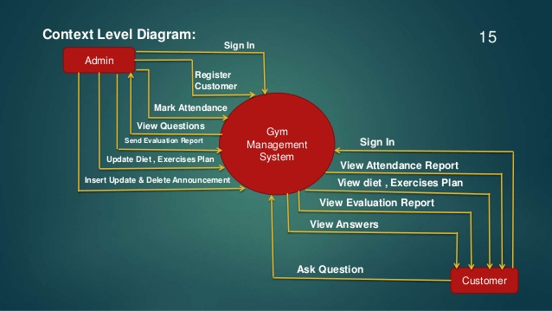

Slide 8
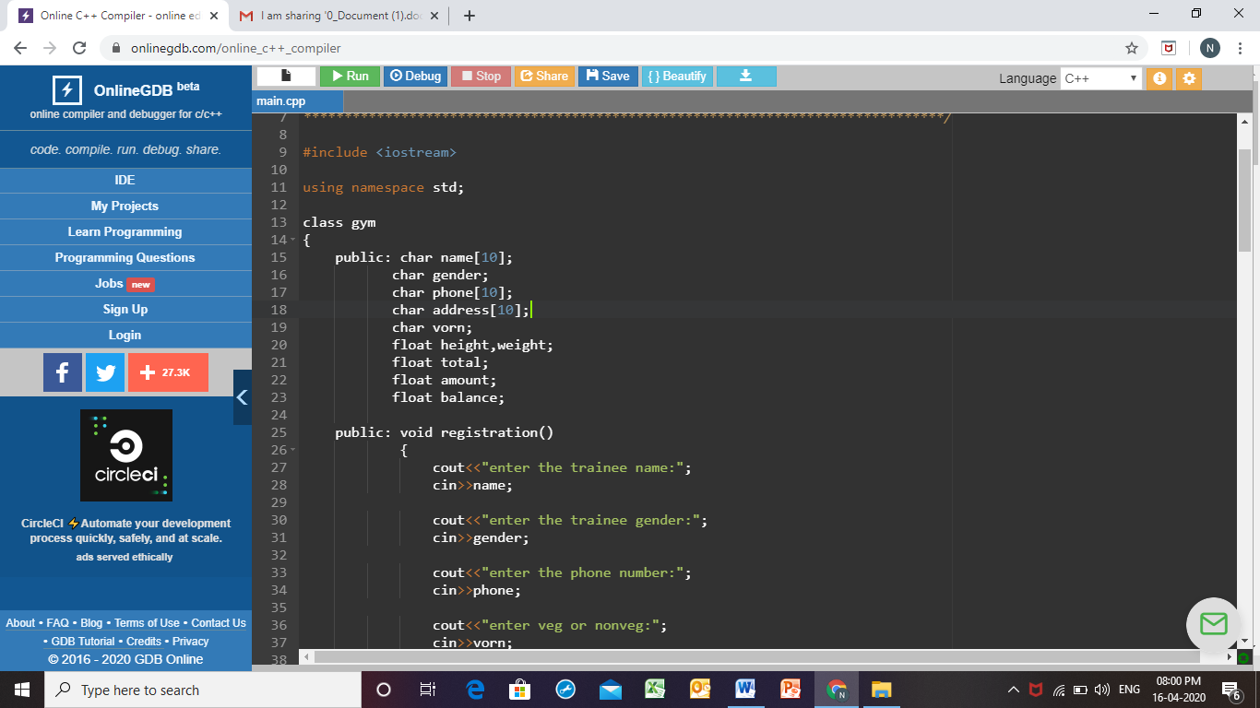
Program:

Slide 9

In the Previous slide, the program for gym management is done.it is implemented using c++,the above slide basically consist of registeration function,which is of type void.where we accept various attributes related to registration from the trainee,
Name(string)
Trainee Gender(char)
Phone number(string)
Habitat i.e either veg or non veg(char)
Height and weight(float)

Slide 10
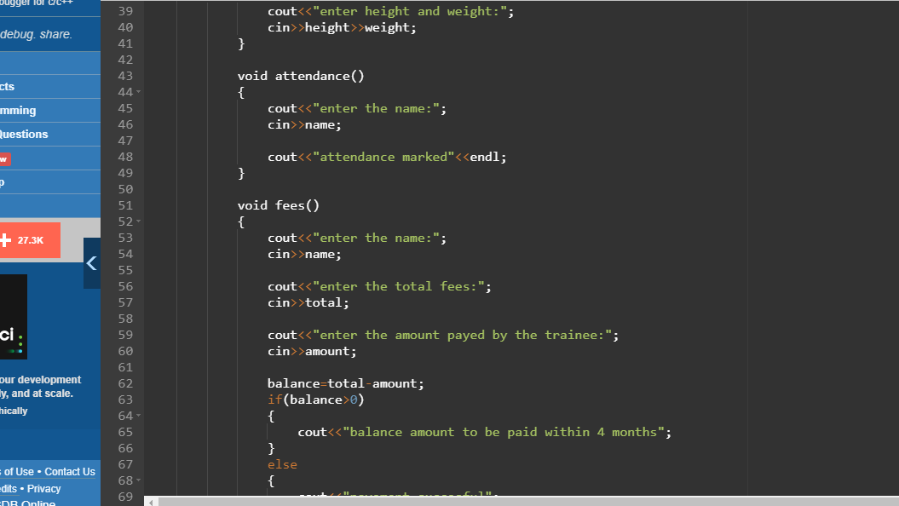

Slide 11

In the above slide,there is function called attendence which is of type void ,where we accept name from the trainee in order verify whether the trainee has attended the gym session
On successful entry of name,it prints “ attendence marked”. i.e trainee attended the session

Slide 12

The slide also includes fees function of type void ,where we accept details such as name,total fees and amount paid by trainee along with balance amount
Balance is calculated by subtracting total with amount paid
If balance is greater than zero then it should be paid within 4 months else payment success

Slide 13
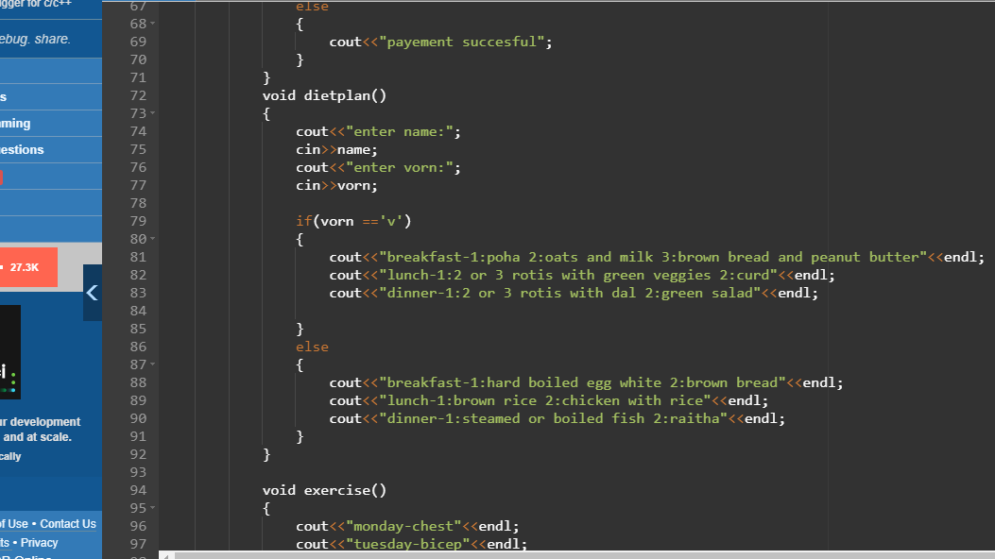

Slide 14

In the above slide, there is function called diet plan where you accept the name of trainee and his/her habitat and provide the required diet plan depending upon his or her habitat. This function has return type of void.
The character “v” is used for vegetarians and "n" is used for non-vegetarian

Slide 15
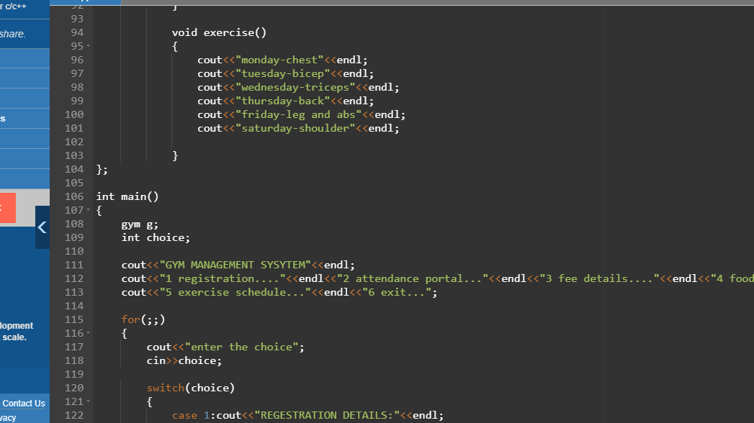

Slide 16

In the above slide,There is exercise function where the trainer provides the list of exercises that has to be done by the trainee on a regular basis. The function is of void typ
Then there is main function where we accept the information that user wants to kn

Slide 17
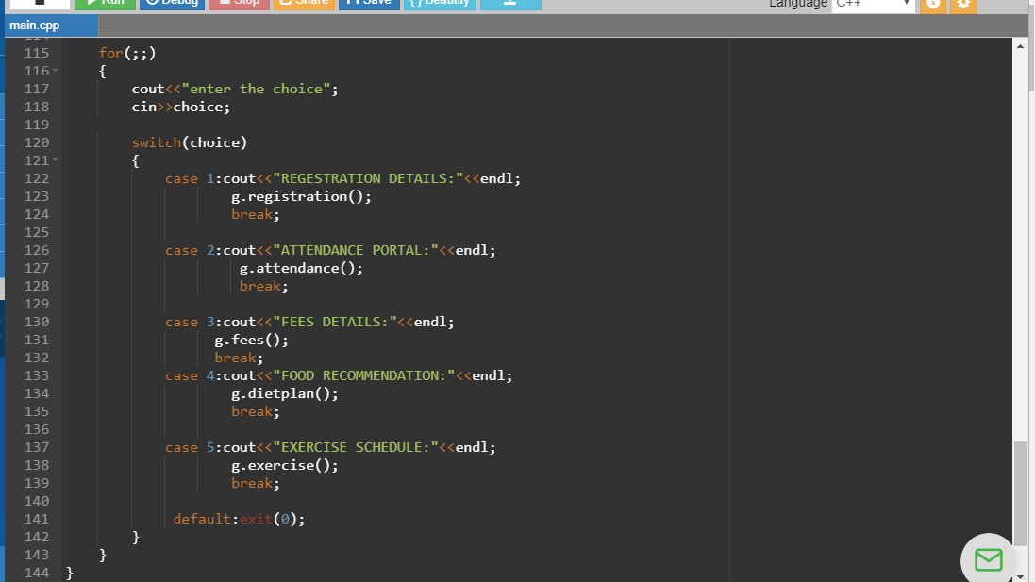

Slide 18

In the above slide,there is switch case which is used inside infinite for loop, where we accept the user choice and perform task depending upon the user choice
Once user selects anything other than given choice the program exit

Slide 19
outputs

Slide 20
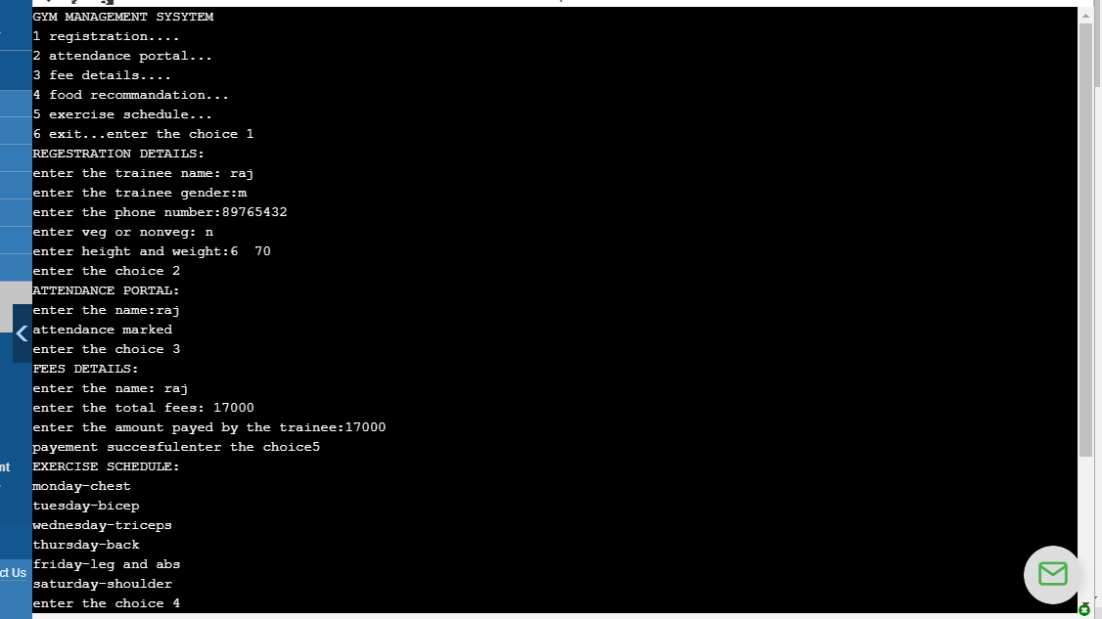

Slide 21
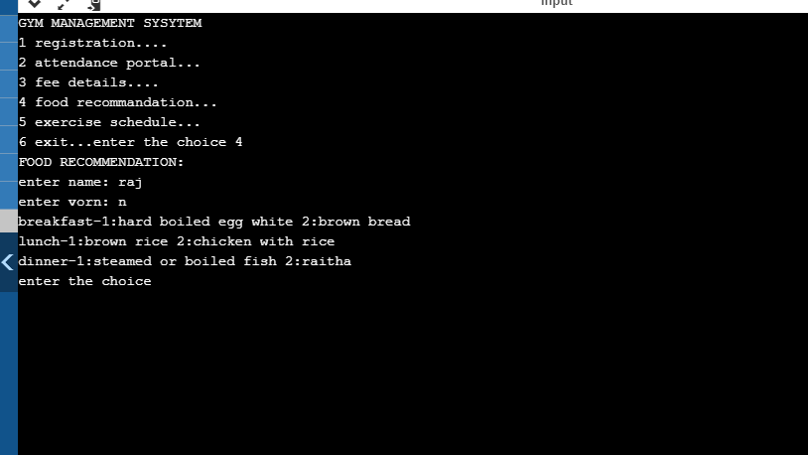

Slide 22
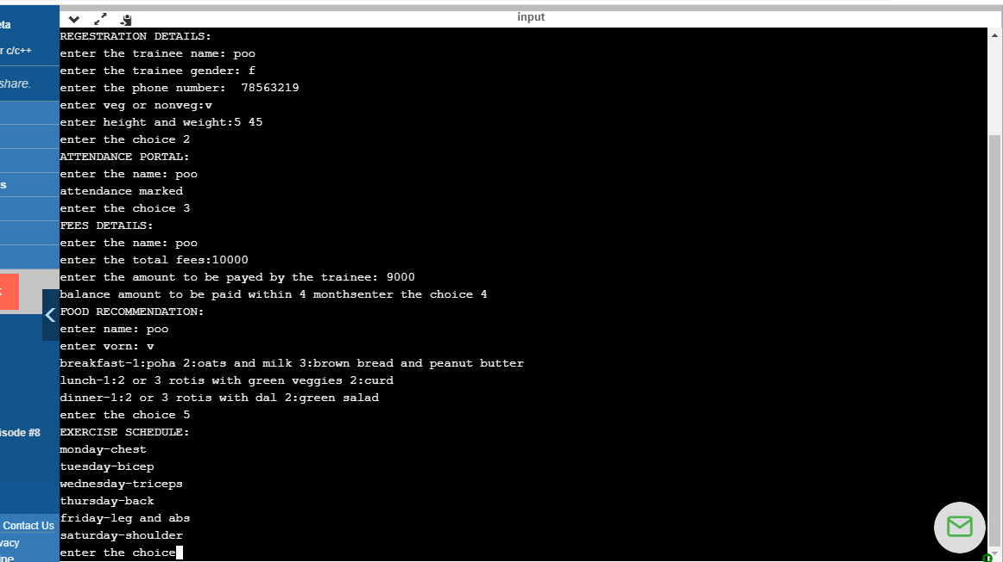

Slide 23


