Slide 1
Welcome Everyone!

Slide 2
Data Science
In a Glance
Ali Nabbi 21 Oct. 2019

Slide 3
Case study

Slide 4
Case study
Data
30 anonymized variables (v0- v29) and one target variable; class.
Goal
Make a model that can discriminate between classes

Slide 5
Approach

Slide 6

The Ultimate Wheel of Modeling
10
1
Model Monitoring
Data Preparation
9
2
Model Deployment
Feature Engineering
8
3
Insights
Diverse Algorithms
7
4
Models Competition
Algorithm Selection
6
5
Ensemble the Model
Training & Testing

Slide 7
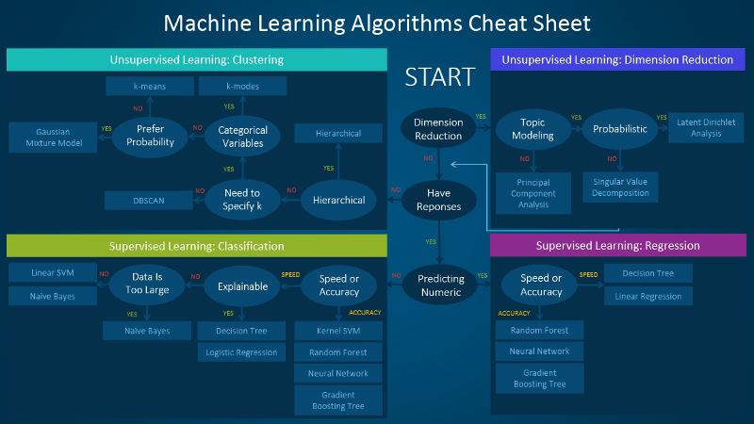

Slide 8
Algorithms

Slide 9
Algorithms
Logistic Regression + Backward Elimination
Logistic Regression + Forward Selection
Decision Tree
Random Forest

Slide 10
Algorithm Competition

Slide 11
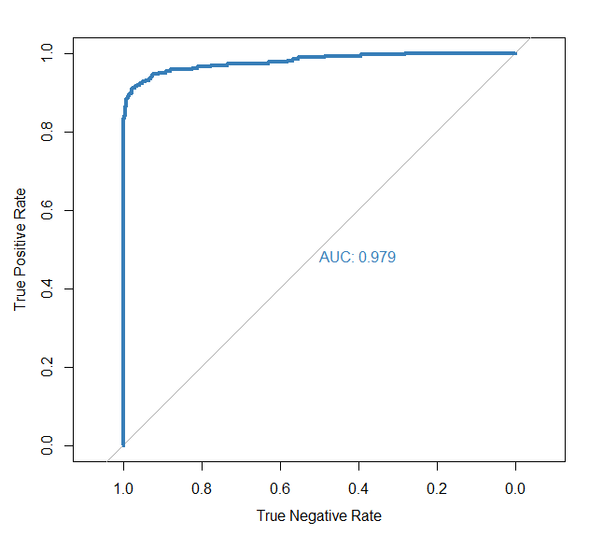
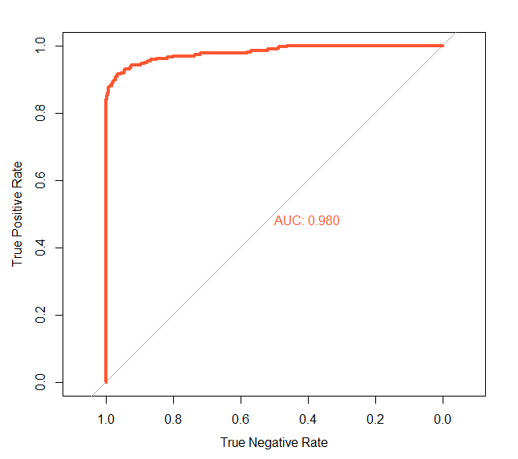
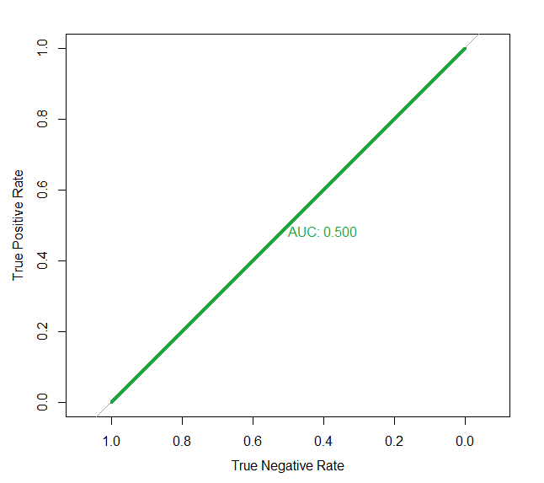
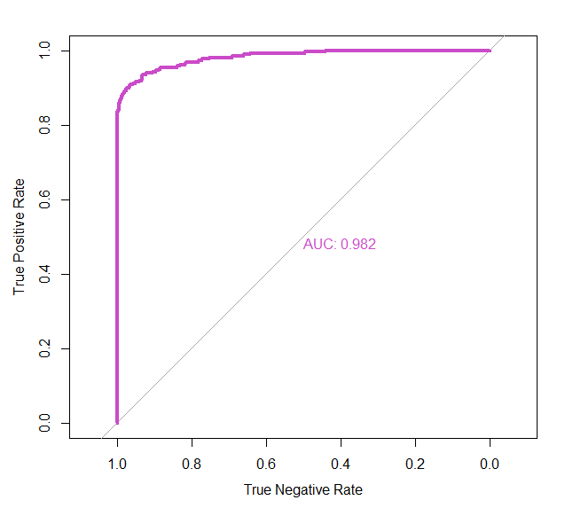
Performance of Logistic Reg.
Full Model
R2 =0.6950079
Backward Elimination
R2 =0.6853384
Null Model
R2=0.000000001
Forward Selection
R2=0.679406

Slide 12

Estimated Coefficients
 | Coefficients | Standard Error | Z-Value | p-Value
intercept | -8.45096 | 0.16741 | -50.479 | < 0.0000000000000002
V3 | 0.10317 | 0.04255 | 2.425 | 0.015321
V4 | 0.63472 | 0.06303 | 10.07 | < 0.0000000000000002
V8 | -0.11764 | 0.03055 | -3.85 | 0.000118
V10 | -0.49993 | 0.0601 | -8.319 | < 0.0000000000000002
V13 | -0.38578 | 0.10691 | -3.608 | 0.000308
V14 | -0.7517 | 0.04632 | -16.227 | < 0.0000000000000002
V16 | -0.29433 | 0.06377 | -4.616 | 0.00000392
V22 | 0.48834 | 0.14945 | 3.268 | 0.001084

Slide 13


Interpretation
From Log of odds to probability

Slide 14
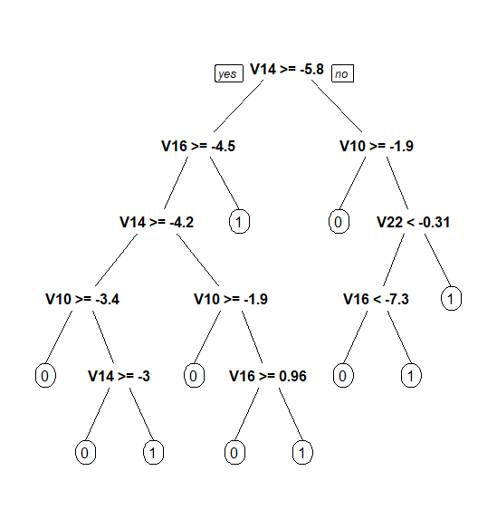
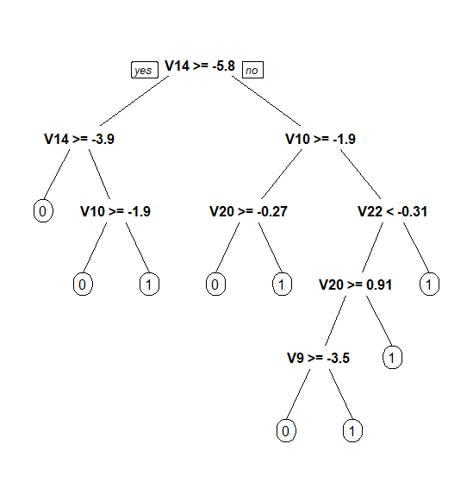
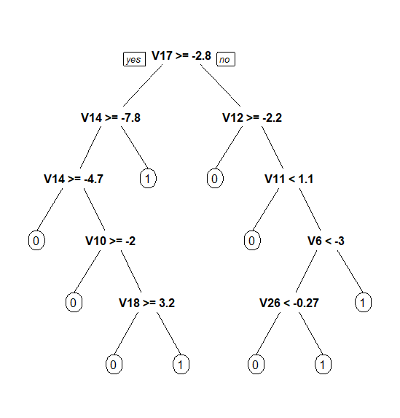
2. Decision Trees
Full Model
Backward Elimination
Forward Selection
Notes:
Entropy

Slide 15
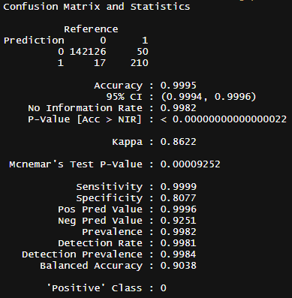
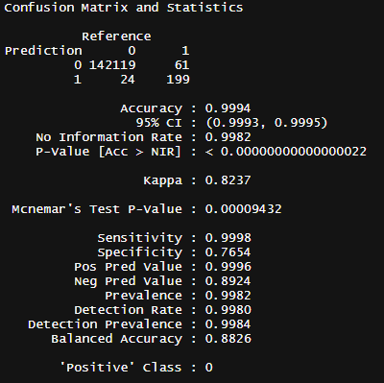
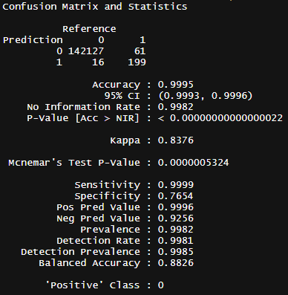
Decision Trees Stats
Full Model
Backward Elimination
Forward Selection
Notes:
Cohen's kappa coefficient (κ) is a to measure inter-rater reliability for categorical items

Slide 16
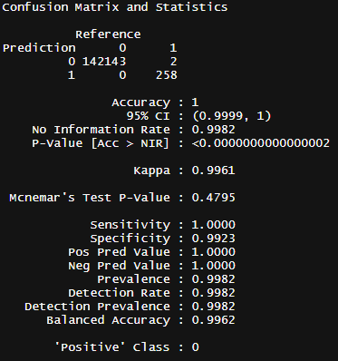
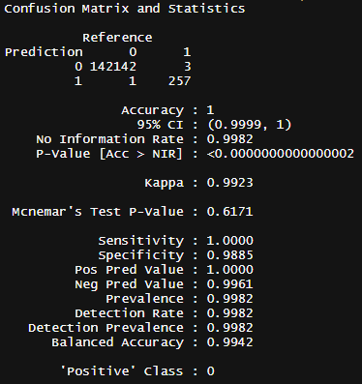
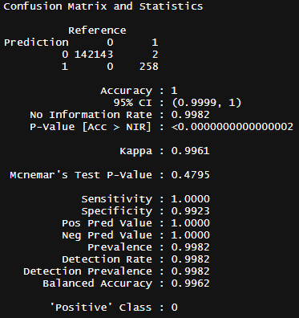
Quick look at Random Forest
Full Model
Backward Elimination
Forward Selection

Slide 17
Q&A

Slide 18
Thank you!

