Slide 1


Tech introduction

Slide 2
About DOIs
Digital Object Identifiers

Slide 3
DOI: Digital Object Identifier
A DOI is a serial code used to uniquely identify content of various types of entities. The DOI system is particularly used for electronic documents such as journal articles or datasets.
What is digital is the identifier, not the object!
DOI
Name
URL
Metadata

Slide 4
DOI Names
Prefixes are assigned to different services. Each one of them manages the ‘suffix’ namespace freely.
DOI Name
Prefix
/
Suffix
Example:
10
.
1234
/
data567

Slide 5
URL
The DOI name points to a URL, and it can be repointed as many times as needed.
This URL can be the object itself or a landing page displaying metadata and how to access the object.
DOI name
http://page1.com
http://page2.com
http://page2.com/old/

Slide 6
Metadata
A metadata schema is a list of core metadata properties chosen for the accurate and consistent identification of a resource.
Mandatory
Recommended
Optional
https://schema.datacite.org
Current version 4.0
XML examples available
Identifier
Subject
Language
Creator
Contributor
Alternate ID
Title
Date
Size
Publisher
Related identifier
Format
Publication year
Description
Version
Resource Type
GeoLocation
Rights

Slide 7
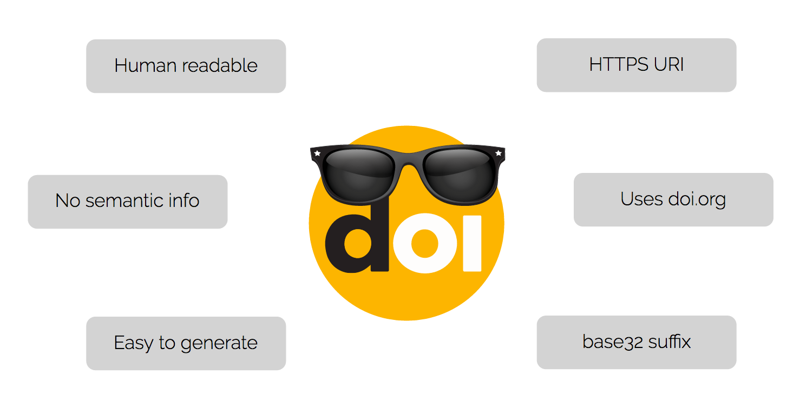
Cool DOIs
DataCite’s display guidelines: DOIs should be displayed as HTTPS URLs
https://doi.org/DOI name
Designing your suffix:
Human readable
Avoid semantic information
Make them easy to generate

Slide 8
About the service

Slide 9
Service agreements
DataCite
Member
Data center
Data center
DataCite serves its members
Two types of members:
Allocating
Non-allocating
Each member serves its affiliated data centers
With different business models
Member
Data center
Member
Data center
Data center
Data center
Data center

Slide 10




Technical infrastructure
Member A
Member C
DataCite serves all the data centers using a centralized infrastructure
Same end-point for all of them
Becoming a member does not require to set up any technical infrastructure
Data center
Data center
Data center
DataCite
Member B
Data center
Data center
Data center
Data center

Slide 11
About the MDS
MetaData Store

Slide 12
The MetaData Store
The DataCite Metadata Store is a service for data publishers to mint DOIs and register associated metadata.
Two ways to use it:
Web interface - https://mds.datacite.org
API - https://mds.datacite.org/static/apidoc

Slide 13
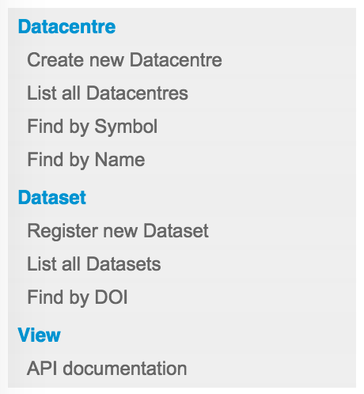
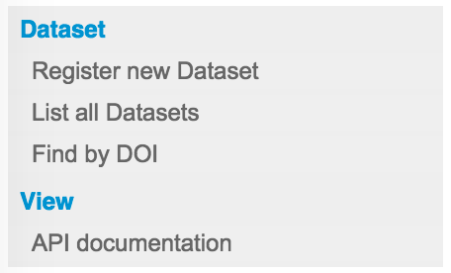
Web interface
“Single” or manual operations.
Members
Datacentres

Slide 14
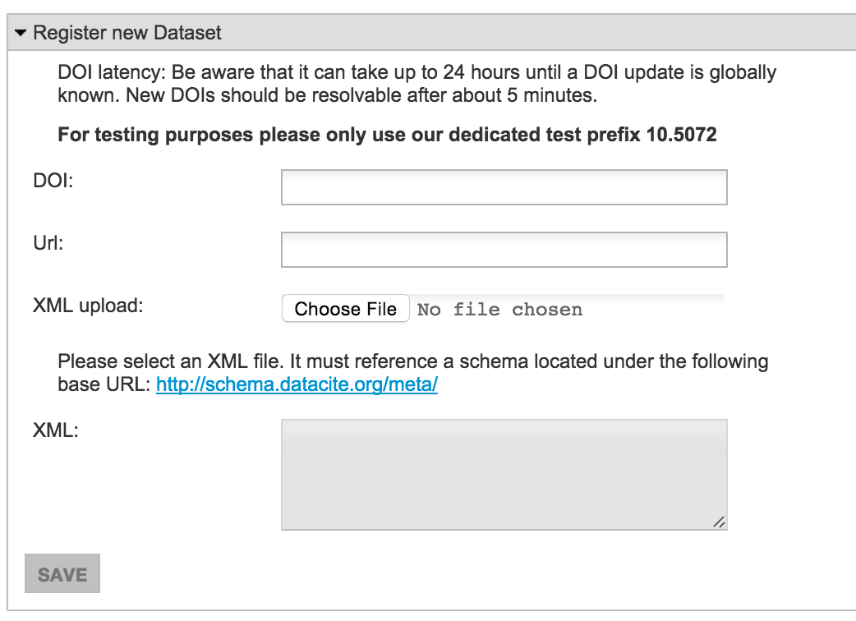
Example: mint a DOI
Name
URL
Metadata

Slide 15
API
RESTful API.
HTTPS with basic authentication.
Example, first upload the metadata, then mint the DOI:
curl -u USER.NAME
-H "Content-Type: application/xml"
--data-binary @metadata.xml
https://mds.datacite.org/metadata
curl -u USER.NAME
-d “url=http://page1.com"
-d "doi=10.1234/dataset567"
https://mds.datacite.org/doi
200 OK
200 OK

Slide 16
Sandbox
DataCite provides a test environment for developers.
The endpoint is https://test.datacite.org and the resolver is http://dx.test.datacite.org
A test prefix exists for all data centres 10. 5072

Slide 17
Distributed System
The Handle system (the technical infrastructure of DOIs) is distributed.
Newly minted DOIs should be resolvable in less than 5 minutes (normally no more than 1 minute).
Updates to DOIs (URL/metadata) can take up to 24h before being distributed through the whole network.

Slide 18
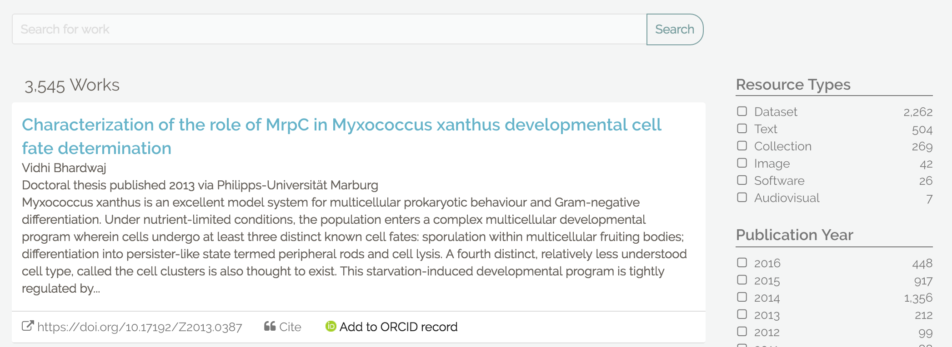
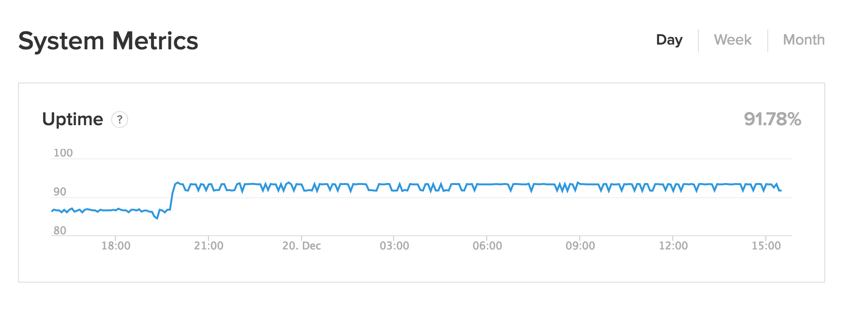
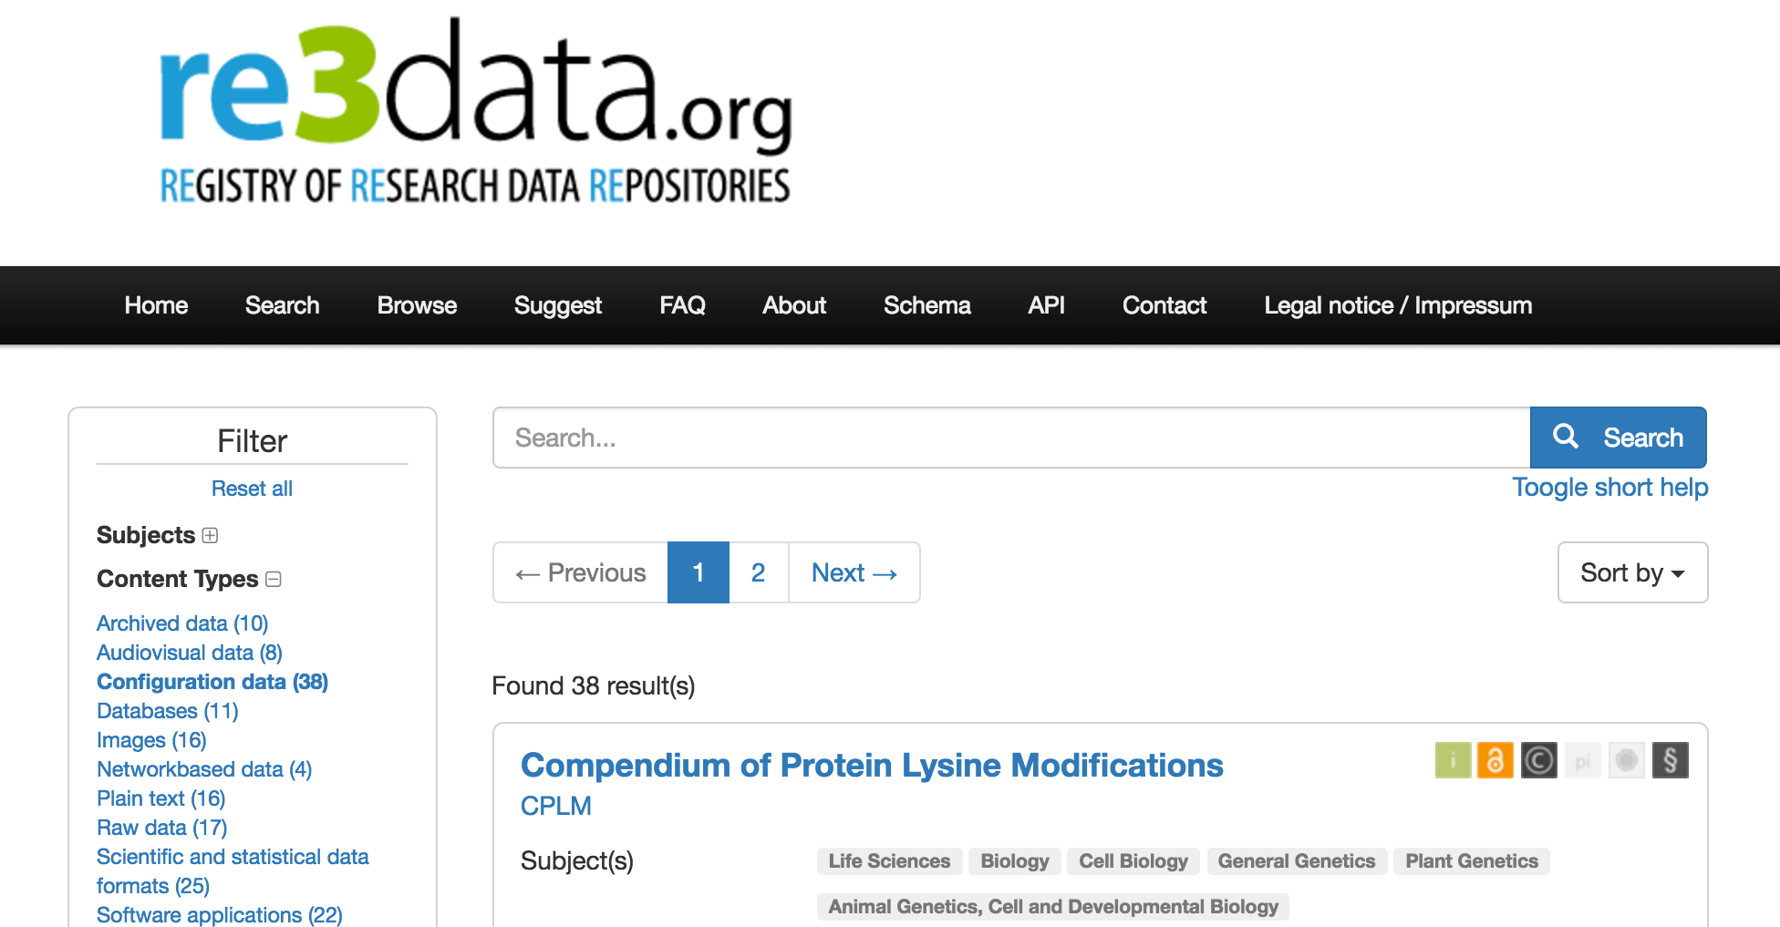
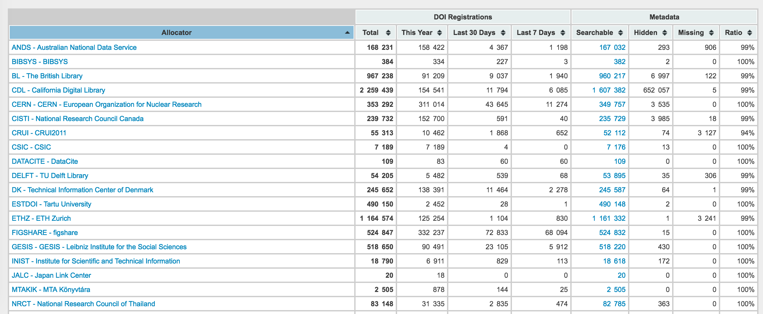
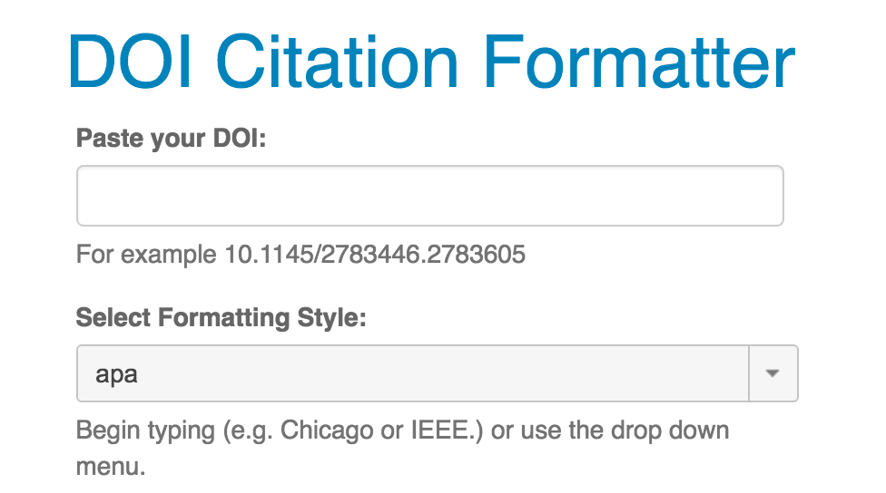
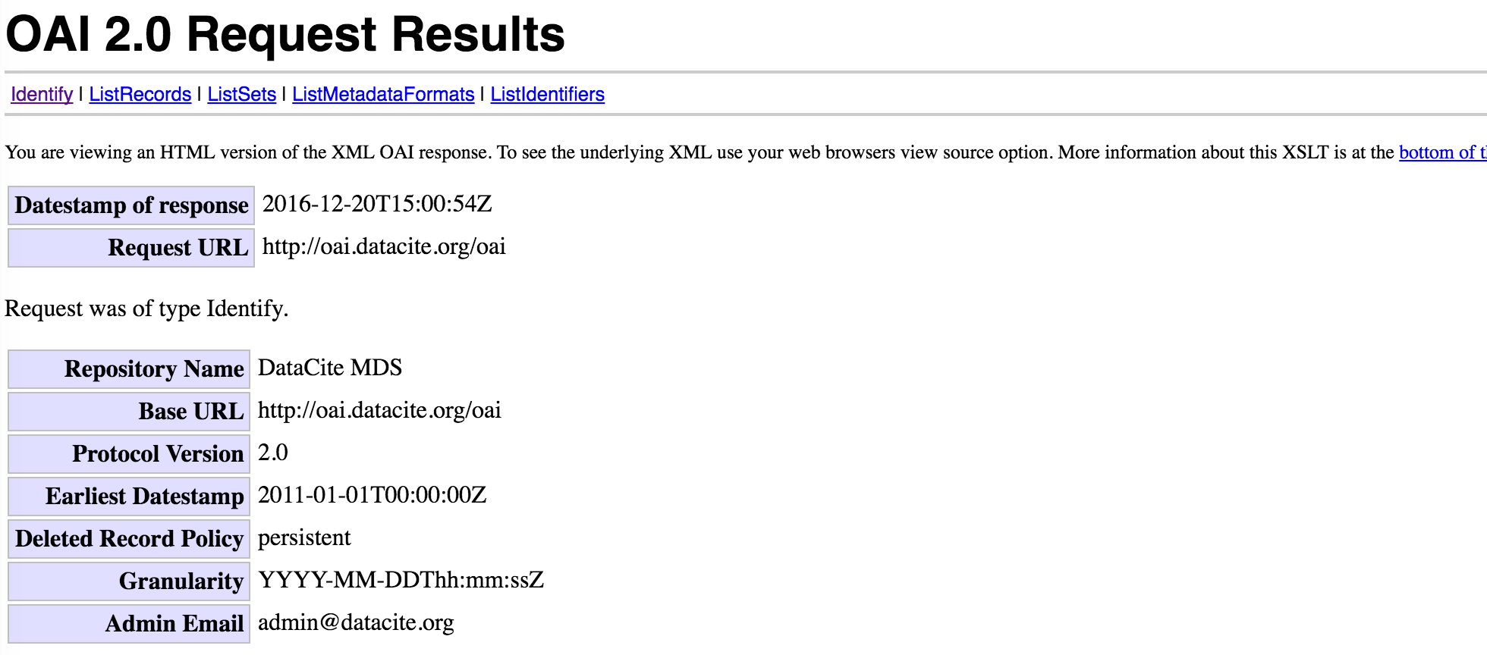
Services around DOIs
Integrated search
Service status
re3data
Statistics
Citation formatter
OAI-PMH

Slide 19
Questions?
support@datacite.org

Slide 20
References
DOI Handbook: https://doi.org/10.1000/182
DataCite Metadata Schema Documentation: https://doi.org/10.5438/0012
DataCite Metadata XML Schema: https://doi.org/10.5438/0013

