Slide 1


Making research better by enabling people to find, share, use, and cite data

Slide 2
Mission
DataCite was founded in 2009 as an international organization which aims to:
establish easier access to research data
increase acceptance of research data as legitimate contributions in the scholarly record
support data archiving to permit results to be verified and re-purposed for future study

Slide 3
Principles
Our purpose is to develop and support methods to locate, identify and cite data and other research objects
Through collaboration, we:
support researchers by helping them to find, identify, and cite research data and other research objects with confidence
support data centers by providing persistent identifiers for datasets, workflows and standards for data publication
support journal publishers by enabling research articles to be linked to the underlying data/objects

Slide 4
Our structure
DataCite has 42 members and more than 800 data centers around the world
Allocating members: they allocate DOI names and use the Registration Agency of DataCite in their capacity as allocating agents. They work actively with data centers and users for the purpose of issuing DOIs.
Non-allocating members: those who support DataCite's mission but do not wish to allocate DOI names. They work actively with DataCite and the wide research data community, but do not act as allocating agents.

Slide 5

All around the world

Slide 6
What is a Persistent Identifier?
A Persistent Identifier (PID) is a long-lasting reference to an object, a single file or set of them
There are multiple types of PIDs. DataCite uses DOIs to reference research data
DOI stands for Digital Object Identifier and it has been used for many years to reference research articles in scholarly communication

Slide 7
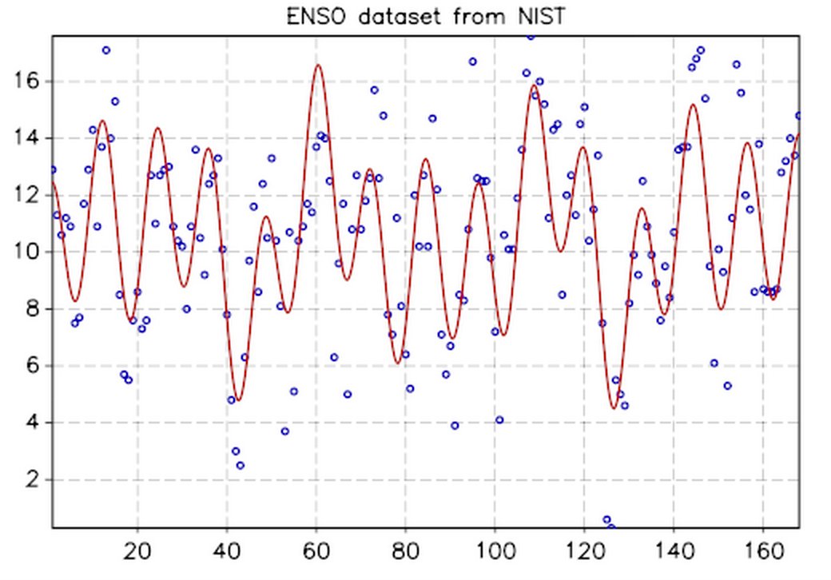


Using DOIs
1. Take a dataset
2. Describe it
3. Assign a DOI
Title
Authors
Year
Description
And others…
10.1234/exampledata
4. Reuse and reference!
5. Enjoy the benefits
Findability
Track citations
Unique
Persistent
Reusability
Measure impact

Slide 8
Become a member and help us
make research better!
https://www.datacite.org/join-datacite

