Slide 1
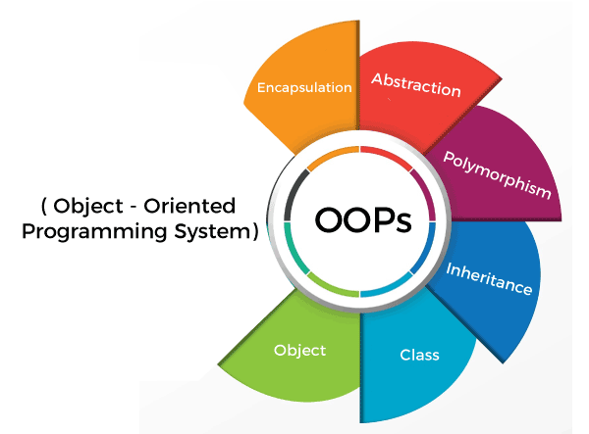
Object Oriented Programming Concepts
By Himaja Geetha

Slide 2
Contents
Need Of Object-Oriented Programming
Difference between Procedural and Object Oriented
Object
Class
Access Modifiers
Encapsulation
Abstraction
Inheritance
Polymorphism
Benefits of OOPS
Real World Applications

Slide 3
Need Of Object-Oriented Programming
Object Oriented Programming was developed due to some limitations of Procedure Oriented Programming.
Some procedural languages are C, Pascal, Basic, Fortran.
In this language main program is divided into functions and to access this we made all data items as global.
We can access the data from one function to other which leads to less security.
Similarly if the new data is to be added then all the function need to be modified to access the data.
To overcome this issues we need object-oriented programming.

Slide 4
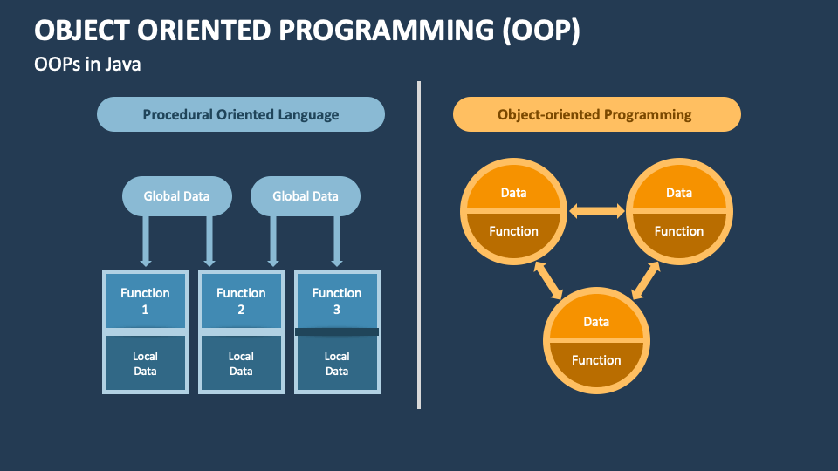
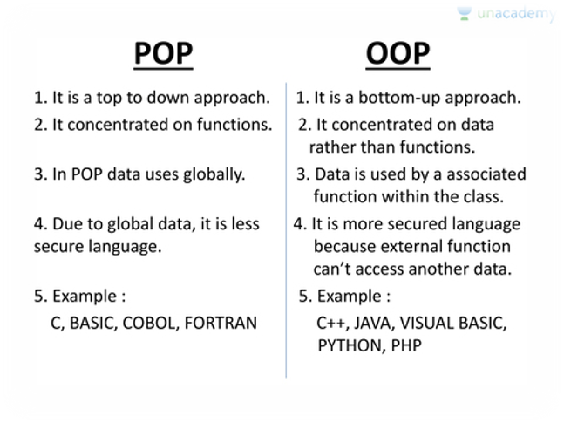
Difference between Procedural and Object Oriented

Slide 5
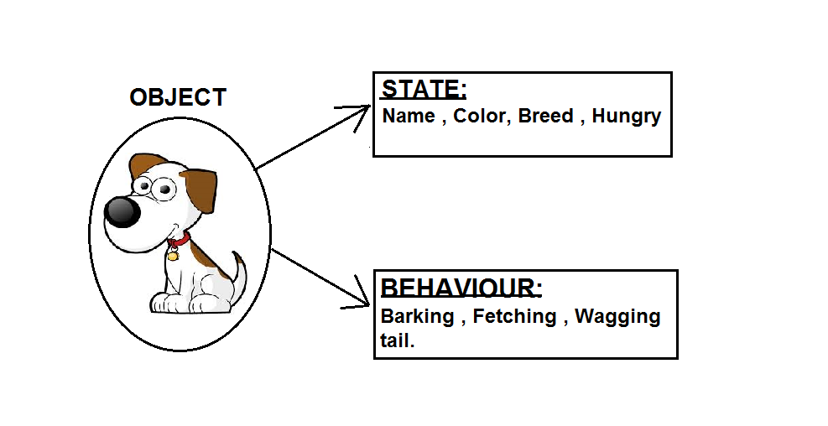
Objects
Object: An object is an instance of a class. It is physical as well as logical entity. It is a fundamental unit comprising both data (state) and behaviors (methods/functions) that operate on that data.
State of Object: The state of an object refers to the values stored in its attributes or properties at a given time.
Behavior of Object: Behavior represents what an object can do. It comprises the methods or functions associated with the object that define its actions or operations.
Identity of Object: The identity of an object distinguishes it from other objects, even if they have the same state.

Slide 6
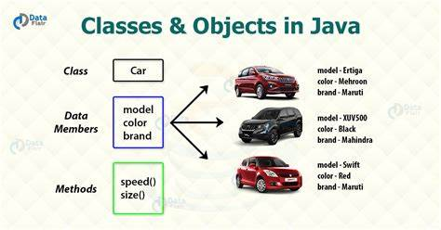
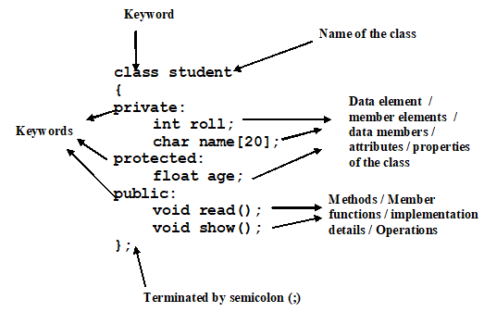
Class
A class is a group of objects which have common properties.
It is a template or blueprint from which objects are created.
It is a logical entity.

Slide 7
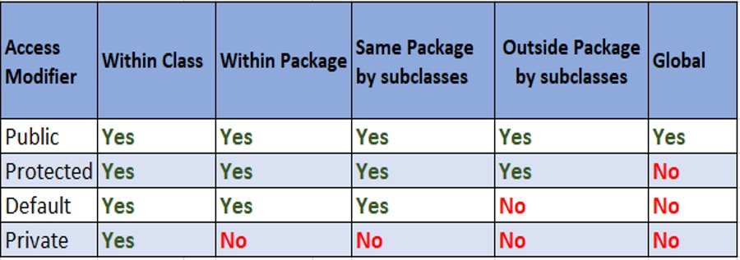
Access Modifiers
There are two types of modifiers in Java: access modifiers and non-access modifiers.
The access modifiers in Java specifies the accessibility or scope of a field, method, constructor, or class.
We can change the access level of fields, constructors, methods, and class by applying the access modifier on it.

Slide 8
Encapsulation
Encapsulation is one of the fundamental principles of Object-Oriented Programming (OOP).
It refers to the bundling of data (attributes) and methods (functions) that operate on the data into a single unit known as an object.
The object's internal state is hidden from the outside, and access to it is restricted to specific methods, ensuring data integrity and security
To achieve encapsulation in Java −
Declare the variables of a class as private.
Provide public setter and getter methods to modify and view the variables values..

Slide 9
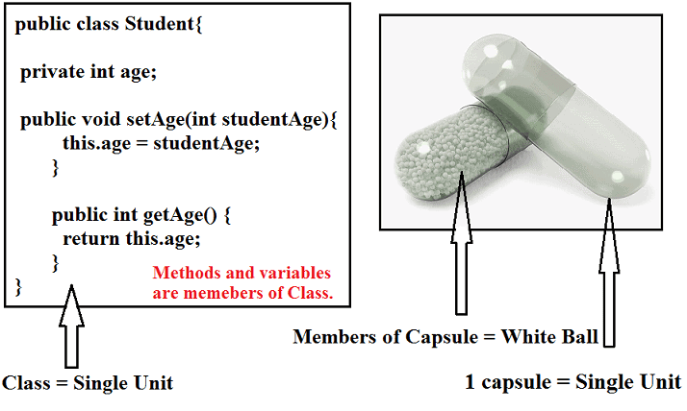
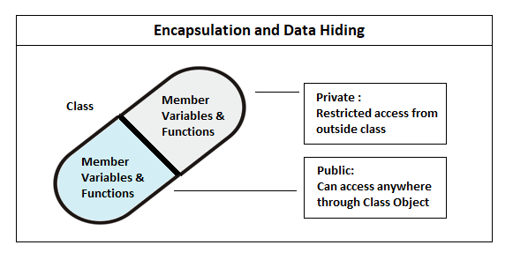

Slide 10
Data Hiding
Data hiding is one of the important features of Object-Oriented Programming which allows preventing the functions of a program to access directly the internal representation of a class type.
The access restriction to the class members is specified by the labeled public, private, and protected sections within the class body.
private, and protected are called access specifiers/modifiers.
A class can have multiple public, protected, or private labeled sections.
The default access for members and classes is private.

Slide 11
Abstraction
Abstraction refers to the act of representing essential features without including the background details or explanation
Classes use the concept of abstraction and are defined as a list of abstract attributes such as size, wait, and cost, and function operate on these attributes.
There are two ways to achieve abstraction in java
Abstract class (0 to 100%)
Interface (100%)
Ex: A television separates its internal implementation from its external interface and we can play with its interfaces like the power button, channel changer, and volume control without having any knowledge of its internals.

Slide 12
Inheritance
Inheritance is the process by which objects of one class acquired the properties of objects of another classes.
The idea behind inheritance in Java is that you can create new classes that are built upon existing classes.
When you inherit from an existing class, you can reuse methods and fields of the parent class.
In OOP, the concept of inheritance provides the idea of reusability
add additional features to an existing class without modifying it

Slide 13
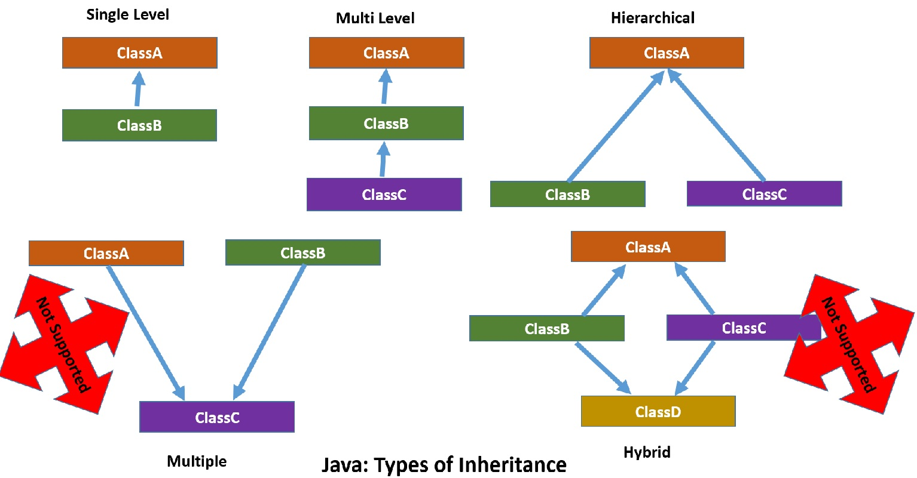
Types of Inheritance

Slide 14
Polymorphism
Definition: Polymorphism is the ability of different classes to be treated as instances of the same class through a shared interface, allowing objects to exhibit different behaviors based on their specific class implementations.
1. Method Overloading: Same method name with different parameters in the same class.
2. Method Overriding: Subclasses provide their implementation for a method defined in the superclass.
3. Compile-Time (Static) Polymorphism: Resolved at compile-time, achieved through method overloading.
4. Run-Time (Dynamic) Polymorphism: Resolved at runtime, achieved through method overriding.

Slide 15
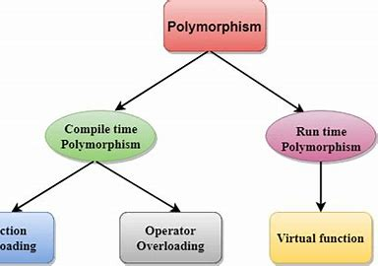
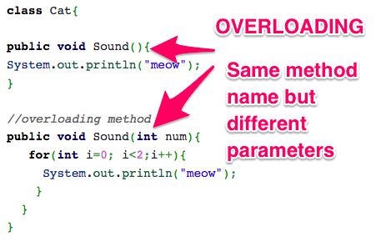
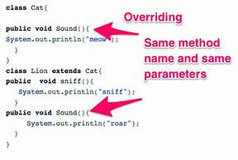

Slide 16
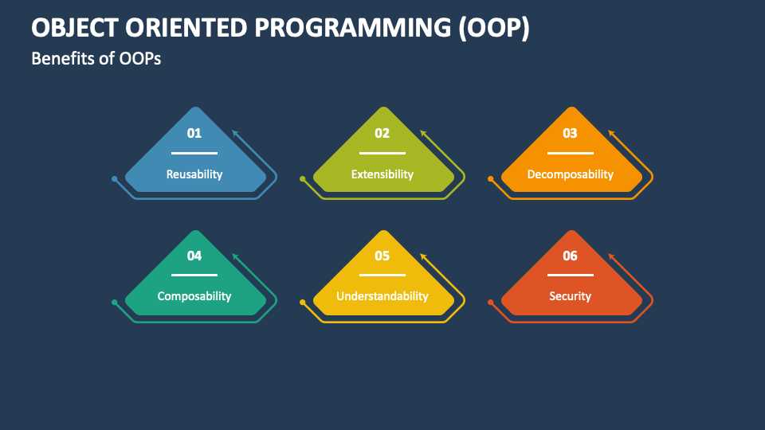
Benefits of OOPS

Slide 17
Modularity: Encourages a modular structure by encapsulating data and behavior within objects.
Reusability: Supports code reusability through the creation of classes and objects.
Maintainability: Easier maintenance and updates due to encapsulation and modular design.
Flexibility and Extensibility: Allows easy adaptation and extension of code through inheritance and polymorphism.
Understandability: Models the real world, making the system's structure and behavior more intuitive.
Encapsulation: Hides the internal details of objects, exposing only what is necessary.
Abstraction: Simplifies complex systems by focusing on essential features and ignoring unnecessary details.
Polymorphism: Enables objects of different types to be treated as objects of a common base type.
Efficiency and Performance: Modern compilers and optimizations minimize potential overhead.
Collaboration: Facilitates collaborative development by allowing teams to work on different modules simultaneously.

Slide 18
Real World Applications
Game Development:
Video Games: OOP is a key paradigm in the development of video games, where game entities, behaviors, and interactions are modeled as objects. Popular game engines like Unity (C#) and Unreal Engine (C++) heavily utilize OOP.
Mobile App Development:
iOS and Android Apps: OOP is fundamental in mobile app development for both iOS (Swift) and Android (Java/Kotlin). Mobile app architectures often rely on OOP principles for code organization.
Financial Systems:
Banking Systems: OOP is applied in the development of banking software for tasks such as managing customer accounts, processing transactions, and handling financial calculations.

Slide 19
Networking and Telecommunications:
Telecommunication Systems: OOP is used in the design and development of telecommunication systems to model network components, communication protocols, and data transmission.
Robotics:
Robot Control Systems: OOP is applied in robotics for modeling the behavior and control of robotic systems, including sensors, actuators, and decision-making algorithms.
Healthcare Systems:
Electronic Health Records (EHR): OOP is employed in healthcare systems to model patient information, medical records, and various healthcare entities.

Slide 20
THANK YOU

