Slide 1
Programming paradigms
Imperative programming paradigm: It performs step by step task by changing state. The main focus is on how to achieve the goal. The paradigm consist of several statements and execution of all the result is stored.
Advantages: Very simple to implement, It contains loops, variables etc.
Disadvantage: Complex problem cannot be solved ,Less efficient and less productive, Parallel programming is not possible
Object oriented programming – The program is written as a collection of classes and object which are meant for communication. The
smallest and basic entity is object and all kind of computation is performed on the objects only. More emphasis is on data rather procedure. It can handle almost all kind of real life problems which are today in scenario.
Advantages:
Data security, Inheritance, Code reusability

Slide 2
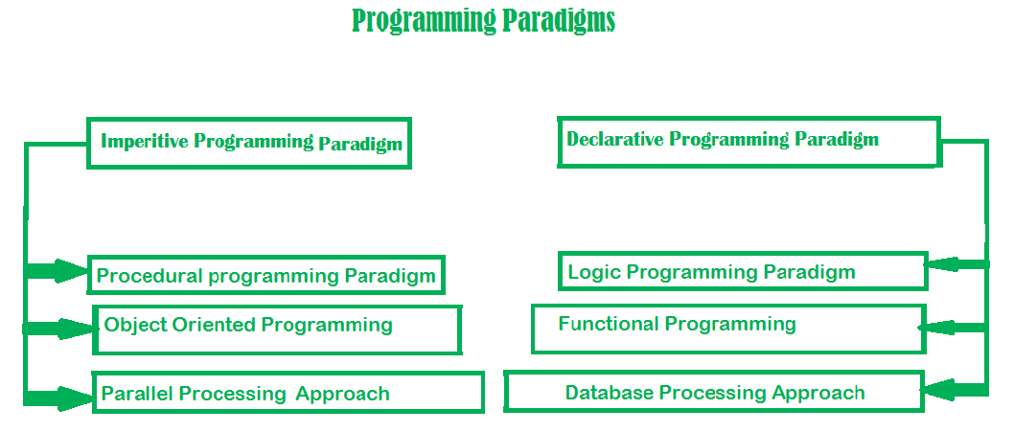

Slide 3
Structure-Oriented Programming:
Emphasis: Focuses on organizing code using structures or records to group related data.
Example :Fortran, COBOL.
Key Feature: Organizing data based on structure.
Advantages: Simple and easy to understand, Suitable for small-scale programs.
Disadvantages: Lacks modularity, Difficulties in managing code as it scales.
Procedural Programming:
Emphasis: Revolves around procedures or routines (functions) to structure the code. Example : C.
Key Feature: Emphasizes procedures and sequences of steps.
Advantages: Clear and straightforward control flow, Well-suited for tasks with a step-by-step process.
Disadvantages: Limited modularity and code reusability, Code can become lengthy and harder to maintain.

Slide 4
Parallel processing approach: Parallel processing is the processing of program instructions by dividing them among multiple processors. A parallel processing system posses many numbers of processor with the objective of running a program in less time by dividing them. This approach seems to be like divide and conquer.
Declarative Programming:
Emphasis: Expresses what a program should accomplish without specifying how to achieve it.- Example : SQL.
Key Feature: Focuses on declarations and expressions rather than explicit control flow.
Advantages: Abstracts away implementation details. Promotes readable and expressive code.
Disadvantages: May not be suitable for all problems. Learning curve for those used to imperative programming.

Slide 5
Logical Programming:
Emphasis: Involves programming with formal logic, where you declare relationships and rules, and the system deduces solutions. Example Language: Prolog.
Key Feature: Programming based on logical inference.
Advantages: Well-suited for problems involving formal logic, Allows concise representation of relationships and rules.
Disadvantages: Limited efficiency for some algorithms. Steeper learning curve for those unfamiliar with logic programming.
Aspect-Oriented Programming (AOP):
Emphasis: Allows modularizing cross-cutting concerns (aspects) that span multiple parts of a program. Example: AspectJ.
Key Feature: Separation of concerns, addressing aspects like logging, security, or error handling.
Advantages: Promotes better separation of concerns. Facilitates code maintenance by isolating concerns.
Disadvantages: Adds complexity to the codebase. Overuse may lead to challenging debugging.

Slide 6
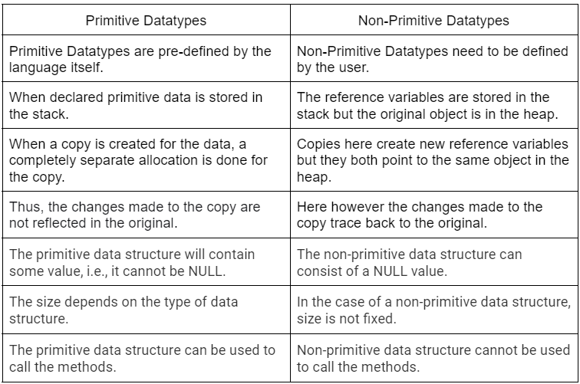
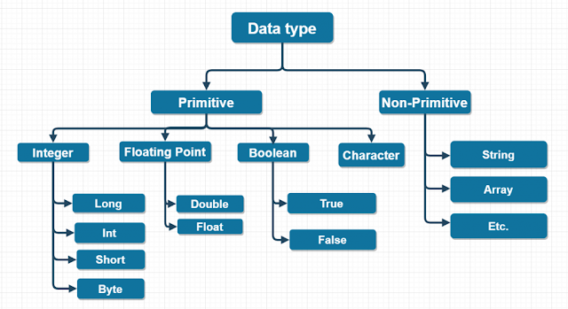
Data Types

Slide 7
Partial Keyword
Partial keyword is used to split the definition of a class or a method across multiple files or parts, allowing developers to work on different aspects of the code in isolation.
Partial Classes:
In languages like C# and Visual Basic .NET, the partial keyword is used to define a class in multiple files. Each part of the class is marked with the partial keyword, and the compiler combines them into a single class during compilation.
Partial Methods:
Partial methods are methods that may or may not have an implementation. If no implementation is provided, the compiler removes the method and all calls to it during compilation.

Slide 8
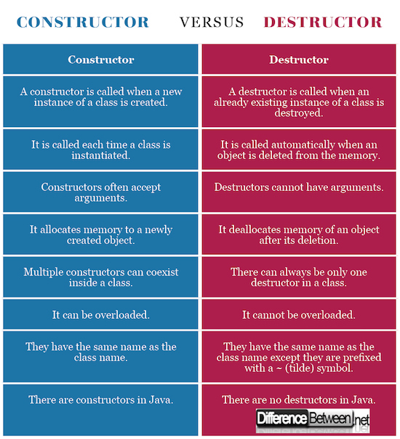
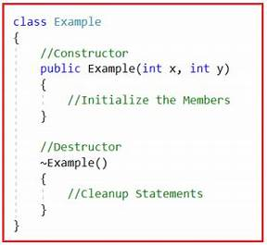
Constructor Vs Destructor

Slide 9
Static Keyword
Static Class:
A class is a blueprint for creating objects. In most languages, classes are used to encapsulate data and behavior related to a specific concept. A static class, however, has some key differences:
No Instantiation: You cannot create an instance (object) of a static class. It is designed to be used without instantiation.
Static Members Only: All members (fields, methods) of a static class must be static. This means they belong to the class itself rather than instances of the class.
Namespace Organization: Static classes are often used for grouping related utility methods or constants under a common namespace, providing a way to organize code.
Static Methods:
Static methods are called on the class rather than on an object of the class. Some characteristics of static methods include:

Slide 10
Directly Accessible: You can call a static method without creating an instance of the class.
Utility and Helper Functions: Static methods are commonly used for utility functions that don't depend on instance state.
When to Use:
Utility Functions: When you have methods that don't depend on instance-specific data, static methods provide a convenient way to organize and use them.
Namespace Organization: Static classes can be used to group related functionalities under a common namespace.
Performance Considerations: In some cases, static methods might be more efficient than instance methods as they don't involve creating object instances.

Slide 11
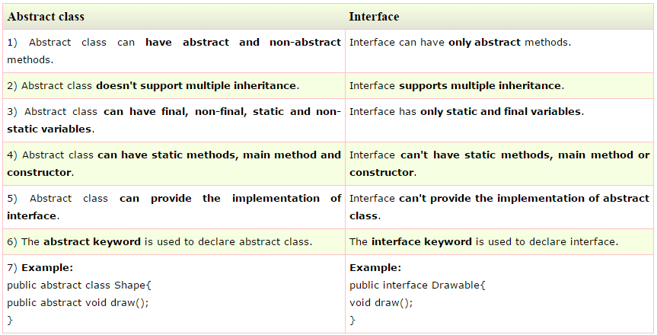
Abstract Class Vs Interface

Slide 12
Example
public void a(){
System .out.println("I am a");
}
}
class Test5{
public static void main(String args[]){
A a=new M();
a.a();
a.c();
}}
interface A{
void a();//by default, public and abstract
void c();
}
abstract class B implements A{
public void c(){
System. out.println("I am C");}
}
class M extends B{

Slide 13
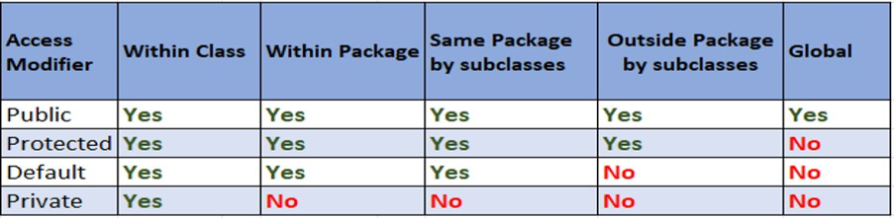
Access Modifiers
There are two types of modifiers in Java: access modifiers and non-access modifiers.
The access modifiers in Java specifies the accessibility or scope of a field, method, constructor, or class.
We can change the access level of fields, constructors, methods, and class by applying the access modifier on it.

Slide 14
Non-access Modifiers
1.final:Prevents further modification of a class, method, or variable. For classes, it makes the class not extendable. For methods, it disallows overriding, and for variables, it makes them constant.
abstract: Applies to classes and methods. A class with an abstract method must be declared abstract. Abstract methods have no implementation in the class and must be implemented by subclasses.
static: Belongs to the class rather than an instance of the class. Static methods and variables are associated with the class itself, not with instances of the class.
transient: Used in Java for instance variables. It indicates that the variable should not be serialized when the class instance containing it is serialized.
volatile: Used for instance variables in a multi-threaded environment. It ensures that multiple threads handle the variable correctly, preventing issues related to thread caching.
synchronized: Applies to methods or blocks of code. Ensures that only one thread can execute the synchronized code at a time, helping to control access in a multi-threaded environment.
native: Indicates that a method is implemented in a language other than Java, typically in a native code (e.g., C or C++).
strictfp: Ensures that floating-point calculations follow the IEEE 754 standard, providing consistent results across different platforms.

Slide 15
Top-down Approach
In the top-down approach, the system is designed from a high-level perspective to a detailed, step-by-step refinement.
It starts with a broad overview of the system and gradually breaks it down into smaller and more manageable sub-systems or modules.
The focus is on defining the overall structure before diving into the details.
void manageLibrary() {
// High-level tasks
inputBooks();
updateInventory();
generateReports();
}
void inputBooks() {
// Code for inputting books
}
void updateInventory() {
// Code for updating inventory
}
void generateReports() {
// Code for generating reports
}

Slide 16
Bottom Level Approach
In the bottom-up approach, the system is built by developing individual components first and then gradually combining them to form a complete system.
It starts with small, atomic elements and assembles them into larger and more complex structures.
The focus is on building and refining the lower-level components before moving to higher-level abstractions.
// Bottom-level class
class Point {
int x, y;
// Code for Point class
}
class Circle extends Point {
int radius;
// Code for Circle class
}
class ShapeManager {
void drawShape(Point p) {
// Code for drawing a shape
}
}

Slide 17
Association
The object of one class may use services/methods provided by the object of another class. This kind of relationship is termed as association..
Aggregation and Composition are subsets of association meaning they are specific cases of association.
In both aggregation and composition object of one class "owns" object of another class.
But there is a subtle difference. In Composition the object of class that is owned by the object of it's owning class cannot live on it's own(Also called "death relationship"). It will always live as a part of it's owning object where as in Aggregation the dependent object is standalone and can exist even if the object of owning class is dead.

Slide 18
Composition Example : Consider the example of a Car and an engine that is very specific to that car (meaning it cannot be used in any other car). This type of relationship between Car and Specific Engine class is called Composition. An object of the Car class cannot exist without an object of Specific Engine class and object of Specific Engine has no significance without Car class. To put in simple words Car class solely "owns" the Specific Engine class.
Aggregation Example : Now consider class Car and class Wheel. Car needs a Wheel object to function. Meaning the Car object owns the Wheel object but we cannot say the Wheel object has no significance without the Car Object. It can very well be used in a Bike, Truck or different Cars Object.
To sum it up association is a very generic term used to represent when a class uses the functionalities provided by another class. We say it's composition if one parent class object owns another child class object and that child class object cannot meaningfully exist without the parent class object. If it can then it is called Aggregation.

