Slide 1
PDBID | chain | resolution (Å) | complete | mutation | ligand | Dunbrack state
2HYY | A | 2.40 | missing 2 residues | 0 | imatinib | 6
2GQG | A | 2.40 | no missing | 0 | dasatinib | 0

Slide 2
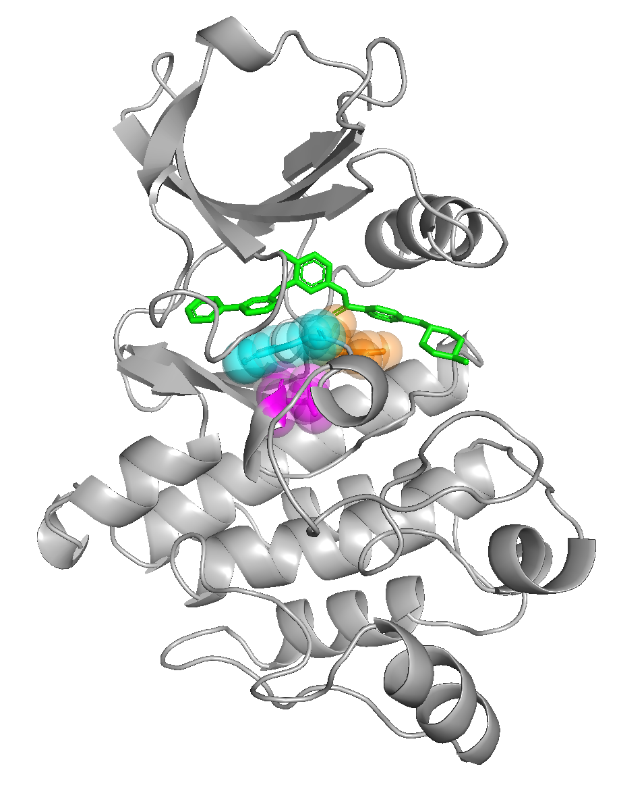
Key questions to ask:
What are the possible dissociation pathways of imatinib from Abl 1?
- ATP channel (Yang et al. 2009)
- allosteric pocket channel (Sun et al. 2015)
- not presuming a particular unbinding pathway (Casasnovas et al. 2017)
2. Are DFG-flips necessarily associated with the dissociation of imatinib?
- No (DFG-out to DFG-in transition is not coupled with the dissociation of BIRB-796 (type II), Casasnovas et al. 2017)
- If yes (our hypothesis): In N368S, the magenta group is less bulky so DFG-flip (indicated by black arrow) is more likely, which destabilizes the binding of imatinib.
Abl 1
imatinib
Phe
Asp
N368

Slide 3
exp # | PDBID | chain | apo/holo | sequence | ligand | SAMS strategy | DFG-flip | # frames
0 | 2HYY | A | holo | WT | imatinib | 1 | no | 501
1 | 2HYY | A | holo | N368S | imatinib | 1 | no | 501
2 | 2HYY | A | apo | WT | - | 1 | out → in Phe above | 469
3 | 2HYY | A | apo | N368S | - | 1 | out → in Phe above | 464
4 | 2HYY | A | apo | WT | - | 2 | out → in Phe above | 501
5 | 2HYY | A | apo | N368S | - | 2 | out → in Phe above | 501
6 | 2GQG | A | holo | WT | dasatinib | 1 | no | 501
7 | 2GQG | A | holo | N368S | dasatinib | 1 | no | 501
8 | 2GQG | A | apo | WT | - | 1 | no | 467
9 | 2GQG | A | apo | N368S | - | 1 | in → out; Phe below | 501
10 | 2GQG | A | apo | WT | - | 2 | no | 501
11 | 2GQG | A | apo | N368S | - | 2 | no | 415

Slide 4
WT 2HYY renumbered | WT 2GQG renumbered | WT 2HYY/2GQG | MT 2HYY renumbered | MT 2GQG renumbered | MT 2HYY/2GQG
ASN133 | ASN146 | ASN368 | SER133 | SER146 | SER368
ASP128 | ASP141 | ASP363 | ASP128 | ASP141 | ASP363
ALA145 | ALA158 | ALA380 | ALA145 | ALA158 | ALA380
ASP146 | ASP159 | ASP381 | ASP146 | ASP159 | ASP381
ALA130 | ALA143 | ALA365 | ALA130 | ALA143 | ALA365
ARG132 | ARG145 | ARG367 | ARG132 | ARG145 | ARG367
HIS126 | HIS139 | HIS361 | HIS126 | HIS139 | HIS361

Slide 5
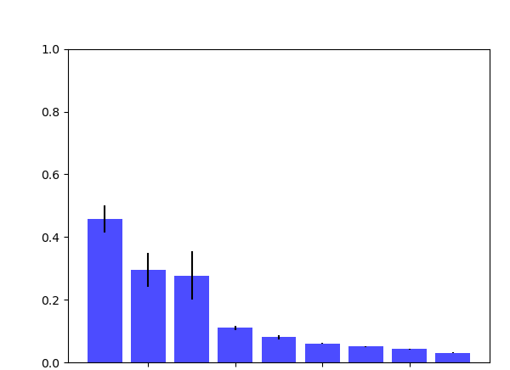
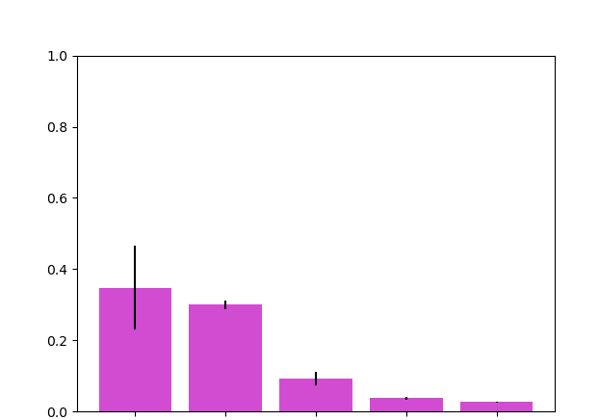
wild type Abl1
N368S Abl1
N368-ND2 -- D363-O
N368-ND2 -- A380-O
N368-OD1 -- A365-N
N368-OD1 -- R367-NH1
N368-ND2 -- D363-OD1
N368-ND2 -- D363-OD2
N368-ND2 -- D381-OD1
N368-ND2 -- D381-OD2
N368-ND2 -- H361-NE2
S368-OG -- D363-O
S368-OG -- A365-N
S368-OG -- A365-O
S368-OG -- A380-O
S368-OG -- R367-NH1

Slide 6
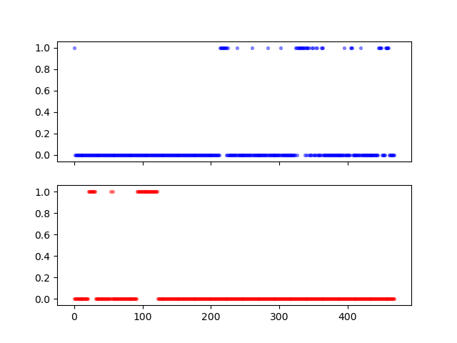
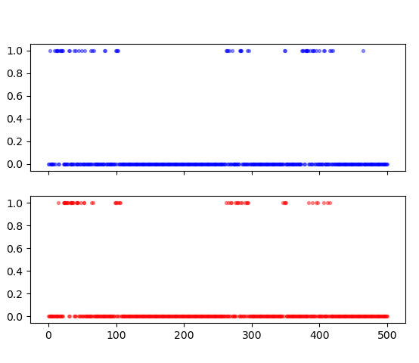
2HYY_apo_WT
2GQG_apo_WT
DFG-out
DFG-in
DFG-in
ASP381-OD1
ASP381-OD1
ASP381-OD2
ASP381-OD2
DFG-flip
(between frame 10-20)

