Slide 1
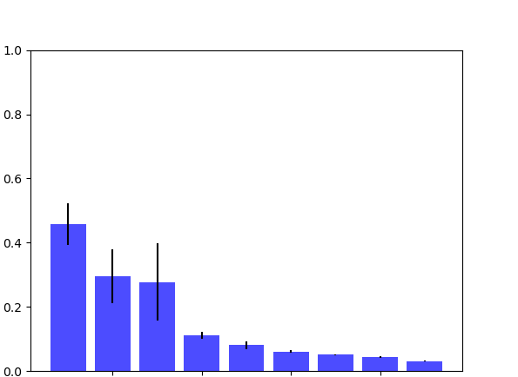
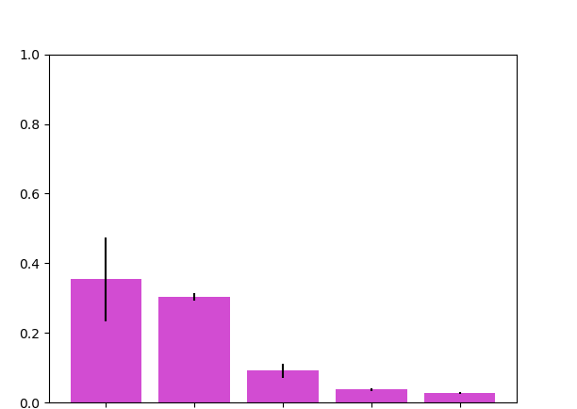
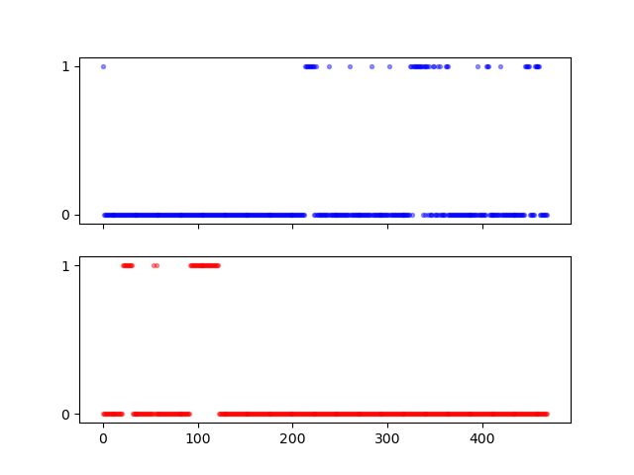
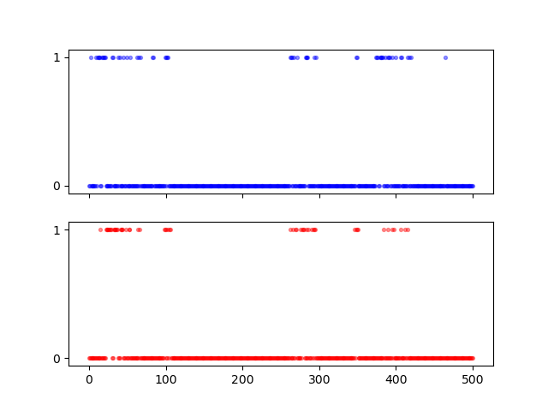
A
wild type Abl1
N368S Abl1
N368-ND2 -- D363-O
N368-ND2 -- A380-O
N368-OD1 -- A365-N
N368-OD1 -- R367-NH1
N368-ND2 -- D363-OD1
N368-ND2 -- D363-OD2
N368-ND2 -- D381-OD1
N368-ND2 -- D381-OD2
N368-ND2 -- H361-NE2
S368-OG -- D363-O
S368-OG -- A365-N
S368-OG -- A365-O
S368-OG -- A380-O
S368-OG -- R367-NH1
H-bond fraction
B
wild type Abl1 (PDBID: 2HYY)
wild type Abl1 (PDBID: 2GQG)
DFG-out
DFG-in
ASP381-OD1
DFG-in
ASP381-OD1
H-bond presence
ASP381-OD2
ASP381-OD2
DFG-flip
(between frame 10-20)
simulation time (2 ns)
simulation time (2 ns)
Notes:
Figure 5. SAMS simulation reveals that N368 forms a H-bond with D-381. A) By considering all 6 trajectories for WT and 6 for N368S, consensus sets of 9 h-bonds and 5 h-bonds were identified. B) Individual trajectories and the interactions with D381 (either OD1 or OD2) mostly happened in the trajectory with 2HYY (WT apo, DFG-flip out --> in) and trajectory with 2GQG structure.

