Slide 1
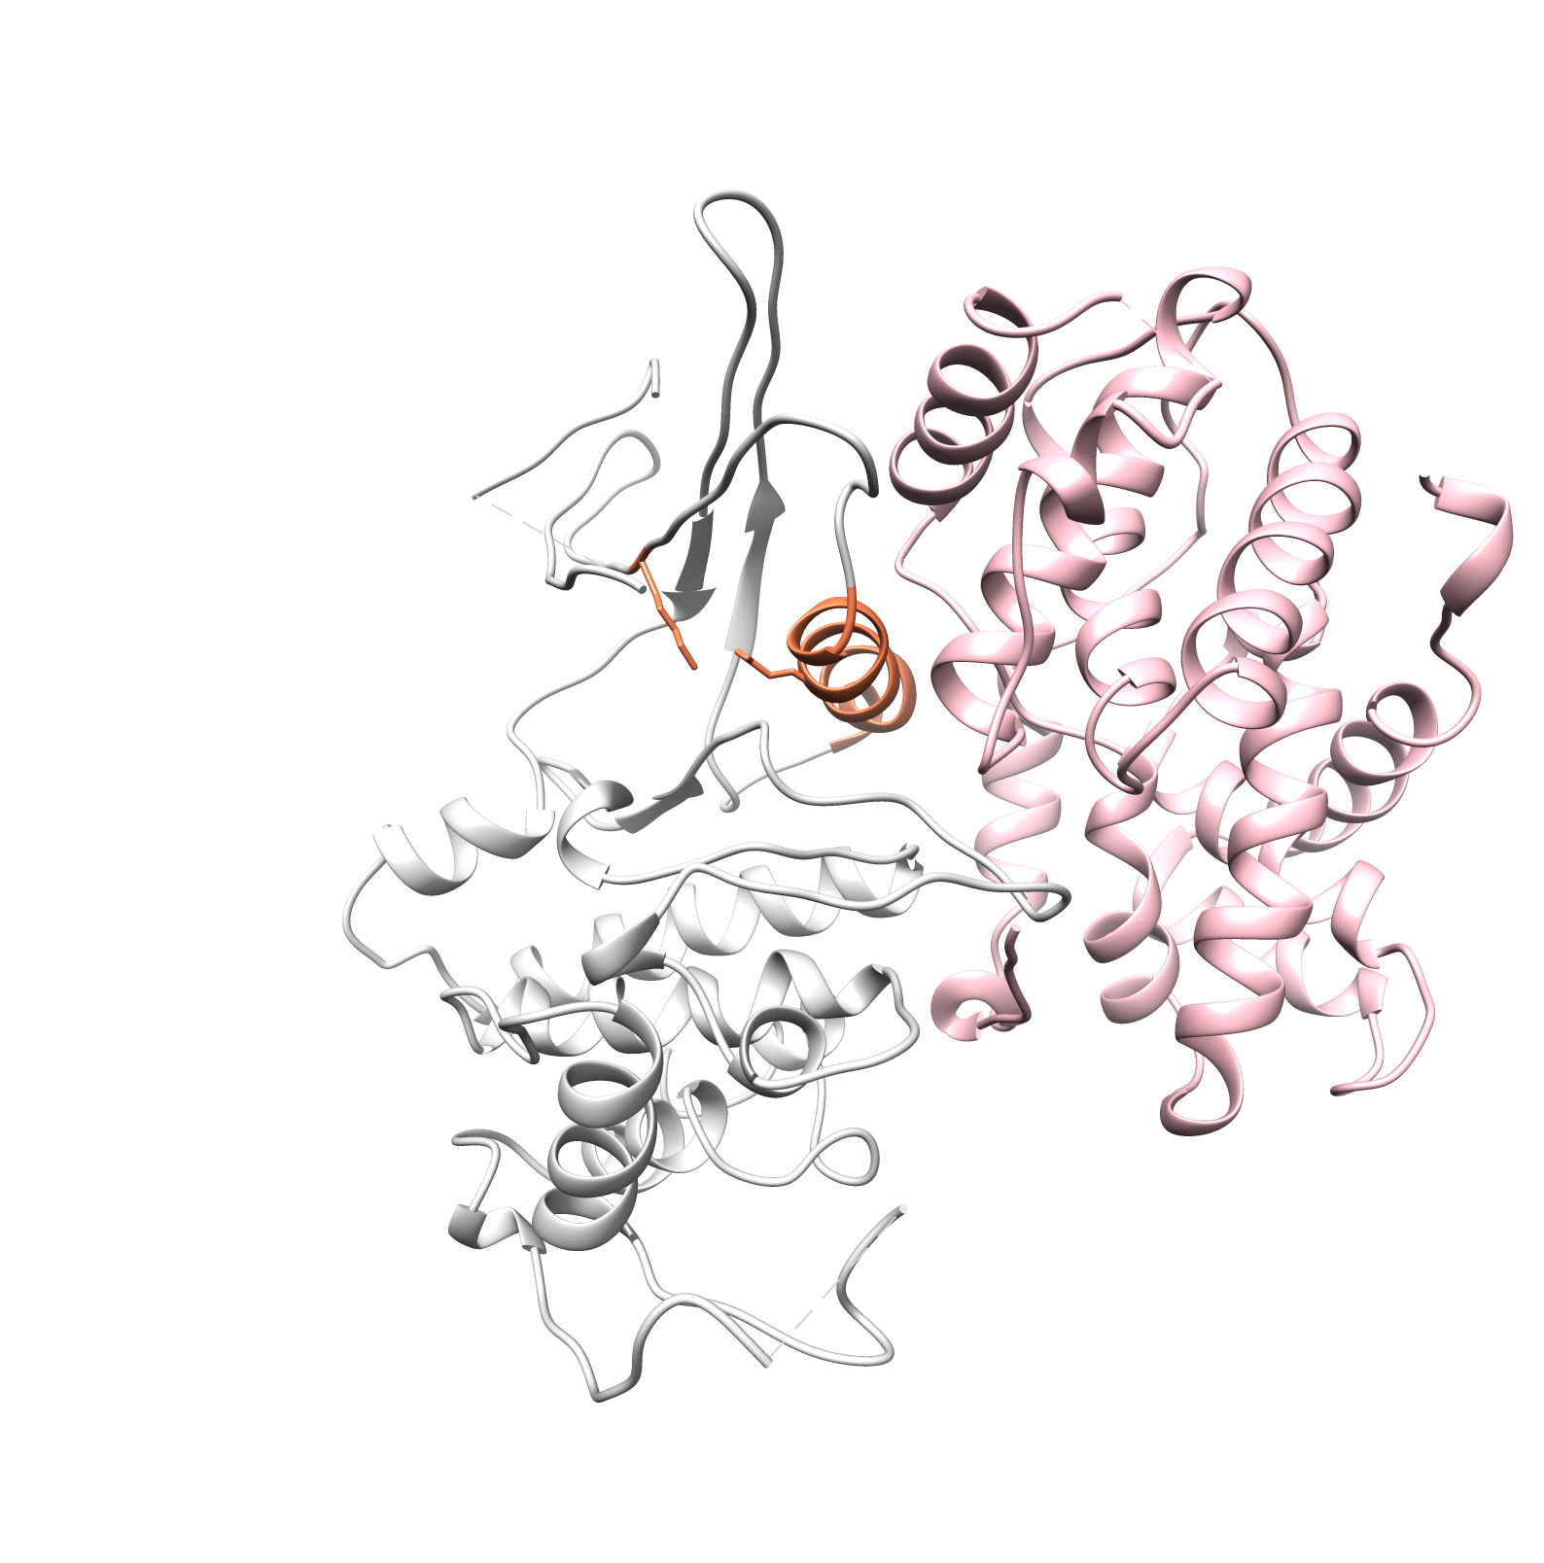
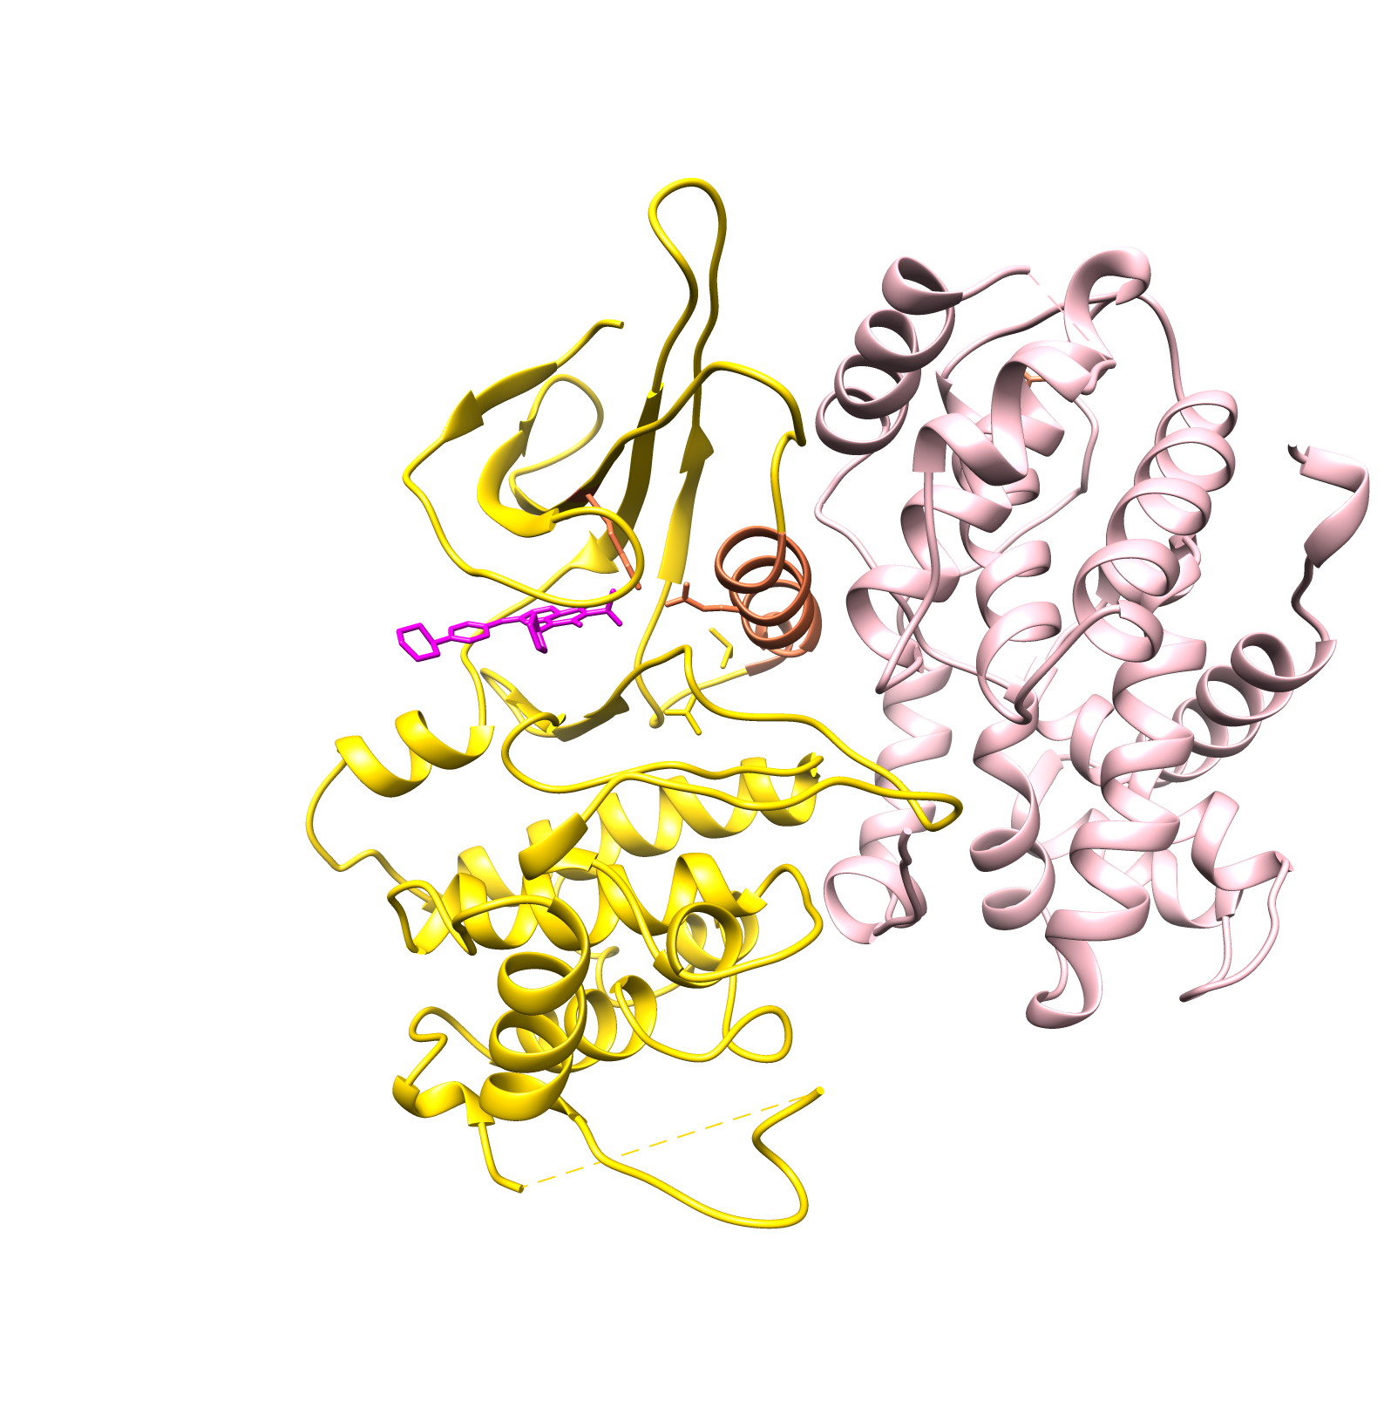
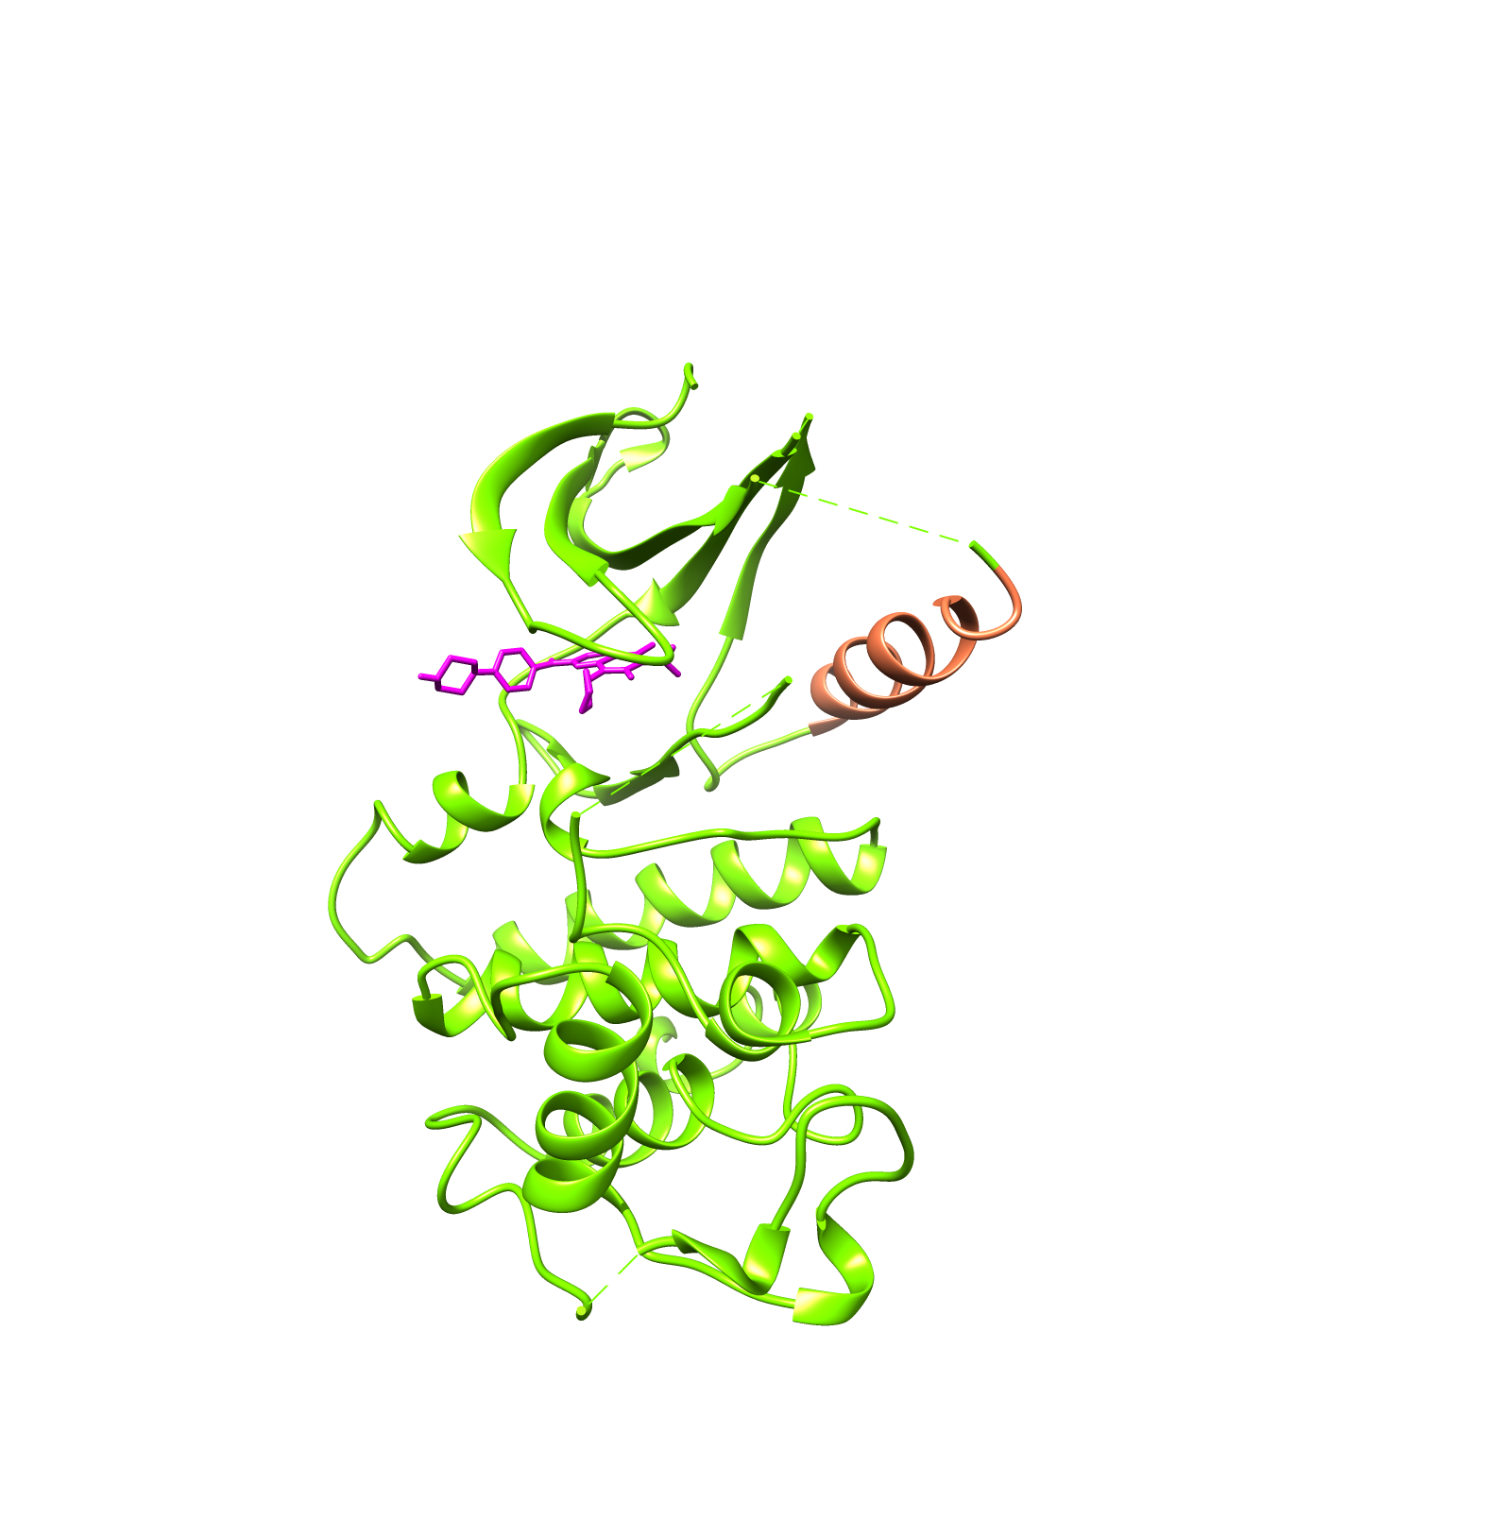
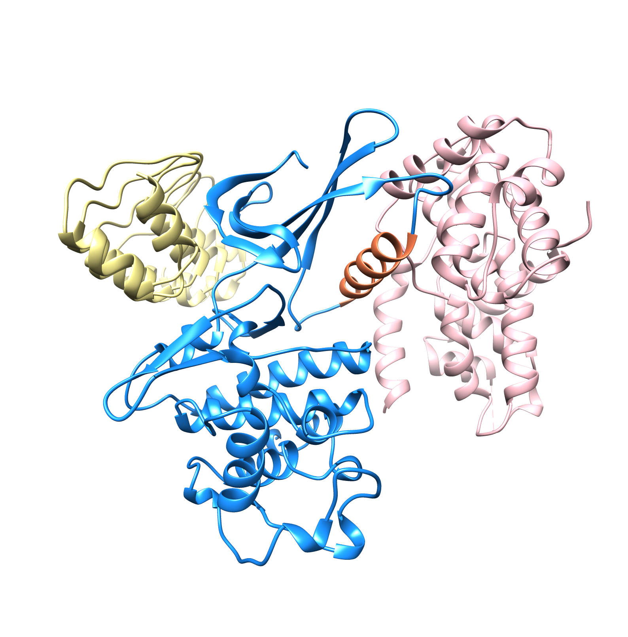

Slide 2
PDB | 1JOW | 2EUF | 5L2I | 1G3N
 | Cdk6 + Vcyclin | Palbociclib + Cdk6 + Vcyclin | Palbociclib + Cdk6 | INK4 + Cdk6 + Vcyclin
 | Helix-in | Helix-in | Helix-out | Helix-out
 | DFG-in | DFG-in | DFG-in | DFG-out
 | Active (K-E salt bridge on) | Active (K-E salt bridge on) | “Intermediate” | Inactive

